Slide 1
Virginia’s Regional EMS Councils
State EMS Advisory Board Orientation
Updated 2020

Slide 2
Role of Regional EMS Councils
Regional EMS Councils collaborate with the Virginia Office of EMS, local government officials, physicians, hospitals, EMS agencies, and other stakeholders to plan and coordinate EMS activities at the regional level to promote quality of care.

Slide 3
Background
The Code of Virginia (§ 32.1-111.11) establishes Regional EMS Councils and defines their function and purpose.
Each council is charged with the development and implementation of an efficient and effective regional emergency medical services delivery system.

Slide 4
Locations of Regional Councils
There are 11 regional EMS councils that are designated to serve specific geographic areas of the Commonwealth. Virginia’s regional EMS councils contract with the Virginia Office of EMS during their designation period and undergo designation reviews every 3 years.

Slide 5
Hybrid Regional Offices
Of the 11 regional EMS councils, there are 3 that are Regional Offices of the Office of EMS. These are hybrid offices, with OEMS staff completing the work of OEMS and the Regional Council’s Board of Directors for their region. Central Shenandoah EMS Council was the first to become a hybrid office followed by Blue Ridge EMS Council and Rappahannock EMS Council.

Slide 6
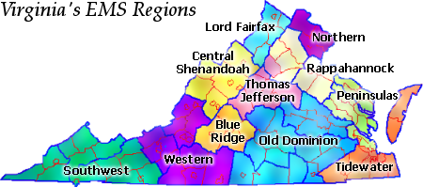
Map of Virginia EMS Regions

Slide 7
Regional Council Services
While services provided by regional EMS councils can vary, generally services can be broken into two distinct categories:
Services required under contract with the OEMS
Services necessary for the region but not required under OEMS contract

Slide 8
Contract Services
Regional Infrastructure
Assistance and Referral
Continuity Planning
State Committees
Local VDH Collaboration
Regional Medical Direction
Regional Medical Direction
Patient Care Protocols
Medication Kit Exchange

Slide 9
Contract Services (cont.)
Regional Planning
Strategic EMS Plan
Stroke Triage Plan
Infectious Disease Planning
Hospital Diversion Planning
Regional Coordination
Information and Referral
Performance Improvement
Trauma Triage Plan

Slide 10
Contract Services (cont.)
Regional Coordination (cont.)
RSAF Program
CISM Program
Regional EMS Awards
Regional Instructor Network
BLS Testing Coordination

Slide 11
Non-Contract Services
Councils may provide other services that are needed in their region but are not required under their OEMS contract including:
EMS Training Programs (various)
Medical Reserve Corps/Hospital and Healthcare Preparedness
Emergency Planning/Preparedness
Communications Systems
Specialty Response Teams
Local/Regional projects

Slide 12
Point of Contact
Virginia’s Regional EMS Councils provide a point of contact and support for all stakeholders in the regional EMS system. They will assist in resolving issues whenever possible, and they will make appropriate referrals to the state office on specific matters.

Slide 13
Virginia’s Regional EMS Councils
We appreciate the opportunity to talk with you. For more information, please visit www.vaems.org. From this website you can obtain contact information for each regional EMS council.
Questions or suggestions should be directed to:
Greg Woods, Chair
Virginia’s Regional EMS Councils
gwoods@vaems.org

