Slide 1
Regulation & Compliance Enforcement
Ronald D. Passmore, NRP, TS-C
Division Director
Virginia Office of EMS
March 2022

Slide 2
Regulation and Compliance Enforcement

Slide 3
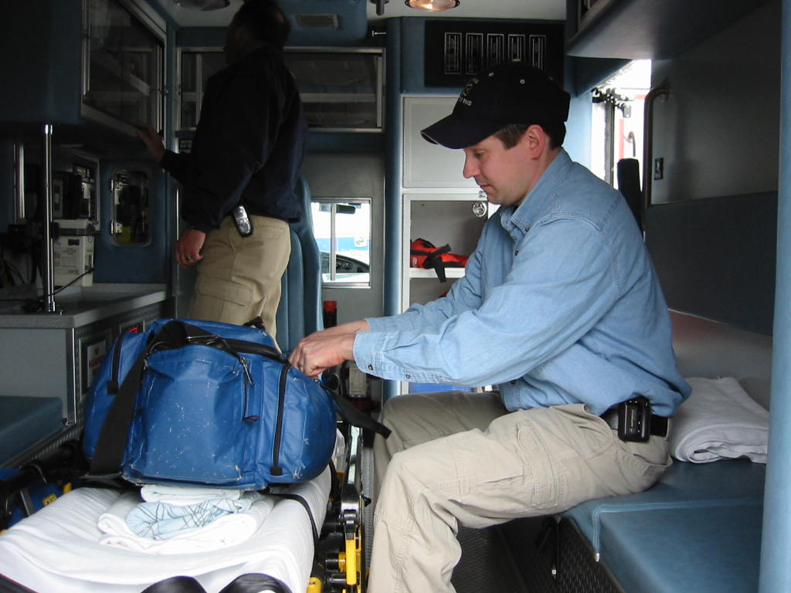
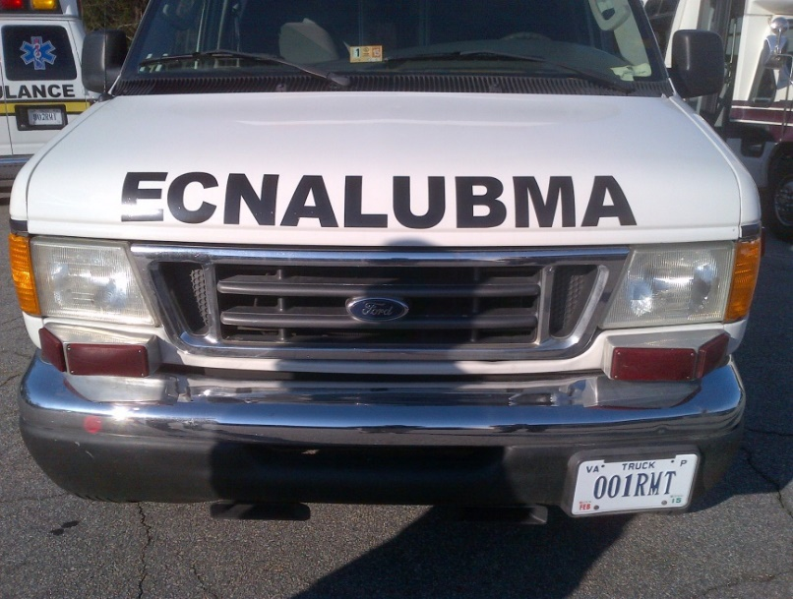
Regulation & Compliance Enforcement
License Regulate Develop & Enforce
EMS Agencies EMS Agencies EMS & DDNR Reg’s
EMS Vehicles EMS Providers Investigations
EMS Aircraft EMS Physicians Regulatory Action
Provide SME resources to Agencies, Providers, & Localities

Slide 4
Regulation & Compliance Enforcement

Slide 5
Regulation & Compliance Enforcement
Division Director
Ron Passmore
Senior Supervisor
Supervisor
Division Support
Jimmy Burch
Marybeth Mizell
Paul Fleenor
Program Rep
Background Investigations
Program Rep
Steve McNeer
Katie Hodges
Ron Kendrick
Program Rep
Program Rep
Doug Layton
Scotty Williams
Program Rep
Program Rep
Chad Gregg
Len Mascaro

Slide 6
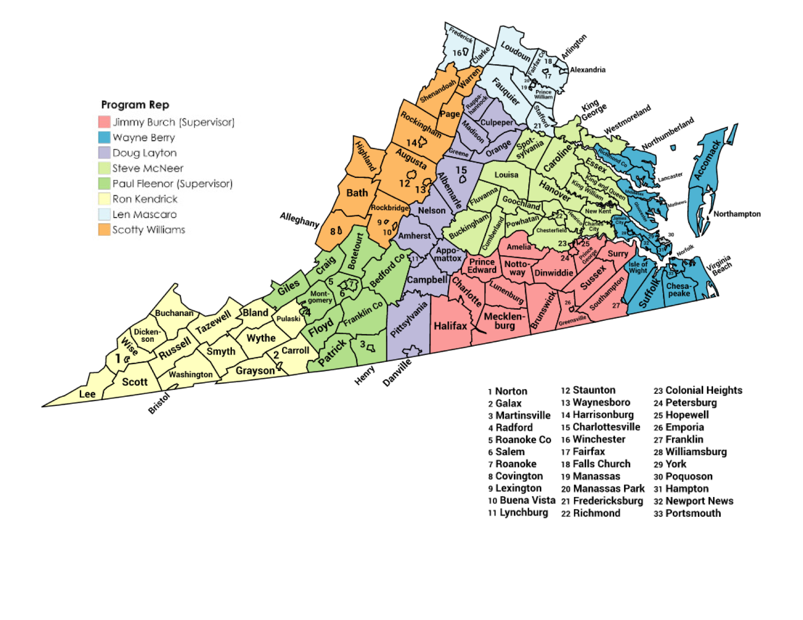

Slide 7
Program Representative Listing by Jurisdiction

Slide 8
Regulation & Compliance Enforcement
EMS Physician (OMD/PCD) initial and re-endorsement (>250)
EMS agency initial and re-licensure (>600)
EMS vehicles permitting and renewal (>4,500)
EMS enforcement (12VAC5-31 & 12VAC5-66) current reg’s
EMS regulations development (12VAC5-32) proposed reg’s
EMS variances/exemption requests (provider/agency/entity)

Slide 9
Regulation & Compliance Enforcement
Investigate complaints of regulatory violations involving
Physicians, Providers, Agencies, Entities, EMS educational
Programs (VCCS & non-VCCS), educators, and students
Litigate IFFC appeal hearings - enforcement actions
(Correction Order, Verbal Warning, Citation, Suspension, Revocation, or Civil Penalty)
Background Investigations of EMS personnel (criminal history)
RASF Grant Compliance verification per cycle

Slide 10
Regulation & Compliance Enforcement
Investigate Drug Diversion complaints
Provide technical assistance & guidance to State EMS Advisory Board and all board committees
Technical resource to state and local government entities, EMS agencies, and providers
National participation with EMS licensure & regulations
(National & State Provider Database Submissions)

Slide 11
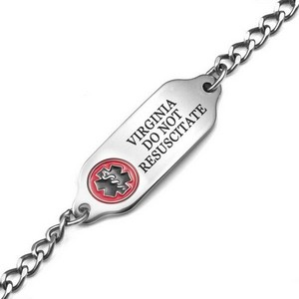
Regulation Requirements of Division Virginia Administrative Code
12VAC5-31 – EMS Regulations
12VAC5-66 – DDNR Regulations
Manage both chapters of regulations
Annual and Tri-Annual review requirements
Annual Virginia Library of Congress reviews
Create and publish Guidance documents
State contact for Technical Resources regarding Durable Do Not Resuscitate
Manage DDNR jewelry VAC approved vendors
Point of Contact for DDNR information for Virginia
Development of complete rewrite of EMS Regulations – Chapter 32 (RIS Project # 5100)

Slide 12
Crystal Ball – What is on the Horizon?

Slide 13
Current Division Deliverables
Develop OEMS resources to comply with new DEA regulations for EMS Agency drug box programs
Collaborate with Virginia Board of Pharmacy
* Develop EMS Scope of Practice to define Critical Care in EMS
* Monitor General Assembly Legislative efforts that impact EMS
* Collaborate with CHaTR Division on developing EMS agency guidelines for implementing CP/MIH programs within Virginia
* Implement new Return to Practice Guideline for the impaired provider
* EMS Physician Recruitment

Slide 14
Regulation & Compliance Enforcement
We welcome you to “spend a day” with one of the OEMS Program Representatives “in the field”.

Slide 15
Contact Information Take a Picture & Save

