Slide 1
Online Referral Portal for Quit Services: Instructions for Referral Partners

Slide 2
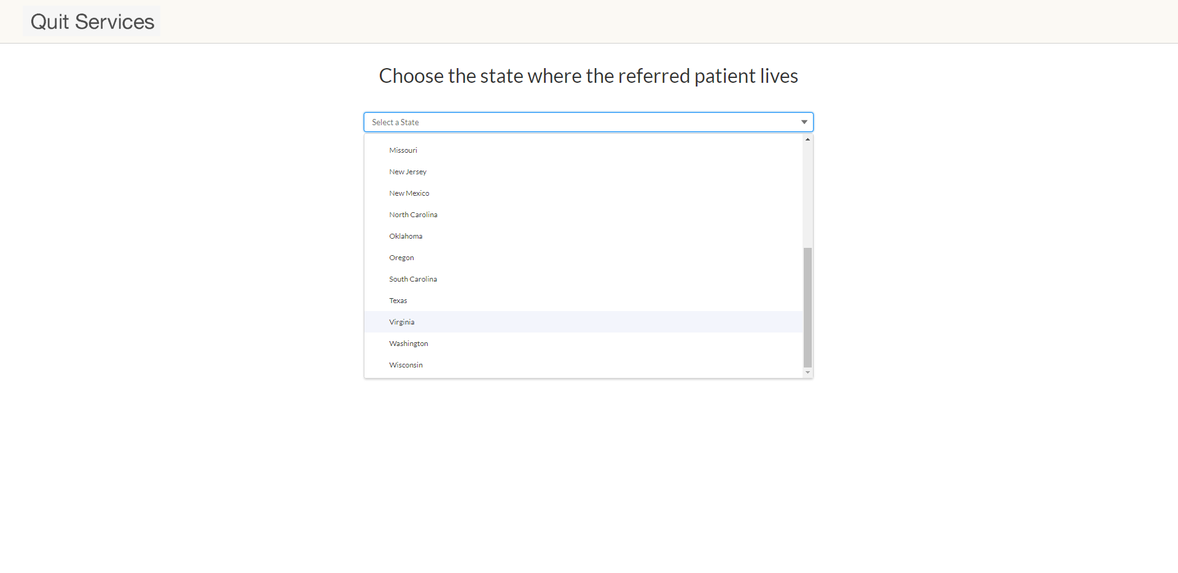
1. Go to https://q4l.force.com/referral/s/ (bookmark this page!).
2. Choose your patient’s state of residence, and confirm state when prompted.

Slide 3
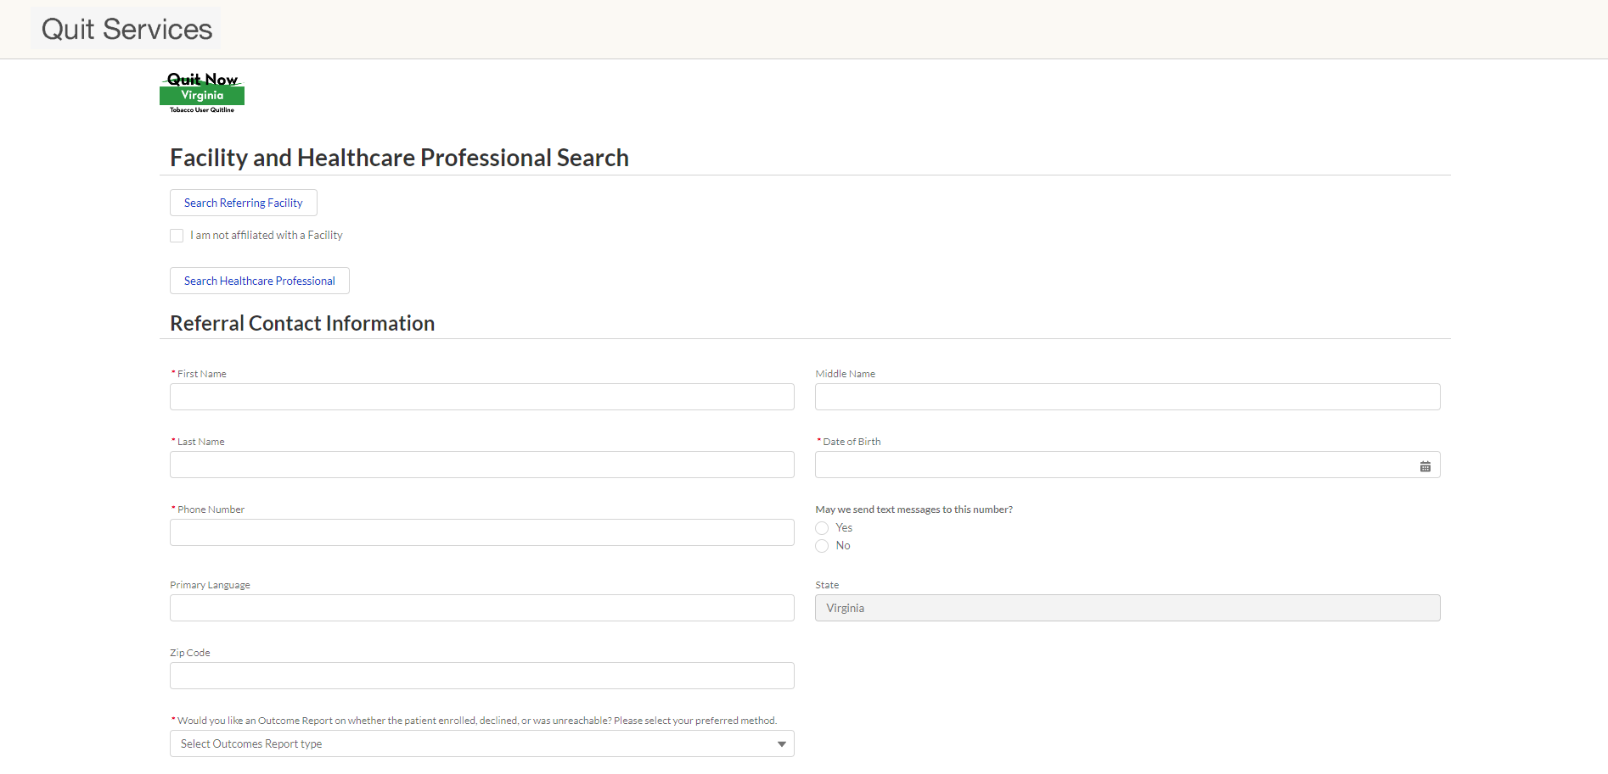
3. Click ‘Search Referring Facility’ (or indicate that you are not affiliated with a facility).

Slide 4
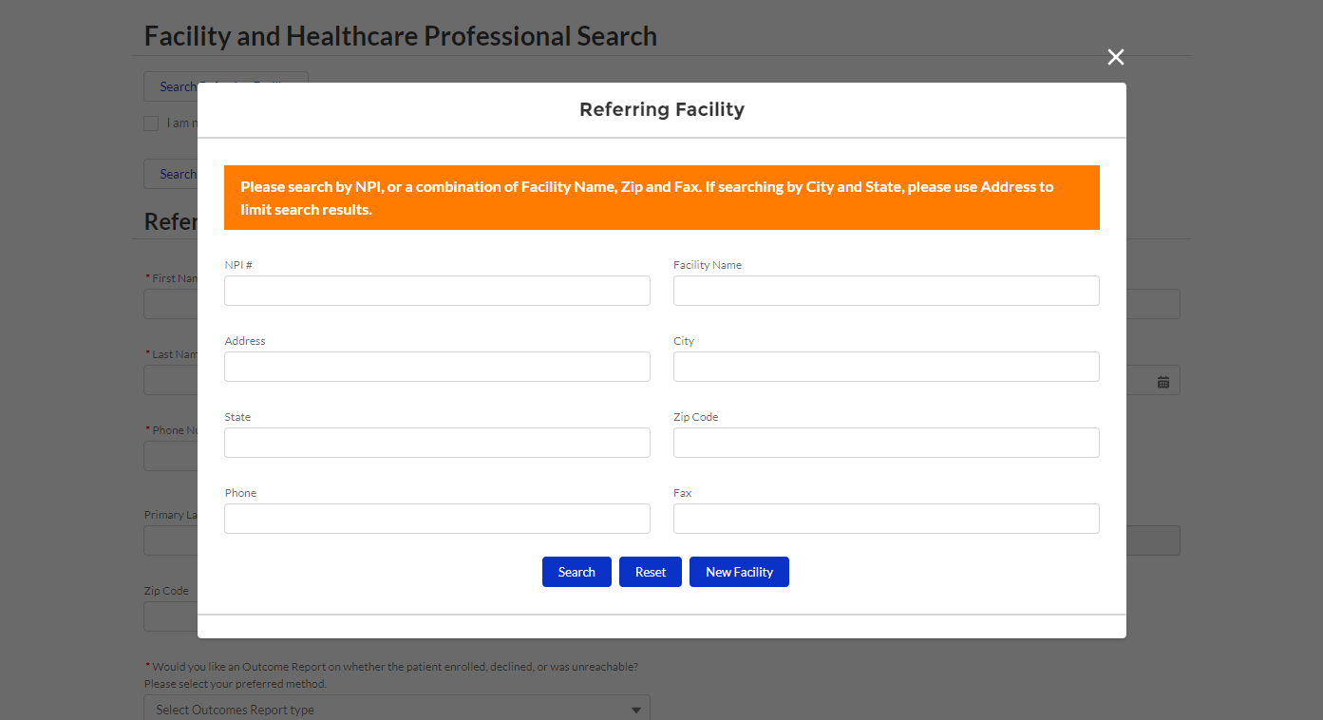
4. Search for the facility with which you are affiliated. If you have your facility’s NPI number, enter it and click ‘Search’. Otherwise, search with a combination of facility name, ZIP code, and/or fax number.

Slide 5
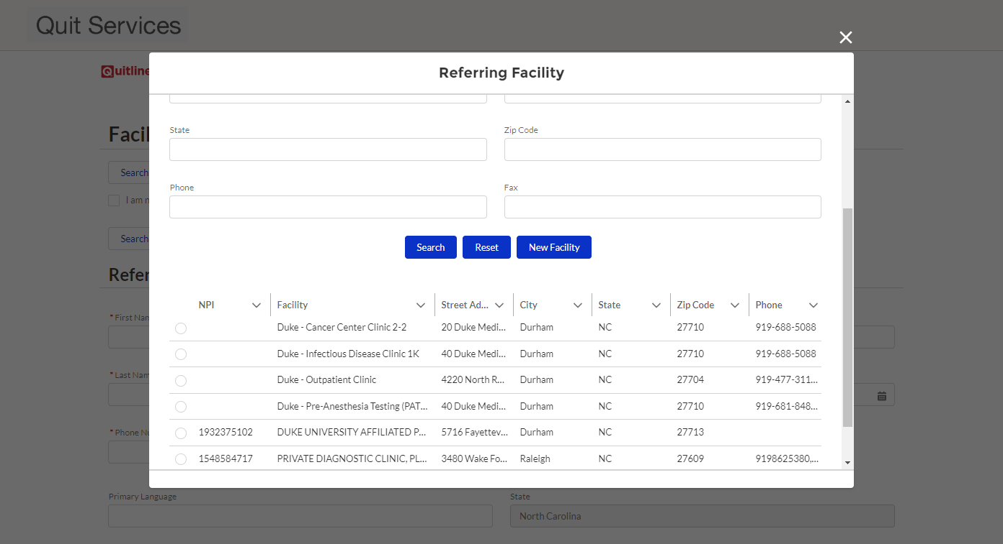
5. Scroll to select from the search results. If there is no match, click ‘New Facility’.

Slide 6
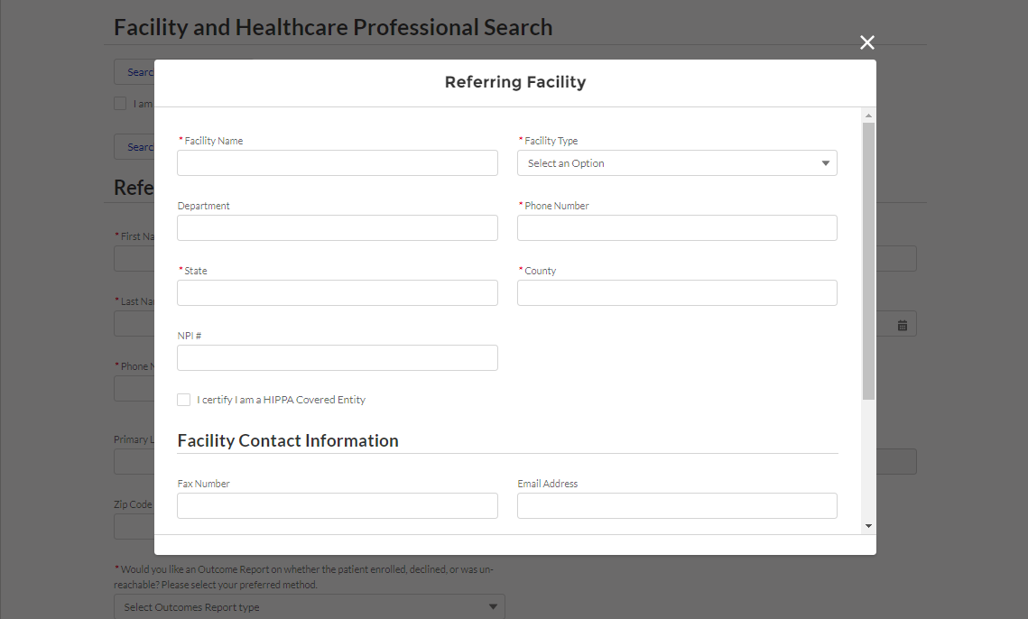
(If applicable, complete the form with information about your facility.)

Slide 7
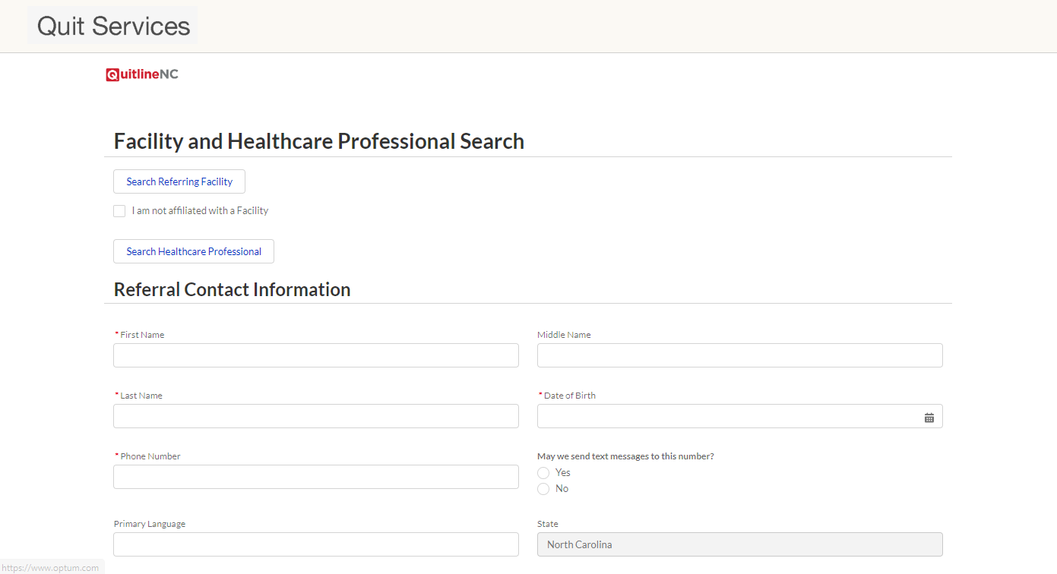
6. Click ‘Search Healthcare Professional’. Follow the same process as with Referring Facility (i.e., search by NPI first, add a new record if no match).

Slide 8
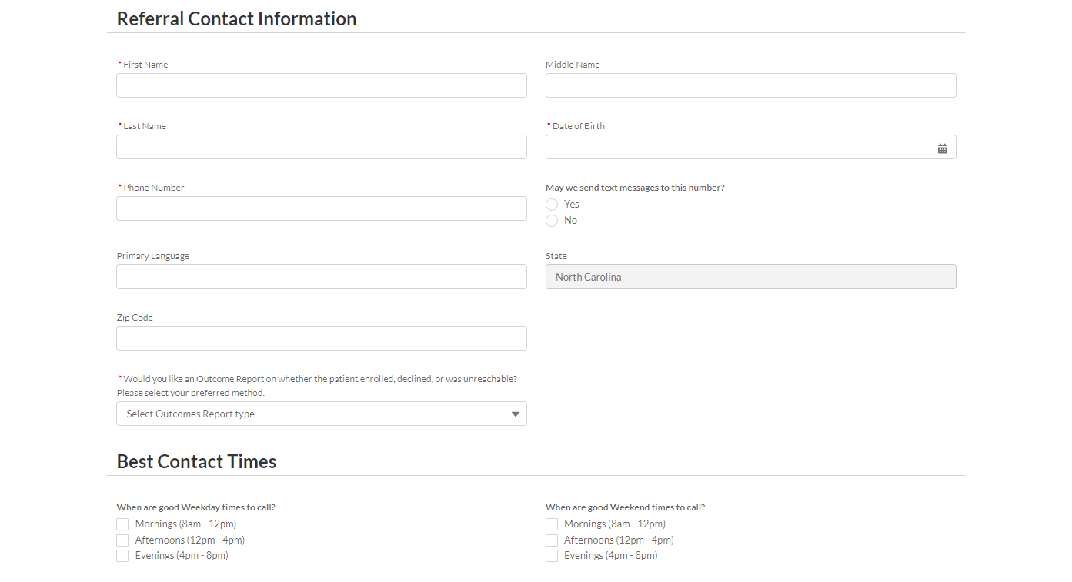
7. Complete the referral form with your patient’s information and indicate if (and how) you would like to receive an outcome report for the referral.

Slide 9
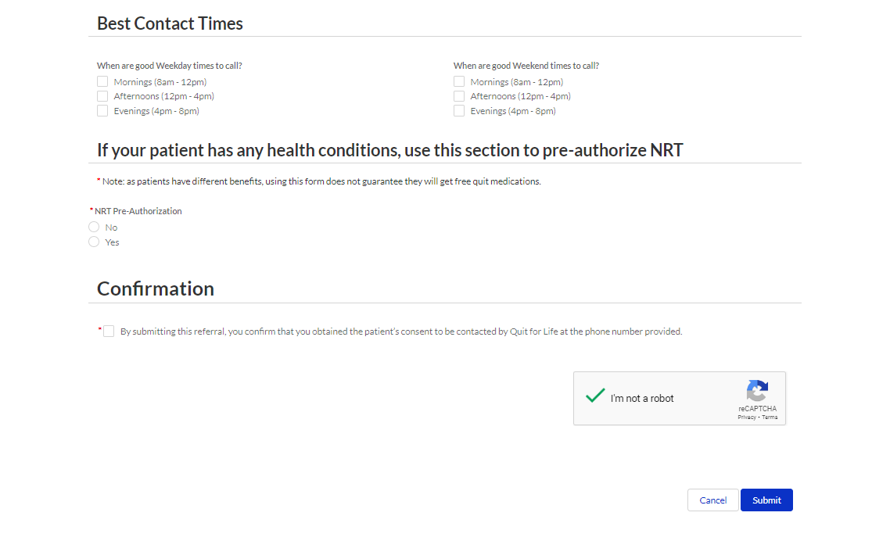
8. Once you have completed the form (and verified that you are not a robot), click ‘Submit’. Thank you for referring your patient to their state’s quit services!

