Slide 1


TRACKING THE FLU WITH…
FLU NEAR YOU
Help spread the word, not the flu!

Slide 2
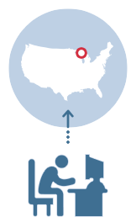
What is Flu Near You (FNY)?
Participatory disease surveillance system for influenza-like illness (ILI)
Website and mobile application that allows the public to report their health status from the previous week
Graphs and maps these data to provide local and national views of self-reported ILI
Also features a “Vaccine Finder” tool
Early detection of ILI and provide user-friendly and actionable insights to the public and stakeholders
Notes:
Flu Near You (FNY) is a participatory disease surveillance system for volunteer reports of ILI symptoms that was created in 2011 through a collaboration between the American Public Health Association (APHA), HealthMap of Boston Children’s Hospital, epidemiologists at Harvard, and the Skoll Global Threats Fund (SGTF). FNY maintains a website (www.flunearyou.org) and mobile application that allows volunteers in the US and Canada to report their health information using a brief weekly survey. FNY allows individuals to register using its website, a mobile application, or Facebook. The system collects symptom data on a weekly basis, which it publishes to the website, while offering an interface to compare its data with data from the CDC sentinel influenza network in the form of maps and charts. Having completed its fourth season in 2015-16, FNY has demonstrated strong correlation with the CDC’s ILINet surveillance system. FNY also hosts a “Vaccine Finder” tool that allows individuals to identify local sources for influenza vaccine and vaccines for other diseases. Any resident of the US or Canada who is at least 13 years old can register to participate in FNY.
The mission of FNY is to collect and freely share participant-reported ILI data that are free, open, and timely, with the general public and key stakeholders (departments of public health, other government agencies, health care providers, etc.) to increase awareness and insights about ILI activity. The long-term vision for FNY is to generate the earliest signal of ILI occurrence and provide user-friendly and actionable insights to the general public and key stakeholders. The system also aims to comprehensively track ILI symptoms across the US.

Slide 3
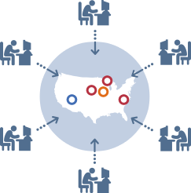
Flu Near You
The tool allows you to:
  Complete quick and easy surveys to build flu awareness
  See self-reported flu activity in your area
  Find nearby locations that offer flu vaccines
  Connect to local public health resources

Slide 4




Who Created Flu Near You?
Flu Near You is a collaboration between:
  HealthMap at Boston Children’s Hospital
  American Public Health Association
  Epidemiologists at Harvard University
  Skoll Global Threats Fund
Notes:
Collaborative effort between the above listed partners, starting in 2011

Slide 5
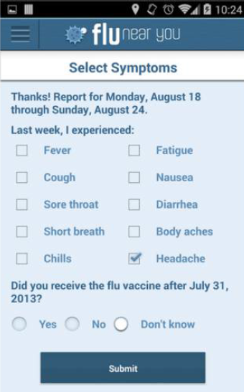
How Can You Participate?
Individuals 13 years and older in US and Canada can register
  Register using the website, a mobile application, or Facebook
After registration is confirmed, users can complete their first health status survey
Each Monday, users receive an email with a link to report any symptoms in the past week
FluNearYou.org
Notes:
Users will be asked to enter sex, date of birth, zip code, and email address. Users can even report for household members who are too young to register.
The weekly health survey is sent on Mondays via email or push notification
Some FAQs about completing the survey:
Should I still report my symptoms even if I do not go to the doctor?
Yes! At Flu Near You, we track influenza-like illness (ILI) using reported symptoms. This allows us to count everyone who felt sick, regardless of whether or not they went to see their doctor.
I don't know if I have the flu, but I do have some symptoms. Should I still report them?
Yes! First, the flu can only be confirmed with a laboratory test from your doctor. This is why we are looking for symptoms of influenza-like illness, rather than a definitive flu diagnosis. Second, even though the focus of Flu Near You is the flu, it is important to know when people are getting sick with other illnesses, too. We do not limit reporting only to people whose symptoms are related to flu.
I had the flu confirmed by my doctor. Why doesn’t Flu Near You give me the option to report this information?
At Flu Near You, we track influenza using symptoms, instead of confirmed cases. This way, we can also count people who may not have visited their doctor or had their flu confirmed by a laboratory test. As long as you reported any symptoms you were experiencing, you provided the information necessary to help understand how influenza is behaving in your community.
I didn't have any symptoms last week, should I still report this?
Yes, you should still report this information. We want to hear from you when you’re healthy, too! This helps better understand how disease is moving in the community. If you've had no symptoms all week, you simply report “no symptoms.”
Do I have to answer a health survey even when it's not flu season?
We conduct the survey year-round instead of only during the flu season for a couple reasons. First, it is possible for an influenza outbreak to occur outside of the traditional flu season. For instance, the first wave of pandemic Influenza A (H1N1) hit in the spring of 2009. We want to capture any emerging outbreak, should something similar occur again. Second, our symptoms based health forms allow us to monitor other diseases that may have different seasons than influenza. We already have a longer symptom list targeted to users in Puerto Rico which also monitors Dengue.
I just joined Flu Near You and would like to report symptoms I had 2 months ago. Can I do this?
The goal of Flu Near You is to provide a real-time view of influenza in your area. To do this, we need to collect symptom information as it happens. Therefore, we ask each week that you report on your health status from the previous week only.
I'm a health care provider and have seen many patients recently with flu-like symptoms?
Flu Near You is a system in which participants report symptom information only about themselves and their household members. Our partner site, HealthMap, allows users to report on known outbreaks such as the one you describe. Please visit healthmap.org and click on the box in the lower left side of the map that says "Outbreak Missing" to report an outbreak, or use the HealthMap "Outbreaks Near Me" mobile app (available in the iTunes store and the Google Play store). Please feel free to refer your patients to Flu Near You so they can report their symptoms directly to us.
Link to FNY FAQs: https://flunearyou.org/#/faq

Slide 6
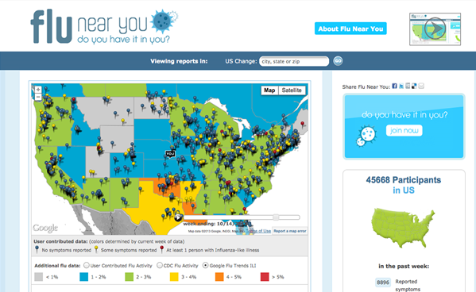
How is the Information Displayed?
Notes:
Here is a visual of Flu Near You -- here is a map where you can see flu activity on a local, regional or nationwide scale, aggregate data compared to CDC flu data, local public health links with vaccine information, and a number of reports in your area.
Source: from NACCHO’s FNY toolkit

Slide 7
