Slide 1
Metrics to Reflect the Health and Well Being of the People of Virginia
Marissa J. Levine, MD, MPH
State Health Commissioner
October 7, 2015

Slide 3
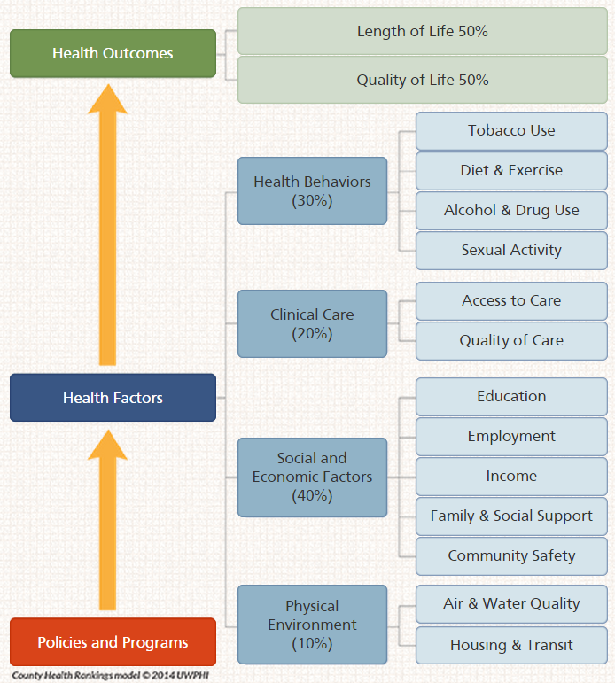
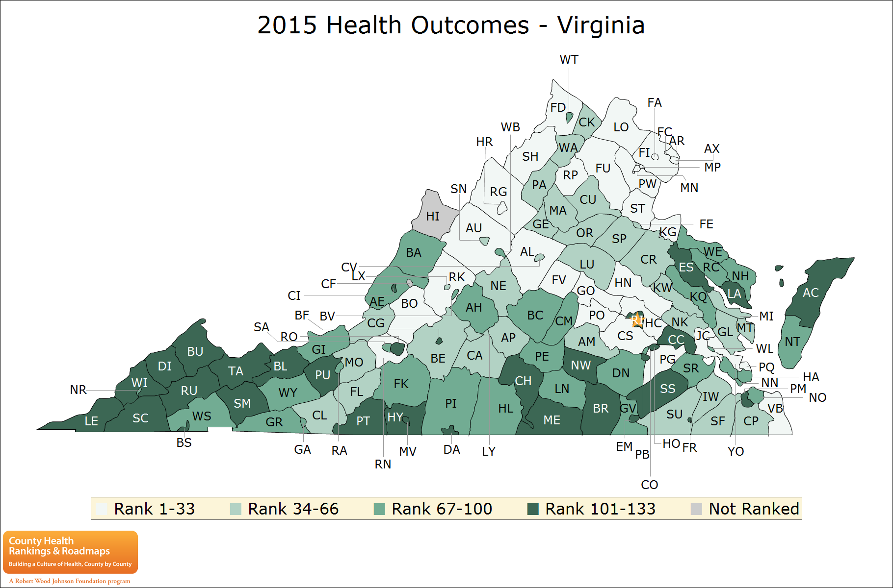
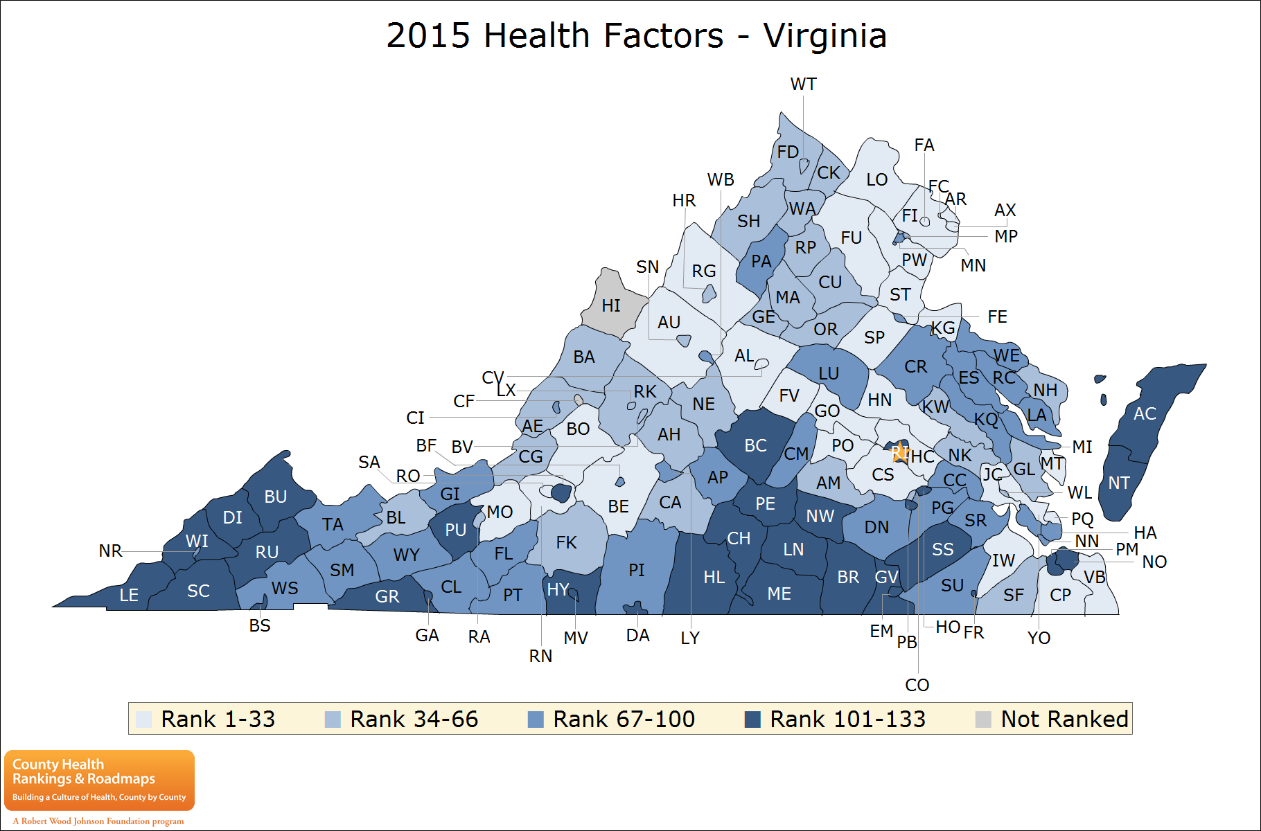
County Health Rankings from Robert Wood Johnson

Slide 4
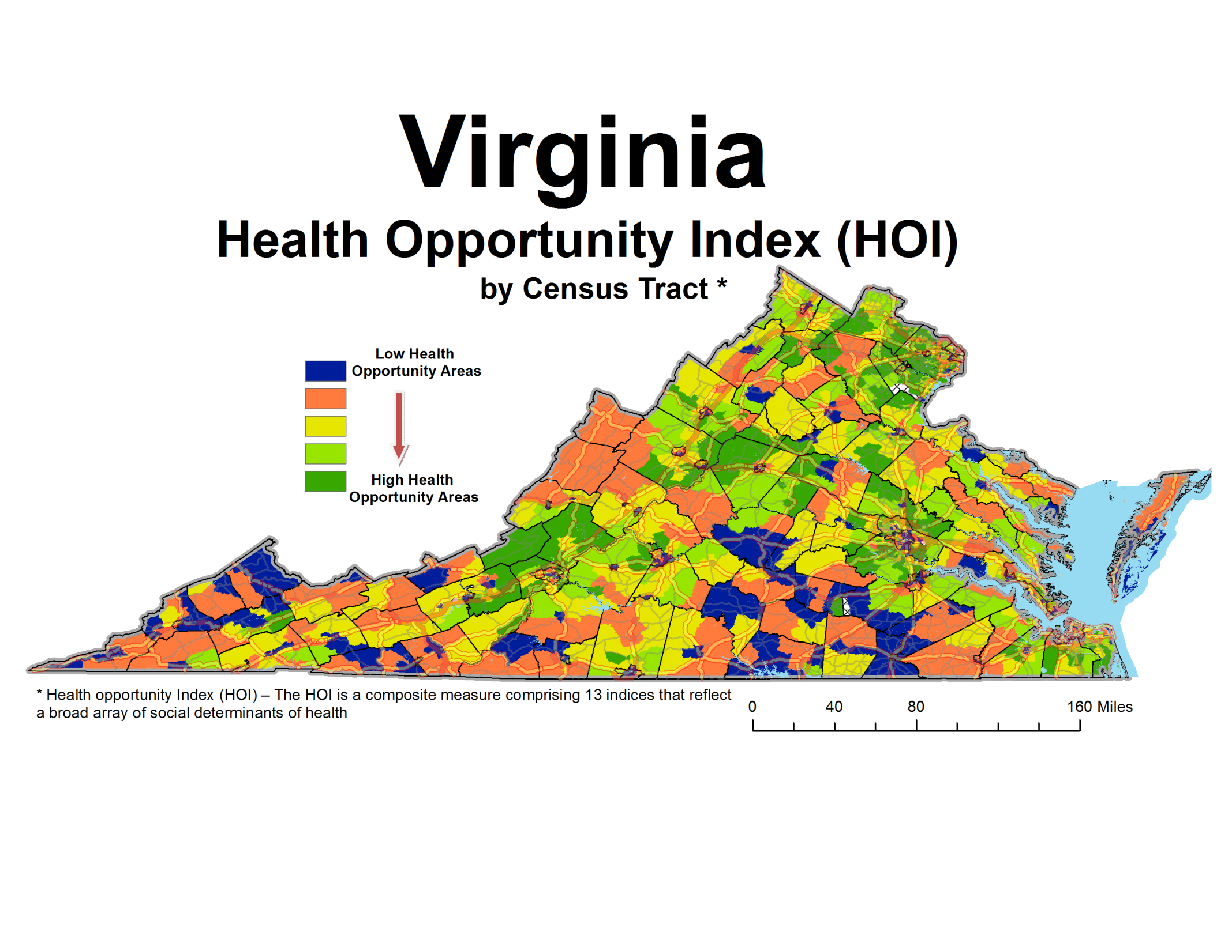

Slide 5
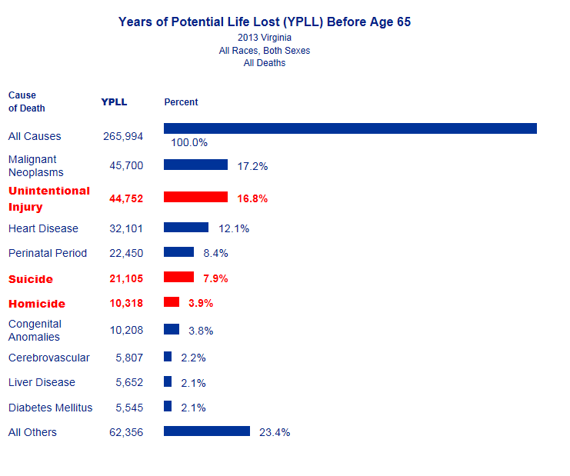
Years of Potential Life Lost Before Age 65
All Causes, Virginia, 2013

Slide 6
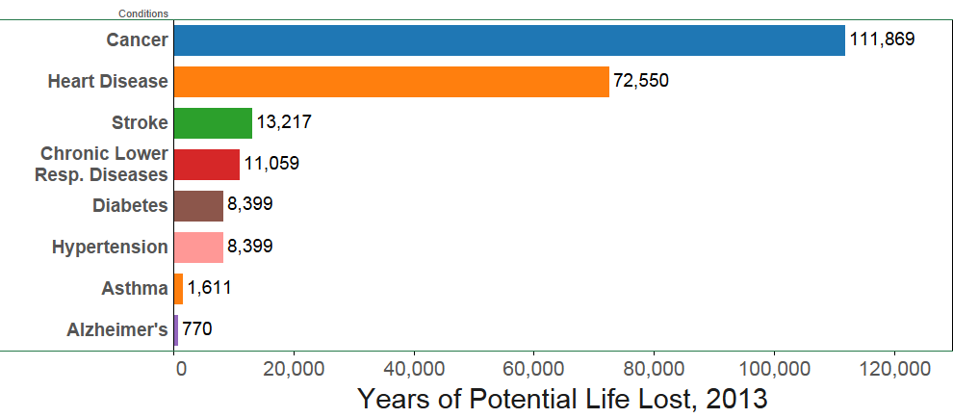
Years of Potential Life Lost Before Age 75
Chronic Diseases
Virginia, 2013
Data Source: Vital Statistics (2013), Annual, Health District Level

Slide 7
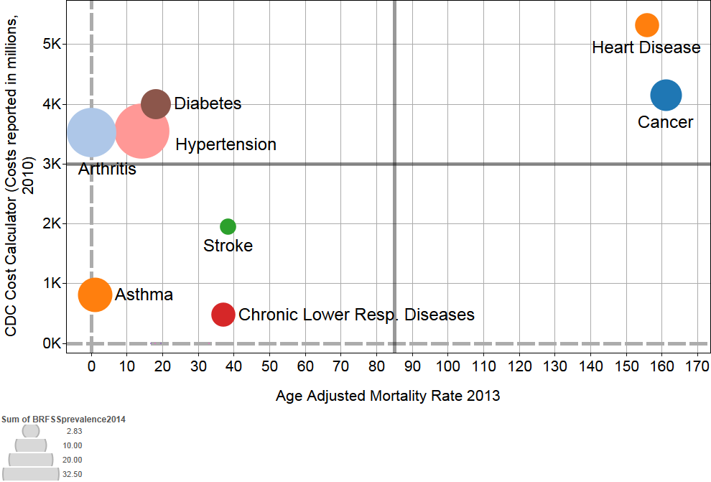
Prevalence, Number of Deaths, and Hospitalization Costs of Chronic Diseases, 2013
Data Sources: Vital Statistics (2013), Behavior Risk Factor Surveillance System (2013), CDC Cost Calculator (2013)
Notes:
BRFSS (2013) All questions are not assessed every year.

Slide 8
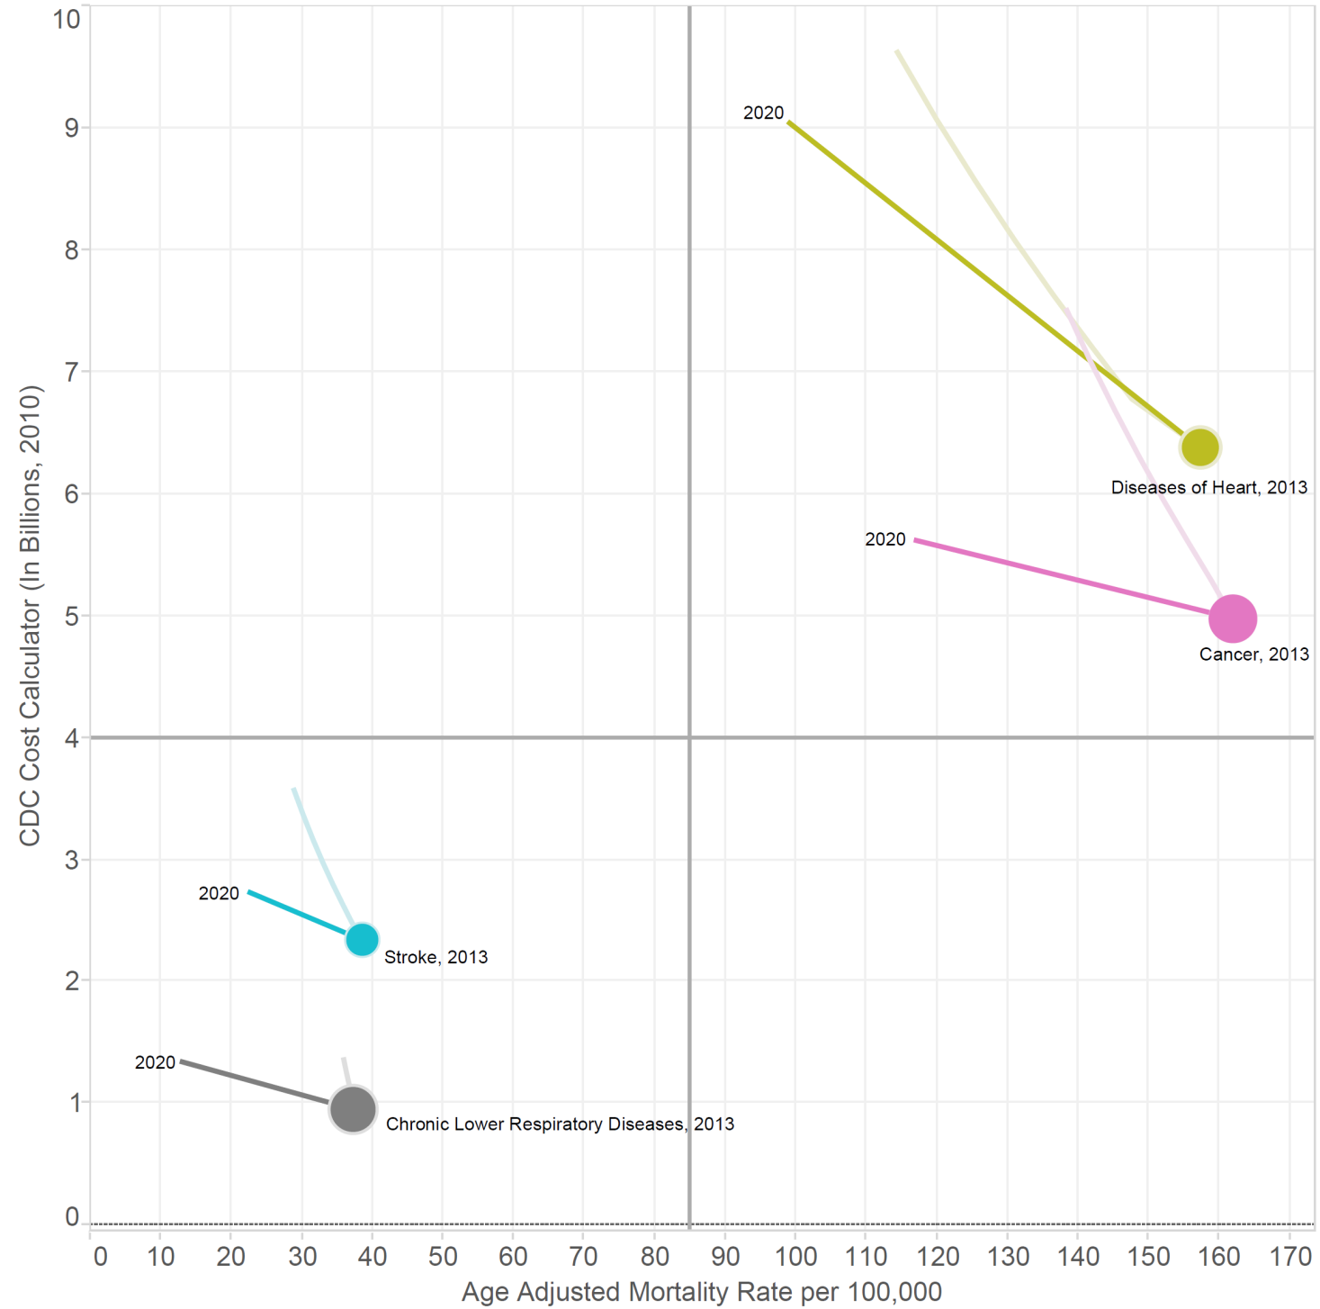
Changing Trajectories To Become the Healthiest State in the Nation

Slide 9
http://www.nap.edu/read/19402/chapter/1

Slide 10
Vision: Virginia is the Healthiest State in the Nation

Slide 11
Framework for Well-Being in Virginia
Well-Being
Physical Wellness
Emotional Wellness
Aging Well
Preventive
Actions
Strong Start for Children
Quality Healthcare
Healthy, Connected Community
Notes:
Build healthy, connected communities
Give Virginia’s children a strong start
Focus on prevention
Provide quality healthcare

Slide 12
Plan for Well Being Metrics
HEALTHY, CONNECTED COMMUNITIES Consumer Opportunity Profile Economic Opportunity Profile Percent of the Commonwealth Connected via a Statewide Health Information Exchange STRONG START FOR CHILDREN Teen Pregnancy Rate Preterm Birth Rate Thriving Infant Rate Childhood Obesity/Overweight Rate Percentage of Children in Kindergarten Not Meeting PALS K Benchmarks and Requiring Literacy Interventions Percent of Third Graders Who Passed the SOL Third Grade Reading Assessment QUALITY HEALTHCARE Avoidable Hospital Stays Percent of Adults Who Report Having a Regular Healthcare Provider Percent of Hospitals Meeting Virginia’s Goal for Prevention of Hospital-onset Clostridium difficile Infections Cost of Healthcare | PREVENTIVE ACTIONS Percent of Children Aged 19-35 Months Who Received the Recommended Vaccines Percent of Girls/Boys Aged 13-17 Who Received Three Doses of Human Papilloma Virus (HPV) Vaccine Percent of Adults 18 Years and Older Who Received an Annual Influenza Vaccination Percent of Females Aged 50 to 74 Years Who Received Breast Cancer Screening Percent of Adults Aged 50 to 75 Years Who Received Colorectal Cancer Screening Percent of Virginian Adults (18 years old and up) Who Report Using Tobacco WELL BEING: PHYSICAL & EMOTIONAL WELLNESS; AGING WELL Percent of Adults Who Reported One or More Days of Poor Health That Kept Them from Doing Usual Activities Percent of Adults Who Did Not Participate In Any Physical Activities Other Than Their Regular Job during the Past 30 Days Rate of Injury Hospitalization Rate of Mental Health and Substance Use Disorder Hospitalization in Adults Life Expectancy

Slide 13
Healthy, Connected Communities
Short Horizon Metrics | Long Horizon Metrics
Consumer Opportunity Profile | Full Health Opportunity Index Includes environmental issues Add measure of social capital, connectedness to index
Economic Opportunity Profile
Percent of the Commonwealth Providers Connected via a Statewide Health Information Exchange | Broadband and cell phone connectivity/coverage Other connectivity metrics

Slide 14
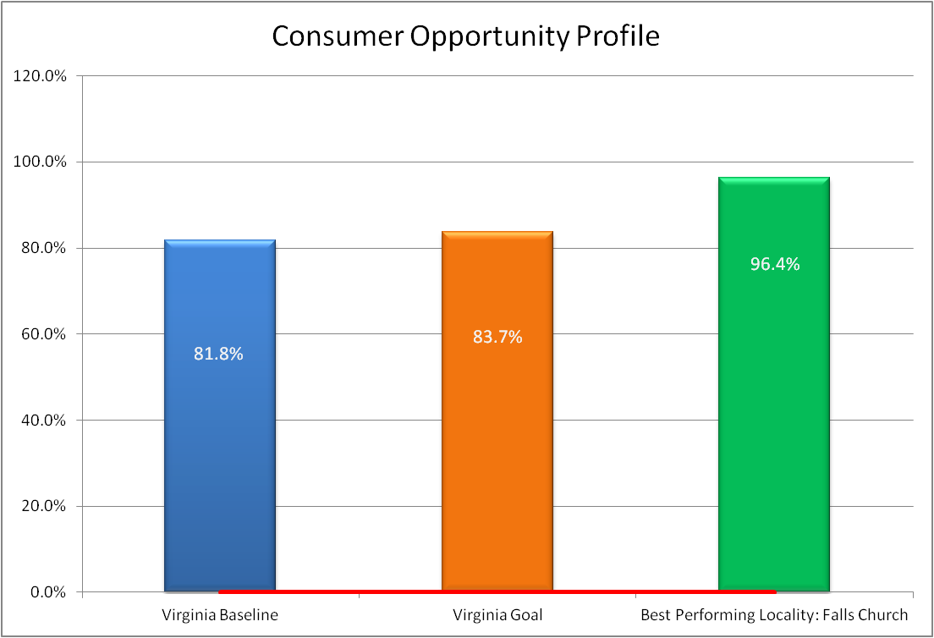
Consumer Opportunity Profile (No Trend Data)
Notes:
The Consumer Opportunity Profile is comprised of four population level variables (average years of education, food accessibility, affordability (cost of housing and transportation as a % of income), and material deprivation (lack of housing access, lack of transportation, prevalence of overcrowding in homes and unemployment). The profile represents access to basic consumer resources that support long and health lives. The profile is measured on a scale of 0 (representing no access) to 100 (representing perfect access). The current baseline for Virginia is 81.8.

Slide 15
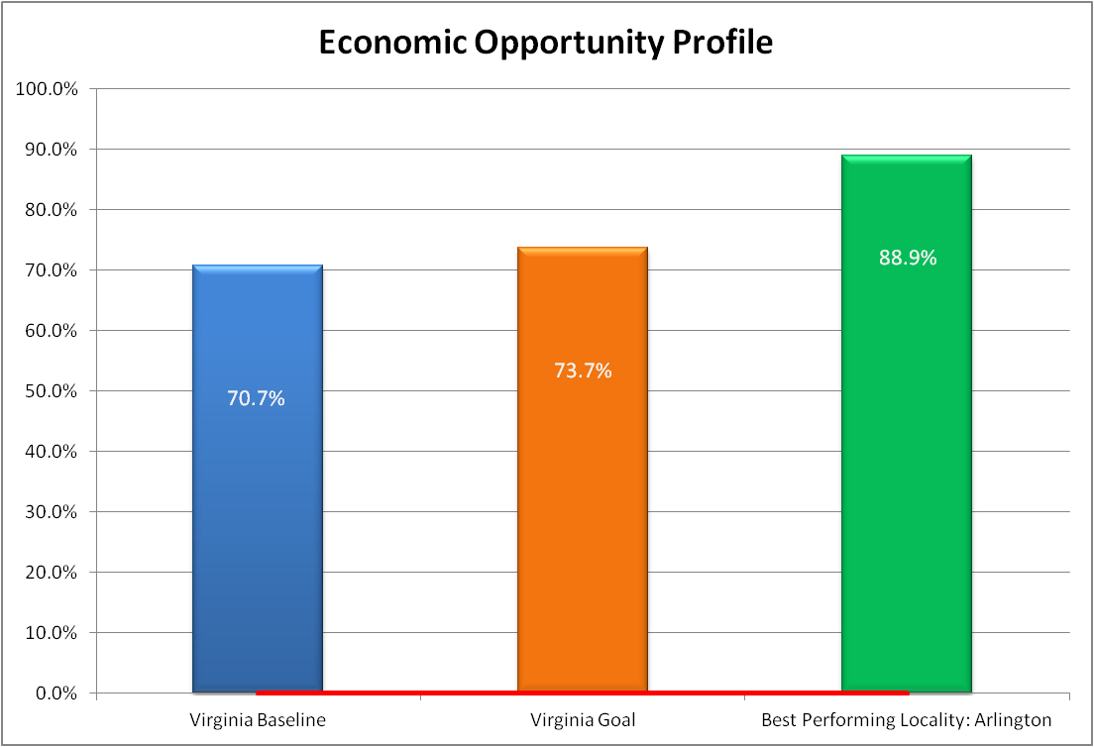
Economic Opportunity Profile (No Trend Data)
Notes:
The Economic Opportunity Profile is comprised of three variables (employment access, job participation and income inequality) that represent access to traditional economic resources that support long and health lives. The profile is measured on a scale of 0 (representing no access) to 100 (representing perfect access). The current baseline for Virginia is 70.7

Slide 16
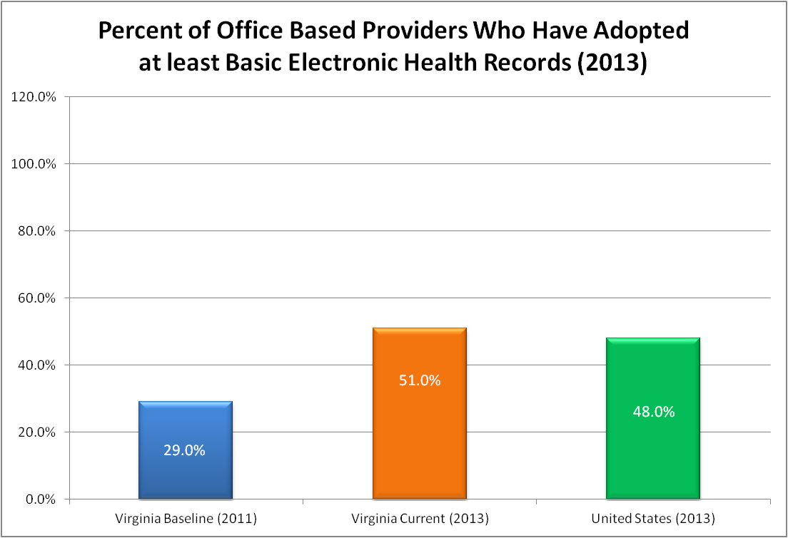
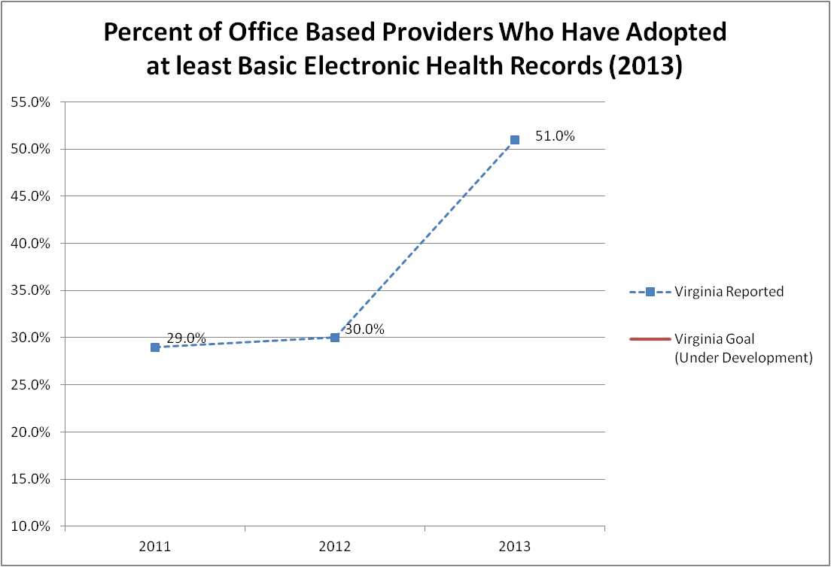
Office Based Providers with at least a Basic Electronic Health Record System
Notes:
HIE connectedness is still under development, however an available surrogate metric is office based providers with a basic EHR system.

Slide 17
Strong Start for Children
Short Horizon Metrics | Long Horizon Metrics
Teen Pregnancy Rate | Measure of Well-Being in Graduating HS students
Preterm Birth Rate | Neonates born at full term
Thriving Infant Rate | Thriving Infant Rate

Slide 18
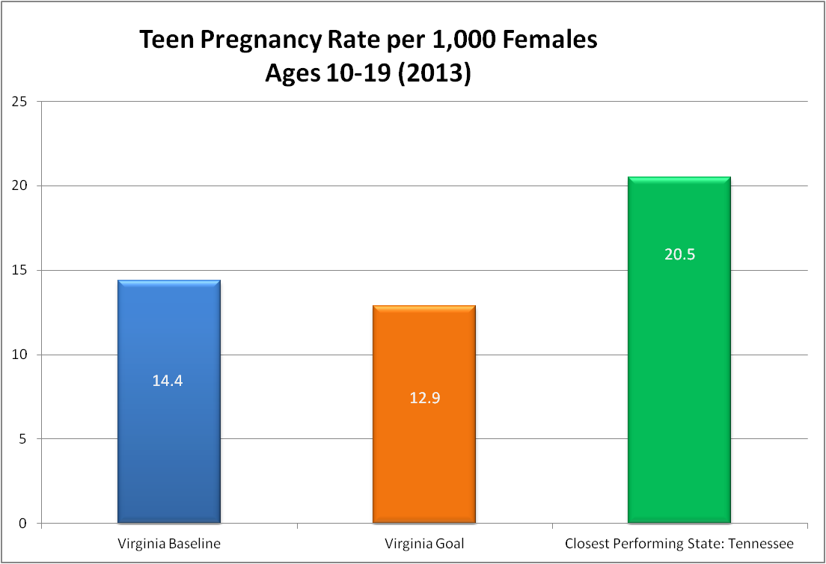
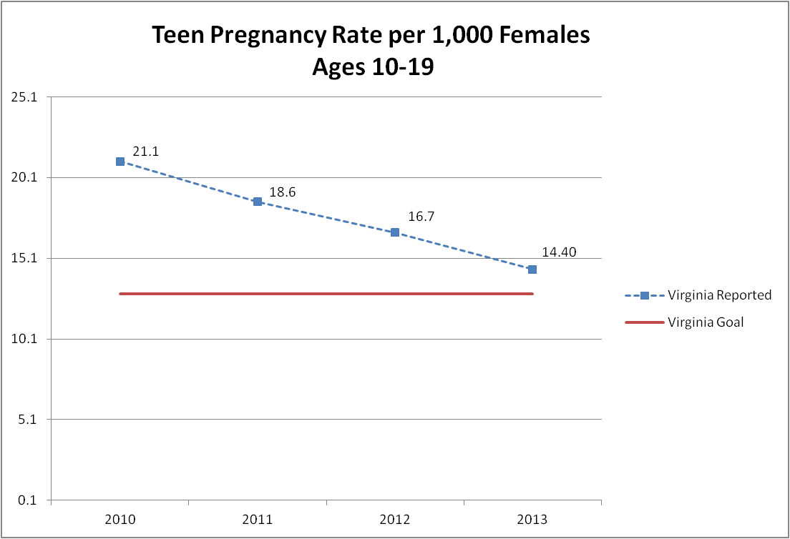
Teen Pregnancy Rate Ages 10-19

Slide 19
Virginia Teen (ages 10-19yrs) Pregnancy Rate, 2013
Source: VDH Division of Health Statistics, compiled by the Division of Policy & Evaluation, Office of Family Health Services
Notes:
Demonstration of geographic disparities for Teen Pregnancy Rate.

Slide 20
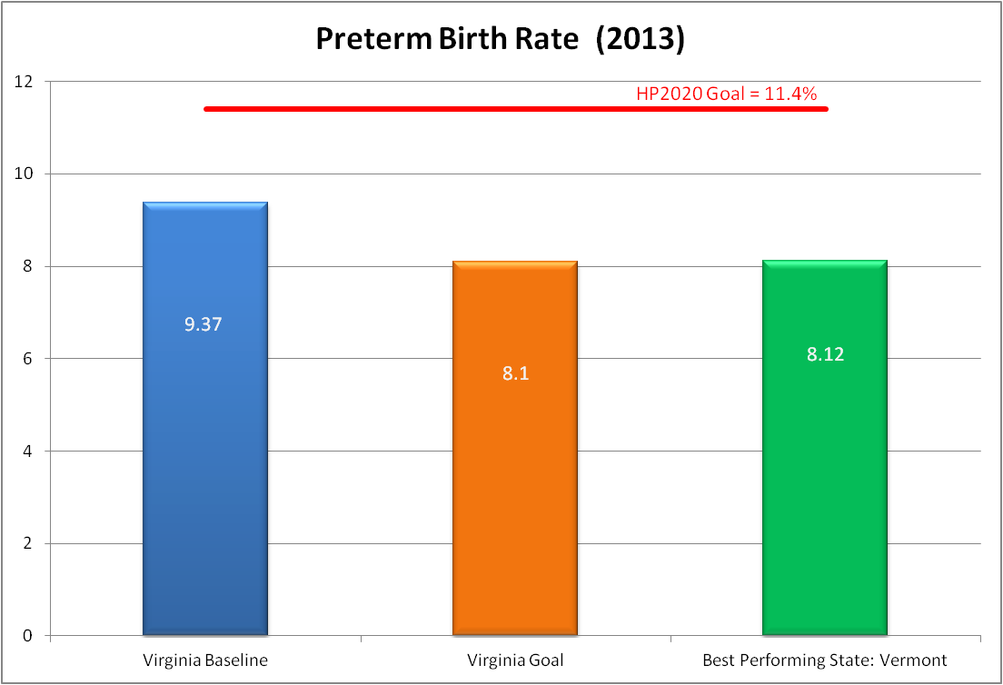
Preterm Birth Rate

Slide 21
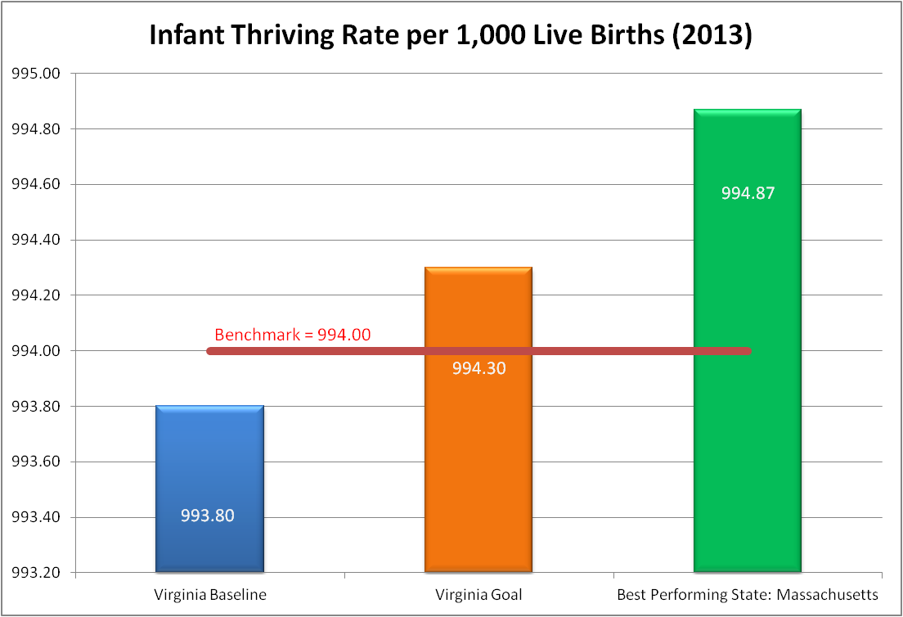
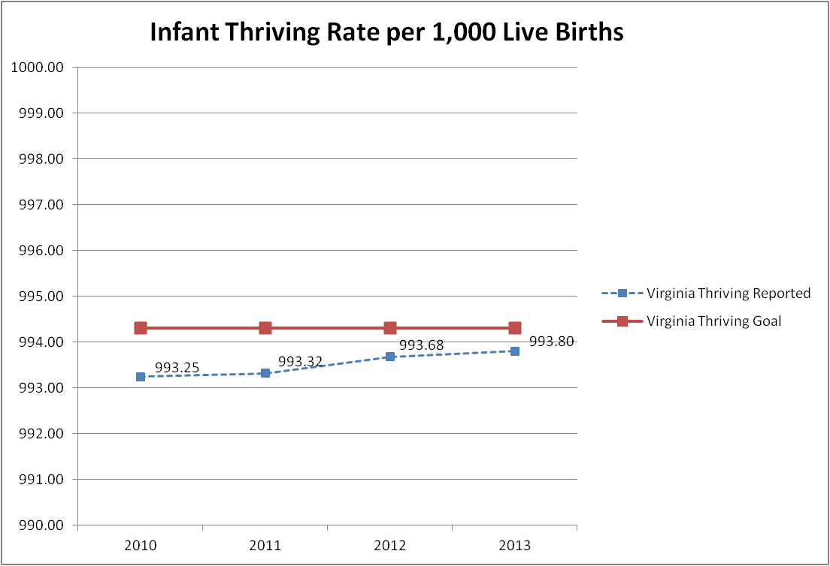
Infant Thriving Rate

Slide 22
Strong Start for Children
Short Horizon Metrics | Long Horizon Metrics
Childhood Overweight/Obesity Rates Source: YRBS Self Report or School Reports | Children At Healthy Weight at Key Milestones
Percent of Children in Fall of Kindergarten Not Meeting PALS K Benchmarks | Percent Attaining Kindergarten Reading Benchmarks
Percent of Third Graders Who Passed the SOL Reading Assessment | Same

Slide 23
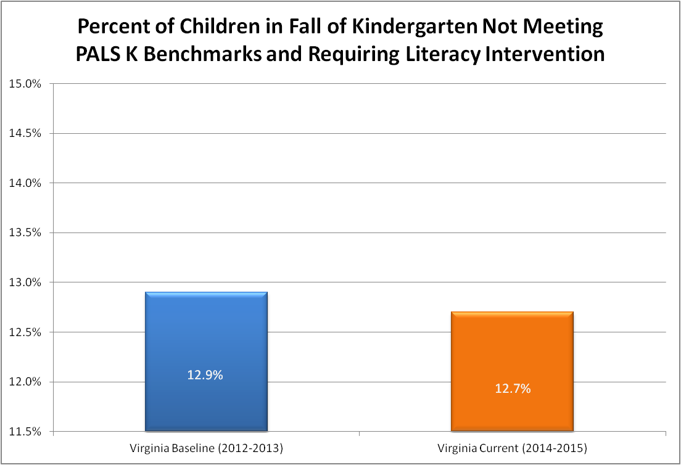
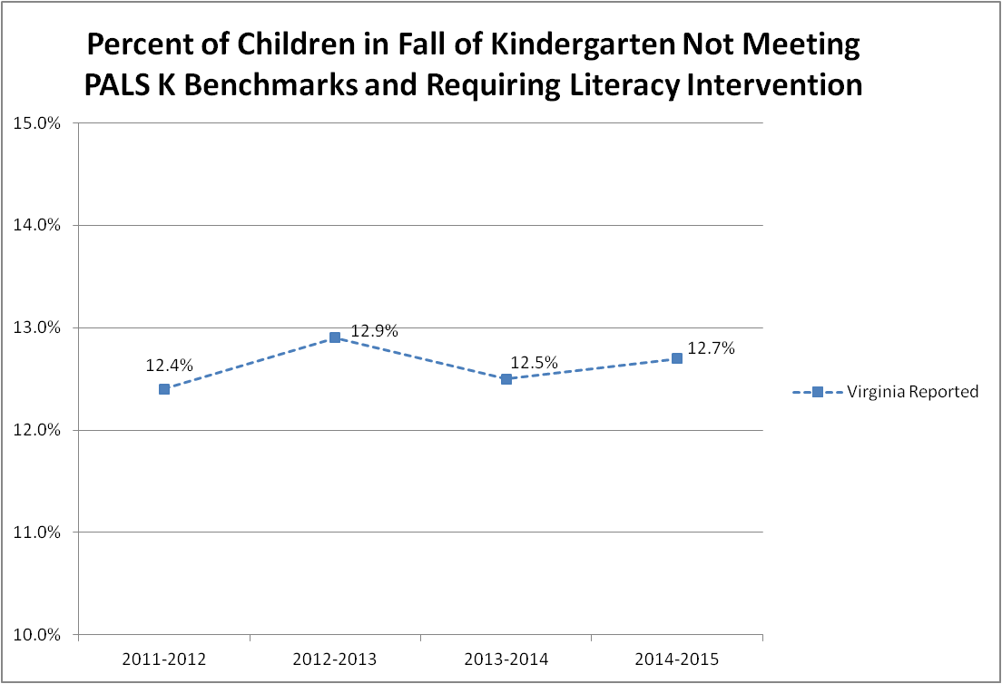
Percent of Kindergarten Children Not Meeting PALS K Benchmarks and Requiring Literacy Intervention

Slide 24
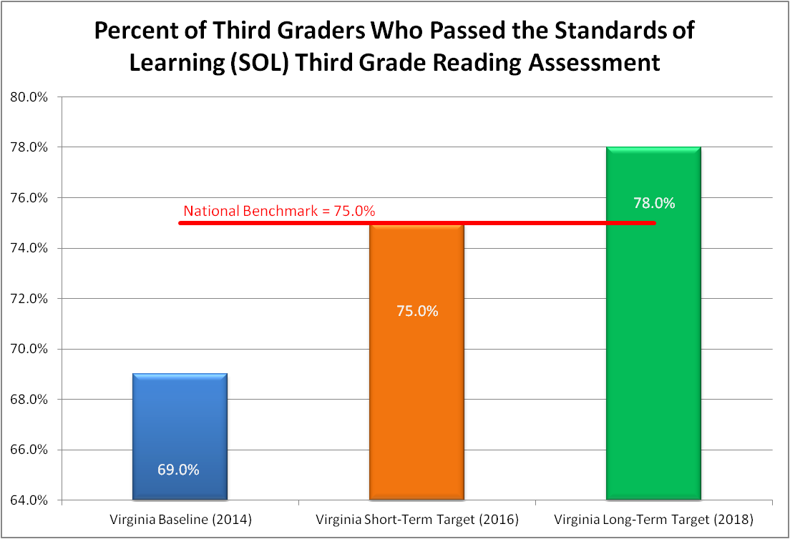
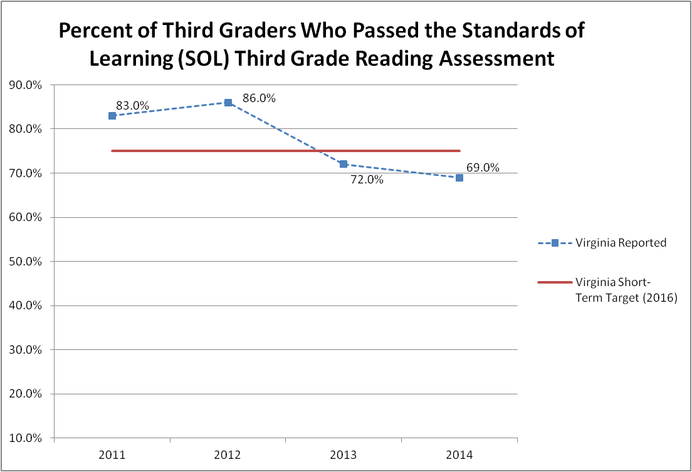
Percent of Third Graders Who Passed the Standards of Learning (SOL) Third Grade Reading Assessment

Slide 25
Quality Healthcare
Short Horizon Metrics | Long Horizon Metrics
Avoidable Hospitalization Rate | Metric related to accessibility of appropriate care when needed
Percent of Adults Who Report Having a Regular Healthcare Provider Source: BRFSS Self Report | Percent of people in an integrated health home (medical, behavioral, dental)
Percent of Hospitals Meeting Virginia’s Goal for Prevention of Hospital-onset Clostridium difficile Infections | Evolving healthcare safety metric

Slide 26
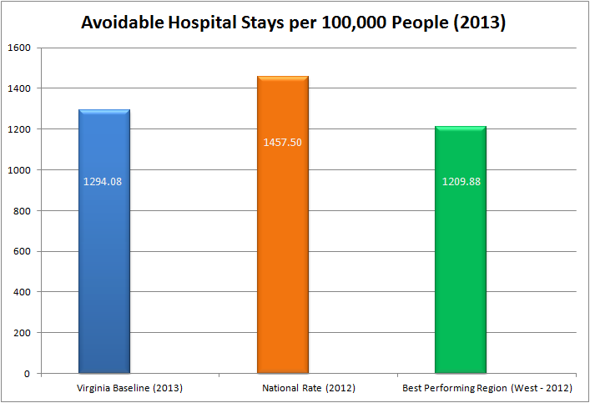
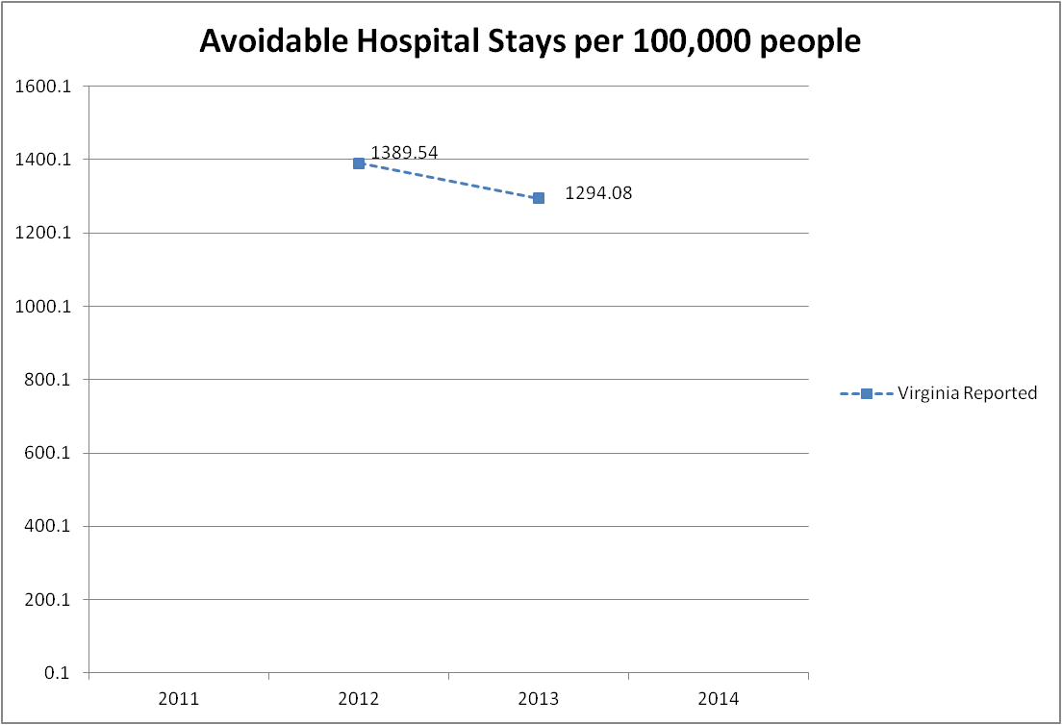
Avoidable Hospital Stays per 100,000 People

Slide 27
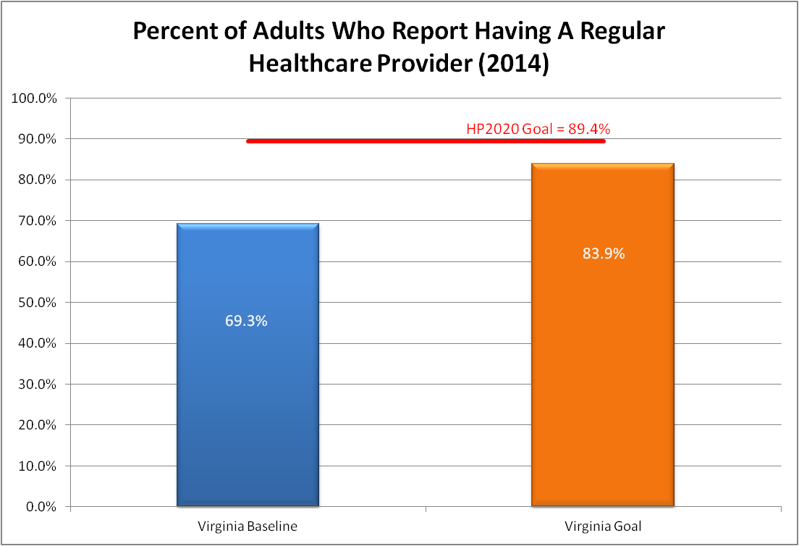
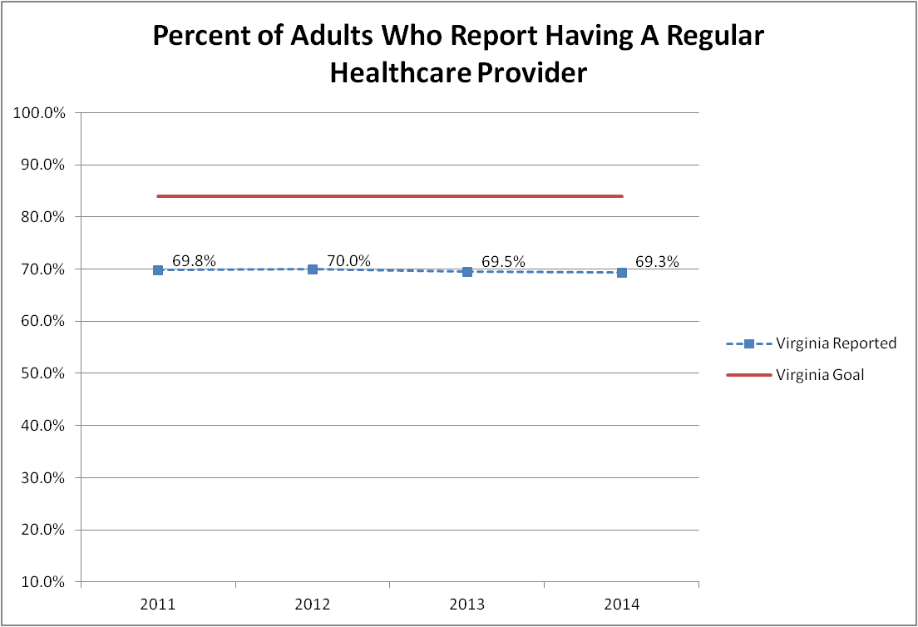
Percent of Adults Having a Regular Healthcare Provider

Slide 28
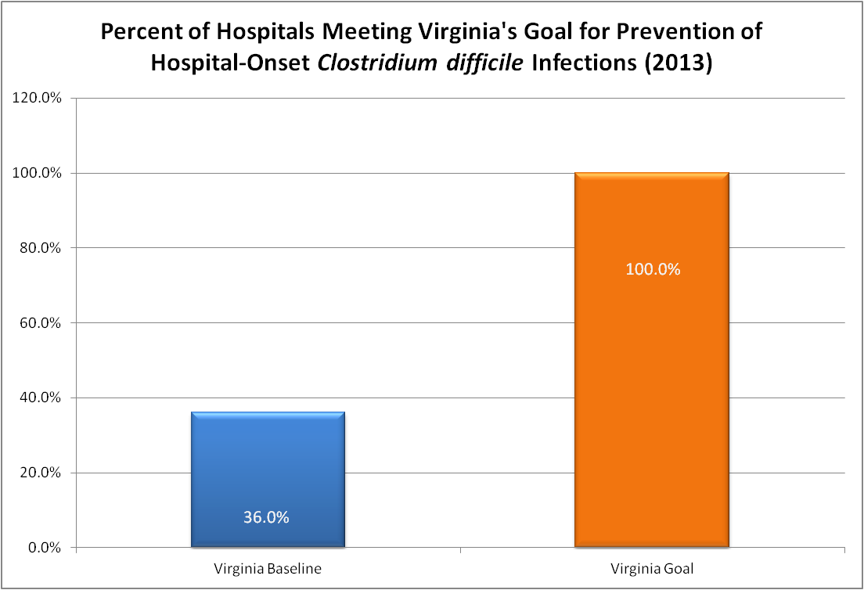
Percent of Hospitals Meeting Virginia's Goal for Prevention of Hospital-Onset Clostridium difficile Infections (No Trend Data)
Notes:
*Data from 2014 have not yet been published. Later this year, VDH will maintain full access to these data and will be able to calculate performance for 2014. These data are not available prior to 2013.

Slide 29
Quality Healthcare
Short Horizon Metrics | Long Horizon Metrics
Per capita healthcare expenditure (Total cost) | Trending inpatient and outpatient costs comparatively Capture health care spending relative to income (measure of burden)
Notes:
This metric is constrained by our available data. The most comprehensive cost data is from 2009, however cost information is captured by APCD and with current participation rates accounts for about 50% of Virginia’s population

Slide 30
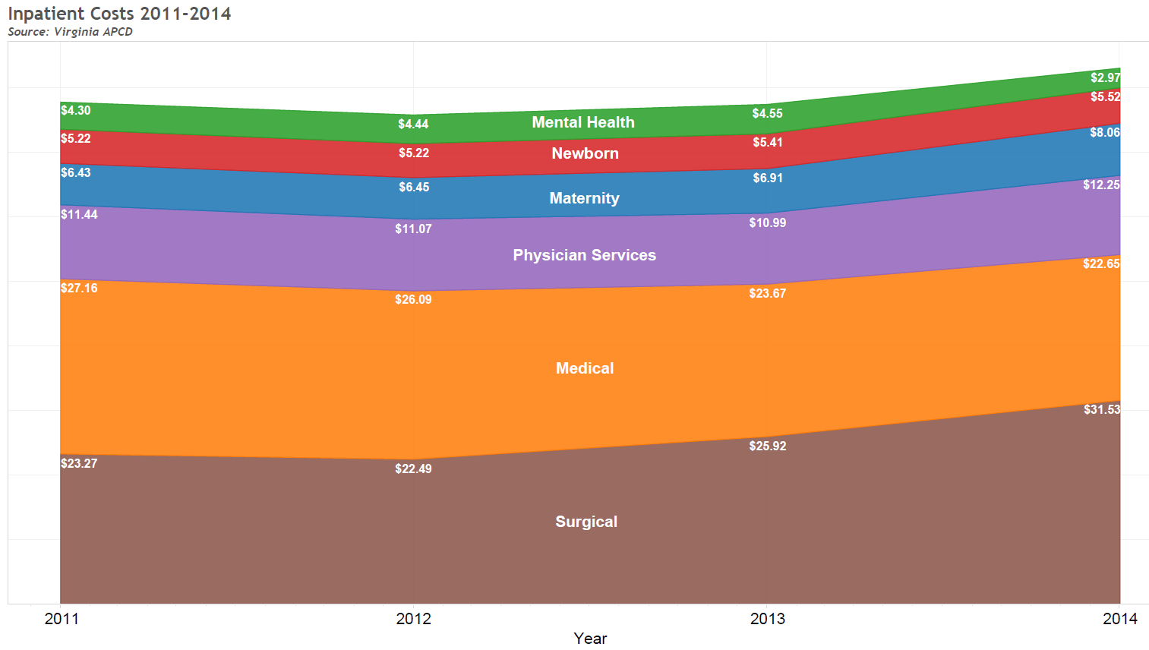
Inpatient Costs 2011-2014
Figures are in U.S. Dollars per member, per month
Total: $82.97
Total: $77.81
Total: $77.45
Total: $75.76
Source: Virginia APCD, all dollars displayed utilize a standardized proxy reimbursement amount
Service categories are derived from Milliman Health Cost Guidelines (HCGs)
The following coverage types are currently not included in the Virginia APCD: Charity Care, Self Pay, TRICARE, FEHBP and Medicare FFS
State Medicaid data is only included through June of 2014

Slide 31
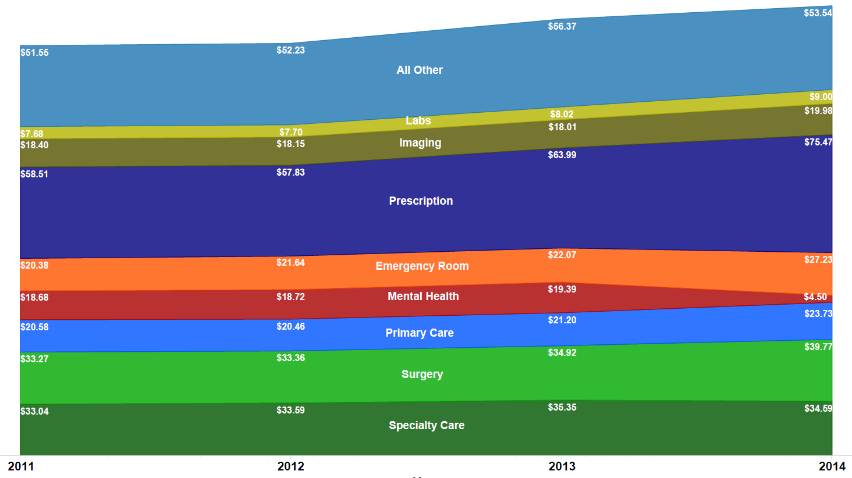
Outpatient Costs 2011-2014
Figures are in U.S. Dollars per member, per month
Total: $287.81
Total: $279.31
Total: $262.09
Total: $263.68
Source: Virginia APCD, all dollars displayed utilize a standardized proxy reimbursement amount
Service categories are derived from Milliman Health Cost Guidelines (HCGs)
The following coverage types are currently not included in the Virginia APCD: Charity Care, Self Pay, TRICARE, FEHBP and Medicare FFS
State Medicaid data is only included through June of 2014

Slide 32
Preventive Actions
Short Horizon Metrics | Long Horizon Metrics
Percent of Two-Year Olds with Up-to-date Immunizations | Percent of Population without vaccine-preventable disease
Percent of Adolescents Fully Vaccinated Against HPV
Percent of Adults Vaccinated Against Influenza

Slide 33
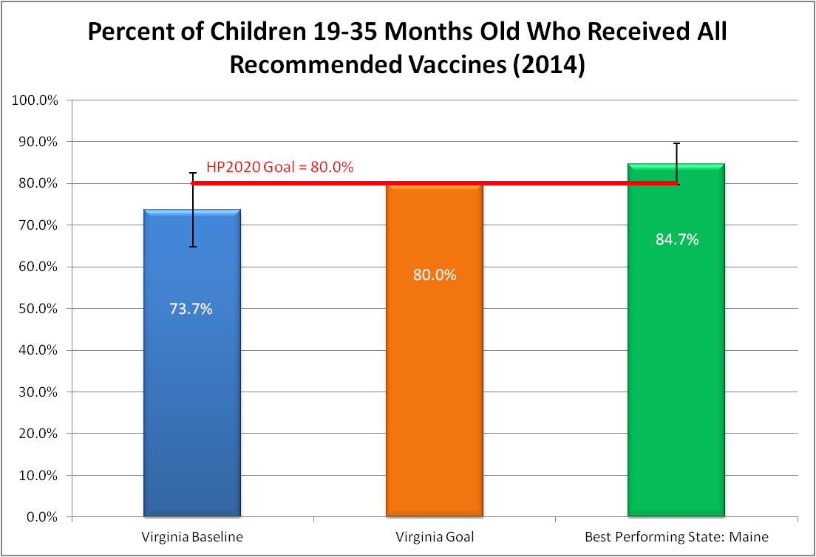
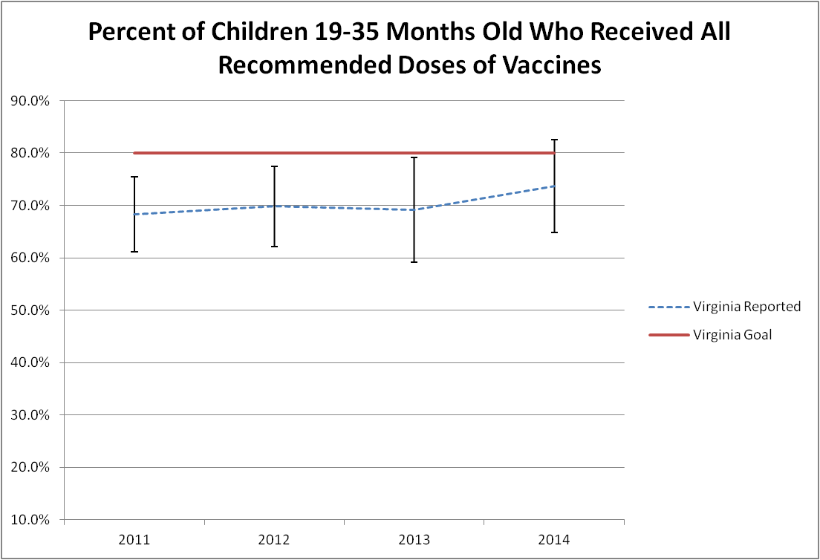
Percent of Children Who Received All Recommended Vaccines

Slide 34
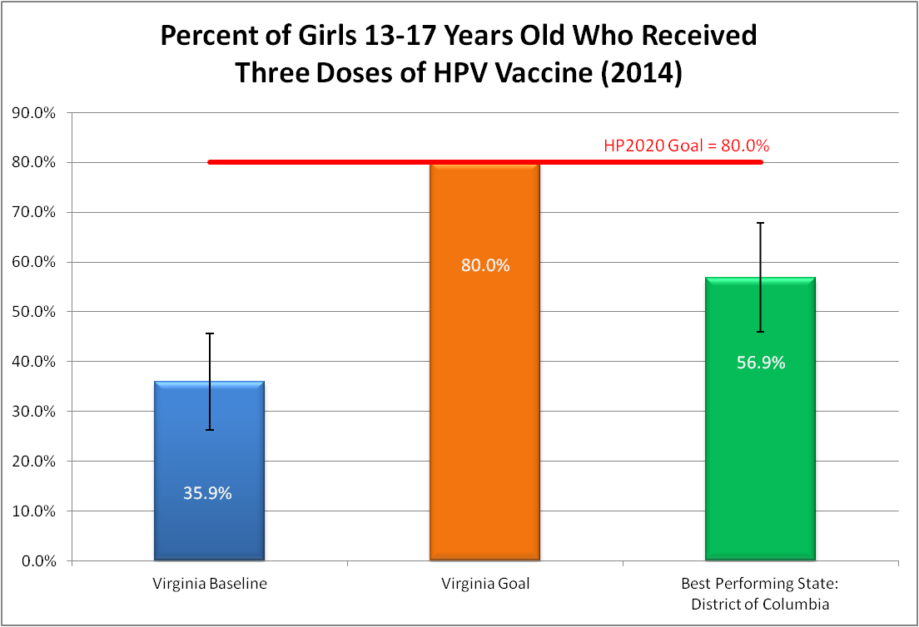
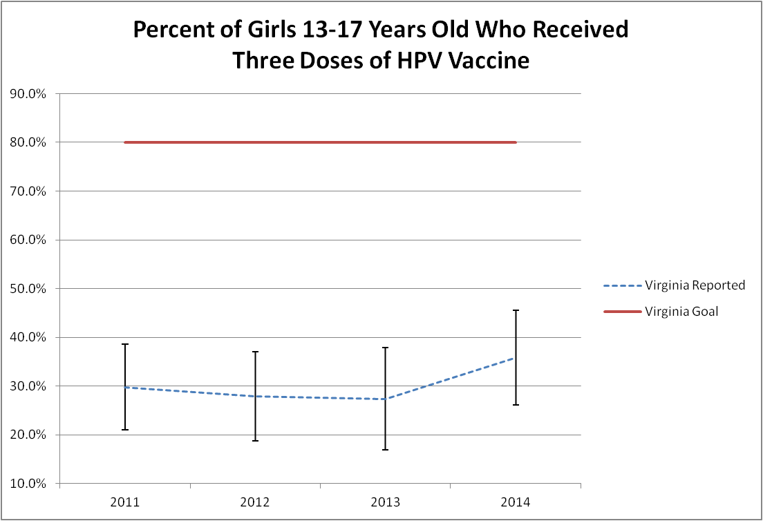
Percent of Girls 13-17 Years Old Who Received Three Doses of HPV Vaccine

Slide 35
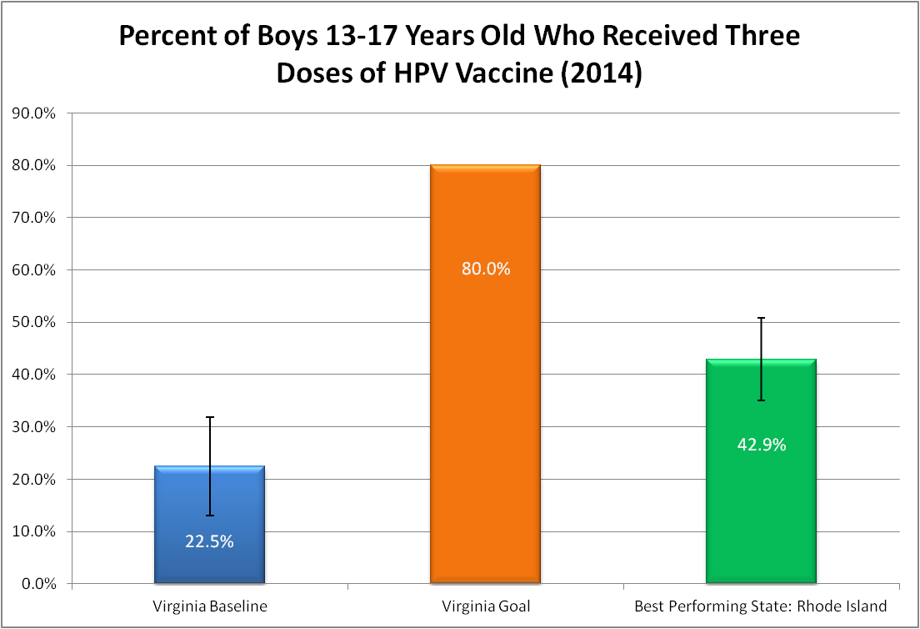
Percent of Boys 13-17 Years Old Who Received Three Doses of HPV Vaccine (No Trend Data)

Slide 36
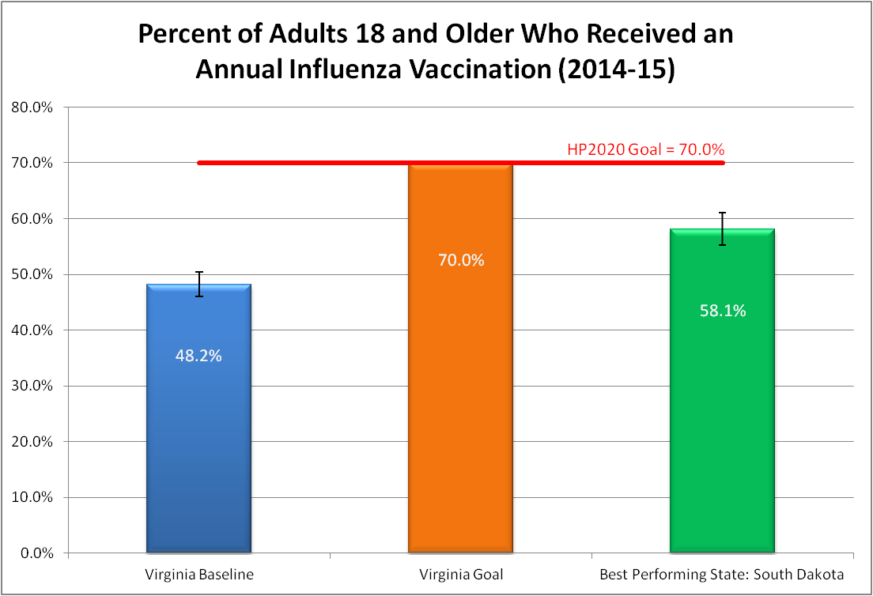
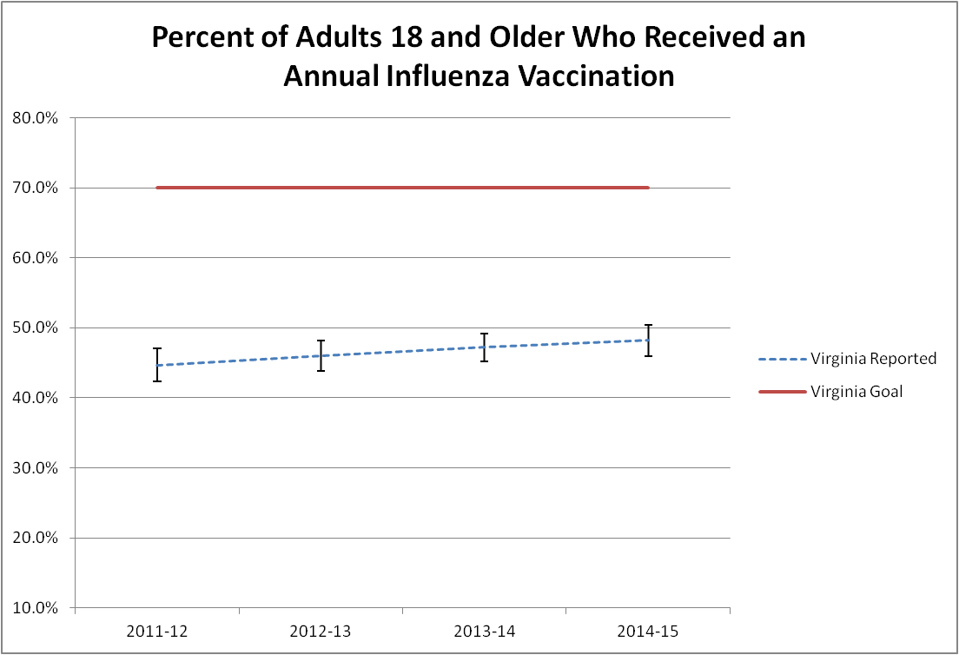
Percent of Adults Who Received an Annual Influenza Vaccination

Slide 37
Preventive Actions
Short Horizon Metrics | Long Horizon Metrics
Percent of Adults Who Use Tobacco Source: BRFSS Self Report | Percent of Population Free of Lung Cancer/Tobacco related illness
Percent of Adults Screened for Colorectal Cancer Source: BRFSS Self Report | Percent of Population Free of Colorectal Cancer
Percent of Females Screened for Breast Cancer Source: BRFSS Self Report | Percent of Population Free of Breast Cancer

Slide 38
Percent of Adults Who Report Using Tobacco

Slide 39
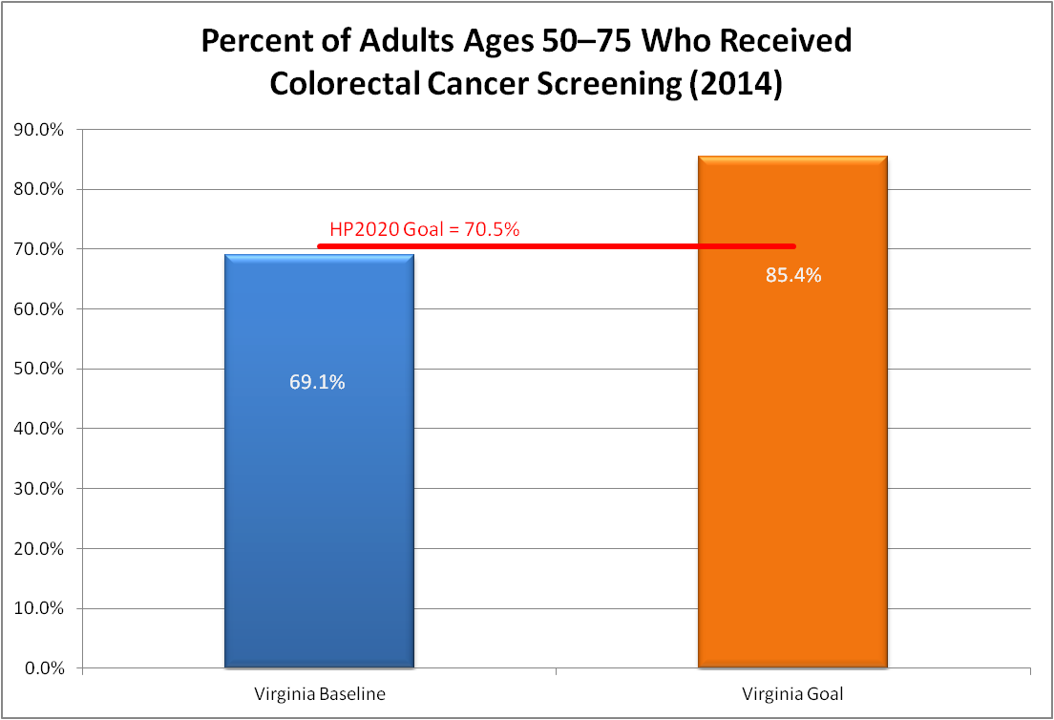
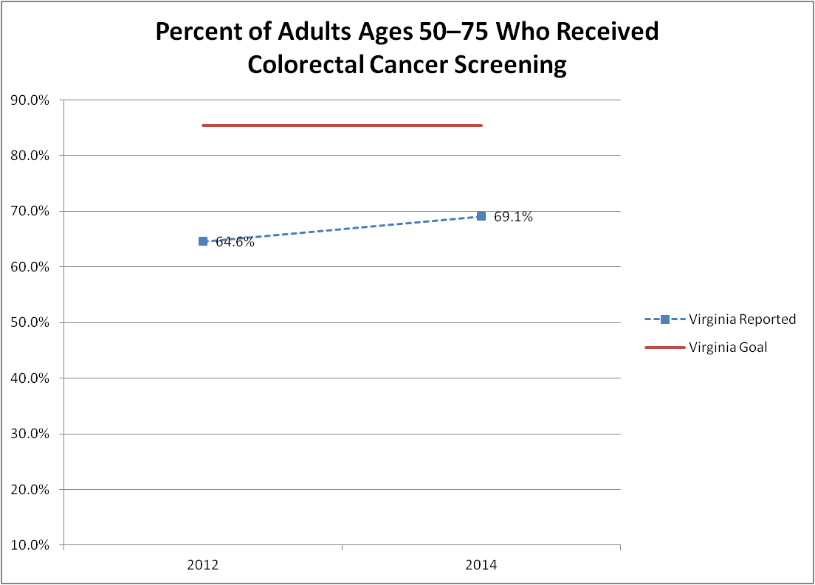
Percent of Adults Who Received Colorectal Cancer Screening in Accordance with Current Guidelines

Slide 40
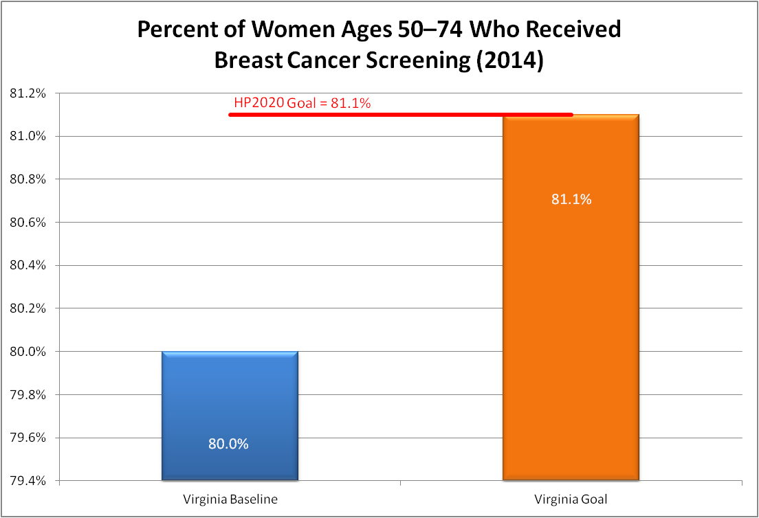
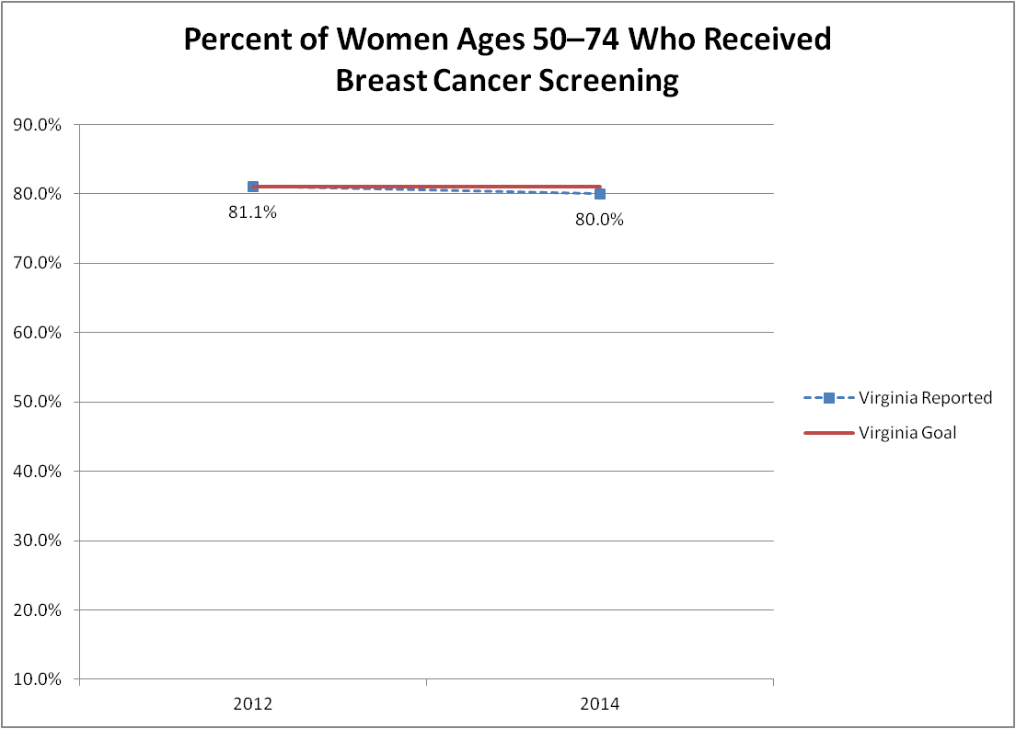
Percent of Women Who Received Breast Cancer Screening in the Past Two Years

Slide 41
Well Being
Short Horizon Metrics | Long Horizon Metrics
Percent of Adults Who Report Poor Health Kept Them from Usual Activities Source: BRFSS Self Report | Percent of Population Reporting Health and Well-Being
Percent of Adults Who Did Not Participate in any Physical Activities Other than Their Regular Job Source: BRFSS Self Report | Percent of Adults Who are Physically Fit

Slide 42
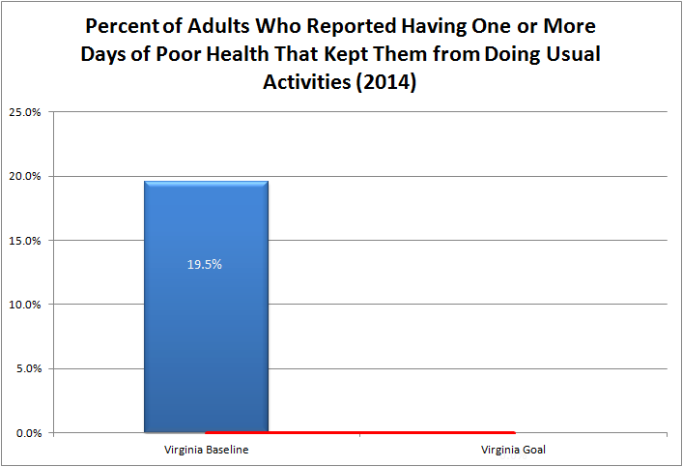
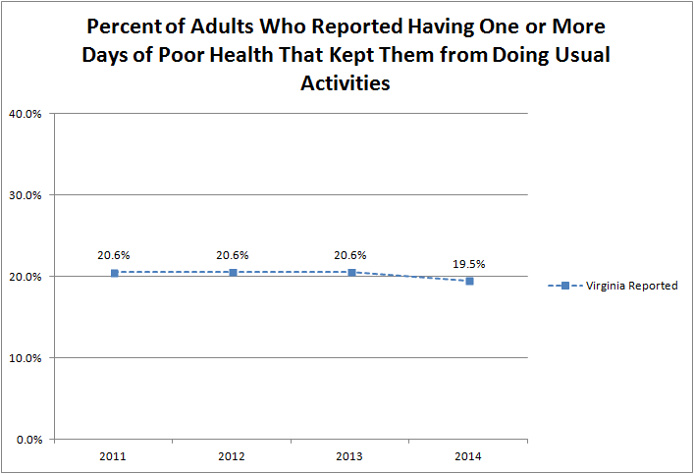
Adults Who Reported Poor Health Kept Them From Usual Activities
Notes:
The BRFSS is an ongoing, annual survey of adults, who are randomly called via landline or cell phone. The survey is coordinated by the Centers for Disease Control and Prevention (CDC) and conducted in all 50 states. Therefore the rates of of Virginia adults who reported having one or more days of poor health that kept them from doing usual activities in Virginia can be easily compared to other states and can be trended over time. While the data can be annually tracked at the state level, the small number of people surveyed in any given locality makes it difficult to estimate the rate of Virginia adults who reported having one or more days of poor health (physical health or mental health) that kept them from doing usual activities within local areas, without combining several years of data.

Slide 43
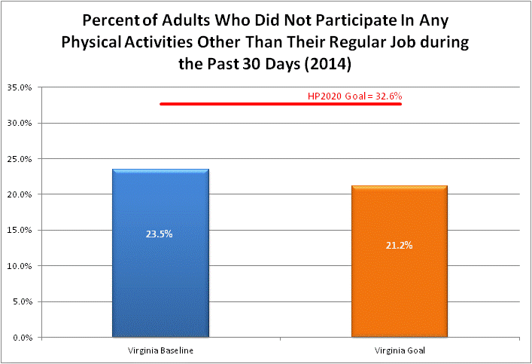
Adults Who Did Not Participate in Physical Activity

Slide 44
Well Being
Short Horizon Metrics | Long Horizon Metrics
Rate of Injury Hospitalization by Age Group
Life Expectancy at Birth | Disability Adjusted Life Years (DALYs); Measure Of Functional Well-Being in Older Adults
Rate of Mental Health and Substance Use Disorder Hospitalization in Adults | Percent of Population reporting no behavioral health/substance use issues impacting daily functioning

Slide 45
Injury Related Hospitalizations

Slide 46
Life Expectancy at Birth

Slide 47
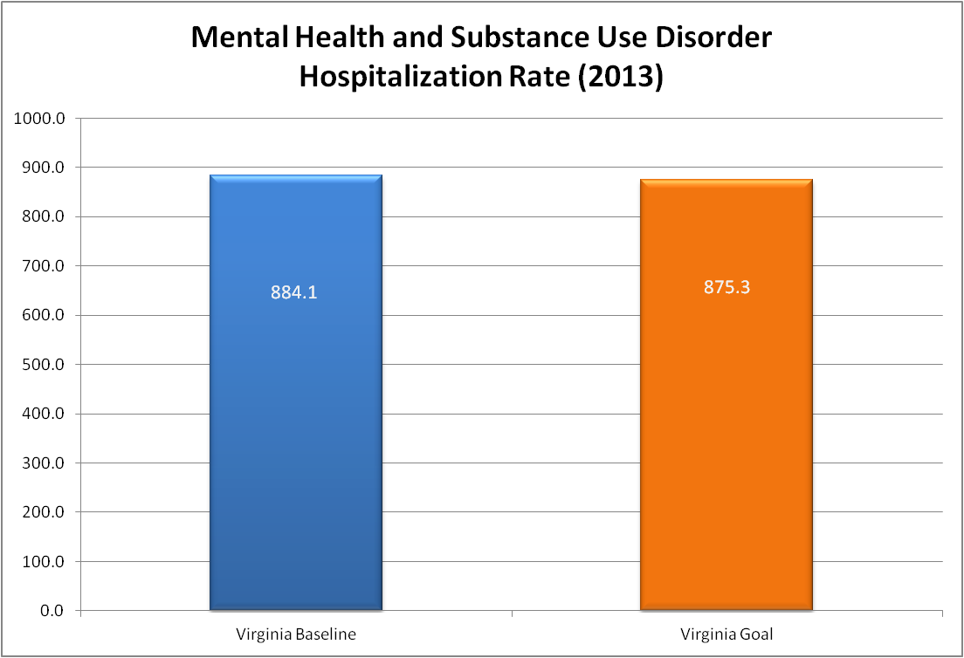
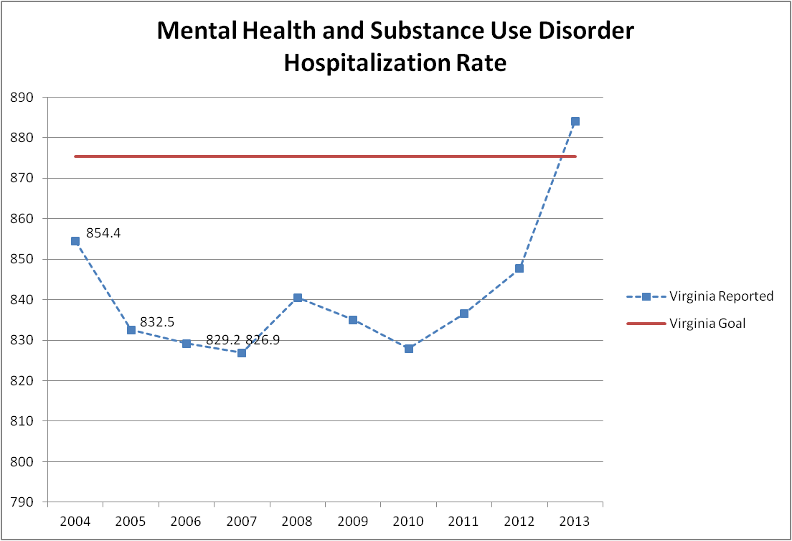
Mental Health and Substance Use Disorder Hospitalization Rate

Slide 48
METRICS ALONE ARE INSUFFICIENT
We also require:
Vision – Where we want to be
Process – How to get there
Accountability – Who does what and by when
Will – A commitment to move forward
Much of the above will be addressed as we collectively create Virginia’s Plan for Well-Being

Slide 49
Framework for Well-Being in Virginia
Well-Being
Physical Wellness
Emotional Wellness
Aging Well
Preventive
Actions
Strong Start for Children
Quality Healthcare
Healthy, Connected Community

Slide 50
EFFECTS OF TOBACCO ON PREGNANCY OUTCOMES

Slide 51
Preterm (<37 completed wks) Birth Across the Nation, 2012
If ~2,800 fewer infants were born preterm, Virginia’s preterm birth rate would be reduced to 8.6%, and Virginia would have the lowest rate in the nation.
Source: VDH Division of Health Statistics, compiled by the Division of Policy & Evaluation, Office of Family Health Services
Notes:
born preterm, Virginia’s preterm birth rate would be reduced to 8.6 %, and Virginia would have the lowest rate in the nation

Slide 52
Virginia’s Goal: The best term rate in the nation

Slide 53
Notes:
New 21st Century Scientific Basis---- provides one system with multiple factors,Provides an understanding of how the social environment gets built into our bodies
• Bridges our intuitive understanding of the social causes of ill health with our understanding of the body’s response and clinical manifestations
• Incorporates our growing scientific understanding of the biology of human development including brain development
• Focuses on root causes of illness and disparities
Adapted from Milt Kotelchuck, Martha May Eliot Symposium, APHA, October

Slide 54
Discussion/Questions

