Slide 1


Virginia WIC Program
2023 Reauthorization Training
Notes:
Welcome to the Virginia WIC program’s 2023 reauthorization training
Content approximately 45 minutes long, with pauses for Q&A, will be about an hour.
We’re here because there is a requirement of interactive training every 3 years. On other years we do the yearly training via newsletters. Today will cover everything you need to satisfy the annual training requirement this year. There will be time for live questions throughout this presentation.

Slide 2
Objectives
Gain knowledge on each area required by federal requirements
Ask and receive answers regarding the WIC program
Notes:
Our objectives today:
Understand WIC requirements, guidelines, and applicable regulations affecting retail stores.
Have the opportunity to talk about any section or questions you have.
Any questions the host does not have the answer to will be recorded as parking lot questions and will be answered in a subsequent announcement.

Slide 3
Expectations
Watch, listen, and write down questions throughout. We will be pausing the recording to allow for interactive Q&A
Use this training to refresh your knowledge
Pass along relevant information to the rest of your staff
Notes:
Expectations for todays training
throughout this recording, a live webinar host will stop and ask for participation. This is the time to ask questions.
It will be a good idea to write down thoughts or questions as the recording plays so that you remember them when the pause occurs.
After, make sure you pass along information to the rest of your store’s staff

Slide 4
Federal Training Requirements for Retailers
Purpose of the Program
Approved Foods/Food List
Minimum Stocking Requirements
Formula supplier/source
eWIC Transaction Procedures
Vendor Sanction System
Vendor Complaint Process
Claims Procedures
Incentive item policies
Program Changes/Updates
Notes:
Federal regulations determine the topics that must be covered during training

Slide 5
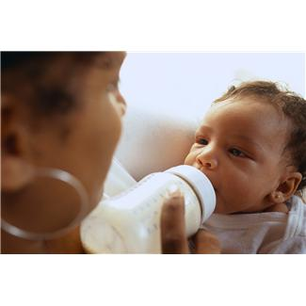
The Purpose of the WIC program
The Special Supplemental Nutrition Program for Women, Infants & Children
Federal health program funded by a grant from USDA
Promotes optimum health and nutrition for pregnant women, new mothers, infants, and children up to age five
Notes:
The Special Supplemental Nutrition Program for Women, Infants, and Children is a food and nutrition program benefitting infants, children up to age 5, and pregnant, postpartum and breastfeeding women with low to moderate incomes.
numerous studies show that :
Women who participate in WIC give birth to healthier babies who are more likely to survive infancy.
WIC supports more nutritious diets and better infant feeding practices. WIC participants buy and eat more fruits, vegetables, whole grains, and low-fat dairy products

Slide 6

Authorized Retailers’ Role
Comply with the WIC Retailer Agreement and the Retailer Procedure Manual
Provide participants with a variety of WIC approved foods
Ensure WIC customers receive the correct foods and quantity
6
Notes:
Authorized retailers play an important role in the WIC program by helping to make sure WIC customers receive the nutritious WIC approved foods they are prescribed.
Retailers are responsible for providing good customer service that ensures a WIC customer feels welcome in their store

Slide 7

Approved Food List
Notes:
NEED TO RE-RECORD
There were some minor changes to the 2022 food list; string cheese, grits, Greek yogurt, and organic infant fruits and vegetables were added, as well as the option to purchase natural peanut butter and single serving fruits and vegetables.
The brochure also Looks a little different than 2 years ago:
English – shown here with a green cover, Spanish is a blue cover, both found on our website. If you didn’t already, throw out the 2020 food lists.
We’ll review the current food list now.

Slide 8

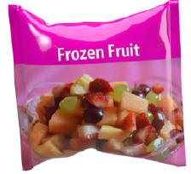
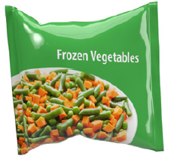



Fruits and Vegetables
Organic and Non-Organic; Fresh, Frozen, and Canned
Notes:
WIC customers are allowed to purchase fresh, frozen or canned fruit and vegetables.
Dried fruit is not allowed. They may choose to buy one type or they may buy a combination.
There are ingredients not allowed in canned and frozen fruits including Sugar or Sugar substitutes
Canned fruits are allowed if packed in water, juice or fruit juice concentrate.
Because no sugar is added, unsweetened applesauce is allowed. Frozen fruits in bags are allowed
Cash Value Benefits ,(or CVB )are issued as a specific dollar amount – in order to grant participants more flexibility in the fruits and vegetables they purchase. CVB are used only for purchasing fruits and vegetables, whether fresh, frozen, or canned. While all other issued benefits are for a specific quantity of food (i.e., 16 oz. bread)
Participants do not receive cash back if their purchase is less than the benefit amount.

Slide 9
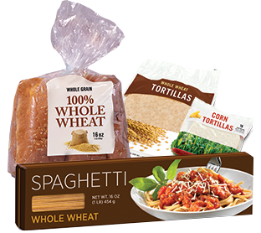
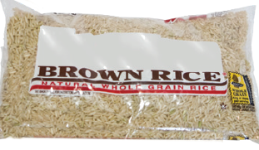
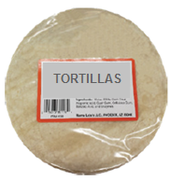
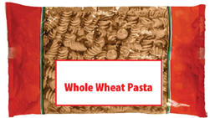
Whole Grains
Whole Wheat Bread
Tortillas (Whole Wheat and Corn)
Whole Wheat Pasta
Brown Rice
16 oz is the only approved size
Notes:
Whole grain foods include whole wheat bread, tortillas made of corn or whole wheat, whole wheat pasta and brown rice. 16 ounces is the approved size for all whole grains.
WIC customers can redeem any combination of whole grain choices up to the amount of ounces in the benefits account. Breakfast cereals don’t count toward whole grain choice for their benefits.

Slide 10
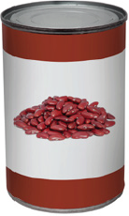
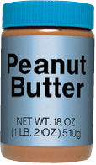




Legumes & Canned Fish
Legumes:
Dried Peas, Beans, Lentils
Canned Beans
And
Peanut Butter
Most cardholders are prescribed *all authorized* so may choose any allowed legume variety
Canned Fish:
Tuna water packed
Salmon, Alaskan or Pink
Notes:
Beans
All single, plain varieties are approved
No mixed bean packages are allowed
Approved dried beans are 16 oz. packages and canned beans 15-16 oz. cans
Peanut butter 16- 18 oz. jars store brands or national brands (images are not shown on the food list)
Note: Legumes cannot be purchased using Cash Value Benefits (CVB)
Canned Fish: tuna in water in 5-6.5 oz and salmon in 7.5 or 14.75 oz

Slide 11
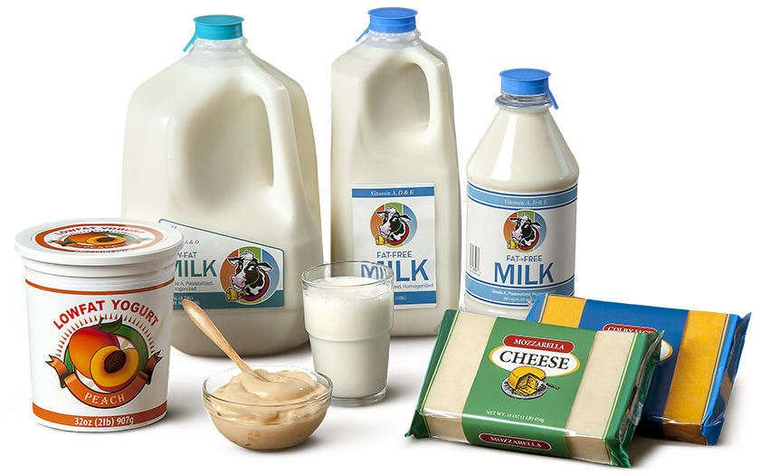

Milk, Eggs, Cheese, Yogurt
Milk: Cow, Specialty milk
Eggs: Large A-AA white or brown one dozen carton
Cheese: 16 oz block or sliced non-wrapped
Yogurt: 32 oz plain or vanilla flavor
Notes:
Milk, Cow’s Milk & specialty milk such as Lactose Free and/or UHT and Soy Milk are on the program, as prescribed on a participant’s card.
Milk: approved container sizes of milk = quarts, ½ gallons & gallon
Approved brands of soy milk are listed in the food list
Eggs: listed on the slide. No specialty eggs are allowed such as cage fee, free range, or Egglands Best
Cheese: certain varieties of private labels and some national brand cheeses are allowed
Yogurt
Is approved in Store brands and selected national brands of regular and Greek yogurt, including Yoplait and Dannon: approved flavors are plain and vanilla
prescriptions may be for whole or non-fat, and will be for 32 oz container size
Participants have the option to purchase any approved brand of cheese or yogurt and are not restricted to the private label/store brand.

Slide 12


Breakfast Cereal
Cereal Basics: Wheat, Rice, Corn, Barley, Oats
Manufactured: Flaked, Puffed, Shredded, Granular
WIC Groups: Whole Grain and Non Whole Grain
Container Size: Cold cereal = 12-36 oz
Hot cereal = 11.8 oz or larger
Store Brand
Cereal
National Brand
Cereal
Notes:
Breakfast Cereal
Private label Brands and National brands are authorized if they meet nutrition requirements
Cereals are pictured in the food list by variety and type
The letter G identifies gluten free cereals
The wheat icon is used for whole wheat or grain cereals

Slide 13

Juice
Frozen concentrate – 12 oz
Non-refrigerated - 64 oz
Refrigerated – 64 oz
Approved varieties: Orange, Grapefruit, Apple, and Grape
Notes:
Juice is approved in 3 forms: Frozen, Non-Refrigerated and Refrigerated.
All brands of 100% unsweetened orange and grapefruit juice are approved in 12 oz. frozen or 64 oz. shelf stable or refrigerated. Other flavors such as grape and apple are approved in certain brands.
Brand Logos are listed in the Juice section of the food list
Juice is listed by brand and not flavor
Not all flavors are approved for each brand.

Slide 14
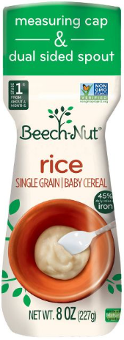
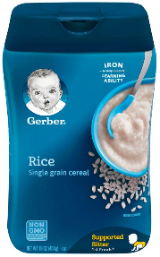
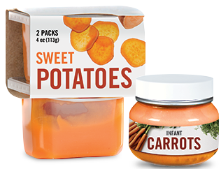
Infant Food
Infant Food (Fruits and Vegetables)
Infant Cereal
Infant Food (Meat)
Notes:
Infant Fruits & Vegetables:
A 2 oz twin pack equals 4 oz
Single 4 oz jars and 4 oz twin packs are approved.
Refer to the buy and don’t buy section in the approved food list
2.5 or 3.5 oz containers and pouches are not allowed
Infant Cereal
8 oz container size only
Rice and oatmeal varieties only, no mixed cereals.
Infant Meats
2.5 oz container size only
Refer to the Buy/Don’t Buy sections in the approved food list

Slide 15
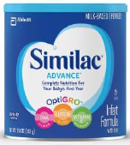
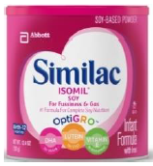
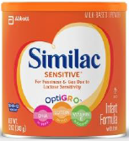
Infant Formula
Powder 12.4 oz. 12.4 oz. 12.0 oz.
Concentrate 13.0 oz. 13.0 oz. n/a
Ready to Feed 32.0 oz. 32.0 oz. 32.0 oz.
Notes:
Infant Formula Flyer: Similac is the contract formula in Virginia. Authorized retailers will stock Similac Advance in great quantity to meet WIC customer demand. Only Similac Advance Powder has a minimum stocking requirement - we’ll talk more about minimum stocking in a little bit.

Slide 16
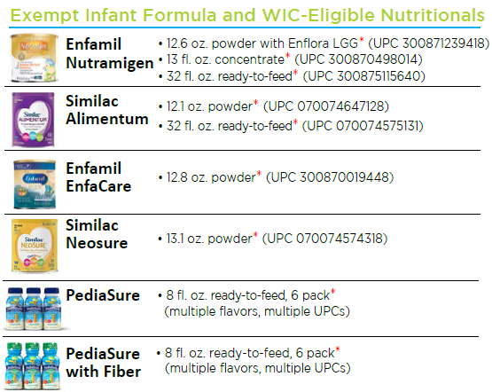
Exempt Infant Formula
Notes:
An exempt infant formula is a formula intended for use by infants who have unusual medical or dietary problems.
The approved exempt formulas are listed here and on the formula flyers that are at each register
If a cardholder asks to purchase a formula that is not included on the list or is ineligible, please refer them back to their local WIC Office.

Slide 17
Approved Product List (APL) SCAN EVERYTHING!
APL is a database containing thousands of WIC approved items listed by individual Universal Product Codes (UPCs) or Price Look Up Codes (PLUs)
Fruits & Vegetables PLU 4469 or 44691
The APL is updated to your POS daily
Manual overrides are not allowed
Reporting Problems
*If an approved item does not scan as an approved item, please report product information including 12-digit UPC code and a picture of the product to store management and ask that they pass along to the State WIC office.
Notes:
Approved Product List (APL) a list of all approved UPCs
- overrides not allowed. Items may be added or deactivated by the state WIC office at any time. SCAN Every item. Even if you don’t believe it is WIC approved, it may have been added without your knowledge. Never tell a participant an item won’t work unless you scan it first.
Participants may purchase any eligible brand of foods/formulas sold at your store as prescribed to them.
If an item does not scan, use the generic PLU 4469 or 44691 for fresh fruits and vegetables (Check to make sure your store allows the use this generic PLU code)
what should be done if an item is not ringing up as WIC approved – refer to *above
UPC update request form to state WIC office

Slide 18
Recap
What Is WIC: Federally Funded; promotes optimum health and nutrition and Pregnant and post-partum women, infants, and children up to age 5
Retail Stores’ Role: Comply with agreement and manual, offer variety of WIC approved foods
Approved food list: Each section has details on what is approved, what is not allowed, and most sections include pictures of brands
Approved Product List (APL): Contains a list of specific products allowed with their UPC or PLU codes
Notes:
Briefly recap the topics already covered in the bullet items.

Slide 19

WIC_retailer@vdh.virginia.gov
Notes:
Host pause to ask for any questions so far

Slide 20
Performance Guidelines
Minimum Stocking Requirements: Identifies which foods and in what quantities are required by all approved retailers to have in stock at all times
Signage & Shelf Labels: Identifies the foods that are allowed
eWIC Transaction: Handling eWIC transactions, eWIC receipts, voids and errors
Notes:
Overview of next topics to be covered

Slide 21
Minimum Stocking Requirement
Cereal
Cheese
Eggs
Infant Cereal
Infant Food
Infant Formula
Juice
Milk
Legumes:
beans, peas, lentils,
peanut butter
Whole Grain Products:
Bread, Brown Rice
Cash Value Benefit:
fruits and vegetables canned, fresh, and frozen
Minimum Stocking Requirement must be met at all times
Notes:
Authorized retailers must stock a reasonable variety of WIC approved foods. The purpose of these requirements is to ensure that authorized retailers have enough consistency, variety, and depth of stock to serve the needs of program beneficiaries who shop at WIC authorized stores.
The minimum stocking requirement in the retailer manual define the Minimum Stocking Requirement, but we’ve also developed an easy to read flyer

Slide 22
Minimum Stock at a Glance
Item | Type | Size | Variety | Quantity | Shelf Label Required
Milk | 1% OR Fat Free | Gallons, ½ gallons, quarts | 2 sizes | 5 gallons | Yes
Cheese | Sliced American Block Cheddar | 16 oz. | - | 1 pkg | Yes
 |  |  |  | 1 pkg | Yes
Eggs | Large, White A or AA | Dozen | - | 2 pkg
Beans | Dry | 16 oz. | - | 2 pkg
 | Canned | 15-16 oz. | - | 8 cans
Peanut Butter | Any approved | 16-18 oz. | - | 2 containers | Yes
Cereal | Non-whole grain | 12-36 oz. | - | 24 oz. total | Yes
 | Whole grain | 12-36 oz. cold 11.8-12 oz. hot | 2 types | 48 oz. total | Yes
Frozen Juice | Single flavored: apple orange, grapefruit, grape | 12 oz. | 2 flavors | 2 containers total | Yes
Refrigerated/shelf stable juice | Single flavored: apple, orange, grapefruit, grape | 64 oz. | 2 flavors | 2 containers total | Yes
Whole Grains | Whole wheat bread | 16 oz. | - | 1 pkg
 | Brown rice |  |  | 1 pkg
Infant cereal | Rice | 8 oz. | - | 3 pkg
Infant vegetables | Single ingredient or combination | 4 oz. | 2 flavors | 128 ounces total
Infant fruits | Single ingredient or combination | 4 oz. | 2 flavors | 128 ounces total
Infant Formula | Similac Advance Powder | 12.4 oz. | - | 9 containers
Fruits and Vegetables (cash value benefit) | Fruit subcategories: canned, fresh, frozen | - | 4 types of fruit AND 2 subcategories | $20.00 total
 | Vegetable subcategories: canned, fresh, frozen |  | 4 types of vegetables AND 2 subcategories | $20.00 total
Notes:
The minimum stock at a glance is an easy to read table that covers all required categories and includes type, size, variety, quantity and the shelf label requirement. Found at virginiawicretailers.com

Slide 23

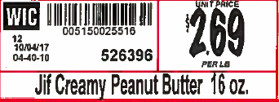

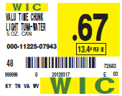
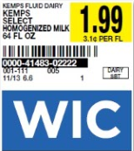

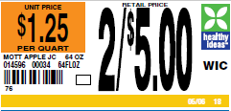
Shelf Labels
Required for some Food Categories
  Required for all WIC approved items within a category
Optional for other Food Categories, but
  Label all items in the category
  OR
  Label no items in the category
Must use either :
  SWO supplied shelf label, or
  State approved store labels
  Not both
State Issued
Approved Store Examples
Notes:
All WIC approved items have either a requirement or an option that WIC shelf labels be posted.
For those items that require a shelf label, all approved WIC items in that food category require a label.
If shelf labels are optional, either labels should be displayed on all approved WIC items in the food category, or there should be no shelf labels on any approved WIC items in the food category.
The rationale behind this “all or none” philosophy is that we don’t want stores to be able to steer customers toward certain eligible items or away from approved items, but rather have a level playing field for all eligible items to allow the cardholder to choose which eligible item best meets their needs.
As you have probably read in the Shelf Label guidance: stores are required to use either the SWO supplied shelf labels, or their own “custom” shelf labels that have been approved by the SWO. if you are unsure if your label has been approved by the state WIC office, please contact your vendor liaison.

Slide 24
Shelf labels required on:
Milk
Cheese
Eggs
Peanut Butter
Cereal
Juice
Notes:
Just as a reminder

Slide 25

Window Decals & Lane Signage Requirements
Window decal required at front entrance of store
Lane signage required if only some checkout lanes are able to accept eWIC
Conduent Help Desk – 1.877.436.6057
Notes:
Retailers are required to post our “eWIC Cards Accepted Here” window decal pictured here in a highly visible location such as the store’s main entrance window or door.
Authorized retailers using stand-beside devices are required to use signage to identify which registers accept eWIC cards.
Authorized retailers using integrated system are not required to use checkout lane signage.
Retailers may obtain signage by contacting the State WIC Office or Conduent Help Desk at 1-877-436-6057
Retailers will need to provide the Conduent Help desk their four digit WIC ID

Slide 26
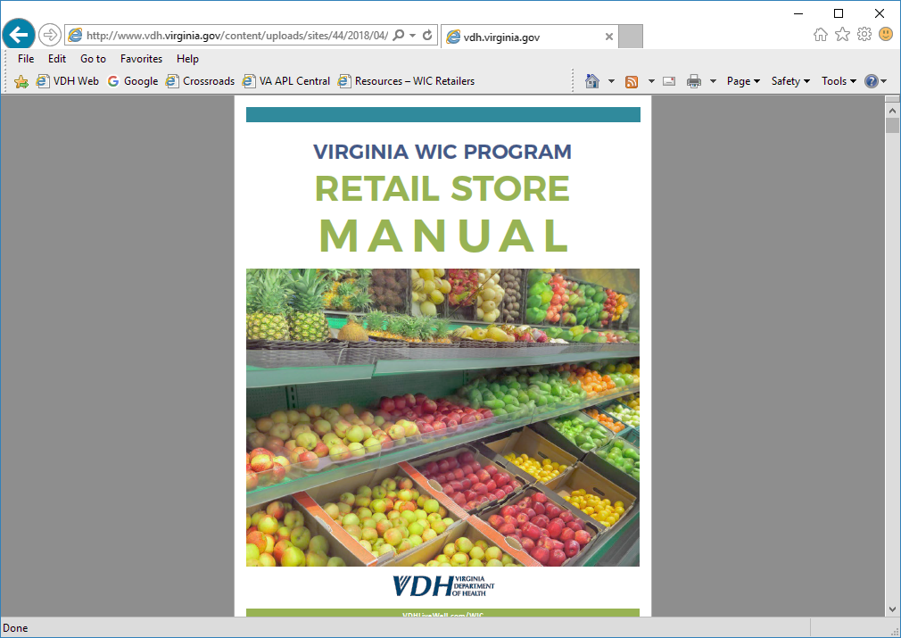
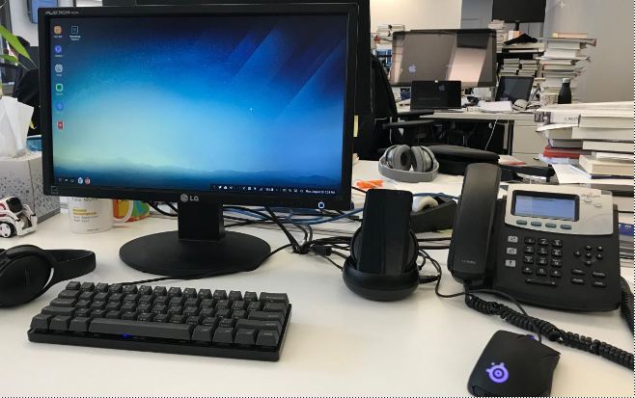
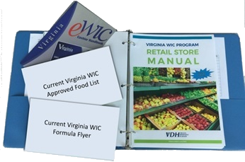
Retailer Resources
Each store is required to have:
A Retail Store Manual
WIC Food Lists
Formula Flyers
Cashier Handbook
Notes:
Each Retail store is required to have the WIC items listed here.
-Note that electronic access to the retail store manual is allowed and will count during a monitoring visit. We’ll discuss monitoring visits shortly.
-Each register that is able to accept WIC must have a food list and a formula flyer

Slide 27
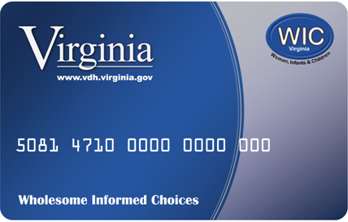
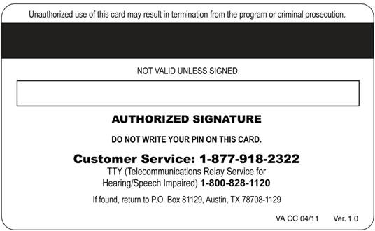
Handling the eWIC Transaction
Coupons and customer loyalty cards
Cardholder swipes card and enters pin
eWIC Benefit Balance Inquiries
Cashier scans foods/formulas
UPCs and the APL
System approves/denies transaction
Receipt information
eWIC Cashier Handbook
Notes:
procedures for accepting eWIC transactions and best practices: steps may vary depending upon your store’s POS
Coupons and Loyalty cards may affect the transaction if not processed first
Certain items may not be work – APL or benefit balance
Food categories are sometimes unique to the cardholder
Split Tender Transactions must be allowed (transactions with multiple forms of payment)
using a balance inquiry at the register can prevent checkout errors
“1-877-TELL-WIC “ toll free number
refer cardholders to the # on the back of their card for assistance

Slide 28
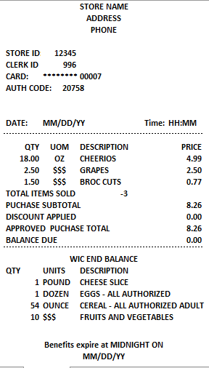
List of WIC items purchased
Total number of WIC items sold
WIC purchase subtotal
Any discounts that have been applied
Total price of all items purchased
List of WIC benefits left for the customer, including type, quantity and package units allowed
The last date WIC food items are available to the shopper
Notes:
The eWIC Transaction Receipts
All retail stores that performs WIC EBT transactions will have the Federally required information listed here.
Discuss the key information that that appears on the receipt.

Slide 29
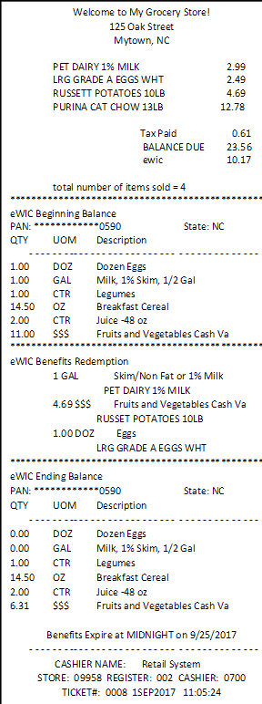
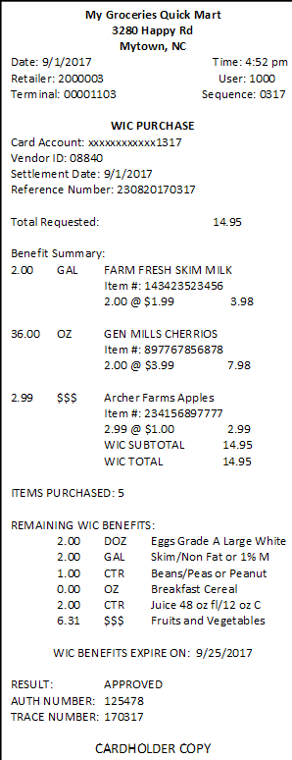
1 Beginning Benefit Balance
Benefits customer CAN use for this purchase
1
2 WIC Foods Purchased
2
Benefits customer USED for this purchase
2
3 Ending Benefit Balance
3
3
REMAINING benefits available next time customer shops
Notes:
Let’s look at a basic WIC transaction. There are three parts within the transaction. The first two are the Beginning Balance and WIC Foods Purchased, numbers 1 & 2 on the slide, and they print after all items have been scanned and totaled; these slips allow the customer a moment to review what is not covered by their benefits if any items scanned as “non-WIC”.
The cashier should provide these slips to the WIC customer after totaling WIC items and before completing the transaction. This is the mid-transaction slip.
After providing the WIC customer with the first two slips, the register will be waiting for the WIC customer to “Accept” the WIC total on the card reader.
The Ending benefit balance, number 3 on the slide will print out once the WIC customer presses the “accept” button to finalize the WIC tender.

Slide 30
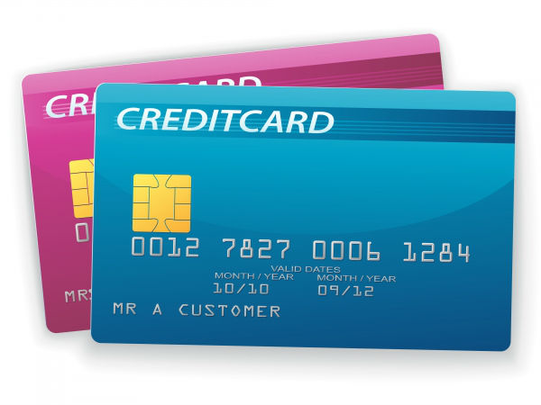
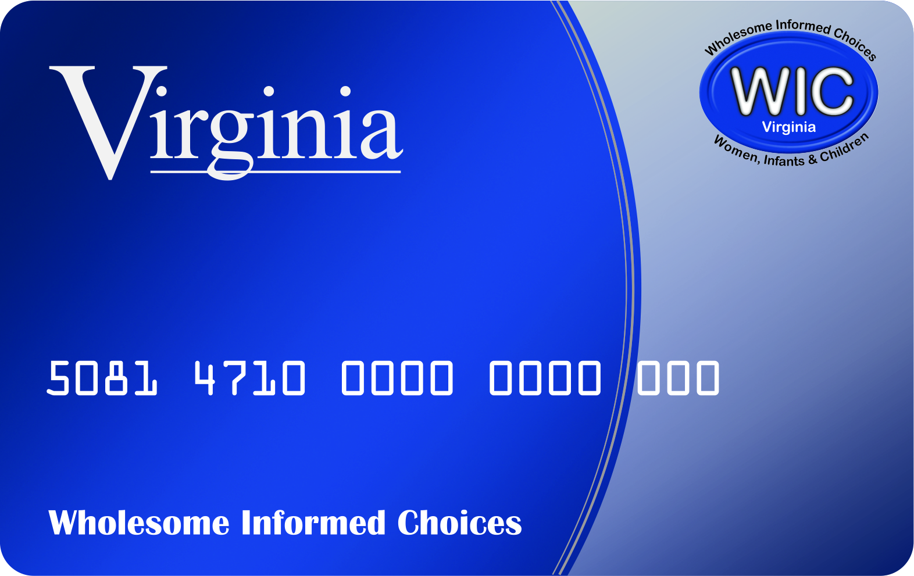


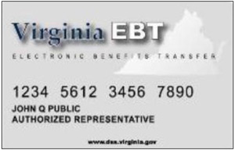
Split Tender Transactions
eWIC cardholders may use other forms of payment with Cash Value Benefit transactions!
30
Notes:
Split Tender Transactions
All stores are required to accept multiple forms of payment with eWIC transactions
A WIC customer must be allowed to pay the difference with another form of payment when a fruit or vegetable purchase exceeds the value of the cash value benefits
Cashiers should know the steps for accepting multiple forms of payment
Customer loyalty cards, sale prices, and coupons are allowed for eWIC purchases and should be used according to the store’s policy

Slide 31
Voiding eWIC Transactions
A. Retailers can cancel at the WIC customer’s request:
  a single WIC food item
  • a method of payment
  • the entire transaction
All rules of voiding transactions must be followed
B. A void must be performed:
  • prior to completing the transaction and tendering WIC
  • prior to the next transaction
When this process is completed, the WIC customer’s benefits will remain on the card
C. Cash back can never be given to a WIC customer, even if a void is unsuccessful
Notes:
During some transactions, voiding may be necessary.

Slide 32
Possible POS Problems
A food item can be declined if:
It is not an authorized WIC food item
It is not available on the WIC customer’s benefit balance
Insufficient quantities of the WIC food item on the WIC cardholder’s benefit balance
The current WIC benefit period has ended
Retailer POS software has out of date APL records (not flagged as WIC item)
Notes:
Three things have to occur to avoid an error
the foods purchased must be prescribed on the card;
the UPC has to be included in APL
the item has to be flagged in the store’s POS system
If a food item doesn’t work, do not use another UPC code to allow the sale.
If a product does not scan due to a problem with the cardholder’s benefit balance, have them call the number on the back of the eWIC benefit card.
Also ask the manager to follow-up with the State WIC office to confirm if the item should be added to the Approved Product List (APL)
Your store’s POS should be downloading the APL file daily

Slide 33
Handling POS Problems
Understanding Error Messages
Points of Contact
Report Reimbursement Issues to State WIC Office
Communications and Reporting
Notes:
There may be times where there’s trouble with a transaction. Employees need to know how to handle POS problems.
There are different types of errors that may be unique to different stores.
Employees need to identify points of contact within their company for reporting errors. Employees also need to know points of contact to report “UPC not found” error messages so that the information can be reported to the SWO

Slide 34
Recap
Minimum Stocking Requirements: Identifies which foods and in what quantities are required by all approved retailers to have in stock at all times
Signage & Shelf Labels: Identifies the approved foods and types of foods allowed
eWIC Transactions: Handling eWIC transactions, eWIC receipts, voids and errors
Notes:
recap the topics already covered in the bullet items.

Slide 35
WIC_retailer@vdh.virginia.gov
Notes:
Host pause to ask for any questions so far

Slide 36
Complaints & Incidents
The Complaint and Incident form is used to report any WIC issues related to WIC participants and their transactions. The form can be found on our retailer website: www.VirginiaWICRetailers.com
Notes:
Authorized retailers, corporate contacts, and support staff should use the Retailer Complaint and Incident Form found on our website, shown on the slide to report suspected abuse and potential violations experienced while serving eWIC cardholders. The State WIC Office uses this information to promote program integrity and educate WIC customers.
The form includes details listed on the eWIC shopping list receipt. Forms must be completed with as much information as possible, including:
eWIC cardholder’s name
2. Any other identifying information available to the retailer ; and
3. Brief description of the complaint or incident.
- This form and any attachments (such as receipts) should be submitted to the State WIC Office. Retailers should keep a copy for future reference.
- If an incident requires the involvement of police, the retailer should submit a copy of the police report if available.
- For assistance in the complaint submission process, contact your Vendor Liaison

Slide 37

Program Integrity and Monitoring
On-Site Monitoring Reviews
Formula Audits
  Required to purchase from approved supplier
  Approved suppliers are on the WIC retailer resources webpage
  Keep records for 12 months
Compliance Buys
Vendor Sanctions – review vendor manual
Customer Service 1.877.TELL.WIC
Notes:
On-site stocking and monitoring visits, eWIC transaction buys, Formula audits, Compliance investigations
Also:
Customer Service help line (877-TELL-WIC), Mandatory training sessions
The state agency monitors authorized store's performance throughout the contract period in order to ensure qualified stores are authorized. Three common types of monitoring are On Site Monitoring Reviews, Inventory Audits, and Compliance Buys.
1. Monitoring Reviews – unannounced, checking for minimum stock and required materials
Manager will be notified in writing by the SWO if any corrective action is required.
Frequency of visits varies
2 . Formula Audits
Keep records of formula purchases for the last 12 months
Confirm formula is being purchased from an approved supplier/distributor
3. Compliance Buys
The Virginia WIC Program is required by federal law to conduct undercover covert buys, such as secret shopper buys, at all authorized stores.

Slide 38
Vendor Claims
A Vendor Claims assessment is a requirement for a retailer to repay the Virginia WIC Program for an erroneous or unauthorized reimbursement
Notes:
Reimbursements for any foods, formulas or medical foods ineligible for purchase using the eWIC benefit card may result in a Vendor Claims assessment. An example of when a Vendor Claim may be assessed is when a generic Price Look-Up (PLU 4469 or 44691) code is improperly used when processing an eWIC transaction.
These types of violations discovered during a compliance investigation can lead to a Vendor Claim being assessed, as well as the store’s WIC Program authorization being at risk for disqualification.

Slide 39
Incentive Items
Virginia WIC retailers will not offer or provide any incentives to lure eWIC customers
Notes:
This is Virginia’s stance on incentive items per the retailer agreement

Slide 40
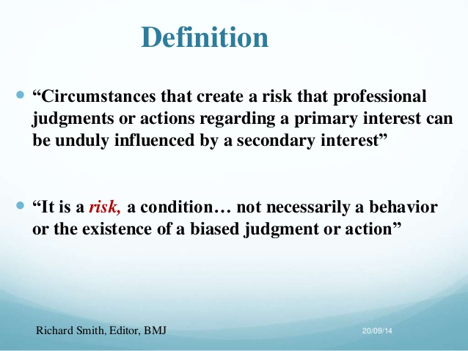
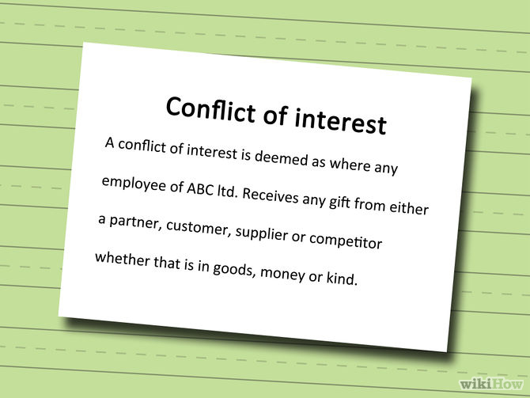
Conflict of Interest
Report
40
Notes:
An example may be if a cashier is a WIC customer as well, they should not ring up their own WIC purchase.
Most stores have a policy in place as a condition of employment, please ask your manager for the policy
Contact vendor liaison if questions come up and or clarification is needed

Slide 41
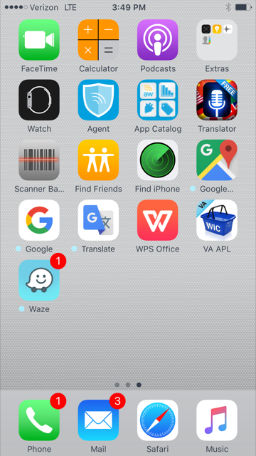

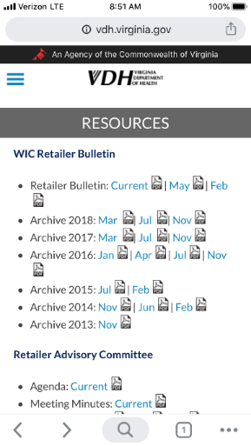
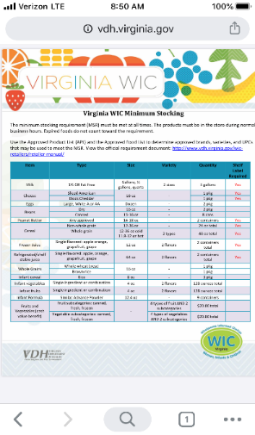
Access to Resources
Access retailer resources web page using mobile device
Accompanied store representative can use their mobile device
Virginia WIC Retailer
www.virginiaWICretailers.com
Notes:
How to access Retailer Resources website on a mobile device or desktop.
The vendor compliance team provides documents and materials for your information and training.
Using a web browser on a mobile device or desktop, you can access retailer information, including training newsletters, the vendor manual, the minimum stocking requirements, and many other resources.
A visual of how to access the information is on the slide. You can also use the direct link listed at the bottom of the slide and save it to your favorites.
During a monitoring visit, resources accessed this way by a store employee will count as having the materials required.

Slide 42

Training Resources
www.VirginiaWICRetailers.com
WIC Approved
Food List
Minimum Stocking Requirements
Retailer
Bulletin
Retail Store Manual
Notes:
The resources that are available on the retailer page vary; some of the most popular ones are listed here.
We created a direct web address to help you find them easily – virginiawicretailers.com
Retailers are encouraged to keep a hard copy of the retailer manual in a centralized location –staff should know where it’s kept

Slide 43
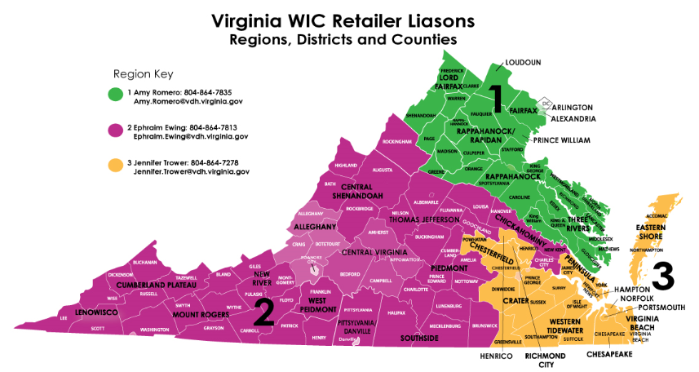
Notes:
Here are the vendor liaison areas, the state is broken up into 3 regions for the WIC program

Slide 44

Communication Requirements
WIC_Retailer@vdh.virginia.gov
Notes:
HANDOUT: TEAM DIRECTORY
Program Requirement/Communications
Retailers must maintain a email account regularly and throughout the contract period
Routine letters will be sent to either the store owner or manager via email. Warning letters are sent Certified Mail to the physical address of the store and email to corporate contact.
Notify us of email address changes. Being on the distribution list keeps you abreast of updates, training and webinars, etc.
Retail stores can use WIC_retailer@vdh.virginia.gov to email Vendor Compliance Team

Slide 45
2023 Contract Reauthorization
Documentation and Reporting
Each store will need to submit a training reporting form documenting today’s training, and must include the attending store representative's full name, position, store name, and WIC ID
Each independent store and each corporate entity will need to complete and return a newly signed retailer agreement.
New agreements will be emailed/mailed later this summer

Slide 46


Review Objectives
Review Expectations
Next Steps
  Pass along info to staff
  Sign and return a new retailer agreement
46
Notes:
By watching this training, you have completed the training requirements for the 2023 reauthorization.
Gained knowledge on each area required by federal regulations
Review Expectations
Refreshed your knowledge on the WIC program
NEXT STEPS:
Pass along relevant information to your staff
Sign and return a new retailer agreement

Slide 47
WIC_retailer@vdh.virginia.gov

Slide 48
THANK YOU!
CONTACT US IF YOU HAVE ANY QUESTIONS
WIC_Retailer@vdh.virginia.gov
Notes:
Thank you for your attention – please contact us with any questions you may have

