Slide 1
Recordkeeping
Guidance for Institutions Participating in the Child and Adult Care Food Program (CACFP)

Slide 2

Training Objectives
Describe the types of records that
must be maintained
Define how long records must be
retained
Respond to challenges and questions related to CACFP recordkeeping
Successfully comply with all federal and state recordkeeping requirements

Slide 3
USDA Guidance
7 CFR 226.15(e)
“Institutions must establish procedures to collect and maintain all records listed in the CACFP regulations and required by the state agency. Failure to maintain records will be grounds for the denial of reimbursement for meals served by the records in question and for the denial of reimbursement for costs associated with such records.”

Slide 4
CACFP Recordkeeping
Why is it important?
To support the validity of claims
How long do they need to be retained?
ALL records must be kept for 3 years after the end of the current fiscal year, or until any audits/investigations of that year’s records have been closed, whichever is longer
What if the records aren’t made available?
The institution may owe the state money for unsubstantiated claims
Notes:
Records of past corrections of serious deficiencies should also be kept and referenced to assist the center in maintaining the systems is was approved to use.

Slide 5

Meal Counts
  Institutions must take and maintain
  daily counts of number served to enrolled participants, taken at point of service
    VDH uses the blended rate computation method, so only a total # of meals served by type must be recorded.
    Reimbursement cannot be claimed for more than 3 meals/day/participant, so institutions serving more than 3 must use the roster rather than headcount method.
Notes:
Disseminate example of Meal Count form

Slide 6
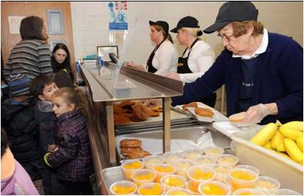
Meal Counts
  Meals served to “program adults” working in the institution’s food service and to other non-enrolled persons must be recorded
  **Emergency shelters must maintain a roster of participants receiving meals, total meal counts by type and menus for all meals served to participants each day

Slide 7
Daily Menu Records
Listing of food items served in each meal type, noting milk fat content, to show compliance with CACFP meal patterns
Child care centers and day care homes serving infants (children 0-12 months) must offer meals that include breast milk or an infant formula that meets CACFP requirements
  An infant formula choice form must be completed and maintained for every child up to 12 months
Notes:
Resources for Menu Planning:
The Menu Magic for Children guide (http://www.fns.usda.gov/tn/menu-magic-children)
Planning Cycle Menus lesson in the Care Connection Child Care Lessons (http://www.nfsmi.org/ResourceOverview.aspx?ID=203)
Formula:
There is an exception to the documentation requirement for Head Start programs, as their policy requires grantees to purchase the formula type that best accommodates each infant’s nutritional needs and feeding preferences.
A list of approved formulas is posted on VDH’s WIC site: http://www.vahealth.org/DCN/Publications/Files/PDFs/Approved%20Formulas.pdf
There is an exception

Slide 8
Participant Records
Daily Attendance Records of Enrollees
  May be maintained with meal count records but must be recorded separately.
Enrollment Records
  For children: signed and updated annually by parent/guardian, to include normal days/hours in care and meals normally received.
  For adults: signed once, upon enrollment
  Current confidential roster, Master Enrollment List (MEL), with name and eligibility status
  **At-risk Afterschool /Outside School-Hours and Emergency Shelters exempt from this requirement.

Slide 9

Participant Records
Title XX Institutions
  Must keep records for each month reimbursement was claimed, documenting that:
    At least 25% of enrollees or 25% of licensed capacity (whichever is less) were Title XX beneficiaries, OR
    At least 25% or enrollees qualified for free/reduced lunch on the Income Eligibility Form (IEF)
**Institutions may not meet the 25% requirement by combining the number of enrollees who qualify under Title XX with the number of enrollees receiving free/reduced lunch.
Notes:
Review the enrollment data for ABC Kids Child Care Center provided in the example provided on page 55 of the handbook and facilitate the calculation to determine their eligibility to participate in the CACFP program for that month.

Slide 10

Participant Records
Eligibility Records
  Institutions claiming free/reduced-price reimbursement must annually obtain and keep on file approved IEFs for participants determined to meet the guidelines.
  **Emergency shelters, at-risk/outside school hour and Head Start programs are exempt from this requirement.

Slide 11
Fiscal Management Records
Institutions must maintain receipts/documentation of:
  Income to the program from all sources
  All submitted reimbursement claims
  All program payments received from VDH
  All food costs
  Operating and administrative costs, which includes time records for employees performing CACFP-related tasks
Notes:
Detailed assistance based on the cost standards, principles, and guidelines is contained is available in the following:
Guidance for Management Plans and Budgets CACFP Handbook
FNS Instruction 796-2
Rev. 4 Financial Management in the Child and Adult Care Food Program
7 CFR 226.15(e)(6)-(8)
A free online training/webinar (Financial Management Number 3) is offered by the National Food Service Management Institute at: http://www.nfsmi.org/Templates/TemplateDefault.aspx?qs=cElEPTI0MQ==

Slide 12
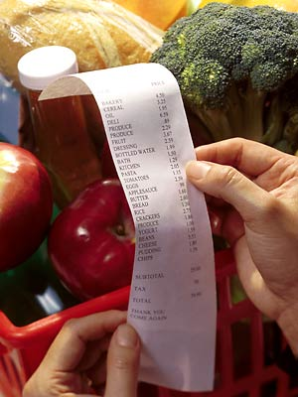
Fiscal Management Records
Operating Costs
Allowable costs include, but are not limited to:
  Food costs
  Food service labor costs
  Costs for certain nonfood supplies
  Costs for purchased services

Slide 13
Fiscal Management Records
Record of Food Costs
  Expenditures may include purchase price and charges for processing, transporting, storing and handling
  May apply to purchased or donated food, including USDA foods
  Costs must be documented by invoices, original receipts, inventory records and itemized bills
  If purchased under a contract with a vendor or agreement with a school food authority, costs are documented by vendor’s invoices for Program meals

Slide 14
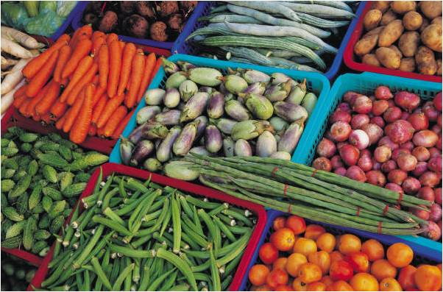
Fiscal Management Records
Inventory Records
  VDH requires institutions to take a food inventory at least once a year so as to facilitate making adjustments to the cost of food on an annual basis.
Notes:
Further guidance and suggested formatting for inventory tracking is available in the National Food Service Management Institute’s Inventory Management Workbook (http://www.nfsmi.org/documentlibraryfiles/PDF/20100423114950.pdf) and the FNS Instruction 796-2, Rev. $ (Exhibit G, Suggested Format for Inventory Reconciliation and Exhibit H, Suggested Format for Inventory Record).

Slide 15
Fiscal Management Records
Food Service Labor Costs
Institutions must document labor costs needed to operate the CACFP, including wages, salaries, benefits and taxes paid to perform:
    Menu planning and purchasing
    Meal preparation, serving and clean-up of Program meals
    Supervision of day-to-day food service operations (including supervision of participants during service)
    On-site preparation of daily program meal service records

Slide 16
Fiscal Management Records
Food Service Labor Costs
  Payroll records and time and attendance reports must be maintained.
  Volunteer labor may not be used to support costs.
  For part-time staff, labor costs must be prorated. CACFP costs may be supported by only that work which is performed in food service.
  When an employee is paid by more than one source, accurate records must be maintained to ensure that both sources are not charged the same costs.
  VDH approval is required before claims involving prorated services may be paid.

Slide 17

Fiscal Management Records
Costs of Nonfood Supplies
  May include small kitchen equipment, paper goods, and cleaning supplies used directly for food service operation
  Annual inventory required
**Any large purchase (over $5,000) must be pre-approved by VDH
Notes:
Paper goods does NOT include toilet paper, paper towels and the like.

Slide 18
Fiscal Management Records
Cost of Purchased Services
  May include utilities, equipment rental, facilities rental, and minor repairs
  Costs for food service rental and repair expenses must be documented
  Costs for prorated shared purchases such as utilities must be documented

Slide 19
Fiscal Management Records
Administrative Costs
Costs incurred in planning, organizing and managing the CACFP food service operation
  Completing CACFP application materials
  Compiling daily records to complete the monthly consolidated reimbursement claim
  Training
  Preparing the monthly reimbursement claim
Labor Costs
Costs incurred in providing actual meal service

Slide 20

Fiscal Management Records
Administrative and Labor Costs Tips
Must be documented by payroll
records and employees’ time and
attendance reports
Value of volunteer time may not
be claimed
Costs for administrative staff that work part-time on CACFP must be prorated and VDH approval must be given in advance.
Notes:
Part-time CACFP staff:
Only CACFP administrative labor may be claimed for reimbursement
Accurate records must be maintained to ensure no duplication of payments if a portion of salary is paid by another source of funding

Slide 21

Fiscal Management Records
Administrative Supplies
Cost of printing/reproduction of materials used for food service and staff nutrition education
Office supplies
Telephone calls
Postage necessary for center’s food service

Slide 22

Fiscal Management Records
Training Requirements and Records
Records of annual or refresher training requirements, as defined by VDH, must be maintained, to include:
    Dates
    Locations
    CACFP topics discussed
    Names of center personnel in attendance
Notes:
VDH will give guidance as to which modules are mandatory each year. Institutions will need to document when training was held and send a participant list and agenda with topics covered. (If staff completed the training online via VDH/TRAIN site, then they will need to document by providing that information to VDH.

Slide 23
Questions?

