Slide 1


Program Accountability:
Child Meal Service within the CACFP
Guidance for Institutions Particpating in the Child and Adult Care Food Program (CACFP)
Notes:
Welcome to the training presentation on Program Accountability: Child Meal Pattern within the Child and Adult Care Food Program—or, the CACFP. This presentation will cover the Child Meal Pattern within the CACFP, as well as other meal service requirements.
This training has been adapted from materials provided by the Institute of Child Nutrition.

Slide 2
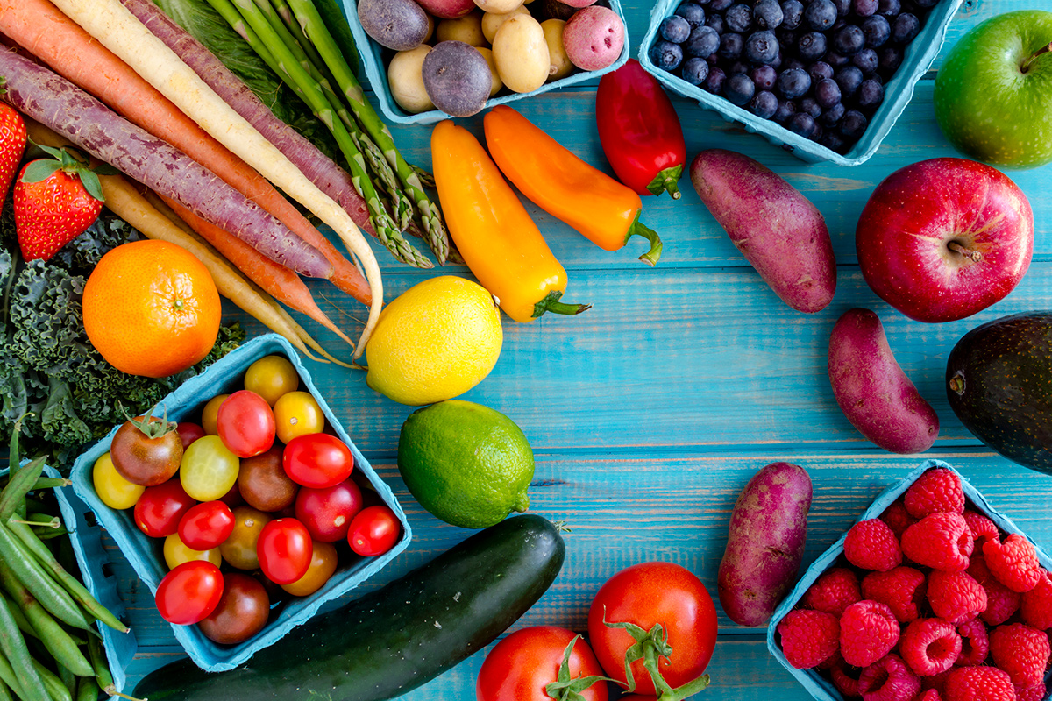
Training Topics
Child Meal Pattern Requirements
Components
Meal Service in the CACFP
Claiming Meals
Recordkeeping
Notes:
In this training we will briefly touch on the CACFP Meal Pattern updates that went into effect October 1, 2017
We’ll review the Child Meal Pattern, creditable foods and Components.
And lastly, we’ll discuss the required Components necessary in order to Claim for meals, including meal Recordkeeping requirements.

Slide 3

Child Meal Pattern: Requirements
Notes:
Now let’s discuss the Meal Pattern requirements for Children

Slide 4




Age Groups
1 – 2 years
3-5 years
6-12 years
13-18 years
Notes:
There are now 4 age groups for children within the CACFP. 1 through 2 years, 3 through 5 years, 6 through twelve years, and thirteen through eighteen years. The 13 through 18-year-old age group is an addition to the meal pattern requirements. This age group was added to better reflect the characteristics of the populations served in the CACFP, specifically those in the at-risk afterschool programs and emergency shelters. Therefore, this age group is used specifically for individuals operating at-risk afterschool programs and emergency shelters
Now let’s look at the meal pattern.

Slide 5
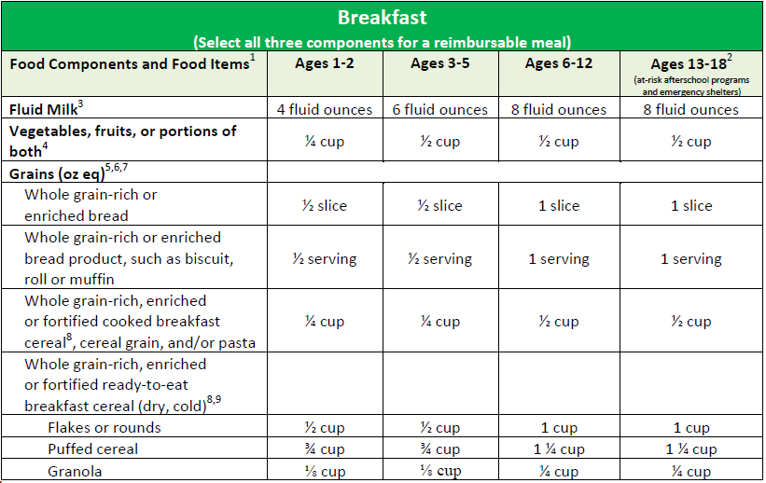
Child Meal Pattern: Breakfast
Notes:
Let’s take a look at the Breakfast Meal Pattern.
[click next slide] You’ll see the 4 age groups at the top row,
[click next slide] and on the left column are the 3 components.
All 3 components—milk, vegetable, fruit, or portion of both, and grains—must be served for a reimbursable meal.

Slide 6
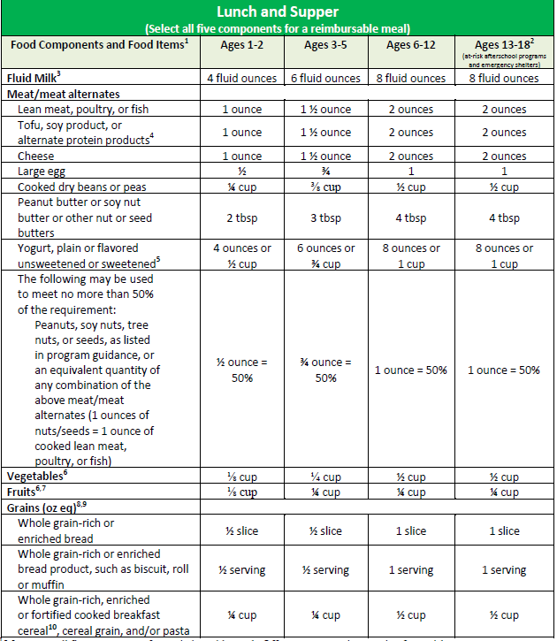
Child Meal Pattern:
Lunch & Supper
Notes:
Here is the Lunch and Supper meal pattern.
[click next slide] Again, the 4 age groups are on the top row,
[click next slide] (2x) and the 5 components are on the column to the left.
All 5 components—milk, meat/meat alternate, vegetables, fruits, and grains—must be served for a reimbursable meal.
Starting October 2019, grains will be measured in ounce equivalents. VDH will offer information regarding this change once USDA provides more guidance.

Slide 7
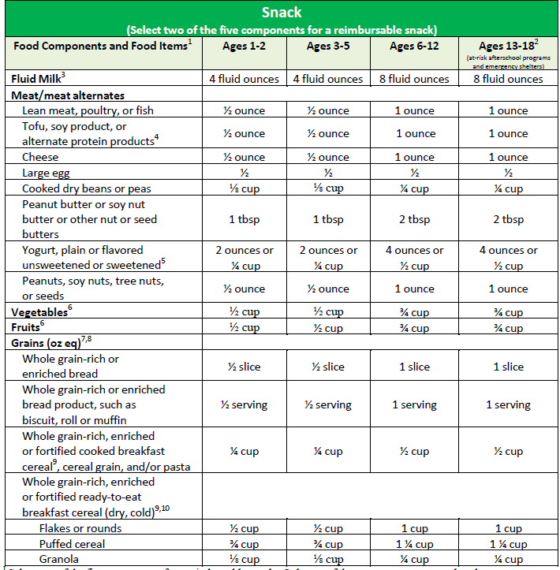
Child Meal Pattern: Snack
Notes:
With snack:
[click next slide] Again, the 4 age groups are on the top row,
[click next slide] (2x) and the 5 components are on the column to the left. However, with snack, only 2 of the 5 components must be served for a reimbursable meal. Because vegetables and fruit are now 2 separate components, you can now serve a vegetable and a fruit for a reimbursable snack.

Slide 8
Child Meal Pattern:
Components

Slide 9

Milk Component
Notes:
Now let’s review the milk component. Milk is a required component for Breakfast, Lunch and Supper, and an optional component for snack.

Slide 10

One Year Olds
Most 1 year olds need whole milk
Provides higher fat content
Whole unflavored milk is required at breakfast, lunch, & supper
Optional at snack
Serve 4 fl oz. (½ cup) of unflavored whole milk
Notes:
According to the American Academy of Pediatrics (AAP), most children between the ages of 1 year and 23 months need whole milk because it provides a higher fat content, promoting healthy growth and development. The updated meal requirements call for children age 1 year through the end of 23 months to be served a minimum of 4 fluid ounces or ½ cup of unflavored whole milk at breakfast, lunch, and supper; and it is optional at snack.
Serving whole milk to 1-year-olds is already required in many states; and, it is now a requirement for all CACFP-operated facilities.

Slide 11


Breastmilk Past Age One
May be served to children of any age
Reimbursable:
If a parent or guardian provides expressed breastmilk
A mother breastfeeds her child on-site
May be served in combination with other milk types for a reimbursable meal
Notes:
Breastmilk may be served to children older than 12 months of age. This update allows operators to claim reimbursement when a mother chooses to breastfeed in the facility or if she or a guardian provides expressed breastmilk to be fed to their child.
When a parent or guardian provides expressed breastmilk, they must supply the age-appropriate minimum serving size for their child to be reimbursable. If a parent or guardian provides less than the minimum serving size, you must make up the difference by serving milk for the meal to be reimbursable. For example, a parent brings ¼ cup of breastmilk for her 1-year-old child. The minimum serving size for this age group is ½ cup; therefore, you would need to provide an additional ¼ cup of whole unflavored milk for a total of ½ cup to make up the difference for the meal to be reimbursable. Another key point to note is breastmilk and whole milk do not need to be mixed, they can be served separately. Always check with parents or guardians to ensure they are aware of this requirement.

Slide 12

2 to 5 Year Olds
Serve unflavored low-fat (1%) milk or fat-free (skim) milk
Minimum serving sizes
2 years – 4 fl oz or ½ cup
3-5 years – 6 fl oz or ¾ cup
Flavored milk is not reimbursable
Notes:
Children between the ages 2 to 5 years old, must be served unflavored low-fat (1%) milk or fat-free (skim) milk. Continue to serve children 2 years old a minimum of 4 ounces (½ cup) of milk and children 3-5 years a minimum of 6 ounces (¾ cups).
The updated meal pattern requirements do not allow flavored milk of any sort for children below the age of 6. Specifically, flavored milk or milk with added flavorings such as syrup may not be served to children below the age of 6 for a reimbursable meal.

Slide 13
6 to 12 Year Olds
Unflavored fat-free (skim)
Flavored fat-free (skim)
Unflavored low-fat (1%)
Flavored low-fat (1%)
Notes:
Children between the ages 2 to 5 years old, must be served unflavored low-fat (1%) milk or fat-free (skim) milk. Continue to serve children 2 years old a minimum of 4 ounces (½ cup) of milk and children 3-5 years a minimum of 6 ounces (¾ cups).
The updated meal pattern requirements do not allow flavored milk of any sort for children below the age of 6. Specifically, flavored milk or milk with added flavorings such as syrup may not be served to children below the age of 6 for a reimbursable meal.

Slide 14



Milk Substitutions
Allowed for non-disability medical or special dietary need
Medical statement is not required if nutritionally equivalent to cow’s milk
Request must be made in writing
Medical statement required when a disability requires a non-dairy beverage that is not nutritionally equivalent to cow’s milk
Notes:
When working with children aged 6 years and older, there are some additional options for the milk component. First, you may continue to serve a minimum of 8 fluid ounces (1 cup) of unflavored low-fat (1%) milk or fat-free (skim) milk. You may also serve fat-free flavored milk.
It is important to note that adding syrup or milk powder to low-fat (1%) milk is not allowed because only fat-free milk may be flavored.
This requirement also means only syrup or favored milk powder, including flavored straws, may be added to fat-free plain milk for these age groups.
On the other hand, if a participant has a disability that requires a non-diary beverage that is not nutritionally equivalent to cow’s milk, you must have a medical statement on file. In these cases, it is important to know when you need it and what to look for when reviewing the form
More information on the on the Special Dietary Prescription Form and required documentation will be provided later on in the presentation.

Slide 15

Meat & Meat
Alternates
Components
Notes:
Now we will discuss the meat and meat alternates component

Slide 16
Meat/ Meat Alternatives
Yogurt
Cheese
Whole eggs
Beans
Tofu
Notes:
Some common examples of meat/meat alternates include meats, yogurt, cheese, whole eggs, beans, and tofu.
It is important to note that nuts and seeds, dry beans, peas, eggs, and cheese may continue to be used to meet all or part of the meat/meat alternates component.

Slide 17

M/MA at Breakfast
A meat/meat alternate may be served in place of the grains component a maximum of 3 times per week
Menu Example:
Cheese Omelet (Credits as the M/MA)
Fruit
Milk
Increases variety in the menus
Notes:
Previously, serving Meat/Meat Alternate at breakfast was optional and it did not credit as part of a reimbursable meal. The updated requirements now allow Meat/Meat Alternate to be served in place of grains at breakfast up to three times per week. For example, a program could serve a cheese omelet with fruit and milk at breakfast. In this example, the omelet is a creditable meat/meat alternate that is used to meet the grains component requirement for the breakfast meal. No additional grain is needed for this reimbursable breakfast meal.
This change is merely an option to allow greater variety and flexibility when planning the breakfast menu.
As a reminder, you may continue to serve a Meat/Meat Alternate as an additional item to the three required breakfast components: milk, vegetable/fruit, and grain.

Slide 18
Crediting Guidelines
Serving M/MA in place of grains:
1 oz. of M/MA credits as 1 serving of grains
Example: 2 year olds & cheddar cheese
Notes:
When serving a meat or meat alternate in place of grains at breakfast, 1 ounce of meat/meat alternate credits as 1 serving of grains. For example, a program serves 2 year olds ¼ ounce of cheddar cheese as part of breakfast. This amount is only a portion of the grains component at breakfast because ½ ounce is equal to half a serving of grains for children between the ages of 1 to 2 years.

Slide 19
Ounce Equivalent
2019: 1 oz. eq. of M/MA is credits as 1 oz. eq. of grains
A way to measure amounts of food
1 oz. eq. of M/MA credits as:
2 tablespoons of peanut butter
½ of a large egg
1 oz of lean meat, poultry, or fish
Notes:
As mentioned earlier, beginning October 1, 2019, a 1-ounce equivalent of meat/meat alternate is equal to one 1-ounce equivalent of grains. Ounce equivalents are a way to measure amounts of food. For example, In the CACFP, 1-ounce equivalent of a meat or meat alternate is equal to 2 tablespoons of peanut butter, ½ of a large egg, or 1 ounce of lean meat, poultry, or fish.
VDH will provide more information on ounce equivalents as USDA rolls out additional guidance.
Remember, if you want to serve meat/meat alternates more than 3 days a week, you must offer them as additional foods, which do not count toward the reimbursable meal.

Slide 20

Tofu and Soy Products
What is Tofu?
Credit as a M/MA for child & adult meals
Does not credit toward reimbursable meals for infants
Notes:
The next topic we will focus on is tofu and soy products, such as soy yogurt, and the three requirements for using it in the CACFP.
Tofu is:
made of soybeans
A great source of protein and iron
Available in silken, soft, medium, firm, and extra firm forms
Great substitute for meat
In the past, tofu and soy yogurt did not credit as part of the meat/meat alternates component. However, tofu and soy yogurt now credits for all or part of the meat/meat alternates component for child and adult meals only. Tofu is not creditable for infant meals.

Slide 21

Tofu C. E. F.
Commercially prepared
Easily recognized as meat substitue
C
Five Grams of Protein
E
F
Notes:
There are three requirements for using tofu and soy yogurt. A great way to remember the requirements is through the acronym: C.E.F.
Commercially prepared
Easily recognized as meat substitute
Five grams of protein

Slide 22
Commercially Prepared
Must be commercially prepared tofu & soy yogurt
Non-commercial or non-standardized are not creditable
e.g. homemade tofu
Notes:
First, when using tofu and soy products, it must be commercially prepared. Those products that are non-commercial or non-standardized are not creditable. For example, preparing or purchasing homemade tofu would not credit because it is not commercially prepared.

Slide 23
Easily Recognized As Meat Substitute
Creditable
Tofu noodles: Mimics a grain component
Smoothies with soft or silken tofu: Adds texture
Baked desserts with soft or silken tofu: Adds texture
Not Creditable
Tofu links and tofu sausages
Tofu pieces in a salad
Tofu cubes in a stir fry
Tofu omelets
Tofu miso soup
Notes:
Second, tofu must be easily recognized as a meat substitute to credit as a meat alternate. A good way to apply this requirement is to think about it from a child’s perspective. Children should be able to easily recognize the tofu item as a meat alternate product.
Some allowable ways to use tofu might include:
Tofu links and tofu sausages
Tofu pieces in a salad
Tofu cubes in a stir fry
Tofu omelets
Tofu miso soup
However, if tofu mimics another food group or is used to add texture, it is not creditable because it is not easily recognizable as a meat alternate. Some examples might include following:
Tofu noodles: mimics a grain component
Smoothies with soft or silken tofu: Adds texture
Baked desserts with soft or silken tofu: Adds texture

Slide 24
Five Grams of Protein
Must contain 5 grams of protein per 2.2 ounces (¼ cup) by weight
Locating products
Nutrition Facts Label
Child Nutrition (CN) Label
Product Formulation Statement
Notes:
The third requirement is that tofu and soy yogurt must contain 5 grams of protein per 2.2 ounces (¼ cup) to credit as 1 ounce of the meat/meat alternate. In plain unprocessed tofu, you can find the total amount of protein by reading the Nutrition Facts Label on the back of the product. However, if it were a processed tofu product, such as links and sausages made from tofu, a Nutrition Facts Label would not provide enough information to determine if the item meets the minimum requirement. In these cases, you will need a Child Nutrition (CN) Label or product formulation statement to verify the food item contains the minimum protein requirement. If you purchase from your local grocery store, you may find that CN Labels are not commonly available for food items. Therefore, you may need to contact the manufacturer to request a product formulation statement.

Slide 25

Yogurt
Some have higher sugar content than others
Must contain no more than 23 grams of total sugars per 6 oz.
Applies to all age groups
Notes:
As a great source of protein, this macronutrient provides energy, builds and maintains muscle, and promotes a healthy metabolism. Although a great source of protein, some yogurts have significantly more sugar than others. Exposing young children to high amounts of sugar early on can have a negative influence on eating habits. As a result, the updated requirements now limit the amount of sugar creditable yogurts may contain to promote healthy habits from the start.
Therefore, to promote healthy habits from the start, the updated meal pattern requirements limit the amount of sugar creditable yogurts may contain. Now, yogurt must contain no more than 23 grams of sugar per 6 ounces to credit as part of reimbursable meal.

Slide 26
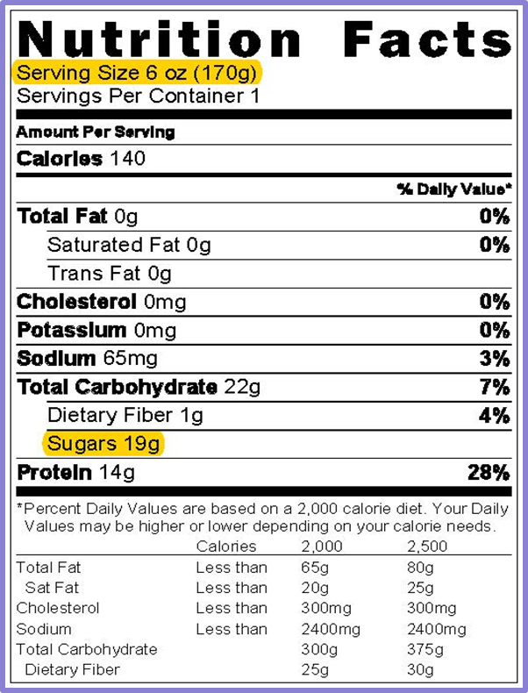
Nutrition Facts Label
Serving Size
  Number of servings in a package
  Unit: ounces, cups, per container, etc.
Sugars or Total Sugars
  Amount per serving
  Means the same thing
Notes:
The first step in determining yogurts that meet the sugar limit is to look at the Nutrition Facts Label.
When reading Nutrition Facts Labels to determine if it meets the sugar requirements, there are two key terms to look for: Serving Size and Sugars or Total Sugars. The serving size is the number of servings in a food package, in which the serving size is provided in units, such as ounces, cups, or container. The serving size is also provided in grams in parenthesis.
The Sugars or Total Sugars state the amount of sugar in grams per serving. It is important to note that the new Nutrition Fact Label lists total sugars and added sugars instead of just “sugars.” This change shows the total amount of natural sugars and added sugars the product contains. However, when reading new labels for yogurt, always use the number beside Total Sugars.

Slide 27
Table Method: Yogurt
Yogurt Sugar Limits
Serving Size (Ounces) | Serving Size (Grams) | Sugar Limit
2.25 ounces | 64 grams | 0-9 grams
3.5 ounces | 99 grams | 0-13 grams
4 ounces | 113 grams | 0-15 grams
5.3 ounces | 150 grams | 0-20 grams
6 ounces | 170 grams | 0-23 grams
8 ounces | 227 grams | 0-31 grams
Notes:
There many ways to determine if a yogurt meets the sugar limit requirements. Today, we will explore the table method for yogurt, as it is the easiest and the fastest way for determining if a yogurt item meets the sugar limit requirement. This method features a table with common sizes of yogurt and the pre-calculated sugar limit for each size.
As you can see in this table, there are three major columns.
The left column, Serving Sizes (Ounces) is used when a yogurt’s Nutrition Fact Label lists the serving size in ounces, such as 6 ounces or 8 ounces.
The middle column, Serving Sizes (Grams), is used when the Nutrition Fact Label’s serving size is not in ounces, but in cups, containers, or other units. In situations such as these, you can use the number in parenthesis, the grams, to determine if the yogurt is within the sugar limit.
The right column lists the sugar limits for each serving size.
The table method was adapted from the USDA Team Nutrition’s training worksheet “Choose Yogurts That Are Low in Added Sugar.” You can find a link to this resource at the end of this presentation.

Slide 28

Table Method Steps
Step 1: Find the Serving Size, in ounces (oz) or grams (g): 6 oz
Step 2: Find the amount for Sugars: 19 grams
Step 3: Find the serving size in the Sugar Limits Table.
Notes:
This method features four steps.
First, use the Nutrition Facts Label to find the Serving Size, in ounces (oz) or grams (g), on the yogurt. In this case, the Serving Size is 6 ounces.
Next, look at the number next to Sugars. There is 19 gram of sugar in this package per serving.
Then, locate the yogurt’s Serving Size in the “Serving Size in Ounces” column on the “Sugar Limits Table.” In this case, it is 6 ounces.

Slide 29
Table Method Steps (Cont.)
Yogurt Sugar Limits
Serving Size (Ounces) | Serving Size (Grams) | Sugar Limit
2.25 ounces | 64 grams | 0-9 grams
3.5 ounces | 99 grams | 0-13 grams
4 ounces | 113 grams | 0-15 grams
5.3 ounces | 150 grams | 0-20 grams
6 ounces | 170 grams | 0-23 grams
8 ounces | 227 grams | 0-31 grams
Step 4: Look at the number to the right of the serving size, under the “Sugar Limit” column
  Serving size: 6 oz
  Total sugars: 19 grams
Notes:
Last, CLICK NEXT SLIDE look at the number to the right of the serving size amount, under the “Sugar Limit” column in the table. If your yogurt has that amount of sugar, or less, the yogurt meets the sugar requirement.

Slide 30
Is it Creditable?
Yogurt Sugar Limits
Serving Size (Ounces) | Serving Size (Grams) | Sugar Limit
2.25 ounces | 64 grams | 0-9 grams
3.5 ounces | 99 grams | 0-13 grams
4 ounces | 113 grams | 0-15 grams
5.3 ounces | 150 grams | 0-20 grams
6 ounces | 170 grams | 0-23 grams
8 ounces | 227 grams | 0-31 grams
Yes, it is creditable –19 grams is between 0-23 sugar limit!
Notes:
According to the table, for a 6-ounce serving, the sugar limit is 23 grams of total sugars.
[click next slide] Therefore, this item is creditable because the sugar amount, 19 grams, is between the sugar limit of 0 and 23 grams.

Slide 31
Serving Size in Grams
Yogurt Sugar Limits
Serving Size (Ounces) | Serving Size (Grams) | Sugar Limit
2.25 ounces | 64 grams | 0-9 grams
3.5 ounces | 99 grams | 0-13 grams
4 ounces | 113 grams | 0-15 grams
5.3 ounces | 150 grams | 0-20 grams
6 ounces | 170 grams | 0-23 grams
8 ounces | 227 grams | 0-31 grams
Serving size:
1 container (170g)
Sugars:
19 grams
Notes:
As mentioned, sometimes you may find yogurts that do not list the serving size in ounces, but in cups or containers. For instance, this yogurt label lists “1 container (170 grams)” as the serving size and “19 grams” for sugar. Using the middle column in the Yogurt Sugar Limits Table, this product would be creditable because 19 grams of sugar is within the sugar limit requirements of 0–23 grams for a product with 170 grams per serving size.
As previously mentioned, some yogurts may list the serving size as one container and not list ounces and grams on the Nutrition Facts Label. In these cases, refer to the front of the package, to see how many ounces or grams are in the container.

Slide 32

Using Yogurt
Use commercial yogurt products only
Soy yogurt is a dairy-free option
4 oz credits as 1 oz of meat alternate
Adults only:
  Yogurt may be used as a milk substitute or meat alternate
Notes:
When incorporating yogurt in your menus, there are some additional points to remember. As previously mentioned, soy yogurt now credits as a dairy-free option for children and adult meals. In addition, 4 ounces of yogurt, including soy yogurt, credits as 1 ounce of meat alternate.
(FOR ADULTS: Also, yogurt may credit as a meat alternate or as a milk substitute for adults only. However, it may not credit for the milk component and the meat alternates components in the same meal.)

Slide 33

Non-Creditable Yogurt Products
Frozen yogurt
Drinkable yogurt
Homemade yogurt
Yogurt flavored products
Yogurt bars
Yogurt covered fruits & nuts
Yogurt in commercially prepared smoothies
Notes:
Lastly, when purchasing yogurt items, you may find a variety of options. However, some of these items are not creditable in the CACFP. Some of these items include, but are not limited to:
frozen yogurt,
drinkable yogurt,
homemade yogurt,
yogurt flavored products,
yogurt bars,
yogurt covered fruits and nuts, and
yogurt in commercially prepared smoothies.
For reimbursable meals and snacks, always choose plain or flavored, sweetened or unsweetened commercially prepared yogurt.

Slide 34

Fruit and Vegetable
Components
Notes:
Now let’s discuss the Fruit and Vegetable Components. Previously these consisted of just one combined component. However, now they are two separate components—the fruit component and the vegetable component.

Slide 35

Separation of Vegetable & Fruit
Breakfast: 1 food component
Lunch & Supper: 2 food components
Snack: Optional
  2 food components
Notes:
The updated meal pattern requirements separate the vegetable and fruit component into two components at lunch, supper, and snack. This means one fruit and one vegetable must be served during lunch and supper meals, and a reimbursable snack may consist of vegetable and a fruit.
Vegetables and fruits are still a combined component at breakfast meals. This means vegetables, fruits, or a combination of both may be served at breakfast to meet the fruit and vegetable component.

Slide 36

Increase Vegetable Consumption
Lunch & Supper: A vegetable may be used to meet the entire fruit component
Must be at least the same serving size as the fruit component it replaced
Notes:
To help increase the amount of vegetables eaten by CACFP participants and to provide greater flexibility to the menu planner, a vegetable may be used to meet the entire fruit component for lunch and supper meals.
For example, during lunch, a serving of broccoli and a serving of carrots would be a reimbursable meal. This means a lunch or dinner can include a vegetable and fruit, or two vegetables. However, two fruits are no longer creditable in the updated meal pattern requirements. Also, the vegetable substitute must be at least the same serving size as the fruit component it replaced.

Slide 37


Two Vegetable Types
Must offer two different types of vegetables
  e.g., two servings of carrots would not credit, but corn and green beans would
Selecting based on vegetable sub-groups is not required
Notes:
When using this option, it is important to note that for a reimbursable meal, you must offer two different types of vegetables. For example, a serving of roasted carrots and a serving of steamed carrots would not credit towards a reimbursable meal because the meal only includes one type of vegetable. The two different types of vegetables do not need to be from different vegetable sub-groups (e.g., dark green vegetables, red and orange vegetables, starchy vegetables, beans and peas (legumes), or other vegetables). For example, you could serve tomatoes and carrots, which are both from the red/orange group, and count it towards a reimbursable meal.

Slide 38

Juice Blends & Purees
Credit as a fruit component or a vegetable component
Contributes to the food component with the highest ingredient
  Fruit component: if it has more fruits than vegetables
  Vegetable component: if it has more vegetables than fruit
Notes:
Because of the separation of the vegetable and fruit component, 100% juice blends and purees now credit as either a fruit or a vegetable. Juice blends and purees will contribute to the food component with the highest ingredient. For example, if the juice blend or puree contains more fruits than vegetables, the beverage would contribute to the fruit component. If it has more vegetables than fruit, it would contribute to the vegetable component.

Slide 39

Juice
Great source of essential nutrients
Lacks dietary fiber
May be served at one meal or snack per day
Extra item, but not encouraged
Notes:
Pasteurized, 100% juice can be a source of essential nutrients. However, it lacks the dietary fiber found in other forms of fruits. Also, juice is often a major source of sugar in which some juices can contain almost the same amount of sugar as soft drinks.
To reduce the amount of sugar in the diets of young children, the updated meal patterns limit the service of juice to one meal or snack per day for child and adult participants. If you should claim fruit or vegetable juice at more than one meal, including snack, the meal with the lowest reimbursement rate containing juice would be disallowed.
As a reminder, juice is not allowed under the infant meal pattern for those of you who have infants in your care.

Slide 40
Juice & Different Groups
Served to only 1 group
Morning Group AM Snack
Afternoon Group
PM Snack
Notes:
If you have two different groups of children in which you serve two different meals, such as a morning group and an afternoon group, you may only serve juice one time in a given day, regardless of the group. Reason being, the limit of juice applies to the facility and not to the individual child or adult participant. Therefore, if you serve two different meals or snacks to two different groups of children or adults, only one meal or snack may contain juice as part of a reimbursable meal.

Slide 41
Juice & Different Groups
Serve to all participants at a single meal or snack
Shift: 1:30
Shift: 2:00
Shift: 2:30
Notes:
Often times, spacing, licensing requirements, or other measures may call for operators to serve each meal or snack in shifts. For example, an operator serves snack to two years olds at 1:30, three year olds at 2:00, and four year olds at 2:30 based on the nap schedule. In this and similar situations, it is reimbursable to serve juice to all participants because juice is being used to meet the vegetable component or fruit component for a single meal or snack.
However as previously mentioned, juice may not be used to meet the vegetable component or fruit component at two distinct meals or snacks.

Slide 42
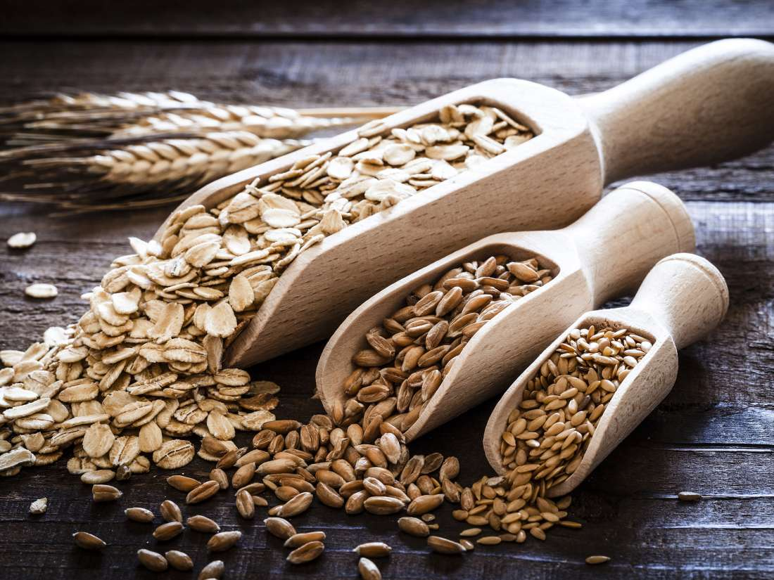
Grain Component
Notes:
Now we will discuss the Grain Component

Slide 43
Grains Overview
At least 1 serving of grains per day must be whole grain-rich
Breakfast cereals must contain no more than 6 grams of sugar per dry oz
Grain-based desserts no longer credit toward the grain component
Use ounce equivalents (oz. eq.) to determine the amount of creditable grains starting October 1, 2019
Notes:
A grain is a required component at breakfast, lunch, and supper, and is an optional component at snack. The updated requirements feature some key changes to enhance the overall variety and nutrient quality of meals and snacks. In particular, the four updates state:
At least one serving of grains per day must be whole grain-rich.
Breakfast cereals must contain no more than 6 grams of sugar per dry ounce.
Grain-based desserts no longer count toward the grain component.
Ounce equivalents (oz eq) will be used to determine the amount of creditable grains beginning October 1, 2019.

Slide 44

Whole Grain-Rich
100% whole grains, or
At least 50% whole grains, &
The remaining grains are enriched
Notes:
The first update for the grain component focuses on whole grain-rich foods. Whole grain-rich foods contain 100% whole grains, or at least 50% whole grains and the remaining grains in the food are enriched.
At least one serving of grains per day must be whole grain-rich. It is important to note that this requirement only applies to meals served to children and adults; it does not apply to infant meals.

Slide 45
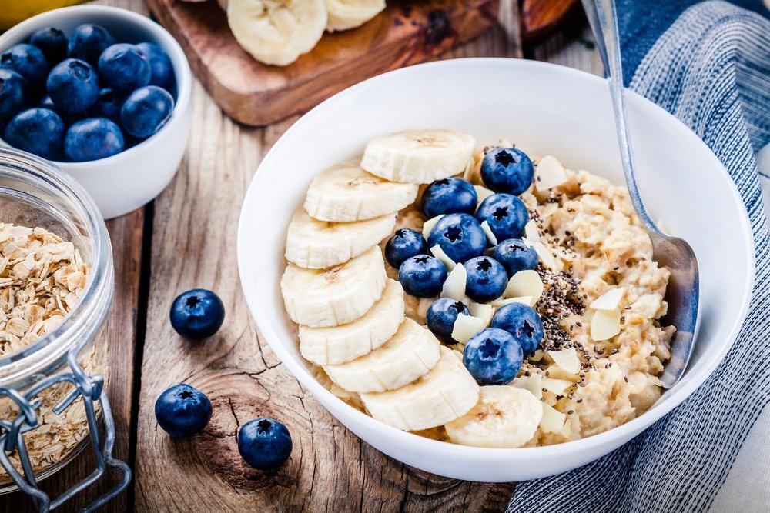
Key Terms
Whole grain
Fortified
Refined grain
Enriched grain
Notes:
To meet the whole grain-rich requirement, there are few key terms to highlight. The first term is whole grain, and it contains the entire cereal grain seed or kernel. Whole grains are the most nutritious when compared to other grains because they contain all three parts of the kernel: the bran, the germ, and the endosperm. This means they naturally contain the fiber, iron, and other essential nutrients for good health.
Refined grains are milled, which is a process that removes the bran and the germ. This process removes dietary essential nutrients found in whole grains. When a grain is enriched, however, it means the nutrients were added back to the refined grain(s).
The last major term is fortified, and it is commonly associated with breakfast cereals or infant formula. Fortified simply means that vitamins and minerals were added to the product that weren’t originally in the food. Cereal in particular will list the added vitamins and minerals near the bottom of the Nutrition Facts Label. Those that are not fortified will not name any added vitamins and minerals.

Slide 46
Whole Grain-Rich Foods at
Meals & Snacks
Each day, at least one meal or snack must include a whole grain-rich food
Option to choose between meal or snack being offered that day
Exception: If serving snacks only, no whole grain-rich food is required, unless a grain is served
E.g, afterschool programs
Notes:
As previously mentioned, one grain served per day must be whole grain-rich. As an operator, you can choose which meal or snack to serve the whole grain-rich food. For example, child care center’s meal schedule features breakfast, lunch, and an afternoon snack. The operator serves a whole grain-rich food at breakfast, a refined grain at lunch, and does not serve a grain at snack. In this case, they are in compliance with the whole grain-rich requirement because at least one grain served was whole grain-rich. On the other hand, if this operator only serves lunch and no other meals or snacks, they must serve a whole grain-rich food during this meal to be in compliance because a grain is required at lunch.
Some programs, such as at-risk afterschool programs, only serve snacks. As we all know, a reimbursable snack consists of two of the five components. In this case, if you should serve a fruit and a vegetable or any other non-grain combination, it is not necessary to serve a whole grain-rich food. However, if you serve a grain as part of the snack, it must be a whole grain-rich item.

Slide 47
Documentation & Whole Grain-Rich Foods
Document whole grain-rich foods on menu
“Whole wheat” bread
“Whole grain-rich” English muffins
English muffins “whole grain-rich”
Notes:
Another key factor to meeting the whole grain-rich requirement is documentation. Fortunately, there are several ways to demonstrate compliance with this requirement. For example, you can list which grain items are whole grain-rich directly on the menu by writing one of the following:
“Whole wheat” in front of “bread” so that the menu item reads “whole wheat bread”
“Whole grain-rich” in front of a food item, such as “whole grain-rich English muffins”

Slide 48
Reviews & Whole Grain-Rich Foods
Review menus, labels, & product information
When a whole grain-rich food is not served:
The meal or snack containing a grain with the lowest reimbursement will be disallowed
Notes:
When State Agency staff or Sponsoring organization conducts a review, they will need to check your menus, labels, and product information to ensure that the whole grain-rich items being served meet FNS whole grain-rich criteria.
When whole grain-rich foods are not served, the meal with the lowest reimbursement from that day will be disallowed. For example, last Tuesday you served grains at breakfast, lunch, and snack; however, none of the items were whole grain-rich. In this case, the snack would be disallowed because it is the meal with the lowest reimbursement rate containing a grain. On the other hand, if you only served grains during breakfast and lunch, and none of the grain items were whole grain-rich, the breakfast would be disallowed because it is the meal with the lowest reimbursement rate containing a grain.

Slide 49
Determining Whole Grain Rich
WIC-Approved Whole Grain Food
Labeled as “Whole Wheat” and has a FDA Standard of Identity
FDA Whole Grain Health Claim
Meets the FNS Rule of Three
Meets the Whole Grain-rich criteria for the NSLP
Proper documentation from a manufacturer or a standardized recipe
Notes:
Now that we have explored the key requirements for serving whole grain-rich items, let’s explore some ways for determining items that meet the FNS whole grain-rich criteria. There are six ways to determine if a grain product is whole grain-rich:
WIC-Approved Whole Grain Food
Labeled as “Whole Wheat” and has a FDA Standard of Identity
FDA Whole Grain Health Claim
Meets the FNS Rule of Three
Meets the Whole Grain-rich criteria for the NSLP
Proper documentation from a manufacturer or a standardized recipe
Any of these six ways can be used to determine if a grain product meets the whole grain-rich criteria.
Let’s review four of these methods and how to use them when identifying whole grain-rich foods.

Slide 50

Use WIC-Approved Grains Food List
Special Supplemental Nutrition Program for Women, Infants, and Children (WIC) food lists
Choose whole grains from ANY State’s WIC Approved list
Notes:
First, use Virginia’s or any State agency’s Special Supplemental Nutrition Program for Women, Infants, and Children (WIC) approved whole grain food list. Each State’s WIC agency provides food lists for identifying nutritious foods for pregnant women, infants, and children. Therefore, any whole grain food featured on these lists will meet the whole grain-rich requirements.
Please visit the Virginia WIC website for a comprehensive approved whole grain list or contact your SNP Specialist and we can send you the Virginia WIC Foodlist

Slide 51
FDA Standard of Identity
Whole wheat breads and pastas, only
Contains specific grain ingredients to be labeled as “whole wheat”
Must list the exact product name
Notes:
The second way is designed specifically for breads and pastas only. The FDA established a Standard of Identify for whole wheat breads and pastas. These rules identify the grain ingredients manufacturers must include to legally label certain products as “whole wheat.”
To be considered as whole grain-rich using this method, the product must list the exact product name as indicated in the chart. For example, if a bread is listed as whole wheat buns, it is considered whole grain-rich. However, it is labeled whole grain buns, it is not whole grain-rich using this method because “whole grain” is not a FDA Standard of Identity for breads and pastas. You would need to use an alternative method for these items to determine if it meets one of the other methods for identifying whole grain-rich foods.

Slide 52
Products Without a Standard of Identify
May not be used on products without a Standard of Identity
E.g, crackers, tortillas, bagels, and biscuits
Watch for tricky wording
“whole grain”
“made with whole grains”
“made with whole wheat”
“contains whole grains”
Notes:
There are two factors to keep in mind when using this method to identify whole grain-rich foods. First, this method may not be used on products without a Standard of Identity, regardless if they are labeled “whole wheat.” These items include crackers, tortillas, bagels, and biscuits; this method must be used for breads and pastas only.
Second, some product labels will have similar, yet tricky wording, such as:
“whole grain,”
“made with whole grains,”
“made with whole wheat,” or
“contains whole grains.”
These terms do not meet the FDA Standard of Identify requirements. Therefore, you must use one of the other methods to determine if items with these labels meet the whole grain-rich criteria.

Slide 53
Whole Grain Health Claim
“Diets rich in whole grain foods & other plant foods, & low in saturated fat & cholesterol, may help reduce the risk of heart disease.”
“Diets rich in whole grain foods & other plant foods & low in total fat, saturated fat, & cholesterol may reduce the risk of heart disease & some cancers.”
Notes:
The next way to determine if a product is whole grain-rich is to look for a whole grain health claim on the packaging. A food contains at least 51 percent whole grains if it has one of these two FDA-approved whole grain health claims on the package:
“Diets rich in whole grain foods and other plant foods and low in total fat, saturated fat, and cholesterol may reduce the risk of heart disease and some cancers.”
“Diets rich in whole grain foods and other plant foods, and low in saturated fat and cholesterol, may help reduce the risk of heart disease.”
It is important to note that the health claims may not be used for documentation purposes in the School Meal Programs.

Slide 54
Rule of Three
Whole Grain Rich
1st
2nd
3rd
  Ingredient is a whole grain
  GRAIN Ingredient is a whole grain, enriched grain, bran, or germ
  GRAIN Ingredient is a whole grain, enriched grain, bran, or germ
Notes:
The next option for identifying whole grain-rich items is called the Rule of Three. This method calls for a three-step process for identifying whole grain-rich foods using the product’s ingredients label. Using this method, a product is whole grain-rich if the first ingredient (or second after water) is a whole grain, and the next two grain ingredients (if any) are whole grains, enriched grains, brans, or germs.
To be successful in using this method, it is important to know the three category of grains:
Creditable
Ingredients to disregard
Non-creditable grains or flours
Pay special attention to two types of grains that can be disregarded when reviewing a product using this method:
Those that follow the wording “contains 2% or less” because they are only small amounts in the package
Grain derivatives because they are often small or trace amounts of by-products of grains
With this method, if the product has any of the non-creditable grains or flours indicated in the list, the product does not meet the whole grain-criteria.

Slide 55
English Muffins
Ingredients:
Whole Wheat Flour, Water, Enriched Wheat Flour, Wheat Starch, Yeast, sugar, and salt
Yes,
It is whole grain-rich
Notes:
The first example is an English muffin. The ingredients label lists “whole wheat flour, water, enriched wheat flour, wheat starch, yeast, sugar, and salt.”
[click next slide] The first ingredient (whole wheat flour) is a whole grain,
[click next slide] and the second grain ingredient (enriched wheat flour) is an enriched grain. The only other grain is wheat starch, but it is a grain derivative; therefore, it does not count as a grain ingredient in CACFP.
[click next slide] This product meets the Rule of Three based on the only two-grain ingredients, and it is whole grain-rich.

Slide 56
Corn Chips
Ingredients:
Whole Corn, Vegetable oil, salt, cheddar cheese, maltodextrin, wheat Flour, Romano cheese, whey protein concentrate.
No,
It is not whole grain-rich
Notes:
Let’s try one more. A corn chip’s ingredient list reads: “whole corn, vegetable oil, salt, cheddar cheese, maltodextrin, wheat flour, Romano cheese, whey protein concentrate.”
[click next slide] Although the first ingredient is a whole grain (whole corn),
[click next slide] the next grain ingredient (wheat flour) is unenriched wheat flour.
[ click next slide] This item is not whole grain-rich based on the Rule of Three criteria. You may still serve this item to meet the grain component; however, it would not credit for the whole grain-rich requirement.

Slide 57
Mixed Dishes: Rule of Three
Second GRAIN Ingredient is a whole grain, enriched grain, bran, or germ
Third GRAIN Ingredient is a whole grain, enriched grain, bran, or germ
WHOLE GRAIN-RICH
First GRAIN Ingredient is a whole grain
CHEESE PIZZA CRUST
INGREDIENTS: MOZZARELLA CHEESE, PARMESAN CHEESE, WHITE WHOLE WHEAT FLOUR, BROWN RICE FLOUR, ENRICHED FLOUR, NON-FAT MILK, WATER, TOMATO PASTE, YEAST
Notes:
When working with mixed dishes, such as pizza crusts or tortillas for burritos, there is a slightly different approach to identifying if the item is whole grain-rich. In this case, the first grain ingredient must be a whole grain, and the next two grain ingredients (if any) must be whole grains, enriched grains, bran, or germ.
[Click next slide]
For example, this cheese pizza ingredients list reads “mozzarella cheese, parmesan cheese, white whole wheat flour, brown rice flour, enriched flour, non-fat milk, water, tomato paste, yeast.”
The grain ingredients are white whole wheat flour, brown rice flour, and enriched flour. This product is whole grain-rich based on the Rule of Three criteria because the first and second grain ingredients are whole grains and the third grain ingredient is enriched

Slide 58
Whole Grain-Rich Cereal
Cereal is fortified
WHOLE GRAIN-RICH
First Grain Ingredient is a whole grain
Notes:
Similar to mixed dishes, there is a slightly different approach for identifying whole grain-rich breakfast cereals. In this case, if the first grain ingredient is a whole grain and the cereal is fortified, the product meets the whole grain-rich criteria.
Fortified cereals are those that have added vitamins and minerals not originally in the product. You can determine if a product is fortified if it has a list of vitamins and minerals on the back of nutrition label.

Slide 59


Whole Grain Stamps
Basic Stamp
DOES NOT MEET FNS WHOLE GRAIN-RICH CRITERIA
100% Stamp
MAY MEET FNS WHOLE GRAIN-RICH CRITERIA, BUT NEEDS ADDITIONAL DOCUMENTATION
X
Notes:
Often you will find whole grain stamps on packages to indicate the total amount of whole grains in a product.
Although this is great information, sometimes the product may contain non-enriched refined flour.
To ensure you are purchasing products that meet FNS whole grain-rich criteria, it is best to always read the ingredients listed on the ingredient’s statement.

Slide 60

Breakfast Cereals
Source of added sugar
Types: Ready-to-eat, instant, & regular hot cereal
Must contain no more than 6 grams of total sugar per dry oz.
Notes:
The next major update to the grains component focuses on breakfast cereals. Both children and adults commonly enjoy breakfast cereals. Yet, some cereals are filled with added sugar, and as we’ve already learned, too much sugar can cause a number of health challenges.
Therefore, to help reduce the amount of added sugar consumed by children and adults, all breakfast cereals, including ready-to-eat, instant, and regular hot cereal, must contain no more than 6 grams of total sugar per dry ounce.

Slide 61
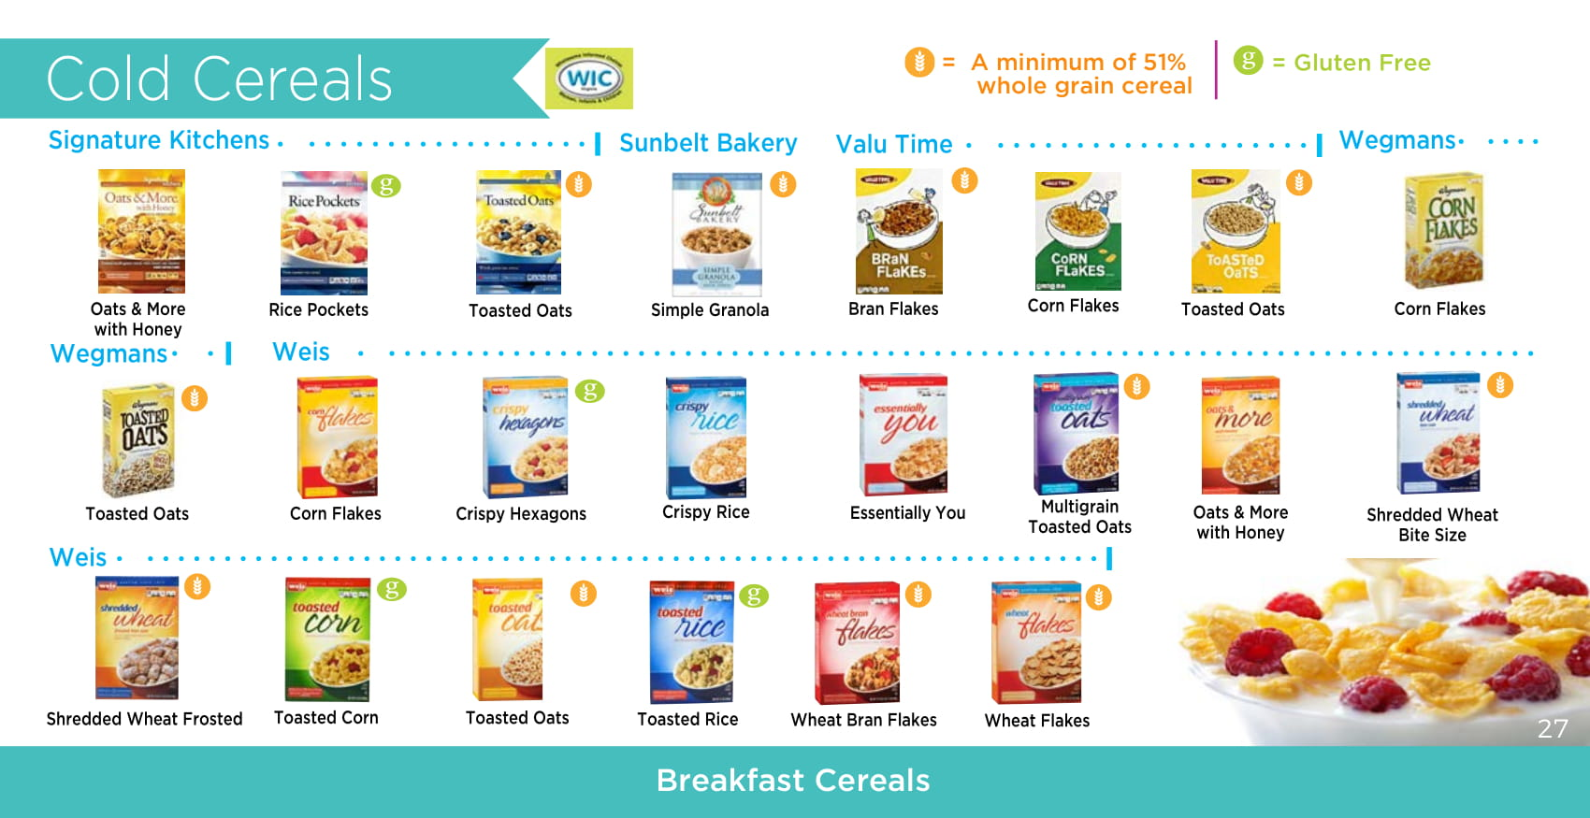
Selecting Creditable
Breakfast Cereal Methods
WIC-Approved Breakfast Cereals List
Table Method
Notes:
The great news is there are two easy ways to identify creditable breakfast cereals:
WIC-Approved Breakfast Cereals List
Table Method
Each of these methods are valid ways of determining if a cereal meets the sugar limit. If a cereal falls within the sugar limit using at least one of these methods, it is considered to be within the sugar limit and can be creditable.
Let’s review both methods to identify which one is best for you and your program.

Slide 62
Use ANY WIC Approved Breakfast Cereal Lists
Meets the sugar limits for the CACFP
All WIC approved breakfast cereals contains no more than 6 grams of sugar per dry oz
www.fns.usda.gov/wic/wic-contacts
Notes:
The first method calls for you to use WIC-Approved breakfast cereal list. Similar to the CACFP, all WIC-approved breakfast cereals must contain no more than 6 grams of sugar per dry ounce (21.2 grams of sugar per 100 grams). Therefore, if you choose a breakfast cereal from any approved WIC cereal list, it will meet the sugar limit requirements for breakfast cereals. To locate WIC-approved food lists for each state, visit the following website: www.fns.usda.gov/wic/wic-contacts. However, it is important to note that WIC-approved yogurt does not meet the sugar requirements; therefore, you should not use it as a source for finding creditable yogurt items.

Slide 63
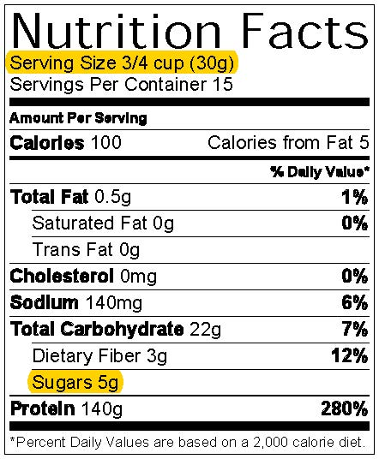
Table Method: Breakfast Cereals
Breakfast Cereal Sugar Limits
Serving Size | Sugar Limit
If the serving size is: | Sugars cannot be more than:
0–2 grams | 0 grams
3–7 grams | 1 gram
8–11 grams | 2 grams
12–16 grams | 3 grams
17–21 grams | 4 grams
22–25 grams | 5 grams
26–30 grams | 6 grams
31–35 grams | 7 grams
Notes:
The next way for determining if a breakfast cereal meets the sugar limit requirement is to use the table method. Very similar to determining yogurt products that meet the sugar requirements, this method uses a table to determine the amount of sugar in breakfast cereal. It features pre-calculated sugar limits for common serving sizes for breakfast cereals. You can also find this method on the USDA Team Nutrition’s training worksheet “Choose Breakfast Cereals That Are Low in Added Sugar” which will be provided at the end of this presentation.

Slide 64


Grain-Based Desserts
Source of added sugars & saturated fats
Increases risk of chronic illnesses
Not creditable towards the grain component
Notes:
The next major update to the grains component focuses on grain-based desserts. According to the Dietary Guidelines for Americans (DGA), grain-based desserts are sources of added sugars and saturated fats. Eating too much sugar and saturated fat may increase the risk of heart disease, stroke, and other chronic illnesses. Because of these findings, grain-based desserts are no longer creditable toward the grains component in the CACFP.

Slide 65
List of SOME Grain-Based Desserts
Breakfast bars
Brownies
Cakes
Cereal bars
Cookies
Doughnuts
Granola bars
Sweet piecrusts
Sweet rolls
Toaster pastries
Separate category for Sweet crackers (graham & animal crackers)
Notes:
USDA provides a breakdown of creditable and non-creditable grain based desserts in their memo 09-2018 Grain Requirements in the Child and Adult Care Food Program Questions and Answers. USDA revised this chart to be consistent with other Child Nutrition Programs and to provide an easy identifier for grain-based desserts.
Grain-based desserts are those food items found in this memo with a superscript 3 or 4. These items include, but are not limited to:
breakfast bars,
brownies,
cakes,
cereal bars,
cookies,
doughnuts,
granola bars,
sweet crackers (graham and animal crackers),
sweet piecrusts,
sweet rolls, and
toaster pastries.
These items are NOT creditable towards the CACFP. Sweet crackers, which consist of graham crackers and animal crackers, are not considered to be grain-based desserts and therefore, are creditable.
For a more comprehensive list of grain-based desserts, please refer to the USDA memo provided at the end of this presentation.

Slide 66
Grain-Based Desserts
Some foods are not easily identified as grain-based dessert
i.e., a cookie is labeled “breakfast round”
Ask the question:
Is this food thought of as a dessert?
Notes:
Also, some foods are advertised in a way that may not be easily identified as a grain-based dessert. For example, a cookie may be labeled a “breakfast round.” When planning menus and searching for creditable grains, it is important to ask the question, “Is this food thought of as a dessert?” If so, then chances are it a grain-based dessert. If you are unsure about a food item, always work with your sponsor or the Virginia Department of health to determine if a food item is a grain-based dessert.

Slide 67

Grain-Based Desserts & Special Occasions
Annual festival, birthday celebrations, end-of-year bash, or other special events
May be served as an additional item only
Notes:
Often, grain-based desserts are served during special occasions, such as an annual festival, birthday celebrations, end-of-year bash, or other special events. Therefore, you have the flexibility to serve grain-based desserts as additional items; however, these items are not reimbursable.

Slide 68

Other Meal Service Items
Notes:
Lets review other meal service items

Slide 69

Water
Must be offered and made available throughout the day
May not be served in place of milk
May be offered alongside milk at meals or at snack
Notes:
Starting in 2011, child care programs participating in the CACFP were required to make water available to children upon their request throughout the day, including mealtimes. In the updated requirements, you must now make water available to children and offer it to them throughout the day.
There are few key requirements for serving water. First, water is not a part of a reimbursable meal, and there is no requirement to serve water during meal service.
Next, it cannot be served in place of milk. However, you may offer it alongside milk or during snack when there are no other beverages. For example, you serve fat-free string cheese and celery at snack; you could serve water as a beverage.

Slide 70

Flavoring Water
Fruits, vegetables, and herbs for added flavor
Plain, potable water must be available
Commercially flavored water is not allowed
Flavoring foods are not creditable for any food component
Notes:
Flavored water has grown in popularity. The updated requirements allow for flavoring water with fruits, vegetables, and herbs as long as plain, potable water is available. It is important to note that commercially flavored water is not allowed, nor can the fruits or vegetables used to flavor the water credit toward the fruit or vegetable component(s).
For more information on serving water, refer to the USDA policy memo: CACFP 20-2016: Water Availability in the Child and Adult Care Food Program. The link to this memo is listed at the end of this presentation

Slide 71

Deep-Fat Frying
May not be used to prepare meals on-site
Includes central and satellite kitchens
Defined as food submerged in hot oil or other fat
May purchase from commercial manufacturer
Pre-fried, Flash-fried, Par-fried, Deep-fat fried
May not deep-fry when reheating
Notes:
Deep fat frying is a method in which the food is cooked by submerging in hot oil or other fat. The updated meal pattern requirements no longer allow deep-fat frying as a way of cooking foods on-site or at central, satellite kitchens who prepare foods, and then deliver them to the site. This requirement applies to all CACFP age groups.
Foods that are pre-fried, flash-fried, par-fried, or deep-fat fried by a commercial manufacturer may be purchased and served as part of a reimbursable meal. Similarly, CACFP facilities that vend meals may claim vended meals that contain deep-fat fried foods as long as the food was prepared by the vendor off-site. These pre-fried items must be reheated by a method other than deep-fat frying.

Slide 72
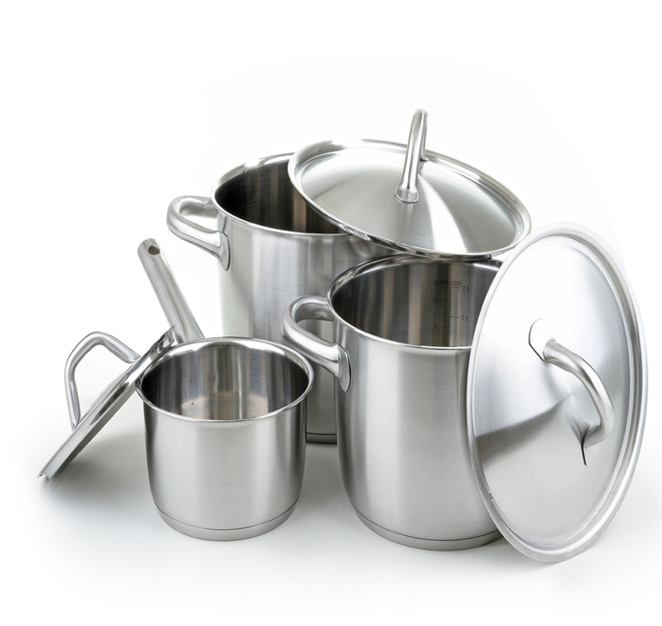
Choose Healthier Methods
Deep-fat fried foods
Strongly discouraged
High in calories and solid fat
Can negatively influence eating habits
Increases the risk of chronic illnesses later in life
Consider the nutritional value of a food and how it contributes to healthy eating habits
Notes:
Serving children any type of deep-fat fried food is strongly discouraged. These foods are often high in calories and solid fat, and eating too many fried foods can negatively influence eating habits and increase the risk of chronic illnesses later in life.
Therefore, it is a good practice to always consider the nutritional value of a food and how it contributes to the development of healthy eating habits when planning meals and snacks for children. Likewise, serving children nutritious foods as opposed to those high in fat, sugar, and calories, will help to establish the foundation for developing habits that can last a lifetime.

Slide 73
Additional Creditable Items
Popcorn
Shelf Stable Dry & Semi-Dried Meat
Tempeh
Surimi
Coconut
Hominy
Corn Masa & Corn Meal
Notes:
Also—pasta products made of vegetable flour

Slide 74

Meal Service in the CACFP
Notes:
Let’s continue by discussing meal service requirements and how to claim children in the CACFP.
Please refer to the Recordkeeping presentation for an exhaustive list of documents required in the CACFP.

Slide 75
Types of Meal Services in the CACFP
Meal service impacts what participants eat
Meal service types:
Pre-plated meals
Family Style
Offer Versus Serve (OVS)
Notes:
The way meals are served can have a huge impact on the children and adults eating the food. CACFP providers may choose from two types of meal service: pre-plated meals and Family style meals. Offer versus serve (OVS) is ONLY allowed in at-risk afterschool programs and adult day care settings. There are requirements for each of these types of meal service important for you to know and must be followed to receive reimbursement.

Slide 76
Family Style Meal Service
Promotes social, emotional, & motor skills
Encourages children to try new foods
Provides control over eating for children & adults
Notes:
Family style meal service (FSMS) is a meal service that allows children and adults to serve themselves from common serving bowls and platters of food with the assistance of supervising adults, if needed.
FSMS is highly encouraged in both child care and adult care settings for many reasons. For example, young children benefit from FSMS because it:
promotes the development of social, emotional, and motor skills;
encourages children to try new foods; and
provides children with control over their eating.
Adults also benefit from meals served family style because it gives them more control over their serving sizes. Also, adults are generally accustomed to eating meals family style.

Slide 77
Meal Pattern Requirements & Family Style Meal Service
Optional, but highly encouraged
Some children may need to develop necessary skills
e.g., passing, pouring, serving
Allow time to practice each skill
Notes:
Although FSMS is highly encouraged and offers many benefits to young children and adults, it may not be appropriate for some CACFP settings or age groups. For example, younger children, such as 1 year olds, may first need to develop the necessary skills for passing, pouring, and serving themselves before beginning FSMS. Therefore, the updated meal pattern requirements encourage, but do not require, meals to be served family style.

Slide 78

Family Style Meal Service Guidelines
Place enough food at each table to provide the required portions
Children, adults, & supervising adults (optional)
Example: 3 children (3-5 years) & 1 supervising adult
Minimum serving size is ¼ cup for sliced apples
Place 1 cup of sliced apples in shared bowl
Includes ¼ cup for supervising adult
Notes:
When you incorporate family style meal service in your facility, there are a few key things to do to ensure you are following the requirements. First, enough food must be placed on each table to provide the required portions of each of the food components for all the participants and to accommodate supervising adults that are eating with the participants. For example, there are 3 children between the ages of 3-5 years old and 1 supervising adult seated at the table for lunch. The minimum serving size for fruit for 3-5 year olds is ¼ cup.
So, there must be at least ¼ cup of sliced apples for each child and adult at the table. This results in a total of 1 cup of sliced apples in the serving bowl. In this example, a total of 1 cup of sliced apples is placed in the shared bowl at the start of the meal to meet the ¼ cup per participant requirement for the fruit component (this includes ¼ cup for the supervising adult).

Slide 79

Family Style Meal Service: Juice & Milk
Optional for participants to serve themselves juice or milk
Supervising adults must serve the required minimum serving size
Notes:
Participants must be allowed to serve the food components themselves, with milk or juice being the exception. Supervising adults may serve juice or milk to participants. If a CACFP facility chooses to have the supervising adult serve the beverages to the participants, they must serve the required minimum quantity to each child and adult.

Slide 80

Family Style Meal Service: Serving Sizes
Children may take smaller portions
Actively encourage children to take the full serving
If the food is refused, do not force
  Meals are reimbursable as long as all food components are offered
Notes:
Children may take smaller serving sizes than required. In that situation, providers are responsible for actively encouraging participants to take the full serving size. Every child should initially be offered and encouraged, but never forced to take the full serving size of each meal component required for his or her age group. If a child or adult does not take a component or the full serving size of a component, the meal is still reimbursable as long as all the food components are offered.

Slide 81

Supervising Adults & Family Style Meal Service
Supervising adult meals are not reimbursable
Cost of adult meals are an allowable expense
Notes:
Eating meals with children is one of the most important ways of promoting healthy eating habits. When children see you eating a variety of nutritious food, they are more likely to try the foods as well. Although meals for supervising adults are not reimbursable, the cost of adult meals is an allowable expense.

Slide 82

Reward & Punishment
Negative effect on development & socialization
Rewards may lead to cavities & weight gain
Punishment may cause overeating
Not allowed in CACFP facilities
Notes:
Using food as a reward for good behavior or punishment for less pleasing behaviors may have a negative effect on children’s development and socialization. For example, providing children sweet treats after they put away their toys may cause them to develop unhealthy eating habits, and these habits may cause cavities, weight gain, and other health problems.
Another example is forcing children to eat all of their food before they can to leave the table. This method can cause children to eat more than they need and not listen to their hunger cues, increasing their risk of becoming overweight or obese. Therefore, the meal pattern requirements do not allow the use of food and beverage as a punishment or reward.

Slide 83
Child Meal Pattern:
Claiming Meals

Slide 84
Claiming Meals: Basic Meal Service Requirements
Follow the CACFP Meal Pattern
Dietary Prescription Form, if necessary
Take point-of-service meal counts
Maintain Menus & cost documentation
Maintain CN Labels and/or Meal Production Records
Notes:
Centers may claim for up to two meals and a snack per day, or two snacks and 1 meal.
The basic requirements needed for claiming meals include, but are not limited to:
Following the CACFP meal pattern
Keeping all necessary Dietary Prescription Forms on file
Taking, and keeping on file, point-of-service meal counts
Maintaining menus (including infant menus) and all cost documentation
And maintaining CN labels and, if applicable, any meal production records.
For a comprehensive list of recordkeeping requirements for the entire Child and Adult Care Food Program, please refer to the Recordkeeping training presentation.

Slide 85

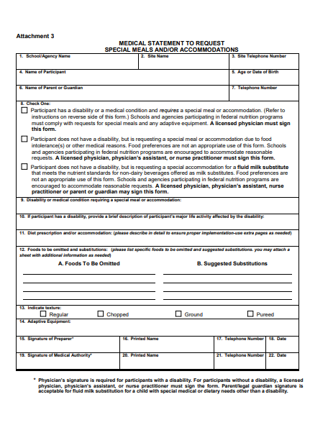
Dietary Prescription Form
Details information about the participant’s disability
Lists alternate food items
Prescribed and signed by a State recognized medical authority
Notes:
The Dietary Prescription Form is required for participants with a disability if the food substitution does not meet the meal pattern requirements.
This form details information about the participant’s disability and lists alternate food items.
A physician’s signature is required for participants with a disability
Licensed physician, physician’s assistant, or a nurse practitioner’s signature required for participants without a disability
A parent/legal guardian signature is acceptable for fluid milk substitution UNLESS the substitution is not nutritionally equivalent to cow’s milk. If the substitution is not nutritionally equivalent to cows milk, a physician’s signature is required.
When requesting and accepting a medical statement, it should feature the following:
Detailed information about the participant’s disability to allow you to understand how it affects their diet
List alternate food items to ensure you know just what you can serve to the participant
Prescribed and signed by a State recognized medical authority, such as a physician, who is authorized to write medical prescriptions under State law (State recognized medical authority)
A template of this document can be found in the Download Forms section of CHAAMPS

Slide 86

Special Dietary Prescription Form
Review it carefully
Request additional information, if necessary
Policy Memo: CACFP 14-2017 Modifications to Accommodate Disabilities in the Child and Adult Care Food Program and Summer Food Service Program
Notes:
Once you receive a medical statement, review it carefully to make sure that it provides the previously mentioned information. If not, request additional information to ensure you can best meet the needs of those requiring substitutions. In addition, always keep medical statements on file in your facility.
For additional information on how to provide meal accommodations to participants of any age, refer to the policy memo: CACFP 14-2017 Modifications to Accommodate Disabilities in the Child and Adult Care Food Program and Summer Food Service Program.

Slide 87
Point of Service Meal Counts
Meal Count Systems
Head Count
Used if approved to serve 3 meals or less/day
Point of Sale
Use of point of sale system for counting
Roster
Used if approved to serve 4 or more meals/day
Meal counts taken on individual basis
Notes:
Meal counts must be taken at the point of service when participants receive their meals. Point of service refers to the moment the participant receives their meal.
There are multiple systems that may be used for point of service. They includes the
Roster System – The roster system is commonly used and refers to ticking the box next to an participant’s name once they receive a meal. Centers approved to serve four or more meals per day must take meal counts on an individual basis, meaning that each participant must be indicated for each meal he/she was served
Head Count System – If a center is approved to serve three meals or less per day, it can take head counts at each meal time. The head count system refers to counting the individuals receiving the meals. For instance, lunch is served to a classroom of 5 children and all of them are served lunch. The lunch server then tallies or writes the number 5 on the meal count sheet for that meal.
Point of Sale System- Sponsors may be approved to use their point of sale system for meal counting. This is most common in cafeteria settings, where meal counts occur when they are logged into the point of sale system.

Slide 88
Point of Service Meal Counts
Program Adults
Meals served to “program adults” working in the program, non-program adults, and other non-enrolled persons must also be recorded*
  Note: these meals may not be included in the CACFP meal counts for reimbursement, but can be used for cost documentation
Notes:
Meals served to “program adults” working in the institution’s food service, non-program adults, and to other non-enrolled persons must be recorded
These meals may not be included in the CACFP meal counts for reimbursement, however, it can be counted for cost documentation purposes.

Slide 89

Point of Service Meal Counts
Unacceptable Meal Counting Methods
Counts based on number of trays or plates available and left over after meal service | Counts based on the number of vended meals received
Counts taken at the beginning of serving line without checking to see if the meals served were creditable | Claiming the same number of meals every day, referred to as “block claiming”
Counts based on the number of children in attendance | Counts based on previous meal counts
Counts based on the number of tickets distributed | Counts based on the number of meals prepared
Notes:
Unacceptable Meal Counting Methods include:
Counts based on number of trays or plates available and left over after meal service
Counts taken at the beginning of serving line without checking to see if the meals served were creditable
Counts based on the number of children in attendance
Counts based on the number of tickets distributed
Counts based on the number of vended meals received
Counts based on previous meal counts
Claiming the same number of meals every day, referred to as “block claiming”

Slide 90
Child Meal Pattern:
Recordkeeping

Slide 91
Recordkeeping: Daily Menu
Past menus must be kept on file
Menus must include:
Month, day, year
Food items served in each meal type, noting milk fat content and juice type
Substitutions
Serving Sizes*
Separate menus required if serving infants
Notes:
Menus must be posted in a prominent location so that participants and parents and guardians of participants are aware of the food being offered by the center.
These menus must be kept on file by the center and, if applicable, the sponsor level.
Menus are required to include the month, day, and year of meals served.
They must include the food items served in each meal type and note the milk fat content and juice type to show compliance with the CACFP meal patterns. Please be specific in the description of item. For instance, Whole Wheat bagel, or, instead of listing vegetable, list the specific vegetable such as carrots.
If, for some reason, the center substitutes one item for another, they must list that substitution on the posted menus. The reason for this is twofold: one, to inform your participants and parents and guardians of participants of the substitution and, two, to have a record of the specific items that were served that day.
Including serving sizes is a best practice
Include the non-discrimination statement on all CACFP documentation, including your menus.
Child care centers and day care homes serving infants must maintain separate menus for meals served
More information regarding infant menus can be found in the Infant Meal Pattern Training

Slide 92
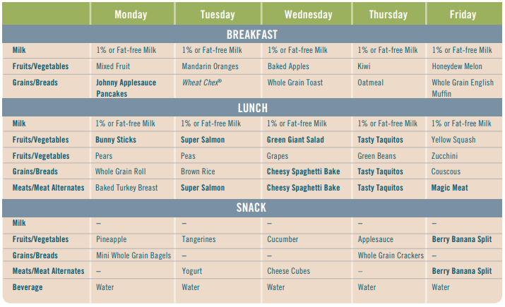
6/24/19-6/28/19
✓
✓
✓
✓
✓
Weekly Cycle Menu Example
This institution is an equal opportunity provider.
Notes:
Here we have a weekly cycle menu example
You’ll notice the days of the week are at the top and the components are listed in the left column.
[click next slide] Instead of mixed fruit, centers should write the specific fruit they plan to serve
[click next slide] This menu includes the brand of cereal being served instead of just writing cereal
[click next slide] Things like Bunny Sticks or Magic Meat listed here do not explain exactly what the dish includes. If institutions wish to give their meals names like this, they should nuclide the ingredients at the bottom of their posted menu.
There are some other items that this menu should include:
[click next slide] Include the month, day, and year of the menu.
[click next slide] The type of milk being served is listed here, but if the organization is serving any 1-2 years olds—they must be served whole milk. Often it can be easier to list the type of milk being served to particular age groups, and the amount of milk at the bottom of the menu.
[click next slide] this menu should also have the civil rights non-discrimination statement posted somewhere on the menu
Best practice would also be to list the serving sizes of each item being served.

Slide 93
Recordkeeping: Cost
Maintain receipts and/or documentation of:
Income to the program from all sources
All submitted reimbursement claims
All program payments received from VDH
All food costs, including milk receipts
Operating and administrative costs, including time records for employees performing CACFP-related tasks
Notes:
When documenting costs for the Child and Adult Care Food Program, be sure to maintain receipts and/or documentation. Documentation may include invoices and proof of payment. Costs should be documented for:
Income to the program from all sources
All submitted reimbursement claims
All program payments received from VDH
All food costs, including milk receipts
Operating and administrative costs, which includes time records for employees performing CACFP-related tasks
For more information on cost documentation, allowable and unallowable costs, and operating versus administrative costs, please refer to the Virginia Department of Health’s CACFP Budget training. Additionally, please refer to the CACFP Handbook titled Guidance for Management Plans and Budgets as well as the FNS Financial Instruction 796-2 Revision 4.

Slide 94

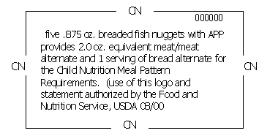
Child Nutrition (CN) Label
Notes:
CN labels are required for all commercially processed combination meal dish products. As a best practice, institutions should have a list, by product, of how much food is required for each age group served
Examples of commercially prepared products: chicken nuggets, fish sticks, pizza, etc.
Looking at the example here we have breaded fish nuggets, where the food is being claimed for both the grain and meat/meat alternate components.
The CN label states the meal contribution and serving size of the product, and can be found on the outside packaging. They are NOT the same as the nutrition label.
For items purchased in bulk, the CN label may be on the outer packaging.
A CN label on a product does not necessarily mean that the food provides an entire serving of a meal component. Here, for example, the CN label notes that 5 fish nuggets provide 2oz equivalent of the meat/meat alternate requirement and 1 serving of the grain component.
Please note that for combination dishes, no more than 3 components can counted toward 1 combination dish.

Slide 95

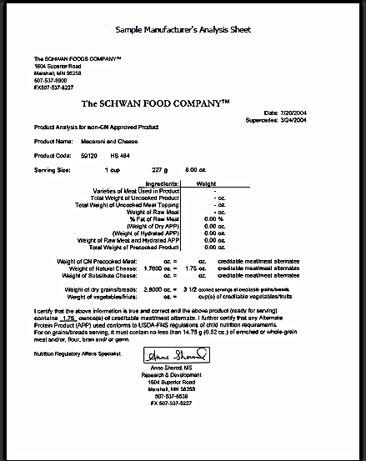
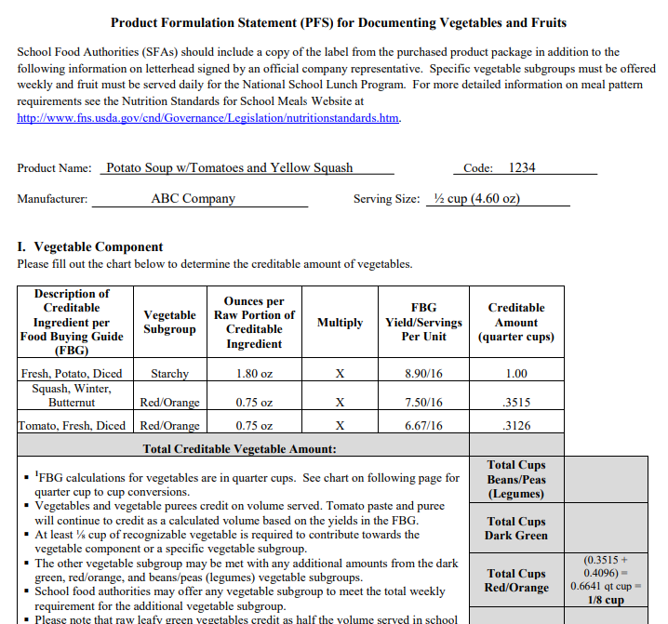
Manufacturer Analysis Sheet
Notes:
If a manufactured product containing multiple components does not have a CN label, organizations can call the manufacturer and ask for an analysis sheet of the product.
Often, they will ask for the UPC number to help provide you with the child nutrition information, so be sure to have the package in front of you.

Slide 96

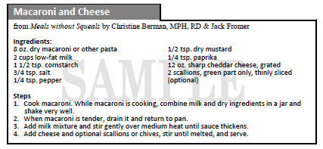
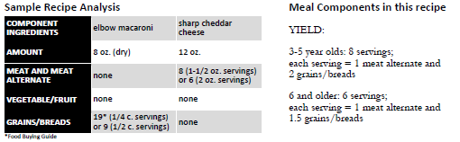
Meal Production Records
Notes:
For homemade dishes, an appropriate standardized recipe should be used to ensure that enough of each planned CACFP meal pattern component is provided.
Institutions that prepare main dishes on-site must maintain documentation of:
Recipes used
Amount of each ingredient used in preparing the dish and estimated contribution toward meeting the component requirements
And number of participants the recipe serves.
Looking at the example listed:
1. The milk used in this recipe cannot be credited to any food component. Milk is required at meals as a beverage.
2. The scallions do not contribute the minimum serving, so are not considered as a component.
3. To determine the portion size, measure the total volume and divide by 8 for 1-1/2 oz. servings of cheese (3-5 year olds) or 6 for 2 oz. servings of cheese (6 and older)
4. The most limiting component of this recipe is the cheese. The total number of servings in the recipe is determined by the number of servings of cheese.
Below the recipe is the Sample Recipe Analysis. Having this documentation on file ensures that the correct serving sizes are being served according to meal pattern requirements.

Slide 97


Questions? Contact Us!
  CACFP@VDH.Virginia.Gov
  (877) 618- 7282
  Virginia Department of Health
  Division of Community Nutrition
  Special Nutrition Programs
  109 Governors Street, 8th Floor
  Richmond, Virginia 23219
This institution is an equal opportunity provider, employer, and lender.
Notes:
This concludes the Virginia Department of Health’s presentation on Child Meal Pattern and meal service requirements within the Child and Adult Care Food Program. For more information on what is required for your organization, please refer to the Recordkeeping training presentation.
Between the Virginia Department of Health, USDA Food and Nutrition Service, Institute of Child Nutrition—from which much of this presentation was adapted from, the CACFP Sponsors Association, and others, there are a large amount of resources available to you as you implement the CACFP. Please reach out to the Virginia Department of Health for programmatic resources and technical assistance.
You can contact us by calling the Helpdesk at 877-618-7282 or by emailing the CACFP Email box at CACFP@vdh.Virginia.gov

