Slide 1
Infant Meal Service
Guidance for Feeding Infants in the Child and Adult Care Food Program (CACFP)
Notes:
Thank you for joining us for the training presentation on Infant Feeding within the Child and Adult Care Food Program—also known as the CACFP. This presentation will cover the Infant Meal Pattern within the CACFP, as well as other meal service requirements for infants.
This training has been adapted from materials provided by the Institute of Child Nutrition.
USDA recently revised the CACFP meal pattern requirements to ensure infants, children, and adults have access to healthy, balanced meals throughout the day. The changes to the infant meal pattern requirements support breastfeeding and the consumption of vegetables and fruits without added sugars. In addition, these changes are based on the scientific recommendations from the National Academy of Medicine, the American Academy of Pediatrics and stakeholder’s input. These changes went into effect October 1, 2017.
<CHANGE SLIDE>

Slide 2
Today’s Topics
Infant Meal Pattern
Claiming Infants
Breastfeeding Friendly
Resources
Notes:
In this training we will talk about the Infant Meal Pattern, creditable infant foods, and developmental readiness.
We’ll discuss the required components necessary in order to claim for infants, including recordkeeping requirements.
We’ll look at how to promote breastfeeding at your center,
And lastly, we’ll connect you to helpful resources.
<CHANGE SLIDE>

Slide 3
Scenario
A child care center or a family day home provider participating in the CACFP does not provide infant foods and/or formula to infants in their care and requires parents to supply these items.
Is this allowable?
Notes:
Before we dive into the meal pattern requirements, let’s look at a Scenario. A child care center or a family day home provider participating in the CACFP does not provide infant foods and/or formula to infants in their care and requires parents to supply these items.
CLICK NEXT Is this allowable?
<NEXT SLIDE>

Slide 4
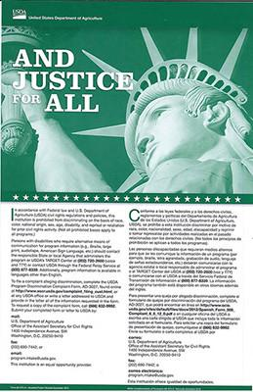
No
This is a civil rights issue. To withold the program from any eligible age group is age discrimination.
Notes:
No—this is not allowable, as this is a civil rights issue. All children who attend a participating center or home must be provided equal access to the benefits of the CACFP. Therefore, infant formula and food must be offered to infants at the center and parents cannot be asked or required to supply these items. To withhold the program from any eligible age group is age discrimination. Federal law prohibits discrimination based on race, color, National origin, age, sex, and disability.
<NEXT SLIDE>

Slide 5
Infant Age Groups
Birth-5 months
6-11 months
Notes:
Previously, the infant meal pattern was split into three age groups—birth-2 months, 4-7 months, and 8-11 months.
However, there are now only two age groups for the infant meal pattern.
Birth through the end of 5 months, and
6 months through the end of 11 months
These new age groups are consistent with the WIC age groups.

Slide 6
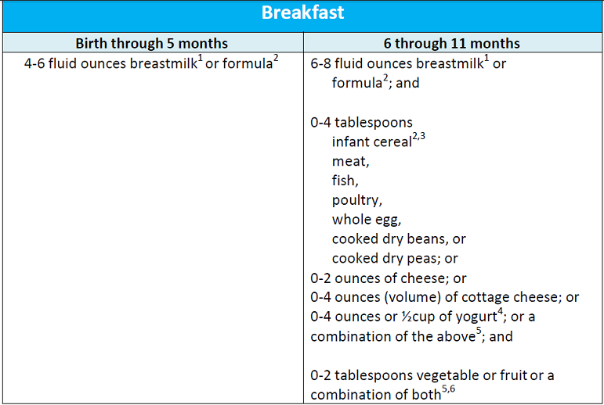
Notes:
Let’s take a look at the Infant Breakfast Meal Pattern.
Birth through 5 months: with this age group, the only requirement is the 4-6 fluid ounces of breastmilk or formula.
For the 6 through 11 months age group, the required components of an infant breakfast include 6-8 fluid ounces of breastmilk or formula, a serving of infant cereal or a meat/meat alternate or a combination of both, and a serving of a vegetable or fruit or a combination of both.
You’ll notice here that serving sizes for solid foods within the 6-11month age group start at 0. This is to allow flexibility with serving those items if the child does not eat the entire portion. Additionally, it allows flexibility with serving those items if and when each child is developmentally ready. Please note that if a child is developmentally ready, that child must be served the food in order to claim reimbursement for that meal.

Slide 7
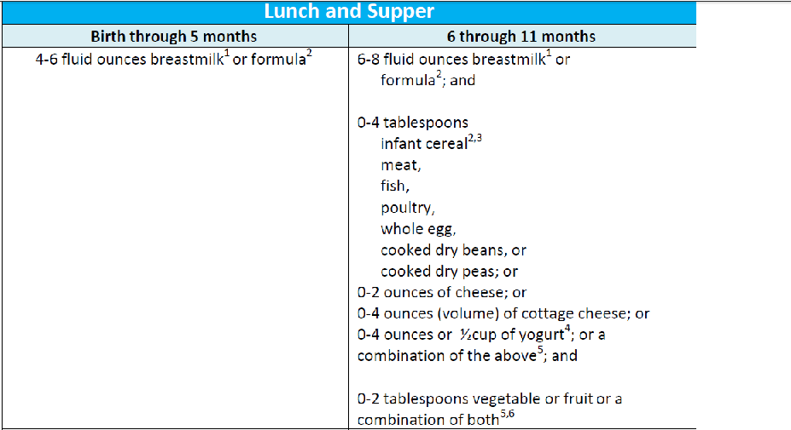
Notes:
Lunch and Supper look very similar to the Breakfast meal pattern for infants.
Birth through 5 months: with this age group, the only requirement is the 4-6 fluid ounces of breastmilk or formula.
For the 6 through 11 months age group, the required components of an infant breakfast include 6-8 fluid ounces of breastmilk or formula, a serving of infant cereal or a meat/meat alternate or a combination of both, and a serving of a vegetable or fruit or a combination of both.
You’ll notice here again that serving sizes for solid foods within the 6-11month age group start at 0. Again, this is to allow flexibility with serving those items if the child does not eat the entire portion. Additionally, it allows flexibility with serving those items if and when each child is developmentally ready. Please note that if a child is developmentally ready, that child must be served the food in order to claim reimbursement for that meal.

Slide 8
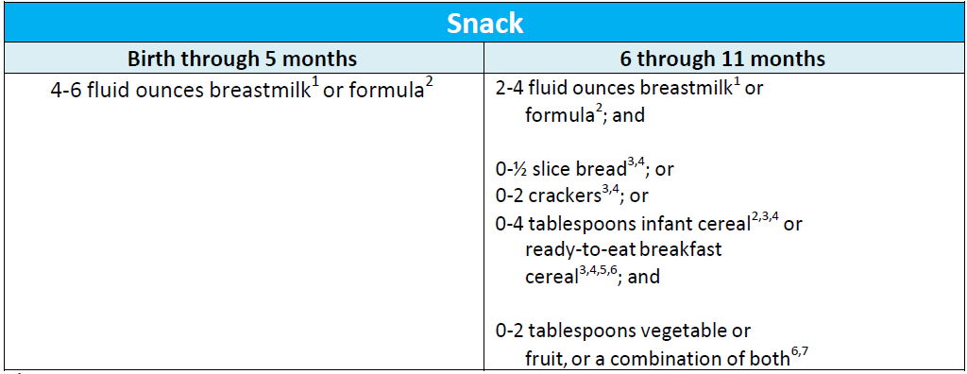
Notes:
With snack:
Again, the only requirement for the birth through 5 months age group is the 4-6 fluid ounces of breastmilk or formula.
For the 6 through 11 months age group, the required components of an infant breakfast include 2-4 fluid ounces of breastmilk or formula, a serving of grains, and a serving of a vegetable or fruit of a combination of both.
You’ll notice here again that serving sizes for solid foods within the 6-11month age group start at 0. Ready to eat cereals may now be served as a grain component for Snack only. Certain ready to eat cereals can be potential choking hazards, always consider the developmental readiness of the child and how it applies to the consistency and texture of the ready to eat cereal. Similar to the Child and Adult meal pattern, ready to eat cereals may have no more than 6 grams of sugar per dry ounce of cereal.

Slide 9
Birth - 5 months
Breastmilk or iron fortified infant formula is the only meal component required
Serve a minimum of 4-6 fluid ounces
Benefits of breastmilk
Generally the best source of nutrients
Protects against illnesses and chronic diseases
Notes:
Previously, the breastmilk and infant formula was the only required component for the first three months. However, breastmilk is the optimal source of nutrients for infants, and it is generally the only source of nutrients infants need for healthy growth and development during the first 6 months of life.
Particularly, breastmilk provides the right balance of proteins, healthy fats, vitamins, and other essential nutrients. It also helps to protect infants against illnesses and chronic diseases, such as obesity, asthma, and type 2 diabetes. What’s more, breastfeeding can have a positive effect on their emotional and physical wellbeing. Therefore, the only required food component for infants between the ages of birth through the end of 5 months is a minimum of 4-6 fluid ounces of expressed breastmilk or infant formula for all meals and snacks.

Slide 10
6 – 11 months
Food components begin with zero
Not all infants are ready for all solids at 6 months
By 7 or 8 months, infants should be consuming solid foods from most food groups
Serving Sizes
0-2 oz.
0-4 tbsp.
Notes:
As we discussed earlier, the serving sizes for all food components for meals and snacks now begin with “zero” for infants 6 through 11 months, with the exception of breastmilk and infant formula. This serving size recognizes that not all infants are ready-to-eat solid foods right at 6 months of age and may need additional time before they are developmentally ready. It is important to note, by 7 or 8 months of age, most infants should consume solid foods from most food groups.

Slide 11
Breastmilk
Centers can claim reimbursement when:
A parent/guardian supplies expressed milk
The infant is breastfed on-site
Notes:
As previously mentioned, breastmilk is generally the best source of nutrients for healthy growth and development. Due to the many benefits of breastmilk, the updated requirements encourage and promote breastfeeding in two key ways. First, you may continue to claim infant meals for reimbursement when a parent or guardian supplies expressed breastmilk (milk that is produced and expelled from the breast) for their infant and you feed the infant the expressed milk. Second, centers can claim reimbursement for meals when a mother breastfeeds her infant at the child care facility.
Later in this presentation, we will discuss way in which you can make your center or home more comfortable for nursing parents by creating a designated nursing area.
<NEXT SLIDE>

Slide 12
Iron Fortified Infant Formula (IFIF)
Best supplement for breastmilk
Supports healthy brain development and growth
Reimbursable meals may include
Iron-fortified formula
Breastmilk
Combination of both
Notes:
When infants are not breastfed or they need a supplement for breastmilk, iron-fortified infant formula is the best alternative. Iron is an important nutrient for infants during their first year because it supports healthy brain development and growth.
The infant meal pattern requirements allow an infant, younger than 12 months, to be served iron-fortified formula, breastmilk, or a combination of both. Therefore, if a mother chooses not to breastfeed or is unable to produce enough breastmilk to satisfy the infant, the center should provide formula.
<NEXT SLIDE>

Slide 13
Supplying & Serving Formula
Offer a minimum of 1 type of IFIF
Formula must be regulated by FDA and should be purchased in the U.S.
Minimum serving size must be offered
Notes:
All CACFP participating child care programs with infants must offer a minimum of one type of iron-fortified infant formula.
When selecting infant formula, it is important to choose those that meet the criteria for a reimbursable meal.
Iron-fortified infant formula must:
--State “Infant Formula with Iron” or a similar statement on the front of the package. All iron-fortified infant formulas must have this type of statement on the package.
--List 1 milligram of iron per 100 calories on the Nutrition Facts Label.
--Not be a Food and Drug Administration (FDA) Exempt Infant Formula. These types of formulas are specifically for infants who have inborn errors of metabolism, lower birth weight, or other special dietary needs.
Also, the selected formula must be regulated by the Food and Drug Administration (FDA) to be creditable in the CACFP. The great news is any formula marketed or purchased in a store in the U.S. is regulated by the FDA. However, if you purchase an infant formula outside of the U.S., such as through an online store with vendors in other countries, it may not be regulated by the FDA. In these cases, the formula may not credit in the CACFP.
When serving formula, some infants may not consume the entire serving. However, as long as you offer the minimum serving size, the meal is reimbursable. This is true for any food or beverage served to all participants (infant, children, and adults) in the CACFP. A participant does not need to consume the minimum serving size of a food component in order for the meal to be reimbursable.
In situations where there are leftovers, always properly store them based on your local health and safety requirements.

Slide 14
Developmental Readiness
Delay introduction of solid foods until ~6 mo
Communicate readiness with parent/guardian
Watch for signs of readiness
Notes:
The changes to the infant meal pattern focus heavily on developmental readiness. The previous infant meal pattern allowed solid foods to be introduced as early as 4 months of age. However, if infants are introduced to solid foods before they are developmentally ready, the risk of being overweight or obese later in life increases. Also, infants need time to develop the skills for eating solid foods, and most infants are not ready to consume solid foods until midway through their first year. Therefore, infants may now be introduced to solid foods when they are developmentally ready to accept them. This means you may serve solid foods to infants before, at, or after 6 months of age.
Introducing solid foods is a very important step for infants, parents, and guardians. It is vital that infants are developmentally ready for solid foods before introducing them.
By 7 or 8 months of age, most infants should consume solid foods from all food groups. However, infants develop at their own rate. This means if an 8-month old is not developmentally ready for solid foods, the meal or snack is still reimbursable if you serve the minimum serving size (6–8 fluid ounces) for breastmilk or infant formula.
In order to determine developmental readiness, the center should speak to the parent/guardian of each infant. What is happening at home? What has the infant tried? Are there allergies that the center should be aware of? These conversations can be ongoing, or, the center has the option of using a written statement. The optional written statement should outline when and which solid foods to serve, and helps the center follow the preferences of the parent/guardian.
The American Academy of Pediatrics has some guidelines that are helpful for determining developmental readiness of solids. What do we think are some signs of readiness to eat solids?
The American Academy of Pediatrics’s guidelines state that an infant may be developmentally ready to accept solid foods when he or she:
is able to sit in a high chair, feeding seat, or infant seat with good head control;
opens their mouth when food comes their way. The infant may watch others eat, reach for food, and seem eager to be fed;
moves food from a spoon into the throat; and
doubles in weight.

Slide 15
Introducing Solid Foods
When developmentally ready, solid foods must be offered
Gradually introduce new foods
Prepare foods in the right texture and consistency
Notes:
Once an infant is developmentally ready to accept solid foods and that has been communicated with the parents, the center MUST offer the food to the infant.
Begin by gradually introducing solid foods, one at a time, and over the course of a few days. This is primarily so that any allergies can be ruled out. It may be appropriate to offer a solid food at only one meal per day when an infant is just starting to eat them. Also, it is not necessary to offer an infant a solid food component at every meal or snack, such as vegetables and fruits, until the infant has established a tolerance for that food component.
Some centers choose to not introduce any new foods until that food has been trialed at home. If the center does choose to introduce a food for the first time after communicating with the parent/guardian, the center should observe each infant closely for reactions after feeding a new food. If there is a reaction, stop feeding the food and discuss this with the parents or guardians. Consult with the parents or guardians, who should contact their baby’s doctor, before introducing that food in the future.
And lastly, foods should be prepared in the right texture and consistency, appropriate for the age and development of each infant. If an infant is able to pick small pieces of food, then the center should no longer be serving the infant only pureed foods. That said, keep in mind some common choking hazards—like dried fruit, nuts, hot dog nickels, grapes, and other hard, small items.
Just remember, the meal is reimbursable as long as it consistent with the eating habits of the infant.

Slide 16
Vegetables & Fruit
Minimum: 0-2 tbsp.
Prepared on site or commercially
Required at all meals and snacks when developmentally ready
Notes:
Let’s first focus on the vegetable and fruit component. Vegetables and fruits are great sources of essential nutrients, such as fiber and vitamin C. Currently, vegetables and fruits are required at breakfast, lunch, and supper meals for infants who are developmentally ready to accept them (usually around 6 months of age). In the updated infant meal pattern requirements, 0–2 tablespoon(s) of vegetables, fruits, or a combination of both must be offered during snacks when infants are developmentally ready to accept them.
Foods may be prepared on site with appropriate modifications or be commercially prepared, like canned. This change promotes vegetable and fruit consumption in infants, and it allows for better acceptance later in life.
<NEXT SLIDE>

Slide 17
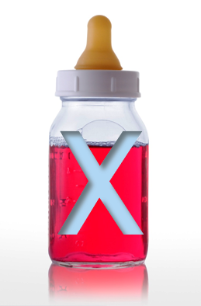
Juice
Lacks dietary fiber
Not creditable towards a reimbursable meal for infants
Notes:
Juice lacks the dietary fiber found in other forms of fruits and vegetables. When infants drink too much juice, they are more likely to experience diarrhea, abdominal pain, and other gastrointestinal problems. Additionally, juice may deter the infant from drinking water later in life.
Therefore, juice is no lot creditable as part of a reimbursable infant meal or snack.
<NEXT SLIDE>

Slide 18
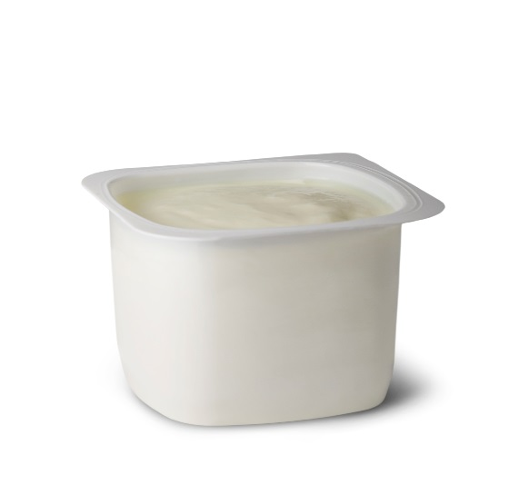
Meat/Meat Alternate
Notes:
Moving on to the meat/meat alternate component. Some common examples of meat/meat alternates include meats, yogurt, cheese, whole eggs, and cooked dry beans.
If eggs are served to infants, the whole egg should be served. Previously, there was a concern that the protein in egg whites may cause an allergic reaction. However, the AAP concluded that there is no convincing evidence to delay the introduction of foods that are considered major food allergens such as eggs. Therefore, the updated infant meal pattern requirements allow 0–4 tablespoons of whole eggs to credit toward a reimbursable meal.
With yogurt, although a great source of protein and probiotics, some yogurts have significantly more sugar than others. Exposing infants to high amounts of sugar early on can have a negative influence on eating habits. As a result, the updated requirements now limit the amount of sugar creditable yogurts may contain to promote healthy habits from the start. Yogurt must contain no more than 23 grams of sugars per 6 ounces to credit as part of reimbursable meal. When serving yogurt, serve 0–4 ounces during breakfast, lunch, or supper meals.
Next, 0–2 ounces of cheese and cottage cheese credits as a meat alternate. Some common examples of cheese may include shredded or sliced Swiss, Colby, and Monterey Jack. However, certain cheese items have significantly higher amounts of sodium than others. Eating too many foods high in sodium can lead to heart disease, stroke, and hypertension. Therefore, the updated infant meal pattern requirements disallow the service of cheese foods or cheese spreads for infant meals. It is important to note, cheese foods are still allowable for children and adults.
Non-creditable items may be identified by reading the product’s packaging for the wording “imitation cheese,” “cheese food,” or “cheese product” on the food label, such as:
cheese whips,
cheese with pimento, and
cream cheese.
A common cheese product that is not creditable is Kraft American Singles, if the packaging says “pasteurized prepared cheese product”
For more information on how to calculate the sugar content in yogurt, please refer to the Virginia Department of Health’s CACFP Child Meal Pattern training.

Slide 19
Grains
Serve 0-4 tbsp when developmentally ready
Breads, crackers, and ready-to-eat cereals: snack only
Grains must be enriched, fortified, or whole-grain rich
Notes:
The next food component for infants is grains. During the first year of life, grains, such as iron-fortified infant cereals, can be a great source of essential nutrients, such as B vitamins, zinc, and magnesium.
When infants are developmentally ready, serve 0–4 tablespoons of iron-fortified infant cereal for a reimbursable meal.
The updated infant meal pattern requirements allow breads, crackers, and now, ready-to-eat cereals to credit for snack meals only. Ready-to-eat cereals are often labeled breakfast cereals or just cereal. For the purpose of this lesson, we are going to call them breakfast cereals.
When choosing to serve breakfast cereals at snack, it must contain no more than 6 grams of sugar per dry ounce to be reimbursable, and must be enriched, fortified, or whole grain-rich.
The term whole grain-rich is a recent update to the meal pattern. These foods are 100% whole grains or at least 50% whole grain and the remaining grains are enriched. The child and adult meal patterns features a whole grain-rich requirements; however, it does not apply to infant meals or snacks. This means that infant meals do not require a whole grain-rich item, it is only a good practice to ensure infants are offered whole grains.
Similar to yogurt, there is a sugar limit for breakfast cereal. There are several ways to determine if a cereal meets the sugar requirements of no more than 6 grams total per dry ounce:
WIC Approved Breakfast Cereals List
Table Method
For more information on these methods, please refer to the CACFP Child Meal Pattern Training

Slide 20
Best Practices
Consider nutritional value of food
Feed on demand
Spoon fed, then feeding themselves
Notes:
It is a good practice to always consider the nutritional value of a food and how it contributes to the development of healthy eating habits when planning meals and snacks for infants. Likewise, serving infants nutritious foods as opposed to those high in fat, sugar, and calories, will help to establish the foundation for developing habits that can last a lifetime.
Along that line, please note that serving foods that are deep-fat fried on-site are not creditable for any age group within the CACFP.
Infants do not typically eat on a strict schedule and do not necessarily eat at traditional breakfast, lunch, or supper times. Rather, it is best to feed infants when they show signs of being hungry. This helps ensure that the infant gets the right amount of food for growth. This “on demand” feeding is considered better for the baby and is supported by USDA.
Providers should serve food from a pouch in the same way that it is served from a jar or plastic container, which is by using a spoon. Spoon-feeding is the most appropriate method for feeding pureed or mashed foods to infants. Infants benefit developmentally from the experience of eating from a spoon. Different tongue and lip motions are used for sucking than for eating from a spoon. Additionally, the American Academy of Pediatric Dentistry warns that sucking on baby food pouches may have the same negative effect as the practice of prolonged sucking of juice from bottles or sippy cups. Once infants are developmentally ready, they should also be encouraged to feed themselves.
<NEXT SLIDE>

Slide 21
Claiming Infants in the CACFP
Include infants on the master enrollment list (MEL)
AEF & IEF on file for each infant
Infant Parent Choice Form on file for each infant
Follow CACFP Meal Pattern
Take point-of-service meal counts
Infant Menus & cost documentation
Notes:
Let’s take a look at some of the requirements needed in order to claim infants:
To claim infants for the CACFP, child care centers or family day home providers must:
Include infants on their Master Enrollment List and have an AEF and IEF on file for each infant
Have an Infant Parent Choice Form on file for each infant
Follow the CACFP Infant Meal Pattern
Maintain Infant Menus and cost documentation
And, lastly, take point-of-service meal counts
This list is not an exhaustive list of recordkeeping requirements for your organization. Please refer to the Virginia Department of Health’s CACFP Recordkeeping training presentation for more information.

Slide 22
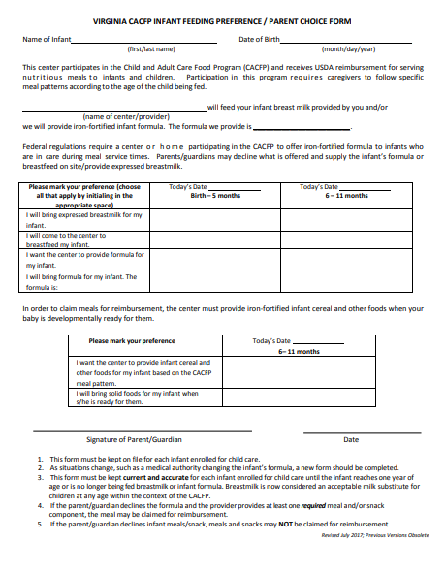
Infant Parent Choice Form
Notes:
Each Infant must have a completed Infant Parent Choice Form on file. The Infant Parent Choice Form is also referred to sometimes as the Infant Formula Choice Form.
This form indicates whether or not the child will receive expressed breastmilk from home, will be breastfed on site, or if they will consume the iron-fortified formula provided by the center.
This form also indicates if the center is to provide solids when the infant is developmentally ready, or if the parent/guardian will provide solids. In order to claim meals for reimbursement, the center must provide iron-fortified infant cereal and other foods when the is developmentally ready for them.

Slide 23
Documenting On-site Breastfeeding
No additional paperwork
Write on menu or meal count “Infant was breastfed on-site” or something similar
Notes:
You may be wondering, how do you document when a mother breastfeeds on-site or will this update pose additional paperwork? The great news about documentation and on-site breastfeeding is there are several ways to demonstrate compliance with this update.
It is not a requirement to measure and record the amount of breastmilk a mother breastfeeds her infant. You may simply write on the menu or meal count form:
“Infant was offered breastmilk”
“Breastfed on-site”
“Mother on-site”

Slide 24
Disabilities + Medical Statements
Must make reasonable accommodations for participants with a disability
Medical Statement is required when modifications do not meet the meal pattern
Notes:
Due to a disability, some infants may not be able to consume breastmilk or iron-fortified infant formulas, as well as other foods outlined in the meal pattern. In these situations, you must make reasonable accommodations.
In addition to working with your State agencies for making reasonable accommodations, there are two key policies memos that feature information on meeting the needs of infants requiring modified meals.
CACFP 14-2017 Modifications to Accommodate Disabilities in the Child and Adult Care Food Program and Summer Food Service Program
CACFP 06-2017 Feeding Infants and Meal Pattern Requirements in the Child and Adult Care Food Program; Questions and Answers
The link to these memos can be found on the VDH CACFP website
The medical statement is an essential tool for serving reimbursable meals to those requiring modifications. In many cases, disabilities can be managed within the meal pattern requirements when a well-planned variety of nutritious foods is available to participants. For example, an infant is allergic to apples; you could work with the parents to identify an alternative food, such as oranges. In these cases, a medical statement is not required for meal modifications that meet the meal pattern requirements.
However, a medical statement is required when the accommodation call for serving a specific food or an entire meal that does not meet the meal pattern requirements. For example, if an infant’s disability is an infant formula that is not iron-fortified, a medical statement is required for reimbursement. In these situations, request a written medical statement, signed by a State recognized medical authority, such as a physician, authorized to write medical prescriptions under State law (State recognized medical authority).
A medical statement should feature two key factors:
Enough information about the participant’s disability to allow you to understand how it affects their diet
Recommends alternate food items to ensure you know just what you can serve to the participant
Once you receive a medical statement, review it carefully to make sure that it provides the necessary information for meeting the needs of those requiring meal modifications. If it does not, request additional information to ensure you know how to best meet the needs of those requiring modifications. In addition, always keep all medical statements on file in your facility.
Please note that centers should not question disabilities.
<NEXT SLIDE>

Slide 25
Point-of-Service Meal Counts
Consistent with infant’s eating habits
Feed “on demand”
Not restricted to exact meal times
Notes:
Point of Service Meal counts look much different for infants than they do for children and adults.
Infants do not typically eat on a strict schedule and do not necessarily eat at traditional breakfast, lunch, or supper times. Rather, it is best to feed infants when they show signs of being hungry. This helps ensure that the infant gets the right amount of food for growth. This “on demand” feeding is considered better for the baby and is supported by FNS. Additionally, the quantity of food an infant consumes changes from feeding to feeding or day to day. Because of an infant’s varied eating pattern, centers and day care homes should be mindful of what the infant eats over the course of the entire day versus each individual feeding. As long as all the required food components (i.e., breastmilk and/or infant formula and the solid foods the infant is developmentally ready to accept) are offered over the course of the entire day, they may be counted towards reimbursable meals. Infant meals must not be disallowed due solely to the fact that foods are served outside of established meal time periods.
For example, if an infant was breastfed at home right before arriving at the center or day care home, the infant may not be hungry for the breakfast meal when he or she first arrives. The center or day care home may offer the meal to the infant later in the morning when the infant is hungry and still claim the breakfast meal. As another example, if an infant who is developmentally ready to eat pureed vegetables is not hungry for the pureed vegetables at lunch, then the pureed vegetables may be offered at another time during the day and the lunch meal may still be claimed for reimbursement. As a reminder, Program participants, including infants, do not need to consume the entire meal offered in order for the meal to be reimbursed.
<NEXT SLIDE>

Slide 26
Infant Menus
Standard Infant Menu
Individualized
Daily Activity Logs

Slide 27
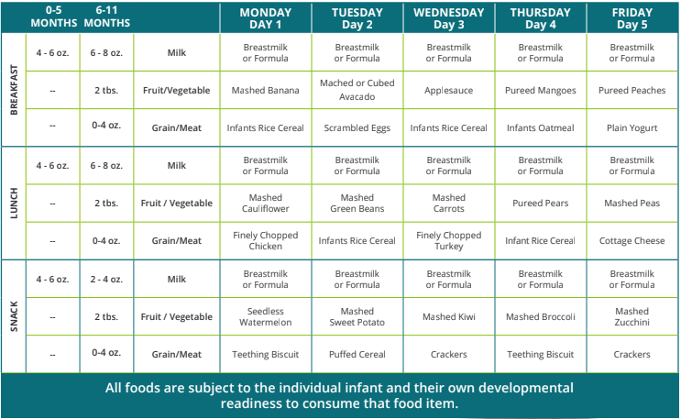
Sample Infant Menu
Notes:
Here is a sample cycle menu for infants, 6-11 months old. This was created by the National CACFP Sponsors Association. You’ll see here at the bottom, there is a note that indicates that all foods are subject to the individual infant and their developmental readiness.
To the left are the meal pattern requirements and components. The right columns are the days of the week. You’ll notice that the foods listed are the right texture and consistency for infants.
Please note this menu is missing the non-discrimination statement.

Slide 28
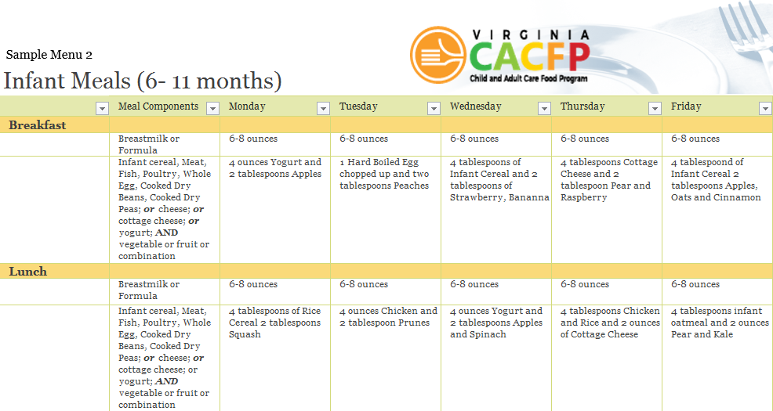
Sample Infant Menu Cont’d.
Notes:
Here is another sample cycle menu for Breakfast and Lunch for infants, 6 through 11 months old. This is set up a bit differently, as the serving sizes are listed next to the item being served

Slide 29
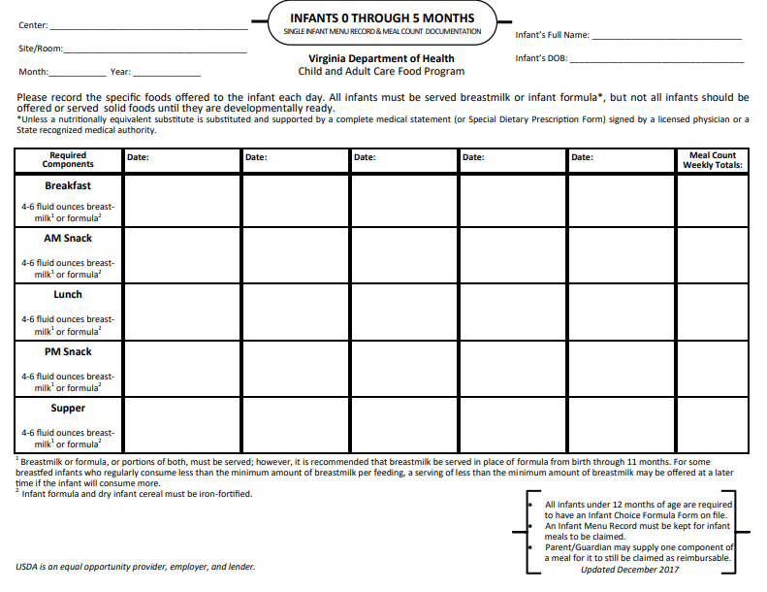
Sample Individualized Infant Menu
Notes:
Here is a sample individualized infant weekly menu. This is for 0 through the end of 5 months. The name of each infant is listed at the top, along with their birthday and center information. The meal pattern for this age group is on the left, and the total meal counts are listed on the right.

Slide 30
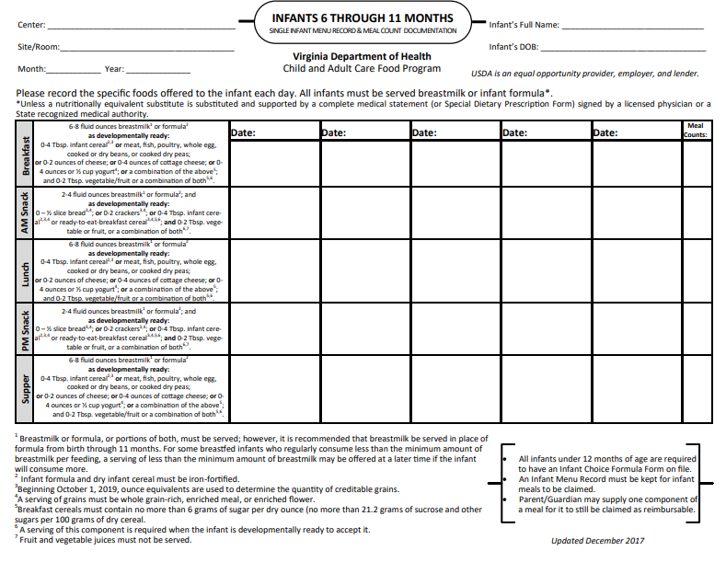
Sample Individualized Infant Menu
Notes:
This is the same Individualized Infant Menu, but for the 6 through 11 month age group. The meal pattern is still listed to the left. Centers and providers can list the foods offered for each day of the week.
If the Individualized Infant Menu method is used, centers and providers must keep copies of these menus on site.

Slide 31
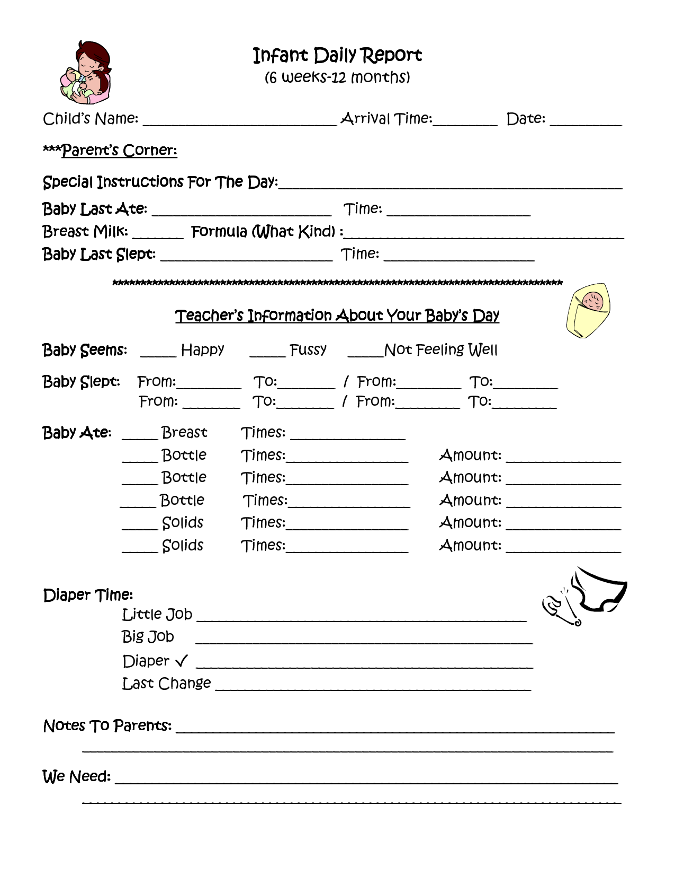
Sample Activity Log
Notes:
Here is a sample of an activity log for an infant. Many centers now choose to document these items electronically, most commonly with Apps. This is an acceptable means of documentation, as long as the information can be retrieved and pulled to be reviewed at a later date.

Slide 32
Breastfeeding Friendly Child Care
Notes:
This World Health Organization declaration is the foundational statement for our efforts. Human milk saves lives and establishes an opportunity for optimal life long health. Breastmilk protects infants from SIDS, asthma, ear infections, diarrhea, constipation, obesity, pneumonia, and cancer and improves the health of breastfeeding women. Lactation is a central part of the reproductive cycle of conception, pregnancy, and birth. Human milk is not only the ideal food for infants, but it is the only food that infants need for the first six months of life.
The World Health Organization, the American Academy of Pediatrics, the US Surgeon General and the Virginia Department of Health all recommend that infants receive Mother’s milk for at least the first full year to receive optimal health benefits.
So, what can Child Cares do to promote breastfeeding?

Slide 33
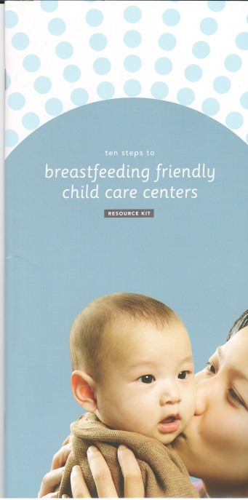
Order toolkit here:
http://www.vdh.virginia.gov/breastfeeding/breastfeeding-friendly-childcare-center-resource-kit-request-form/
Notes:
The Breastfeeding Friendly Child Care Center Tool kit a self guided resource to help Child Care providers adopt best practices to support breastfeeding families.
It is available on the VDH website for free
CLICK NEXT The toolkit can be ordered here: If you would like to have a copy, please fill out a request form.
The Virginia Department of Health collaborated with the Virginia Breastfeeding Coalition and Childcare Aware of Virginia to launch a statewide Breastfeeding Friendly Recognition Program. There are 5 Implementation Standards.

Slide 34
VA Breastfeeding Friendly Child Care Recgnition Program
Environment Standard
Family Support Standard
Infant Feeding Standard
Professional Development Standard
Breast Feeding Policy Standard
Notes:
The first standard in the VA breastfeeding friendly child care recognition program is the Environment Standard. Child cares meet this standard by having a culturally appropriate, breastfeeding-friendly environment that welcomes families
The next standard is the Family Support Standard. Centers meet this if Information about breastfeeding is provided to new mothers and family members. An example will be to post information about WIC and other Community Based Breastfeeding support groups. Every WIC office has a community resource list and we are happy to share them with our community partners. There are also huge numbers of many free online resources.
The third standard is the Infant Feeding standard. As we mentioned earlier, infants should be fed on-demand, and the program should communicate with parent/guardians about infant feeding preferences. Staff should be trained to watch the baby for feeding cues and signs of readiness—not the clock.
The fourth standard is the Professional Development Standard. All program staff who care for children ages 0-3 and at least one director/administrator will complete training in lactation to build the skills to support and promote breastfeeding.
The content must include:
The benefits of breastfeeding
Infant feeding in response to baby’s cues/paced bottle feeding
Promoting and supporting breastfeeding mothers/babies
Storage and handling of breastmilk*
Training on these topics can be found at the Better Kid Care or Go NAPSACC breastfeeding and infant feeding modules.
The last standard is the Breastfeeding Policy Standard. Centers/Providers can meet this standard if the program has a written policy that reflects support for breastfeeding mothers and families, that is shared with staff and families.
The written policy addresses the following:
A private space is available for breastfeeding mothers to use.
Staff will encourage and assist mothers to provide breastmilk to their children
Infants will be fed on demand, and mothers will be informed about child’s feeding preferences
Staff will be trained on breastfeeding support practices, and handling/storage of breastmilk.
Staff know the policy and it is available for reference.
The Virginia Breastfeeding Friendly Child Care Recognition Program is updating the Breastfeeding Friendly Child Care Tool kit and it will include a sample policy. Once you request a t

Slide 35
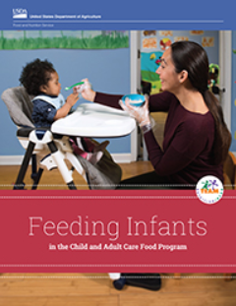
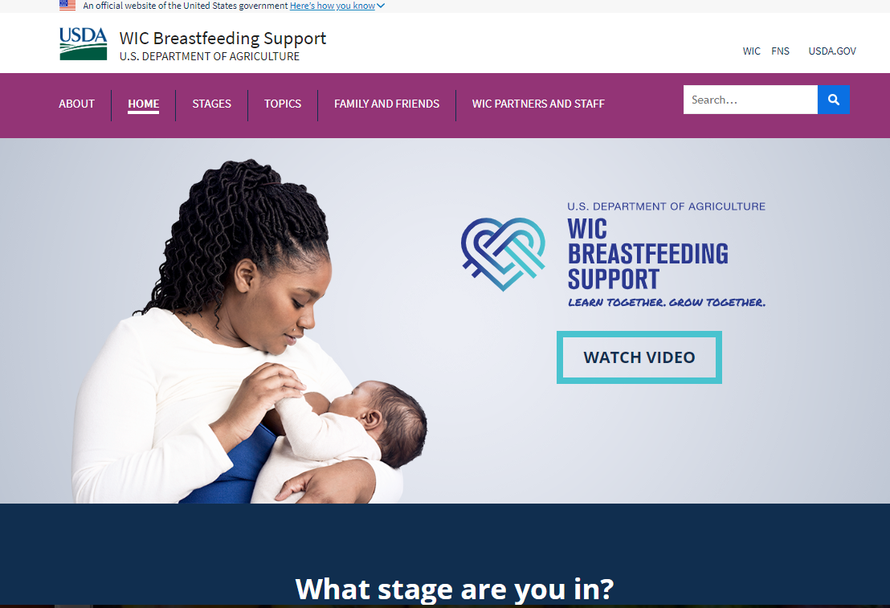
Resources

Slide 36
Questions? Contact Us!
CACFP@VDH.Virginia.Gov
(877) 618- 7282
Virginia Department of Health
Division of Community Nutrition
Special Nutrition Programs
109 Governors Street, 8th Floor
Richmond, Virginia 23219
This institution is an equal opportunity provider.
Notes:
Thank you for your time and attention during today’s training. If you have any additional questions or would like to share some resources you’ve found helpful during your operation of the CACFP, please share them at the contact information on the screen, or reach out to your assigned Specialist.

