Slide 1


Civil Rights Requirements
Guidance for Institutions Particpating in the Child and Adult Care Food Program (CACFP)
Notes:
Welcome to the Civil Rights Requirements training presentation, Guidance for Institutions Participating in the Child and Adult Care Food Program (CACFP).
CACFP participating organizations that receive federal financial assistance are required to comply with federal civil rights laws to ensure all participants have equal access to all benefits and services.
This training will provide you with the information you need to make sure your program is in compliance with these requirements.

Slide 2
Training Topics
Definitions: Civil Rights and Discrimination
Protected Classes
The 4 D’s
Components of Civil Rights Compliance
Public Notification
Outreach and Education
Reasonable Accommodations
Customer Service
Conflict Resolution
Complaint Procedures
Racial and Ethic Data Collection
Technical Assistance & Training
Notes:
In this training we will discuss the definition of discrimination and the components of civil rights compliance.
This training will help you demonstrate knowledge of Civil Rights requirements for the CACFP, it will help you develop and implement policies and procedures to ensure compliance with all USDA Civil Rights requirements, and it will ensure that the benefits of CACFP are made available to all eligible participants in a non-discriminatory manner.

Slide 3

What are Civil Rights?
Rights of individuals to receive equal treatment
…treatment of discrimination
Be free from unfair…
Guaranteed to all US citizens
Of the Constitution
14th Amendment
13th Amendment
Notes:
What are civil rights?
Civil rights are the rights of individuals to receive equal treatment and to be free from unfair treatment of discrimination.
These rights are guaranteed to all US citizens by the 13th and 14th amendments to the Constitution and by multiple Acts of Congress.

Slide 4

What is Discrimination?
The act of distinguishing one person or group of persons from others, either:
Intentionally;
By Neglect
By the actions or lack of actions based on a protected class.
Notes:
If civil rights are the rights of individuals to receive equal treatment and to be free from unfair treatment of discrimination, then what is the definition of discrimination?
Discrimination is defined as different treatment which makes a distinction of one person or group of persons from others
This can be done intentionally, by neglect, or by the actions or lack of actions based on a protected class.

Slide 5
Discrimination: “The 4 D’s“ Discrimination occurs when an individual or group of individuals are:
Delayed in receving benefits or services that others received
Denies benefits or services that others received
Treated Differently than others to their disadvantage
Given Disparate treatment
D
D
D
D
Notes:
How do you decide if an action is discriminatory? Using the 4D’s test can help determine if an action constitutes a civil rights violation.
Discrimination occurs when an individual or group of individuals are:
Delayed in receiving benefits or services that others received
Denies benefits or services that others received
Treated Differently than others to their disadvantage
Given disparate treatment—meaning given different treatment—this can be something that doesn’t seem discriminatory but has a discriminatory impact in practice.

Slide 6

Protected Classes
Race
Color
National Origin
Age
Sex
Disability
Notes:
Specific civil rights laws prohibit discrimination based on 6 protected classes. A protected class refers to any person or group of people who have a characteristic for which discrimination is prohibited by law.
Protected classes in the CACFP are:
Race, Color, National Origin, Age, Sex, and Disability

Slide 7
Examples of Discrimination: Scenario 1
A child care center does not provide infant foods and/or formula to infants in their care. Instead, they require parents to supply these items.
yes
Is this a Civil right issue?
Notes:
Let’s look at a few scenarios:
A child care center does not provide infant foods or formula to infants in their care. Instead, they require parents to supply these items. Is this a civil rights issue?
[click next slide] Yes. All children who attend a center must be provided equal access to the benefits of the CACFP, and this include infants. To withhold the program from an eligible age group is considered age discrimination.

Slide 8
Examples of Discrimination: Scenario 2
An adult day care facility has a large Asian population, which requests more culturally appropriate meals. The adult day care facility denies the request.
No
Is this a Civil right issue?
Notes:
In the next scenario:
An adult day care facility has a large Asian population, which requests more culturally appropriate meals. The adult day care facility denies the request. Is this a civil rights issue?
[click next slide] No. While the adult day care facility is encouraged to provide culturally appropriate meals, they are not required to provide them.

Slide 9
Examples of Discrimination: Scenario 3
A child care center asks their Spanish speaking participants to sit together at a Spanish-speaking table.
yes
Is this a Civil right issue?
Notes:
In the third scenario, a child care center asks their Spanish speaking participants to sit together at a Spanish-speaking table. Is this a civil rights issue?
[click next slide] Yes. Segregating children who share a particular characteristic into groups would be considered a civil rights issue and discrimination based on the protected class of national origin.
Organizations should also be aware of implied segregation. An example of this would be having an all-boy or all-girl table.

Slide 10
Examples of Discrimination
Refusing a participant’s enrollment based on disability
Failing to provide reasonable accommodations to disabled individuals
Serving meals at a time, place, or manner that is discriminatory
Selectively distributing applications
Failing to provide the same eligibility criteria to all participants
Notes:
A few examples of discrimination as it pertains to the CACFP are:
Refusing a participant’s enrollment based on disability
Failing to provide reasonable accommodations to disabled individuals
Serving meals at a time, place, or manner that is discriminatory
Selectively distributing applications Or
Failing to provide the same eligibility criteria to all participants
While not specifically related to Civil Rights, with the new CACFP Meal Pattern that just went into effect on October 1st of 2017, USDA clarified that food cannot be used as a reward or punishment

Slide 11
Components of Civil Rights Compliance
Public Notification
Outreach and Education
Reasonable Accommodations
Customer Service
Conflict Resolution
Complaint Procedures
Racial and Ethnic Data Collection
Technical Assistance and Training
Notes:
There are multiple components of civil Rights compliance.
These include Public Notification, Outreach and Education, Reasonable Accommodations, Customer Service, Conflict Resolution, Complaint Procedures, Racial and Ethnic Data Collection, and Technical Assistance and Training.
We will now review each specific component of Civil Rights Compliance, starting with Public Notification.

Slide 12
Components of Civil Rights Compliance:
Public Notification
Notes:
The first component of civil rights compliance is public notification.

Slide 13
Public Notification Components
Program Availability
Public media statement required annually to ensure access and knowledge of program
Complaint Information
Advise of right to file complaint
Non-Discrimination Statement
Required on all materials
Procedures for filing complaint
Notes:
All sponsors who operate the CACFP must notify the public annually of their participation in the program. This is done through announcing program availability, providing complaint information, and communication of the non-discrimination statement.
With program availability, each agency must take action to inform potentially eligible persons of their program rights. Sponsors are required to make public, via public announcement, their program availability. This is why sponsoring and independent organizations are required to release a media statement each year with a list of locations where CACFP services are provided. This practice ensures all qualifying members of your community have access to, and knowledge of, the program.
Regarding complaint information, applicants and participants must be advised at the service delivery point of their right to file a complaint and the complaint process. This information is listed on the And Justice for All poster.
With the non-discrimination statement, institutions must communicate the non-discrimination statement on all CACFP materials.
A Civil right assurance statement must be incorporated in all agreements between CACFP sponsors and their sub-recipients. (FNS Instructions 113-1, Appendix B(D)(2) and form FNS-74

Slide 14
Public Notification Methods
Make program information available to public
Convey message of equal opportunity in all pictures and other graphics used to provide program information
Provide appropriate information in alternative formats for persons with disabilities and in appropriate language(s)
Include non discrimination statement on all informational material provided to the public
Prominently display “And Justice for All” poster; and, for programs serving children, the “Building for the Future” poster
Notes:
There are multiple methods organizations should use when notifying the public. Organizations should ensure they:
Make program information available to the public—this is by announcing program availability through their yearly public release statement, or by conducting outreach to inform potentially eligible applications about the program
Organizations should convey a message of equal opportunity in all pictures and other graphics when providing program information.
Organizations must also provide information in alternative formats available for those with disabilities. Often, there are public libraries or people in the community who can provide this service for free.
CACFP participating organizations must include the non-discrimination statement on all informational material provided to the public. We’ll review a list of materials later in this training.
And, as mentioned earlier in the training, organizations must prominently display the “And Justice for All” poster. Programs serving children are also required to display the “Building for the Future” poster, which can also be found in the Download Forms section of CHAAMPS.

Slide 15
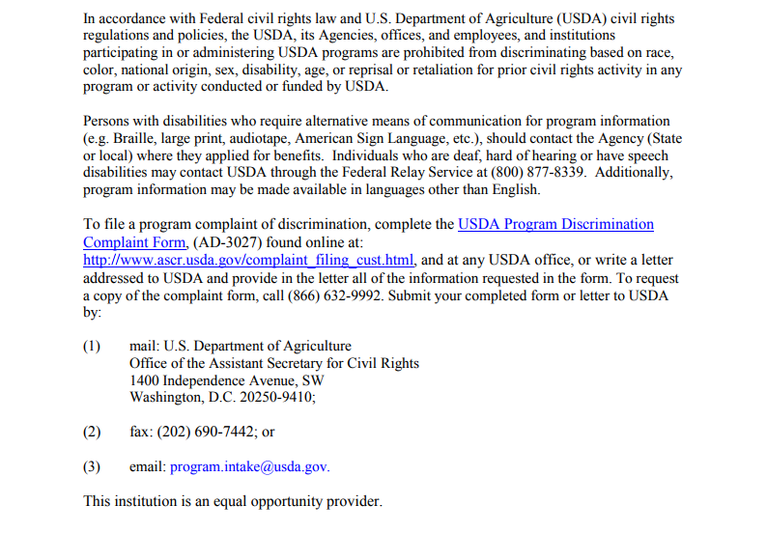
Non-Discrimination Statement
Institutions are required to use the following language on ALL informational materials:
Notes:
The most recent non-discrimination statement was updated in November 2015. All materials mentioning the CACFP must include this statement
Examples of Informational Materials include anything related to the CACFP. This includes menus, enrollment forms, employee handbooks, brochures, parent/student handbook, newsletters, flyers, print or broadcast advertisement, and websites. If the CACFP is mentioned in any way on your website, the non-discrimination statement should be included on your website.

Slide 16
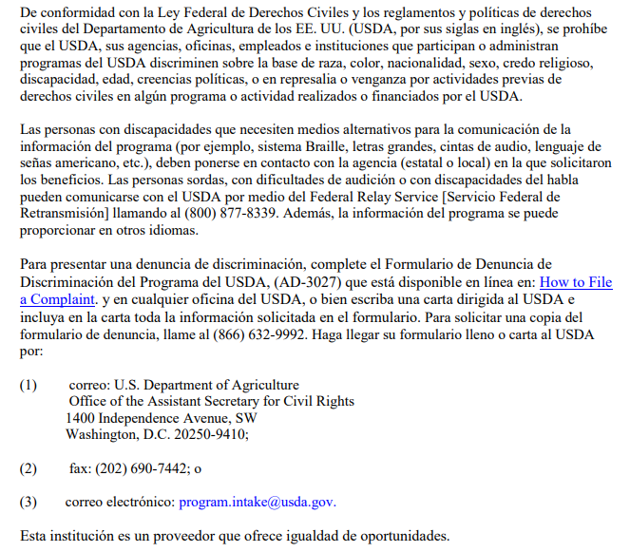
Non-Discrimination Statement (Spanish)
Notes:
The most recent non-discrimination statement was updated in November 2015. All materials mentioning the CACFP must include this statement
For more languages please visit https://www.fns.usda.gov/cr/fns-nondiscrimination-statement

Slide 17

Non-Discrimination Statement
If the material or document is too small* to permit the full statement to be included, at a minimum, the following statement MUST be included:
This institution is an equal opportunity provider.
* One 8 ½ x 11” page, front and back or less
Notes:
If the material or document is too small to fit the full statement from the previous slide, the material MUST include the statement that reads “This institution is an equal opportunity provider and employer”
Sponsors CANNOT use the name of the sponsor in place of the words “this institution” in the short non-discrimination statement. The statement must read exactly as stated “This institution is an equal opportunity provider and employer.”
The statement must be on the front page, unless the document goes to the back of the page.

Slide 18
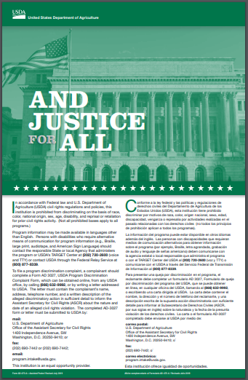
“And Justice for All” Poster
Required at each site
Posted in a prominent public location
Notes:
The green And Justice for All poster is the most up-to-date version of the poster—the one with the picture of the USDA building on it. The green And Justice for All Poster with the Statue of Liberty on it is now out of date as of September 2019. Each CACFP participating organization is required to have this And Justice for All poster posted in a prominent public location for all to view, such as a lobby, cafeteria or as a best practice, both. If your organization has a different And Justice for All poster, the green poster with the USDA building image can be found in the Download Forms section of CHAAMPS, or you can send a request to the Department of Health by emailing the CACFP mailbox at cacfp@vdh.Virginia.gov

Slide 19
Components of Civil Rights Compliance:
Outreach and Education
Notes:
The next component of civil rights compliance is outreach and education, which closely aligns with public notification.

Slide 20





Outreach and Education
Reach as many potential children as possible
Ensure program access
Identify and pay particular attention to under-represented groups
Include the required nondiscrimination statement on all publications, web sites, posters, and informational materials
When using graphics, reflect diversity and inclusion
Notes:
The purpose of outreach and education is to reach as many potential participants as possible and to ensure program access.
Additionally, organizations should ensure they are representing all members of the community, especially under-represented groups.
As mentioned earlier, organizations must include the required nondiscrimination statement on all CACFP materials, and, when using graphics, reflect diversity and inclusion.

Slide 21
Components of Civil Rights Compliance:
Reasonable Accomodations
Notes:
The next component of civil rights compliance is providing reasonable accommodations.

Slide 22



Reasonable Accommodations: Disability
Provide facilities for participants with disabilities
Provide appropriate information in alternative formats for persons with disabilities
Provide food substitutions for students with disabilities when documented in writing by a licensed physician
Notes:
As part of civil rights compliance, CACFP participating organizations are required to provide reasonable accommodations for persons with disabilities.
Organizations must provide facilities for participants with disabilities. For example, having accessible entrances and exits, or making alternative arrangements for service
Additionally, organizations must provide appropriate information in alternative formats for persons with disabilities. For example, braille program materials—resources for this might be available from local organizations in your area, including your local library
And lastly, organizations must also provide food substitutions for participants with disabilities when documented in writing by a licensed physician. The Medical Statement from the licensed physician must be kept on file, and documentation should include appropriate food alternatives for the participant. For more information on the Special Dietary Prescription Form, please see the Virginia Department of Health’s recordkeeping training presentation.

Slide 23
Reasonable Accommodations: Disability
Any person who has a physical or mental impairment which substantially limits one or more major life activities, has a record of such an impairment, or is regarded as having such an impairment
Sponsors should never question a participant’s disability
Notes:
The Americans with Disabilities Act of 2008, or the ADA, defines a person with a disability as a person who has a physical or mental impairment that substantially limits one or more major life activities, has record of such an impairment, or is regarded as having such an impairment.
Major life activities means function such as caring for one’s self, performing manual tasks, walking, seeing, hearing, speaking, breathing, learning and working.
Examples of impairment /conditions include, but are not limited to: Orthopedic/visual/speech/hearing impairments, cerebral palsy, heart condition, food anaphylaxis, mental retardation, emotional illness, drug addiction/alcoholism, HIV, autism, traumatic brain injury, epilepsy, muscular dystrophy, multiple sclerosis, cancer, specific learning disabilities, and diabetes
USDA recently released a memo reminding CACFP participating organizations to not question a participant’s disability, as the ADA very broadly defines “disability.”

Slide 24
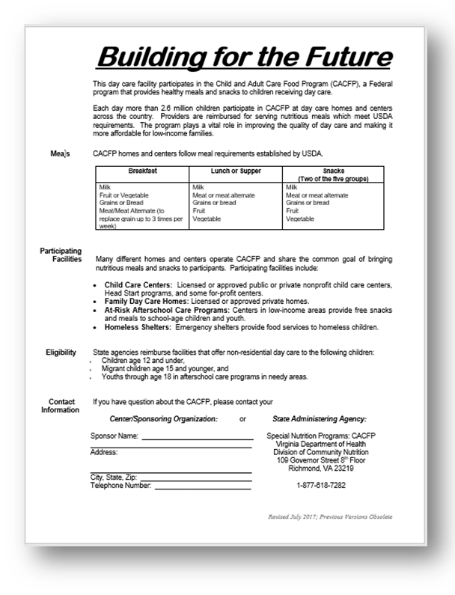
“Building for the Future” Flyer and Poster
Notes:
Programs serving children are also required to display the “Building for the Future” poster, which can also be found in the Download Forms section of CHAAMPS. The flyer in CHAAMPS is a Word document, and allows for the organization to list contact information at the bottom. The poster on the right can also be displayed
Please note that Adult Day Care Centers do not have to display the “Building for the Future” poster.
Each CACFP participating organization is required to have this posted in a prominent public location, such as a lobby, cafeteria or as a best practice, both. For more information regarding the poster, please send a request to the Department of Health by emailing the CACFP mailbox at cacfp@vdh.Virginia.gov

Slide 25



Reasonable Accommodations: Limited English Proficiency (LEP)
Upon request, make information available about program eligibility, benefits, services, and procedures for filing a complaint, in English and/or in the appropriate translation
If needed, the use of alternative means of communication is required
Notes:
A person with Limited English Proficiency, or LEP, is defined as someone who does not speak English as their primary language and has a limited ability to read, speak, write, or understand English
Recipients of federal financial assistance (such as CACFP participating organizations) have an obligation to reduce language barriers that can preclude meaningful access by LEP persons to important benefits, programs, information, and services.
Upon request, organizations should make available to the public, participants, and potential participants information about program eligibility, benefits, services, and procedures for filing a complaint, in English and/or in the appropriate translation
If needed, organizations must use alternative means of communication as required. Examples of this include Braille, large print, or audiotape.
For individuals with limited English Proficiency, sponsors should make available all CACFP documentation in the appropriate translation upon request.
The Limited English Proficiency division of USDA promotes a positive and cooperative understanding of the importance of language access to federally assisted programs. Please visit LEP.gov for more information.

Slide 26
Components of Civil Rights Compliance:
Customer Service
Notes:
The fourth component of civil rights compliance is Customer Service.

Slide 27
Customer Service
Equal apportunity provided to participate
Equal treatment provided for all participants
Regardless of race, color, national origin, sex, age, disability, or sexual orientation
Notes:
To operate the CACFP in compliance with Civil Rights, all participants must be allowed equal opportunities to participate in the CACFP regardless of race, color, national origin, sex, age, or disability.
Additionally, all participants must be treated in the same manner. Examples of this include seating arrangements, serving lines, services and facilities, assignment of eating periods, and methods of selection for application approval processes.

Slide 28
Components of Civil Rights Compliance:
Conflict Resolution
Notes:
The next component of Civil Rights compliance is conflict resolution.

Slide 29

Conflict Resolution
Alternative Dispute resolution (ADR) Program:
Use of a neutral third party to resolve informally a complaint of discrimination through use of various techniques
For more information:
https://www.fas.usda.gov/about-fas/civil-rights/complainants-notification-rights
Notes:
USDA recommends using an Alternative Dispute Resolution program for conflict resolution, by using a neutral third party to informally resolve complaints of discrimination. Various techniques include fact finding, mediation, peer panels, and facilitation.

Slide 30
Components of Civil Rights Compliance:
Complaint Procedure
Notes:
The sixth component of Civil Rights compliance is complaint procedure.

Slide 31

Complaint Procedure
A Civil Rights Complaint Form must:
Sponsors are required to:
develop and implement a written procedure to handle any discrimination complaint that may be received
be readily available at all sites
Every effort must be made to assist a complainant and make reasonable accommodation for complainants with a disability
Notes:
Each CACFP participating institution is required to develop and implement a Civil Rights Complaint Procedure for handling any discrimination that is received.
Within the full USDA Civil Rights statement, there is a link to the online fillable complaint form.
Complaints do NOT have to be in writing. They can be made verbally as well.
If the form is returned to the sponsor, the sponsor is required to forward the form to the USDA within 3 working days.
As mentioned, the Civil Rights Complaint Form can be found linked to the full USDA Civil Rights statement. Your organization can also print a few forms to have them on Site. Either way, the form must be readily available at all sites.
If a complainant needs assistance with filing a complaint, or needs reasonable accommodations, sponsors must make every effort to assist
Disseminate a Civil Rights Complaint Form (http://www.ocio.usda.gov/sites/default/files/docs/2012/Complain_combined_6_8_12.pdf)

Slide 32


Complaint Procedure
A complaint of unequal treatment may be:
Verbal
In writing
Observed
Notes:
There is no one way to discriminate, and discrimination can happen in various ways.
A complaint of unequal treatment may be verbal, in writing, or even observed.

Slide 33
Complaint Procedure: Process
Complaint filed within 180 days*
Complaint documented in complaint Log
Complaint submitted to USDA within 3 days
* Waver may be granted under certain circumstances
Notes:
Every CACFP participating institution must have a process in place to document and submit civil rights complaints. The process should include the positions responsible for each action item and the time frame for filing complaints.
A complaint can be filed within 180 days of the alleged discriminatory action. A waiver of the 180 day filing deadline may be granted for the following reasons:
(1) the discriminatory act could not reasonably be expected to be known within the 180-day period
(2) illness or incapacitation
(3) the same complaint was filed with another Federal, state, or local agency
(4) any other basis determined by the Director of the Office of Adjudication
All complaints must be documented in the Civil Rights Complaint Log
Then, the complaint must be submitted to USDA within 3 days.
Complaints can be sent to the following mail address, fax, or email. This information is included in the full USDA non-discrimination statement.
To file a complaint of discrimination:
(1) mail: U.S. Department of Agriculture
Office of the Assistant Secretary for Civil Rights
1400 Independence Avenue, SW
Washington, D.C. 20250-9410;
(2) fax: (202) 690-7442; or
(3) email: program.intake@usda.gov

Slide 34
Complaint Procedure: Record Retention
Keep Complaint Log on site
Complaint Log must be dated and kept current for 3 years plus the current year, even if no complaints have been received
Notes:
With regards to record retention, all Sponsors are required to maintain a CACFP Civil Rights Complaint Log on site. All complaints must be documented in the log. If there are no complaints for the year, sponsors should document that no complaints have been received in the log at the end of the year.
The log must be dated and kept current for 3 years plus the current year, even if no complaints have been received
If no complaints have been received, sponsors should document “no complaints received” in the Log at the end of the fiscal year

Slide 35
Components of Civil Rights Compliance:
Racial and Ethnic Data Collection
Notes:
The next component of Civil Rights compliance is racial and ethnic data collection

Slide 36
Racial and Ethnic Data Collection
Ensures programs are reaching all potentially eligible children
Used to guide outreach
Collected annually
Maintained on file
Notes:
Annually, Sponsors are required to collect the racial and ethnic data of their participants and maintain that data on file. Sponsors are required to compare this data with the racial and ethic data of the area from which is draws its participants. This is to ensure programs are effectively reaching all potentially eligible children, and determine where outreach may be needed.
During Administrative Reviews, the Virginia Department of Health confirms that this information is collected annually. Additionally, this information is currently required during the yearly recertification period in the Sponsor Application of CHAAMPS.
The Racial and Ethnic Data Collection Form can be found in the Download Forms section of CHAAMPS

Slide 37
Racial and Ethnic Data Collection
Ethnic Data
Mark One
Hispanic or Latino
Non-Hispanic or Non-Latino
Racial Data
Mark One or More
American Indian or Alaskan Native
White
Asian
Black or African American
Native Hawaiian or Pacific Islander
Notes:
Centers that participate in any FNS program like the CACFP, must have a system to collect the racial and ethnic data of its program participants in accordance with FNS policy. As stated earlier, the data is used to determine how effectively these programs are at reaching potential eligible participants and to help identify areas where additional outreach is needed.
There are two distinct ethnic categories: Hispanic or Latino OR Not Hispanic or Latino.
There are six racial categories: American Indian or Alaskan Native, Asian, Black or African American, Native Hawaiian or Other Pacific Islander, and White.
Definitions of racial categories include:
American Indian or Alaskan Native- A person having origins in any of the original peoples of North America (including Central America), and maintains tribal affiliation or community attachment.
Asian-A person having origins in any of the peoples of the Far East, Southeast Asia, or the Indian subcontinent, including, Cambodia, China, India, Japan, Korea, Malaysia, Pakistan, the Philippine Islands, Thailand, and Vietnam.
Black or African American –A person having origins in any of the black racial groups of Africa.
Native Hawaiian or Other Pacific Islander- A person having origins in any of the original peoples of Hawaii, Guam, Samoa, or other Pacific Islands.
White-A person having origins in any of the original peoples of Europe, the Middles East, or North America.
Racial and ethnic data is typically collected on the enrollment form used by a child or adult care center, although this is not required. Parents or a family member or guardian of a participant are asked to identify the racial and ethnic group of the participant after it has been explained that the collection of this information is strictly for statistical reporting requirements and has no effect on the determination of their eligibility to receive program benefits. The person who completes the form is asked to self-identify or self-report the racial and ethnic make-up of the participant. They must be offered the option of selecting one or more racial categories and only one of the two ethnic categories.
Organizations should document this information on the Civil Rights Data Collection Form. A template of this form can be found in the Download Forms section of CHAAMPS.
Please keep in mind that racial and ethnic data is considered private data – be sure to maintain the data in a confidential file and do not use the data for non-civil rights purposes.

Slide 38

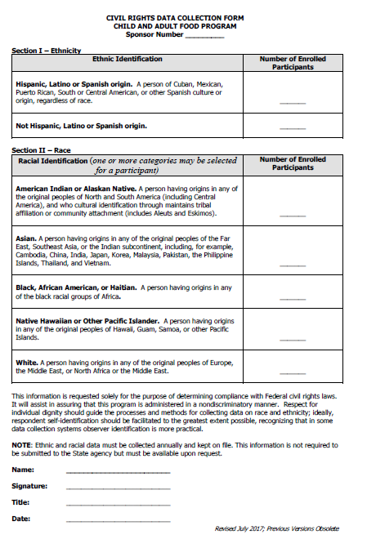
Racial and Ethnic Data Collection
Civil Rights Data Collection Form
Notes:
Organizations should document this information on the Civil Rights Data Collection Form. This form breaks down the total number of enrolled participants by ethnicity and race. A template of this form can be found in the Download Forms section of CHAAMPS and is titled Racial and Ethnic data collection form. This form should be completed on an annual basis.
Please keep in mind that racial and ethnic data is considered private data – be sure to maintain the data in a confidential file and do not use the data for non-civil rights purposes.

Slide 39
Racial and Ethnic Data Collection
Information provided from participants should not be changed or challenged
It is optional for participants to provide racial and ethnic information. If participant/family choose not to provide, use the following methods:
Visual identification
Personal knowledge, records, other available documentation
Notes:
A few notes regarding racial and ethic data collection:
If a self-declaration of ethnicity and/or race is made by a participant, data collectors can not second guess, change, or challenge this information unless the declaration is blatantly false.
As mentioned earlier, the Racial and Ethnic Data Collection Form can be found in the Download Forms section of CHAAMPS
Participants are not required to provide you with their ethnicity or race. However, according to the USDA CACFP participating organizations are still required to obtain this information. In order to do this organizations may use one of the following two methods:
Visual determination by a staff person or sponsor
Personal knowledge, records, or other documentation the institution possesses that identifies household racial/ethnic data

Slide 40
Racial and Ethnic Data Collection: Scenario
A family does not wish to identify their race or ethnicity on their Annual Enrollment Form used by the center to collect racial/ethnic data.
What should the Center staff do?
Notes:
Here is a scenario: A parent does not want to identify their child’s race or ethnic background on the enrollment form used by the center to collect racial/ethnic data. What should center staff do?
Staff should explain to families that identification is voluntary. Center staff can explain that the collection of this information is strictly for statistical reporting requirements and has no effect on the determination of their eligibility to receive program benefits.
Program applicants or participants are not required to provide information on their race or ethnicity. When an applicant or participant does not provide this information, the data collector must, through visual observation or prior personal knowledge, records, or other available documentation, make the racial/ethnic determination.

Slide 41
Components of Civil Rights Compliance:
Technical Assistance and Training
Notes:
The last component of civil rights compliance is technical assistance and training.

Slide 42
Technical Assistance and Training
Civil Rights training required annually for ALL staff
Training Topics
Defining discrimination
Collecting/recording ethnic and racial data
Where to display posters
Defining a civil rights complaint
Procedures for handling a civil rights complaint
Notes:
All CACFP participating organizations and staff who administer OR have contact with program applicants and participants must receive civil rights training. This training must occur annually. New employees must be trained prior to assuming their duties.
Training topics should include:
Defining discrimination
Collecting/recording ethnic and racial data
Where to display posters
Defining a civil rights complaint
Procedures for handling a civil rights complaint

Slide 43
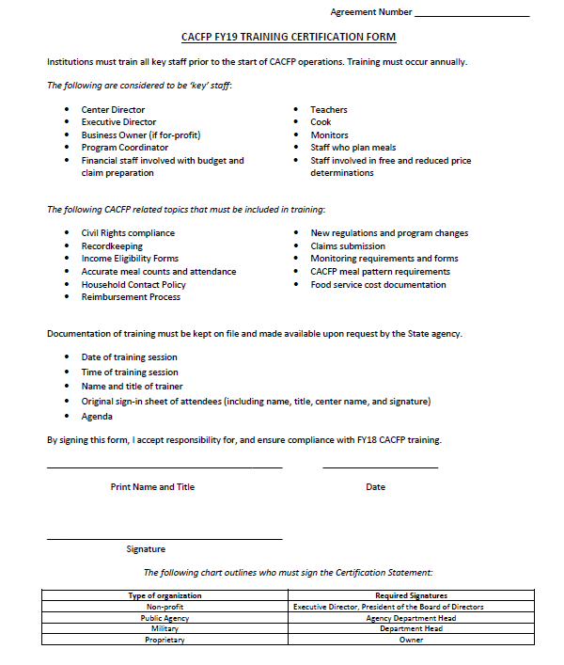
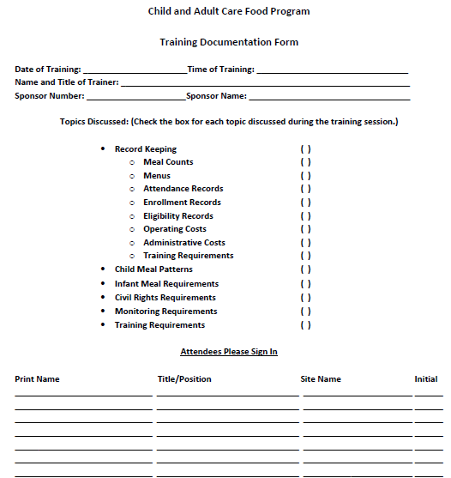
Training Documentation
Date
Time
List of Topics Discussed
Name and Title of Trainer
Names of Attendees*
Notes:
Similar to all other trainings for the CACFP, organizations must retain records of the annual civil rights training that is conducted.
Documentation of training should include the date and time of the training, the name and title of the trainer, a list of topics discussed, and the names and signature of the training participants.

Slide 44
Any Questions?
CACFP Mailbox: cacfp@vdh.virginia.gov
CHAAMPS: https://www.vdh.virginia.gov/CHAAMPS/Splash.aspx
Website: http://www.vdh.virginia.gov/child-and-adult-care-food-program
Help Desk: 877.618.7282
Virginia Department of Health
Division of Community Nutrition
Special Nutrition Programs
109 Governor Street, 8th floor
Richmond, Virginia 23219
This institution is an equal opportunity provider.
Notes:
This concludes the Civil Rights training for CACFP participating organizations. More information on Civil Rights compliance can be found in the FNS Instruction 113-1 titled “Civil Rights Compliance and Enforcement – Nutrition Programs and Activities”
For questions or guidance related to this training, please contact us by calling the Helpdesk at 877-648-7282 or by emailing the CACFP Email box at CACFP@vdh.Virginia.gov

Slide 45
Thank You!
Notes:
Thank You for participating in the USDA Civil Rights and Special Nutrition Programs, Guidance for Institutions Participating in the Child and Adult Care Food Program (CACFP) training presentation.
We hope that this training provided you with the information you need to make sure your program is in compliance with these requirements.

