Slide 1


Income Eligibility & Annual Enrollment Forms
Guidance for Institutions Participating in the Child and Adult Care Food Program
Notes:
Welcome to the Income Eligibility and Annual Enrollment Forms for Child Care Centers presentation—Guidance for Institutions Participating in the CACFP
This training is designed to help you complete the Annual Enrollment Form (known as AEF) and the Income Eligibility Form (known as IEF) to be in compliance with CACFP program regulations. We will mainly be focusing on Annual Enrollment Statements for child care centers, however we will mention specific difference to adult enrollment statements.
Please note, for specific requirements for your individual program, including whether or not the AEF and IEF are required for your program, please refer to the Recordkeeping presentation.

Slide 2
Training Topics
Annual Enrollment Form (AEF)
Requirements
Step-by-step instructions for completion
Income Eligibility Form (IEF)
Requirements
Parent letter
Step-by-step instructions for completion
Eligibility types and classifications
Notes:
In this presentation, we will review the Annual Enrollment Form (or AEF) requirements and how to complete the form.
We will also review the IEF requirements, how to complete the form, and eligibility types and classifications.

Slide 3
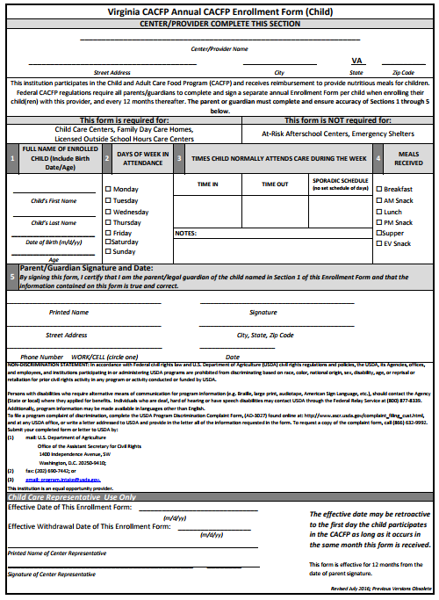
Annual Enrollment Forms (AEFs)
Complete annually
Separate forms for each child enrolled
All sections must be completed
If mistakes are made, a new form must be completed
Notes:
The Annual Enrollment Form (or AEF) is a form that lists participant information and used to enroll a participant in the CACFP. This form must be completed for each participant annually by a parent or guardian. Each individual participant must have an enrollment form on file in order to claim reimbursement for meals served.
While the Virginia Department of Health (or VDH) has its own enrollment form, CACFP participating organizations are not required to use this specific form. If CACFP participating organizations choose not to use this form, they must ensure that their own enrollment form includes all of the same information listed on VDH’s AEF, including the whole nondiscrimination statement.
To have a valid AEF, all sections must be complete and accurate. A completed form is valid up to one year after the dated signature.
To find this AEF template, please go to the Download Forms section of CHAAMPS.

Slide 4
Annual Enrollment Forms (AEFs)
Center information may be completed by center representative
Sections 1-5 must be completed by parent/guardian of child being enrolled
Effective date and signature completed by center representative
Notes:
Now let’s review how to complete an AEF:
(click) The center information can be completed by a center representative or by the parent or guardian.
(click) Sections 1-5 MUST be completed by the parent or guardian of the child being enrolled. Centers representatives CANNOT complete any of these sections. If the center completes any of the information in sections 1-5 the AEF will be deemed invalid.
(click) Once the parent or guardian of the participant has completed sections 1-5, the center representative can complete the bottom portion, which includes the effective date and name and signature of center representative.

Slide 5
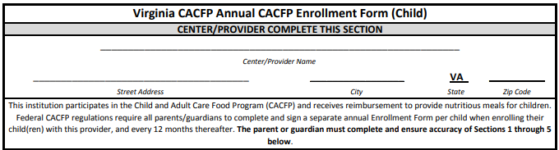
AEF Completion - Center
Center Information
Indicate center name and address
Notes:
(say) zooming in and going piece by piece. The center information may be completed by the center representative. These top two lines should indicate the center name and address.
[Slide]

Slide 6
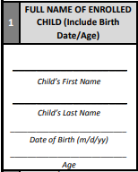
AEF Completion – Parent/Guardian
Section 1
First & last name = Enrollment Roster
Date of Birth
Age of Participant
Notes:
Sections 1-5 must be completed by the Parent or guardian of the enrolled participant.
Let’s look at section one:
This should list the full name of the enrolled child. Each child should have their own form. Indicate the child’s date of birth, and their age.
[Slide]

Slide 7
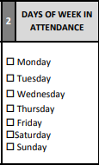
AEF Completion – Parent/Guardian
Days of Week in Attendance
Indicate each day of the week the child will attend
Notes:
Section two lists the day of the week the enrolled child usually attends.
[Slide]

Slide 8
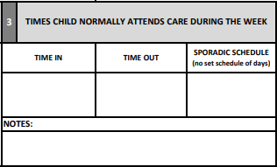
AEF Completion – Parent/Guardian
Hours in Attendance
Indicate times that the child will be dropped off and picked up; OR
“Sporadic Schedule” may be indicated if hours are inconsistent
Notes:
Section three should indicate the times that the child is typically checked in and checked out. If the child has hours that are inconsistent, “sporadic schedule” may be checked and “time in” and “time out” do not need to be indicated.
If there are any notes the parent or guardian wishes to include, they can list those notes in this section.
[Slide]

Slide 9

AEF Completion – Parent/Guardian
Meals Received
Indicate each meal the child will receive at the center
Notes:
Section four includes meals that are received. The parent or guardian should check each meal that their child will receive at the center.
[Slide]

Slide 10
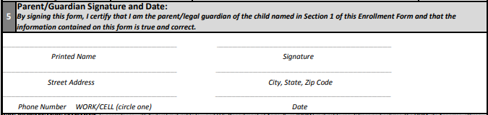
AEF Completion – Parent/Guardian
Signature and Date
Parent/Guardian must:
Print and sign name
Indicate address and phone number
Indicate date of completion
Notes:
Section five is the parent or guardian signature and date. The parent or guardian should print and sign their name, and list their home address, provide their phone number, and date the form. Each of these items can ONLY be completed by the parent or guardian. Centers are not allowed to complete any of the items in sections 1 through 5.

Slide 11
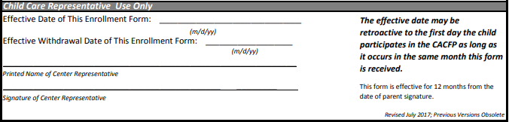
AEF Completion - Center
*Note: Effective date may be retroactive to the first day the child participates in the CACFP as long as it occurs in the same month the form is signed
Effective Dates and Signature
Indicate effective date of form*
Indicate withdrawal date (when applicable)
Signature and date of center representative
Form is effective for 12 months from the date of parent/guardian signature
Notes:
The child care representative should complete the bottom section. They should list the effective date, which may be retroactive to the first day the child participated in the CACFP, as long as it occurs in the same month as the form is received.
The center representative should then print their name and sign the form.
If the participant withdrawals from the program, the withdrawal date should be listed at the bottom of the form. This line will be blank unless the child is no longer a participant of the program. Once the participant withdrawals from the program, meals can no longer be claimed for that participant.
As mentioned previously, the AEF is effective for 12 months from the date of the parent or guardian signature.
Once this form is complete, it should be kept on file in your records.
[Slide]

Slide 12
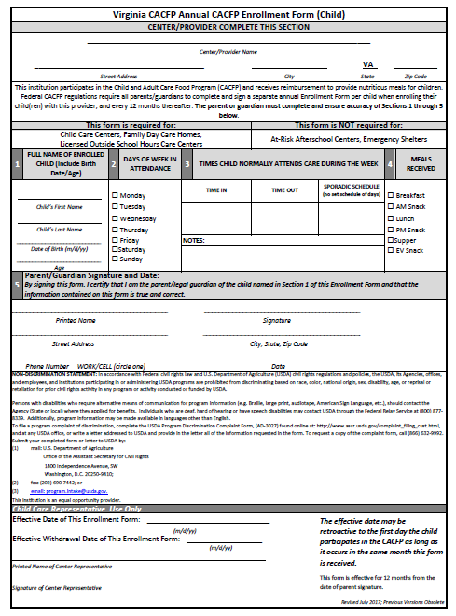

Common Deficiencies
Incomplete
Expired
Not on File
REMEMBER: Meals for a participant without a valid enrollment form or with an expired enrollment form are not claimable.
Annual Enrollment Errors (AEF)
Notes:
(say) We’ve just covered the steps in completing an enrollment form. (click) Now let’s touch on the most common deficiencies noted during a Program review related to enrollment forms.
(say) Forms are incomplete, missing a child or participants full name… or have multiple participants per form. Or the parent will fill out the whole form… then forget to sign.
(click)
(say) The form is expired, or what’s even worse.. It’s current but the parent/guardian dated it incorrectly.
(click)
(say) The ever elusive case of the missing form! There hasn’t been a form collected, or the staff needs additional training on the internal processes and procedures for collection and maintenance.
(click)
(say) or, we’ll see that the there are multiple participants per form.
[Slide]

Slide 13
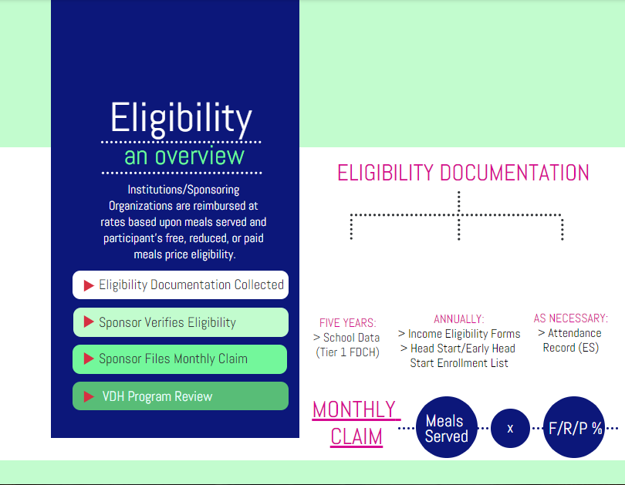



Notes:
(say) Before getting into Income Eligibility Forms, I want to do a quick overview of why exact these forms are important.
(say) Your organization is reimbursed at rates based upon meals served and participant’s free, reduced, or paid eligibility. The monthly F/R/P percentage is multiplied by the total meals served (by site) to determine the monthly claim for reimbursement. Prior to submitting a claim, you’ve certified that this information is current and correct. That’s why it’s so important to have practiced standard operating procedures set in place with adequate edit checks.
(say) On the left side of the screen, I’ve outlined how eligibility documentation is verified. The site (or sponsor if you’re a FDCH sponsor and you’re provider has elected for the sponsor to collect eligibility documentation) collects the documentation annually. Depending on your organization’s processes, it’s categorized at the site level and re-verified at the sponsor level or it’s categorized and re-verified at the sponsor level… either way, the sponsoring organization verifies the eligibility documentation.
(say) Each month, the sponsoring organization reviews the eligibility documentation and files the monthly claim, certifying the f/r/p number (or enrollment totals) are accurate.
(click) Then, the State agency conducts mandatory Program reviews, part of which is verifying that the sponsoring organization is maintaining their records correctly and claiming correctly.
(say) Then, the State agency conducts mandatory Program reviews, part of which is verifying that the sponsoring organization is maintaining their records correctly and claiming correctly.
(say) Now, on the right of the screen I’ve listed out three main types of eligibility documentation and their frequency. The first is for family day care home providers that are classified based on school data, which is collected every five years. The second is income eligibility forms which are used for categorical eligibility determination for adult day cares, child cares, family day care home providers, and outside school hours care facilities. This documentation is collected annually. Also collected annually, are Head Start/Early Head Start Enrollment lists and verifications. And finally, there are attendance records. These are for emergency shelters , whose meals are all reimbursed at the free rate, but determine by attendance and meal counts only the number of meals to claim.
(click)
(say) For this session, we are going to focus on the most common categorical eligibility determination tool, the annual income eligibility form.
[Slide]

Slide 14
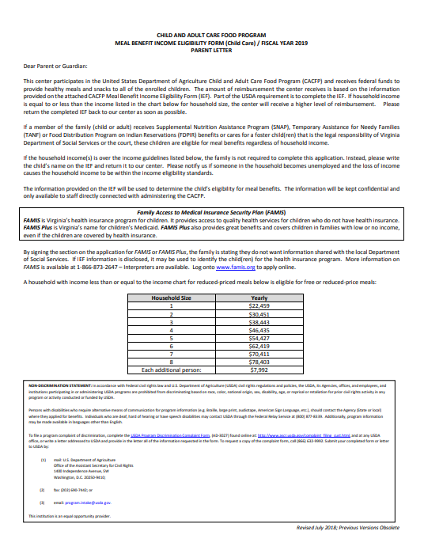
Parent Letter / Letter to Households
Distributed with Income Eligibility Form
Inform parents/guardians that form is optional, however completion is beneficial to child and center
Notes:
The Parent Letter should be distributed with the IEF. This letter informs parents that the center participates in the Child and Adult Care Food Program, that the completion of the IEF is optional, and that completion of the form is beneficial to the child and to the center. Each year, the Parent Letter is updated with the new income eligibility guidelines.
Income eligibility guidelines are the household income thresholds used to classify a participant as free, reduced, or paid. We will discuss the Income Eligibility Guidelines after we review IEF completion information.
When distributing the Parent Letter each year, centers must ensure they are using the most up-to-date form with the correct Income Eligibility Guidelines. The most up-to-date version of this form can be found in the Download Forms section of CHAAMPS.

Slide 15
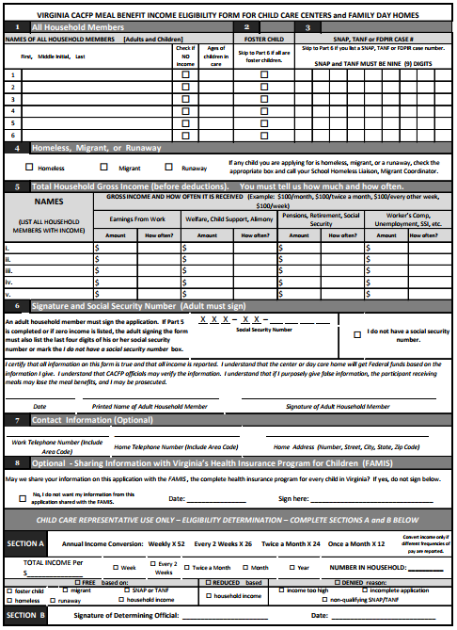
Income Eligibility Forms (IEFs)
Distributed annually to parents or guardians of each child enrolled
Distributed with parent letter
If mistakes are made, a new form must be completed
Notes:
Now let’s take a look at the Income Eligibility Forms, or IEFs.
The IEF is a form that is used for each participant within the CACFP to classify the meals they receive at the free, reduced, or paid level of reimbursement. This form must be completed annually by parents or guardians.
While each individual child MUST have an AEF, the IEF can be completed at the household level.
Any participant enrolled in the program must have an IEF. If they do not, they will be automatically classified as ‘paid.’ Additionally, if the form is incomplete, the participant will automatically be classified as ‘paid.’
To find this IEF template, please go to the Download Forms section of CHAAMPS.
The IEF is accompanied by a Parent Letter.
Similar to the AEF, while the Virginia Department of Health (or VDH) has its own IEF, CACFP participating organizations are not required to use this specific form. If CACFP participating organizations choose not to use this form, they must ensure that their own income eligibility form includes all of the same information listed on VDH’s IEF.

Slide 16
Income Eligibility Forms
Parts 1 through 8 must be completed by the parent/guardian enrolling child
Sections A and B are completed by center representative
Notes:
(say) On the screen is a standard child income eligibility form. The adult form looks slightly different, however the main components are similar enough. I’d recommend following along on an adult copy while we walk through the one on the screen.
(click)
(say) Parts 1 through 9 must be completed by the parent or guardian of the enrolled participant. For adult day cares, if able the participant can complete the form themselves, however if they are unable and there is not another household member who can assist them, it’s okay for the center staff to assist the participant in completing the documentation. My guidance for best practice would be, if there is a situation in which the center staff must assist the participant in completing the form, have a post-it or notation somewhere the reasoning and that the staff helped. In the completion.
(click)
(say) The section at the bottom, sections A&B, is completed by the center or sponsor staff (depending on your organization’s processes and procedures).
[Slide]

Slide 17
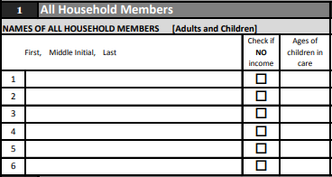
IEF Completion – Parent/Guardian
All Household Members
List everyone who lives in the home and shares income and expenses
Include foster children
Indicate age of enrolling child(ren)
Indicate members with no income
Notes:
The first section is the household section. All members of the household should be listed here if they share income and expenses. Foster child should be included as well in determining household size.
Indicate the age of participants and mark which members have no income in the column that says “check if no income.”
The parent or guardian should list the ages of the children.
If there are more than six members in a household, it’s okay to write the additional members in with the required information where there is space or to have a second income eligibility form noted as being a continuation from the first.
The names of those in the household should be clear, for verification purposes. If you can’t identify who the household members are and if one of them is the enrolled participant, how will you know to assign a categorical eligibility determination?
[Slide]

Slide 18

IEF Completion – Parent/Guardian
Foster Status
Indicate any child who is legal responsibility of a welfare agency or court
If ALL children are fostered, sections 3, 4 and 5 are skipped
Notes:
Section 2 is requesting the foster status of each child listed on the form. The parent or guardian should indicate whether the child listed is a foster child, which is any child within the household that is the legal responsibility of a welfare agency or court. Foster children are considered a household of one, but can be considered as household members in homes with both foster and non-foster children.
If ALL children are foster children, the parent or guardian can skip sections 3, 4, and 5, and go straight to section 6.
Foster children are automatically categorized as free.
*There is no foster child section on adult IEFs*
[Slide]

Slide 19
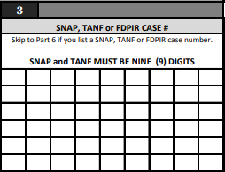
IEF Completion – Parent/Guardian
SNAP, TANF, FDPIR
Case #
Indicate appropriate case number* for enrolling child(ren)
If a case number is indicated, sections 4 and 5 are skipped
*SNAP and TANF numbers must be 9 digits in Virginia.
Notes:
Section three on the child IEF and 2 on the adult IEF asks for the SNAP, TANF, or FDPIR Case number. The parent or guardian completing the form should list the appropriate care number for the enrolled child or children.
SNAP is the Supplemental Nutrition Assistance Program (formerly known as food stamps)
TANF is the Temporary Assistance for Needy Families
And FDPIR is the Food distribution Program on Indian Reservations
Please note that the SNAP and TANF case numbers were changed to nine digit numbers.
If a case number is indicated, the parent or guardian can skip sections 4 and 5 and go straight to completing section 6.
Households that participate and receive SNAP, TANF, or FDPIR are automatically classified as free.
Also, a slight difference on the adult IEF, this section is also where Medicaid case numbers can be documented. These case numbers are 12 digits long and also qualify the participant’s meals for the free reimbursement rate.
[Slide]

Slide 20
IEF Completion – Parent/Guardian
Homeless, Migrant, Runaway
Indicate as appropriate for any enrolling child
Notes:
(say) Section 4 on the child IEF is for a homeless, migrant, or runaway participant. If this applies to the participant, the parent or guardian should check the corresponding box.
Participants who are homeless, migrant, and/or runaway are automatically classified as free.
[Slide]

Slide 21
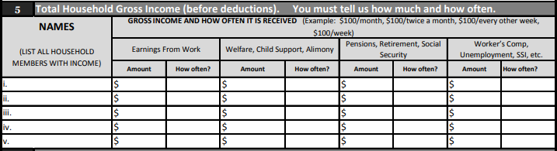
IEF Completion – Parent/Guardian
Total Gross Household Income
For each income category, indicate the amount of gross income earned and how often it is received
List names of household members who earn income
Notes:
(say) The next section is section 5, section 3 for my adult IEFs, which lists the Total Household Gross Income
The parent or guardian should list all household members who earn income. In addition to listing their names, they should list their gross income (i.e. their earnings before deductions) and how often it is received.
Gross income includes earnings from work, earnings from welfare, child support, or alimony, earnings from pensions, retirement, social security, and earnings from worker’s compensation, unemployment, SSI, or any other earnings.
In addition to the earnings amount, the parent or guardian must be sure to also include how often that amount is received—this could be weekly, every other week, two times a month, monthly, or yearly.
Hourly incomes that do not report the average hours worked each week are considered incomplete.
When reviewing the form, centers should check the list of people in section 1 against the list of people in section 5. If someone is listed in number 1 as a household member and is not a child, and does not have the box checked for no income, that person should be listed in section 5.
[Slide]

Slide 22
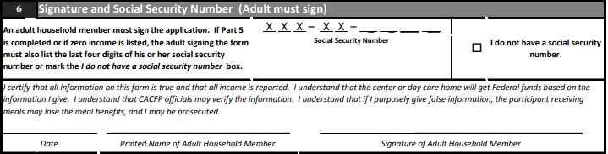
IEF Completion – Parent/Guardian
Signature and Social Security Number
If part 5 is completed, or zero income is listed, indicate the last 4 digits of Social Security Number for participant or parent/guardian completing form
If there is no SSN, check the box “I do not have a SSN”
Date, print and sign name
Notes:
(say) Section six on the child IEF, and 4 on the adult, is requesting the social security number, date, and signature of the parent or guardian completing the form. If section 5 is completed with income amounts or if zero income is listed, the adult signing the form must also list the last four digits of his or her social security number or mark the box that states “I do not have a social security number.”
The parent or guardian should date the form, print their name, and sign the form. For adults, the participant/guardian/household member should date, print, and sign.
[Slide]

Slide 23

IEF Completion – Parent/Guardian
Contact Information
Optional
No penalty if left blank
Notes:
(say) The parent or guardian completing the form then has the option to list their contact information. Because this section is option, the form is still valid if that section is left blank.
[Slide]

Slide 24

IEF Completion – Parent/Guardian
Sharing Information with Virginia’s Health Insurance Program for Children (FAMIS)
Optional
No penalty if left blank
Notes:
(say) The last section for the parent or guardian to complete on a child IEF is section 8. This is an optional section where is asks about sharing information with Virginia’s Health Insurance Program form FAMIS.
If the parent or guardian does not with should share their information, they should click the box next to ‘No, I do not want my information from this application shared with FAMIS.’ If they do wish their information to be shared with FAMIS, they should date and sign that section.
Center representatives should not complete any of these sections one through eight. Only the parent or guardian of the household is allowed to complete sections one through eight.
(say) The last section for a participant/guardian to complete on the Adult IEF is section 5, Participant’s Residency/Living Arrangements. This information is not required to be reported on the IEF, but it must be collected, verified, and documented by the adult day care center or sponsor somewhere else if it’s not collected here. Adults that are residents of the facility in which they receive care are not eligible for Program participation.
[Slide]

Slide 25
Eligibility
Categorical
Income
SNAP, TANF, FDPIR
Foster children
Migrant
Runaway
Homeless
Emergency Shelter
Eligibility based on household income
Refer to Income Eligibility Guidelines for Current Year
Notes:
(say) Eligibility of a participant is split into categorical eligibility and income eligibility.
A participant is categorically free if they are:
A recipient of SNAP, TANF, or FDPR, a Foster Child, a migrant, a runaway, homeless, and/or enrolled in Head Start. Or for adults, are Medicaid recipients.
Participants can also be classified based on their household income. In these circumstances, they would be classified as either free, reduced, or paid. This eligibility is based on the household income and the Income Eligibility Guidelines that are released each year help the center representative in determining the participant’s classification.
[Slide]

Slide 26

Income Eligibility Guidelines
Notes:
(say) Here are the Income Eligibility Guidelines for the year ending June 30, 2020. These Income Eligibility Guidelines can be found under the Download Forms section in CHAAMPS.
The first column on the left is the household size. In the middle columns, you’ll see the classifications for Free Meals, and on the right you’ll see the classifications for Reduced Meals.
Let’s try an example. You’re reviewing an IEF with a household size of two. Their annual income is $20,000. Using the Income Eligibility Guidelines, you would look for the household size of two. Then look to the right of that. In the Income Eligibility Guidelines listed, in a household of two, for a participant to be classified as Free, they must have a household income of $21,398 or lower. Because our example has an income of $20,000, this participant would be categorized as Free.
Let’s try another example. You’re reviewing an IEF with a household of four. Their annual income is $45,000. Using the Income Eligibility Guidelines, you would look for the household size of four. Then look to the right of that. In the Income Eligibility Guidelines listed, in a household of four, for a participant to be classified as Free, they must have a yearly household income of $32,630or lower. Because our example has an income of $45,000, this participant does not meet the Free rate. So, we’ll keep looking to the right. In the Income Eligibility Guidelines listed, in a household of four, for a participant to be classified at the Reduced rate, they must have an yearly income of $46,435 or lower. Because our example has an income of $45,000, this participant does meet the Reduced rate and, therefore, would be classified as Reduced.
[Slide]

Slide 27
Classifications Based on Income
Free
Meets current eligibility requirements for free meals;
Receives SNAP, TANF, FDPIR; and/or
Is foster, migrant, runaway, homeless, enrolled in Head Start
Reduced-Price
Meets current income eligibility requirements for reduced-priced meals
Paid
Does not meet current income eligibility requirements for free or reduced-price meals; and
Does not receive SNAP, TANF, or FDPIR;
Income eligibility form incomplete or not submitted
Notes:
(say) Lets look at our classifications in another way.
To be classified as free, the participant meets one or more of the criteria—they meet the current eligibility requirements for free meals, received SNAP, TANF, FDPIR, and/or, they are a foster child, migrant, runaway, homeless, or enrolled in Head Start/Early Head Start. Or for adults, are Medicaid recipients.
To be classified as Reduced, the participant meets current income eligibility requirements for reduced-priced meals
To be classified as paid, the participant does not meet current income eligibility requirements for free or reduced-price meals, and does not receive SNAP, TANP, or FDPIR. Additionally, the participant would be classified as paid if the IEF is incomplete or not submitted.
[Slide]

Slide 28
Classifying Participants
Independent Centers
Classifications should be determined by center staff
Verified by a 2nd center staff (preferably management)
Sponsoring Organizations
Classifications should be made by center staff
Verified by sponsor
Notes:
(say) Participants are classified at the center level. For independent centers, classifications should be determined by center staff, and then verified by one or more people on staff.
Sponsors should ensure that classifications are made by the center staff. Sponsors should then verify classifications.
Verification is an important piece of classifying an IEF. It is easy overlook a number, or read something incorrectly. Having another set of eyes to verify to correctness of the classification will ensure accuracy of your IEFs.
[Slide]

Slide 29
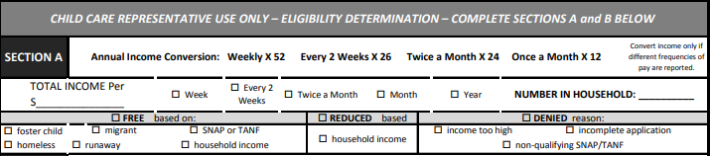
IEF Completion – Center
Section A
Determine and indicate annual income, using conversion table as necessary
Indicate income frequency
Indicate household size
Determine and indicate eligibility, as appropriate
Notes:
(say) Now that the parent or guardian has completed sections 1 through 8, the center can then go in an classify the IEF as Free, Reduced, or Paid.
A center representative must complete Sections A and B for the IEF to be considered complete. If different income frequencies are listed in section 5, first convert the incomes to the same frequency.
List the total income from all of section 5, and then mark the frequency in which income is being reported, (i.e. week, month, year, etc.) and also the household size. For incomes reported in different frequencies, for example a pension listed by month and an annual salary, calculate each income annually and add them together to determine the income classification.
If the participant is categorized as free or paid, mark what this categorization is based on, for example foster child, household income, SNAP or TANF, Medicaid, income too high, or incomplete application.
[Slide]

Slide 30
IEF Completion - Center
Section B
Signature of center staff determining classification
Determination Date
Notes:
(say) The last step of IEF completion is signing and dating the form. This should be signed and dated by the center representative who determined the eligibility of the participant.
[Slide]

Slide 31
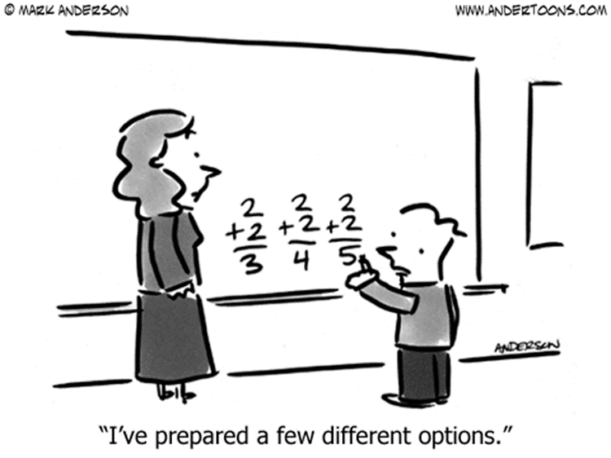
Avoiding Misclassification
Proofread
Slow Down
Incomplete Areas
Date
Parent Signature
Social Security Number
Misprints
Date/Expiration
Invalid Case Number
Hourly Wage Only Reported
Second Set of Eyes
Show Your Work!
Classify and Compare
Process
Sign off on Classification
Notes:
(say) Okay, we’ve walked through how to complete an income eligibility form. Before moving on let’s discuss the most common errors I see when verifying them and some tips on how to fix them.
(click)
(say) So many of the issues I see on reviews are attributed to a poor edit check system. Proofreading would help most incomplete areas that cause misclassification.
(click)
(say) The most common incomplete areas are the date, parent/guardian participant signature, and the social security number.
(click)

Slide 32
Common Scenarios
Valid Enrollment
Valid Income Eligibility
Eligible participant for F/R
Invalid Enrollment
Valid Income Eligibility
Meals ineligible for reimburse-ment
Valid Enrollment
Invalid Income Eligibility
Meals eligible at the “Paid” rate
*excludes EMS
Notes:
(Say) Let’s go over some common eligibility documentation and their impacts.
(say) Are a participant’s meals eligible for free or reduced reimbursement if you have a valid enrollment form and valid income eligibility form?
(click) Yes, based on the eligibility documentation this participant’s meals would be eligible for reimbursement at the free or reduced rate.
(click) (ask) What is the outcome if participant does not have a valid enrollment form on file, but does have a valid income eligibility form on file?
(click) Correct, because there is not a valid enrollment form, documentation wise this participant is not classified as “enrolled”. These meals would not be eligible for reimbursement.
(click)(ask) What is the outcome if a participant has a valid enrollment form on file, but their income eligibility form is not on file, incomplete, or expired?
(click) Very good! Yes, these meals would be reimbursable at the “Paid” rate because the eligibility classification documentation is not on file.
(say) Now, I should note for my family day care home sponsors in the audience, there are some different allowances when determining categorical eligibility of a participant’s meals in Tier 2 day care homes. Please keep in mind we are presenting on the standard scenario for most centers.

Slide 33

Enrollment Total Errors
Common Causes
Fixes
Consolidation Errors
Transcription Errors
Outdated Enrollment Claimed
Update Enrollment Roster Monthly
Compare IEFs to Enrollment Roster
Have an Editor
AEF Total Errors
The amount of F/R/P participants claimed for the month is not validated by documentation provided at the Program Review.
Notes:
(say) We’ve covered how to fill out enrollment forms, the importance of eligibility documentation, how to classify documentation, and discussed common scenarios.
(say) If you’ll recall from our discussion on categorical eligibility documentation, for our centers (not so much for family day care homes) the participant’s eligibility classification impacts a key part of the claim for reimbursement process – enrollment totals. These are the F/R/P ratios you enter each month and certify as accurate each month when submitting a claim for reimbursement. We commonly see enrollment total errors on reviews. I’d like to walk through some common causes and fixes with you before wrapping up.
(click)
(say) Common causes for enrollment total errors are consolidations errors, transcription errors (meaning it isn’t documented properly from the IEF to the enrollment roster), or the enrollment totals reported are outdated and/or flat out incorrect.
(click)
(say) Some best practices to help avoid these common causes, are to create an enrollment roster and update it each month. Compare eligibility documentation to the enrollment roster frequently. Ensure that the enrollment roster is up to date and doesn’t include participants that have withdrawn. Have a peer editor. Make it part of your organization’s SOPs to have a second set of eyes review your work. Communicate this practice with staff so they are in the practice of proofreading their work too!
[Slide]

Slide 34


Questions? Contact Us!
CACFP@vdh.virginia.gov
Help Desk
(877) 618- 7282
Virginia Department of Health
Division of Community Nutrition
Special Nutrition Programs
109 Governor Street, 8th Floor
Richmond, Virginia 23219
This institution is an equal opportunity provider.
Notes:
Thank you for your time and attention during today’s training. If you have any additional questions or would like to share some resources you’ve found helpful during your operation of the CACFP, please share them at the contact information on the screen, or reach out to your assigned Specialist.
Or
This concludes the Virginia Department of Health’s presentation on AEFs and IEFs within the Child and Adult Care Food Program. For more information on what is required for your organization, please refer to the Recordkeeping training presentation.
To find the forms mentioned in this presentation, please go to the Download Forms section of CHAAMPS.
If you have any questions or need assistance, please call the Help Desk at 877-648-7282 or email the CACFP email box at cacfp@vdh.virgnia.gov.

