Slide 1


Farm to CACFP
Linking farm and food education with the Child and Adult Care Food Program
Notes:
Good morning everyone thanks so much for joining us for this Farm to CACFP webinar. Today we’re going to talk about how to link farm and food education with the Child and Adult Care Food Program.
My name is Bee Thorp and I am a Special Nutrition Programs Specialist with the Virginia Department of Health. In addition to providing CACFP applicants and participants with programmatic assistance, I also work on trainings to help participants navigate the CACFP requirements and improve their meal services at their centers.
I’d like to first poll the audience and see where you all are from and the programs you have. In the question box to the right of the screen, please type where you’re coming from. Are you with a child care? A family day care home provider? A Sponsor? A partner organization? Are you currently doing any Farm to CACFP work? Are you interested in starting?
Okay it looks like we have a good mix of child care, providers, and even some outside partners. Thank you all for being here!
>Next slide

Slide 2
Webinar Objectives
Farm to CACFP 101
How to get started
Resources
Rules of the Road
Handout has links to all resources
Questions
Notes:
There are so many excellent resources on the internet for you to explore on nutritious meal preparation, recipes, menu plans, etc. Our goal in this webinar is to highlight a fraction of these tools, and really get a conversation started about where and how to utilize these resources for healthier meals in the CACFP. By the end of today’s webinar we’ll have gone over:
The elements of Farm to CACFP, and some real world examples of the program being put to use
Easy steps to get started with your Farm to CACFP program
And we’ll connect you to some free resources, which include lesson plans, activities, and recipe ideas
(click) Also, before we kick things off there’s just a few “rules of the road” to go over:
If you need any of the hyperlinks from today’s presentation, don’t worry we’ve got you covered! Today’s webinar has a handout available with all of the hyperlinks and resources discussed. Additionally, a recording of this webinar will be viewable anytime on the VDH CACFP LiveWell website once we get it uploaded.
Questions! If you have any as we go along or have any additional resources you’d like to share – You’re welcome to type them into the questions box to the right of the screen. We will answer them at the end of the presentation.
Lastly, once we wrap up please fill out our very short and sweet survey so we can work to put together more resources and tools that will most benefit you. I promise it’s nothing too long!
>Change slide.

Slide 3
Farm to Preschool
Farm to CACFP
Farm to Early Care and Education
Notes:
So before we get started, I’d love to hear the first thing that comes to your mind when you think of Farm to CACFP.
>click There are a lot of phrases out there—Farm to School or Farm to Preschool, Farm to Early Care and Education, Farm to Head Start, and Farm to CACFP. So in the questions box to the right of your screen, please type in the first thing that comes to mind when you hear about these programs.
--Okay interesting—you’re thinking about _____
>Change slide.

Slide 4
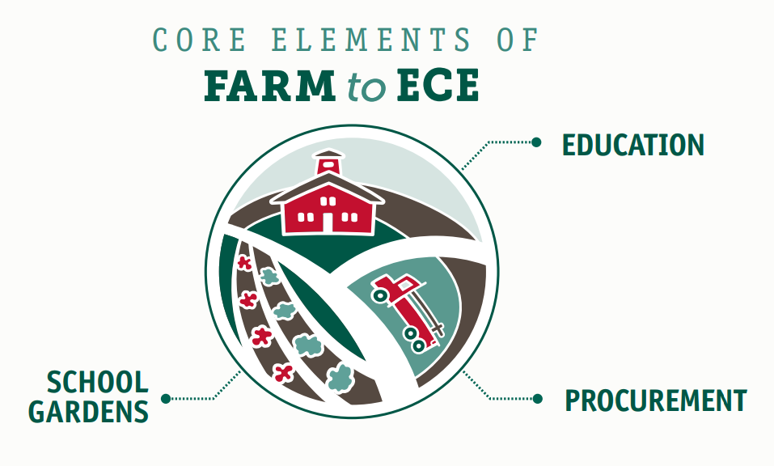


Notes:
Yes—so all of these programs are the same in that they have three major elements to them.
<click>The education component—Students participate in education activities related to agriculture, food, health or nutrition
<click>the procurement piece—Local foods are purchased, promoted and served during the meal service or as a snack or taste-test;
<click> and then the gardens—Students engage in hands-on learning through gardening. And this could be through small or large gardens, container gardens, or even small growing spaces inside.
So when we are talking about Farm to ECE, we are talking about brining all of these elements to your existing CACFP program.
You’ll see that a lot of the resources available say Farm to ECE or Farm to School, but because these programs are so similar there are plenty of ways to tailor these initiatives to fit your center or day care home. And some of the resources, which we’ll talk about later, are geared specifically towards those younger age groups in early child care settings.
And here in Virginia, of the 9 respondents to the National Farm to School Network survey regarding Farm to Early Care and Education—5 of them reported to have some sort of Farm to Early Care activities—whether that was gardening, education, or procurement of local foods. I think there are a lot more organizations out there , but this really means we have so much room to grow here in the Commonwealth.
>Change slide.

Slide 5
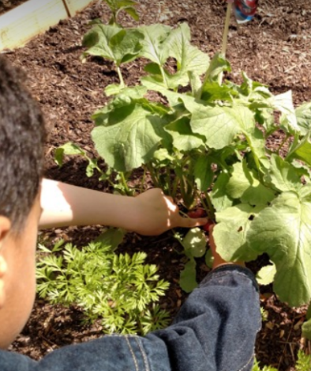
Why?
Aligns with early care and education activities
Increases access to health foods & improved early eating habits
Supports local businesses and communitites
Incorporates CACFP goals and objectives
Notes:
Farm to CACFP really offers benefits that support the goals and priorities of the early care and education community, and this includes an emphasis on experiential learning opportunities, parent and community engagement, and life-long health and wellness for children, families and caregivers.
In line with the CACFP, Farm to CACFP activities also expand healthy food access for children and families
We all know, especially you as educators, that when children are invested, they are more open to exploring, and this also applies to what’s on their plate. Engaging them with food, nutrition, and gardening activities, --providing those experiential learning opportunities--will help make them open to trying those items during meal times and develop those healthy eating habits.
From a business standpoint, a program such as Farm to CACFP could be a great marketing tool for your center to attract more participants, on the other side of the coin it that it is also a great thing for local farmers because it can provide additional market opportunities for farmers to support thriving communities.
And lastly—it incorporates CACFP goals and objectives. At the end of the day, we are all here to increase the quality of care for our participants, and a major component of that is increasing the quality of meals served. We know you all are already doing so much to make your centers great for your students, and the resources we’ll discuss can help you add small things here and there to really elevate your program.
Farm to CACFP really is a win-win for everyone.
>Change slide.

Slide 6
Notes:
Let’s take a look at some opportunities for each of these Farm to CACFP elements. You’ll notice that they are all very interconnected—as one activity might incorporate more than one element of the Farm to CACFP model.
We’ll start with Education
>Change slide.

Slide 7
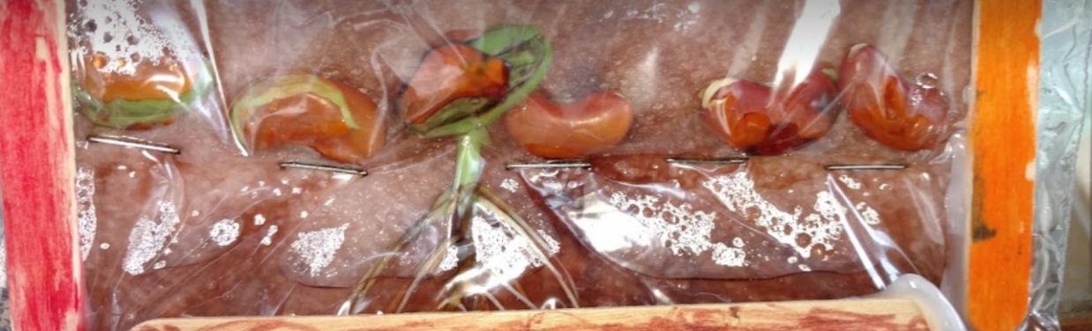
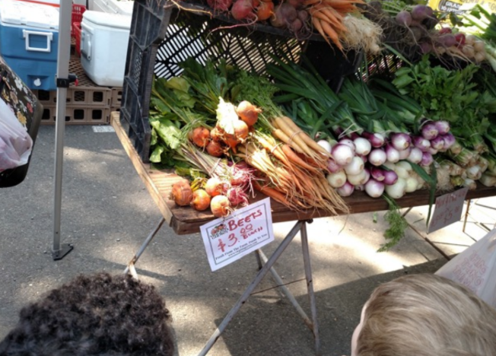
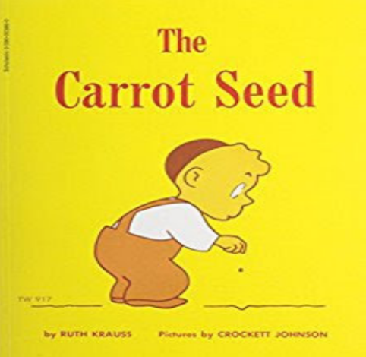
Education
Notes:
Monica Jackson at Jackson Child Care integrates Farm to CACFP activities into her family day care home curriculum.
They have gone on field trips to grocery stores and farmers markets, where they learned about the farmers and food being sold—learning about new foods and how to buy them, while also improving their math skills.
The top picture is where the students learned about seed germination and root formation. This lesson was taken out of the Grow It, Try It, Like It toolkit from USDA.
They also incorporate books into their food education—where the children learn about the carrot seed, get to plant the carrot seeds and watch them grow, and then taste the carrots in their CACFP meals.
These are all examples of integrating that educational component of Farm to CACFP into your program.
>Change slide.

Slide 8
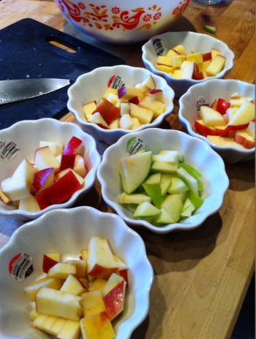
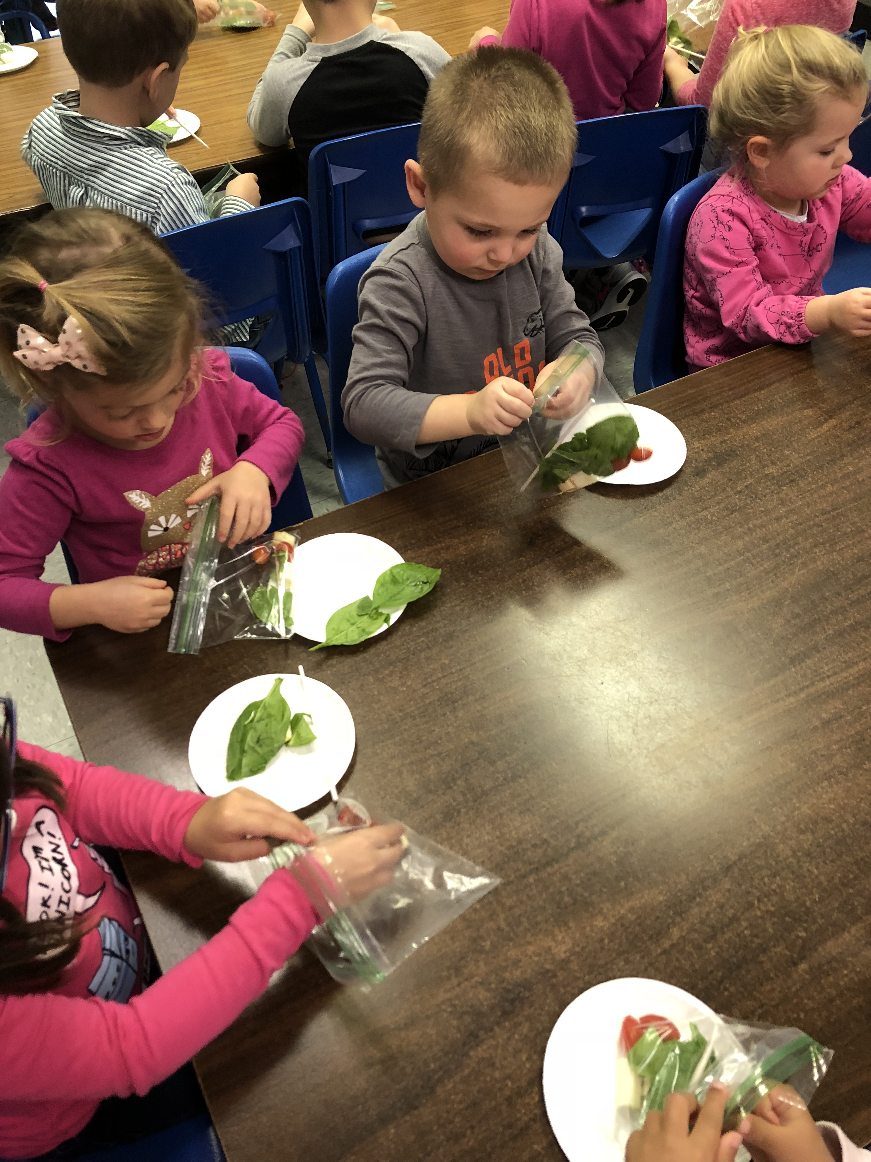
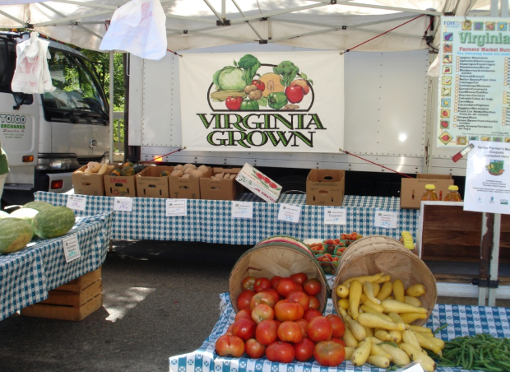
Procurement
Notes:
The next element of Farm to CACFP is that Procurement piece. When we talk about procurement we are talking about purchasing items, and this is where you can really beef up your meals or snacks.
Local foods span from produce to dairy, grains, meat, eggs, and even beans. We are lucky in that Virginia has quite a long growing season, making products available for longer stretches of time. And I should note here that there is no one concrete definition of local—it is all about what works for your organization. Some organizations define “Local” as being in Virginia, others define it as within a 100 mile radius, its all up to you.
So with Procurement, the main example is purchasing food from a local supplier, like a farmer, and serving that to children. You can also purchase local food through food hubs, distributors, or a food service management company. If you already work with a food supplier, you can ask them what local produce they have available.
Often times fruit and vegetables are much cheaper when they are in season, and there are ways to cuts costs even further by creating relationships with farmers who might be trying to get rid of their “ugly” (but still delicious) produce. Creating relationships with farmers can be a key to success, and they might even be willing to come to your center for an educational meet-the-farmer activity, or even be willing to host a field trip.
There are also other ways you can incorporate procuring local, seasonal items.
An example might be offering taste tests—maybe in the Fall purchasing different varieties of apples, and serving those different varieties while discussing the different colors, tastes, and textures of the varieties.
Another activity might be purchasing unique fruit or vegetable items that the children might not have access to at home.
Using an example from the previous slide, teaching the children about carrot seeds, and then purchasing whole carrots with the tops on for the children to explore, then providing carrots as a snack or as part of a meal.
The picture on the right is of students at Four Seasons Daycare where they got to collect the elements of their own salads.
A different CACFP center in Richmond was celebrating St. Patricks day by having a traditional meal that included potatoes. They procured some potatoes for the meal and also for an education exercise. Because they don’t have space for a garden, they put some potatoes in a bin with some dirt and let even the littlest participants pick out the potatoes from the dirt. With the connection to the potatoes, the children were more excited to try the finished, cooked product during meal time. I like to share that story because it’s a perfect example of an inexpensive, fun way to incorporate food education into an already existing lesson plan.
>Change slide.

Slide 9

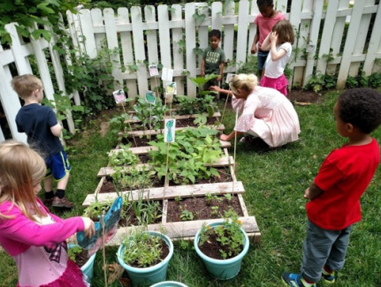
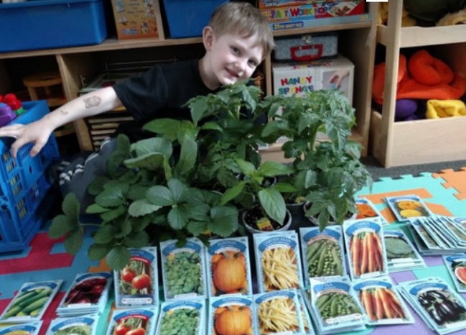
Garden
Notes:
The last element of Farm to CACFP is the garden.
Back at Jackson Child Care, Monica Jackson incorporates the garden into all of her lessons. Students pick out the seed packets, sort and count them, plant them, and watch them grow. When the vegetables are ready, the students harvest them and learn different ways of eating and cooking the veggies. She got the pallets you see in the picture for free from her local hardware store. She also taps into other local businesses for donations and equipment to help supplement the cost. With that, along with her CACFP reimbursement, she is able to provide a robust program.
Organizations with limited space can also participate in this element of Farm to CACFP by container gardening or even placing plants in windowsills in the classroom. Or, the center can choose to grow easy care-free herbs for use in the kitchen and also for education, such as sensory activities.
>Change slide.

Slide 10
CACFP Benefits
Use CACFP reimbursement for gardens
Use CACFP reimbursement for food and nutrition education
Continue using CACFP reimbursement to improve the quality of meals
Notes:
CACFP participants are already working towards improving the quality of their meals—that is essentially what the reimbursement is for! Incorporating these activities can improve your program even more. Luckily, USDA has provided guidance that allows CACFP participants to use their reimbursement on allowable costs—allowable costs include garden supplies and activities, and food and nutrition education. This doesn’t mean organizations will get more of a reimbursement, just that they can use the reimbursement they receive for eligible meals served on these types of activities.
We look at it as the reimbursement making local food and other Farm to CACFP activities more economical, while freeing up resources for other activities.
>Change slide.

Slide 11
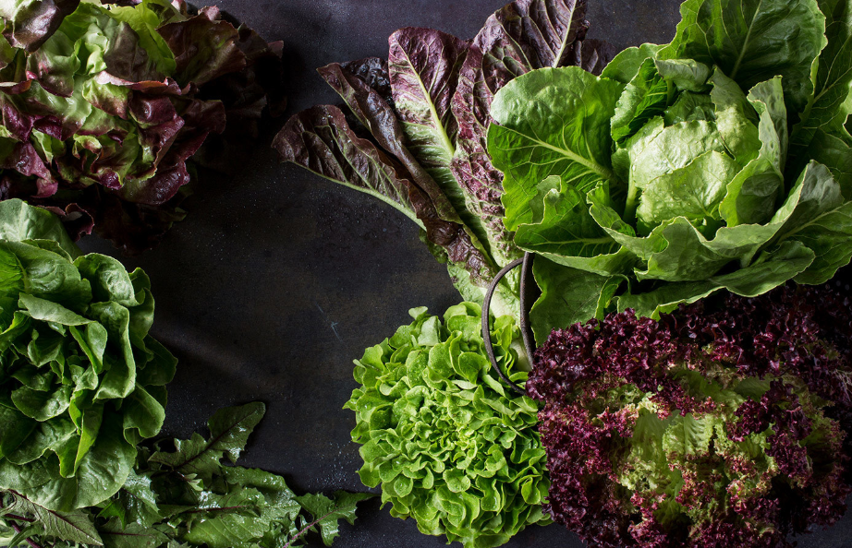

Activity
Mystery Bag
?
SPINACH
Notes:
Here is a quick example of an easy activity to do inside the classroom. This lesson is pulled out of the Grow It, Try It, Like It workbook provided for free by the USDA for CACFP participants.
Pass around a mystery bag—that might be more decorated and exciting than this boring paper bag we have here. Have the children feel what’s inside the bag and describe what they’re feeling—but keep their guesses a secret!
So this item feels like smaller, flat leaves with small stems. The leaves feel strong, not weak and are round in shape. The leaves are smooth, but don’t feel shiny. They’re cold, and some break a little. What do you think it is?
--wait a second—
<click> It’s spinach!
>Next slide.

Slide 12
Mystery Bag: CACFP Alignment
Meal Pattern Requirements
Spinach served for any meal or snack is reimbursable as a vegetable component under the CACFP Meal Pattern.
Reimbursable Expense Items purchased for activities such as food and nutrition education are a reimbursable expense. (Memo CACFP 11-2015)
Notes:
So how does that activity align with the CACFP? A center might also want to serve spinach as part of their meal to help encourage the children to try the spinach. Spinach served for any meal or snack is reimbursable as a vegetable component under the CACFP meal pattern.
Additionally, items purchased for food and nutrition education are a reimbursable expense. This means that you can use your CACFP reimbursement on food and nutrition activity expenses.
>Change slide.

Slide 13
Getting Started
Assess where you are and where you’d like to be
Form a team
Start small! Establish one or two attainable goals
Promote your program
Notes:
Now that we’ve learned about the three elements of Farm to CACFP and how they are aligned with the CACFP, let’s talk about how to get started.
First—look at where you are as a center or home, and where you would like to be. Are you interested in having a robust Farm to CACFP program? Or maybe you’re envisioning doing a few things here and there. Or, maybe, after learning more about Farm to CACFP, you’ve realized that you’re already doing great things related to local food and education!
Next you’ll want to form a team. This could include other teachers, volunteers in the community, or even parents. Having invested people will help ensure the program is successful, and help distribute tasks and responsibilities. I spoke with one Farm to CACFP participant and they mentioned the importance of having an engaged teacher base—at least just a few to help keep the momentum going.
Next, Start small. Pick just a few items you’d like to start with. This is the best way to ensure your program is sustainable. That might be providing one local food a month, maybe through a Harvest of the Month program. Or, revamping your menu for one meal a week. Or maybe its identifying a few activities related to food, gardens, or healthy eating. If you have a garden in mind, maybe start with one bed and build on from there.
Nothing is too small—as long as you’ve started!
Just remember to promote your activities by highlighting menu items or including activities in your newsletters. Of course, the Virginia Department of Health would also love to hear about what you’re doing too!
>Change slide.

Slide 14
Save the Dates!
Crunch Heard Round the Commonwealth
First week in October—exact date TBD
Farm to CACFP Week
Third full week in October—October 21-25
Notes:
So how does that activity align with the CACFP? A center might also want to serve spinach as part of their meal to help encourage the children to try the spinach. Spinach served for any meal or snack is reimbursable as a vegetable component under the CACFP meal pattern.
Additionally, items purchased for food and nutrition education are a reimbursable expense. This means that you can use your CACFP reimbursement on food and nutrition activity expenses.
>Change slide.

Slide 15







Resources
Notes:
We have a helpful resource guide that will help you get started. If you’d like us to send it to you, please contact me and I’m happy to share. There are really so many tools available.
USDA Food and Nutrition Service has a ton of resources available as well, including a fan favorite—the Grow It, Try It, Like It! Workbook. CACFP Participating organizations can order all of these resources on USDA’s website for FREE
The National Farm to School Network has a whole section on Farm to Early Care and Education—archived webinars on specific topics, resources to help get you started, and insights into best practices.
I really love Harvest for Healthy Kids’s free resources, which are broken down by type of fruit or vegetable. Eat Kit has activity plans, picture cards, teacher bites newsletter, a family newsletter in three different languages, and recipes. All you have to do is create a free account.
Virginia Ag in the Classroom’s goal is to provide educators and volunteers with resources to connect children to agriculture. What I like about their resources is that they are geared specifically towards Virginia.
Growing Minds has a great Farm to Preschool toolkit that includes lesson plans, activity guides, and even weekly newsletter examples. It also includes sourcing guidance, tips for cooking with young children, and more.
And then there is also a short video created by University of Massachusetts at Amherst regarding food safety in the farm to preschool setting.
Additionally, to the right of your screen, you’ll find some resources attached to the webinar. Please be sure to download these—there is one Farm to CACFP resource, that includes what we discussed today as well as additional resources, there is a resource guide created by the Department of Education, and then I’ve also attached a few one-sheet informational guides to help get you started.
Let’s just say there are a lot of resources out there to help you get started on your Farm to CACFP journey!
>Change slide.

Slide 16

Recap
Farm to CACFP 101
How to get started
Resources
Survey
Notes:
Thanks so much for joining us today and for your interest in Farm to CACFP. To recap—today we reviewed
Farm to CACFP—the different elements of the program—education, procurement, and gardening. We also reviewed how Farm to CACFP can help elevate your exisiting CACFP programs.
We went over some helpful tips to get started—with program sustainability in mind
We also reviewed some helpful (and free!) Farm to CACFP resources.
And also, when you exit the webinar, please take the quick survey to share with us what resources or tools you’d like from us, the Virginia Department of Health, in the future.
Our goal here at the Virginia Department of Health is to build the community of Farm to CACFP participants so that we can share best practices, and, ultimately, help you all build and improve your programs. We’ll be diving into more specific areas of interest in later webinars, but if you have any roadblocks you’d like us to help with please let us know! Also, as I mentioned earlier, we’d love to hear about the work you’re doing at your center.
It looks like we have time for a few questions. If you have any questions, please type them into the questions box on the right hand side of your screen.
>Change slide.

Slide 17
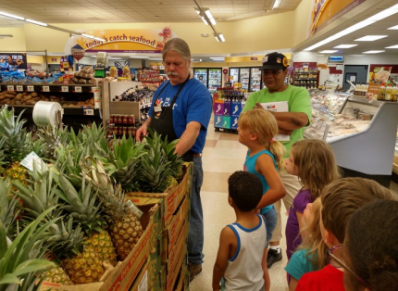

Questions? Contact Us!
Brittany “Bee” Thorp
Brittany.thorp@VDH.Virginia.Gov
(804) 864-7827
Virginia Department of Health
Division of Community Nutrition
Special Nutrition Programs
109 Governors Street, 8th Floor
Richmond, Virginia 23219
USDA is an equal opportunity provider and employer.
Notes:
This session will now come to a close. Thank you for your time and attention during today’s webinar. If you have any additional questions or would like to share the work you’re doing, please reach out to me—my contact information is listed on the screen
Thanks again for joining us today and please be on the lookout for more webinars from the Virginia Department of Health.
>Change slide.

