Slide 1



Teen Dating Violence Module

Slide 2
What is Project RADAR?
Project RADAR is an initiative of VDH’s Office of Family Health Services that was developed to enable health care providers to effectively recognize and respond to intimate partner violence (IPV) by providing:
  “Best Practice” Policies, Guidelines, and Assessment Tools
  Training Programs and Specialty-Specific Curricula
  Awareness and Educational Materials
  Current Research Findings on Intimate Partner Violence

Slide 3


Training Objectives
By the end of this training, participants will be able to:
  Define intimate partner violence (IPV)
  Perform specific screening, assessment, and intervention strategies
  Identify and formulate responses to challenges specific to the health care setting
  Direct victims of IPV to appropriate resources
  Train providers using the RADAR curricula

Slide 4


What is IPV?
Intimate Partner Violence (IPV) is a pattern of assaultive and coercive behaviors that may include inflicted physical injury, psychological abuse, sexual assault, progressive social isolation, stalking, deprivation, intimidation, and threats. These behaviors are perpetrated by someone who is, was, or wishes to be involved in an intimate or dating relationship with an adult or adolescent, and are aimed at establishing control by one partner over another.

Slide 5


Who Are Victims and Batterers?
VICTIMS:
Girls and boys
People of all cultures and religions
Blue collar, middle class, and wealthy
Straight, gay, lesbian, and transgender
Over and underachievers
Outgoing or shy
BATTERERS:
Girls and boys
People of all cultures and religions
Blue collar, middle class, and wealthy
Straight, gay, lesbian, and transgender
Over and underachievers
Outgoing or shy

Slide 6

The Dynamics of Abuse:
The Power & Control Wheel
In the early 80’s in Duluth, Minnesota, victims of IPV attending educational groups were interviewed about the behaviors of their abusers and factors that influenced why they stayed in violent relationships/returned to their abusers.
Based on input from over 200 battered women, they developed a framework for understanding IPV.
Key finding, as conceptualized in the “power and control wheel” is that abusers use an array of tactics--apart from physical and sexual violence--to gain and maintain control over their victims.

Slide 7
Making and/or carrying out threats to do something to hurt her Threatening to leave her, to commit suicide, to report her to welfare Making her drop charges Making her do illegal things
Making her afraid by using looks, actions, gesturesSmashing things Destroying her property Abusing pets  Displaying weapons
VIOLENCE
Physical
Sexual
Using Coercion & Threats
Using Intimidation
Putting her downMaking her feel bad about herselfCalling her names Making her think she’s crazy  Playing mind games  Humiliating her  Making her feel guilty
Preventing her from getting or keeping a job Making her ask for money Giving her an allowance Taking her money  Not letting her know about or have access to family income
Using Economic Abuse
Using Emotional Abuse
Power
&
Control
Controlling what she does, who she sees and talks to, what she reads, where she goesLimiting her outside involvement Using jealousy to justify actions
Using Male Privilege
Using Isolation
Treating her like a servantMaking all the big decisionsActing like the “master of the castle” Being the one to define men’s and women’s roles
Using Children
Minimizing, Denying & Blaming
Making light of the abuse,and not taking her concerns about it seriouslySaying the abuse didn’t happen Shifting responsibility for the abusive behavior Saying she caused it
Making her feel guilty about the children Using the children to rely messages Using visitation to harass her Threatening to take the children away
Physical
Sexual
VIOLENCE

Slide 8
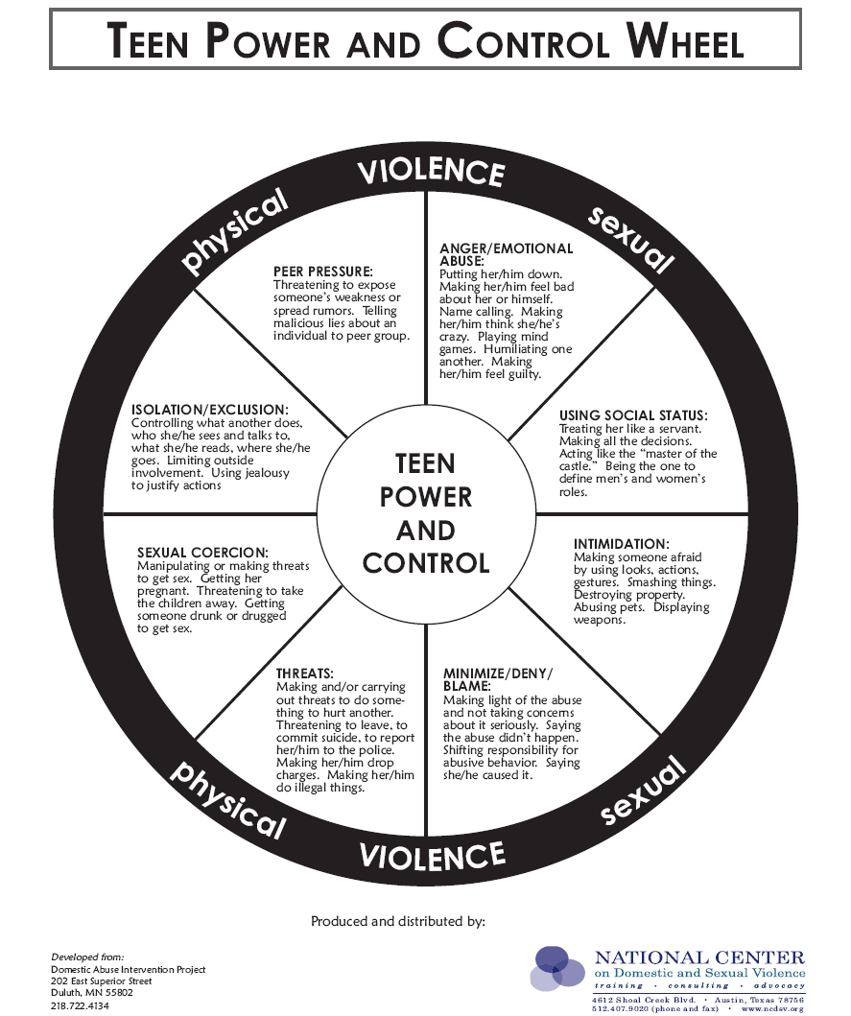

Slide 9

Factors that Influence Victims
Loss of status
$$$
Good times
Family
Religion
Kids
Culture
FEAR
**Intimate partner violence occurs within the context of the victim’s life.
Notes:
75% of women seriously injured or killed were victimized in the process of or just after leaving their abusers.

Slide 10

IPV as a Critical Public Health Issue
      More than 25% of women are abused by a partner at some point in their lives.
      Based on data from 1995, the CDC concluded that IPV costs the U.S. $4.1 billion each year in direct medical costs and another $1.8 billion in indirect costs (lost productivity, etc). Extrapolated to 2003, these costs were estimated at $8.3 billion.
      Mental health care costs are estimated to be 800% higher for abused versus non abused women.
      In addition to injuries sustained by victims during violent episodes, abuse is linked to:
--Arthritis --Chronic neck, back, & --Migraines pelvic pain
  --Gastrointestinal problems --STI’s --Pregnancy Complications --Substance abuse
Notes:
Costs of Intimate Partner Violence Against Women in the United States (Centers for Disease Control and Prevention, 2003)
**Note that since costs were re-estimated in 2003 and that health care costs have continued to increase since that time, the costs associated with IPV are likely MUCH higher now.
Reference for mental health care costs comes a study published in the Journal of Family Medicine. Intimate partner violence against women: do victims cost health plans more? (Wisner C.L. et al, 1999). Note that these costs are likely to also be much higher, given that the data was collected ten or more years ago.

Slide 11
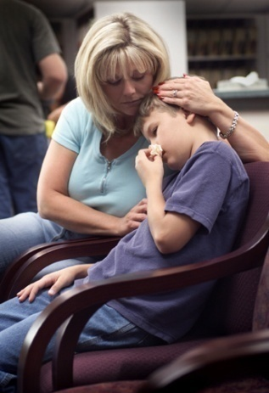
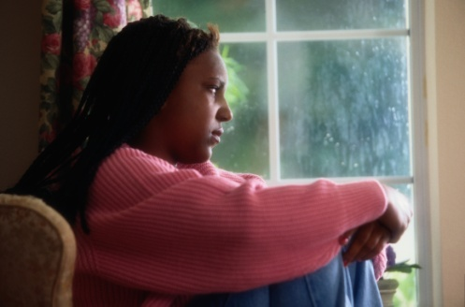



The Impact of IPV on its Victims
Adults
Physical injuries
Chronic physical ailments related to injuries and stress
Mental health problems including depression, anxiety, and PTSD
Social consequences caused by loss of contact with family, friends, work, and children
Financial strain due to: loss of income and denial of education and/or career advancement
Spiritual effects such as loss of faith and alienation from religious community
Children
Developmental delays
Mental health issues including depression, anxiety, PTSD, ODD, and sleep disorders
Behavior disorders
Poor adaptive and social skills
Increased risk for substance abuse, suicide, and criminal behavior as teens and adults
Elevated likelihood for perpetrating abuse as teens and adults
Increased vulnerability to victimization as teens and adults

Slide 12


Dating Violence & Adolescent Health
      1 in 4 adolescents reports experiencing some form of abuse by a dating partner
      In 30% of all homicides of teenage girls, the perpetrator is a boyfriend or former boyfriend
      In addition to injuries sustained by victims during violent episodes, dating violence is linked to higher rates of:
        Sexually Transmitted Infections
        Pregnancy
        Depression
        Anxiety
        Alcohol, Substance Abuse, & Smoking
        Involvement with the Criminal Justice System
  -

Slide 13
Virginia High School Survey
Percentage of students who were ever hit, slapped, or physically hurt on purpose by their boyfriend or girlfriend during the past 12 months
Q20 - Weighted Data
*Non-Hispanic.

Slide 14

Dating Violence &
Teen Pregnancy
Dating violence is associated with higher rates of
teen pregnancy.
  “Birth control sabotage” is often used as a form of abuse.
The experience of dating violence is associated with a number of sexual risk behaviors
  Not using a condom
  Alcohol or drug use before sex
  First sexual experience before the age of 15
  Multiple sexual partners
As with adult women, teen mothers are at an elevated risk for violence from their partners during pregnancy and postpartum.
Notes:
14
From literature review found in Pediatrics. Dating violence and associated sexual risk and pregnancy among adolescent girls in the United States (Silverman, J.G. et al, 2004)

Slide 15

DATING VIOLENCE AND CONDOM USE
Girls who experienced physical dating violence were 2.8 times more likely to fear the perceived consequences of negotiating condom use than non-abused girls
.
Wingood et al, 2001
Notes:
These data demonstrate how important it is to ask clients about whether it is safe to talk to their partner about using condoms and birth control.
In this study by Wingood et al. (2001), black females, 14 to 18 years old, were recruited from several different sites (health department, adolescent medicine clinic, and school health classes) to participate in a HIV/STD prevention study (n=522). Girls with a history of dating violence were significantly less likely to use condoms consistently compared to nonabused girls.
In another study by Roberts et al. (2005), Girls in verbally abusive relationships were less likely to use a condom during their most recent sexual intercourse.
Reduced likelihood of using condoms has also been shown with adult women experiencing IPV. Wingood and DiClemente (1997) conducted interviews with 165 sexually active African-American women, ages 18 through 29. Women in abusive relationships were less likely than nonabused women to use condoms and were more likely to experience verbal/emotional abuse or threats of physical violence when they discussed condoms. There were more fearful of asking their partners to use condoms, worried more about acquiring HIV, and felt more isolated than women who were not in abusive relationships.
- These are the same notes on slide 17. Are they supposed to be on both slide notes?

Slide 16

SEXUALLY TRANSMITTED INFECTIONS
AND INTIMATE PARTNER VIOLENCE
More than one-third (38.8%) of adolescent girls tested for STI/HIV have experienced dating violence.
DECKER ET AL, 2005
16
Notes:
16

Slide 17


DATING VIOLENCE AND TEEN PREGNANCY
Adolescent girls in physically abusive relationships were
3.5 times more likely to become pregnant than non-abused girls.
Roberts et al, 2005
Notes:
This study by Roberts and colleagues (2005) analyzed data from the National Longitudinal Study of Adolescent Health. The analyses adjusted for sociodemographic factors, the number of intimate partners, and a history of forced sexual intercourse. A past history or current involvement in a physically abusive relationship was associated with a history of being pregnant among sexually active adolescent girls. Physical abuse was defined as “push you,” “shove you,” or “throw something at you.”
In a study by Silverman et al. (2001), adolescent girls who experienced physical or sexual dating violence were 6 times more likely to become pregnant than their non abused peers.

Slide 18
Stalking via Technology
1 in 5 teens report that a partner has used the internet or a cell phone to spread rumors about them
1 in 10 teens report that a dating partner has shared private or embarrassing photos of them
1 in 3 teens report being texted 10-30 times/hour by a partner asking where they are, what they are doing, or who they are with
1 in 4 teens have been called names harassed or put down by a partner via technology
**72% of teens who have been checked on 10 times/hour by e-mail or texting did not tell their parents
Notes:
National Center for Victims of Crime Stalking Resource Center

Slide 19

Intimate Partner Homicide:
Paying the Ultimate Price
In Virginia:
  Nearly one in three homicides is related to family or intimate partner violence.
  Over half of all adult female homicide victims are killed by intimate partners.
Notes:
Reference: Family & Intimate Partner Homicide Report (Office of the Chief Medical Examiner, 2007)

Slide 20

IPV is an Issue for ALL
Health Care Providers.
Joint Commission Standards
Professional standards
Providers have a unique opportunity to identify victims and provide critical interventions and referrals.
  The majority of adolescents see a health care professional (school nurse, pediatrician, etc.) routinely, or at least fairly so, due to illnesses.
  These visits provide regular opportunities to offer resource and referral information to them on dating violence.

Slide 21

Joint Commission Standards Relevant to IPV Policy and Practice
In 2004, The Joint Commission instituted new standards for hospitals on how to respond to domestic abuse, neglect and exploitation and revised them in 2009.
RI.2.150—Patients have the right to be free from mental, physical, sexual, and verbal abuse, neglect, and exploitation.¹
RI.2.170—Patients have the right to access protective and advocacy services.
RI.3.10—Criteria for identifying and assessing victims of abuse, neglect, or exploitation should be used throughout the hospital.
EC.2.10—The hospital identifies and manages its security risks

Slide 22
Joint Commission Standards Relevant to IPV Policy and Practice
Elements of Performance:
The organization addresses how it will, to the best of its ability, protect patients from real or perceived abuse, neglect [including involuntary seclusion for Long Term Care], or exploitation from anyone, including staff, students, volunteers, other [patients/residents/clients], visitors, or family members.
All allegations, observations, or suspected cases of abuse, neglect, or exploitation that occur [in the organization for all except OME] are investigated by the organization.

Slide 23

Professional Standards
The American Medical Association’s Guidelines for Detecting and Treating Family Violence state¹:
“Physicians should routinely inquire about physical, sexual, and psychological abuse as part of the medical history. Physicians must also consider abuse in the differential diagnosis for a number of medical complaints, particularly when treating women…[and] have an obligation to familiarize themselves with protocols for diagnosing and treating abuse and with community resources for battered women, children, and elderly persons… Physicians must be better trained to identify signs of abuse and to work cooperatively with the range of community services…Comprehensive training on family violence should be required in medical school curricula and in residency programs for specialties in which family violence is likely to be encountered.”
¹E-2.02 Abuse of Spouses, Children, Elderly Persons, and Others at Risk

Slide 24

How Are We Doing in Virginia?
The 2009 Intimate Partner Violence
Health Care Provider Survey
Methodology
Designed to assess knowledge attitudes and behaviors of Virginia’s health care providers concerning IPV
Sent to dentists, hygienists, licensed clinical social workers, psychiatrists and medical doctors who self-identified a specialty area of family/general practice, obstetrics/gynecology, pediatrics or emergency. Other settings included were: community health centers, free clinics, family planning clinics at local health departments, and campus health centers.
Of 10,325 surveys mailed, a total of 4,481 were returned, for an overall response rate of 43.4%.
Notes:
Virginia Department of Health (2010)

Slide 25
How Are We Doing in Virginia?
The 2009 Intimate Partner Violence
Health Care Provider Survey
Results—Pediatric Health Care Providers
Of the 849 pediatricians surveyed, 28.4% responded.
Only 4% of pediatric providers have every attended a training or workshop
Over 1/3 (40%) reported that they do not use screening questions with any patients, and less than half (44%) asked about the possibility of IPV, even with the patient presented with a bruise or laceration.
Only 8% of providers reported that they were aware of their workplace having any written guidelines regarding IPV.
Only 1 in 6 pediatric care providers said that patient education or resource materials were available at their practice.
Although half indicated that either they or someone close to them had been a victim, the same amount of pediatricians (around half) estimated prevalence of IPV in their practice to be “very rare” (1 in 1,000) or “rare” (10 in 1,000).
Notes:
Methodology Note:
Although providers were advised to include the family members as patients, there did appear to be confusion amongst pediatric providers as to whether/how to consider or include those other than the “primary” patient (the child) when answering some of the survey questions.

Slide 26
How Are We Doing in Virginia?
The 2009 Intimate Partner Violence
Health Care Provider Survey
Results—Campus Health Centers
Of the 39 campus health centers surveyed, 61% responded.
A majority (76%) have never attended a workshop or training on IPV.
22% reported that they do not use screening questions with any patients; and only 5% reported using screening questions with every patient.
About 25% reported that they were aware of their workplace having any written guidelines regarding IPV.
Only 18% of providers indicated that patient education or resource materials were available at their campus health center.
Half of providers agreed with the statement, “any patient may be a victim of IPV,” yet nearly a third (32%) estimated prevalence of IPV in their practice to be “very rare” (1 in 1,000) or “rare” (10 in 1,000).
Notes:
Methodology Note:
Although providers were advised to include the family members as patients, there did appear to be confusion amongst pediatric providers as to whether/how to consider or include those other than the “primary” patient (the child) when answering some of the survey questions.

Slide 27

The Hospital Policy
Analysis Project
Characteristics of Participating Hospitals
62 hospitals participated (RR=76.5%)
Distributed across the five health planning districts
Equally distributed in terms of bed size and average number of ED visits annually
67% of study hospitals in a health system, compared to 61% of all Virginia hospitals
Type of ownership (public, private, government) of study hospitals representative of ownership distribution of all Virginia hospitals.
Notes:
The 2008 Virginia Intimate Partner Violence Hospital Policy Analysis Project (Virginia Department of Health, Division of Injury & Violence Prevention, 2009)

Slide 28

The Hospital Policy
Analysis Project
Key Findings
Only 24.6% of participating hospitals had a ‘stand-alone’ policy on IPV.
36.1% did not provide any definition of IPV or DV anywhere in the policy.
Only 2.4% referenced JCAHO standards on abuse.
Reporting requirements regarding IPV were unclearly or incorrectly stated in 59% of the policies that we reviewed.
Referral sources with phone numbers were provided in 49.2% of the policies, but only 13.1% included a written safety plan.
37.7% made mention of requiring staff training/education on IPV, but only 1.6% discussed how to address employees affected by IPV and only 6.6% discussed related security issues (e.g. what to do if an abuser is on-site)
Notes:
The 2008 Virginia Intimate Partner Violence Hospital Policy Analysis Project (Virginia Department of Health, Division of Injury & Violence Prevention, 2009)

Slide 29

Challenges to Accurately
Identifying and Diagnosing IPV
Chief complaints initially seem unrelated to IPV
Time
Limited resources
Provider may suspect, but be hesitant to ask
  Don’t ask directly about cause of injury
  Have too low/high suspicion index
  Co-presentation of behavioral health/
  substance use
“Patient Resistance” to Problem
  May provide inaccurate history
  May have skewed perception of problem
  (may blame self and or minimize abuse)
Notes:
Stress that the RADAR steps are designed to be a quick and easy approach to identifying and that the most important aspects are recognizing the signs that may indicate high risk of danger/lethality and knowing referrals.

Slide 30

Challenges to Identifying Dating Violence
Teens are less likely than other age groups to report crimes against them. Reasons for underreporting include:
  Fear that they won’t be believed
  Fear implications of reporting incidents that occurred when they were doing something they weren’t allowed/supposed to do
  Fear of retaliation or intimidation by perpetrators or other teens
  Mandatory reporting laws requiring certain adults (teachers, counselors, social workers, health care professionals, etc.) to report crimes against minors
Notes:
Statistics provided by National Center for Victims of Crime, Networks newsletter, Fall 2003/Winter 2004

Slide 31

Challenges to Identifying Dating Violence
Young women may have even more reasons
to deny dating violence than adults
  Inexperience with dating relationships
  Pressure by peers to have/continue dating
  relationships
  Romanticized view of relationships
Adolescents are less aware of available legal and community resources
Parents vastly underestimate the problem and, therefore, do not identify their teens as victims or perpetrators.
  Survey data suggests that as many as 80% of parents are unaware or do not believe there is a problem with dating violence in their children’s schools.

Slide 32

How Do I Begin?
Add printed materials to the
office/clinic environment
Make screening part of your routine
  Include prompts/forms in chart
  Include questions about IPV in health surveys/hx
Frame screening questions so that they make patients comfortable
Utilize RADAR methodology

Slide 33
Management of Patient Care
Use your RADAR
Routinely inquire about violence
Ask direct questions
Document findings
Assess safety
Review options and referrals
  RADAR action steps developed by the Massachusetts Medical Society, ©1997, 2004. Adapted with permission

Slide 34
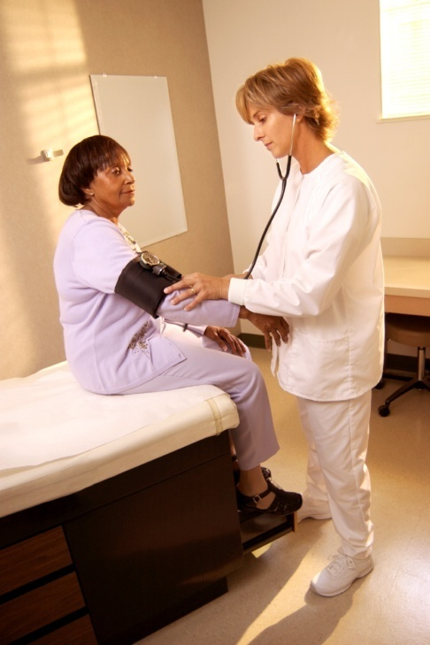
Routinely Inquire About Violence
Ask even if physical indicators are absent
Use private setting/space
Add in with other routine inquires
  Substance use, depression, smoking,
  violence
Use framing statements
  E.g. “Because violence is common in many people’s lives, I’ve begun to ask all my patients about it.”

Slide 35

ASK DIRECT QUESTIONS
Validate and be non-judgmental
Use culturally/linguistically appropriate language
Examples:
  “Do you ever feel afraid of your partner?”
  “Are you in a relationship with a person who physically hurts or threatens you?”
  “Is it safe for you to go home?”
Notes:
A list of examples of framing statements and assessment questions is in the RADAR booklet for providers. They should choose one statement and question with which they are comfortable and use it routinely.

Slide 36

Document Findings
Include:
  Patient’s statements about incident, relationship, injuries
  Relevant history
  Results of physical examination
  Laboratory and other diagnostic procedures
  Results of health and safety assessments, interventions, and referrals
Use body diagram
File reports when required by law
Safety Note:
IPV should not be documented on any discharge forms or billing statements, as it may increase the risk of violence to the victim.

Slide 37

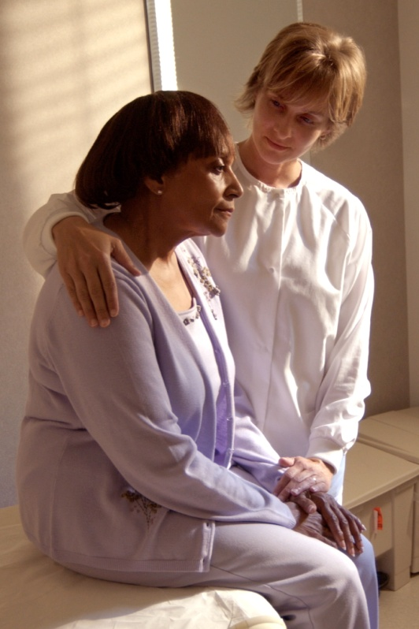
Assess Safety
  Review history of abuse
    Escalation in frequency, severity
    Threats of homicide/suicide
    Weapons used or available
  Inquire as to whether the batterer has harmed the child(ren)
  Determine what patient perceives as risks and strengths
  Safety planning/protective strategies should be employed, regardless of whether victim plans
  to stay or leave
Notes:
Resource: Danger Assessment Tool (www.dangerassessment.org)

Slide 38

Review Options and Referrals
Become familiar with a variety of resources
Let the patient decide what is the safest option
Schedule follow-up appointment or plan
Possible referrals may include:
  Local/statewide hotlines
  School Counselors
  Shelters/domestic violence programs
  Legal Resources
  Parents, caregivers, and/or other trusted adults
**Be aware that “traditional resources” such as civil/criminal charges, domestic violence programs, and mental health may be difficult for minors to access and utilize, as they carry issues of parental consent with them. It is, therefore, especially important to ensure that young victims of abuse have confided in a parent or other trusted adult.

Slide 39
Management of Patient Care
Use your RADAR
Routinely inquire about violence
Ask direct questions
Document findings
Assess safety
Review options and referrals
  RADAR action steps developed by the Massachusetts Medical Society, ©1997, 2004. Adapted with permission

Slide 40


Cultural Considerations
    Religious beliefs, values, social relationships can
    affect decisions and options for victims and perpetrators.
    Cultural responses to IPV can vary across populations.
    Institutional racism and other forms of discrimination can influence outcomes.
    Acceptable behaviors within a culture can be interpreted as false positives.
    Availability of language/culture interpreters for diversity of victims served is critical.

Slide 41

Helpful Information on Mandated Reporting v. Confidentiality
When the IPV victim is a physically and mentally
able adult, providers are bound by confidentiality
not to contact law enforcement or other agencies
against a victim’s will unless wounds have been inflicted by specific weapons such as firearms or knives. (Code of Virginia § 54.1-2967 & § 18.2-308)
When a child or elder is the victim of abuse, mandated reporting statutes apply. (Code of Virginia § 63.2-1509 and Code of Virginia § 63.2-1606)

Slide 42

General Management of
Abused Patients
Support and protect victim
Avoid judgmental statements
Report if child or elder abuse/neglect suspected
Protect victim confidentiality
Enlist social work/crisis services support
Ensure follow up regarding both IPV and medical issues

Slide 43

A Public Health Approach to IPV
Success is routine screening, assessment, and education, NOT
  Disclosure
  Leaving the relationship
    Leaving actually significantly increases the risk of severe injury or death
You do not need to “FIX” the problem
Key is to:
  Be there
  Listen
  Educate
  Refer
Notes:
National and state-specific reviews of domestic-violence related homicides shows that 75% of women seriously injured or killed by their batterers suffer that event just after leaving the relationship or while they are in the process, suggesting that staying with an abuser is safer than leaving. Each time a victim leaves, we must provide her with more resources and assistance so that, when she does leave, she can do so as safely as possible.

Slide 44
Review: Why is Routine
Screening and Assessment so Critical to the Health Care Role?
It can relieve suffering and save lives.
It’s good medical practice.
IPV impacts patient health and treatment outcomes.
Unidentified IPV costs money and time
Potential future liability
JCAHO and Professional Association
Standards

Slide 45

The Outcomes of Taking a Public Health Approach to IPV
Enhanced safety for victims
Improved care and satisfaction of
patients
Attitudinal change
Decrease in homicides
Increase in positive health outcomes

Slide 46
Resources for Providers
VDH’s Project RADAR
  www.projectradarva.com/804-864-7705
Futures Without Violence
  www.furtureswithoutviolence.org/888-Rx-ABUSE
Virginia Sexual and Domestic Violence Action Alliance
  www.vsdvalliance.org/800-838-8238 (24 hr hotline for victims)
Centers for Disease Control, National Center for Injury Prevention & Control
  www.cdc.gov/ncipc/800-CDC-INFO
American Medical Association, Violence Prevention
  http://www.ama-assn.org/ama/pub/category/3242.html
Massachusetts Medical Society Violence Prevention Program
  http://www.massmed.org/AM/Template.cfm?Section=Violence/800-322-2303
Academy on Violence & Abuse
  www.avahealth.org

Slide 47

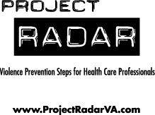
For more information about Project RADAR, to request additional training or to order materials, contact:
Laurie K. Crawford, MPA
Sexual and Domestic Violence Healthcare Outreach Coordinator
Office of Family Health Services
Virginia Department of Health
804-864-7705
Laurie.Crawford@vdh.virginia.gov

