Slide 1

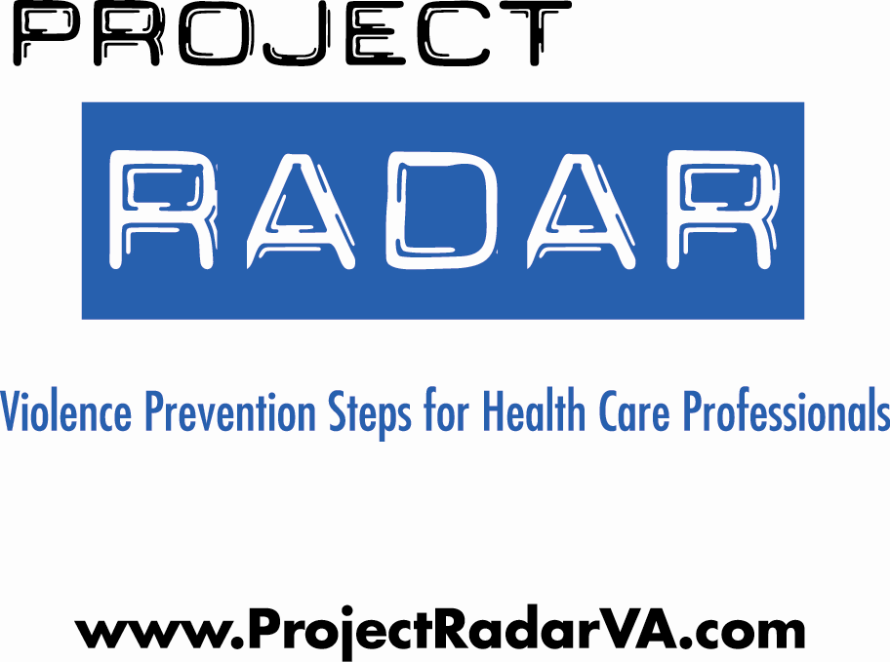

Geriatric Provider Module

Slide 2
What is Project RADAR?
Project RADAR is an initiative of VDH’s Office of Family Health Services that was developed to enable health care providers to effectively recognize and respond to intimate partner violence (IPV) by providing:
  “Best Practice” Policies, Guidelines, and Assessment Tools
  Training Programs and Specialty-Specific Curricula
  Awareness and Educational Materials
  Current Research Findings on Intimate Partner Violence

Slide 3


Training Objectives
By the end of this training, participants will be able to:
  Define intimate partner violence (IPV)
  Perform specific screening, assessment, and intervention strategies
  Identify and formulate responses to challenges specific to the health care setting
  Direct victims of IPV to appropriate resources
  Train providers using the RADAR curricula

Slide 4


What is IPV?
Intimate Partner Violence (IPV) is a pattern of assaultive and coercive behaviors that may include inflicted physical injury, psychological abuse, sexual assault, progressive social isolation, stalking, deprivation, intimidation, and threats. These behaviors are perpetrated by someone who is, was, or wishes to be involved in an intimate or dating relationship with an adult or adolescent, and are aimed at establishing control by one partner over another.

Slide 5
Who Are Victims and Batterers?
VICTIMS:
Women and men
Adolescents, teens, young, middle-aged and older adults
People of all cultures and religions
Blue collar, middle class, and wealthy
Straight, gay, lesbian, and transgender
Married and unmarried
People with and without high school or college degrees
BATTERERS:
Women and men
Adolescents, teens, young, middle-aged and older adults
People of all cultures and religions
Blue collar, middle class, and wealthy
Straight, gay, lesbian, and transgender
Married and unmarried
People with and without high school or college degrees

Slide 6

The Dynamics of Abuse:
The Power & Control Wheel
In the early 80’s in Duluth, Minnesota, victims of IPV attending educational groups were interviewed about the behaviors of their abusers and factors that influenced why they stayed in violent relationships/returned to their abusers.
Based on input from over 200 battered women, they developed a framework for understanding IPV.
Key finding, as conceptualized in the “power and control wheel” is that abusers use an array of tactics--apart from physical and sexual violence--to gain and maintain control over their victims.

Slide 7
Making and/or carrying out threats to do something to hurt her Threatening to leave her, to commit suicide, to report her to welfare Making her drop charges Making her do illegal things
Making her afraid by using looks, actions, gesturesSmashing things Destroying her property Abusing pets  Displaying weapons
VIOLENCE
Physical
Sexual
Using Coercion & Threats
Using Intimidation
Putting her downMaking her feel bad about herselfCalling her names Making her think she’s crazy  Playing mind games  Humiliating her  Making her feel guilty
Preventing her from getting or keeping a job Making her ask for money Giving her an allowance Taking her money  Not letting her know about or have access to family income
Using Economic Abuse
Using Emotional Abuse
Power
&
Control
Controlling what she does, who she sees and talks to, what she reads, where she goesLimiting her outside involvement Using jealousy to justify actions
Using Male Privilege
Using Isolation
Treating her like a servantMaking all the big decisionsActing like the “master of the castle” Being the one to define men’s and women’s roles
Using Children
Minimizing, Denying & Blaming
Making light of the abuse,and not taking her concerns about it seriouslySaying the abuse didn’t happen Shifting responsibility for the abusive behavior Saying she caused it
Making her feel guilty about the children Using the children to rely messages Using visitation to harass her Threatening to take the children away
Physical
Sexual
VIOLENCE

Slide 8

Factors that Influence Victims
Loss of status
$$$
Good times
Family
Religion
Kids
Culture
FEAR
**Intimate partner violence occurs within the context of the victim’s life.
Notes:
75% of women seriously injured or killed were victimized in the process of or just after leaving their abusers.

Slide 9

IPV as a Critical Public Health Issue
      More than 25% of women are abused by a partner at some point in their lives.
      Based on data from 1995, the CDC concluded that IPV costs the U.S. $4.1 billion each year in direct medical costs and another $1.8 billion in indirect costs (lost productivity, etc). Extrapolated to 2003, these costs were estimated at $8.3 billion.
      Mental health care costs are estimated to be 800% higher for abused versus non abused women.
      In addition to injuries sustained by victims during violent episodes, abuse is linked to:
--Arthritis --Chronic neck, back, & --Migraines pelvic pain
  --Gastrointestinal problems --STI’s --Pregnancy Complications --Substance abuse
Notes:
Costs of Intimate Partner Violence Against Women in the United States (Centers for Disease Control and Prevention, 2003)
**Note that since costs were re-estimated in 2003 and that health care costs have continued to increase since that time, the costs associated with IPV are likely MUCH higher now.
Reference for mental health care costs comes a study published in the Journal of Family Medicine. Intimate partner violence against women: do victims cost health plans more? (Wisner C.L. et al, 1999). Note that these costs are likely to also be much higher, given that the data was collected ten or more years ago.

Slide 10
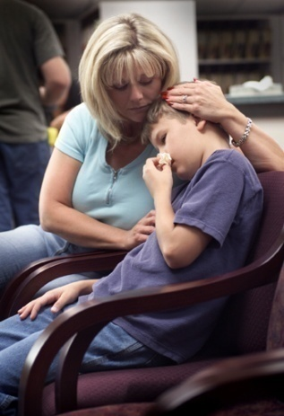




The Impact of IPV on its Victims
Adults
Physical injuries
Chronic physical ailments related to injuries and stress
Mental health problems including depression, anxiety, and PTSD
Social consequences caused by loss of contact with family, friends, work, and children
Financial strain due to: loss of income and denial of education and/or career advancement
Spiritual effects such as loss of faith and alienation from religious community
Children
Developmental delays
Mental health issues including depression, anxiety, PTSD, ODD, and sleep disorders
Behavior disorders
Poor adaptive and social skills
Increased risk for substance abuse, suicide, and criminal behavior as teens and adults
Elevated likelihood for perpetrating abuse as teens and adults
Increased vulnerability to victimization as teens and adults

Slide 11
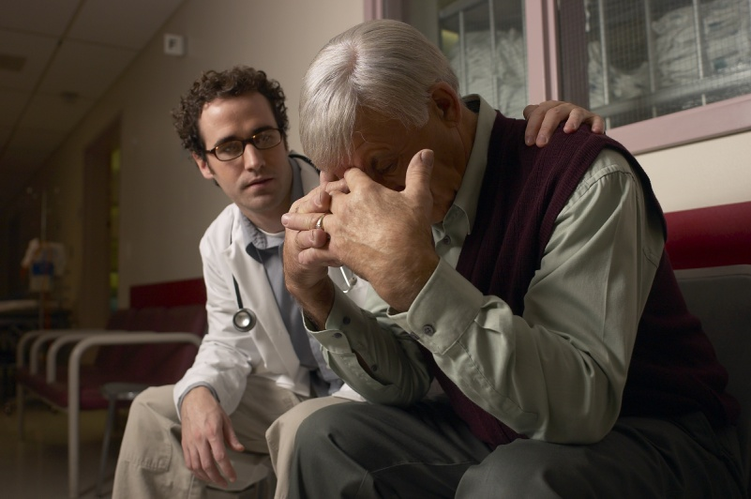
IPV in the Second Half of Life
Over 30% of substantiated reports of abuse directed at elders is alleged to have been perpetrated by a spouse or intimate partner.
2:3 elder abuse victims are women
May be long-term, late onset, or occur in a new relationship
Often presents as neglect or
financial exploitation.
Notes:
Stats from the National Center on Elder Abuse (2004). The largest percentage is perpetrated by adult children (33%).
Note that the ratio of male victims (1/3) is much higher in the second half of life. In other groups, only 5% of IPV victims are men.

Slide 12

Key Point:
IPV in later life is NOT caused by caregiver stress or level of victims’ dependence. The power and control dynamics that exist in younger violent relationships exist in older ones.

Slide 13

Intimate Partner Homicide:
Paying the Ultimate Price
In Virginia:
  Nearly one in three homicides is related to family or intimate partner violence.
  Over half of all adult female homicide victims are killed by intimate partners.
Notes:
Reference: Family & Intimate Partner Homicide Report (Office of the Chief Medical Examiner, 2007)

Slide 14

IPV is an Issue for ALL
Health Care Providers.
Victims report that they are not embarrassed to be asked about abuse and that discussing it would strengthen relationships with health care providers.
Victims feel that providers can help.
Joint Commission and professional standards
Providers have a unique opportunity to identify victims and provide critical interventions and referrals.
  44-47% of women killed by their intimate partners have been seen by a health care provider in the year prior to their deaths.
Notes:
All references are from studies conducted by Dr. Jacqueline Campbell of Johns Hopkins University School of Nursing

Slide 15

Joint Commission Standards Relevant to IPV Policy and Practice
In 2004, The Joint Commission instituted new standards for hospitals on how to respond to domestic abuse, neglect and exploitation and revised them in 2009.
RI.2.150—Patients have the right to be free from mental, physical, sexual, and verbal abuse, neglect, and exploitation.¹
RI.2.170—Patients have the right to access protective and advocacy services.
RI.3.10—Criteria for identifying and assessing victims of abuse, neglect, or exploitation should be used throughout the hospital.
EC.2.10—The hospital identifies and manages its security risks

Slide 16
Joint Commission Standards Relevant to IPV Policy and Practice
Elements of Performance:
The organization addresses how it will, to the best of its ability, protect patients from real or perceived abuse, neglect [including involuntary seclusion for Long Term Care], or exploitation from anyone, including staff, students, volunteers, other [patients/residents/clients], visitors, or family members.
All allegations, observations, or suspected cases of abuse, neglect, or exploitation that occur [in the organization for all except OME] are investigated by the organization.

Slide 17

Professional Standards
The American Medical Association’s Guidelines for Detecting and Treating Family Violence state¹:
“Physicians should routinely inquire about physical, sexual, and psychological abuse as part of the medical history. Physicians must also consider abuse in the differential diagnosis for a number of medical complaints, particularly when treating women…[and] have an obligation to familiarize themselves with protocols for diagnosing and treating abuse and with community resources for battered women, children, and elderly persons… Physicians must be better trained to identify signs of abuse and to work cooperatively with the range of community services…Comprehensive training on family violence should be required in medical school curricula and in residency programs for specialties in which family violence is likely to be encountered.”
¹E-2.02 Abuse of Spouses, Children, Elderly Persons, and Others at Risk

Slide 18

How Are We Doing in Virginia?
The 2009 Intimate Partner Violence
Health Care Provider Survey
Methodology
Designed to assess knowledge attitudes and behaviors of Virginia’s health care providers concerning IPV
Sent to dentists, hygienists, licensed clinical social workers, psychiatrists and medical doctors who self-identified a specialty area of family/general practice, obstetrics/gynecology, pediatrics or emergency. Other settings included were: community health centers, free clinics, family planning clinics at local health departments, and campus health centers.
Of 10,325 surveys mailed, a total of 4,481 were returned, for an overall response rate of 43.4%.
Notes:
Virginia Department of Health (2010)

Slide 19
How Are We Doing in Virginia?
The 2009 Intimate Partner Violence
Health Care Provider Survey
Results
85.4 % of providers have never attended an IPV training/workshop.
Even though over 1 in 3 providers indicated that either they or someone close to them had been a victim of IPV, half reported that they do not use screening questions with any patients.
Even when the patient presented with a bruise or laceration, only 1 in 4 providers consistently (“always” or “almost always”) asked about the possibility of IPV.
Over 2/3 (67%) of providers reported that, to their knowledge, their workplace does not have any written guidelines regarding IPV.

Slide 20

The Hospital Policy
Analysis Project
Characteristics of Participating Hospitals
62 hospitals participated (RR=76.5%)
Distributed across the five health planning districts
Equally distributed in terms of bed size and average number of ED visits annually
67% of study hospitals in a health system, compared to 61% of all Virginia hospitals
Type of ownership (public, private, government) of study hospitals representative of ownership distribution of all Virginia hospitals.
Notes:
The 2008 Virginia Intimate Partner Violence Hospital Policy Analysis Project (Virginia Department of Health, Division of Injury & Violence Prevention, 2009)

Slide 21
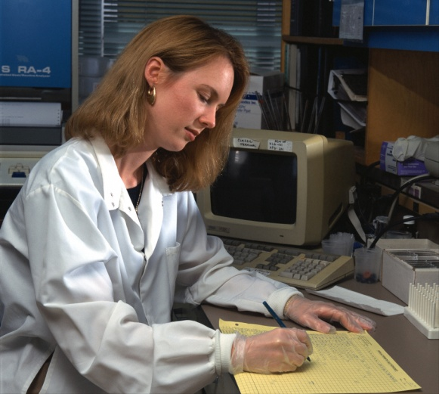
The Hospital Policy
Analysis Project
Key Findings
Only 24.6% of participating hospitals had a ‘stand-alone’ policy on IPV.
36.1% did not provide any definition of IPV or DV anywhere in the policy.
Only 2.4% referenced JCAHO standards on abuse.
Reporting requirements regarding IPV were unclearly or incorrectly stated in 59% of the policies that we reviewed.
Referral sources with phone numbers were provided in 49.2% of the policies, but only 13.1% included a written safety plan.
37.7% made mention of requiring staff training/education on IPV, but only 1.6% discussed how to address employees affected by IPV and only 6.6% discussed related security issues (e.g. what to do if an abuser is on-site)
Notes:
The 2008 Virginia Intimate Partner Violence Hospital Policy Analysis Project (Virginia Department of Health, Division of Injury & Violence Prevention, 2009)

Slide 22

Challenges to Accurately
Identifying and Diagnosing IPV
Chief complaints initially seem unrelated to IPV
Time
Limited resources
Provider may suspect, but be hesitant to ask
  Don’t ask directly about cause of injury
  Have too low/high suspicion index
  Co-presentation of behavioral health/
  substance use
“Patient Resistance” to Problem
  May provide inaccurate history
  May have skewed perception of problem
  (may blame self and or minimize abuse)
Notes:
Stress that the RADAR steps are designed to be a quick and easy approach to identifying and that the most important aspects are recognizing the signs that may indicate high risk of danger/lethality and knowing referrals.

Slide 23
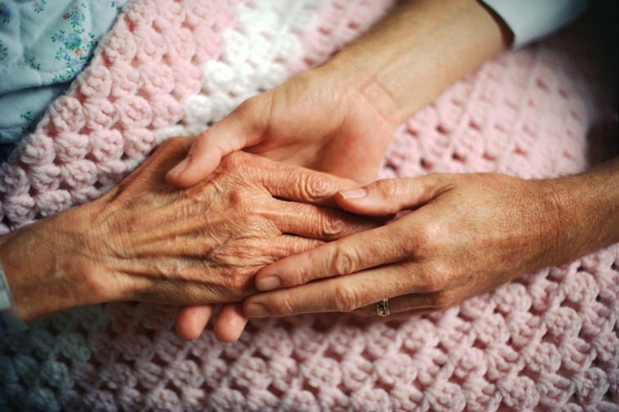
Challenges Unique to Assisting Victims in the Second Half of Life
“Shame factor” more prevalent than in younger victims.
Caretaker or dependency concerns
Health, cognitive, and functional status
Economic barriers
Transportation issues
Isolation
Notes:
Many older victims entered relationships long before the Battered Women’s Movement. Raised in a generation where wife took care of family and was raised to do what her husband said. Talking about abuse is, to them, admitting they failed at their role.

Slide 24

How Do I Begin?
Add printed materials to the
office/clinic environment
Make screening part of your routine
  Include prompts/forms in chart
  Include questions about IPV in health surveys/hx
Frame screening questions so that they make patients comfortable
Utilize RADAR methodology

Slide 25
Management of Patient Care
Use your RADAR
Routinely inquire about violence
Ask direct questions
Document findings
Assess safety
Review options and referrals
  RADAR action steps developed by the Massachusetts Medical Society, ©1997, 2004. Adapted with permission

Slide 26
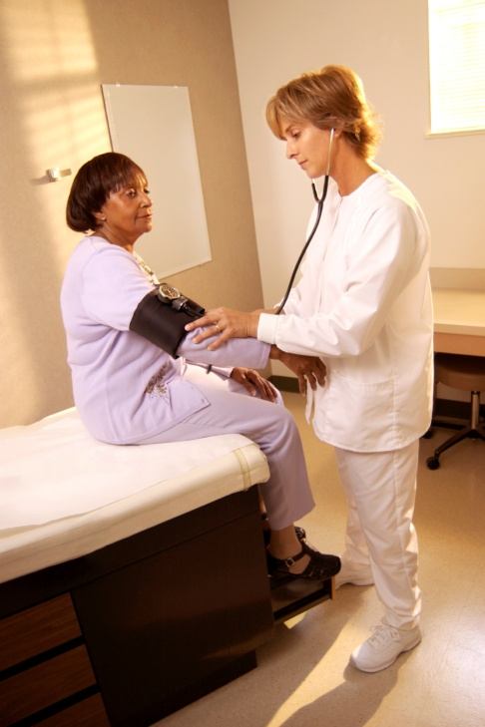
Routinely Inquire About Violence
Ask even if physical indicators are absent
Use private setting/space
Add in with other routine inquires
  Substance use, depression, smoking,
  violence
Use framing statements
  E.g. “Because violence is common in many people’s lives, I’ve begun to ask all my patients about it.”

Slide 27

ASK DIRECT QUESTIONS
Validate and be non-judgmental
Use culturally/linguistically appropriate language
Examples:
  “Do you ever feel afraid of your partner?”
  “Are you in a relationship with a person who physically hurts or threatens you?”
  “Is it safe for you to go home?”
Notes:
A list of examples of framing statements and assessment questions is in the RADAR booklet for providers. They should choose one statement and question with which they are comfortable and use it routinely.

Slide 28

Document Findings
Include:
  Patient’s statements about incident, relationship, injuries
  Relevant history
  Results of physical examination
  Laboratory and other diagnostic procedures
  Results of health and safety assessments, interventions, and referrals
Use body diagram
File reports when required by law
Safety Note:
IPV should not be documented on any discharge forms or billing statements, as it may increase the risk of violence to the victim.

Slide 29

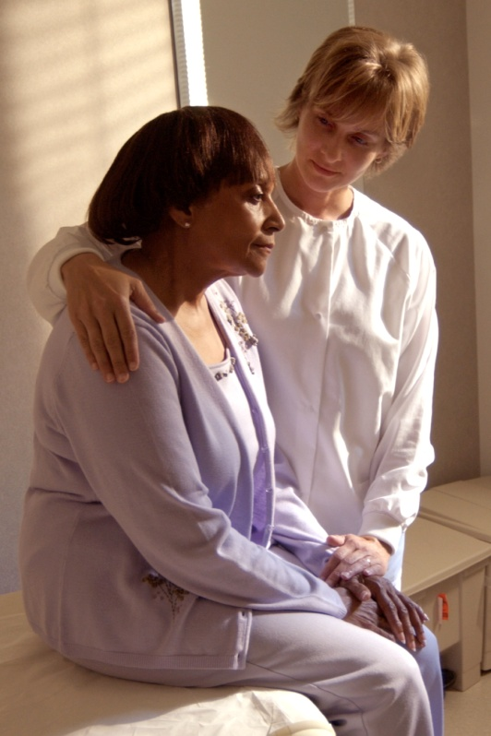
Assess Safety
  Review history of abuse
    Escalation in frequency, severity
    Threats of homicide/suicide
    Weapons used or available
  Inquire as to whether the batterer has harmed the child(ren)
  Determine what patient perceives as risks and strengths
  Safety planning/protective strategies should be employed, regardless of whether victim plans
  to stay or leave
Notes:
Resource: Danger Assessment Tool (www.dangerassessment.org)

Slide 30
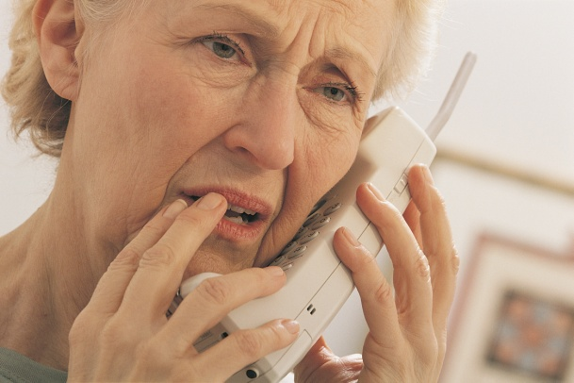

Review Options and Referrals
Become familiar with a variety of resources
Let the patient decide what is the safest option
Possible referrals may include:
  Local/statewide hotlines
  Counselors
  Social Workers
  Shelters/domestic violence programs
  Legal Resources
Schedule follow-up appointment or plan

Slide 31
Management of Patient Care
Use your RADAR
Routinely inquire about violence
Ask direct questions
Document findings
Assess safety
Review options and referrals
  RADAR action steps developed by the Massachusetts Medical Society, ©1997, 2004. Adapted with permission

Slide 32


Cultural Considerations
    Religious beliefs, values, social relationships can
    affect decisions and options for victims and perpetrators.
    Cultural responses to IPV can vary across populations.
    Institutional racism and other forms of discrimination can influence outcomes.
    Acceptable behaviors within a culture can be interpreted as false positives.
    Availability of language/culture interpreters for diversity of victims served is critical.

Slide 33

Helpful Information on Mandated Reporting v. Confidentiality
When the IPV victim is a physically and mentally
able adult, providers are bound by confidentiality
not to contact law enforcement or other agencies
against a victim’s will unless wounds have been inflicted by specific weapons such as firearms or knives. (Code of Virginia § 54.1-2967 & § 18.2-308)
When a child or elder is the victim of abuse, mandated reporting statutes apply. (Code of Virginia § 63.2-1509 and Code of Virginia § 63.2-1606)

Slide 34

General Management of
Abused Patients
Support and protect victim
Avoid judgmental statements
Report if child or elder abuse/neglect suspected
Protect victim confidentiality
Enlist social work/crisis services support
Ensure follow up regarding both IPV and medical issues

Slide 35

A Public Health Approach to IPV
Success is routine screening, assessment, and education, NOT
  Disclosure
  Leaving the relationship
    Leaving actually significantly increases the risk of severe injury or death
You do not need to “FIX” the problem
Key is to:
  Be there
  Listen
  Educate
  Refer
Notes:
National and state-specific reviews of domestic-violence related homicides shows that 75% of women seriously injured or killed by their batterers suffer that event just after leaving the relationship or while they are in the process, suggesting that staying with an abuser is safer than leaving. Each time a victim leaves, we must provide her with more resources and assistance so that, when she does leave, she can do so as safely as possible.

Slide 36
Review: Why is Routine
Screening and Assessment so Critical to the Health Care Role?
It can relieve suffering and save lives.
It’s good medical practice.
IPV impacts patient health and treatment outcomes.
Unidentified IPV costs money and time
Potential future liability
JCAHO and Professional Association
Standards

Slide 37

The Outcomes of Taking a Public Health Approach to IPV
Enhanced safety for victims
Improved care and satisfaction of
patients
Attitudinal change
Decrease in homicides
Increase in positive health outcomes

Slide 38
Resources for Providers
VDH’s Project RADAR
  www.projectradarva.com/804-864-7705
Futures Without Violence
  www.furtureswithoutviolence.org/888-Rx-ABUSE
Virginia Sexual and Domestic Violence Action Alliance
  www.vsdvalliance.org/800-838-8238 (24 hr hotline for victims)
Centers for Disease Control, National Center for Injury Prevention & Control
  www.cdc.gov/ncipc/800-CDC-INFO
American Medical Association, Violence Prevention
  http://www.ama-assn.org/ama/pub/category/3242.html
Massachusetts Medical Society Violence Prevention Program
  http://www.massmed.org/AM/Template.cfm?Section=Violence/800-322-2303
Academy on Violence & Abuse
  www.avahealth.org

Slide 39


For more information about Project RADAR, to request additional training or to order materials, contact:
Laurie K. Crawford, MPA
Sexual and Domestic Violence Healthcare Outreach Coordinator
Office of Family Health Services
Virginia Department of Health
804-864-7705
Laurie.Crawford@vdh.virginia.gov

