Slide 1

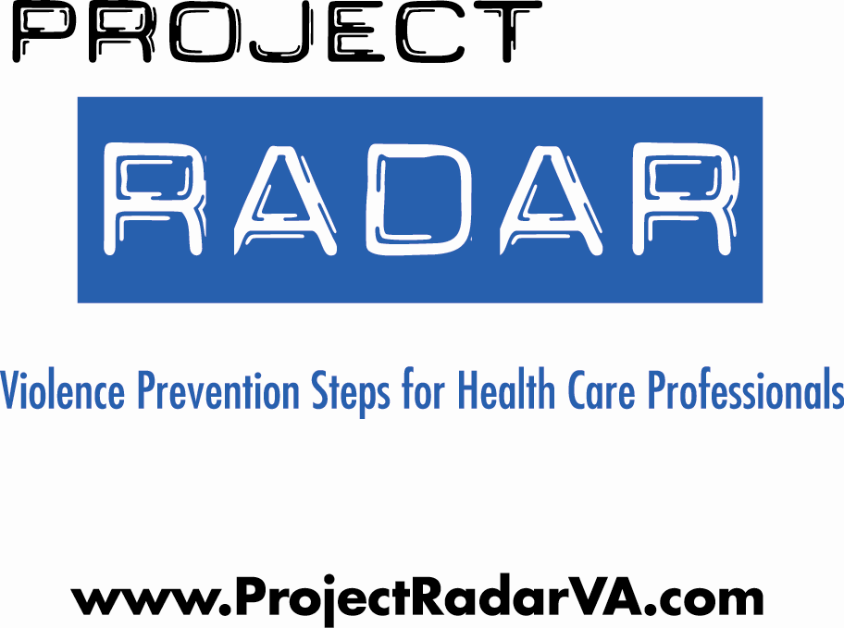

Obstetrics & Gynecology Module
Notes:
**Important Note: Given the breadth of information, this RADAR curriculum should be allocated a minimum of 90 minutes. Virginia has a 4-hour training curriculum available for family planning/reproductive health providers that reviews the screening process and options for services/referrals in much more detail for this setting. Visit www.projectconnectva.com for more information.

Slide 2
What is Project RADAR?
Project RADAR is an initiative of VDH’s Office of Family Health Services that was developed to enable health care providers to effectively recognize and respond to intimate partner violence (IPV) by providing:
  “Best Practice” Policies, Guidelines, and Assessment Tools
  Training Programs and Specialty-Specific Curricula
  Awareness and Educational Materials
  Current Research Findings on Intimate Partner Violence

Slide 3


Training Objectives
By the end of this training, participants will be able to:
  Define intimate partner violence (IPV)
  Perform specific screening, assessment, and intervention strategies
  Identify and formulate responses to challenges specific to the health care setting
  Direct victims of IPV to appropriate resources
  Train providers using the RADAR curricula

Slide 4


What is IPV?
Intimate Partner Violence (IPV) is a pattern of assaultive and coercive behaviors that may include inflicted physical injury, psychological abuse, sexual assault, progressive social isolation, stalking, deprivation, intimidation, and threats. These behaviors are perpetrated by someone who is, was, or wishes to be involved in an intimate or dating relationship with an adult or adolescent, and are aimed at establishing control by one partner over another.

Slide 5
Who Are Victims and Batterers?
VICTIMS:
Women and men
Adolescents, teens, young, middle-aged and older adults
People of all cultures and religions
Blue collar, middle class, and wealthy
Straight, gay, lesbian, and transgender
Married and unmarried
People with and without high school or college degrees
BATTERERS:
Women and men
Adolescents, teens, young, middle-aged and older adults
People of all cultures and religions
Blue collar, middle class, and wealthy
Straight, gay, lesbian, and transgender
Married and unmarried
People with and without high school or college degrees

Slide 6

The Dynamics of Abuse:
The Power & Control Wheel
In the early 80’s in Duluth, Minnesota, victims of IPV attending educational groups were interviewed about the behaviors of their abusers and factors that influenced why they stayed in violent relationships/returned to their abusers.
Based on input from over 200 battered women, they developed a framework for understanding IPV.
Key finding, as conceptualized in the “power and control wheel” is that abusers use an array of tactics--apart from physical and sexual violence--to gain and maintain control over their victims.

Slide 7
Making and/or carrying out threats to do something to hurt her Threatening to leave her, to commit suicide, to report her to welfare Making her drop charges Making her do illegal things
Making her afraid by using looks, actions, gesturesSmashing things Destroying her property Abusing pets  Displaying weapons
VIOLENCE
Physical
Sexual
Using Coercion & Threats
Using Intimidation
Putting her downMaking her feel bad about herselfCalling her names Making her think she’s crazy  Playing mind games  Humiliating her  Making her feel guilty
Preventing her from getting or keeping a job Making her ask for money Giving her an allowance Taking her money  Not letting her know about or have access to family income
Using Economic Abuse
Using Emotional Abuse
Power
&
Control
Controlling what she does, who she sees and talks to, what she reads, where she goesLimiting her outside involvement Using jealousy to justify actions
Using Male Privilege
Using Isolation
Treating her like a servantMaking all the big decisionsActing like the “master of the castle” Being the one to define men’s and women’s roles
Using Children
Minimizing, Denying & Blaming
Making light of the abuse,and not taking her concerns about it seriouslySaying the abuse didn’t happen Shifting responsibility for the abusive behavior Saying she caused it
Making her feel guilty about the children Using the children to rely messages Using visitation to harass her Threatening to take the children away
Physical
Sexual
VIOLENCE

Slide 8

Factors that Influence Victims
Loss of status
$$$
Good times
Family
Religion
Kids
Culture
FEAR
**Intimate partner violence occurs within the context of the victim’s life.
Notes:
75% of women seriously injured or killed were victimized in the process of or just after leaving their abusers.

Slide 9

IPV as a Critical Public Health Issue
      More than 25% of women are abused by a partner at some point in their lives.
      Based on data from 1995, the CDC concluded that IPV costs the U.S. $4.1 billion each year in direct medical costs and another $1.8 billion in indirect costs (lost productivity, etc). Extrapolated to 2003, these costs were estimated at $8.3 billion.
      Mental health care costs are estimated to be 800% higher for abused versus non abused women.
      In addition to injuries sustained by victims during violent episodes, abuse is linked to:
--Arthritis --Chronic neck, back, & --Migraines pelvic pain
  --Gastrointestinal problems --STI’s --Pregnancy Complications --Substance abuse
Notes:
Costs of Intimate Partner Violence Against Women in the United States (Centers for Disease Control and Prevention, 2003)
**Note that since costs were re-estimated in 2003 and that health care costs have continued to increase since that time, the costs associated with IPV are likely MUCH higher now.
Reference for mental health care costs comes a study published in the Journal of Family Medicine. Intimate partner violence against women: do victims cost health plans more? (Wisner C.L. et al, 1999). Note that these costs are likely to also be much higher, given that the data was collected ten or more years ago.

Slide 10
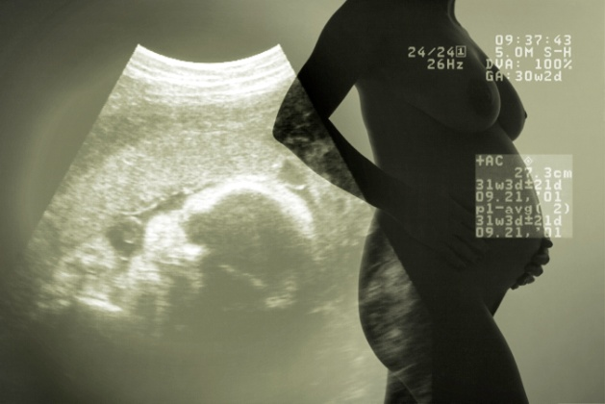

Intimate Partner Violence & Reproductive Health
Approximately 4%-8% of American women (and 5.7 % of Virginia women) experience violence before and/or during pregnancy, as often as conditions regularly screened for in prenatal care such as gestational diabetes and pre-eclampsia.
Affects as many as 324,000 pregnant women each year.
Homicide is one of the leading causes of injury-related death in pregnancy
Physical violence has shown to be associated
with unintended pregnancy and late entry
into prenatal care.
Notes:
National statistic from CDC bulletin on Pregnancy Risk Assessment Monitoring System (2/06), Virginia PRAMS data is from VDH’s survey (2008).

Slide 11

WOMEN WHO EXPERIENCE ABUSE AROUND THE TIME OF PREGNANCY ARE MORE LIKELY TO:
Smoke tobacco
Drink during pregnancy
Use drugs
Experience depression, higher stress, and lower self-esteem
Attempt suicide
Receive less emotional support from partners
Amaro, 1990; Bailey & Daugherty, 2007; Berenson et al, 1994; Campbell et al, 1992; Curry, 1998; Martin et al, 2006; Martin et al, 2003; Martin et al, 1998; McFarlane et al, 1996; Perham-Hester & Gessner, 1997
Notes:
Experiencing domestic violence around the time of pregnancy has been shown to be associated with substance abuse, mental health problems, and other risk behaviors that are associated with poor pregnancy outcomes.

Slide 12
IMPACT OF PSYCHOLOGICAL ABUSE
Psychological abuse by an intimate partner was a stronger predictor than physical abuse for the following health outcomes for female and male victims:
      Depressive symptoms
      Substance use
      Developing a chronic mental illness
Coker et al, 2002
Notes:
In this study:
Women were significantly more likely than men to experience physical or sexual abuse and abuse of power and control by an intimate partner than men
Both physical and psychological abuse by an intimate partner were associated with significant physical and mental health problems for male and female victims

Slide 13
In Virginia, 26% of women having a live birth reported depressive symptoms after pregnancy.
Women with a controlling or threatening partner are 5X more likely to experience persistent symptoms of postpartum maternal depression.
Coker et al, 2002
13
Notes:
13
In this study:
Women were significantly more likely than men to experience physical or sexual abuse and abuse of power and control by an intimate partner than men
Both physical and psychological abuse by an intimate partner were associated with significant physical and mental health problems for male and female victims

Slide 14

Domestic violence negatively impacts reproductive health outcomes including:
Unplanned pregnancy
Rapid Repeat Pregnancies
Unprotected sex
Sexually transmitted infections
Intentional Termination of Pregnancy
Notes:
These are common goals among many family planning programs. There is a wide body of research that has shown how domestic violence is connected to each of these outcomes. These connections will be described in this training.

Slide 15
Definition: Reproductive Coercion
Reproductive coercion involves behaviors that a partner uses to maintain power and control in a relationship that are related to reproductive health:
  Explicit attempts to impregnate a partner against her wishes
  Controlling outcomes of a pregnancy
  Coercing a partner to have unprotected sex
  Interfering with birth control methods
Notes:
Facilitator should note that there is a cultural assumption that it is always women who manipulate contraception to get pregnant and trap men in relationships.
The data that follows demonstrates a less known occurrence of men and boys participating in pregnancy promoting behaviors.

Slide 16
BIRTH CONTROL SABOTAGE
Tactics used by IPV perpetrators include:
Destroying or disposing of contraceptives
Impeding condom use (threatening to leave her, poking holes in condoms)
Not allowing her to obtain or preventing her from using birth control
Threatening physical harm if she uses contraceptives
Campbell et al, 1995; Coggins et al, 2003; Fanslow et al, 2008;
Lang et al, 2007; Miller et al, 2007; Wingood et al, 1997
16
Notes:
16
Qualitative and quantitative research have shown an association between birth control sabotage and IPV.
Fanslow et al. (2008) conducted interviews with a random sample of 2790 women who had ever had sexual intercourse, ages 18-64 years old. Women who had ever experienced IPV were more likely to have had partners who refused to use condoms or prevented women from using contraception (5.4% vs. 1.3%).
Miller et al (2007) conducted interviews with sexually active adolescent females (n=53). One-quarter (26%; n=14) of participants reported that their abusive male partners were actively trying to get them pregnant. Common tactics used by abusive male partners included:
Manipulating condom use
Sabotaging birth control use
Making explicit statements about wanting her to become pregnant

Slide 17
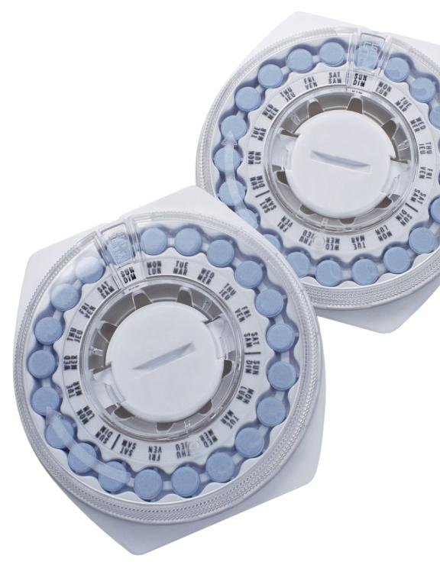
IPV & Unintended Pregnancy
40% of pregnant women experiencing
abuse reported that the pregnancy was
unwanted compared to 8% of nonabused
pregnant women (Hathaway et al, 2000)
Women experiencing physical and emotional IPV are more likely to report not using their preferred method of contraception in the past 12 months (OR=1.9).
Notes:
Williams and colleagues conducted a case control study with 225 women to examine whether IPV was associated with women’s risk for problems in contraception use.

Slide 18


DATING VIOLENCE AND TEEN PREGNANCY
Adolescent girls in physically abusive relationships were
3.5 times more likely to become pregnant than non-abused girls.
Roberts et al, 2005
Notes:
This study by Roberts and colleagues (2005) analyzed data from the National Longitudinal Study of Adolescent Health. The analyses adjusted for sociodemographic factors, the number of intimate partners, and a history of forced sexual intercourse. A past history or current involvement in a physically abusive relationship was associated with a history of being pregnant among sexually active adolescent girls. Physical abuse was defined as “push you,” “shove you,” or “throw something at you.”
In a study by Silverman et al. (2001), adolescent girls who experienced physical or sexual dating violence were 6 times more likely to become pregnant than their non abused peers.

Slide 19
In Virginia..
49% of women 18 to 29 years old and 98% of teens less than 17 years old giving birth said that their pregnancy was unintended.
32% of women 18 to 29 and 35% of teens under 17 were not trying to get pregnant but not using contraception before pregnancy
  21% indicated that they did not use contraception because their partner did not want them to do so
Notes:
Virginia PRAMS 2007-2008

Slide 20
IPV AND SEXUAL RISK BEHAVIORS
Women who experienced past or current IPV are more likely to:
Have multiple sexual partners
Have a past or current sexually transmitted infection
Report inconsistent use or nonuse of condoms
Have a partner with known HIV risk factors
Wu et al, 2003
Notes:
This study by Wu and colleagues (2003) was part of a larger, randomized clinical trial that recruited urban, minority women (n=1590) from out-patient clinics at a large urban hospital in New York City. The mean age of participants was 35.4 years with the majority of women identifying as African American or Latina. Sexual risk behaviors were measured with the Sexual Risk Behavior Questionnaire (SRBQ).
Approximately 1 in 5 women reported experiencing current physical and/or sexual IPV in their primary heterosexual relationship.
Compared to women who reported never experiencing IPV, women who reported experiencing current or past IPV were:
2.9 times as likely to have multiple sexual partners in the past year
2.5 times more likely to report having a past or current STI
2.1 times more likely to never use condoms
3.6 times more likely to use condoms less than half of the instances of sex with their primary partners versus using condoms 100% of the time
3.0 times more likely to report having a partner with a known HIV risk factor

Slide 21

SEXUALLY TRANSMITTED INFECTIONS
AND INTIMATE PARTNER VIOLENCE
More than one-third (38.8%) of adolescent girls tested for STI/HIV have experienced dating violence.
DECKER ET AL, 2005
21
Notes:
21

Slide 22
IPV & SEXUALLY TRANSMITTED INFECTIONS (STIS)
Women disclosing physical abuse were
Women disclosing psychological abuse were
3 TIMES
2 TIMES
more likely to experience a STI.
more likely to experience a STI.
Coker et al, 2000
Notes:
For additional information on the health effects of forced sex, refer to the section on women’s health
In the Coker et al. (2000) study, the relative risk (RR) of physically abused women experiencing a STI was 3.13 compared to non-abused women. The relative risk of psychologically abused women experiencing a STI was 1.82.
RR is the abbreviation for relative risk. Relative risk is defined as the incidence rate for persons exposed to a factor compared to the incidence rate for persons not exposed to that factor. In this study, the factor or exposure is domestic violence and the incidence rate of sexually transmitted diseases is compared among women who have disclosed domestic violence compared to women who did not disclose a history of domestic violence. (Mausner & Kramer, 1985)

Slide 23

KNOWLEDGE ISN’T ENOUGH
Under high levels of fear for abuse, women with high STI knowledge were more likely to use condoms inconsistently than nonfearful women with low STI knowledge.
Ralford et al, 2009
Notes:
In this study by Ralford et al. (2009), women were asked about the degree to which they were worried that if they talked about using condoms with their sexual partner that he would respond in negative ways including threatening to hit, push or kick them; leave them, swear at them; or call them names. Almost half (47.6%) of young (18-21 years) African American women (n=715) reported having experienced relationship abuse in their lifetime; 15% reported abuse by a main sexual partner in the past 60 days. Under high levels of fear for abuse, 76% of women with high STI knowledge were more likely to exhibit inconsistent condom use during their last sexual intercourse with a man compared to 60% of women with low levels of knowledge. One of the explanation for this counterintuitive finding that the authors offer is that women with more knowledge about STI transmission may balance the risk of abuse with the risk of acquiring an STI, particularly if they know or suspect that their partner is at low risk for STIs. Overall these findings emphasize the importance of integrating dating violence assessment and prevention into STI and HIV prevention programs.

Slide 24
IMPLICATIONS
FOR SEXUALLY TRANSMITTED INFECTIONS/HIV PROGRAMS
Partner notification may be dangerous for clients experiencing abuse.
Clients may not be able to negotiate safe sex with an abusive partner.
IPV may be a more immediate threat to a client than a sexually transmitted infection or HIV status.

Slide 25

IPV AND ABORTION
Prevalence of physical and/or sexual IPV among women seeking abortions:
Lifetime: 27.3% - 39.5%
Past year: 14.0% - 21.6%
Lifetime: Evins et al, 1996; Glander et al, 1998; Keeling et al, 2004; Leung et al, 2002
Past Year: Evins et al, 1996; Keeling et al, 2004 ; Woo et al, 2005; Weibe et al, 2001; Whitehead & Fanslow, 2005
25
Notes:
25
Glander et al, (1998) reported that women with a history of abuse reported relationship issues as the sole reason for pregnancy termination more often than women who did not disclose a history of abuse.
Leung et al, (2002) interviewed women seeking termination of pregnancy at a hospital in Hong Kong and a comparison group of non-abortion seeking, general gynecology patients.
The prevalence of lifetime IPV was 27.3% among women seeking abortions compared to 8.2% among non-abortion seeking, general gynecology patients
More than 25% of abortion-seeking patients indicated that their decision for termination of pregnancy had been affected by their experience of abuse
Abortion seeking patients reported more serious physical injuries from abuse compared to non-abortion seeking, gynecology patients who also disclosed abuse
Whitehead and Fanslow (2005) conducted a survey with 218 women seen at an abortion clinic. In the past year, nearly 1 out of 10 (8.5%) had experienced sexual abuse.

Slide 26
IPV AND REPEAT ABORTION
1 IN 5 WOMEN
seeking a repeat abortion
disclosed a history of physical IPV
Fisher et al, 2005
26
Notes:
26
This study by Fisher and colleagues (2005) was conducted with a large, nonrandom sample (n=1145) of women presenting for termination of pregnancy in Ontario, Canada.
Wu et. al. (2006) analyzed data from 2002 young women seeking abortion in China. Women presenting for a third or subsequent abortion were 2.78 times more likely to have experienced physical abuse by a male partner compared to women seeking their first abortion.

Slide 27
Food for Thought…
No matter where you as an individual fall on the issue of abortion, we can all agree our hope for women is they have less unwanted unintended pregnancies and less need for abortion.
Notes:
Abortion can be a controversial topic so it is always good to preface any research on the issue with this acknowledgement of the different opinions in the room about this issue.
The facilitator does not need to take any positions but rather to lift up what the data says about violence and risk for unplanned pregnancy and abortion.

Slide 28

Intimate Partner Homicide:
Paying the Ultimate Price
In Virginia:
  Nearly one in three homicides is related to family or intimate partner violence.
  Over half of all adult female homicide victims are killed by intimate partners.
Notes:
Reference: Family & Intimate Partner Homicide Report (Office of the Chief Medical Examiner, 2007)

Slide 29

IPV is an Issue for ALL
Health Care Providers.
Victims report that they are not embarrassed to be asked about abuse and that discussing it would strengthen relationships with health care providers.
Victims feel that providers can help.
Joint Commission and professional standards
Providers have a unique opportunity to identify victims and provide critical interventions and referrals.
  44-47% of women killed by their intimate partners have been seen by a health care provider in the year prior to their deaths.
Notes:
All references are from studies conducted by Dr. Jacqueline Campbell of Johns Hopkins University School of Nursing

Slide 30

Joint Commission Standards Relevant to IPV Policy and Practice
In 2004, The Joint Commission instituted new standards for hospitals on how to respond to domestic abuse, neglect and exploitation and revised them in 2009.
RI.2.150—Patients have the right to be free from mental, physical, sexual, and verbal abuse, neglect, and exploitation.¹
RI.2.170—Patients have the right to access protective and advocacy services.
RI.3.10—Criteria for identifying and assessing victims of abuse, neglect, or exploitation should be used throughout the hospital.
EC.2.10—The hospital identifies and manages its security risks

Slide 31
Joint Commission Standards Relevant to IPV Policy and Practice
Elements of Performance:
The organization addresses how it will, to the best of its ability, protect patients from real or perceived abuse, neglect [including involuntary seclusion for Long Term Care], or exploitation from anyone, including staff, students, volunteers, other [patients/residents/clients], visitors, or family members.
All allegations, observations, or suspected cases of abuse, neglect, or exploitation that occur [in the organization for all except OME] are investigated by the organization.

Slide 32

Professional Standards
The American College of Obstetricians and Gynecologists (ACOG) recommends that physicians screen all patients for intimate partner violence.

Slide 33

How Are We Doing in Virginia?
The 2009 Intimate Partner Violence
Health Care Provider Survey
Methodology
Designed to assess knowledge attitudes and behaviors of Virginia’s health care providers concerning IPV
Sent to dentists, hygienists, licensed clinical social workers, psychiatrists and medical doctors who self-identified a specialty area of family/general practice, obstetrics/gynecology, pediatrics or emergency. Other settings included were: community health centers, free clinics, family planning clinics at local health departments, and campus health centers.
Of 10,325 surveys mailed, a total of 4,481 were returned, for an overall response rate of 43.4%. Of the 750 OB/GYNs surveyed, 29.5% responded.
Notes:
Virginia Department of Health (2010)

Slide 34
How Are We Doing in Virginia?
The 2009 Intimate Partner Violence
Health Care Provider Survey
Results—Obstetrics & Gynecology
95 % of providers have never attended a training or workshop on IPV.
1 in 5 providers reported that they do not use screening questions with any patients; and only 30% use screening questions with every patient.
90% of providers reported that, to their knowledge, their workplace did not have any written guidelines regarding IPV.
Even though 1 in 3 providers indicated that either they or someone close to them had been a victim of IPV, 40% estimated IPV prevalence in their practice to be “very rare” (1 in 1,000) or “rare” (10 in 1,000).

Slide 35

The Hospital Policy
Analysis Project
Characteristics of Participating Hospitals
62 hospitals participated (RR=76.5%)
Distributed across the five health planning districts
Equally distributed in terms of bed size and average number of ED visits annually
67% of study hospitals in a health system, compared to 61% of all Virginia hospitals
Type of ownership (public, private, government) of study hospitals representative of ownership distribution of all Virginia hospitals.
Notes:
The 2008 Virginia Intimate Partner Violence Hospital Policy Analysis Project (Virginia Department of Health, Division of Injury & Violence Prevention, 2009)

Slide 36

The Hospital Policy
Analysis Project
Key Findings
Only 24.6% of participating hospitals had a ‘stand-alone’ policy on IPV.
36.1% did not provide any definition of IPV or DV anywhere in the policy.
Only 2.4% referenced JCAHO standards on abuse.
Reporting requirements regarding IPV were unclearly or incorrectly stated in 59% of the policies that we reviewed.
Referral sources with phone numbers were provided in 49.2% of the policies, but only 13.1% included a written safety plan.
37.7% made mention of requiring staff training/education on IPV, but only 1.6% discussed how to address employees affected by IPV and only 6.6% discussed related security issues (e.g. what to do if an abuser is on-site)
Notes:
The 2008 Virginia Intimate Partner Violence Hospital Policy Analysis Project (Virginia Department of Health, Division of Injury & Violence Prevention, 2009)

Slide 37

Challenges to Accurately
Identifying and Diagnosing IPV
Chief complaints initially seem unrelated to IPV
Time
Limited resources
Provider may suspect, but be hesitant to ask
  Don’t ask directly about cause of injury
  Have too low/high suspicion index
  Co-presentation of behavioral health/
  substance use
“Patient Resistance” to Problem
  May provide inaccurate history
  May have skewed perception of problem
  (may blame self and or minimize abuse)
Notes:
Stress that the RADAR steps are designed to be a quick and easy approach to identifying and that the most important aspects are recognizing the signs that may indicate high risk of danger/lethality and knowing referrals.

Slide 38

How Do I Begin?
Add printed materials to the
office/clinic environment
Make screening part of your routine
  Include prompts/forms in chart
  Include questions about IPV in health surveys/hx
Frame screening questions so that they make patients comfortable
Utilize RADAR methodology

Slide 39
Management of Patient Care
Use your RADAR
Routinely inquire about violence
Ask direct questions
Document findings
Assess safety
Review options and referrals
  RADAR action steps developed by the Massachusetts Medical Society, ©1997, 2004. Adapted with permission

Slide 40
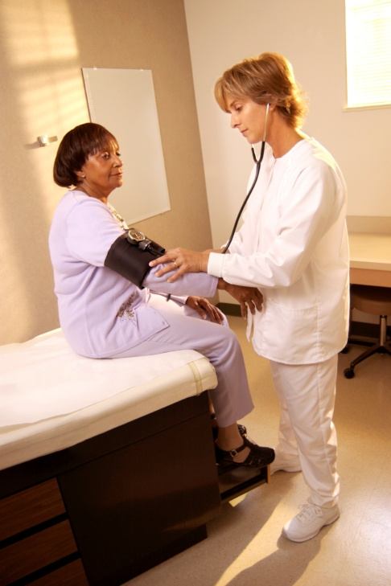
Routinely Inquire About Violence
Ask even if physical indicators are absent
Use private setting/space
Add in with other routine inquires
  Substance use, depression, smoking,
  violence
Use framing statements
  E.g. “Because violence is common in many people’s lives, I’ve begun to ask all my patients about it.”

Slide 41

ASK DIRECT QUESTIONS
Validate and be non-judgmental
Use culturally/linguistically appropriate language
Examples:
  “Do you ever feel afraid of your partner?”
  “Are you in a relationship with a person who physically hurts or threatens you?”
  “Is it safe for you to go home?”
Notes:
A list of examples of framing statements and assessment questions is in the RADAR booklet for providers. They should choose one statement and question with which they are comfortable and use it routinely.

Slide 42
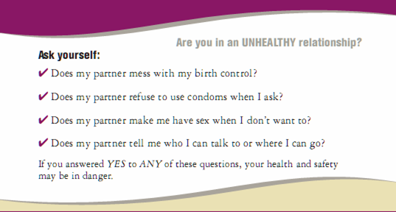
Intervention/Education Tool:
ASK DIRECT QUESTIONS
Notes:
In the study – providers used this card as both a prompt for themselves to ask these questions by introducing the card as a self quiz for patients – walking through the questions with the card and asking the patient:
Does YOUR partner mess with your birth control
Does YOUR partner refuse to use condemns when you ask
Does YOUR partner make you have sex when you don’t want to?
Does YOUR partner tell you who to talk to or where to go?
Training participants will be asked to do this same approach in their clinic.

Slide 43

Document Findings
Include:
  Patient’s statements about incident, relationship, injuries
  Relevant history
  Results of physical examination
  Laboratory and other diagnostic procedures
  Results of health and safety assessments, interventions, and referrals
Use body diagram
File reports when required by law
Safety Note:
IPV should not be documented on any discharge forms or billing statements, as it may increase the risk of violence to the victim.

Slide 44

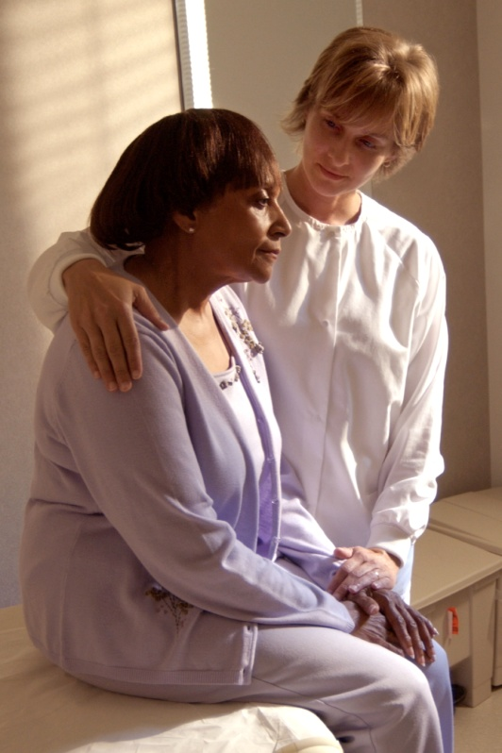
Assess Safety
  Review history of abuse
    Escalation in frequency, severity
    Threats of homicide/suicide
    Weapons used or available
  Inquire as to whether the batterer has harmed the child(ren)
  Determine what patient perceives as risks and strengths
  Safety planning/protective strategies should be employed, regardless of whether victim plans
  to stay or leave
Notes:
Resource: Danger Assessment Tool (www.dangerassessment.org)

Slide 45
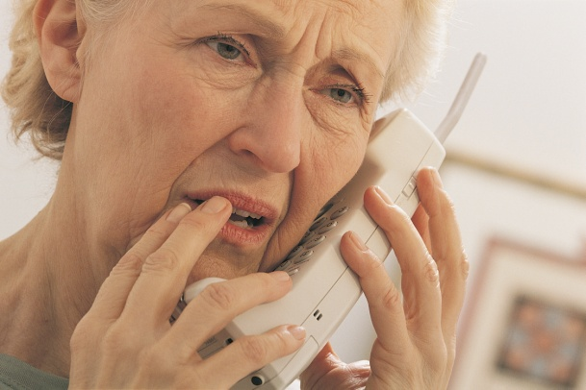

Review Options and Referrals
Become familiar with a variety of resources
Let the patient decide what is the safest option
Possible referrals may include:
  Local/statewide hotlines
  Counselors
  Social Workers
  Shelters/domestic violence programs
  Legal Resources
Schedule follow-up appointment or plan

Slide 46

Family Planning Intervention Elements:
Review Options and Referrals
Harm Reduction Counseling specific to sexual and reproductive health. eg:
  Birth control that your partner doesn’t have to know about (IUD, Implanon)
              Emergency contraception
              STI partner notification in clinic vs. at home
              Safety planning regarding partner violence
Notes:
The next step of the intervention is Harm Reduction Counseling
This involved
Providing supportive messages
Offering birth control that the patient can control
Emergency contraception
Discussing safety planning regarding partner notification for an STI
Facilitator can explain that you will be talking more about STI’s later.
Note – some clients have male partners that monitor their period – and any change could clue them into the fact that she is using birth control.
In that case it is important for the patient to chose a birth control method for her that does not change bleeding patterns – such as some IUD’s and of course Emergency contraception.

Slide 47

Review Options and Referrals
Intervention: Supported Referral
Family planning counselors may help client contact relevant resources
  Annotated referral list for violence related community resources
  Family planning staff should know names of staff, languages spoken, how to get there etc.
Educate clients that family planning clinic is safe place for women to connect to such resources
Normalize use of referral resources
Outcome: Increased awareness and utilization of IPV/SA victimization services
Notes:
What makes interventions and referrals made in the case of reprotductive coercion and pregnancy pressure is that that it lies in the family planning provider reviewing options and THEN making referrals to domestic/sexual violence advocacy sevices.
Final element of the intervention that facilitator should review is the Supportive referral
Stress here that this is different than just handing out a phone number – that the key here is knowing the services involved, discussing the people who are there “I know a woman Clara – she really understands this – and she could be really helpful to talk to”

Slide 48
Management of Patient Care
Use your RADAR
Routinely inquire about violence
Ask direct questions
Document findings
Assess safety
Review options and referrals
  RADAR action steps developed by the Massachusetts Medical Society, ©1997, 2004. Adapted with permission

Slide 49


Cultural Considerations
    Religious beliefs, values, social relationships can
    affect decisions and options for victims and perpetrators.
    Cultural responses to IPV can vary across populations.
    Institutional racism and other forms of discrimination can influence outcomes.
    Acceptable behaviors within a culture can be interpreted as false positives.
    Availability of language/culture interpreters for diversity of victims served is critical.

Slide 50

Helpful Information on Mandated Reporting v. Confidentiality
When the IPV victim is a physically and mentally
able adult, providers are bound by confidentiality
not to contact law enforcement or other agencies
against a victim’s will unless wounds have been inflicted by specific weapons such as firearms or knives. (Code of Virginia § 54.1-2967 & § 18.2-308)
When a child or elder is the victim of abuse, mandated reporting statutes apply. (Code of Virginia § 63.2-1509 and Code of Virginia § 63.2-1606)

Slide 51

General Management of
Abused Patients
Support and protect victim
Avoid judgmental statements
Report if child or elder abuse/neglect suspected
Protect victim confidentiality
Enlist social work/crisis services support
Ensure follow up regarding both IPV and medical issues

Slide 52

A Public Health Approach to IPV
Success is routine screening, assessment, and education, NOT
  Disclosure
  Leaving the relationship
    Leaving actually significantly increases the risk of severe injury or death
You do not need to “FIX” the problem
Key is to:
  Be there
  Listen
  Educate
  Refer
Notes:
National and state-specific reviews of domestic-violence related homicides shows that 75% of women seriously injured or killed by their batterers suffer that event just after leaving the relationship or while they are in the process, suggesting that staying with an abuser is safer than leaving. Each time a victim leaves, we must provide her with more resources and assistance so that, when she does leave, she can do so as safely as possible.

Slide 53
Review: Why is Routine
Screening and Assessment so Critical to the Health Care Role?
It can relieve suffering and save lives.
It’s good medical practice.
IPV impacts patient health and treatment outcomes.
Unidentified IPV costs money and time
Potential future liability
JCAHO and Professional Association
Standards

Slide 54

The Outcomes of Taking a Public Health Approach to IPV
Enhanced safety for victims
Improved care and satisfaction of
patients
Attitudinal change
Decrease in homicides
Increase in positive health outcomes

Slide 55
Resources for Providers
VDH’s Project RADAR
  www.projectradarva.com/804-864-7705
Futures Without Violence
  www.furtureswithoutviolence.org/888-Rx-ABUSE
Virginia Sexual and Domestic Violence Action Alliance
  www.vsdvalliance.org/800-838-8238 (24 hr hotline for victims)
Centers for Disease Control, National Center for Injury Prevention & Control
  www.cdc.gov/ncipc/800-CDC-INFO
ACOG’s Violence Against Women Homepage
  http://www.acog.com/departments/dept_web.cfm?recno=17
American Medical Association, Violence Prevention
  http://www.ama-assn.org/ama/pub/category/3242.html
Massachusetts Medical Society Violence Prevention Program
  http://www.massmed.org/AM/Template.cfm?Section=Violence/800-322-2303
Academy on Violence & Abuse
  www.avahealth.org

Slide 56

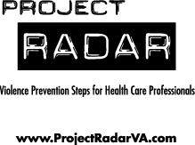
For more information about Project RADAR, to request additional training or to order materials, contact:
Laurie K. Crawford, MPA
Sexual and Domestic Violence Healthcare Outreach Coordinator
Office of Family Health Services
Virginia Department of Health
804-864-7705
Laurie.Crawford@vdh.virginia.gov

