Slide 1

Healthy Moms, Happy Babies:
Domestic Violence,
Reproductive Coercion
and Children Exposed
Introduction and Workshop Guidelines
Notes:
Estimated Module Time: 25 minutes
Training Outline
Workshop guidelines
Pre-training survey
Review the importance of addressing domestic violence (DV) in home visitation programs
Next steps to get started
Overview
The purpose of this module is to help the learner understand how screening for DV or Intimate Partner Violence (IPV) can make a difference in the lives of women and children. The module makes the case for home visitors—showing how DV is connected to many other home visitation program outcome goals, and most importantly, demonstrates how talking with health care providers and home visitors increases the likelihood that women are safer and more likely to seek domestic violence advocacy services.

Slide 2

Workshop Guidelines
Because family violence is so prevalent, assume that there are survivors among us.
Be aware of your reactions and take care of yourself first
Respect confidentiality
Notes:
Notes to Trainer: It is very helpful to have a domestic violence advocate present or on call when you are doing a training on domestic violence. This type of training can trigger painful memories while also creating the opportunity for survivors to process their feelings and experiences.
Encourage participants to do what they need to feel safe and comfortable throughout the training such as leaving the room and taking unscheduled breaks. They may also approach one of the trainers at breaks or lunch to talk about issues. As a trainer, you should anticipate that survivors will come forward and want to talk you, or an advocate for support
Remain aware of anyone who may be reacting to or be affected by the content of the training. A good example of this is the DVD, First Impressions, which is used in the module on “The Effects of Domestic Violence on Children,” which sometimes brings up strong emotions. Consider giving extra breaks after particularly sensitive material, or when you observe that someone is having a difficult time. Connect with that person during the break to check-in and ask if he or she would like to talk with someone and determine how follow-up can occur.

Slide 3

Please complete the
Pre-Training Survey
Notes:
Estimated Activity Time: 5 minutes
Hand-out the pre-training survey for participants to complete and advise them that they will be asked to do a post-training survey at the end of the training. Allow approximately five minutes for participants to complete the survey. Advise participants that they do not need to put their names on the surveys and that their responses are confidential.

Slide 4
“Where Am I?”
Draw a “comfort meter”
On the left end of the meter is “not at all comfortable”
On the right end of the meter is “very comfortable”
Notes:
Estimated Activity Time: 2-3 minutes
Ask participants to follow the directions below. Advise them that they do not have to share what they draw/write.
Take out a sheet of paper and draw a line with the words “not at all comfortable” on the far left side of their line and the words “very comfortable” on the far right side of their line.
Ask participants to take a minute to think about their comfort level right now with talking to clients about domestic violence—and if he or she feels comfortable asking questions and getting a “yes” as the answer.
Discuss how the goal at the end of today’s session is that each person has personally moved that needle towards the ‘totally comfortable’ end of the scale.
Advise participants that this exercise will be repeated at the end of today’s session and that you will ask them to consider whether the needle moved as a result of the training, where it moved, and their thinking about this in the context of what they have learned.
The exercise is followed by small group discussion (see next slide) to help participants identify and share why it is important for home visitors to know about domestic and sexual violence.
The “Where Am I?” exercise is followed by small group discussion (see next slide) to help participants identify and share why it is important for home visitors to know about domestic and sexual violence.

Slide 5

Getting Started: Small Group Discussion
Why is it important for home visitors to know about domestic violence?
Notes:
Estimated Activity Time: 10 minutes
Ask participants to discuss this question for five minutes, breaking up into small groups, if feasible. Instruct groups to prepare a brief answer, consisting of two sentences.
Ask each group to share their answers.
Go to the next slide which describes how domestic violence is connected to the goals of many programs that provide home visitation services.

Slide 6
Domestic Violence Negatively Impacts Home Visitation Program Outcomes Including
Maternal health
Pregnancy outcomes
Children’s cognitive and emotional development and physical health
Parenting skills
Family safety
Social support
Notes:
Notes to Trainer: These are common goals among many home visitation programs. There is an extensive body of research that has shown how domestic violence is connected to each of these outcomes. These connections will be described in this training.

Slide 7
Women Who Talked to Their Health Care Provider About the Abuse Were
4 times more likely to use an intervention
2.6 times more likely to exit the abusive relationship
(McClosky et al. 2006)
Notes:
Notes to Trainers: This section closes with a review of the research that has shown that just having the opportunity to talk to a home visitor or health care provider about domestic violence can increase access to domestic violence services. Examples are also provided for home visitation programs that have had significant impact on domestic violence.
In this study by McCloskey et al. (2006), 132 women outpatients who disclosed domestic violence in the preceding year were recruited from multiple hospital departments and community agencies. Abused women who talked with their health care providers about the abuse were more likely to use an intervention and exit the abusive relationship. Women who were no longer with their abuser reported better physical health than women who stayed.
McCloskey LA, Lichter E, Williams C, Gerber M, Wittenberg E, Ganz M. Assessing Intimate Partner Violence in Health Care Settings Leads to Women’s Receipt of Interventions and Improved Health. Public Health Reporter. 2006;121(4):435-444.

Slide 8

Promising Practice: The Nurse Family Partnership (NFP)
Randomized, controlled trial
First-time pregnant women received home visits by paraprofessionals or nurses during pregnancy and during the first 2 years of their child’s life
Two years after the program ended, nurse-visited women reported less domestic violence compared to women in the control group
(Olds, Robinson, et al. 2004)
Notes:
The study population was primarily unmarried Mexican American and white pregnant women.
At the time of this study, domestic violence was not routinely assessed or addressed as part of the Nurse Family Partnership (NFP) home visitation model.
It is important to note that NFP has an excellent protocol for dealing with abuse when it comes up and routinely asks about IPV at visit one. However, NFP does not routinely ask at other points during visitation. NFP does ask nurse home visitors to inquire further if they see signs.
Olds DL, Robinson J, Pettitt L, Luckey DW, Holmberg J, Ng RK, Isacks K, Sheff K, Henderson CR. Effects of Home Visits by Paraprofessionals and by Nurses: Age 4 Follow-up Results of a Randomized Trial. Pediatrics. 2004;114(6):1560-1568.

Slide 9
Lessons Learned from Nurse Family Partnership
The effectiveness of home visitation services in preventing child abuse is diminished and may even disappear when mothers are being victimized by an intimate partner.
(Eckenrode, et al. 2000)
Notes:
In a 15-year follow-up of the Nurse Family Partnership model, a home visitation program that has been shown to reduce child maltreatment, the treatment effect of home visits on reducing verified child abuse maltreatment reports decreased as the frequency of IPV increased.
Eckenrode J, Ganzel B, Henderson C, Smith E, Olds D, Powers J, Cole R, Kitzman H, Sidora K. (2000) Preventing Child Abuse and Neglect with a Program of Nurse Home Visitation: The Limiting Effects of Domestic Violence. Journal of the American Medical Association. 284(11): 1385-1391.

Slide 10

Barriers to Identifying and Addressing Domestic Violence
Home visitors identified the following barriers during the implementation phase of a perinatal home visitation program to reduce domestic violence (DV):
Comfort levels with initiating conversations with clients about DV
Feelings of frustration and stress when working with clients experiencing DV
Concerns about personal safety when working in homes where DV may escalate
(Eddy et al, 2008)
Notes:
Notes to Trainer: This Train the Trainer curriculum is designed to address the barriers uncovered in this study.
These barriers were identified during the implementation of the DOVE project which is described as a promising practice in this chapter. Described as a “Town and Gown” partnership, a university partnered with home visitation programs in several counties. The home visitors who participated in the qualitative study about barriers and facilitators to addressing DV during home visits were a combination of nurses, social workers, and unlicensed home visitors.
Eddy T, Kilburn E, Chang C, Bullock L, Sharps P. Facilitators and Barriers for Implementing Home Visit Interventions to Address Intimate Partner Violence: Town and Gown Partnerships. Nursing Clinics of North America. 2008;43:419-435.

Slide 11

Promising Practice: DOVE
DOVE: Domestic Violence Enhanced Home Visitation Program
Brochure-based, empowerment intervention delivered by public health nurses to reduce domestic violence among pregnant and post-partum women
Randomized controlled trial in urban and rural settings
(Eddy et al, 2008)
Notes:
The brochure-based, empowerment intervention described in the Eddy study is modeled after the empowerment intervention by McFarlane & Parker (1994) which was developed from the Dutton (1992) empowerment model. McFarlane and Parker have evaluated this brief intervention, which allows a woman to share her story and provides information on the cycle of violence, community resources, and safety planning in several studies including an 18-month clinical trial (McFarlane et al, 2002, 2004; Parker et al, 1999). The empowerment model, which takes approximately 20 minutes, is also featured in the “March of Dimes’ Protocol for Prevention and Intervention, 3rd Edition” (2007).
For more information about the DOVE program, contact Phyllis Sharps at psharps@son.jhmi.edu
Dutton M. Empowering and Healing the Battered Woman. 1992. Springer, New York, NY
Eddy T, Kilburn E, Chang C, Bullock L, Sharps P. Facilitators and Barriers for Implementing Home Visit Interventions to Address Intimate Partner Violence: Town and Gown Partnerships. Nursing Clinics of North America. 2008;43:419-435.
March of Dimes. Abuse During Pregnancy: A Protocol for Prevention and Intervention, 3rd Edition. 2007. White Plains, NY. www.marchofdimes.com/nursing
McFarlane J, Malecha A, Gist J, Watson K, Batten E, Hall I, Smith S. An intervention to increase safety behaviors of abused women: results of a randomized clinical trial. Nursing Research. 2002;51:347-354.
McFarlane J, Malecha A, Gist J, Watson K, Batten E, Hall I, Smith S. A nursing intervention to increase safety behaviors of abused women that remains effective for 18 months. American Journal of Nursing. 2004;104(3):40-50.
Parker B, McFarlane J, Soeken K, Sliva C, Reel S. Testing an intervention to prevent further abuse to pregnant women. Research in Nursing and Health. 1999;22:59-66.

Slide 12
Implications for Home Visitation
DV can reduce the effectiveness of home visitation services
Home visitors have a unique opportunity to observe clients’ home life and relationship dynamics
Home visitors have contact with women and children in violent households who may not be allowed to access other service providers
Notes:
Notes to Trainer: You may want to read the next sentence aloud .
Home visitors may observe a wide range of environmental clues indicating that domestic violence may be present including damaged furniture, doors, and/or walls; high levels of tension in the home; rigid family roles; mistrust of outsiders; high levels of anxiety exhibited by the mother and/or children; and violent acting-out by children.
Evanson, T. (2006). Addressing Domestic Violence Through Maternal-Child Health Home Visiting: What We Do and Do Not Know . Journal of Community Health Nursing 23:2, 95-111
Landenburger, Campbell, & Rodriquez. 2004 [Textbook: Family Violence and Nursing Practice, J. Humphreys & J. Campbell, Eds]

Slide 13

Overview
Of Domestic
Violence:
Definitions
and
Dynamics
Notes:
Estimated Module Time: 30 minutes (Depending on the amount of discussion time and activities)
This module is recommended if your audience has not had previous training on domestic violence or would benefit from an overview of introductory content on domestic violence. Recommend that participants contact their local domestic violence advocates for more in-depth, comprehensive training on domestic violence.
Training Outline
Learning objectives
Magnitude of problem, definitions, and key concepts
Culture and domestic violence
Validation and supportive messages
Overview
The module begins with statistics about how common domestic violence is. This is followed by several key definitions and a handout of the Power and Control Wheel to help participants recognize the many different forms of abuse that can occur within intimate relationships.

Slide 14

Learning Objectives
1 Describe the prevalence of domestic violence.
2 List two examples of power and control in an abusive relationship.
3 Discuss two reasons why a
woman may stay in an abusive
relationship after violence has
occurred.
Notes:
Notes to Trainer: Read the learning objectives aloud.

Slide 15

What We Know
1 in 4
(25%) U.S. women
and
1 in 5
(20%) U.S. teen girls report ever experiencing physical and/or sexual partner violence
(CDC Morbidity and Mortality Weekly Report, February 2008; Silverman et al, 2001)
Notes:
Due to how common domestic violence is, an estimated 15.5 million children live in households where domestic violence has occurred within the past year.
Black MC, Breiding MJ, National Center for Injury Prevention and Control, CDC. Adverse Health Conditions and Health Risk Behaviors Associated with Intimate Partner Violence---United States, 2005. MMWR. 2008;57(05):113-117.
Silverman JG, Raj A, Mucci LA, Hathaway JE. Dating Violence Against Adolescent Girls and Associated Substance Use, Unhealthy Weight Control, Sexual Risk Behavior, Pregnancy, and Suicidality. JAMA. 2001;286(5)572-579.

Slide 16
What We Know
14% to 52%
of home visited
perinatal clients
experienced
domestic violence
in the past year
(Sharps et al. 2008)
Notes:
Sharps and colleagues identified eight studies that assessed DV and used home visitation during the perinatal period. All of the studies are described in a detailed table in the publication by Sharps et al. (2008).
The considerable variation in estimates of prevalence among home-visited perinatal clients is influenced by many factors including whether assessment was routinely implemented, how often the questions were asked, what type of questions/assessment tool was used and how the questions were asked, whether home visitors received training on screening and their comfort level with screening, and differences in the study populations.
Sharps PW, Campbell J, Baty ML, Walker KS, Bair MH. Merritt Current Evidence on Perinatal Home Visiting and Intimate Partner Violence. J Obstet Gynecol Neonatal Nurs. 2008; 37 (4): 480-491.

Slide 17

Definitions of Domestic Violence
Legal definitions are often more narrowly defined with particular focus on physical and sexual assault
Public health definitions include a broader range of controlling behaviors that impact health including:
emotional abuse, social isolation, stalking, intimidation and threats
Notes:
Notes to Trainer: Advise participants that a definition of reproductive coercion will be provided during this presentation.

Slide 18

Domestic and Adolescent Relationship Violence
Patterns of coercive and controlling behaviors perpetrated by an adult or teen against an intimate partner.
(National Consensus Guidelines on Identifying and Responding to Domestic Violence Victimization in Health Care Settings. San Francisco, CA: Family Violence Prevention Fund)
Notes:
Notes to Trainer: This is the definition of domestic violence.

Slide 19
Group Discussion
Why might a woman stay in a relationship when domestic violence has occurred?
Notes:
Estimated Activity Time: 2 minutes (a quick question and answer for the audience)
Notes to Trainer: Remind the audience that we are focusing on teens and adults who are experiencing abusive behaviors that are perpetrated by their intimate partners. There would be other reasons and circumstances if we were talking about children who were being physically or sexually abused by a parent or another adult.
Reasons why women stay:
Because she loves him and has hope that he will change
Lack of safe option for herself and children
Lack of family or community support/Lack of money or loss of status
Women do leave—but leaving is a process
In some cases, the violence does end

Slide 20
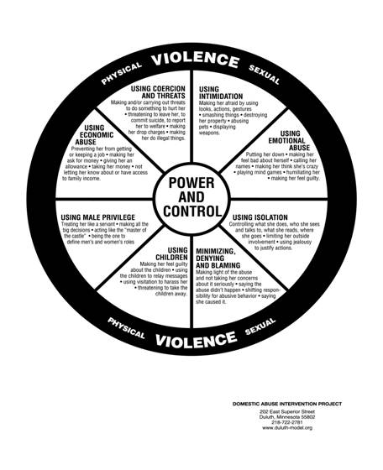
Power and Control Wheel
Domestic and dating
violence are
NOT
just physical or
sexual assault!
Notes:
Notes to Trainer: Provide the Power and Control Wheel handout and allow participants a moment or two to review the handout.
For more information on the Wheel go to: www.theduluthmodel.org
A handout on the Power and Control Wheel is available in Appendix B

Slide 21

Domestic violence cuts across all races, ethnicities, religions, sexual orientation, age groups, and socioeconomic levels
Every culture has elements that condone domestic violence…
and elements that resist it
Notes:
Notes to Trainer: Every culture has elements that condone men’s controlling behavior of women and some line differentiating what level of abuse is considered acceptable. For example, under certain circumstances, minor violence such as pushing or shoving might be condoned, while abuse beyond that level is considered unacceptable.
Shelter from the Storm, a curriculum for mental health clinicians who work with children exposed to domestic violence, raises the point that ethnic/cultural background may influence any of the following factors when domestic violence is present:
The batterer’s tactics
The survivor’s coping strategies
Community response
Institutional response
The individual meaning of violence
The quality of the service provider-client relationships
Anyone can be a victim of domestic violence regardless of: age, race, ethnicity, sexual orientation, religion, class, immigration status, disability, region (rural/urban).
Some studies show that African American, Native American, and Latina women experience higher rates of domestic violence while others find that when socioeconomic status is accounted for ethnic differences are reduced or eliminated.
Mitchell SJ, See HM, Tarkow AKH, Cabrera N. Conducting Studies with Fathers: Challenges and Opportunities Applied Development Science 2007, Vol. 11, No. 4, 239-244.
Tjaden P, Thoennes N. Extent, Nature, and Consequences of Intimate Partner Violence. U.S. Department of Justice, Offices of Justice Programs, National Institute of Justice. Washington, DC. July, 2000.

Slide 22

Cultural
Competency
Definitions:
Case Study Handout
and Discussion
Notes:
Estimated Activity Time: 10 minutes
Notes to Trainer: Distribute the case study on cultural competency and ask participants to read the definitions and scenario (provide a few minutes to do this). Ask the group the following questions:
Question #1: Focusing on cultural and linguistic competency, what concerns do you have about how the home visitor responded to this client’s concerns?
Concerns about using the client’s husband to interpret should be noted by participants. While the male is usually the head of the household in Dominican culture and is often consulted about health-related decisions, in this situation, the sensitivity of the client’s problem would indicate that using her husband as the interpreter is not appropriate. There may also be religious considerations that may be a barrier to the client asking the husband to use condoms.
The client’s concern that her husband would be angry raises significant concerns about domestic violence and/or reproductive coercion. Using the client’s husband or any family member as an interpreter could be dangerous. The husband may retaliate against the client. Other family members may not keep the information confidential or may confront the husband which could lead to retaliation against the client.
Question #2: What would be a safer approach for this client?
Use a trained interpreter (in-person or by phone) who understands Dominican culture, language, and domestic violence to discuss the following concerns with the client:
Ask the client if she is being hurt or threatened by her partner and if her partner is interfering with her ability to make choices about her reproductive health, such as using condom.
Discuss with the client what may be the safest option to notify her husband that he needs treatment for the sexually transmitted infection.
Provide information about sexually transmitted infections and treatment and a safety card that addresses domestic and sexual violence with hotline phone numbers and local resources in Spanish for the client to review and keep if it is safe for her to do so.

Slide 23
Group Discussion
Given the prevalence and complexity of domestic violence—what is the role of the home visitor?
Notes:
Estimated Activity Time: 2 minutes (quick check with audience)
Key points to cover in group discussion:
Goal is not to get her to leave (can be the most dangerous time for her)
Identify the problem and support her by offering harm reduction strategies
Connect her to an advocate for safety planning

Slide 24

Assessment and Safety Planning for Domestic Violence in Home Visitation
Notes:
Module Time: 1 hour 15 minutes
Training Outline
Learning objectives
Group discussion exercise
Scripted assessment
Using the Healthy Moms/Happy Babies Safety Card
Using the Relationship Assessment Tool
Partnering with local domestic violence programs and advocates
Safety planning characteristics and defining success
Resources
Overview
Many home visitation programs struggle with domestic violence screening, referral and with building partnerships with local domestic violence programs. Assessment strategies and tools have been developed to integrate screening for domestic violence more comfortably into home visitation programs. The new federal benchmarks for home visitation require that programs document screening, and track referrals. This module will train home visitors how to screen, refer and document these activities as part of routine programming.

Slide 25
Learning Objectives
1 Identify two barriers to home visitors doing domestic violence assessment with clients.
2 Demonstrate how to discuss limits of confidentiality prior to screening clients for domestic violence.
3 Describe how to use the safety card and the “Relationship Assessment Tool” to screen clients for domestic violence.
4 List action steps in a safety plan that a client can take if she feels unsafe.
Notes:
Notes to Trainer: Read the learning objectives aloud.

Slide 26
Group Discussion
Starting and ending conversations about difficult or stigmatizing issues like domestic violence can be challenging during home visits.
We take care of ourselves by presenting questions and educational messages in a way that feels most comfortable to us.
Notes:
Estimated Activity Time: 5 minutes
Notes to Trainer: Ask participants to take the first statement and just think about it for a minute. Each person should take a second and ask themselves if this was ever true for you—or true for a colleague?
Ask participants: “When doing an assessment with one of your clients and working with standardized forms you have to fill out, have you ever not asked a question the way it was written on the form, or changed the order in which the question appeared?” Ask participants to raise their hands if they think it is a safe environment to share their thoughts. If they are worried about getting in trouble with their supervisor they may remain silent.”
Question to pose to the audience: “Do you think this kind of deviation is a good or bad thing?” Then ask about why participants (hypothetically if need be) might deviate from a form—bringing it back to the statements on the slide.
Now let’s look at the second statement—do you think this is true?

Slide 27

Consider These Quotes from Home Visitation Staff
1 “No one is hurting you, right?”
2 “You aren't being abused, are you?”
3 “Have you been experiencing any domestic violence?”
4 “Are you being abused by your partner?”
5 “Are you safe in your home?”
Notes:
Estimated Activity Time: 5-10 minutes
Notes to Trainer: Taking the first statement, ask participants: What do you think? Does it work? Why do you think they asked this way?
Answer: This assures that clients are clear that the home visitor is looking for a negative answer (same is true of the second question, yes?).
A home visitor could ask any of the questions 1-5—asking any of them as they are would allow someone to check their list that the DV screening or assessment was completed, but it may not effectively identify women in violent relationships.
Discuss question 3 and 4. What are the problems with these questions?
Answer: Using words like domestic violence or asking if someone is abused can be stigmatizing. Also, women in abusive or controlling relationships may not think these words apply to them because what is happening isn’t bad enough. Many clients may imagine that women in violent relationships need to be acutely injured or hospitalized. Or they may say no to a screening question because they don’t want the label of being abused—avoiding labels and describing behaviors.
Again this is someone looking to get a ‘no’ from the client, not a yes or positive disclosure of violence.
Question #5. Ask participants: What does this make you think of? Community violence, loose railings or floorboards, etc. This question isn’t direct enough to establish safety in the relationship.

Slide 28

Starting the Conversation: Discuss the Limits of Confidentiality and Other Client Fears First
Scripts can include
normalizing language:
“So many of our moms are struggling in their relationships we have started asking everyone about their partners and how they are being treated....”
Scripts should also address clients’ fears about what may or may not fall into your state’s mandatory reporting requirements.
Notes:
Notes to Trainer: It is important to keep in mind fears about immigration status and child welfare workers. This study overview may be interesting to read aloud to participants:
In a study by Renker & Tonkin (2006), 97% of women stated that they were not embarrassed, angry, or offended by their health care provider asking about domestic violence during prenatal care visits.
Renker P, Tonkin P. (2006) Women’s views of confidentiality issues related to and acceptability of prenatal violence screening. Obstetrics and Gynecology, V.107 N.2, February, 2006: 348-354

Slide 29
Example: (check with requirements in your county/state)
“Everything you share with me is confidential. This means what you share with me is not reportable to child welfare, INS (now Homeland Security) or law enforcement. There are just two things that I would have to report—if you are suicidal, or your children are being harmed.
The rest stays between us and
helps me better understand
how I can help you and
the baby.”

Slide 30

Safety Card on Domestic Violence and Safety Planning
How does using the safety card support domestic violence screening?
Notes:
Estimated Activity Time: 2–3 minutes
Notes to Trainer: Hand out the safety card Healthy Moms, Happy Babies to audience. This can be turned into a group discussion, quick debrief or small group activity.
Safety first! Never leave this card for the client without going over it with her—it may put her at risk if her partner accidently finds it. After reviewing the card ask your client if it is safe to take the card.
This card was developed with the clients safety in mind and modeled after the ‘shoe card’ that domestic violence advocates have used for years—making it easier for the client to hide.
To turn the card to a staff prompt you would just need to change the wording on the card to make it an assessment tool. Example from the card: “Do I feel respected, cared for and nurtured by my partner?” Can easily be changed to: “Do you feel respected, cared for and nurtured by your partner?” This works with the other sections of the card as well.
Home visitors can introduce this card and say: “We started giving this card to all our Moms. It talks about healthy and safe relationships, it’s kind of like a magazine quiz…” How else might you start the conversation about the card?
Take a minute to think about how you might introduce the card. Debrief ideas with the group.

Slide 31
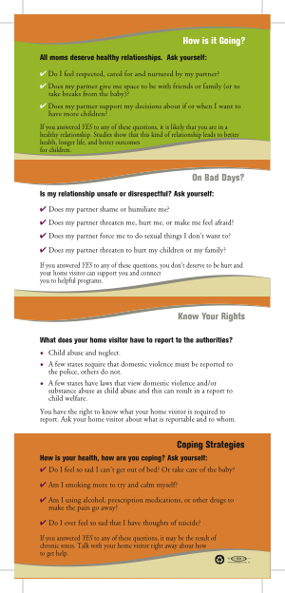

Notes:
Notes to Trainer: This is the second panel of the safety card Healthy Moms, Happy Babies.

Slide 32
Notes:
Notes to Trainer: This section of the card reflects portions of the self-administered Relationship Assessment (see handout) and can be used as a way to introduce that tool. “This section is similar to this questionnaire we are doing with all our moms, so why don’t we take a minute and have you do that now?”
What to do with a negative screen for domestic violence: ”I’m glad nothing like this is going on for you. Because many women are in unhealthy or abusive relationships, we are giving this card to all our moms so you will know how to help a friend or family member…”

Slide 33
Notes:
Notes to Trainer: This section of the card highlights home visitation staff’s responsibility to understand state reporting laws and lets clients know that they can turn to you for important information in this area. It may be useful to refer back to slide 28 and the study done by Renker to highlight the importance of knowing and informing clients about reporting laws. (For additional information on reporting issues please see Module 11 of this curriculum).

Slide 34

Relationship Assessment Tool
A good, evidence based
tool to use with clients
but consider:
Almost a quarter of all adult Americans read at or below a 5th grade level.
(review verbally if needed)
Notes:
Notes to Trainer: Once you have reviewed the card, next review the Relationship Questionnaire. The script at the top of the page is set up to be modified state by state—please encourage participants to make the changes to this assessment tool before using in the field. It may be necessary to read all the questions on the tool aloud to your client, taking a moment to make sure they understand what is being read to them. “So let’s go over this Relationship Assessment Tool together, here is how the scoring for each question works. So for question #1 looking at this scale (read entire scale to client) what number best reflects how you feel?”
“Everything you share with me today is confidential unless (NOTE: Participants must double check state law and insert here—this may also include any reports to child welfare for witnessing domestic violence or mandatory reports to police for injury associated with domestic violence for adult women) you were to tell me that you are going to hurt yourself, someone has hurt you with a weapon, or your children are being harmed. Those things I would have to report, ok?”
Next train home visitors on how to offer support, safety planning and referral if a client scores over 20 on the Relationship Questionnaire. Validate, do a safety plan and refer her to domestic violence advocacy services.
AMA: Ad Hoc Committee on Health Literacy for the Council on Scientific Affairs. Health literacy: report of the Council on Scientific Affairs. JAMA. 1999;281: 552-557.

Slide 35

Validation: First Step to Safety Planning
Can talking about abuse make a difference?
Your recognition and validation
of her situation is important.
You can help:
Reduce her sense of isolation and shame
Encourage her to believe a better future is possible

Slide 36

What Should You do When You Get a Positive Disclosure of Domestic Violence?
Validate:
“I'm so sorry this is happening in your life, you don’t deserve this”
“It’s not your fault”
“I’m worried about the safety of you and your children”

Slide 37
Where Should You Document Safety Plans and Referrals?
Document:
On pages 2 and 3 of the Relationship Assessment Tool
Safety planning is addressed both in the Healthy Moms, Happy Babies Safety Card and Appendix F of this curriculum
Notes:
Notes to Trainer: Documentation of what you discussed is important. Using the Relationship Assessment Tool, all you need to do is circle the options to record what you have offered or given your client.
Every client should be given the Healthy Moms, Happy Babies card unless it is unsafe for her to take it. Always double check to see if it is ok to leave the card with her.
IMPORTANT! The Healthy Moms, Happy Babies card should be given (unless it is unsafe for her to take it) to all clients no matter whether their scores are high or low on the Relationship Assessment Tool.
Some women will not be comfortable recording how bad things are in their relationship and sharing that information with her home visitor, but can benefit from receiving the information on the card.

Slide 38
When Domestic Violence is Disclosed: Provide a ‘Warm’ Referral
“I want to go over this section of the safety card I gave you before, if you ever need to get out of the house quickly it is so helpful to have planned out what you will do and this can help remind you about your next steps”
Offer referral: “If you are comfortable with this idea I would like to call my colleague at the local program (fill in person's name) Jessica, she is really an expert in what to do next and she can talk with you about supports for you and your children from her program…”
Notes:
Notes to Trainer: Getting to know your local DV program staff will help ensure that each referral feels genuine and supportive to your clients.

Slide 39
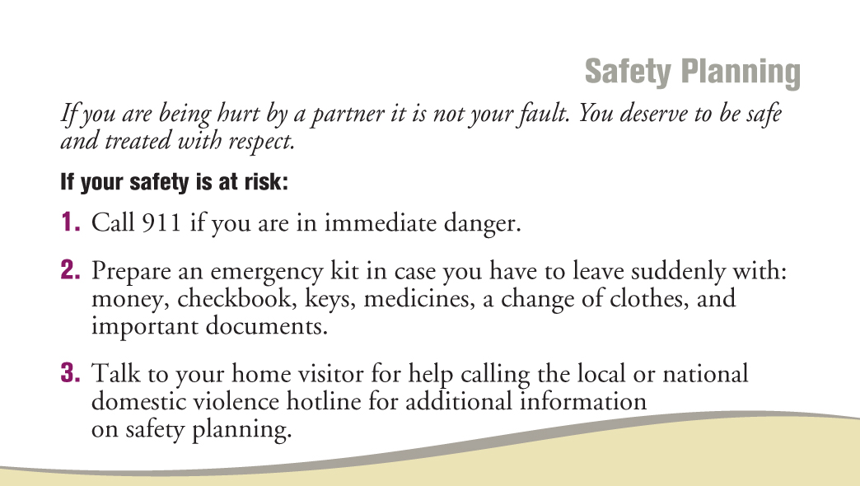
Notes:
Notes to Trainer: This is the section of the safety card you are referring to on the previous slide.

Slide 40

Role of the Domestic Violence Advocate
Domestic violence advocates provide safety planning and support
Safety planning is designed to assist mothers and children who have experienced domestic violence to think and act in a way to increase personal safety
Home visitors can help clients connect with an advocate to work on a safety plan and additional services like:
Housing
Legal advocacy
Support groups/counseling
Notes:
Notes to Trainer: Contact the nearest domestic violence shelter or the domestic violence coalition in your state to talk with domestic violence advocates and learn more about safety planning, training, and resources for families who have experienced violence in a relationship.

Slide 41

Amber Video Clip
The following video clip
demonstrates how to
screen for domestic
violence and educate
about safety planning
and referrals even when
the client isn’t open to
accepting referrals for
domestic violence.
Notes:
Estimated Activity Time: 10 minutes to watch video and 10 minutes for discussion
Discussion questions to ask after watching this video clip include:
Let’s start by discussing the opening of the video—what do you think about the way the home visitor began the visit with mom?
How do you think the presentation of the Healthy Moms, Happy Babies card went? Did it feel judgmental or supportive to you? The goal with this question is to get the audience to think about the way the card was introduced and how the home visitor suggests the card can be used for a friend or a family member.
What do you think about the way that Lonna (Home Visitor) handled the way Amber responded to the Relationship Assessment Tool? What did you like about it and what would you change?
What did you think about the situation shown between the two home visitors at the end of the video? How many of you have an opportunity to debrief with colleagues about difficult situations with your clients?
Any final thoughts about what you saw? Doable? Concerns?

Slide 42
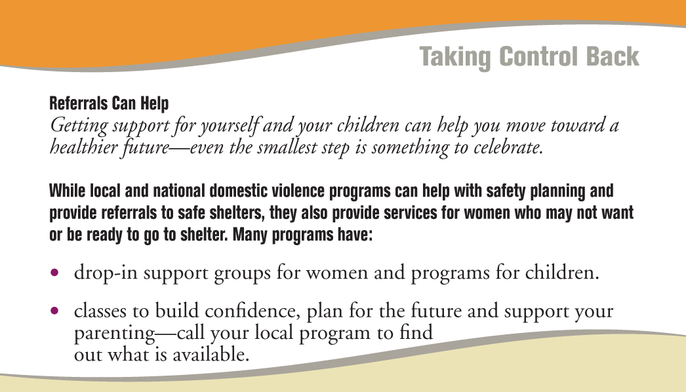
Notes:
Notes to Trainer: Many people think domestic violence programs provide only shelter beds. This panel of the card can help clients understand the range of services available in their community.

Slide 43

Providing a ‘Warm’ Referral to The National Hotline
“On the back of this card there are national confidential hotline numbers and the people who work there really care and have helped thousands of women. They are there 24/7 and can help you find local referrals too—and often can connect you by phone…”
Notes:
Notes to Trainer: If there are not any local resources or you do not have information about local referrals, the National Domestic Violence Hotline can help.

Slide 44

Notes:
Notes to Trainer: This is the panel of the safety card referred to in the previous slide.

Slide 45
Role Play (Option 1)
"Your client, Stephanie, is a 24-year-old mother of four children. Using Healthy Moms, Happy Babies safety card, please review the first two panels of the card and follow the key steps you just learned to best help the client with safety planning and referral.
(Clients, please answer yes to at least one question from the ‘On Bad Days’ section of the Healthy Moms, Happy Babies safety card).
Notes:
Estimated Activity Time: 15-20 minutes
Directions for Role Play
Divide participants into groups of three.
Advise participants that one person will role play the home visitor, one is the client, and the third person is the observer.
Advise the person who is role playing the home visitor to use the panel of the card to assess for a controlling relationship.
Read the scenario, as shown on the slide, aloud to participants: “Your client, Stephanie, is a 24-year-old mother of four children. Using Healthy Moms, Happy Babies safety card, please review the first two panels of the card (clients, please answer yes to at least one question from the On Bad Days? section of the Healthy Moms, Happy Babies safety card) and follow the key steps you just learned to best help client with safety planning and referral.
Allow 10 minutes for the role play.
Ask participants who were the observers of the interaction to think about the kinds of things that the home visitor said that worked well, such as how did she/he introduce the card? Did she/he make the discussion comfortable? What would they have liked to see more of? Did the provider do safety planning with the client? How did the home visitor handle describing the hotline numbers on the back of the card?
Ask the participants who role played the client how the assessment made them feel.
Ask participants who role played the home visitor if they were comfortable asking these questions. If some of the home visitors indicated that they were not comfortable, ask what would help to increase their comfort level.
Ask participants who were the observers to share their thoughts and observations about what they liked and thought would be helpful.
If there is enough time, you can ask groups to switch roles and do the role play again.

Slide 46
Defining Success
“
“
Success is measured by our efforts to reduce isolation and to improve options for safety.
Futures Without Violence
Notes:
Notes to Trainer:
You do not need to be an expert in domestic violence to help women in your home visitation program.
Our job is not to “fix” domestic violence or to tell victims what to do.
Providing support and information can make a difference in the lives of victims.
We can help victims by understanding their situation and recognizing how abuse can impact health, risk behaviors and parenting.

Slide 47
To Order More of These Free Cards:
www.projectconnectva.com or
futureswithoutviolence.org/health

Slide 48
Danger Assessment Tool
20-question tool designed to assess for risk of severe injury and potentially lethal assault by a current or former partner
Used by domestic violence advocates and other service providers
On-line training and certification to use tool is available
Can aid home visitors in recognizing indicators of high risk situations and facilitate safety planning
The absence of indicators on this tool does not mean that a woman is not at risk.
Notes:
Notes to Trainer: Some programs may consider getting training and certification to use the danger assessment tool. Others programs may refer to DV programs who may use it with clients.

Slide 49
Additional Resources: Helping an Abused Woman 101 Things to Know, Say and Do
Includes information on the dynamics of abuse, 10 points about coping with abuse, 10 promises not to make women, and handouts for clients.
Cost is $30 plus shipping; order online www.lfcc.on.ca
(Baker & Cunningham, 2008)
Notes:
Baker L, Cunningham A. Helping an Abused Woman: 101 Things to Know, Say and Do. 2008. www.lfac.on.ca

Slide 50

Impact of Domestic Violence
on Perinatal Health
Outcomes
Notes:
Estimated Module Time: 20 minutes
Training Outline
Learning objectives
Large group discussion
Effects of domestic violence around the time of pregnancy
Overview
Improving perinatal and birth outcomes are core goals for many home visitation programs. This module makes the connection between pregnancy and domestic violence including associated risk behaviors around the time of pregnancy that are associated with poor birth outcomes, low birth weight, interference with breastfeeding, and postpartum depression. By beginning with a large group discussion to identify these connections, participants demonstrate what they already know about domestic violence and pregnancy through their work and life experiences.

Slide 51
Learning Objectives
1 List three effects of domestic violence on women’s risk behaviors during pregnancy.
2 List two effects of domestic violence on birth outcomes.
3 Describe the connection between domestic violence and breastfeeding.
4 Explain why women experiencing domestic violence are more likely to experience postpartum depression.
Notes:
Notes to Trainer: Read the learning objectives aloud.

Slide 52

Large Group Discussion
How does domestic violence impact women's perinatal health and their birth outcomes?
Notes:
Estimated Activity Time: 15 minutes
Notes to Trainer: For this activity, you will need a flipchart and markers.
Ask participants to call out responses to the question “How does domestic violence impact women’s perinatal health and their birth outcomes?”
Repeat participants’ responses, clarify as needed and give hints about what is missing. For example, if depression has not been mentioned the facilitator could ask , “So let’s talk about how this might impact moms’ feelings or emotional health…”
If you are working with another trainer, one of you should be the note-taker. The note-taker records what the participants call out onto the flipchart and then tapes sheets when they are full around the room so the responses can be seen by the audience.
When the trainer feels that some of the key effects have been identified, move forward through the next slides in this module to review and highlight examples that were given, as well as anything that was missing.

Slide 53

Homicide is the second leading cause of injury-related deaths among pregnant women.
(Chang et al, 2005)
Notes:
Notes to Trainer: Inform participants that a majority of female homicides are women who were murdered by a current or former intimate partner.
Pregnancy-associated homicides were analyzed with a national dataset (1991-1999) from the Pregnancy Mortality Surveillance System at the Centers for Disease Control and Prevention for this study.
Pregnancy-associated injury deaths and homicides were defined as women who died during or within one year of pregnancy.
Of all pregnancy-associated injury deaths, motor vehicle accidents was the leading cause (44.1%) and homicide was the second leading cause (31.0%). The rest of the pregnancy-associated injury deaths were attributed to unintentional injuries (12.7%), suicides (10.3%), and other (2.0%).
Chang J, Berg CJ, Saltzman LE, Herndon J. Homicide: A Leading Cause of Injury Deaths Among Pregnancy and Postpartum Women in the United States, 1991-1999. American Journal of Public Health. 2005;95(3):471-477.

Slide 54

Women Who Experience Abuse Around the Time of Pregnancy Are More Likely to:
Smoke tobacco
Drink during pregnancy
Use drugs
Experience depression, higher stress, and lower self-esteem
Attempt suicide
Receive less emotional support from partners
(Amaro, 1990; Bailey & Daugherty, 2007; Berenson et al, 1994; Campbell et al, 1992; Curry, 1998; Martin et al, 2006; Martin et al, 2003; Martin et al, 1998; McFarlane et al, 1996; Perham-Hester & Gessner, 1997)
Notes:
Experiencing domestic violence around the time of pregnancy has been shown to be associated with substance abuse, mental health problems, and other risk behaviors that are associated with poor pregnancy outcomes.
Amaro H, Fried LE, Cabral H. Zuckerman B. Violence During Pregnancy and Substance Use. American Journal of Public Health. 1990;80(5):575-579.
Bailey BA, Daugherty RA. Intimate Partner Violence During Pregnancy: Incidence and Associated Health Problems in a Rural Population. Maternal and Child Health Journal. 2007;11(5):495-503.
Berenson AB, Wiemann CM, Wilkinson GS, Jones WA, Anderson GD. Perinatal Morbidity Associated with Violence Experienced by Pregnant Women. American Journal of Obstetrics and Gynecology. 1994;170:1760-1769.
Campbell JC, Poland ML, Waller JB, Ager J. Correlates of Battering During Pregnancy. Research in Nursing and Health. 1992;15:219-226.
Curry MA. The Interrelationships Between Abuse, Substance Use, and Psychosocial Stress During Pregnancy. JOGNN. 1998;27(6):692-699.
Martin SL, Beaumont JL, Kupper LL. Substance Use Before and During Pregnancy: Links to Intimate Partner Violence. American Journal of Drug and Alcohol Abuse. 2003;29:599-617.
Martin SL, Kilgallen B, Dee DL, Dawson S, Campbell JC. Women in Prenatal Care/Substance Abuse Treatment Programme: Links between Domestic Violence and Mental Health. Journal of Maternal and Child Health. 1998;2:85-94.
McFarlane J, Parker B. Soeken K. Physical Abuse, Smoking and Substance Abuse During Pregnancy: Prevalence, Interrelationships and Effects on Birth Weight. Journal of Obstetrics, Gynecology and Neonatal Nursing. 1996;25:313-20.
Perham-Hester KA, Gessner BD. Correlates of Drinking During the Third Trimester of Pregnancy in Alaska. Maternal and Child Health Journal. 1997;1(3): 165-172.

Slide 55

Tobacco Cessation and DV
42% of women experiencing some form of DV could not stop smoking during pregnancy compared to 15% of nonabused women.
(Bullock et al, 2001)
Notes:
In this retrospective study by Bullock et al. (2001), rural postpartum women (n=293) were interviewed during their hospital stay about their tobacco use and experiences with DV. DV was measured with the Abuse Assessment Screen which includes questions on physical, sexual, and emotional abuse within the past year and since pregnancy. The rate of smoking among abused women during pregnancy is in agreement with other prospective studies that found between 44% and 60% of abused women continue to smoke during pregnancy.
Bullock LFC, Mears JLC, Woodcock C, Record R. Retrospective Study of the Association of Stress and Smoking During Pregnancy in Rural Women. Addictive Behaviors. 2001;26:405-413.

Slide 56
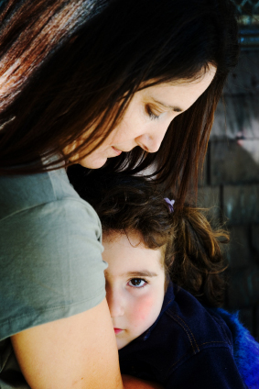
Impact of Psychological Abuse
Psychological abuse by an intimate partner was a stronger predictor than physical abuse for the following health outcomes for female and male victims:
Depressive symptoms
Substance use
Developing a chronic mental illness
(Coker et al, 2002)
Notes:
In this study:
Women were significantly more likely than men to experience physical or sexual abuse and abuse of power and control by an intimate partner compared to men.
Both physical and psychological abuse by an intimate partner were associated with significant physical and mental health problems for male and female victims.
Coker AL, Smith PH, Thompson MP, McKeown RE, Bethea L, Davis KE. Social Support Protects Against the Negative Effects of Partner Violence on Mental Health. Journal of Women’s Health & Gender-Based Medicine. 2002;11(5):465-476.

Slide 57

Domestic Violence During Pregnancy is Associated With
Lower gestational weight gain during
pregnancy (Moraes et al, 2006)
Low and very low birth weight (Lipsky et al, 2003)
Pre-term births (Silverman et al, 2006)
Notes:
Numerous studies have documented the impact of domestic violence on pregnancy. An overview of the effects of domestic violence on women’s reproductive health and pregnancy can be found in a review study by Sarkar (2008).
Lipsky S, Holt VL, Esterling TR, Critchlow C. Police-Reported Intimate Partner Violence During Pregnancy and Risk of Antenatal Hospitalization. Maternal and Child Health Journal. 2009;8(2):55-63.
Moraes CL, Amorim AR, Reichenheim ME. Gestational Weight Gain Differentials in the Presence of Intimate Partner Violence. International Journal of Gynaecology and Obstetrics. 2006;95:254-260.
Silverman JG, Decker MR, Reed E, Raj A. Intimate Partner Violence Victimization Prior to and During Pregnancy Among Women Residing in 26 U.S. States: Associations with Maternal and Neonatal Health. American Journal of Obstetrics and Gynecology. 2006;195:140-148.
Sarkar NN. The Impact of Intimate Partner Violence on Women’s Reproductive Health and Pregnancy Outcome. Journal of Obstetrics and Gynaecology. 2008;28(3):266-271.

Slide 58

Domestic Violence and Breastfeeding
Women experiencing physical abuse around the time of pregnancy are:
35%-52% less likely to
breastfeed their infants
41%-71% more likely to
cease breastfeeding by 4
weeks postpartum
(Silverman et al, 2006)
Notes:
This study analyzed data from 26 U.S. states that participated in the 2000-2003 Pregnancy Risk Assessment Monitoring System (PRAMS).
Domestic violence (DV) was measured by two questions as follows:
“During the 12 months before you got pregnant, did your husband or partner push, hit, slap, kick, choke or physically hurt you in any other way?”
“During your most recent pregnancy, did your husband or partner push, hit, slap, kick, choke, or physically hurt you in any other way?”
Women who reported DV in the year prior to pregnancy but not during pregnancy, women who reported DV during pregnancy but not in the year prior to pregnancy, and women who reported DV during the year prior to pregnancy and during pregnancy were significantly less likely to breastfeed their infants.
Silverman JG, Decker MR, Reed E, Raj A. Intimate Partner Violence Victimization Prior to and During Pregnancy Among Women Residing in 26 U.S. States: Associations with Maternal and Neonatal Health. American Journal of Obstetrics and Gynecology. 2006;195:140-148.

Slide 59

Postpartum Maternal Depression
Women with a controlling or threatening partner are 5X more likely to experience persistent symptoms of postpartum maternal depression
(Blabey et al, 2009)
Notes:
This data is from the Alaska Pregnancy Risk Assessment Monitoring System (PRAMS). Women completed a survey within a few months after delivery and were then contacted again approximately two years later.
Blabey MH, Locke ER, Goldsmith YW, Perham-Hester KA. Experience of a Controlling or Threatening Partner Among Mothers with Persistent Symptoms of Depression American Journal of Obstetrics & Gynecology. 2009;201:173.e1-9.

Slide 60
Use This Card to Help
Make Connections Between Depression, Substance Abuse,
and DV

Slide 61
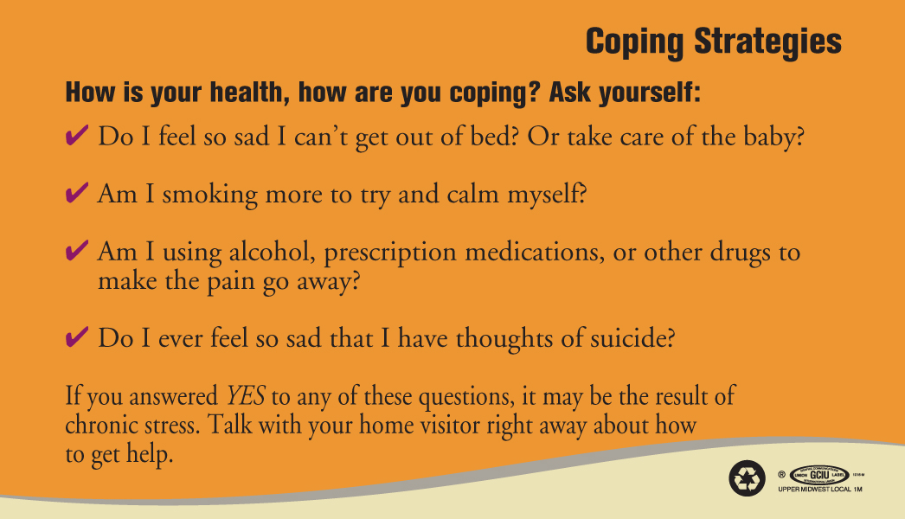
Notes:
Notes to Trainer: Home visitors can reintroduce the card with a focus on this panel like this: “You might remember this card I showed you before? I want to talk about this panel today because we are going to be talking about depression and it helps connect some of the ways people cope when they are in stressful relationships…”
It is important to note that this card can be used in conjunction with substance abuse, depression and tobacco cessation assessment tools.

Slide 62

Making the Connection: Domestic and Sexual Violence, Birth Control Sabotage, Pregnancy Pressure, and Unintended Pregnancies
Notes:
Estimated Module Time: 65 minutes
Training Outline
Learning objectives
Definitions, statistics, and examples of reproductive coercion
Group discussion: birth control sabotage
Assessment for reproductive coercion and responding to disclosures
Role play (slide)
Overview
As we have learned more about different forms of abusive and controlling behaviors that are used by partners to maintain power and control in a relationship, patterns of behaviors that affect women’s reproductive health have been identified. These behaviors, which are referred to as reproductive coercion, include forced sex, birth control sabotage, pregnancy pressure, and condom manipulation. Using a skills-based approach, this module includes assessment questions, scripting, and information about birth control options that may be less visible and more effective for clients whose partners are interfering with their birth control.

Slide 63
Learning Objectives
1 Define reproductive coercion.
2 List three examples of birth control sabotage.
3 Demonstrate two assessment questions for reproductive coercion.
4 Identify two birth control methods that you can discuss with a client who discloses that she is worried about getting pregnant due to her partner’s interference with her birth control methods.
Notes:
Notes to Trainer: Read the learning objectives aloud.

Slide 64
Video: Overview of Reproductive Coercion
Notes:
This video is from the Reproductive Health Curriculum—gives a great overview of reproductive coercion and is a good “intro” for this section.

Slide 65
Definition: Reproductive Coercion
Reproductive Coercion
involves behaviors that a partner uses
to maintain power and control in a
relationship that are related
to reproductive health:
Explicit attempts to impregnate a partner against her wishes
Controlling outcomes of a pregnancy
Coercing a partner to have unprotected sex
Interfering with birth control methods

Slide 66

Domestic violence increases women’s risk for
Unintended
Pregnancies
(Sarkar, 2008)
Notes:
Sarkar conducted a literature review of publications from 2002 through 2008 on the impact of domestic violence on women’s reproductive health and pregnancy outcomes.
In a study by Goodwin et al (2000), women who had unintended pregnancies were 2.5 times more likely to experience physical abuse compared to women whose pregnancies were intended.
Goodwin MM, Gazmararian JA, Johnson CH, et al. Pregnancy Intendedness and physical abuse around the time of pregnancy: Findings form the pregnancy risk assessment monitoring system, 1996-1997. PRAMS Working Group. Pregnancy Risk Assessment Monitoring System. Maternal and Child Health Journal. 2000;4(2):85-92.
Sarkar NN. The Impact of Intimate Partner Violence on Women’s Reproductive Health and Pregnancy Outcome. Journal of Obstetrics and Gynaecology. 2008;28(3):266-271.

Slide 67
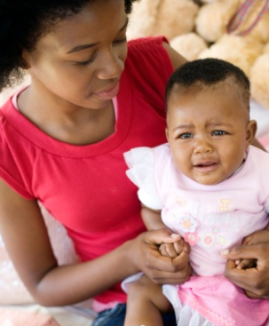
Why is Reproductive Coercion Important?
Rapid Repeat Pregnancy
Adolescent mothers who experienced physical abuse within three months after delivery were nearly twice as likely to have a repeat pregnancy within 24 months
(Raneri & Wiemann, 2007)
Notes:
In this study with teenage mothers (ages 12-18) who were recruited from a labor and delivery unit at a university hospital, physical abuse by an intimate partner was defined as being hit, slapped, kicked, or physically hurt enough to cause bleeding or having been hit during an argument or while her partner was drunk or high.
The odds of repeat pregnancy was 1.9 times higher among teen mothers who were physically abused by their partner within three months of delivery compared to non-abused teen mothers.
Raneri LG, Wiemann CM. Social Ecological Predictors of Repeat Adolescent Pregnancy. Perspectives on Sexual and Reproductive Health. 2007;39(1):39-47.

Slide 68
Forced Sex
“
“I’m not gonna say he raped me, he didn’t use force, but I would be like, “No” and then next thing, he pushes me to the bedroom, and I’m like “I don’t want to do anything” and then we ended up doing it, and I was crying like a baby and he still did it. And then after that he got up, took his shower, and I just stayed there like shock.”
“
17 yr. old female
(Miller et al, 2007)
Notes:
This quotation is from a qualitative study by Miller et al. (2007) on male pregnancy-promoting behaviors and adolescent partner violence. The teen girl was parenting a baby from a different relationship and the abusive relationship started shortly after she broke up with her son’s father. She went to a teen clinic and started Depo-Provera injections without her new partner’s knowledge.
Miller E, Decker MR, Reed E, Raj A, Hathaway JE, Silverman JG. Male Partner Pregnancy-Promoting Behaviors and Adolescent Partner Violence: Findings From a Qualitative Study with Adolescent Females. Ambulatory Pediatrics. 2007;7(5):360-366.

Slide 69

Domestic Violence and HIV
Women and girls who are victims of DV are 4x more likely to be infected with HIV
(Decker, 2005)
Notes:
Decker MR, Silverman JG, Raj A. Dating Violence and Sexually Transmitted Disease/HIV Testing and Diagnosis among Adolescent Females. Pediatrics. 2005;116(2):e272-276.

Slide 70
Pregnancy Pressure and Condom Manipulation
“
Like the first couple of times, the condom
seems to break every time. You know what I mean, and it was just kind of funny, like, the first 6 times the condom broke. Six condoms, that's kind of rare I could understand 1 but 6 times, and then after that when I got on the birth control, he was just like always saying, like you should have my baby, you should have my daughter, you should have my kid.”
“
17 yr. old female who started Depo-Provera
without partner’s knowledge
(Miller et al, 2007)
Notes:
This quotation is from a qualitative study by Miller et al. (2007) on male pregnancy-promoting behaviors and adolescent partner violence. The teen girl was parenting a baby from a different relationship and the abusive relationship started shortly after she broke up with her son’s father. She went to a teen clinic and started Depo-Provera injections without her new partner’s knowledge.
Miller E, Decker MR, Reed E, Raj A, Hathaway JE, Silverman JG. Male Partner Pregnancy-Promoting Behaviors and Adolescent Partner Violence: Findings From a Qualitative Study with Adolescent Females. Ambulatory Pediatrics. 2007;7(5):360-366.

Slide 71
Group Discussion
What are other ways a partner can interfere with a woman's birth control?
Notes:
Estimated Activity Time: 3-5 minutes
Ask participants to give some examples of birth control sabotage.
Proceed to the next slide which provides examples of birth control sabotage and highlight any examples that were not identified by participants.

Slide 72

Birth Control Sabotage
Tactics include:
Destroying or disposing contraceptives
Impeding condom use (threatening to leave her, poking holes in condoms)
Not allowing her to obtain or preventing her from using birth control
Threatening physical harm if she uses contraceptives
Notes:
Qualitative and quantitative research have shown an association between birth control sabotage and domestic violence.
Fanslow et al. (2008) conducted interviews with a random sample of 2,790 women who had ever had sexual intercourse. Women who had ever experienced domestic violence were more likely to have had partners who refused to use condoms or prevented women from using contraception compared to women who had not experienced domestic violence (5.4% vs. 1.3%).
Miller et al (2007) conducted interviews with 53 sexually active adolescent females. One-quarter (26%) of participants reported that their abusive male partners were actively trying to get them pregnant. Common tactics used by abusive male partners included:
Manipulating condom use
Sabotaging birth control use
Making explicit statements about wanting her to become pregnant
Campbell J, Pugh LD, Campbell D, Visscher M. The Influence of Abuse on Pregnancy Intention. Women’s Health Issues. 1995;5:214-223.
Coggins M, Bullock LF. The Wavering Line in the Sand: the Effects of Domestic Violence and Sexual Coercion. Issues in Mental Health Nursing. 2003:24(6-7):723-738.
Fanslow J, Whitehead A, Silva M, Robinson E. Contraceptive Use and Associations with Intimate Partner Among a Population-based Sample of New Zealand Women. Australian & New Zealand Journal of Obstetrics & Gynaecology. 2008;48(1):83-89.
Lang DL, Salazar LF, Wingood GM, DiClemente RJ, Mikhail I. Associations Between Recent Gender-based Violence and Pregnancy, Sexually Transmitted Infections, Condom Use Practices, and Negotiation of Sexual Practices Among HIV-Positive Women. Journal of Acquired Immune Deficiency Syndromes. 2007;46(2):216-221.
Miller E, Decker MR, Reed E, Raj A, Hathaway JE, Silverman JG. Male Partner Pregnancy-Promoting Behaviors and Adolescent Partner Violence: Findings From a Qualitative Study with Adolescent Females. Ambulatory Pediatrics. 2007;7(5):360-366.
Wingood GM, DiClemente R. The effects of an Abusive Primary Partner on the Condom Use and Sexual Negotiation Practices of African-American Women. Journal of Public Health. 1997;87:1016-1018.

Slide 73

Teen Birth Control Sabotage
Among teen mothers on public assistance who experienced recent domestic violence:
66% experienced birth control sabotage by a dating partner
34% reported work or school- related sabotage by a dating partner
(Raphael, 2005)
Notes:
In this study by Raphael (2005), 474 teen girls on Temporary Assistance to Needy Families completed written surveys. The teens were recruited from two state-funded Teen Parent Services sites and two community-based health clinics. Seventy percent were between the ages of 15 and 17 at the time of the birth of their first infant (mean =18 years) and 95% of the girls were African Americans. Almost half (43%) of the girls were involved with males who were older by 4 or more years. Fifty-five percent disclosed domestic violence in the past 12 months. Findings included:
Two-thirds (66%) of teen dating violence victims experienced birth control sabotage compared to 34% of non-abused teens
34% of teen dating violence victims reported work or school related sabotage compared to 7% of teens who did not experience dating violence but were sabotaged in relation to work or school.
Raphael J. Teens Having Babies: The Unexplored Role of Domestic Violence. The Prevention Researcher. 2005;12(1):15-17.

Slide 74
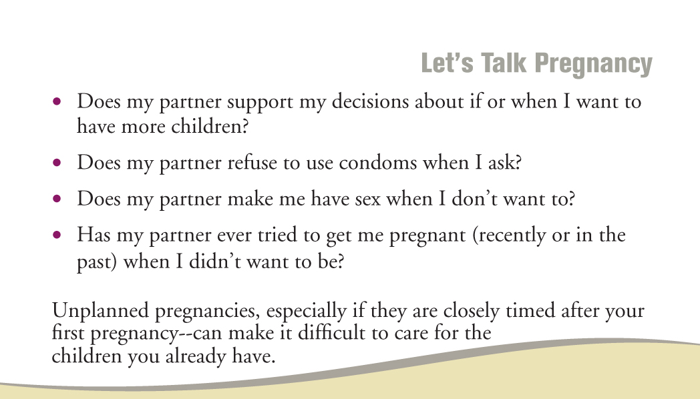

Use the Loving Parents, Loving Kids Safety Card
Assessment for Reproductive Coercion
Notes:
Notes to Trainer: Please hand out the Loving Parent, Loving Kids safety cards to participants.
Advise participants that they can order the cards from Futures Without Violence www.FuturesWithoutViolence.org (write the website on the flipchart). If you do not have the cards available, then use this to discuss the safety card and give everyone ample time to review it so that they can use that information in the role play.
Review these sample assessment questions from the Loving Parents, Loving Kids safety card and ask participants how well these questions would work with their clients and their comfort level asking these questions.

Slide 75
Client Discloses She is Concerned About Getting Pregnant Due to Partner(s)’ Actions
“I'm really glad you told me about what is going on—it happens to a lot of women and it is so stressful to worry about getting pregnant when you don't want to be. I want to talk with you about some methods of birth control that your partner doesn’t have to know about like Implanon or the IUD—so you don’t have to worry about unplanned pregnancy.”
Notes:
Notes to Trainer: Implanon is a 3-year implantable contraceptive (etonogestrel). It is a progestin-only method and does not contain estrogen. Information about Implanon and the IUD can be found on the handout “Birth Control Education Handout” (see next slide).

Slide 76

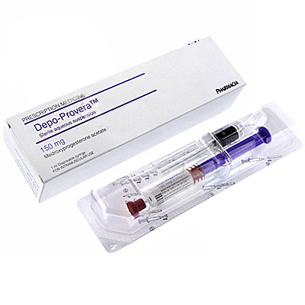

Review Handout: Invisible Contraception
Birth Control Methods That Are Less Likely to be Detected by a Sexual Partner
Notes:
Notes to Trainer: Provide the handout Birth Control Education Handout and discuss two or three examples that are listed on the handout including the information provided about that example. Ask participants if they are familiar with the methods described in the handout. If participants indicate that they are not familiar with these methods, brainstorm about how they can learn more about them. For example, asking someone from a local reproductive health clinic to come to talk to their program about these methods and what is available locally.

Slide 77
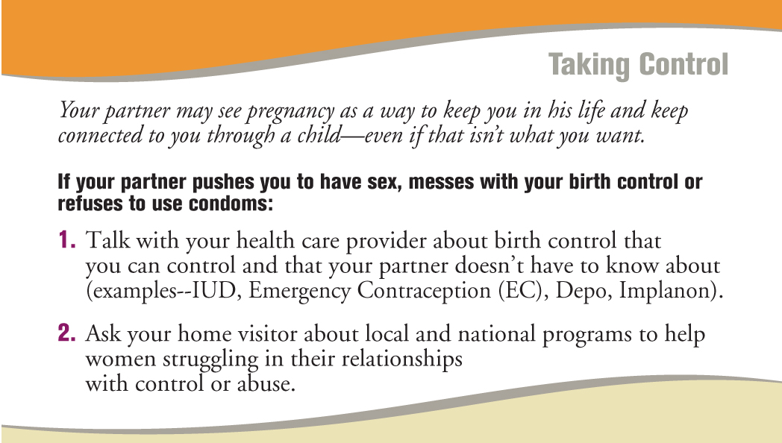
Use the Loving Parents, Loving Kids Safety Card
Helping Mothers Who Experience Reproductive Coercion
Notes:
Notes to Trainer: Review these intervention strategies from the Loving Parents, Loving Kids safety card. Highlight the importance of having local reproductive health referrals to support mothers experiencing reproductive coercion.

Slide 78

Follow-up to Disclosure of Birth Control Sabotage
“What you’ve told me also makes me worried about your health and safety in other ways. Sometimes when a partner is trying to get you pregnant when you don’t want to be they might also try and control or hurt you in other ways.”
“Is anything like this happening in your relationship?”
Notes:
Notes to Trainer: This is a good example of where to reintroduce the Relationship Assessment Tool and have the client review it with you for any changes.

Slide 79

Responding to Disclosures
1 Validate client’s experience.
2 Offer a safety card for client to review and keep if it is safe to do so.
3 Discuss where client can go to learn more about and obtain birth control options.
4 Ask client if she has immediate safety concerns and discuss options.
5 Refer to a domestic violence advocate for safety planning and additional support.
6 Follow up at next visit.
Notes:
“I’m glad you talked to me about this today.”
“I’m so sorry this happening in your life, you don’t deserve this.”
“It’s not your fault.”
“I’m worried about the safety of you and your children.”
“You deserve to be treated with respect.”

Slide 80
The following video clip
demonstrates an
approach to integrated
assessment for
postpartum depression,
reproductive coercion
and domestic violence
in a home visitation
setting.
Marta Video Clip
Notes:
Estimated Activity Time: 10 minutes to watch video “Marta: Home Visitation Visit – Assessment for Post Partum Depression and Domestic Violence“ and 10 minutes for discussion.
Discussion questions to ask after watching this video clip include:
What do you think worked well?
What did not work well?
Were there some other questions that should have been asked? (Assessment for hurting the kids should have been included in the depression assessment for example.)
How could this approach to integrated assessment be adapted for home visits?
How many of you have ever called the hotline “just to see what it was like?” Was this approach effective?
What kinds of examples did you see to help “normalize” the conversation?

Slide 81

Role Play
Your client is a 19-year-old mother of a newborn infant. Review the “Let’s Talk Pregnancy” and then use the Loving Parents, Loving Kids safety card to discuss unwanted sex, birth control sabotage, and ability to negotiate pregnancy spacing with your client.
Notes:
Exercise Activity Time: 15 minutes
Divide participants into groups of three.
Advise participants that one person will role play the home visitor, one is the client, and the third person is the observer.
Advise the person who is role playing the home visitor to use the “Let’s Talk Pregnancy” panel of the card to assess for reproductive coercion.
Read the scenario, as shown on the slide, aloud to participants:
“Your client is a 19 year old mother of a newborn infant and the discussion is about pregnancy spacing. Using the Loving Parents, Loving Kids safety card, review the panel, “Let’s Talk Pregnancy,” and ask your client questions about her ability to negotiate unwanted sex, any experiences with birth control sabotage, and her ability to negotiate pregnancy spacing.”
Allow 3-5 minutes for the role play.
Ask the observers to think about the kinds of things that the home visitor said that worked well such as how did she/he introduce the card? Did she/he make the discussion comfortable? What would they have liked to see more of?
Ask the participants who role played the client how the assessment made them feel.
Ask participants who role played home visitors if they were comfortable asking these questions. If some of the home visitors indicated that they were not comfortable, ask what would help to increase their comfort level.
Ask the observers to share their thoughts and observations about what they liked and thought would be helpful.
If there is enough time you can ask groups to switch roles and do the role play again.

Slide 82

Resource
Reproductive Health
and Partner Violence
Guidelines:
An Integrated Response to
Intimate Partner Violence and
Reproductive Coercion
This tool is available online:
www.FuturesWithoutViolence.org/health
Notes:
Reproductive Health and Partner Violence Guidelines; An Integrated Response to Intimate Partner Violence and Reproductive Coercion focuses on the transformative role of the reproductive health care provider in identifying and addressing intimate partner violence (IPV) and reproductive coercion.
Available in hard copy or as a PDF from the Futures Without Violence online store. To place orders, visit www.FuturesWithoutViolence.org/health

Slide 83
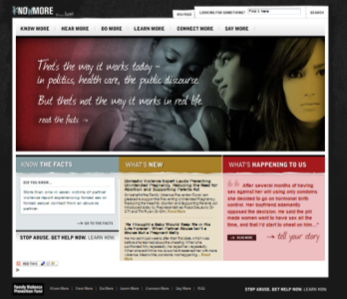

Resource: Website on Assessment
Women’s stories about their experience with reproductive coercion
Clinical and patient tools
www.knowmoresaymore.org
Notes:
Resource: www.knowmoresaymore.org

Slide 84

The Effects of
Domestic Violence
on Children
Notes:
Notes to Trainer: Read the learning objectives aloud.

Slide 85
Learning Objectives
1 List four examples of how exposure to domestic violence can impact children’s physical and/or mental health.
2 From the DVD, First Impressions, describe one strategy that a mother described as helping her child to heal from exposure to domestic violence.
Notes:
Notes to Trainer: Read the learning objectives aloud.

Slide 86
Large Group Discussion
"How does
exposure to
domestic violence
affect children?"
Notes:
Estimated Activity Time: 10-15 minutes
Notes to Trainer: The goal for this large group discussion is for the audience’s expertise to be highlighted—to use their knowledge to educate those around them. Ideally, two people should work together to facilitate this section—one person guiding the discussion and one person recording participants responses on butcher paper, a blackboard, or some other means of recording and sharing feedback.
The facilitator asks the audience: “How does exposure to domestic violence affect children?” The facilitator should be prepared to repeat what is said and clarify and give hints about what is missing. For example, if anxiety and depression have not been mentioned the facilitator could ask, “So let’s talk about how domestic violence might make children feel…”
The note-taker records what the participants call out. It is helpful for the note-taker also to repeat what is being said and clarify as needed as the responses are recorded.
When the facilitator feels that some of the key effects have been identified, the next three slides on the effects of violence on children can be reviewed to highlight examples that were given as well as anything that was missing.

Slide 87

Childhood Exposure to Domestic Violence Increases the Likelihood of Children Experiencing
Failure to thrive
Bed wetting
Speech disorders
Vomiting and diarrhea
Asthma
Allergies
Gastrointestinal problems
Headaches
(Campbell and Lewandowski, 1997;
Graham-Bermann & Seng, 2005)
Notes:
Many studies have shown that children who are exposed to violence have more physical health problems and these problems may persist after the violence has ended.
Campbell JC, Lewandowski LA. Mental and Physical Health Effects of Intimate Partner Violence on Women and Children. Psychiatric Clinics of North America. 1997;20(2):353-374.
Graham-Bermann SA, Seng J. Violence Exposure and Traumatic Stress Symptoms as Additional Predictors of Health Problems in High-risk Children. Journal of Pediatrics. 2005;146(3):349-354.

Slide 88

Children Exposed to Domestic Violence are at Significantly Higher Risk for
Posttraumatic Stress Disorder
Depression
Anxiety
Developmental delays
Aggressiveness
(Edleson J, 1999; Graham-Bermann & Levendosky, 1998; Hurt et al, 2001; Lehmann, 2000; McCloskey & Walker; 2000; Pfouts et al, 1982; Spaccarelli et al, 1994; Wilden et al, 1991; Wolfe et al, 2003)
Notes:
Children exposed to domestic violence are at much higher risk for mental health problems and have significantly higher usage of mental health services compared to children who are not exposed to domestic violence.
Edelson J. Children’s Witnessing of Adult Domestic Violence. Journal of Interpersonal Violence. 1999;14:839-870.
Graham-Bermann SA, Levendosky AA. Traumatic Stress Symptoms in Children of Battered Women. Journal of Interpersonal Violence. 1998;13(1):111-128.
Hurt H, Malmud E, Brodsky NL, Giannetta J. Exposure to Violence: Psychological and Academic Correlates in Child Witnesses. Archives of Pediatric Adolescent Medicine. 2001;155:1351-1356.
Lehmann P. Posttraumatic Stress Disorder (PTSD) and Child Witnesses to Mother-Assault: A Summary and Review. Children and Youth Services Review. 2000;22(3/4):275-306.
McCloskey LA, Walker M. Posttraumatic Stress in Children Exposed to Family Violence and Single-Event Trauma. Journal of the American Academy of Child and Adolescent Psychiatry. 2000;39:108-115.
Pfouts J, Schopler J, Henley H. Forgotten Victims of Family Violence. Social Work. 1982; July:367-368.
Spaccarelli S, Sandler IN, Roosa M. History of Spouse Violence Against Mother: Correlated Risks and Unique Effects in Child Mental Health. Journal of Family Violence. 1994;9(1):79-98.
Wilden SR, Williamson WD, Wilson GS. Children of Battered Women: Developmental and Learning Profiles. Clinical Pediatrics. 1991;30:299-304.
Wolfe DA, Crooks CV, Lee V, McIntyre-Smith A, Jaffe PG. The Effects of Children’s Exposure to Domestic Violence: A Meta-Analysis and Critique. Clinical Child and Family
Psychology Review. 2003; 6(3):171-187.

Slide 89

School Health & Performance
Childhood exposure to DV increases the likelihood of:
More school nurse visits
Referral to a school speech pathologist
Frequent school absences
Lower grade point averages
School suspension
(Hurt et al, 2001, Kernic et al, 2002)
Notes:
Exposure to domestic violence has significant consequences for children’s school performance.
Hurt H, Malmud E, Brodsky NL, Giannetta J. Exposure to Violence: Psychological and Academic Correlates in Child Witnesses. Archives of Pediatric Adolescent Medicine. 2001;155:1351-1356.
Kernic MA, Holt VL, Wolf ME, McKnight B, Hueber CE, Rivara FP. Academic and School Health Issues Among Children Exposed to Maternal Intimate Partner Abuse. Archives of Pediatric and Adolescent Medicine. 2002;156:549-555.

Slide 90


DVD and Discussion
15-minute DVD
For parents and caregivers
Describes impact of DV on children
Available at no cost from Futures Without Violence
(In English and Spanish)
www.futureswithoutviolence.org
Notes:
Estimated Activity Time: 20 minutes
First Impressions is a DVD that is designed to educate adult caregivers and parents about the effects of exposure to violence on children’s early brain development and their health. The DVD is available on the curriclum CD/DVD and is frequently used in trainings for service providers.
Activities: First Impressions DVD and Large Group Discussion
For this activity, you will need the First Impressions DVD, a DVD player and speakers. First Impressions is found on the CD/DVD provided for this training.
Play the DVD ahead of the training to check the volume level for the speakers.
First Impressions is approximately 15 minutes in length and is the first selection on the menu (the DVD also includes short clips from the DVD). You also have the option of playing the DVD in English or Spanish.
After you have played First Impressions, ask participants to describe some strategies they could offer to a mother to help her children when they have been exposed to violence.
Allow approximately 5 minutes for this group discussion; there is no note-taking for this discussion.

Slide 91
Large Group Discussion
What are some strategies you can offer to a mother to help her children when they have been exposed to domestic violence?
Notes:
Notes to Trainer: Some of the strategies that we heard in the “First Impressions” DVD from parents who have experienced domestic violence and adult survivors who were exposed to domestic violence as children are listed below:
Ask children how they are feeling and validate their feelings
Increase quality time of parents/caregivers with the child
Reach out to other caregivers to help them understand the child’s situation and how they can be supportive
Create lots of opportunities for exploring and learning to promote healthy brain development

Slide 92

Impact of Domestic Violence on Mothering:
Helping Moms Promote Resiliency for Children
Notes:
Estimated Module Time: 30 minutes
Training Outline
Learning objectives
Information on the effects of violence on parenting
Past exposure to violence and resiliency
Strategies to strengthen mother-child bond
Overview
The impact of exposure to domestic violence goes beyond the health effects on women and children– it also can diminish parenting skills. There are important findings on how to build resiliency in the face of domestic violence and improve mother/child bonding. This module covers multiple tools that home visitors can use to help mothers and children thrive.

Slide 93
Learning Objectives
1 List two ways that domestic violence may affect a mother’s parenting.
2 Describe the most consistent protective factor for children exposed to domestic violence.
3 Describe three core strategies to strengthen mother/child bonding.
4 Demonstrate the importance of developing a memorandum of understanding with local domestic violence programs.
Notes:
Notes to Trainer: Read the learning objectives aloud.

Slide 94

Mothers who experience
domestic violence around the
time of pregnancy have lower
maternal attachment
with their infants
(Quinlivan & Evans, 2005)
Notes:
Despite excellence in prenatal care, domestic violence was associated with poorer maternal attachment and assessment of infant temperament in this study.
Poor maternal-infant attachment is associated with several negative outcomes for children including behavioral problems, aggression, and poorer social interaction.
Quinlivan JA, Evans SF. Impact of Domestic Violence and Drug Abuse in Pregnancy on Maternal Attachment and Infant Temperament in Teenage Mothers in the Setting of Best Clinical Practice. Archives of Women’s Mental Health. 2005;8:191-199.

Slide 95

Domestic Violence (DV) and Parenting Skills
Mothers who experienced DV were more likely to have maternal depressive symptoms and report harsher parenting
Mothers’ depression and harsh parenting were directly associated with children’s behavioral problems
(Dubowitz et al, 2001)
Notes:
This study demonstrates the importance of educating victims about how DV can affect their mental health, their parenting skills, and ultimately, their children’s well-being.
Dubowitz H, Black MM, Kerr MA, Hussey JM, Morrel TM, Everson MD, Starr RH. Type and Timing of Mothers’ Victimization: Effects on Mothers and Children. Pediatrics. 2001;107(4):728-735.

Slide 96
Domestic Violence: Risk Factor for Child Abuse
Families with
domestic violence are
to have a substantiated case of
child abuse compared to families
without domestic violence
2X as Likely
(Rumm et al, 2000)
Notes:
Domestic violence is a well-documented risk factor for child abuse.
Rumm PD, Cummings P, Krauss MR, Bell MA, Rivara FP. Identified spouse abuse as a risk factor for child abuse. Child Abuse and Neglect. 2000;24(11):1375-1381.

Slide 97
Domestic Violence is Predictive of Child Abuse
Domestic violence during the first 6 months of a child’s life was predictive of child abuse up to the child’s fifth birthday among home-visited families
Domestic violence preceded child abuse in 78% of the cases where domestic violence and child abuse were co-occurring in families
(McGuigan et al, 2001)
Notes:
This study was conducted with a large sample of 2,544 mothers of first-born children who participated in a Healthy Start home visitation program designed to prevent child abuse among higher risk families.
Findings indicate that domestic violence during the first six months of a child’s life is significantly related to physical abuse, psychological abuse, and neglect up to a child’s fifth year.
Among home visited families, domestic violence occurred among 38% of the cases of confirmed child abuse.
McGuigan WM, Pratt CC. The predictive impact of domestic violence on three types of child maltreatment. Child Abuse & Neglect. 2001;25:869-883.

Slide 98

Victimization May Compromise Parenting But…
Battered mothers may be more likely than others to use some type of aggression against their children but are less likely to do so when they are safe (Edleson et al. 2003)
Battered mothers appear to have greater stress than non-battered women
However, this stress does not always translate to diminished parenting
(Holden and Ritchie, 1991, Holden et al., 1998)
Notes:
Edleson JL, Mbilinyi LF, Shetty, S. Parenting in the context of domestic violence. San Francisco, CA. 2003; Judicial Council of California.
Holden GW, Ritchie KL. Linking extreme marital discord, child rearing, and child behavior problems: Evidence from battered women. Child Development, 1991; 62, 311-327.
Holden, Stein, Ritchie, Harris, Jouriles, Children exposed to maritial violence: Theory, research and applied issues, 1998 pp. 289-334.

Slide 99
Resiliency in Mothers Exposed to Violence
Some mothers who face severe stress may compensate for violent events by offering increased nurturing and protection of their children
(Levendosky et. Al , 2003)
Notes:
Levendosky AA, Huth-Bocks AC, Shapiro DL, & Semel MA. The impact of domestic violence on the maternal-child relationship and preschool-age children’s functioning. Journal of Family Psychology, 2003; 17, 275-287.

Slide 100
Most Consistent Protective Factor for Children Exposed to Domestic Violence
Children’s emotional recovery from exposure to DV depends more on the quality of their relationship with the nonbattering parent than any other single factor
(Bancroft & Silverman, 2002)
Notes:
Strengthening mother-child bonding is a key strategy for helping children exposed to violence that fits well with home visitation programs’ emphasis on building relationships and promoting healthy parenting skills.
Bancroft L, Silverman J. The Batterer as Parent. 2002. Sage Publications, Thousand Oaks, California.

Slide 101
Ways That Violence May Affect a Mother’s Parenting
Letting children make the rules
Unable to pay attention
Unable to control anger
Feeling stressed and tired
Afraid to discipline
Source: A Kid is So Special (KISS)
Notes:
Notes to Trainer: This slide provides examples of how victimization can negatively impact a mother’s parenting skills. This slide is adapted from a worksheet that is designed for mothers to review and discuss with a domestic violence advocate during home visits. This tool can be adapted for use by home visitors to help mothers understand how violence can compromise parenting skills and also help her identify things that she is doing to help her children. After each example of a potential impact of victimization on a mother’s parenting, there are questions for her to consider. For example, for “Letting Children Make the Rules,” there are two questions to consider:
Have there been times when you have given in to the children—let them get away with things because you feel guilty about what was occurring in your relationship?
Have there been times when you have not disciplined or corrected the children to make up for the way the batterer has disciplined them?
This information, including the worksheet for mothers, is from the “Understanding Together” workbook that is part of the KISS resources that were previously noted
Pennsylvania Coalition Against Domestic Violence. A Kid is So Special (KISS). 2008. www.pcadv.org

Slide 102
The following video clip
shows home visitation
programs partnering
with domestic violence
advocates to better
serve mothers and their
children.
Desiree Video Clip
Notes:
Estimated Activity Time: 10 minutes to watch video and 10 minutes for discussion.
Discussion questions to ask after watching this video clip include:
What do you think about the partnership between the advocate and the home visitor?
Do you think that their working together made a difference with the case presented? Why or why not?
Are there some other questions that they should have been asked?
How many of you have ever worked with a local DV advocacy program?
Final thoughts about what you saw? Doable? Concerns?

Slide 103
Strategies to Strengthen Mother/Child Bond
(Script for mothers)
Reassure your children and tell them that:
You will take care of them the best you can
You love them unconditionally
You will help them make a plan to be as safe as possible
Notes:
Baker L, Cunningham A. Helping Children Thrive: Supporting Women Abuse Survivors as Mothers. 2004. www.lfac.on.ca

Slide 104

Strategies to Strengthen Mother/ Child Bond
Moms can:
Be willing to talk about the violence
Respect their child’s feelings
Acknowledge that these feelings are okay
Help their child to find the words to talk about their feelings
Be prepared to hear things that may be painful
(Baker and Cunningham, 2004)
Notes:
Baker L, Cunningham A. Helping Children Thrive: Supporting Women Abuse Survivors as Mothers. 2004. www.lfac.on.ca

Slide 105

Resource
The Amazing Brain Series
Developed for parents
5th grade reading level
Six key factors about early brain development and what children need
Notes:
This booklet, part of the Amazing Brain Series developed by the Institute for Safe Families (www.instituteforsafefamilies.org), is a resource designed for parents. The information provided in the booklet can help parents to understand how violence affects early brain development and may lead to predictable physical, mental, and behavioral problems. The booklet includes strategies that parents can use to support their children such as telling children that the violence is not their fault and asking a child what they are most worried about. A key message is also that we can help our brains to heal as adults. Six key concepts in this Amazing Brain booklet are:
Trauma such as exposure to violence can affect how the brain organizes and develops
Trauma interferes with learning
Children can develop posttraumatic stress disorder (PTSD) due to exposure to violence
Trauma leads to other health problems
You can make a difference
It is never too late to change our brains!

Slide 106
Resource
A Kid is So Special (KISS)
Series of booklets developed by the Pennsylvania Coalition Against Domestic Violence
These interactive booklets are designed to strengthen mother/child bonds
“Growing Together” discusses child development
“Playing Together” includes information on what a parent can do when there is hurting at home
Notes:
Notes to Trainer: The KISS booklets are provided in PDF format on the DVD provided with this training resource manual.
Copies can also be purchased by contacting Jo Sterner at the Pennsylvania Coalition Against Domestic Violence (PCADV) at 800-537-2238

Slide 107
Resource
Helping Children Thrive
Supporting Women Abuse Survivors as Mothers
Section for service providers includes:
working with mothers in shelters
how abusers parent
10 principles for service delivery
Section for women includes:
parenting tips
how abuse affects parenting
strategies to strengthen the mother-child bond
(Baker and Cunningham, 2004)
Notes:
Notes to Trainer: This 75-page booklet can be downloaded at no cost, in English and French, at: www.lfcc.on.ca
The booklet is organized into two sections: one for service providers and one for women. A wide range of topics are covered that address issues spanning from infancy through adolescence to help service providers and mothers respond appropriately to children exposed to domestic violence.
Baker L, Cunningham A. Helping Children Thrive: Supporting Women Abuse Survivors as Mothers. 2004. www.lfac.on.ca

Slide 108
Promising Practice
Project SUPPORT
Mothers and children leaving a domestic violence shelter received weekly home visits
Home visits focused on improving social support and mothers parenting skills
Two years after the intervention:
Children had a reduction in clinical levels of conduct problems
Mothers less likely to use aggressive child management strategies
Mothers less likely to return to their abusive partners
(McDonald, Jouriles, & Skopp, 2006)
Notes:
Notes to Trainer: This as an important partnership between home visitation and domestic violence programs.
Ask participants for a show of hands to see if they currently use shelter partnership as a way to enroll women in your home visitation program.
In this randomized, controlled trial, home visits were provided by a therapist and graduate student team for up to eight months after the mother and child(ren) left the domestic violence shelter
The median number of home visits was twenty-three
The prevalence of conduct problems was 15% among children (ages 4 to 9 years old at the start of the study) who received the intervention compared to 53% among children in the control group. Children in the control group received “usual care.”
Aggressive child management strategies were defined as slapping, hitting, and spanking.
McDonald R, Jouriles EN, Skopp NA. Reducing Conduct Problems Among Children Brought to Women’s Shelters: Intervention Effects 24 Months Following Termination of Services. Journal of Family Psychology. 2006;20(1):127-136.

Slide 109

Childhood Exposure to Domestic Violence and Its Impact on Parenting
Notes:
Estimated Module Time: 45 minutes
Training Outline
Learning objectives
Information on the effects of violence on parenting
Past exposure to violence and resiliency
Universal education with safety card
Video clip and role play with safety card
Overview
The following slides introduce the issue of adults’ childhood experiences with violence. This topic will be addressed in the home visitor video clip and role play. We discuss the role of the home visitor in talking with parents about their childhood experiences, using the Loving Parents, Loving Kids safety card featured in the slides.
Acknowledge that parenting is personal, subjective and can be difficult—especially if there is a history of violence or current violence.
Explain how talking with parents about their experiences as children can be a platform for discussing safe homes, safe strategies for caring for children, and what it means to be in a healthy relationship.
Remind home visitors that parents who seem uncaring or neglectful—may not know another way based on their life experiences. If we believe change can happen—they are more likely to believe it too.

Slide 110
Learning Objectives
1 List two ways that violence may affect a mother’s parenting.
2 Describe how a parent’s childhood exposure to violence can impact her parenting.
3 Describe the difference between universal education and assessment with clients.
4 Explain how the safety card can be used for universal assessment to discuss the impact of violence on parenting.
Notes:
Notes to Trainer: Begin by introducing the learning objectives for this module and then review the slides on the impact of violence on parenting and resiliency.

Slide 111

Ways that Exposure to Violence Can Impact Parenting
Feeling out of control
Flooding/Triggering
Feeling Overwhelmed
Shame/Anxiety
Case Study
Notes:
Exercise Activity Time: 10 minutes
Notes to Trainer: Read the case study below aloud to participants.
“Stella is a survivor of childhood exposure to domestic violence and childhood sexual abuse by her father. Prior to having her son (planned pregnancy) at age 23, she had undergone therapy for her abuse, taken classes on the subject, and felt she had ‘dealt’ with her issues.
When her son is about 6 months old, she stops bathing him in the kitchen sink and moves him to the regular bathtub. As she puts him in the water, she has a flashback to her own abuse as a child that occurred in the bathroom. Her hands and feet get numb, she hyperventilates—can’t catch her breath, starts crying—all the while realizing that her helpless baby could drown if she doesn’t get him out of the tub right now. She pulls him out—and later that evening tells her husband that he has to bathe the baby in the tub from now on.
Stella was totally surprised by what happened, nothing could have prepared her for it, and it came from a place inside her that she didn’t know was there.”
Questions for the audience:
Do you think she told her pediatrician or doctor about what happened the first time she tried to give her baby a bath?” (The audience will probably say no; if they do not respond “no”, you can advise the audience that she did not tell her pediatrician).
Why do you think that she did not tell her pediatrician? (Examples of responses will probably include that she was worried that her baby would be taken away by social worker and she would be seen as unfit as a mother).
Did she tell friends or family? (The audience will probably respond that she may be afraid to tell her family depending on whether they know about the abuse she experienced, that she was ashamed to tell her friends etc.)
Then ask: “Why did I share this case study with you?” (Explain that the goal of this case study and discussion is to recognize the important role of home visitors in identifying issues that otherwise may not be addressed. Mothers may not feel like talking about these issues from their past abuse unless a safe space is created for them to do so. Home visits can provide the opportunity, when it is safe to do so, to problem solve and develop a plan for how to support mothers and address triggers that may occur).

Slide 112
Resiliency
Only a third of abused children have grown up to be abusive parents. (Kaufman et al, 1987; Kaufman et al, 1993)
Number one factor present among those who broke the cycle of abuse: empathy for self and others. (Higgins, 1994; Steel 1997)
Notes:
Kaufman, J., and E. Zigler, 1987, “Do Abused Children become Abusive Parents?” American Journal of Orthopsychiatry 57(2): 186-192
Kaufman, J., and E. Zigler, 1993, “The Intergenerational Transmission of Abuse is Overstated.” In Current Controversies in Family Violence. Edited by R. J Gelles and D. R. Loseke, Newbury Park, CA: Sage Publications.
Higgins, Gina O’Connell (1994) Resilient Adults: Overcoming a Cruel Past (San Francisco: Jossey-Bass)
Steele, Brandt F. (1997), “Further Reflections on the Therapy of Those Who Mistreat Children,” in Mary Edna Helfer, Ruth S. Kempe, and Richard Kempe, and Richard D. Krugman, eds., The Battered Child, 5th addition (Chicago: University of Chicago Press), Chapter 26.

Slide 113

Strategies for Home Visitors
Discussing childhood exposure to violence with parents can be a way to discuss healthy relationships, parenting and the impact of violence on health and emotional well-being from infancy to adulthood.

Slide 114
Universal Education vs. Direct Assessment
When talking to moms about childhood exposure to violence we recommend universal education rather then direct assessment.
Why?
Because disclosure of childhood exposure is not the goal—making her aware that she might have unexpected triggers and a plan for what to do is the goal.
Notes:
Notes to Trainer: Clients may not be ready to disclose past experiences of childhood victimization or exposure to violence. By using a universal education approach, you are planting a seed for clients to recognize that adverse childhood experiences can influence their parenting skills and how they react to stressful situations as adults.

Slide 115
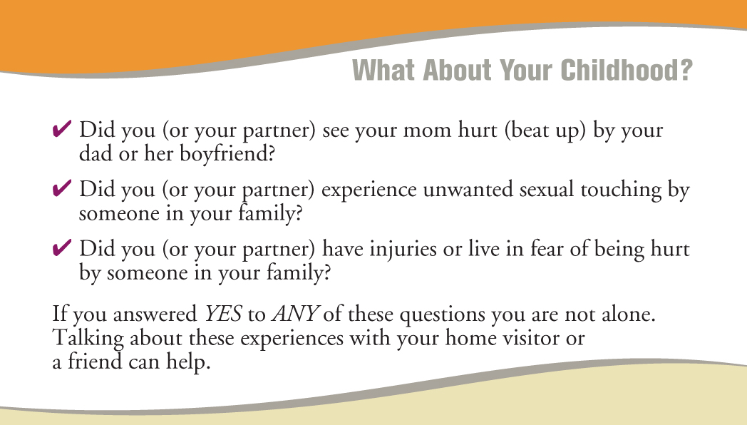

Use the Loving Parents, Loving Kids Safety Card
Educate Mothers About the Impact of Domestic Violence on Parenting
Notes:
Hand out Loving Parent, Loving Kids safety cards (order at www.FuturesWithoutViolence.org/health) to participants.

Slide 116
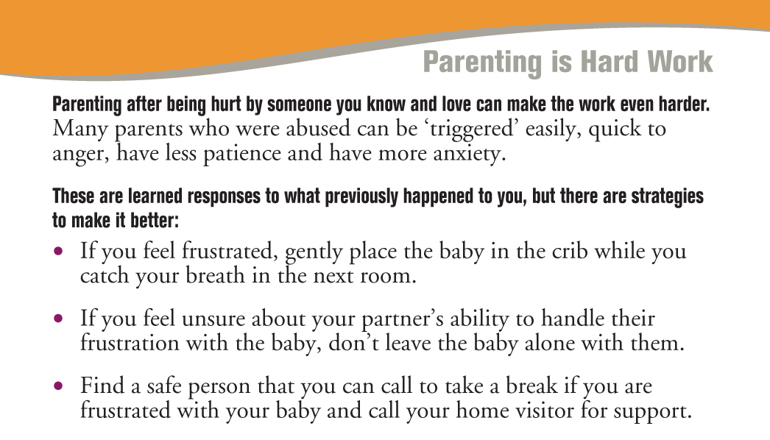
Use the Loving Parents, Loving Kids Safety Card
Educating Mothers About Steps to Take When Triggered

Slide 117
Providing Universal Education on Childhood Exposure to Violence
Ms. Macon Home Visitor Video Clip
Notes:
Estimated Activity Time: 10 minutes to watch video and 10 minutes for discussion
Notes to Trainer: Show the video clip of the home visitor talking to a client about the Loving Parents, Loving Kids safety card (Ms. Macon, Tiffany and Richie: Home Visitation and the Impact of Childhood Exposure to Violence on Parenting).
Then discuss the video clip. Questions to ask include:
Was the home visitor able to build rapport with the client?
What did you think about the way Ms. Macon offered universal education to Tiffany about childhood exposure to violence? Did it feel judgmental?
Did the client feel like she/he was being judged? Did the home visitor make the client feel comfortable when discussing childhood exposure to violence?
Could discussing childhood exposure to violence with the client create the opportunity to also ask about domestic violence and/or discuss healthy relationships?
How did Ms. Macon handle Richie coming into the picture? What do you think about the idea of educating both fathers and mothers about the impact violence can have on their parenting?

Slide 118


Role Play with
Safety Card
Notes:
Notes to Trainer
Ask participants to form groups of three with each person taking one of the following roles: home visitor, client, and observer.
Allow five minutes for the role play and 5-7 minutes for discussion.
Read the following information for this role play:
Your client is a 19-year old mother of a newborn infant and the discussion is about childhood exposure.
The home visitor should use the Loving Parents, Loving Kids safety card to discuss childhood exposure to violence with this mother by focusing on the following two panels on the card: “What About Your Childhood?” and “Parenting is Hard Work.” If you are the home visitor, your goal is to use the card to introduce the concept that childhood exposure to violence can affect parenting, discuss possible steps that your client can take if she is feeling out of control or triggered by something happening with her baby, and point out the helpline phone number that is included on the safety card.
Advise observers to note what the home visitor said that worked well.
Ask participants who role played observers:
How did the home visitor introduce the safety card? Did she/he make the discussion comfortable? What would you have liked to see more of?
Ask participants who role played as clients:
How did you feel? What would help you to feel more comfortable talking about this?
Ask participants who role played home visitors:
Were you comfortable talking about the card panels? If not, what did you wish you had more of to make this work better for you?

Slide 119

Fathering
After Violence
Notes:
Estimated Module Time: 30 minutes
Training Outline
Learning objectives
Characteristics of parenting by men who batter
Fathering after domestic violence initiatives
Something My Father Would Do DVD
Resource on parenting after violence
Overview
Men who perpetrate domestic violence often have unhealthy parenting patterns that cause further harm to children who may already be traumatized from witnessing violence. This module covers interventions that promote empathy within fathers by educating them about how violence affects their children. These interventions have shown success with some fathers in reducing violent behaviors and improving parenting skills.

Slide 120
Learning Objectives
1 List three unhealthy parenting traits of men who are abusive to their partners.
2 Identify one potential positive outcome of educating men about the impact of domestic violence on children.
3 Describe a resource that addresses fathering after domestic violence.
Notes:
Notes to Trainer: Read the learning objectives aloud.

Slide 121

Parenting After Violence
Many men who have used violence grew up in abusive households and have lived through the cycle of violence. (Silverman and Williamson, 1997)
Many mothers who have suffered abuse want their children to have safer and healthier contact with their fathers. (Bent-Goodley and Williams, 2007)
Notes:
Bent-Goodley TB. Health Disparites and Violence Against Women Why and How Cultural and Societal Influences Matter. Trauma Violence Abuse. April 2007 vol. 8 no. 2 90-104.
Silverman JG, Williamson GM. Social ecology and entitlements involved in battering by heterosexual college males: contributions of family and peers. Violence and Victims. 1997;12(2):147-165.

Slide 122
Unhealthy Parenting Traits of Abusive Men
Controlling
Very strict discipline—more likely to use physical punishment
Under-involved
Undermining and/or interfering with mother’s parenting
Using the children to meet their needs
Limited sense of age appropriateness
Notes:
Notes to Trainer: As we learn more about the effects of exposure to violence on children, we are also learning more about how being abusive in a relationship affects parenting. Researchers and service providers have observed how fathers who perpetrate domestic violence often parent differently. This list describes some of the negative parenting styles that abusers may use. This information is from a resource called “Parenting After Violence” which can be downloaded at www.instituteforsafefamilies.org. Examples of negative parenting styles are provided below:
Controlling: Controlling behavior is a hallmark of domestic violence and usually extends to the children; never allowing a child to make any choices can make them feel helpless.
Very strict discipline and physical punishment: There can be many negative consequences of using physical discipline; these experiences can reinforce that it is acceptable to hit and hurt people whom you love.
Undermining and/or interfering with mother’s parenting: Examples include criticizing the mother in front of the children, teaching the children to put their mother down and call her names, telling children that they do not have to do what their mother asks them to do.
Using the children to meet their needs: Examples include asking children to report back about what their mother is doing, who she talks to, or where she goes.
Limited sense of age appropriateness: Abusers often have unrealistic expectations of their children, do not understand age–appropriate behaviors, and use inappropriate discipline methods.

Slide 123
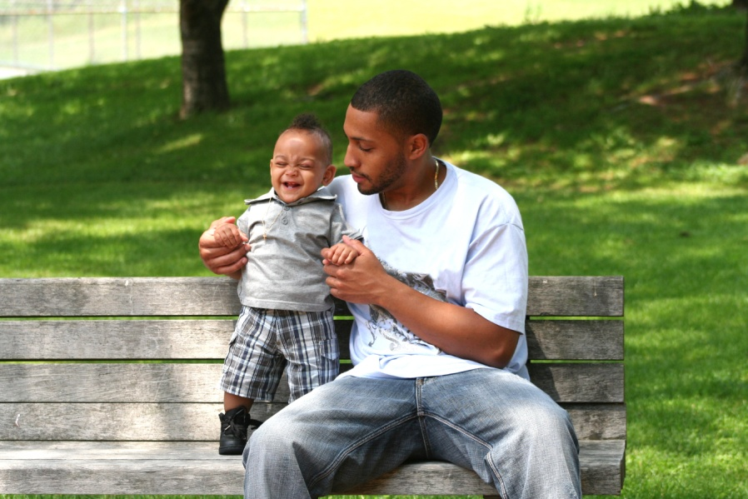
Fathering After Violence
Understanding the effects of domestic violence on their children can be an important motivator for abusive fathers to change their violent behavior (Donovan and Paterson, 1999)
Positive involvement by a father figure can be very beneficial to children’s development (Dubowitz et al, 2001)
Notes:
Giving men more opportunities for change and healing is an essential component to end violence against women and children.
Dovovan RJ, Paterson D, Francas M. Targeting male perpetrators of intimate partner violence: Western Australia’s “Freedom from Fear” campaign. Social Marketing Quarterly. 1999;5(3):128-144.
Dubowitz H, Black MM, Kerr MA, Hussey JM, Morrel TM, Everson MD, Starr RH. Type and Timing of Mothers’ Victimization: Effects on Mothers and Children. Pediatrics. 2001;107(4):728-735.

Slide 124
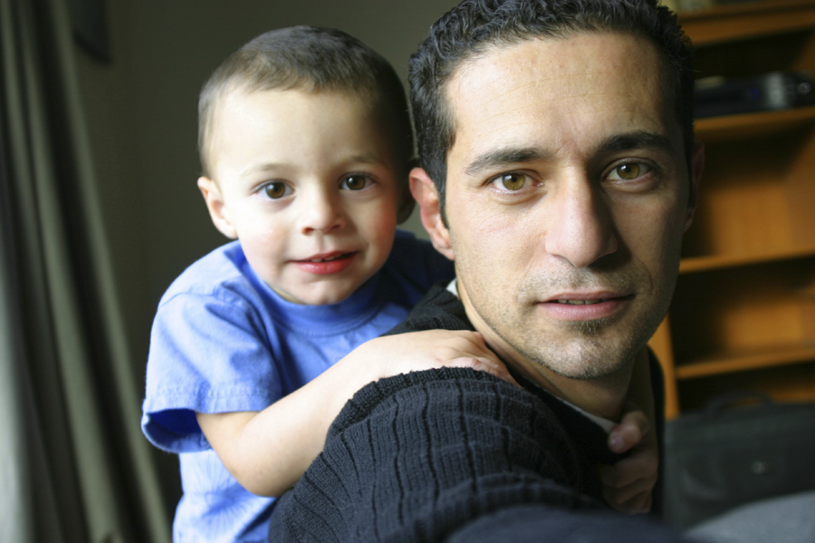
Fathering After Domestic Violence Initiatives
There are programs that are designed to improve the parenting skills of men who batter
These programs focus on the safety of the mother and children as the first priority
Notes:
Notes to Trainer: Guiding principles for fathering after violence programs include:
That the safety of women and children always comes first
That this work must be informed by the experiences of battered women and children
Critical awareness of cultural context in which parenting occurs
Abuse is a deliberate choice and a learned behavior that must be unlearned
Working with fathers is an essential piece of ending violence against women and children
Work with fathers must embrace notions of non-violence broadly
Service coordination is essential
Examples of fathering after DV programs include:
Domestic Abuse Project, Minneapolis, MN
Child Witness to Violence Project, Boston, MA

Slide 125

Resource
Something My Father Would Do: Overcoming Legacies of Family Violence
15-minute DVD features stories of three men who grew up with abusive fathers and how they grappled with their own choices as fathers
Includes discussion questions for general audiences and questions to ask when working with men who batter
Notes:
Notes to Trainer: Review the DVD before the training and consider showing at least one of the men’s stories and asking some of the discussion questions below:
QUESTIONS
What is your first impression about this story?
What did you like the best and least about this story?
What does this story tell you about fatherhood and violence?
What does this story tell you about the effects of violence on children? How does domestic violence affect children across the lifespan?
How do you think culture may affect this man’s life choices?

Slide 126

Preparing Your Program
and Supporting Staff Exposed to Violence and Trauma
Notes:
Estimated Module Time: 20 minutes
Training Outline
Learning objectives
Brainstorming session on strategies to enhance home visitors’ safety
Secondary traumatic stress
Handout on common reactions to working with trauma
Strategies for home visitors and program managers
Organizational self-assessment tool
Overview
Working with clients who experience trauma can affect the caregiver/service provider, creating secondary traumatic stress. This module reviews personal safety and self-care strategies for caregivers and policies that managers can implement to support their staff.
The subsequent slides can be used as a large group brainstorming session to ask participants what they do to enhance their safety during home visits, especially when they suspect or know that domestic violence is occurring in a household.
Review the explanation of secondary traumatic stress and acknowledge that personal experiences with violence can impact how home visitors respond to clients experiencing violence and vulnerability to secondary traumatic stress. Then provide the handout on common reactions to caring for survivors of trauma and give participants a few minutes to review the handout.
Home visitors face unique challenges and risks when working with families who are experiencing domestic violence. Home visitors may see things while visiting clients in their homes that other service providers working with the same family are not aware of such as escalating tension, threatening behaviors, and signs of violence (broken furniture, hole in the wall etc.). Because a home visitor may be in the home when physical violence erupts, it is essential that home visitation programs have a safety protocol for staff to follow when they are working with families experiencing domestic violence.

Slide 127
Learning Objectives
1 Name two strategies to enhance personal safety for home visitors who are working with families experiencing domestic violence.
2 Name two common reactions when caring for survivors of trauma.
Notes:
Notes to Trainer: Read the learning objectives aloud.

Slide 128
Personal Safety Strategies for Home Visitors
Meet with the client at the office if the situation does not feel safe
Establish check-in times with the home office
Park with the front of your vehicle pointed towards exit
Observe and listen before entering a household
Do not enter the household until you see the client at the door
Position yourself near the door/exit in the household
Have emergency numbers programmed into your cell phone and set on auto-dial
Notes:
Estimated Activity Time: 10 minutes
Notes to Trainer: Other service providers that work with families experiencing domestic violence and have contact with families in their homes may have protocols and safety strategies that could be helpful for home visitors.
Inviting service providers such as police officers and child protection workers to do a brown bag lunch training provides the opportunity for cross-training and building partnerships between agencies that are often working with the same families.
These safety strategies are discussed along with other practical lessons learned about working with domestic violence within the context of home visits in the following publication:
“Chamberlain L. Addressing Domestic Violence within the Context of Home Visitation”
This is a great topic for brainstorming. Ask participants what they do to stay safe during home visits, especially when they have concerns about a particular situation. Create a list of strategies that the audience recommends (working together as pairs to do home visits, wearing slip on shoes that can be slipped into quickly, keep car keys easily accessible, etc.)
Home visitors have emphasized how important it is to look for behavioral clues and to always be aware and to not get too comfortable that you ignore warning signs that it may not be a safe situation.
Chamberlain L. Addressing Domestic Violence within the Context of Home Visitation. Journal of Emotional Abuse, Volume 8 (1/2): 2008; available online at http://jea.haworthpress.com

Slide 129

Secondary Traumatic Stress
Secondary traumatic stress, also referred to as vicarious trauma, burnout, and compassion fatigue, describes how caring for trauma survivors can have a negative impact on service providers.
Handout: Secondary Trauma Handout

Slide 130
Exposure to Violence and Secondary Traumatic Stress
Lifetime exposure to violence is common among home visitors
Working with clients who are experiencing domestic violence can trigger painful memories and trauma for staff
A personal history of exposure to violence increases the risk of experiencing secondary traumatic stress

Slide 131
Personal Strategies to Prevent Traumatic Stress
Identify resources available through employee assistance/human resource programs
Implement debriefing sessions and periodic case reviews
Develop plans for how to respond to different situations that are stressful for staff
Offer stress management training to staff
Implement policies to maintain a secure and violence-free work environment
Notes:
Notes to Trainer: Workplaces Respond to Domestic and Sexual Violence: A National Resource Center, makes it easier than ever for employers to adopt vitally important policies to protect employees from domestic and sexual violence. The new Center was formed by a partnership of seven national organizations led by Futures Without Violence, and funded by the Justice Department’s Office on Violence Against Women (OVW). For more information, visit: www.workplacesrespond.org
Encourage program managers to implement strength-based practices so that only staff who have had training on domestic violence, who are comfortable with doing screening, and who are prepared to respond appropriately to disclosures are doing assessment with clients.

Slide 132
Resource: Trauma-Informed Organizational Self-Assessment
Instrument designed to help agencies create trauma-informed, supportive work environments
Checklist format for organizations to evaluate:
Training and education
Support and supervision
Communication
Employee control and input
Work environment
Self–assessment handout for employees
Notes:
Trauma-informed Organizational Self Assessment. The National Center on Family Homelessness. Download at www.familyhomelessness.org

Slide 133

Mandated
Reporting for
Child Abuse:
Challenges and Considerations
Notes:
Estimated Module Time: 20 minutes
Training Outline
Learning objectives
Key considerations
Supporting mothers
Resource
Overview
This module offers a brief introduction to a complex topic that should be part of continuing education for home visitors. While all states have mandated reporting for child abuse, requirements and procedures vary considerably by county and state. It is important for trainers to be aware of local response practices. Trainers should consult with their local child protection agency before doing any training to learn the basics and have referral information for further training and consultation available.
If time allows, this module provides an excellent opportunity for a guest speaker to talk about mandated reporting for child abuse in your jurisdiction.
For more information on state laws and regulations go to: www.FuturesWithoutViolence.org to see a compendium of state statutes and policies on DV and healthcare.

Slide 134
Learning Objectives
1 Describe two key considerations for addressing child maltreatment when domestic violence is also present.
2 Identify two strategies to support and involve mothers when making a mandated report to child protective services.
3 Explain the importance of working with child welfare workers and other community partners to learn more about procedures and practices in your community.
Notes:
Notes to Trainer: Read the learning objectives aloud.

Slide 135
Key Considerations
Batterers may threaten that they will get sole custody if their partner seeks a divorce
Moms may be charged with failure to protect
Cross-training with child welfare workers is essential to understand how batterers may manipulate systems and service providers in ways that can further endanger battered women and their children
Promoting safety and keeping children in the care of their non-battering parent whenever possible are core principles in intervention
Notes:
Notes to Trainer: Encourage home visitors to request and program managers to arrange cross-training with their local/regional child protection agencies. It is very helpful to include domestic violence advocates in these trainings to identify strategies for collaboration on cases where domestic violence and child maltreatment are co-occurring. Periodic brown bag lunches or other opportunities for home visitors, child welfare workers and domestic violence advocates to meet and brainstorm about best practices can lead to a more coordinated response to domestic violence and child maltreatment.

Slide 136
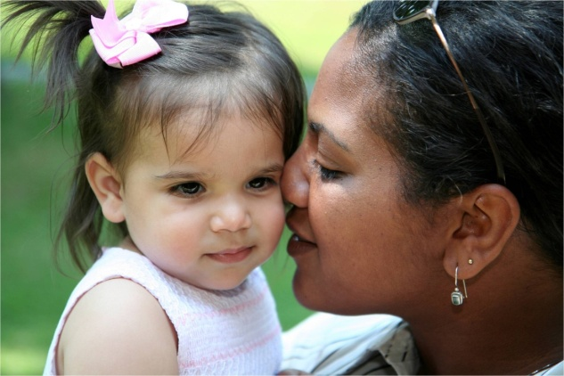
Supporting Mothers When Making a Mandated Report to Child Protective Services
Inform your client of your requirement to report
Explain what is likely to happen when the report is made
Ask your client if she is willing to call or meet with an advocate to develop a safety plan in case of retaliation
Maximize the role of the client in the process
Notes:
Notes to Trainer: Before you do training, learn about the reporting requirement for your county. Information that you will need to know includes:
Who is required to report?
What must be reported?
To whom is the report made?
What are the likely outcomes of calling the police or child protective services?
What are the safety considerations you can address with your client?
Are there provisions for confidentiality of reports?
Ways to involve the client in the process include asking if she would like to be present when you make the report if that is safe to do and keeping her informed about the process.
Encourage participants to contact local domestic violence program/shelter and domestic violence coalitions in their state to learn about additional training, consultation on particular cases, and resources for their clients.
Remind participants that making a report can never substitute for the important care they provide.

Slide 137
Example: (check your county/state specific requirements)
“Everything you share with me is confidential. This means what you share with me is not reportable to child welfare, INS (Homeland Security) or law enforcement. There are just two things that I would have to report-if you are suicidal, or your children are being harmed. The rest stays between us and helps me better understand how I can help you and the baby. ”
Notes:
IMPORTANT TIP: Before you ask about anything that the client may be worried about being reportable—(INCLUDING immigration status) always discuss limits of confidentiality:
(This is a good example of something you might consider using on the top of a self administered form or put on the top of the form the staff fill out so they don’t forget).
It is important to research what the law and requirements are in your county/state regarding reporting domestic violence prior to conducting any training. You can add additional slides to this module about what is required in your area and you should be prepared for questions on this topic and offer contacts for additional information and questions that you may not be able to answer.

Slide 138
Key Partnership: Develop a Memorandum of Understanding with your Local Child Welfare Program
Unless your state has a law that requires mandated reporting for children who are exposed to domestic violence, reporting all cases of children exposed to domestic violence is discouraged. Such practices often have unintended consequences that prevent mothers from seeking help and may cause greater risk to women and children. In addition, children may be unnecessarily removed from their mother’s care.

Slide 139

Closing and
Post-Training Survey
Notes:
Estimated Module Time: 10 minutes
Training Outline
“Where am I” exercise
Post-training survey
Overview
If time allows, you can solicit feedback from participants as you transition to the next slide on the “Where Am I” exercise. Ask participants to reflect back to the “Where Am I?” exercise that they completed at the beginning of the training and think about how this training may have impacted their comfort level with addressing domestic violence during home visits.

Slide 140
Exercise: “Where Am I Now?”
On the left end of the meter is “not at all comfortable”
On the right end of the meter is “very comfortable”
Write down where you are now and compare it to what you wrote down this morning
Notes:
Notes to Trainer: Ask participants if anyone would like to share their observations about any impact that the training has had on their level of comfort with addressing domestic violence with clients.
A key strategy for effective trainers is always having the last word at a training. Complete the discussion and then provide your closing comments about what you want the participants to take home from this training.

Slide 141
Technical Assistance
For questions about how to introduce and facilitate training vignettes and for other free technical assistance and tools including:
Posters
Safety cards
Guidelines on Reproductive Coercion
Contact The National Health Resource Center on Domestic Violence, a project of Futures Without Violence:
Visit: www.FuturesWithoutViolence.org/health
Call Toll-free: 888-Rx-ABUSE (792-2873)
800-595-4889 TTY
Email: health@FuturesWithoutViolence.org

Slide 142
Please complete the Post-Training Survey
Thank You!
Notes:
Notes to Trainer: Hand-out the post-training survey for participants to complete and provide your contact information for any questions and follow-up.
Remind participants that their responses are confidential.
Share your closing thoughts and thank participants for their time, expertise, and dedication to making a difference for the families and communities they work with.

Slide 143
Questions about Project Connect in Virginia?
Laurie K. Crawford, MPA
Sexual/Domestic Violence Healthcare Outreach Coordinator
Virginia Department of Health
Office of Family Health Services
804.864.7705
Laurie.Crawford@vdh.virginia.gov

