Slide 1


Healthy Relationships Matter:
The Impact of Intimate Partner Violence and Reproductive Coercion on Reproductive Health
Notes:
Estimated Module Time: 15 minutes
Training Outline
Workshop guidelines
Review the importance of health care providers addressing domestic violence (DV)
Population focus of the these training modules
Overview
The purpose of this module is to help the learner understand how screening for DV or Intimate Partner Violence (IPV) can make a difference in the lives of women. This module describes narrowed focus of today’s training on women of reproductive age with the goal of teaching providers about a brief interventions and harm reduction strategies to improve reproductive health and safety. And most importantly, demonstrates how talking with health care providers increases the likelihood that women are safer and more likely to seek domestic violence advocacy services.

Slide 2


Workshop
Guidelines
Because family violence is so prevalent, assume that there are survivors among us.
Be aware of your reactions and take care of yourself first
Respect confidentiality
Notes:
Notes to Trainer: It is very helpful to have a domestic violence advocate present or on call when you are doing a training on domestic violence. This type of training can trigger painful memories while also creating the opportunity for survivors to process their feelings and experiences.
Encourage participants to do what they need to feel safe and comfortable throughout the training such as leaving the room and taking unscheduled breaks. They may also approach one of the trainers at breaks or lunch to talk about issues. As a trainer, you should anticipate that survivors will come forward and want to talk you, or an advocate for support
Remain aware of anyone who may be reacting to or be affected by the content of the training. Consider giving extra breaks after particularly sensitive material, or when you observe that someone is having a difficult time. Connect with that person during the break to check-in and ask if he or she would like to talk with someone and determine how follow-up can occur.

Slide 3
On a scale of 1-10 how comfortable would you say you are with a positive disclosure of domestic violence?
Not comfortable?
Very comfortable?
Notes:
Estimated Activity Time: 2-3 minutes
Ask participants to follow the directions below. Advise them that they do not have to share what they draw/write.
Take out a sheet of paper and draw a line with the words “not at all comfortable” on the far left side of their line and the words “very comfortable” on the far right side of their line.
Ask participants to take a minute to think about their comfort level right now with talking to clients about domestic violence—and if he or she feels comfortable asking questions and getting a “yes” as the answer.
Discuss how the goal at the end of today’s session is that each person has personally moved that needle towards the ‘totally comfortable’ end of the scale.
Advise participants that this exercise will be repeated at the end of today’s session and that you will ask them to consider whether the needle moved as a result of the training, where it moved, and their thinking about this in the context of what they have learned.
The exercise is followed by small group discussion (see next slide) to help participants identify and share why it is important for health care providers know about domestic and sexual violence.
The “Where Am I?” exercise is followed by small group discussion (see next slide) to help participants identify and share why it is important for providers to know about domestic and sexual violence.

Slide 4

Barriers to Identifying and Addressing Domestic Violence
Clinicians identified the following barriers when screening for domestic violence (DV):
  Comfort levels with initiating conversations with clients about DV
  Feelings of frustration if a patient doesn’t leave a relationship when abuse is identified
  Not knowing what to do about positive disclosures of violence
Notes:
Notes to Trainer: This Train the Trainer curriculum is designed to address these barriers . Bullet point 2 is an important issue to high light since women are at greatest risk for being hurt or killed when leaving a partner—so it’s important that providers don’t consider this a measure of success. We will come back to this issue at the end of the domestic violence module.

Slide 5

Goal of this Curriculum
Simplify process of direct assessment and/or universal education about domestic violence for providers
  By connecting domestic violence and reproductive coercion assessment to visit type
  Safety Card Intervention
  Referral support
  Case Studies

Slide 6
What this training covers:
Domestic and sexual violence within a relationship (not stranger rape, elder abuse, same sex relationship abuse etc)
An evidenced based intervention for reproductive coercion for women at risk for forced unwanted pregnancies and other poor reproductive health outcomes.
Notes:
Notes to Trainer:
This training does not cover information on same sex relationship violence, elder abuse, etc—it is focused on primarily pregnancy risk as well as risks associated with partner notification of sexually transmitted infections.
Provider TIP:
It is important to establish whether your patients have sex with men, women or both in order to adjust your assessment, intervention strategy and referrals.
The provider tip is important—you might ask the audience how and or if they currently assess for this as part of routine care. You may want to give the example script: “So before we get into your visit any further, I wanted better understand your relationships—are your partners men, women, or both? “ If the clinic doesn’t currently have a question like this on their forms you can suggest they add it to their medical history forms.

Slide 7

Getting Started:
Large
Group Discussion
Why is it important for health care providers to know about domestic violence in the context of reproductive health?
Notes:
Estimated Activity Time: 2-3 minutes
Ask participants to share there thoughts about this question. Had they considered this specific question before? What might some ideas include?
The goal is to have the audience being to make connections to the impact of violence on reproductive health outcomes —in part to explain the next slide—that the focus of this training is on women’s reproductive health and risks associated with male partners.

Slide 8
Women
Who Talked to Their Health Care Provider About the Abuse Were
4 times more likely to use an intervention
2.6 times more likely to exit the abusive relationship
(McClosky et al. 2006)
Notes:
Notes to Trainers This section closes with a review of the research that has shown that just having the opportunity to talk to a health care provider about domestic violence can increase access to domestic violence services.
In this study by McCloskey et al. (2006), 132 women outpatients who disclosed domestic violence in the preceding year were recruited from multiple hospital departments and community agencies. Abused women who talked with their health care providers about the abuse were more likely to use an intervention and exit the abusive relationship. Women who were no longer with their abuser reported better physical health than women who stayed.
McCloskey LA, Lichter E, Williams C, Gerber M, Wittenberg E, Ganz M. Assessing Intimate Partner Violence in Health Care Settings Leads to Women’s Receipt of Interventions and Improved Health. Public Health Reporter. 2006;121(4):435-444.

Slide 9

Overview
Of Domestic
Violence:
Definitions
and
Dynamics
Notes:
Estimated Module Time: 15 minutes (Depending on the amount of discussion time and activities)
This module is recommended if your audience has not had previous training on domestic violence or would benefit from an overview of introductory content on domestic violence. Recommend that participants contact their local domestic violence advocates for more in-depth, comprehensive training on domestic violence.
Training Outline
Learning objectives
Magnitude of problem, definitions, and key concepts
Culture and domestic violence
Validation and supportive messages
Overview
The module begins with statistics about how common domestic violence is. This is followed by several key definitions to help participants recognize the many different forms of abuse that can occur within intimate relationships.

Slide 10

Learning Objectives
1 List two examples of power and control in an abusive relationship.
2 Describe the prevalence of domestic and sexual violence.
  3 Discuss two reasons why a woman may stay in an abusive relationship
  after violence has occurred.
4 Demonstrate supportive messages and discuss safety planning.
Notes:
Notes to Trainer: Read the learning objectives aloud.

Slide 11

What We Know
1 in 4 (25%) U.S. women
and
1 in 5 (20%) U.S. teen girls report ever experiencing physical and/or sexual partner violence
(CDC Morbidity and Mortality Weekly Report, February 2008; Silverman et al, 2001)
Notes:
Black MC, Breiding MJ, National Center for Injury Prevention and Control, CDC. Adverse Health Conditions and Health Risk Behaviors Associated with Intimate Partner Violence---United States, 2005. MMWR. 2008;57(05):113-117.
Silverman JG, Raj A, Mucci LA, Hathaway JE. Dating Violence Against Adolescent Girls and Associated Substance Use, Unhealthy Weight Control, Sexual Risk Behavior, Pregnancy, and Suicidality. JAMA. 2001;286(5)572-579.

Slide 12

Definitions of Domestic Violence
Legal definitions are often more narrowly defined with particular focus on physical and sexual assault
Public health definitions include a broader range of controlling behaviors that impact health including:
  emotional abuse, social isolation, stalking, intimidation, threats
Notes:
Notes to trainer: Providers are often concerned about legal definitions—work with providers to understand the larger public health implications of abuse.

Slide 13

Domestic and
Adolescent Relationship Violence
Patterns of coercive and controlling behaviors perpetrated by an adult or teen against an intimate partner.
(National Consensus Guidelines on Identifying and Responding to Domestic Violence Victimization in Health Care Settings. San Francisco, CA: Family Violence Prevention Fund)
Notes:
Notes to Trainer: This is the definition of domestic violence.

Slide 14
Group Discussion
Why might a woman stay in a relationship when domestic violence has occurred?
Notes:
Estimated Activity Time: 2 minutes (a quick question and answer for the audience)
Notes to Trainer: Remind the audience that we are focusing on teens and adults who are experiencing abusive behaviors that are perpetrated by their intimate partners. There would be other reasons and circumstances if we were talking about children who were being physically or sexually abused by a parent or another adult.
Reasons why women stay:
Because she loves him and has hope that he will change
Lack of safe option for herself and children
Lack of family or community support/Lack of money or loss of status
Women do leave—but leaving is a process
In some cases, the violence does end
Financial reasons

Slide 15
Why do women stay in abusive relationships?
  She loves him
  She is scared to death of him. Leaving an abusive relationship can be the most dangerous time
  She wants the good behavior to stay and the bad to go away (hope)
  Financial reasons
  Connections to her community
  Religion
  Children
Notes:
Domestic violence is not caused by stress, alcohol, poverty, illness, rage, or anger management problems. Factors such as substance abuse and poverty can , however, increase the risk of domestic violence occurring.

Slide 16

Domestic and sexual violence cuts across all races, ethnicities, religions, sexual orientation, age groups, and socioeconomic levels
Every culture has elements that condone violence…
and elements that resist it
Notes:
Notes to Trainer: Every culture has elements that condone men’s controlling behavior of women and some line differentiating what level of abuse is considered acceptable. For example, under certain circumstances, minor violence such as pushing or shoving might be condoned, while abuse beyond that level is considered unacceptable.
Anyone can be a victim of domestic or sexual violence regardless of: age, race, ethnicity, sexual orientation, religion, class, immigration status, disability, region (rural/urban).
Some studies show that African American, Native American, and Latina women experience higher rates of domestic violence while others find that when socioeconomic status is accounted for ethnic differences are reduced or eliminated.
Mitchell SJ, See HM, Tarkow AKH, Cabrera N. Conducting Studies with Fathers: Challenges and Opportunities Applied Development Science 2007, Vol. 11, No. 4, 239-244.
Tjaden P, Thoennes N. Extent, Nature, and Consequences of Intimate Partner Violence. U.S. Department of Justice, Offices of Justice Programs, National Institute of Justice. Washington, DC. July, 2000.

Slide 17
Your Role is Important
Simple
Doable
You do not have to be a domestic violence expert to recognize and help patients experiencing domestic violence
You have a unique opportunity for education, early identification, and intervention

Slide 18
Defining Success
“
Success is measured by our efforts
to reduce isolation and to improve options for safety.
“
Futures Without Violence
Notes:
Notes to Trainer:
You do not need to be an expert in domestic violence to help women in your health setting.
Our job is not to “fix” domestic violence or to tell victims what to do.
Providing support and information can make a difference in the lives of victims.
We can help victims by understanding their situation and recognizing how abuse can impact health, risk behaviors and parenting.

Slide 19

Making the Connection: Domestic Violence, Birth Control Sabotage, Pregnancy Pressure, and Unintended Pregnancies
Notes:
Estimated Module Time: 30 minutes
Note to trainer:
Training Outline
Learning objectives
Definitions, statistics, and examples of reproductive coercion
Group discussion: birth control sabotage
Overview
As we have learned more about different forms of abusive and controlling behaviors that are used by partners to maintain power and control in a relationship, patterns of behaviors that affect women’s reproductive health have been identified. These behaviors, which are referred to as reproductive coercion, include forced sex, birth control sabotage, pregnancy pressure, and condom manipulation.

Slide 20
Learning
Objectives
1 Describe the impact of domestic violence on reproductive health outcomes.
2 Define reproductive coercion.
3 Identify two ways to increase identification and provide harm reduction strategies for reproductive coercion.
4 Recognize the unique intervention role health care providers play for woman experiencing reproductive coercion.
Notes:
Notes to Trainer: Read the learning objectives aloud.

Slide 21
  Group Discussion
How does domestic violence impact reproductive health?
Notes:
Estimated Activity Time: 3 minutes (a quick question and answer for the audience)
Notes to Trainer: Remind the audience that we are focusing on teens and adults who are experiencing abusive behaviors that are perpetrated by their intimate partners. There would be other reasons and circumstances if we were talking about children who were being physically or sexually abused by a parent or another adult.
Key points to cover in group discussion:
Unintended pregnancies
Increased risk for
Connect her to an advocate for safety planning

Slide 22
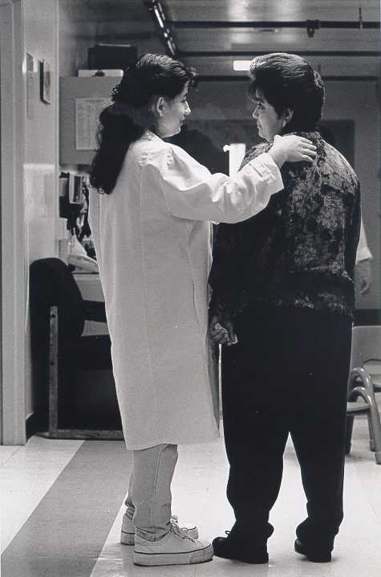
What We Know
Among a random sample of 1278 women ages 16-29 in 5 Family Planning clinics
  53% experienced DV/SA
Mirrors findings from studies nationwide – family planning clients have high rates of violence
Miller, et al 2010
Notes:
Miller E, Decker MR, McCauley HL, Tancredi DJ, Levenson RR, Waldman J, Schoenwald P, Silverman JG. A family planning clinic partner violence intervention to reduce risk associated with reproductive coercion. Contraception. 2011;83:274-280

Slide 23

Boys and girls who experience sexual dating violence are more likely to:
  Initiate sex before age 11
  Have sexual intercourse
  with 4 or more people
  Use alcohol or drugs before sex
Kim-Goodwin et al, 2009
Notes:
Notes to trainer: Pose the last question to the audience: Why is this last bullet point important (Answer—less likely to use condoms).
Kim-Goodwin et al. (2009) used data from the Youth Risk Behavior Survey for southeastern North Carolina to examine the relationship between dating violence and risk behaviors. The sexual risk behaviors described in the slide are from 2007 data (n=372 male and female high school students).
In a study by Silverman and colleagues (2001), data from the 1997 and 1999 Massachusetts Youth Risk Behavior Surveillance System was analyzed. High school age girls who were physically (but not sexually abused) by a dating partner were 1.6 times more likely to have first intercourse before age 15. Girls who were physically and sexually abused by a dating partner were 3.5 times more likely to have their first intercourse before age 15.

Slide 24
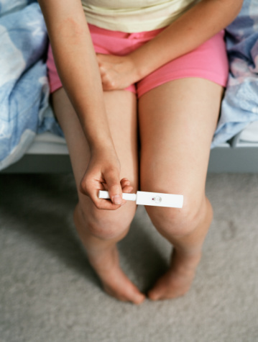
Domestic violence increases women’s risk for
Unintended
Pregnancies
(Sarkar, 2008)
Notes:
Sarkar conducted a literature review of publications from 2002 through 2008 on the impact of domestic violence on women’s reproductive health and pregnancy outcomes.
In a study by Goodwin et al (2000), women who had unintended pregnancies were 2.5 times more likely to experience physical abuse compared to women whose pregnancies were intended.
Goodwin MM, Gazmararian JA, Johnson CH, et al. Pregnancy Intendedness and physical abuse around the time of pregnancy: Findings form the pregnancy risk assessment monitoring system, 1996-1997. PRAMS Working Group. Pregnancy Risk Assessment Monitoring System. Maternal and Child Health Journal. 2000;4(2):85-92.
Sarkar NN. The Impact of Intimate Partner Violence on Women’s Reproductive Health and Pregnancy Outcome. Journal of Obstetrics and Gynaecology. 2008;28(3):266-271.

Slide 25
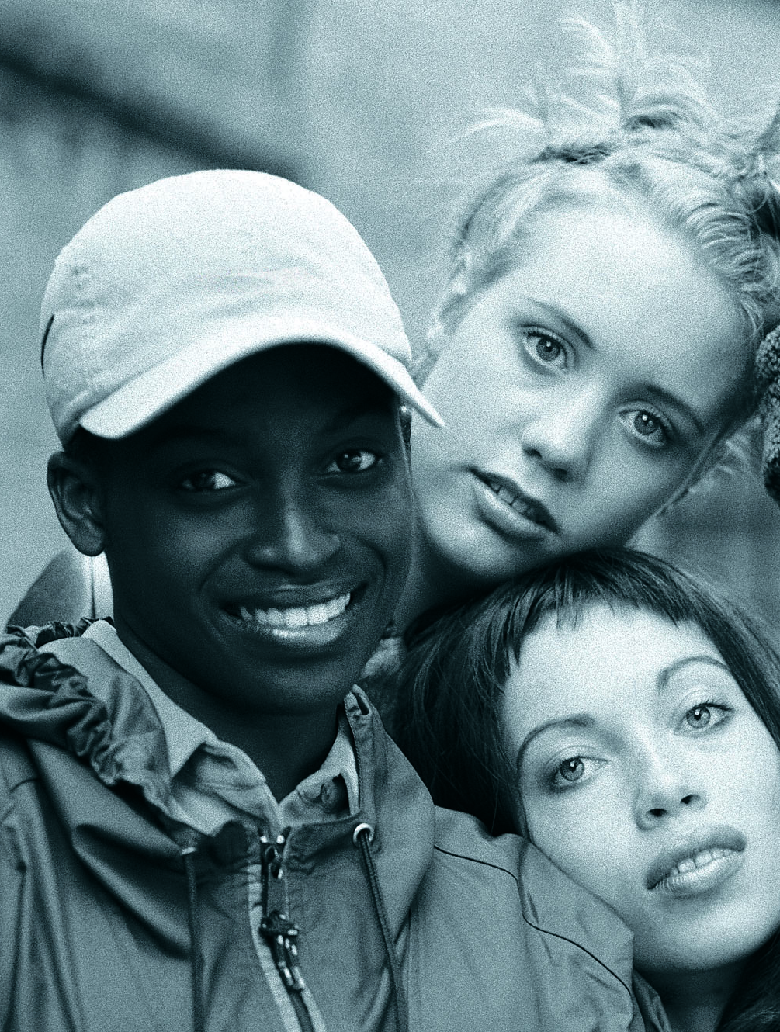

DATING VIOLENCE AND
TEEN PREGNANCY
Adolescent girls in physically abusive relationships were
3.5 times more likely to become pregnant than non-abused girls.
Roberts et al, 2005
Notes:
Notes to trainer: It may be interesting for the participants to consider what we know about teen pregnancy from media. Pose this question to the audience: Is this something the average American thinks about when they think about teen pregnancy?
This study by Roberts and colleagues (2005) analyzed data from the National Longitudinal Study of Adolescent Health. The analyses adjusted for sociodemographic factors, the number of intimate partners, and a history of forced sexual intercourse. A past history or current involvement in a physically abusive relationship was associated with a history of being pregnant among sexually active adolescent girls. Physical abuse was defined as “push you,” “shove you,” or “throw something at you.”
In a study by Silverman et al. (2001), adolescent girls who experienced physical or sexual dating violence were 6 times more likely to become pregnant than their non abused peers.

Slide 26

DATING VIOLENCE AND CONDOM USE
Girls who experienced physical dating violence were 2.8 times more likely to fear the perceived consequences of negotiating condom use than non-abused girls
Wingood et al, 2001
Notes:
Notes to trainer: Ask the audience how many of them do condom education with patients? And then ask, how many in the audience routine ask her if she is afraid to ask him to use a condom.
These data demonstrate how important it is to ask clients about whether it is safe to talk to their partner about using condoms and birth control.
In this study by Wingood et al. (2001), black females, 14 to 18 years old, were recruited from several different sites (health department, adolescent medicine clinic, and school health classes) to participate in a HIV/STD prevention study (n=522). Girls with a history of dating violence were significantly less likely to use condoms consistently compared to nonabused girls.
In another study by Roberts et al. (2005), Girls in verbally abusive relationships were less likely to use a condom during their most recent sexual intercourse.
Reduced likelihood of using condoms has also been shown with adult women experiencing IPV. Wingood and DiClemente (1997) conducted interviews with 165 sexually active African-American women, ages 18 through 29. Women in abusive relationships were less likely than nonabused women to use condoms and were more likely to experience verbal/emotional abuse or threats of physical violence when they discussed condoms. There were more fearful of asking their partners to use condoms, worried more about acquiring HIV, and felt more isolated than women who were not in abusive relationships.

Slide 27

KNOWLEDGE ISN’T ENOUGH
Under high levels of fear for abuse, women with high STI knowledge were more likely to use condoms inconsistently than nonfearful women with low STI knowledge.
Ralford et al, 2009
27
Notes:
Note to trainer: Remind participant s that this statistic demonstrates that we should not assume a knowledge deficit or automatically give a bag of condoms to prevent disease that we have to know first if she is afraid to ask her partner to use them.
In this study by Ralford et al. (2009), women were asked about the degree to which they were worried that if they talked about using condoms with their sexual partner that he would respond in negative ways including threatening to hit, push or kick them; leave them, swear at them; or call them names. Almost half (47.6%) of young (18-21 years) African American women (n=715) reported having experienced relationship abuse in their lifetime; 15% reported abuse by a main sexual partner in the past 60 days. Under high levels of fear for abuse, 76% of women with high STI knowledge were more likely to exhibit inconsistent condom use during their last sexual intercourse with a man compared to 60% of women with low levels of knowledge. One of the explanation for this counterintuitive finding that the authors offer is that women with more knowledge about STI transmission may balance the risk of abuse with the risk of acquiring an STI, particularly if they know or suspect that their partner is a low risk for STIs. Overall these findings emphasize the importance of integrating dating violence assessment and prevention into STI and HIV prevention programs.

Slide 28
Pregnancy Pressure and Condom Manipulation
“
Like the first couple of times, the condom
seems to break every time. You know what I mean, and it was just kind of funny, like, the first 6 times the condom broke. Six condoms, that's kind of rare I could understand 1 but 6 times, and then after that when I got on the birth control, he was just like always saying, like you should have my baby, you should have my daughter, you should have my kid.
“
17 yr. old female who started Depo-Provera
without partner’s knowledge
(Miller et al, 2007)
Notes:
This quotation is from a qualitative study by Miller et al. (2007) on male pregnancy-promoting behaviors and adolescent partner violence. The teen girl was parenting a baby from a different relationship and the abusive relationship started shortly after she broke up with her son’s father. She went to a teen clinic and started Depo-Provera injections without her new partner’s knowledge.
Miller E, Decker MR, Reed E, Raj A, Hathaway JE, Silverman JG. Male Partner Pregnancy-Promoting Behaviors and Adolescent Partner Violence: Findings From a Qualitative Study with Adolescent Females. Ambulatory Pediatrics. 2007;7(5):360-366.

Slide 29
Group Discussion
What are other ways a partner can interfere with a woman's birth control?
Notes:
Estimated Activity Time: 5 minutes
Review some examples of birth control sabotage.
Proceed to the next slide which provides examples of birth control sabotage and highlight any examples that were not identified by participants.

Slide 30
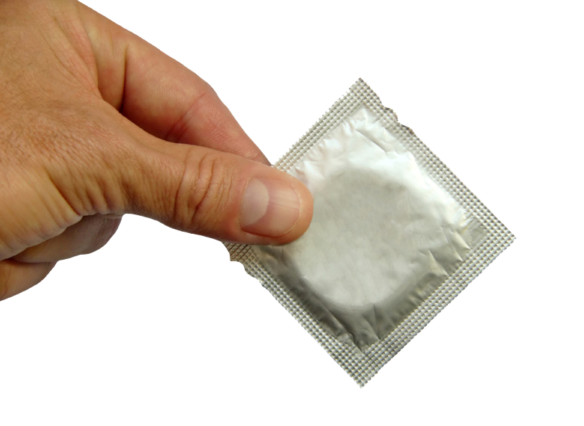
Birth Control Sabotage
Tactics include:
Destroying or disposing contraceptives (pills, patch, ring)
Impeding condom use (threatening to leave her, poking holes in condoms)
Not allowing her to obtain or preventing her from using birth control
Threatening physical harm if she uses contraceptives
Campbell et al, 1995; Coggins et al, 2003; Fanslow et al, 2008;Lang et al, 2007; Miller et al, 2007; Wingood et al, 1997
Notes:
Qualitative and quantitative research have shown an association between birth control sabotage and domestic violence.
Fanslow et al. (2008) conducted interviews with a random sample of 2,790 women who had ever had sexual intercourse. Women who had ever experienced domestic violence were more likely to have had partners who refused to use condoms or prevented women from using contraception compared to women who had not experienced domestic violence (5.4% vs. 1.3%).
Miller et al (2007) conducted interviews with 53 sexually active adolescent females. One-quarter (26%) of participants reported that their abusive male partners were actively trying to get them pregnant. Common tactics used by abusive male partners included:
Manipulating condom use
Sabotaging birth control use
Making explicit statements about wanting her to become pregnant
Campbell J, Pugh LD, Campbell D, Visscher M. The Influence of Abuse on Pregnancy Intention. Women’s Health Issues. 1995;5:214-223.
Coggins M, Bullock LF. The Wavering Line in the Sand: the Effects of Domestic Violence and Sexual Coercion. Issues in Mental Health Nursing. 2003:24(6-7):723-738.
Fanslow J, Whitehead A, Silva M, Robinson E. Contraceptive Use and Associations with Intimate Partner Among a Population-based Sample of New Zealand Women. Australian & New Zealand Journal of Obstetrics & Gynaecology. 2008;48(1):83-89.
Lang DL, Salazar LF, Wingood GM, DiClemente RJ, Mikhail I. Associations Between Recent Gender-based Violence and Pregnancy, Sexually Transmitted Infections, Condom Use Practices, and Negotiation of Sexual Practices Among HIV-Positive Women. Journal of Acquired Immune Deficiency Syndromes. 2007;46(2):216-221.
Miller E, Decker MR, Reed E, Raj A, Hathaway JE, Silverman JG. Male Partner Pregnancy-Promoting Behaviors and Adolescent Partner Violence: Findings From a Qualitative Study with Adolescent Females. Ambulatory Pediatrics. 2007;7(5):360-366.
Wingood GM, DiClemente R. The effects of an Abusive Primary Partner on the Condom Use and Sexual Negotiation Practices of African-American Women. Journal of Public Health. 1997;87:1016-1018.

Slide 31
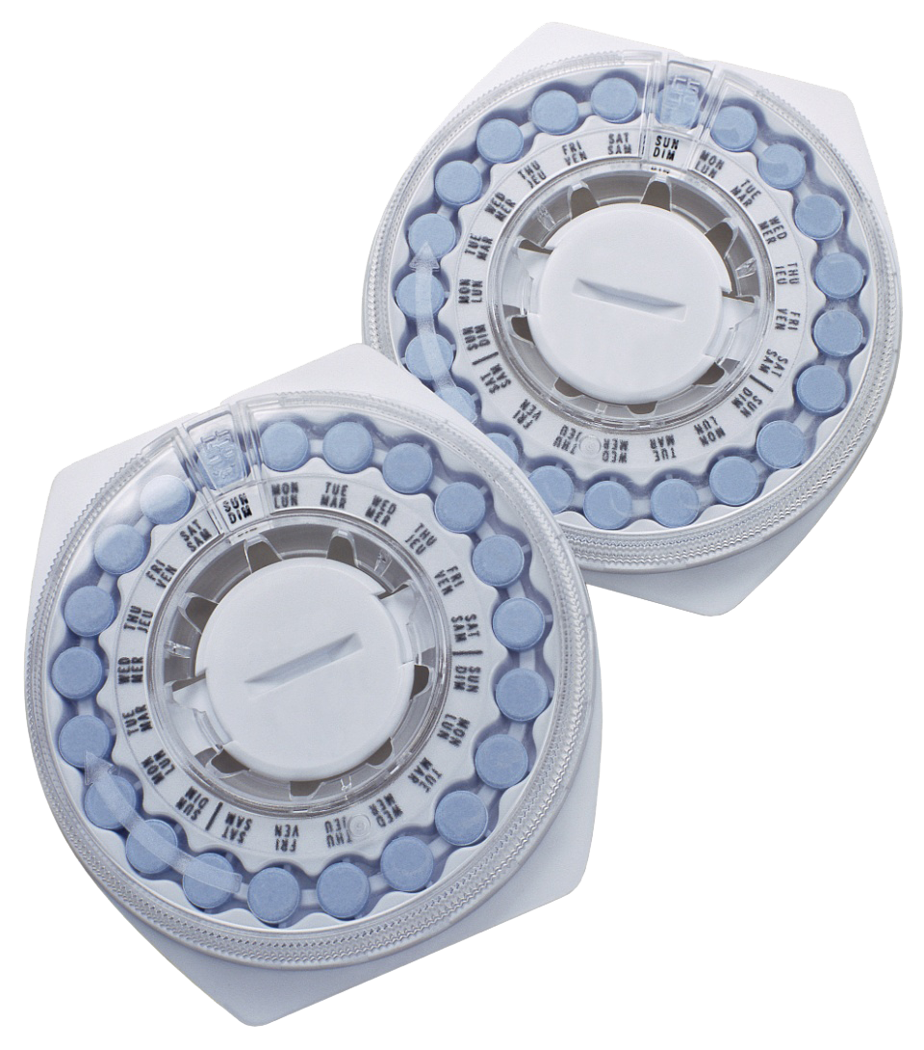
Women, including teens, experiencing physical and emotional IPV are more likely to report not using their preferred method of contraception in the past 12 months (OR=1.9).
Williams et al, 2008
Notes:
Williams and colleagues conducted a case control study with 225 women to examine whether IPV was associated with women’s risk for problems in contraception use.

Slide 32

PREGNANCY-PROMOTING BEHAVIORS
One-quarter (26.4%) of adolescent females reported that their abusive male partners were
TRYING TO GET THEM PREGNANT
Miller et al, 2007
Notes:
In this qualitative study by Miller and colleagues (2007), 53 teen girls between the ages of 15 and 20 years (21% African American, 38% Latina) with known history of IPV were recruited from adolescent clinics, domestic violence agencies, schools, youth programs for pregnant/parenting teens, and homeless and at-risk youth. Approximately one-third of the participants were recruited from pregnant and parenting teen programs to ensure sufficient representation of teens experiencing both IPV and pregnancy. Older male partners were typical with the median age difference between the female and the male partner being 4 years. Pregnancy-promoting behaviors by their abusive male partners included:
Poking holes in condoms
Explicit statements (e.g. “I want a baby”)
Getting angry if she asked him to use a condom
Removing the condom during intercourse
Several girls reported hiding contraceptive use from their abusive male.

Slide 33

Teen Birth Control Sabotage
Among teen mothers on public assistance who experienced recent domestic violence:
66% experienced birth control sabotage by a dating partner
  34% reported work or school-related sabotage by a dating partner
(Raphael, 2005)
Notes:
In this study by Raphael (2005), 474 teen girls on Temporary Assistance to Needy Families completed written surveys. The teens were recruited from two state-funded Teen Parent Services sites and two community-based health clinics. Seventy percent were between the ages of 15 and 17 at the time of the birth of their first infant (mean =18 years) and 95% of the girls were African Americans. Almost half (43%) of the girls were involved with males who were older by 4 or more years. Fifty-five percent disclosed domestic violence in the past 12 months. Findings included:
Two-thirds (66%) of teen dating violence victims experienced birth control sabotage compared to 34% of non-abused teens
34% of teen dating violence victims reported work or school related sabotage compared to 7% of teens who did not experience dating violence but were sabotaged in relation to work or school.
Raphael J. Teens Having Babies: The Unexplored Role of Domestic Violence. The Prevention Researcher. 2005;12(1):15-17.

Slide 34
Continuum of Control and Abuse
Controlling Behaviors
Emotional Abuse
Homicide
Rape
Birth Control Sabotage
Pregnancy Coercion
Reproductive Coercion
Notes:
Notes to Trainer: Something to share with the audience. When you think about abuse and control you might envision a continuum with smaller things on one end—he takes her cell phone, won’t let her see her friends or family to the other extreme—injures her, chokes her kills her. Reproductive control fall on this continuum. The next two slides describes ways a partner control of pregnancy.

Slide 35
LACK OF CONTROL AROUND SEX WITH ABUSIVE MALE PARTNER
“
I'm not gonna say he raped me... he didn't use force, but I would be like, "No," and then, next thing, he pushes me to the bedroom, and I'm like, "I don't want to do anything," and then, we ended up doin' it, and I was cryin' like a baby, and he still did it. And then, after that... he got up, took his shower, and I just stayed there like shock...
“
Miller et al, 2007
Notes:
35
Notes to trainer: Review this thought with the audience. And ask, Do you think this woman was raped? (Nearly 100 percent of your audience will say yes) .
Then say, let’s look at the very first thing she said here—”I’m not going to say he raped me…” This kind of response is really common among women in relationships—who sometimes have consensual sex with partners and at other times the sex is like what is described here. This is an important detail as you consider the continuum of control from the last slide. In her mind , she may well put this event at a different place on the continuum other than rape. So the language we use in clinical encounters should reflect this and is included on the safety card.

Slide 36
Threats to
Promote a Birth
“
He really wanted the baby—he wouldn’t let me have—he always said, “If I find out you have an abortion,” you know what I mean, “I’m gonna kill you,” and so I really was forced into having my son. I didn’t want to; I was 18. […] I was real scared; I didn’t wanna have a baby. I just got into [college] on a full scholarship, I just found out, I wanted to go to college and didn’t want to have a baby but I was really scared. I was scared of him.
“
age 26, white, some college
Notes:
Notes to trainer: Pregnancy coercion involves threats or acts of violence if a woman does not comply with her partner’s wishes whether to continue or terminate the pregnancy.
Respondents described abusive partners making them feel bad about their desire to abort; begging, badgering and making promises to support the baby to pressure them into giving birth. Some respondents described giving in to this pressure, and some did not. One woman’s partner kept on making her eat which prevented her from going in for her second trimester abortion for which she needed to be sedated since one of the rules was that she could not eat anything the day of her abortion. Respondents also described more invasive tactics used by partners to keep them from obtaining abortions such as refusing to pay or help pay for an abortion. This respondent described how her partner threatened her into carrying an unwanted pregnancy to term.

Slide 37
Threats To Promote Abortions
“
He really wanted me not to keep it... I was under 18 so we had to go to [neighboring state with no parental consent law]. And I went to [the clinic] and I remember only the lady asked me if I really [wanted to have an abortion], but she gave me a paper, and she [asked] me that if I wanted to do that, that if nobody else was making me. And I remember I just wanted to leave and not do it, because I did want to keep the baby. But he told me, he was next to me and he went like this [poke] and told me that – “Tell her!
“
Age 25 , graduated high school

Slide 38
The risk of being a victim of IPV in the past year was nearly
3X HIGHER
for women seeking an abortion compared to women who were continuing their pregnancies.
Bourassa & Berube, 2007
Notes:
Bourassa and Berube (2007) conducted interviews with 350 adult and teen females who elected to have abortions at a family planning clinic and 653 pregnant women at a perinatal clinic. The probability of being a victim of physical, sexual, and/or psychological IPV was almost three times higher for women electing to have an abortion compared to women who were continuing their pregnancies (25.7% vs. 9.3%, p < 0.0001).

Slide 39
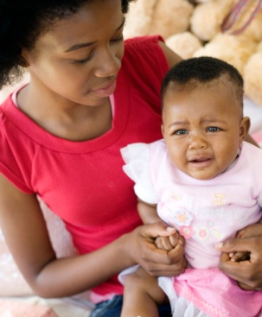
Rapid Repeat Pregnancy
Adolescent mothers who experienced physical abuse within three months after delivery were nearly twice as likely to have a repeat pregnancy within 24 months
(Raneri& Wiemann, 2007)
Notes:
In this study with teenage mothers (ages 12-18) who were recruited from a labor and delivery unit at a university hospital, physical abuse by an intimate partner was defined as being hit, slapped, kicked, or physically hurt enough to cause bleeding or having been hit during an argument or while her partner was drunk or high.
The odds of repeat pregnancy was 1.9 times higher among teen mothers who were physically abused by their partner within three months of delivery compared to non-abused teen mothers.
Raneri LG, Wiemann CM. Social Ecological Predictors of Repeat Adolescent Pregnancy. Perspectives on Sexual and Reproductive Health. 2007;39(1):39-47.

Slide 40
Definition: Reproductive Coercion
Reproductive Coercion
involves behaviors that a partner uses to maintain power and control in a relationship that are related to reproductive health:
  Explicit attempts to impregnate a partner against her wishes
  Controlling outcomes of a pregnancy
  Coercing a partner to have unprotected sex
  Interfering with birth control methods

Slide 41
Can Men Experience
Reproductive Coercion?
What about men?
Yes, they can. A female partner could lie about contraceptive use and he could become a father as a result of this activity.
The question to consider is whether this activity accompanied by threats or harm?
To date there have been no studies indicating that men have become fathers when they didn’t want to be because she threatened to kill him if he didn’t get her pregnant.

Slide 42
Men and reproductive coercion
One study, shows a clear discrepancy between young males' desire to prevent pregnancy and their perceived responsibility for birth control.
Reliance on a partner's use of hormonal contraceptives, and in several cases, beliefs of low personal responsibility for pregnancy prevention reduced young males' participation in fertility control.
(Smith, et al, 2011)
Notes:
For these men, concerns over pregnancy failed to motivate their continued use of condoms when STI risk was perceived as low and a partner was using birth control.
Smith JL, Fenwick J, Skinner R, Merriman G, Hallett J. Young males’ perspectives on pregnancy, fatherhood and conom use: Where does responsibility for birth control lie? Sexual & Reproductve Healthcare. 2011;2:37-42

Slide 43
Messages for men who have sex with women
Male clients need to hear the same messages as female clients--the importance of healthy relationships and consensual contraception to prevent unwanted pregnancies.
Since contraception does fail and some women may engage in reproductive coercion, discuss the importance of condom use in preventing unwanted pregnancies with male clients.

Slide 44
Assessment and Response to Reproductive Coercion and Violence in Reproductive Health Settings
Notes:
Estimated Module Time: 120 minutes
Note to trainer: Due the length of this module please offer a 10 minute break
Training Outline
Learning objectives
Assessment for reproductive coercion and responding to disclosures
Video case studies
Role plays
Overview
Using a skills-based approach, this module includes assessment questions, scripting, and information about birth control options that may be less visible and more effective for clients whose partners are interfering with their birth control.

Slide 45




A Community-Based Family Planning Intervention to Reduce Partner Violence
Elizabeth Miller, MD, PhD
Michele R. Decker, ScD
Heather L. McCauley, MS
Rebecca Levenson, MA
Phyllis Schoenwald, PA
Jeffrey Waldman, MD
Jay G. Silverman, PhD
Notes:
Notes to trainer: This was and NIH (National Institutes of Health) Community Collaboration grant which brought together 4 institutions—Harvard School of Public Health, UC Davis Medical Center, Futures Without Violence and Planned Parenthood Federation of America along with local domestic violence and sexual assault programs to develop this community informed intervention.

Slide 46
Intervention Elements: Enhanced IPV/SA Assessment
Assessment specific to sexual and reproductive health and relevant to visit
Normalizing domestic violence experiences and connecting those experiences to reproductive health
Harm reduction and supported referral
Notes:
This is an overview of the elements of this brief intervention .

Slide 47
Intervention Results
Among women in the intervention
who experienced recent partner
violence:
71% reduction in odds for pregnancy coercion compared to control
Women receiving the intervention were 60% more likely to end a relationship because it felt unhealthy or unsafe
Notes:
Miller E, Decker MR, McCauley HL, Tancredi DJ, Levenson RR, Waldman J, Schoenwald P, Silverman JG. A family planning clinic partner violence intervention to reduce risk associated with reproductive coercion. Contraception. 2011;83:274-280

Slide 48
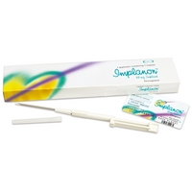
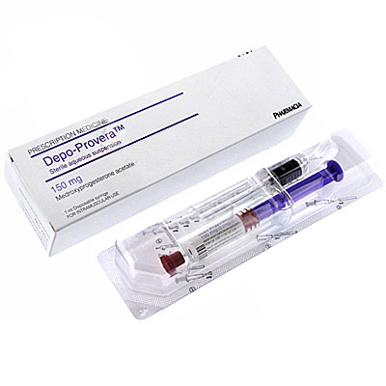
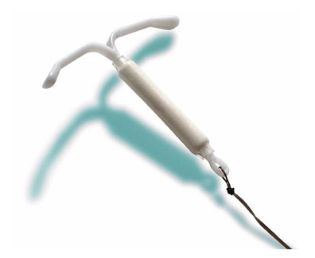
Our Intervention
To be sure, these methods are less vulnerable to tampering by a sexual partner-- but are detectable due to loss of period or irregular bleeding.
Notes:
Notes to Trainer:
Safety First!
Asking if her partner monitors menstrual cycles/bleeding patterns is essential to enhancing patients safety
It helps when making a decision about contraception they can control with the least
risk of retaliation
When training participants that are both DV/SA advocates and reproductive health providers the following handout may be useful to make sure all participants understand in detail the way various forms of contraception work and safety considerations to take into account when providing patient education about which method may help keep her safer.
Ask participants to review the birth control information sheet
Any if there are any questions about these methods and how a partner might interfere with them

Slide 49
KEY CONSIDERATION:
If her partner monitors her menstrual cycles—Copper T IUD may be the safest method to offer her.
Especially if we cut the strings in the cervical canal so they can’t be pulled out or felt by a partner.
The inconvenience of IUD removal with ultrasound may well be worth avoiding an unwanted pregnancy by abusive partner.
Notes:
Notes to trainer. For providers who are resistant to this concept of cutting the strings, ACOG supports this practice in when patient is faced with reproductive coercion.

Slide 50

Animated Video
Following the animated
series opening:
The following video clip
demonstrates how to
screen for reproductive
coercion and use this as a bridge to ask questions about domestic violence
Notes:
Estimated Activity Time: 3 minutes to watch video
This animated video could be used as a time saver when you have limited training time available. We have placed it here to function as a summary and as the introduction to the video case studies that follow.
Discussion questions to ask after watching this video clip include:
Let’s start by discussing the series opening—we just heard in three minutes and overview of all the slides reviewed in this section.
Any final thoughts about what you saw? This animated opening is the lead in to the following case studies.

Slide 51
Case Study: Marta
The following video clip
demonstrates how to
screen for reproductive
coercion and provide
harm reduction strategy—
using a safety card.
Notes:
Estimated Activity Time: 10 minutes to watch video “Marta: Oral Contraceptive Visit“ and 5 minutes for discussion.
Discussion questions to ask after watching this video clip include:
What do you think worked well?
What kinds of examples did you see to help “normalize” the conversation?
What did not work well? (When participants identify a problem—ask them what would work better in their clinic? )
A frequently asked question is whether it is possible to have someone open up with such a brief assessment. The answer is yes, some women do open up the first time they are asked in a compassionate non-judgmentatal way others will take more time. We have learned from providers that once they begin screening using this approach they get many more disclosures than before.

Slide 52
Question:
How does an intervention for reproductive coercion differ from an intervention for IPV?
Notes:
Exercise 1-2 minute
Note to trainer:
Ask the audience if they have ideas about how these things differ?
Use the comments or lack there of to tie it back to the video:
What did they see that was different in the video?
What was it that the provider did with the patient that an advocate could not?

Slide 53

      Answer:
      When it comes to reproductive coercion, the health care provider is now key to intervention.
      This is done through offering harm reduction strategies for reproductive coercion and providing discreet methods of contraception.

Slide 54
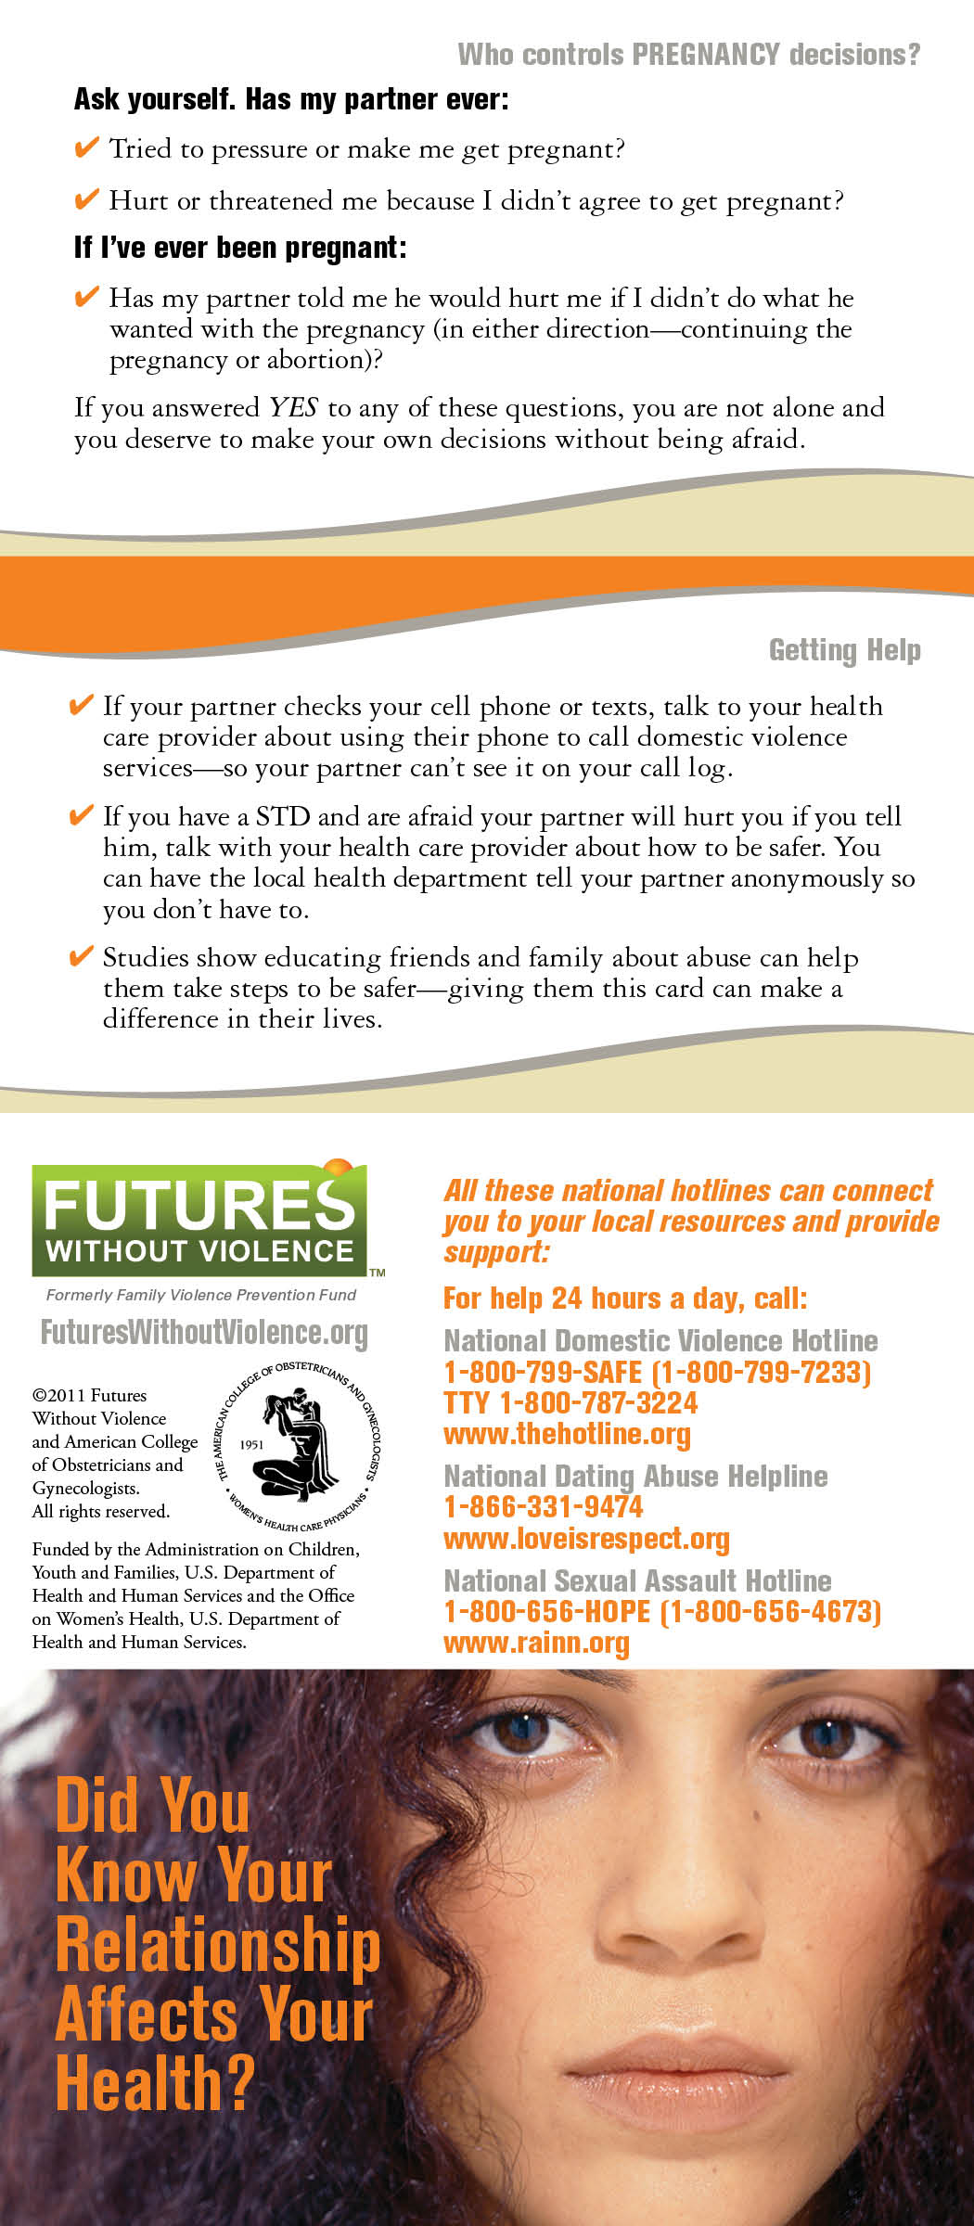
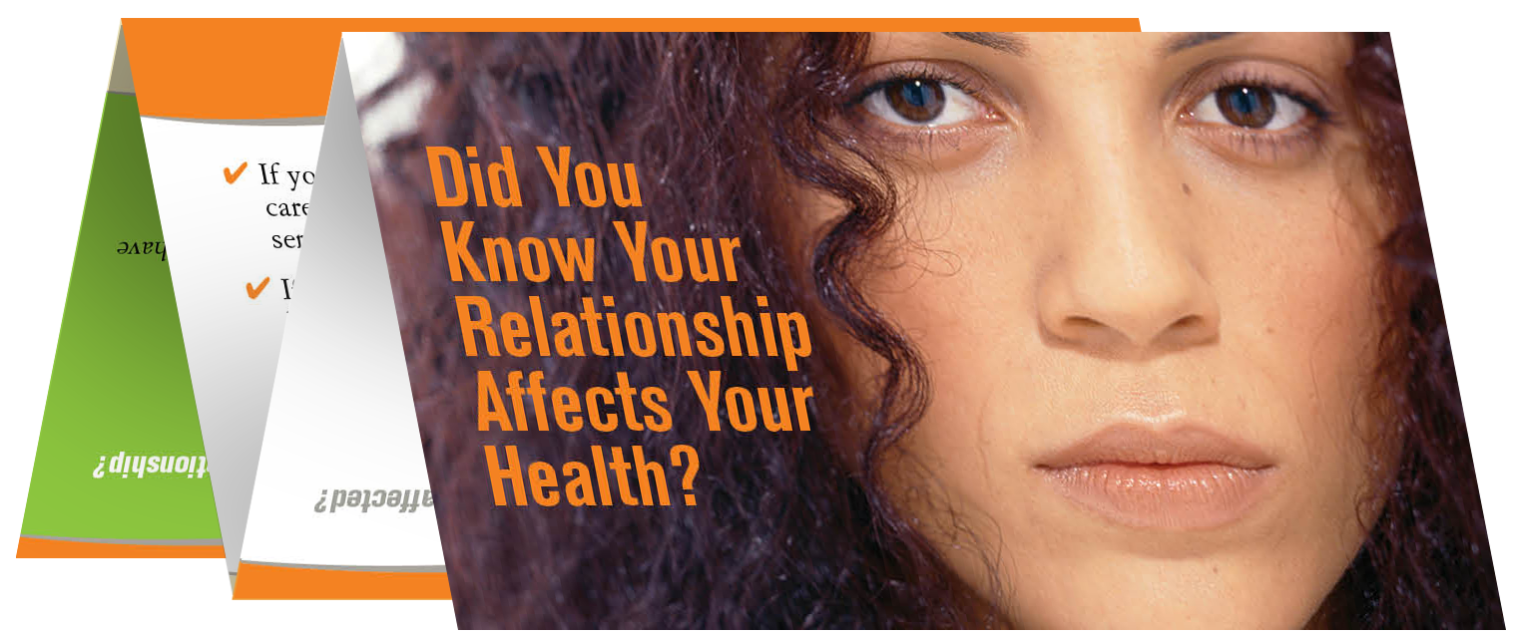
Group Discussion
How might this safety card enhance patient care?
Notes:
Notes to trainer:
In provider focus groups, we found this safety card supported the provider’s screening. It gave them the opening they needed to start asking about healthy relationships and those that aren’t.
It is important to note that ¼ of American’s read at the 5th grade level or below—it may well be that this card needs to be read to the patient. This card has only been translated into English and Spanish. For patients with low literacy or those that speak other languages it is important –to recognize the hotline numbers on the back of the card can accommodate most languages spoken– educating non-English or Spanish speaking patients about how the hotline is a 24/7 multi-lingual service and available to help them if they need support or a plan to be safer .

Slide 55
These safety cards are an evidence based simple intervention and can be given to clients within seconds.
Help victims of violence and reproductive coercion learn about safety planning, harm reduction strategies and support services.
Plant seeds for those who are experiencing abuse but not yet ready to disclose.
Provide primary prevention for adolescents who have not yet been in this kind of relationship—so they can identify signs of an unhealthy relationship and ideally avoid them.
Educate clients about what they can do if they have a friend or family member who may be struggling with abuse by providing 24/7 hotline

Slide 56

How to Introduce the Card:
"We started giving this card to all our patients so they know how to get help for themselves or so they can help others."
(Unfold card and show it) "See, it's kind of like a magazine quiz. On the back are confidential hotline numbers you can call 24/7..."
Notes:
Notes to trainer: Discuss the importance of adapting your script as need to you audience. For example, if you were working with migrant farm workers you wouldn’t say this is like a magazine quiz.

Slide 57
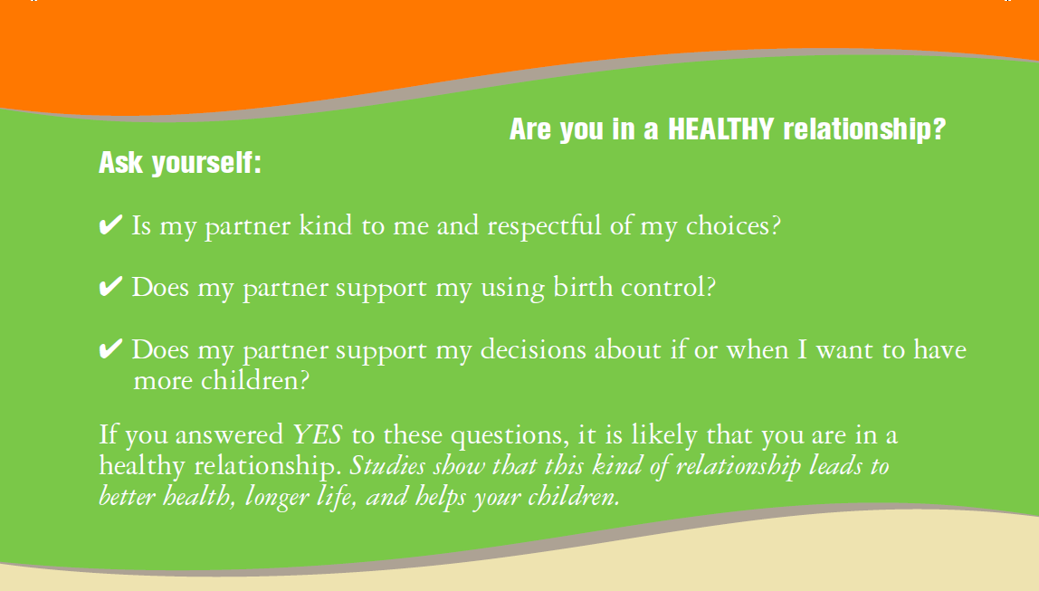
Healthy
Relationships
Notes:
Notes to trainer: Why is this panel important? It’s important because many patients have come from homes with violence and may not know what they deserve in a relationship.

Slide 58
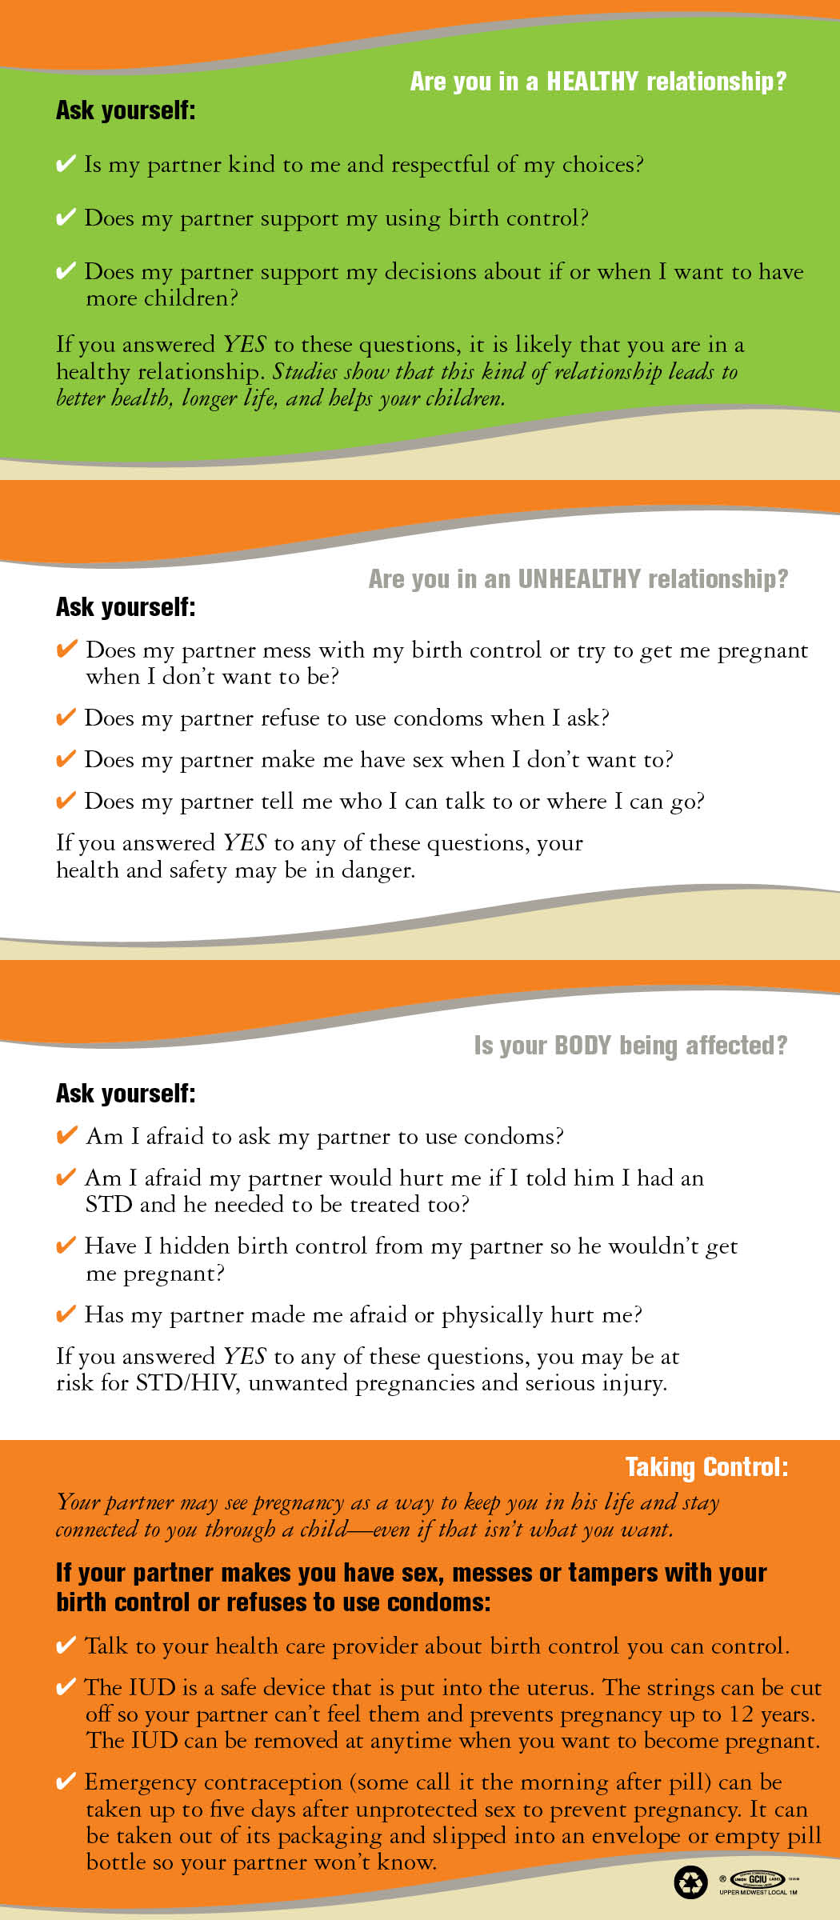
Review Panel with all Contraceptive
Visits
Notes:
Notes to trainer: We want to double check that she isn’t worried that her partner is trying to get her pregnant when she doesn't want to be.
Does he know he is there for her appointment?
Do they agree about family planning and pregnancy spacing?

Slide 59
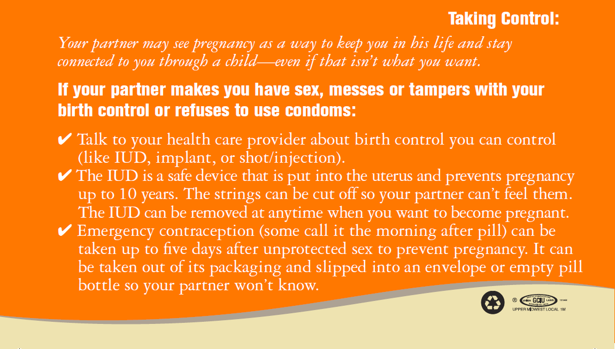
Reproductive
Coercion
Intervention
Notes:
Notes to trainer: Anytime we talk with women about contraceptive options we highlight this section of the card—to make this connection between partner control and pregnancy risk—we want you to know what your options are in case this is ever a problem for you or a friend or family member.

Slide 60
Follow-up to Disclosure of Birth Control Sabotage
“What you’ve told me also makes me worried about your health and safety in other ways. Sometimes when a partner is trying to get you pregnant when you don’t want to be they might also try and control or hurt you in other ways.”
“Is anything like this happening in your relationship?”
Notes:
Notes to trainer: Train participants to use disclosure of reproductive coercion as an opening to assess for other forms of control or violence.

Slide 61

Validation:
First Step to Safety Planning
Can talking about abuse
make a difference?
Even if a patient is not ready to leave a relationship, your recognition and validation of her situation is important.
You can help:
  Reduce her sense of isolation and shame
  Encourage her to believe a better future is possible

Slide 62
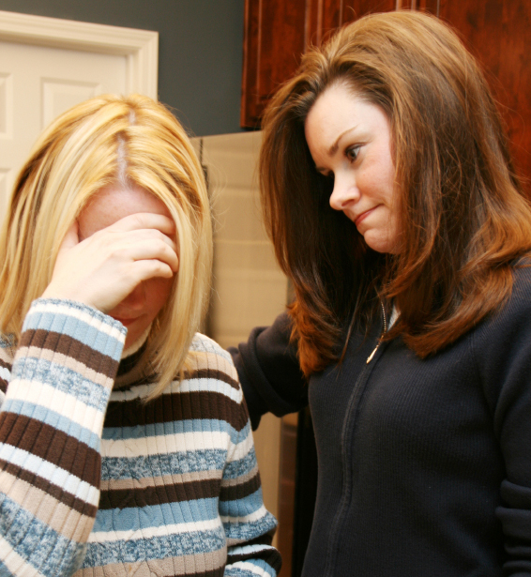
What Should You Do When You Get a Positive Disclosure of Domestic Violence?
Validate:
“I'm so sorry this is happening in your life, you don’t deserve this”
“It’s not your fault”
“I’m worried about your safety”
Notes:
Notes to trainer: Oftentimes providers forget how important validation is for patients—this may be the first time she has ever opened up and received support.

Slide 63

Responding to Disclosures
1 Validate client’s experience.
2 Offer discreet methods of contraception including EC.
3 Review safety card harm reduction strategies.
4 Ask client if she has immediate safety concerns and discuss options.
5 Refer to a domestic violence advocate for safety planning and additional support.
6 Follow up at next visit.
Notes:
Notes to trainer: Sample validating messages
“I’m glad you talked to me about this today.”
“I’m so sorry this happening in your life, you don’t deserve this.”
“It’s not your fault.”
“I’m worried about the safety of you and your children.”
“You deserve to be treated with respect.”

Slide 64
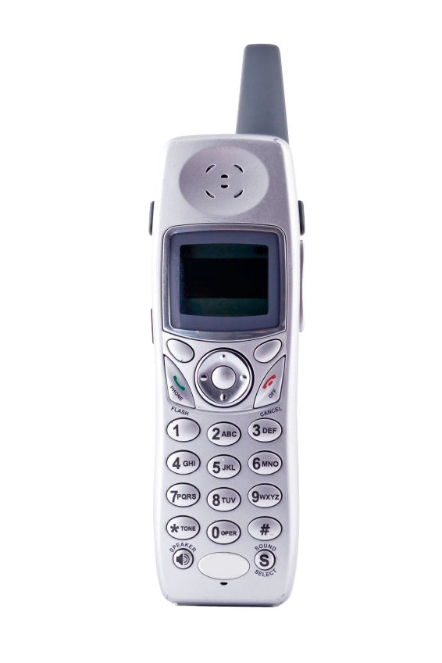
Providing a ‘Warm’ Referral to The National Hotline
“there are national confidential hotline numbers and the people who work there really care and have helped thousands of women. They are there 24/7 and can help you find local referrals too—and often can connect you by phone…”
Notes:
Notes to Trainer: If there are not any local resources or you do not have information about local referrals, the National Domestic Violence Hotline can help.

Slide 65
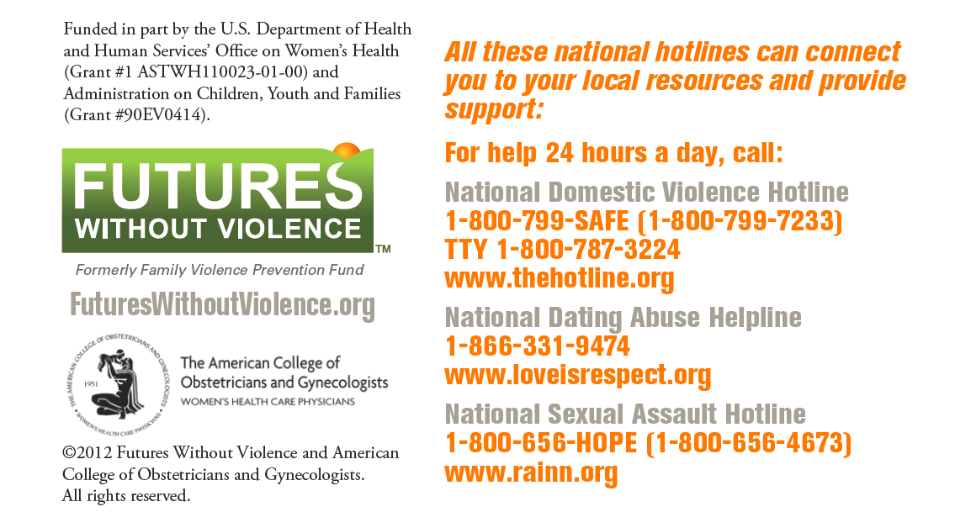
Have you ever called the Hotline?
It’s difficult to give a strong referral if you don’t know that it will happen when your patient makes the call.
Notes:
Estimated Activity Time: 5 minutes
Ask participants : How many of you have ever called the hotline “just to see what it was like?”
What did you see in the Marta video? The provider said she had a kind colleague Nina—what sort of impact do you think that had on the patient?
Have you ever sold a referrals to a patient? Like—they are really nice at this clinic (fill in the blank) or so and so provider is really great. It works the same way with referrals.

Slide 66

Role of the Domestic Violence Advocate
Domestic violence advocates provide safety planning and support
Safety planning is designed to assist mothers and children who have experienced domestic violence to think and act in a way to increase personal safety
Providers can help patients connect with an advocate to work on a safety plan and additional services like:
Housing
Legal advocacy
Support groups/counseling
Notes:
Notes to Trainer: Contact the nearest domestic violence shelter or the domestic violence coalition in your state to talk with domestic violence advocates and learn more about services they provide, languages spoken, safety planning, training, and resources for families who have experienced violence in a relationship.

Slide 67

Temperature Check:
Thoughts on the intervention now that you have seen it an action?
Notes:
Notes to trainer: This is an opportunity to check in with the participants. How are they feeling? Does this seem doable? Concerns? Give just a couple of minutes to hear from participants and then move on.

Slide 68
Case Study: Maya
The following case study
demonstrates how to
screen for reproductive
coercion when a patient
Requests Emergency Contraception
Notes:
Estimated Activity Time: 10 minutes to watch video and 5 minutes for discussion
Discussion questions to ask after watching this video clip include:
Let’s start by discussing the opening of the video—what did you think?
How do you think the presentation of the safety card went? Did it feel judgmental or supportive to you? The goal with this question is to get the audience to think about the way the card was introduced and how the suggests the card can be used for a friend or a family member.
What did you think about way the provider addressed-- weight gain concerns and birth control myths that the boyfriend was telling the client about?
Any final thoughts about what you saw? Doable? Concerns?

Slide 69
Double Check
“Are you ever afraid to ask your partner to use condoms?”
“Does he know you are here for emergency contraception?”

Slide 70
Review last bullet for every EC visit
Notes:
Note to trainer: Inform the participants that the cards can be used for either direct assessment or for universal education. For example, to make the information more universal, they can offer the card to the patient or their friend. Sample script:
“Just in case this is ever an issue for you or a friend…take a look at this last bullet point—we focus on this panel of the card with all our EC visits.”

Slide 71

Role Play
Zoe is 18 year old, coming in for emergency contraception and a repeat pap—her main method of contraception is condoms. The clinic routinely provides both a dose of EC on that visit as well as an additional dose for her to take home just in case.
Using the two safety card panels just reviewed as a guide to your assessment please—give the card to the client and review these panels.
Notes:
Exercise Activity Time: 15 minutes
Divide participants into groups of three.
Advise the person who is role playing the clinician introduce the card to assess for reproductive coercion.
Allow 3-5 minutes for the role play.
Ask the observers to think about the kinds of things that the clinician said that worked well such as how did she/he introduce the card? Did she/he make the discussion comfortable? What would they have liked to see more of?
Ask the participants who role played the client how the assessment made them feel.
Ask participants who role played clinician if they were comfortable asking these questions—how did the card work as a support?
Ask the observers to share their thoughts and observations about what they liked and thought would be helpful.
If there is enough time you can ask groups to switch roles and do the role play again.

Slide 72
Case Study: Alicia
The following case study
demonstrates how to
screen for Pregnancy
Coercion with a positive
pregnancy test result
Notes:
Estimated Activity Time: 10 minutes to watch video and 5 minutes for discussion
Discussion questions to ask after watching this video clip include:
What did you think? Were there any questions or things the provider said that especially resonated with you?
What questions did you think the provider asked that were helpful?
Any final thoughts about what you saw? Concerns?

Slide 73
Case Study: Olivia
The following video clip demonstrates providing universal education on healthy relationships during an adolescent health visit and assessment for reproductive coercion
Notes:
Estimated Activity Time: 5 minutes to watch video Domestic Violence“ and 5minutes for discussion.
Discussion questions to ask after watching this video clip include:
What do you think worked well?
What did not work well?
Were there some other questions that should have been asked?

Slide 74
Please use this section of the card with all pregnancy test visits

Slide 75
Role Play
Jasmine is 22 and here for a pregnancy test (the result is negative). She has been with new partner for two months—and come in twice for emergency contraception.
Using the safety card as a guide to your assessment please review.
Notes:
Exercise Activity Time: 15 minutes
Divide participants into groups of three.
Advise participants that one person will role play the clinician, one is the client, and the third person is the observer.
Advise the person who is role playing the clinician to use the “Pregnancy Decisions” panel of the card to assess for reproductive coercion.
Allow 3-5 minutes for the role play.
Ask the observers to think about the kinds of things that the clinician said that worked well such as how did she/he introduce the card? Did she/he make the discussion comfortable? What would they have liked to see more of?
Ask the participants who role played the client how the assessment made them feel.
Ask the observers to share their thoughts and observations about what they liked and thought would be helpful.
If there is enough time you can ask groups to switch roles and do the role play again but this time have the patient’s pregnancy test be positive.

Slide 76
Intimate Partner Violence (IPV)
Sexually Transmitted Infection and
Safer Partner Notification
Notes:
Estimated Module Time: 3o minutes
Training Outline
Learning objectives
Definitions and statistics,
Group discussion: safer partner notification
Video Case Study
Role play (slide)
Overview
As we have learned more about different forms of abusive and controlling behaviors that are used by partners to maintain power and control in a relationship, patterns of behaviors that affect women’s reproductive health specific to STIs and HIV have been identified. These behaviors, include risk for forced non condom use, increased risk for STI/HIV risk for harm associated with partner notification of STI/HIVUsing a skills-based approach, this module includes assessment questions, scripting, and information about birth control options that may be less visible and more effective for clients whose partners are interfering with their birth control.

Slide 77
Learning
Objectives
1 List three effects of domestic & sexual violence on risk for sexually transmitted infections.
2 Demonstrate two questions you could ask to assess for safety when a patient has an STI.
3 Identify a harm reduction strategy for women in abusive relationships who have to notify their partner about and STI.
Notes:
Notes to Trainer: Read the learning objectives aloud.

Slide 78

STIs and Teens Experiencing Violence
More than one-third (38.8%) of adolescent girls tested for STI/HIV have experienced dating violence.
DECKER ET AL, 2005
Notes:
Notes to trainer: Remind participants : given this statistic every client coming in for testing or treatment of STIs should be considered at risk for domestic violence and coercion—which makes seeking testing for STI a clinical indicator to screen for domestic violence.

Slide 79
IPV and Sexual Risk Behaviors
Women who experienced past or current IPV are more likely to:
Have multiple sexual partners
Have a past or current sexually transmitted infection
Report inconsistent use or nonuse of condoms
Have a partner with known HIV risk factors
Wu et al, 2003
Notes:
This study by Wu and colleagues (2003) was part of a larger, randomized clinical trial that recruited urban, minority women (n=1590) from out-patient clinics at a large urban hospital in New York City. The mean age of participants was 35.4 years with the majority of women identifying as African American or Latina. Sexual risk behaviors were measured with the Sexual Risk Behavior Questionnaire (SRBQ).
Approximately 1 in 5 women reported experiencing current physical and/or sexual IPV in their primary heterosexual relationship.
Compared to women who reported never experiencing IPV, women who reported experiencing current or past IPV were:
2.9 times as likely to have multiple sexual partners in the past year
2.5 times more likely to report having a past or current STI
2.1 times more likely to never use condoms
3.6 times more likely to use condoms less than half of the instances of sex with their primary partners versus using condoms 100% of the time
3.0 times more likely to report having a partner with a known HIV risk factor

Slide 80

Knowledge
Isn’t Enough
Under high levels of fear for abuse, women with high STI knowledge were more likely to use condoms inconsistently than nonfearful women with low STI knowledge.
Ralford et al, 2009
Notes:
Note to trainer: Remind participant s that this statistic demonstrates that we should not assume a knowledge deficit or automatically give a bag of condoms to prevent disease that we have to know first if she is afraid to ask her partner to use them.
In this study by Ralford et al. (2009), women were asked about the degree to which they were worried that if they talked about using condoms with their sexual partner that he would respond in negative ways including threatening to hit, push or kick them; leave them, swear at them; or call them names. Almost half (47.6%) of young (18-21 years) African American women (n=715) reported having experienced relationship abuse in their lifetime; 15% reported abuse by a main sexual partner in the past 60 days. Under high levels of fear for abuse, 76% of women with high STI knowledge were more likely to exhibit inconsistent condom use during their last sexual intercourse with a man compared to 60% of women with low levels of knowledge. One of the explanation for this counterintuitive finding that the authors offer is that women with more knowledge about STI transmission may balance the risk of abuse with the risk of acquiring an STI, particularly if they know or suspect that their partner is at low risk for STIs. Overall these findings emphasize the importance of integrating dating violence assessment and prevention into STI and HIV prevention programs.

Slide 81
HIV AND IPV
Based on a study of 310 HIV-positive women:
  68% experienced physical abuse as adults
  32% experienced sexual abuse as adults
  45% experienced abuse after being diagnosed with HIV
  Gielen et al, 2000
Notes:
IPV can be a consequence of HIV. In this study by Gielen and colleagues (2000), 4% of women reported that they experienced physical abuse as a direct consequence of disclosing their HIV status. In another study by Koenig et al. (2002), 10% of HIV-positive women reported negative reactions to disclosing their HIV status.

Slide 82
Perpetrator Condom Refusal
Leading to STD
“
I told him to put a condom on, he didn't. ..I went to a clinic, and they were like, "Oh, he gave you Chlamydia." [H]e said it was me messin' around with some other guy, and that's not true, 'cause I was like, "You were the only guy I was with." And he's like, "Oh, that's you, you're messin' around," he's like, “f-you, I thought you loved me.
“

Slide 83
Video Clip: Jocelyn
The following video clip
demonstrates assessing
for abuse and safe partner
notification during an
STI test visit
Notes:
Estimated Activity Time: 5 minutes to watch video Domestic Violence“ and 10 minutes for discussion.
Discussion questions to ask after watching this video clip include:
What do you think worked well?
What did not work well?
Were there some other questions that should have been asked?

Slide 84
Implications for STI and HIV Programs
Partner notification may be dangerous for clients experiencing abuse.
Clients may not be able to negotiate safe sex with an abusive partner.
IPV may be a more immediate threat to a client than a sexually transmitted infection or HIV status.
Notes:
Notes to trainer: One strategy to consider with your audience is a recent example of harm reduction being utilized in Virginia.
County STI programs have developed a system to help keep women safer by having health department ‘s from other area codes call to do the partner notification. Calling from a difference area code than the one the victim resides in can help reduce the likelihood that he will know it is his current partner who was just diagnosed with the STI. This kind of strategy can help keep a woman safer, reducing the likelihood that he would know to blame her for the infection.

Slide 85

Use this panel with all STI/HIV related visits (review the first two bullets)
Notes:
Notes to trainer:
Remind participants that all patients coming in for an STI test or for treatment of STI should have the following panel of the card reviewed with them.
Advise participants that they can introduce the card as we have demonstrated before.
“We have started giving this card to all our patients. It talks about healthy relationships. “

Slide 86
Partner Notification Harm Reduction:
Offer to educate partner about STIs (especially if she is afraid he will blame it on her)
If the partner is in clinic with her today—assess for her safety and staff safety.
  “Are you worried about what will happen if you tell him about the STI or if we tell him about the STI?”
Notes:
Encourage providers to offer different strategies to promote safety when they have to notify a partner about an STI.
Trainer can acknowledge that this is not a perfect solution but better than not addressing safety at all.

Slide 87
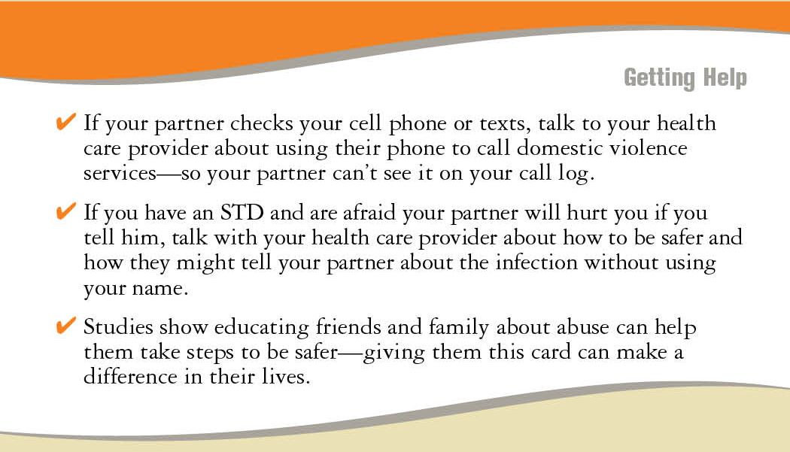
Harm Reduction is Empowerment: Making the call for her can help keep her safer
Notes:
Notes to trainer:
Any health care provider can let the partner know that he was exposed to (Fill in blank STI) by a partner within the last 2 years and needs to be treated—and you cannot divulge the name .

Slide 88
Safe Partner Notification: Contact your local DV program or the Hotline for support
“If you would like I can put you on the phone right now with (name of local advocate) and we can create a plan for you to protect your safety.”
Notes:
Note to Trainer: Remind participants that they can play an important role in promoting safety by offering to call the DV program right there in clinic.

Slide 89
Role Play
Janice is a 20 year-old young woman. You have been seeing her since she turned 18. Today you are telling her that she has a Chlamydia infection.
Notes:
Exercise Activity Time: 5minutes
Divide participants into groups of three.
Advise participants that one person will role play the clinician one is the patient, and the third person is the observer.
Allow 3-5 minutes for the role play.
Ask the observers to think about the kinds of things that the clinician said that worked well such as how did she/he introduce the card? Did she/he make the discussion comfortable? What would they have liked to see more of?
Ask the participants who role played the client how the assessment made them feel.
Ask participants who role played clinician what they thought about using the card for safer partner notification and implications for expedited partner treatment

Slide 90


Trauma-Informed
Reporting for Abuse:
Challenges
and Considerations
Notes:
Estimated Module Time: 10 minutes
Training Outline
Learning objectives
Key considerations
Supporting mothers
Resource
Overview
This module offers a brief introduction to a complex topic that should be part of education for providers. State reporting laws on domestic violence vary and providers should learn their law and how it is implemented locally.
For more information on state laws and regulations go to: www.FuturesWithoutViolence.org to see a compendium of state statutes and policies on DV and healthcare.

Slide 91
Virginia Reporting Laws on Domestic Violence
VA Code: 54.1-2967 and 18.2-308
Unless wounds have been caused by specific weapon (i.e. guns and/or knives) providers are bound by confidentiality not to report domestic violence unless the woman wants to do so.
All other forms of abuse for adults including reproductive coercion are not reportable.
Notes:
*The relevant section of § 18.2-308 lists the following types of weapons:
(i) any pistol, revolver, or other weapon designed or intended to propel a missile of any kind by action
of an explosion of any combustible material; (ii) any dirk, bowie knife, switchblade knife, ballistic
knife, machete, razor, slingshot, spring stick, metal knucks, or blackjack; (iii) any flailing instrument
consisting of two or more rigid parts connected in such a manner as to allow them to swing freely,
which may be known as a nun chahka, nun chuck, nunchaku, shuriken, or fighting chain; (iv) any
disc, of whatever configuration, having at least two points or pointed blades which is designed to be
thrown or propelled and which may be known as a throwing star or oriental dart; or (v) any weapon
of like kind as those enumerated in this subsection

Slide 92
For consideration:
Remember: Most types of domestic violence and reproductive coercion are not reportable
It is highly unlikely that reproductive health providers will encounter an acute injury or wound caused by a weapon or firearm

Slide 93
Child Abuse and Neglect
Health professionals who have reason to suspect that a child is an abused or neglected child, shall report the matter immediately to the local department of social services in the county or city wherein the child resides.
Providers are also required to report suspected sexual abuse of a minor (focused on minors 15 and younger) to Department of Social Services.
Notes:
In each region you are conducting training find out as much as possible about what happens when a report for sexual abuse is made.
Child abuse relevant code (63.2-1509).
The following persons who, in their professional or official capacity, have reason to suspect that a child is
an abused or neglected child, shall report the matter immediately to the local department of the county or
city wherein the child resides or wherein the abuse or neglect is believed to have occurred or to the
Department's toll-free child abuse and neglect hotline:
Family Planning providers in VA. are required under the code of Virginia to report as mandated reporters to the Department of Social Services, CPS and suspected sexual coercion or sexual abuse of a minor. This usually is the result of a young minor and an older male partner. It is all age relevant with a high priority focused on minors 15 and younger. This is under the Code of Virginia section 63. Family Planning staff is required to follow protocol in reporting.

Slide 94

For Minor age
15 and under Always Disclose the Limits of Confidentiality
Always review with teens or adults the limits of confidentiality before direct screening for relationship violence —in case there is disclosure and you need to report.
Notes:
Notes to Trainer: It is important to keep in mind fears about immigration status and child welfare workers. This study overview may be interesting to read aloud to participants:
In a study by Renker & Tonkin (2006), 97% of women stated that they were not embarrassed, angry, or offended by their health care provider asking about domestic violence during prenatal care visits.
Renker P, Tonkin P. (2006) Women’s views of confidentiality issues related to and acceptability of prenatal violence screening. Obstetrics and Gynecology, V.107 N.2, February, 2006: 348-354

Slide 95
Example Script when working with Teens 15 and younger
“Everything you share with me is confidential. Unless you were to tell me that that someone was forcing you to do sexual things you did not want to do or if a parent or caregiver was hurting you. Those things I would have to report…”

Slide 96
When you need to report:
After the reason the patient was seeking care has been addressed, remind the young person of the limits of confidentiality discussed at the start of the visit, then inform her of the requirement to report.
“Remember at the start of this visit how we talked about situations where if your safety is at risk that we might have to get others involved? This is one of those times. I know it took a great deal of courage to share this with me, and we need to make sure that you are safe.”

Slide 97
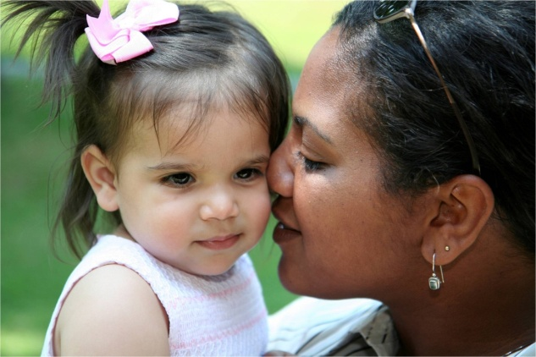
Supporting a patient when you need to make a report
Inform your patient of your requirement to report
Explain what is likely to happen when the report is made
Ask your patient if she is willing to call or meet with an advocate to develop a safety plan in case of retaliation
  Maximize the role of the client in the process
Notes:
Notes to Trainer: Before you do training, learn about the implementation of the reporting requirement for your county. Information that you will need to know includes:
Who is required to report?
What must be reported?
To whom is the report made?
What are the likely outcomes of calling the police or child protective services?
What are the safety considerations you can address with your client?
Are there provisions for confidentiality of reports?
Ways to involve the client in the process include asking if she would like to be present when you make the report if that is safe to do and keeping her informed about the process.
Encourage participants to contact local domestic violence program/shelter and domestic violence coalitions in their state to learn about additional training, consultation on particular cases, and resources for their clients.
Remind participants that making a report can never substitute for the important care they provide.

Slide 98

Closing
Notes:
Estimated Module Time: 10 minutes
Training Outline
“Where am I” exercise
Information on National Health Resource Center on Domestic Violence
Overview
If time allows, you can solicit feedback from participants as you transition to the next slide on the “Where Am I” exercise. Ask participants to reflect back to the “Where Am I?” exercise that they completed at the beginning of the training and think about how this training may have impacted their comfort level with addressing domestic violence during home visits.

Slide 99
Where are you now?
Less comfortable?
More comfortable?
Notes:
Ask that each person draw a comfort meter and take a minute to really think about how comfortable they are with the assessing for and hearing positive disclosures of DV/SA and mark their meter.
Training Goal: Leave the participants with the hope that the information provided today will have made you more comfortable addressing this important public health Issue.

Slide 100
Technical Assistance
For questions about how to introduce and facilitate training vignettes and for other free technical assistance and tools including:
  Posters
  Safety cards
  Guidelines on Reproductive Coercion
Contact The National Health Resource Center on Domestic Violence, a project of Futures Without Violence:
Visit: www.FuturesWithoutViolence.org/health
Call Toll-free: 888-Rx-ABUSE (792-2873)
800-595-4889 TTY
Email: health@FuturesWithoutViolence.org

Slide 101
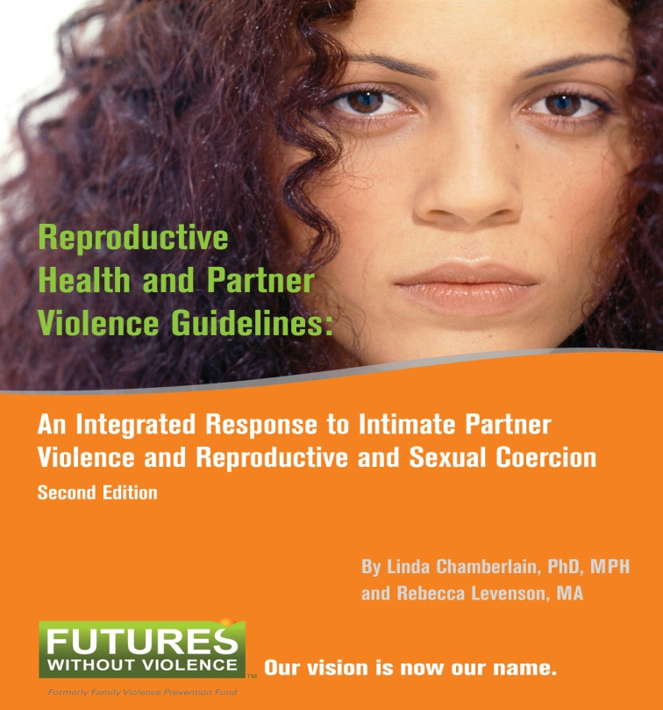
Getting started is as simple as downloading these Guidelines
Coming soon:
Reproductive Health
and Partner Violence
Guidelines:
An Integrated Response to
Intimate Partner Violence and Reproductive Coercion
This tool will be available online:
www.FuturesWithoutViolence.org/health
Notes:
Reproductive Health and Partner Violence Guidelines; An Integrated Response to Intimate Partner Violence and Reproductive Coercion focuses on the transformative role of the reproductive health care provider in identifying and addressing intimate partner violence (IPV) and reproductive coercion.
Available in hard copy or as a PDF from the Futures Without Violence online store. To place orders, visit www.FuturesWithoutViolence.org/health

Slide 102

For Helping to Make the World Safer for Women and for Helping to Ensure Their Reproductive Health
Thank you!

