Slide 1
VDH School Immunization Record Translation (SIRT) Process for Local Health Districts (LHD) and Public School Nurses August 2025

Slide 2
Translation of Immunization Records
This Service is provided by the Virginia Department of Health (VDH) and is only for translation purposes. School division enrollment policies and procedures are to be followed.
This translation service is only available to VDH local health department staff and public-school nurses/registrar.
Please allow a minimum of 5 business days for translation of immunization records.
Please limit response to one per student.
All submissions will receive an email confirmation of receipt and PDF version of response.
A registered nurse (RN) will need to verify compliance with school immunization requirements as per Code of Virginia 32.1-46.
Notes:
Documentary proof” is defined as “an appropriately completed copy of the most current version of Form MCH 213G signed by a physician or his designee, registered nurse, or an official of a local health department. A copy of the immunization record signed or stamped by a physician or his designee, registered nurse, or an official of a local health department indicating the dates of administration including month, day, and year of the required vaccines, shall be acceptable in lieu of recording these dates on Form MCH 213G, as long as the record is attached to form MCH 213G and the remainder of form has been appropriately completed per 12VAC5-110-70. A Registered Nurse in the school setting is allowed to sign Certification of Immunizations.
After a review of translated immunization records, a Registered Nurse in the school setting is allowed to determine adequately immunized and sign the Certification of Immunizations (MCH213G) form. For documentation, please attach a copy of child’s vaccine record(s), presented upon enrollment, and the translated documentation from VDH to the Certification of Immunizations (MCH213G) form found on page 2 of the School Entrance Health Form. ​

Slide 3
Translation of Immunization Records - Process Flow
Initial Contact
Request immunization record from parent.
Electronic copy of the child’s immunization records
Make an electronic copy of the immunization record and store it in a secure folder – you will be requested to upload the scanned immunization record into the RedCap survey.
Access RedCap Survey
Access the RedCap survey: https://redcap.link/SIRT
Determine the language of the child’s immunizations records and the need for translation.
Obtain a copy of the child’s immunization record and return the original record to family.
Additional Option: Using an approved device, take a photo of the immunization record to upload into the RedCap survey.
Complete the RedCap Survey
Complete all requested information in the RedCap Survey; there should only be one student per survey submission.
Upload the stored immunization record from approved device into the RedCap survey when requested: Up to 5 immunization files for an individual student can be uploaded into the survey.
Receive Confirmation
Once the RedCap survey has been completed you will receive a confirmation of your submission.
RedCap survey also linked on the VDH School Health website
You will need to know your VIIS Org Code to complete the survey
Please allow 5 days for the immunization record to be translated and returned. This is only a submission confirmation. School divisions will need to keep enrollment records per local policy.

Slide 4
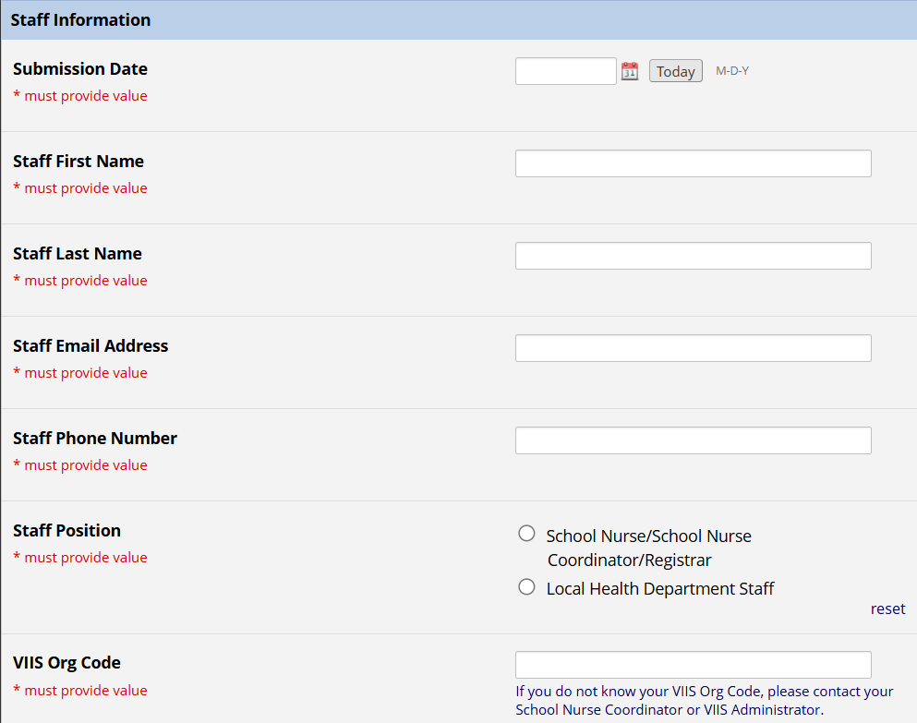
RedCap Survey Questions: Staff Information
Staff Position: Select School Nurse/School Nurse Coordinator/Registrar” OR “Local Health Department Staff” when prompted
Know your VIIS Org Code. If you do not know your VIIS Org Code, please contact your School Nurse Coordinator or VIIS Administrator.

Slide 5
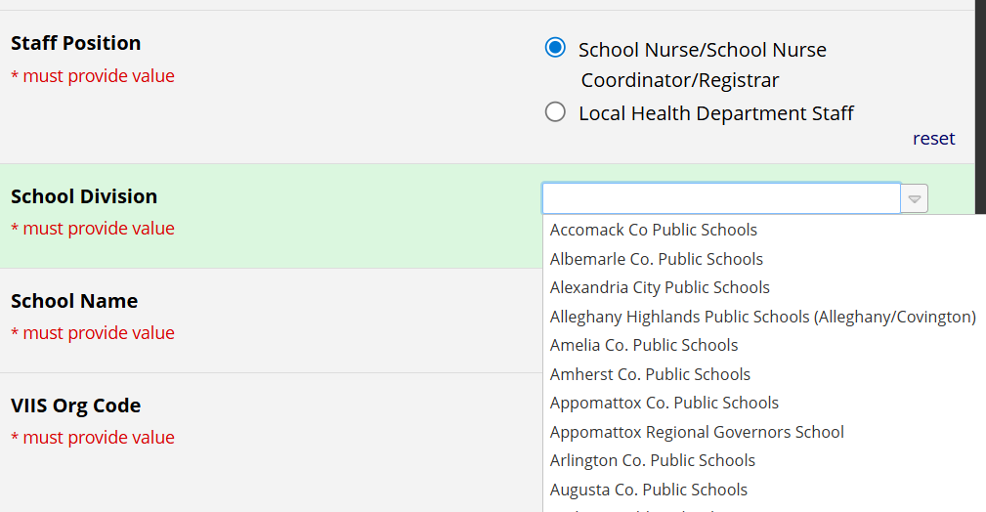
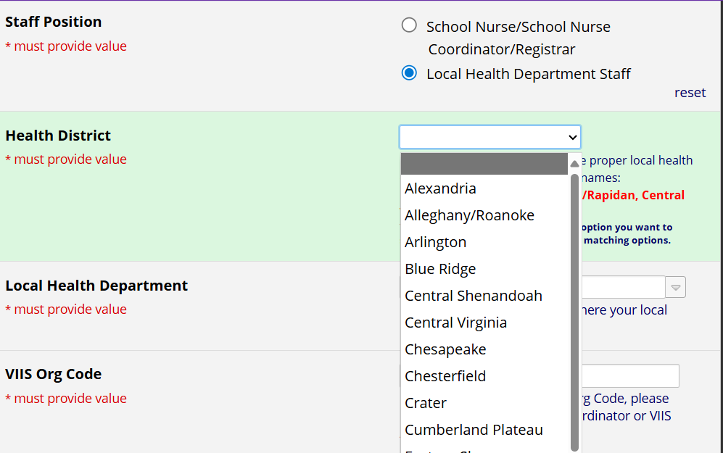
RedCap Survey Questions: Staff Position
School Nurse/School Nurse Coordinator/
Registrar
Select your school division
Enter your school name
Local Health Districts
Select your health district and local health department

Slide 6
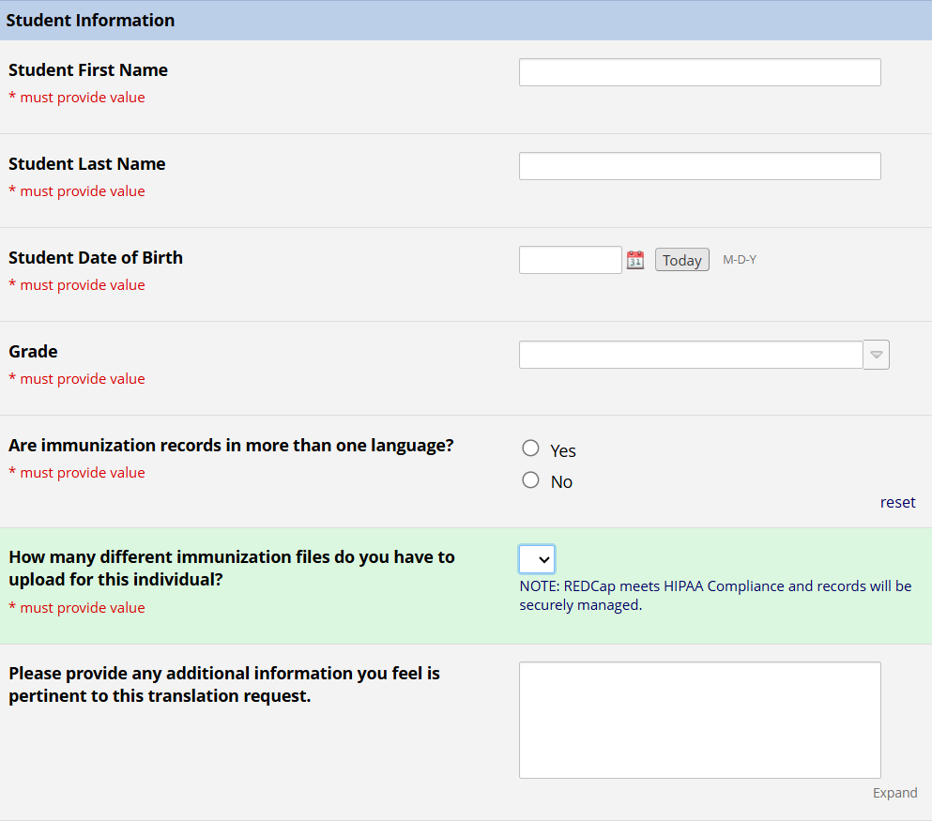
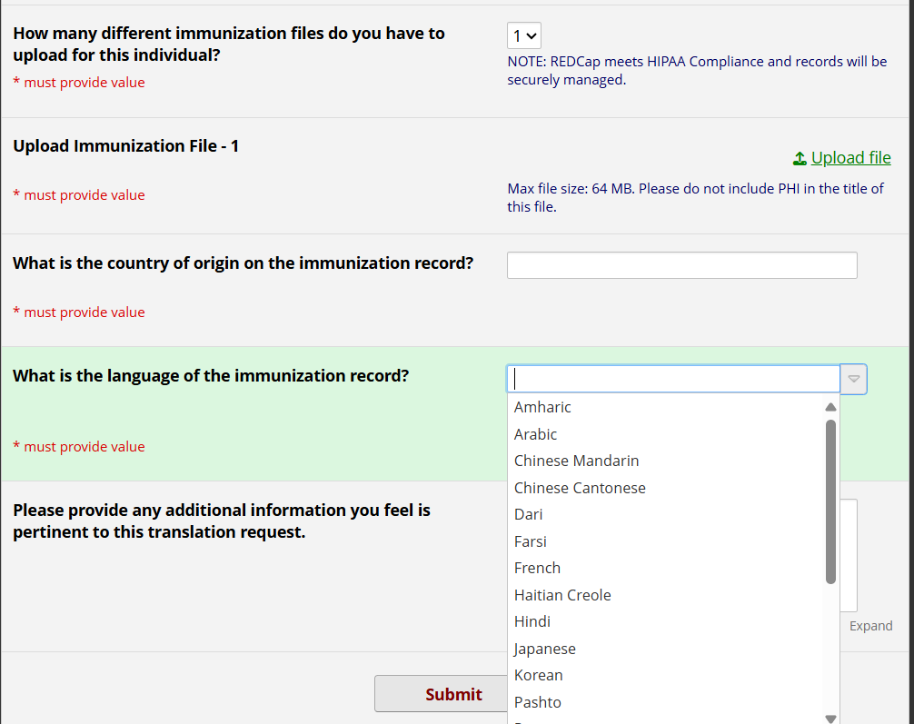
RedCap Survey Questions: Student Information
Enter student information
RedCap meets HIPAA Compliance and records will be securely managed.
Upload immunization file information
One survey per student.
Select language

Slide 7
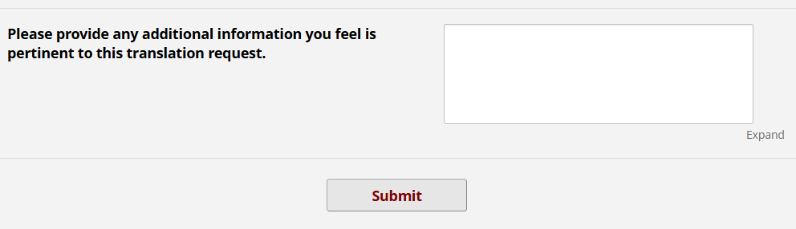
Thank you!
Questions?
Andrea Mendes
andrea.mendes@vdh.virginia.gov
Terry Clark
terry.clark@vdh.virginia.gov

