Slide 1
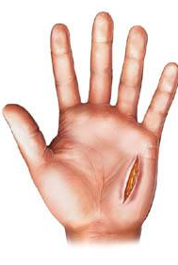
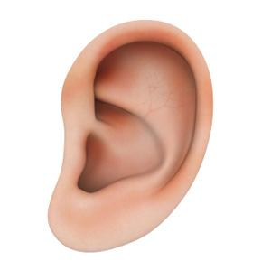
Oh No Vibrio!
How you get Vibriosis:
Eating raw oysters, clams, or mussels
Salt water gets into open cuts or sores in skin
Salt water enters the ear while swimming
How you avoid Vibriosis:
Only eat properly cooked seafood!
Don’t swim with open wounds!
Wear earplugs!
#swimhealthyVA Swim Healthy. Stay Healthy. www.SwimHealthyVa.com

Slide 2
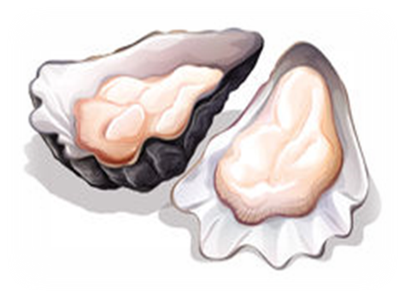
Vibriosis Prevention Tips
Eat seafood that is properly cooked
Shellfish is more likely to contain Vibrio bacteria when waters are warm
Don’t swim with skin wounds or cuts
Or use waterproof bandages to cover wounds before getting into the water
Think twice about swimming with a medical condition.
If you have liver disease, diabetes, or cancer for example, you are more vulnerable to infections
#swimhealthyVA Swim Healthy. Stay Healthy. www.SwimHealthyVa.com

