Slide 1


Slide 2

The Health Opportunity
Index (HOI): Mapping the
DNA of Communities
Virginia Department of Health
Office of Health Equity

Slide 3
IDENTIFYING THE PROBLEM

Slide 4
America’s Health Rankings
United Health Foundation Scorecard
Overall Ranking = 21st

Slide 5
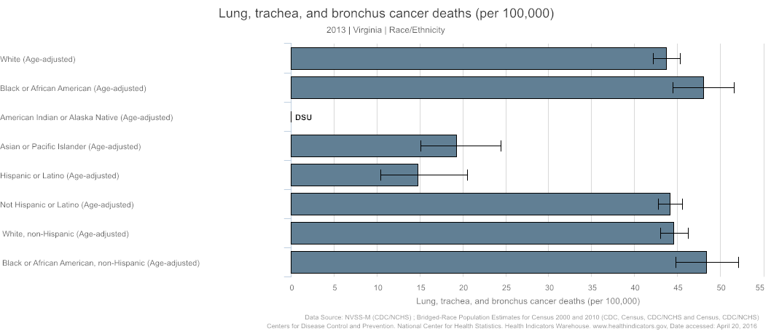
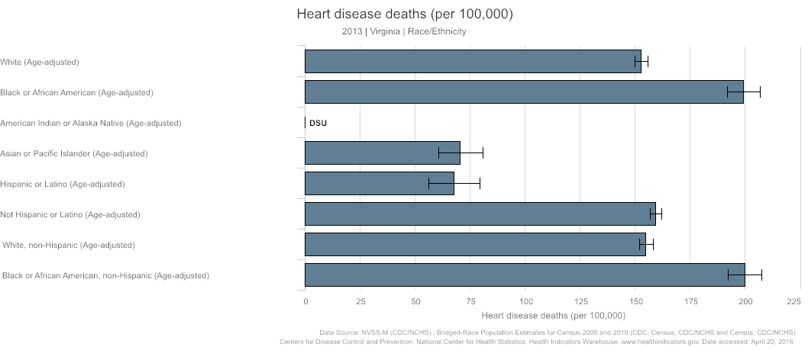
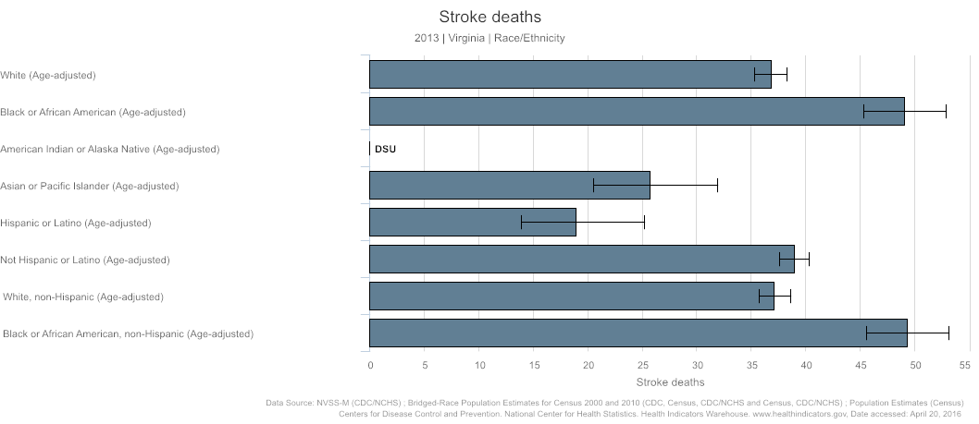
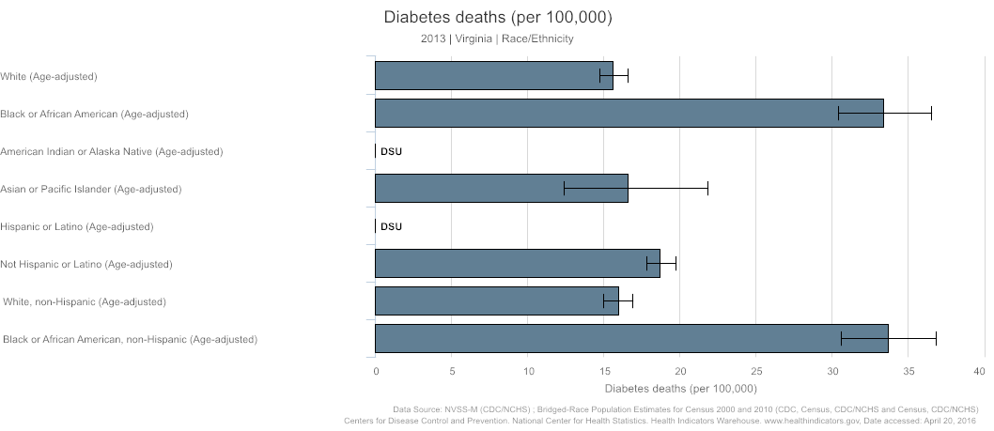
Health Inequities – Racial/Ethnic

Slide 6

Health Inequities- Geographic

Slide 7
Root Causes
 | All | White | Black | Hispanic or Latino Origin | Asian | American Indian and Alaska Native | Native Hawaiian and Other Pacific Islander
Unemployment Rate (2015 Q3) | 4.5% | 3.4% | 8.3% | 5.2% | NR | NR | NR
Education: On-Time Graduation Rate (2015) | 90.5% | 92.9% | 86.3% | 84% | 95.6% | 87.9% | 94.4%
Poverty: Less than 50% FPL | 5.2% | 4.2% | 9.2% | 6.4% | 3.8% | 7% | 7.4%
Poverty: Less than 100% FPL | 11.4% | 9.2% | 20.1% | 15.8% | 8.3% | 13.9% | 11%
Poverty: Less than 125% FPL | 15.2% | 12.3% | 25.7% | 21.4% | 11.3% | 18.7% | 13.6%
Source: EPI analysis of Bureau of Labor Statistics Local Area Unemployment Statistics (LAUS) data and Current Population Survey (CPS) data;Virginia Department of Education State-level Cohort Report, Class of 2015; U.S. Census Bureau, 2010-2014 American Community Survey 5-Year Estimates.

Slide 8
Root Causes

Slide 9
IDENTIFYING THE MEANS
TO A SOLUTION

Slide 10
America’s Health Rankings
United Health Foundation Scorecard
GOAL= 1st

Slide 11
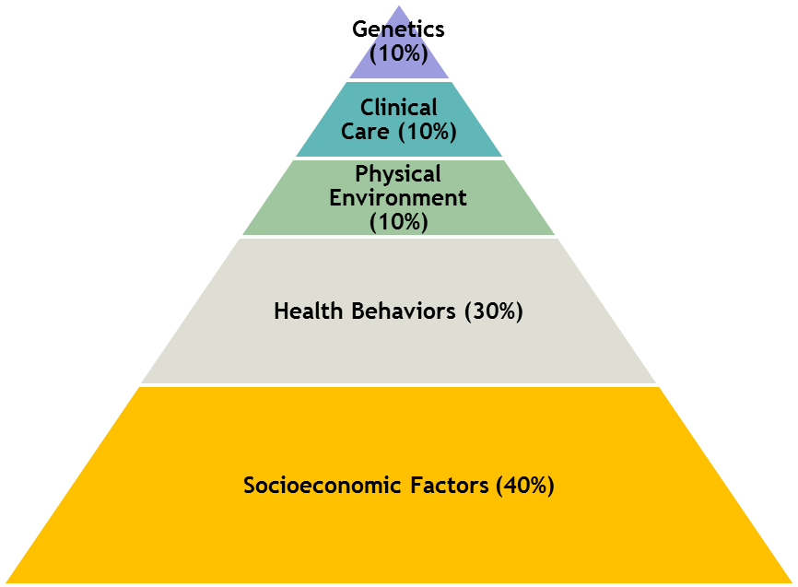

What Creates Health?

Slide 12

Virginia State Health Improvement Plan

Slide 13
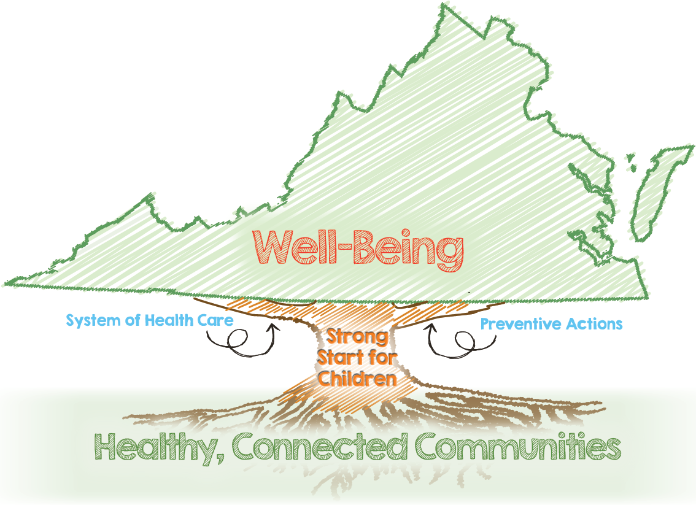

Slide 14

Source: King County (WA) Equity and Social Justice Annual Report December 2015

Slide 15
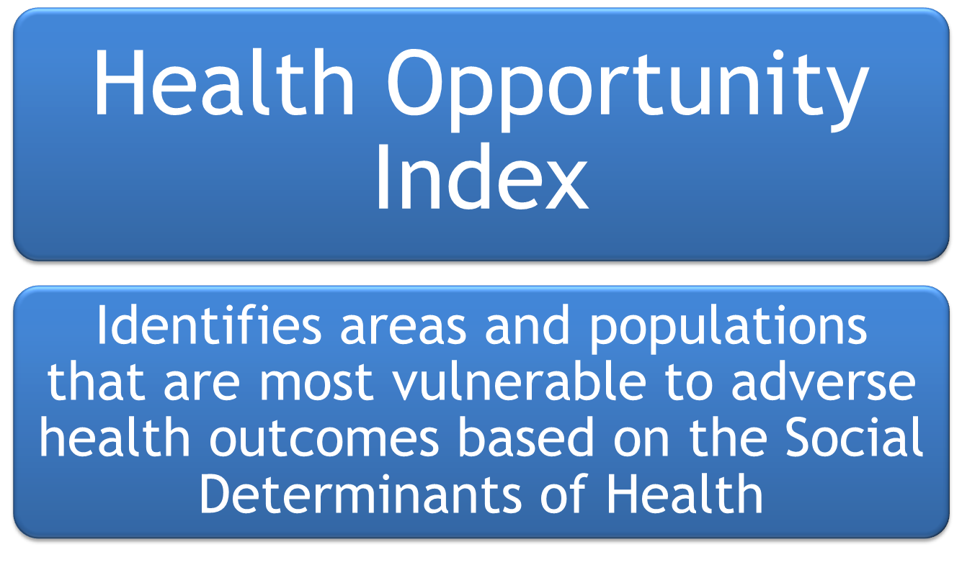
www.vdh.virginia.gov/omhhe/hoi

Slide 16
DESIGN AND METHODS

Slide 17
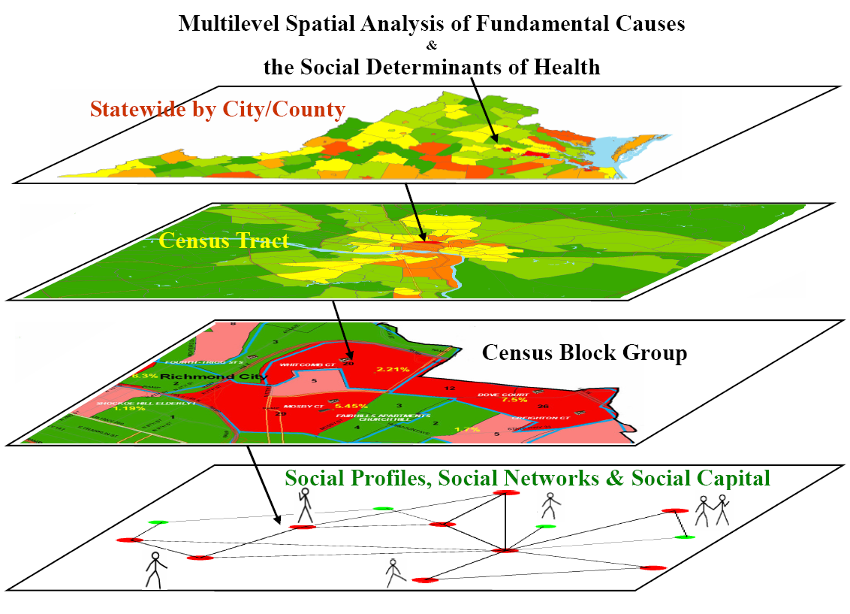
Geographic Level Can Mask Detail

Slide 18

Healthy People 2020:
Five Elements of SDOH

Slide 19
Health Opportunity Index
Educational Attainment
Population Density
Spatial Segregation
Population Churning
Job
Participation
Income
Diversity
Affordability of Housing and Transportation
EPA Environmental Hazards
Food Access
Material Deprivation
Walkability
Access to Care
Employment Access
HOI

Slide 20
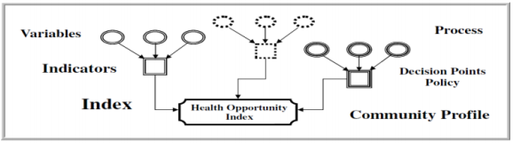
Structure
30+ Variables
13 Indicators
4 Profiles
1 Health Opportunity Index

Slide 21
Economic Opportunity Profile
Wellness Disparity Profile
Community Environmental Profile
Consumer Opportunity Profile
Health Opportunity Index

Slide 22
Community Environmental Profile
Cancer Risk
Inflow Mobility
Air Quality Index (EPA)
Population Churning Index
Population-Weighted Density
Walkability Index
Respiration Risk
Outflow Mobility
Density
Diversity (Land-use)
Design (Connectivity)
Distance to Transit
Neurological Risk
On-road Pollution
Non-road
Non-point

Slide 23
Consumer Opportunity Profile
Transportation Costs
Avg. Years of Schooling
Affordability Index
Education Index
Food Accessibility Index
Material Deprivation Index
Average Income
Unemployment
Autoless Homes
Home Ownership
Overcrowding
Housing Cost
Distance to Grocery Store
% Low Income
% Low Access to Major Grocery Store

Slide 24
Economic Opportunity Profile
Distance to Jobs
Gini Coefficient
Employment Access Index
Income Inequality Index
Job Participation Index
Number of Jobs
% of Working Age Population in the Labor Force

Slide 25
Wellness Disparity Profile
Primary Care Physician FTEs within 30 miles
Race/Ethnicity
Access to Care Index
Segregation Index
% Uninsured
Population
Spatial Influence Weighting

Slide 26
MAKING THE DATA ACCESSIBLE

Slide 27
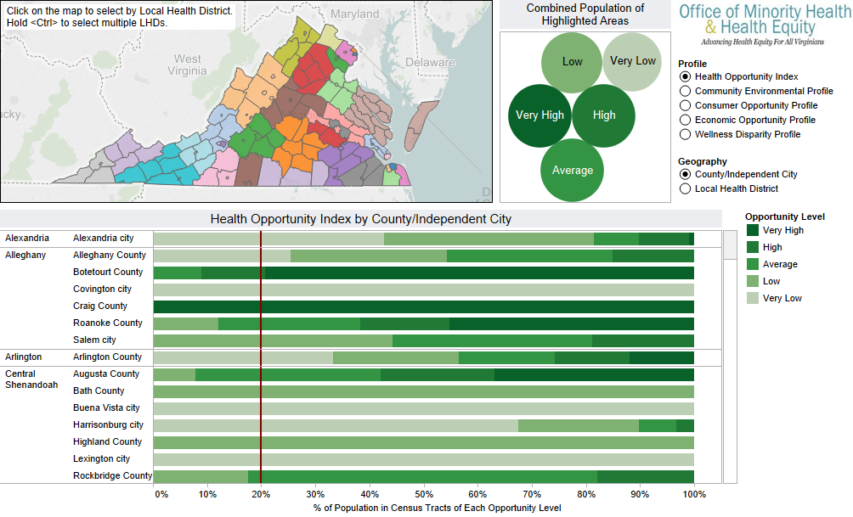
Population Experience

Slide 28
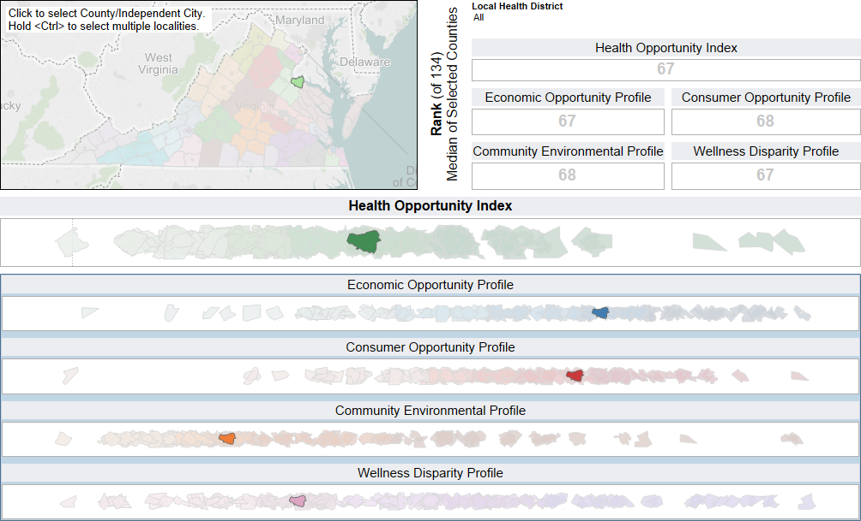
County Rankings

Slide 29
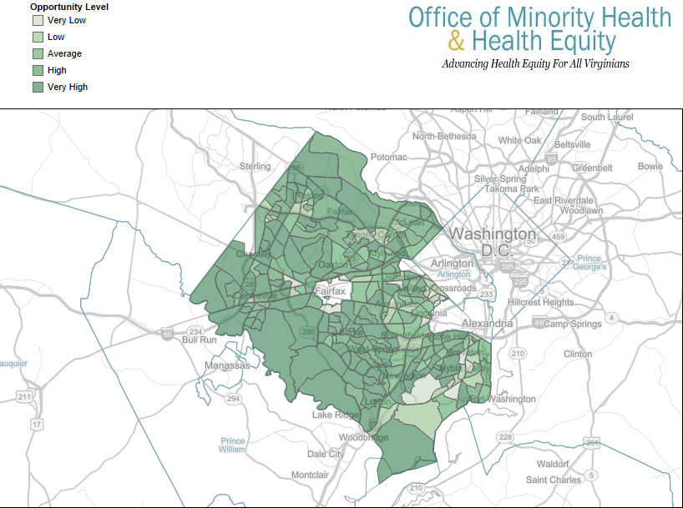
Fairfax County

Slide 30
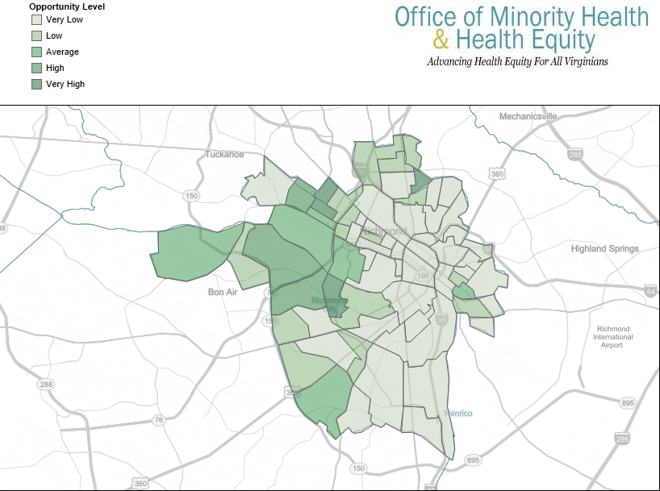
Richmond City

Slide 31
USES AND APPLICATIONS

Slide 32
Uses of the HOI
To show that place matters when it comes to health
To identify the impact of social determinants of health on statewide health landscape
To identify HOI indicators that are most influential on local health
To learn from communities with good health despite adverse HOI indicators
To build collaboration across all sectors to promote health equity

Slide 33
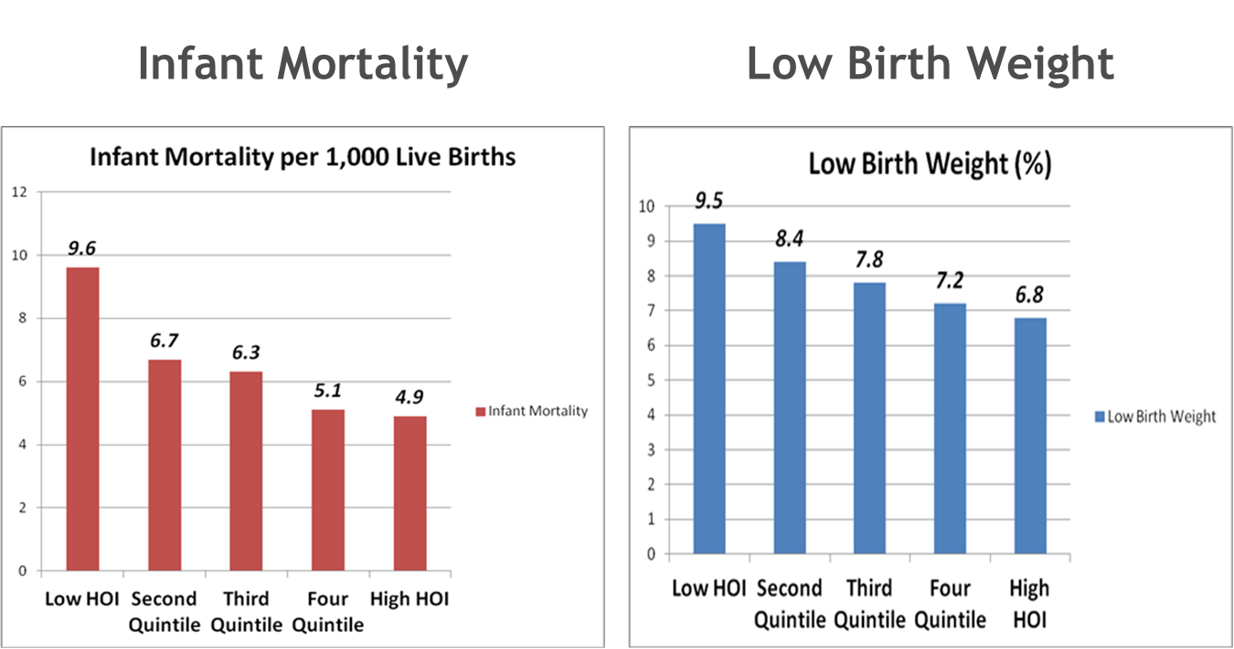
Monotonicity of HOI

Slide 34
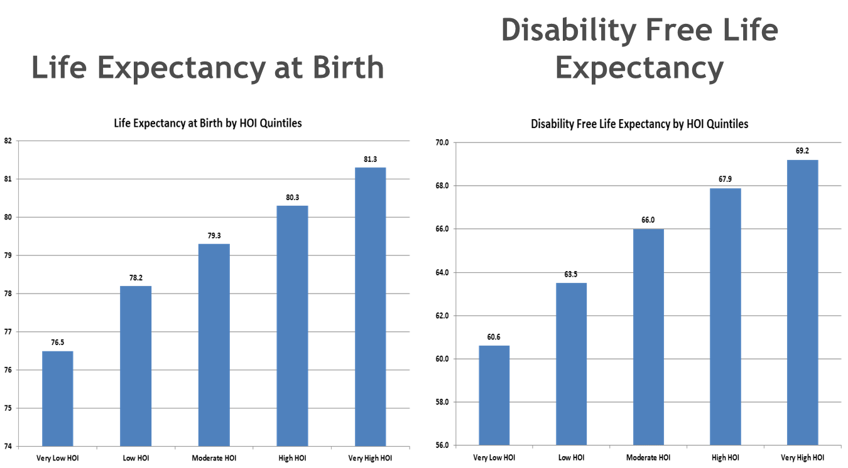
Monotonicity of HOI

Slide 35
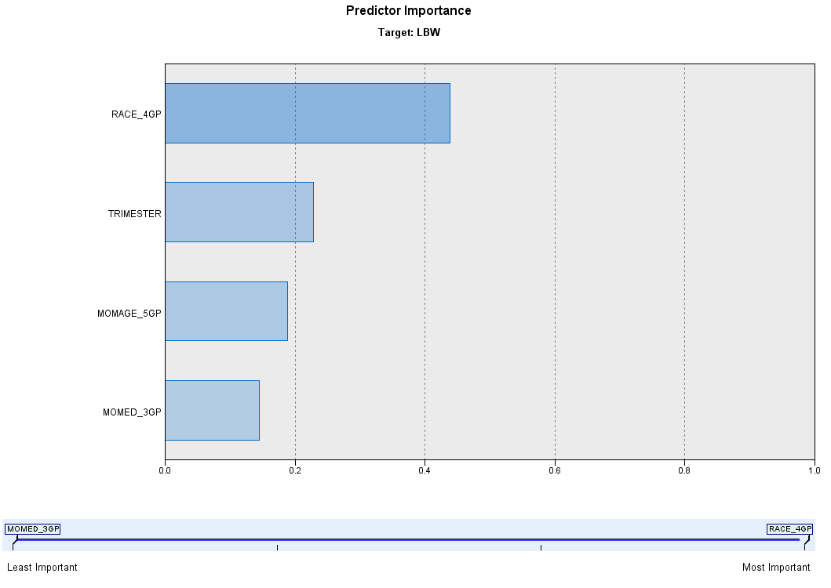
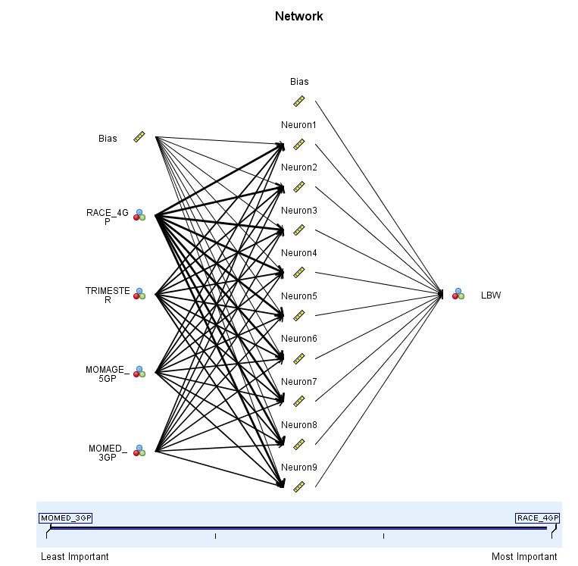
Predictive Analytics
for Low Birth Weight (Low HOI)

Slide 36
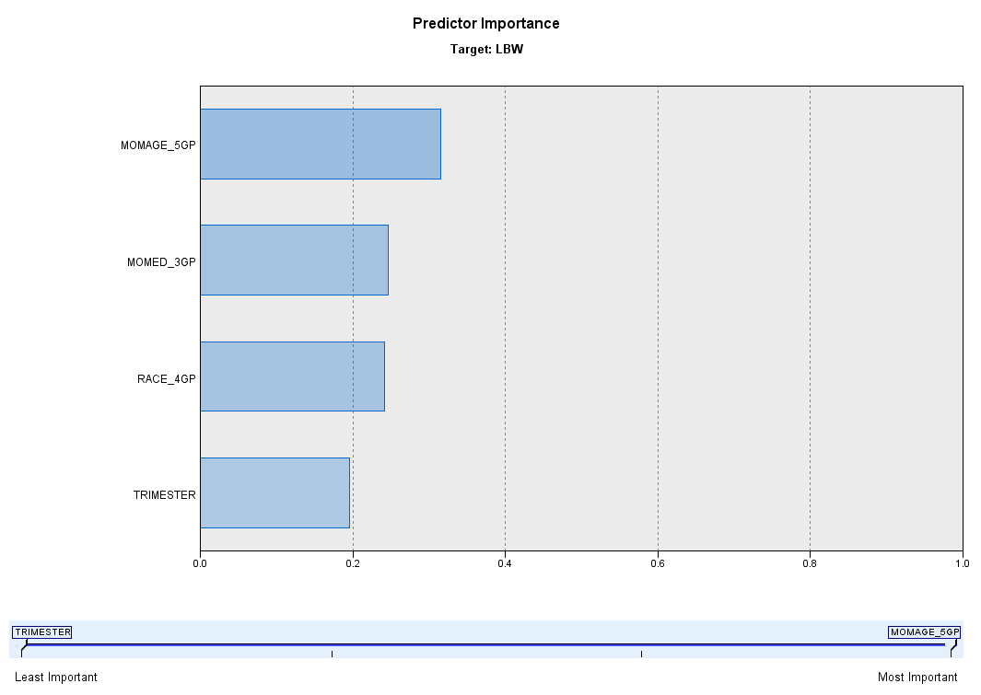
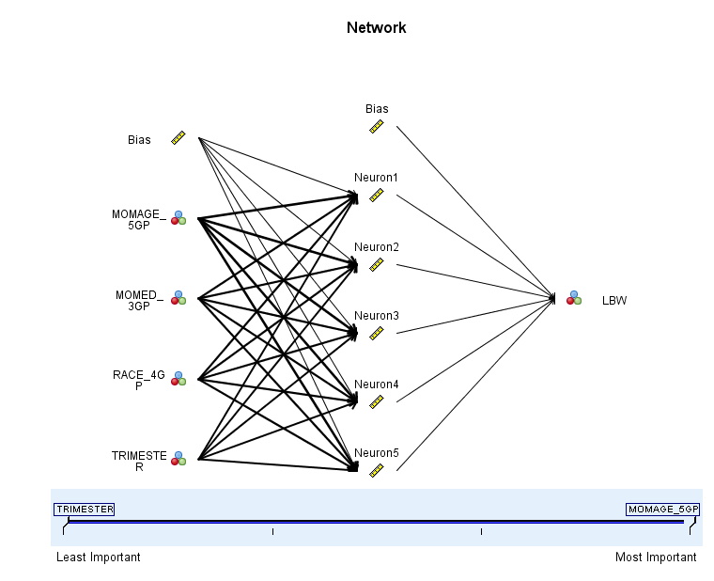
Predictive Analytics
for Low Birth Weight
(High HOI)

Slide 37
REPLICATION

Slide 38
Resources Needed
Staff
  1-2 Epidemiologist skilled in Geospatial techniques
Money
  Software to facilitate the analyses (~$25,000-30,000 one time investment)
  Time
    6 month timeframe
    Bonus
      Free advice from colleagues

Slide 39


For more information
please contact:
Adrienne McFadden, MD, JD
Adrienne.Mcfadden@vdh.virginia.gov
Justin Crow, MPA
Justin.Crow@vdh.virginia.gov
Rexford Anson-Dwamena, MPH
Rexford.Dwamena@vdh.virginia.gov

