Slide 1

Virginia Department of Health – Office of Health Equity (VDH-OHE)
Health Workforce & Designations
Justin Crow, MPH
Director, Division of Social Epidemiology
Olivette Burroughs, M.B.A., HCM, PHIC
Health Workforce Specialist

Slide 2
NEW NAME, SAME MISSION
We are excited to officially launch the new name of our office, Office of Health Equity (OHE)!
Our values, goals, and ultimate mission remain the same, but we hope that our new name will paint a better picture of our office and what we stand for.

Slide 3

Health Workforce
Serving Virginia’s Underserved through Primary Care Incentive Programs
Notes:
To improve and increase access to quality health care by ensuring that there are an adequate number of qualified practitioners providing services to Virginia residents in the specific disciplines in Health Professional Shortage Areas (HPSAs)

Slide 4
Types of Programs
Federal and State Incentive Programs
Programs available to providers seeking practice opportunities in the Commonwealth of Virginia
  Administer VA- SLRP (Loan Repayment Program)
  Conrad 30 Waiver Programs
  Administer four (4) Nursing Scholarships
  Promote/Technical Assistance the National Health Service Corp Programs

Slide 5
VA- SLRP
The purpose of the VA- SLRP program is to improve and increase access to quality health care by ensuring that there are an adequate number of qualified practitioners providing services to Virginia residents in the specific disciplines in Health Professional Shortage Areas (HPSAs).
    Medical
    Dental
    Behavioral health
    Pharmaceuticals

Slide 6
VA-SLRP Application info
  Application Cycle: January 1 – July 31
  Match Available from the State of Virginia
  Eligibility guidelines: http://www.vdh.virginia.gov/OMHHE/primarycare/incentives/loanrepayment/documents/Virgina%20State%20Loan%20Repayment%20Program%20Eligibility%20Guidelines.pdf

Slide 7
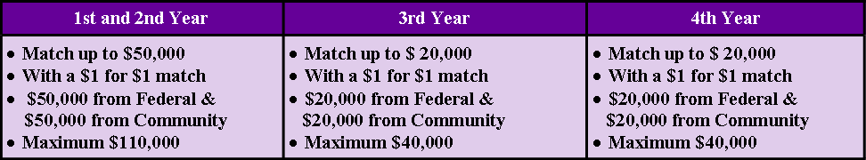
VA - SLRP Award Distribution
The amount of the Federal portion of the award will be determined partially by the amount provided by the community/ State match portion.
The total amount of awards for all four years cannot exceed $140,000.

Slide 8

Award Distribution Cont.
Award
  Minimum service obligation for the initial approval is two (2) years
  Maximum payment is $100,000 ($50,000 is paid by the community/ State match in the first two years of the agreement and up to $50,000 paid by the VA-SLRP Program)
  For the third and fourth renewal years, extensions can be awarded each year for a total of up to $40,000 (Cash match $20,000 Federal and $20,000 Community/State match)
  All approvals are based on availability of funds
  The total amount of awards for all four years cannot exceed $140,000.

Slide 9
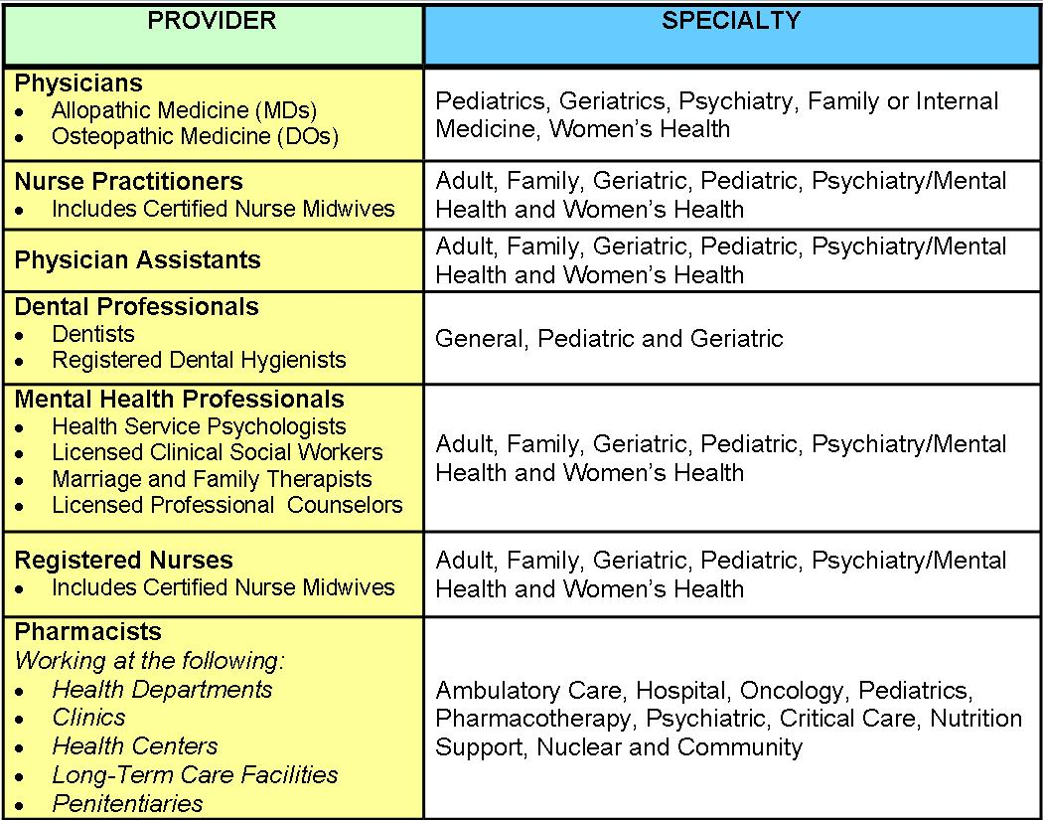

Who is eligible for VA-SLRP?

Slide 10
VA- SLRP Eligibility Requirements
Participant Eligibility
  All applicants must meet the following criteria to be eligible for VA-SLRP:
    Must be citizens or nationals of the United States
    Clinicians must have completed
      Residency training
      Be board eligible or Board certified in their specialty
      Accredited program
      No restrictions

Slide 11
Eligibility Requirements Cont.
Must completely satisfy any other contractual service obligation for health professional service prior to beginning the period of service under the VA-SLRP
    Federal
    State
    Other entity
  Must not have any federal or state obligations
      Judgment liens
        Against their property for a debt to the United States
        No history

Slide 12
Eligibility Requirements Cont.
Must be eligible for federal employment
    Must practice full-time at an approved and eligible practice site
      Full-time service equates to 40 hours per week for a minimum of 45 weeks per year
      No more than 4 hours of administrative duties per week
Must agree to use the VA-SLRP funds only to repay qualifying educational loan(s)

Slide 13
Eligibility Requirements Cont.
Practice Site Eligibility
  All health care professionals who participate in the VA-SLRP must fulfill their service obligation at an eligible site.
  The eligible practice site must be a:
    Primary Care
    Mental Health Care
    Dental Health Care

Slide 14
Eligibility Requirements Cont.
Facility must be located in a HPSA and be one of the following:
    A public entity
    Not-for-profit
    Non-profit
    For-profit health facilities operated by non-profit organizations
  Medically Underserved Areas or Populations and shortage areas designated by the State do not qualify.
  Practice site must be related to training and/or discipline
  Must charge for professional services at the standard current rates.
  Participant site will follow the HHS Poverty Guidelines which requires a very nominal fee, or no
        Sliding scale

Slide 15
Eligibility Requirements Cont.
The following are eligible to be approved as practice sites
Federally Qualified Health Centers (FQHCs)
FQHC Look-A-Likes
Centers for Medicare & Medicaid Services Certified Rural Health Clinics (RHCs)
Other Health Facilities
        Free Clinics
Indian Health Service Facilities, Tribally-Operated 638 Health Programs, and Urban Indian Health Programs (ITU)
Correctional or Detention Facilities
Private Practices (Solo or Group)
        Must be a public or private non-profit entity

Slide 16

Got Questions?
Discussions
Sign up for individual Question and Answer
For more information regarding Loan Repayment, please contact:
Olivette Burroughs
Health Workforce Specialist
Olivette.Burroughs@vdh.virginia.gov
(804) 864-7431

Slide 17
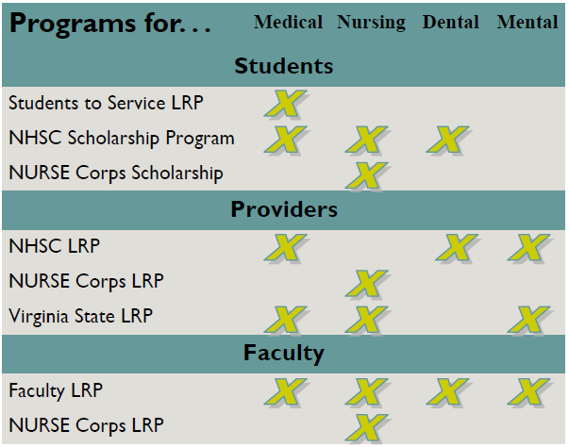
National Health Service Corps

Slide 18
Virginia NHSC Field Strength
Virginia NHSC Field Strength
nts
87 NHSC LRP
117 Total Participants
31 Physicians
21 Nurse Practitioners
10 Dentists
8 Physician Assistants
2 Pharmacists
1 Dental Hygienist
1 Registered Nurse
43 Mental/Behavioral Providers
87% Retention Rate*
63% Plan to Remain at Current Site
117 Total Participants
87 NHSC LRP
6 NHSC Scholarship
24 Va. SLRP
*At original NHSC site or at another site within a Federally designated shortage area

Slide 19
National Health Service Corps
NHSC LRP Participants
NHSC Sites
Physician Loan Repayment

Slide 20
NHSC LRP Participants
Eligibility
  US citizen or national
  Currently work, or applying to work, at an NHSC-approved site
  Have unpaid student debt (gov’t or commercial) for tuition, reasonable education expenses, and reasonable living expenses, segregated from other debt.
  License to practice in the state where the employing NHSC-site is located.

Slide 21
NHSC LRP Participants
Primary Care HPSA
Eligible Providers
  Physicians (MD or DO)
  Primary Care Nurse Practitioner
  Certified Nurse-Midwife
  Physician Assistant
Eligible Specialties
  Family Medicine
  Internal Medicine
  Pediatrics
  OB/GYN
  Geriatrics
  Mental Health

Slide 22
NHSC LRP Participants
Mental Health HPSA
Eligible Providers
  Psychiatrist
  Clinical Psychologist
  Licensed Clinical Social Worker
  Psychiatric Nurse Specialist
  Marriage & Family Therapist
  Licensed Professional Counselor

Slide 23
Dental Health HPSA
NHSC LRP Participants
Eligible Providers
  Family/General Dentist
  Geriatric Dentist
  Pediatric Dentist
  Dental Hygienist

Slide 24
Program Benefits
NHSC LRP Participants
Based on HPSA Score & Work Schedule
Participants may re-apply after 2-year service obligation
 | 2-Years, full-time | 2-Years half-time
HPSA Score 14 or higher | Up to $50,000 | Up to $25,000
HPSA Score 13 or lower | Up to $30,000 | Up to $15,000
Tax Free!

Slide 25
Program Benefits
NHSC LRP Participants
Based on HPSA Score & Work Schedule
Participants may re-apply after 2-year service obligation
Program is competitive—very competitive
 | 2-Years, full-time | 2-Years half-time
HPSA Score 14 or higher | Up to $50,000 | Up to $25,000
HPSA Score 13 or lower | Up to $30,000 | Up to $15,000

Slide 26
How to Apply
NHSC LRP Participants
Review NHSC LRP Application & Guidelines
  http://www.nhsc.hrsa.gov/loanrepayment/loanrepaymentprogram.html
Find a job at an NHSC site, or check your current job
  http://nhscjobs.hrsa.gov
Apply during application window (Jan)
  http://www.nhsc.hrsa.gov/loanrepayment/howtoapply.html

Slide 27
Eligibility
NHSC Sites
  Located in a federally designated HPSA.
  See all patients regardless of ability to pay.
  Provide services on a discount (sliding scale) fee schedule.
  Accept Medicare, Medicaid & CHIP/FAMIS.
  Not discriminate on provision of services.
  Document sound fiscal management.
  Pay a competitive salary & benefits, and malpractice package.

Slide 28
Eligible Site Types
NHSC Sites
  Federally Qualified Health Centers
  FQHC Look-A-likes
  Correctional/Detention Facilities
  Certified Rural Health Clinics
  Critical Access Hospitals
  Community Mental Health Centers
  State or County Health Departments
  Community Outpatient Facilities
  Private Practices
  School-based Clinics
  Mobile Units/Clinics
  Free Clinics

Slide 29
NHSC Sites
Other Benefits
Student Scholarship Program
Student to Service Loan Repayment Program
Community & Site Development Assistance
Access to NHSC Jobs Center

Slide 30
How to Apply
NHSC Sites
Determine HPSA Status
  http://datawarehouse.hrsa.gov/tools/analyzers/hpsafind.aspx
  A good time to contact Va. Primary Care Office (me)
Review site application checklist
  http://nhsc.hrsa.gov/sites/becomenhscapprovedsite/
Apply during application window (March 2016)
  http://nhsc.hrsa.gov/sites/requireddocumentation/index.html

Slide 31

Other NHSC Programs
Student to Service (S2S)
  Provides up to $120,000 loan repayment to final year medical students in return for a commitment to provide primary health care at an approved NHSC site
    full-time for minimum of 3-years
    half-time for at least 6 years
Loan Scholarship Program (SP)
  Incentives
    Payment of tuition and required fees (tax-free)
    Some other tax-free educational costs (books, etc.)
    A monthly living stipend (taxable)
  Year of Support = Year of Service (Min 2 years)
Nurse Corps
  Up to 85% repayment of total eligible student loan debt
  2 years of full time service

Slide 32
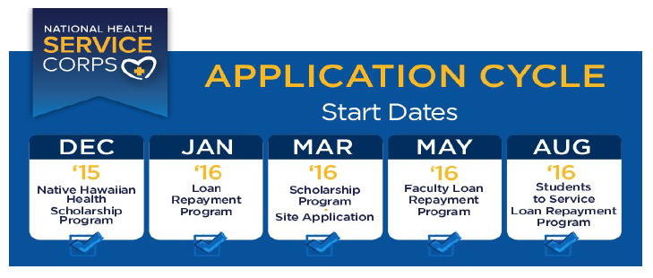

Slide 33
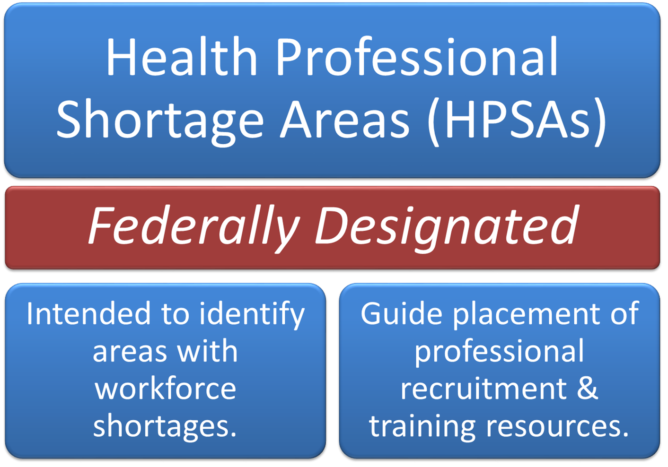

Slide 34
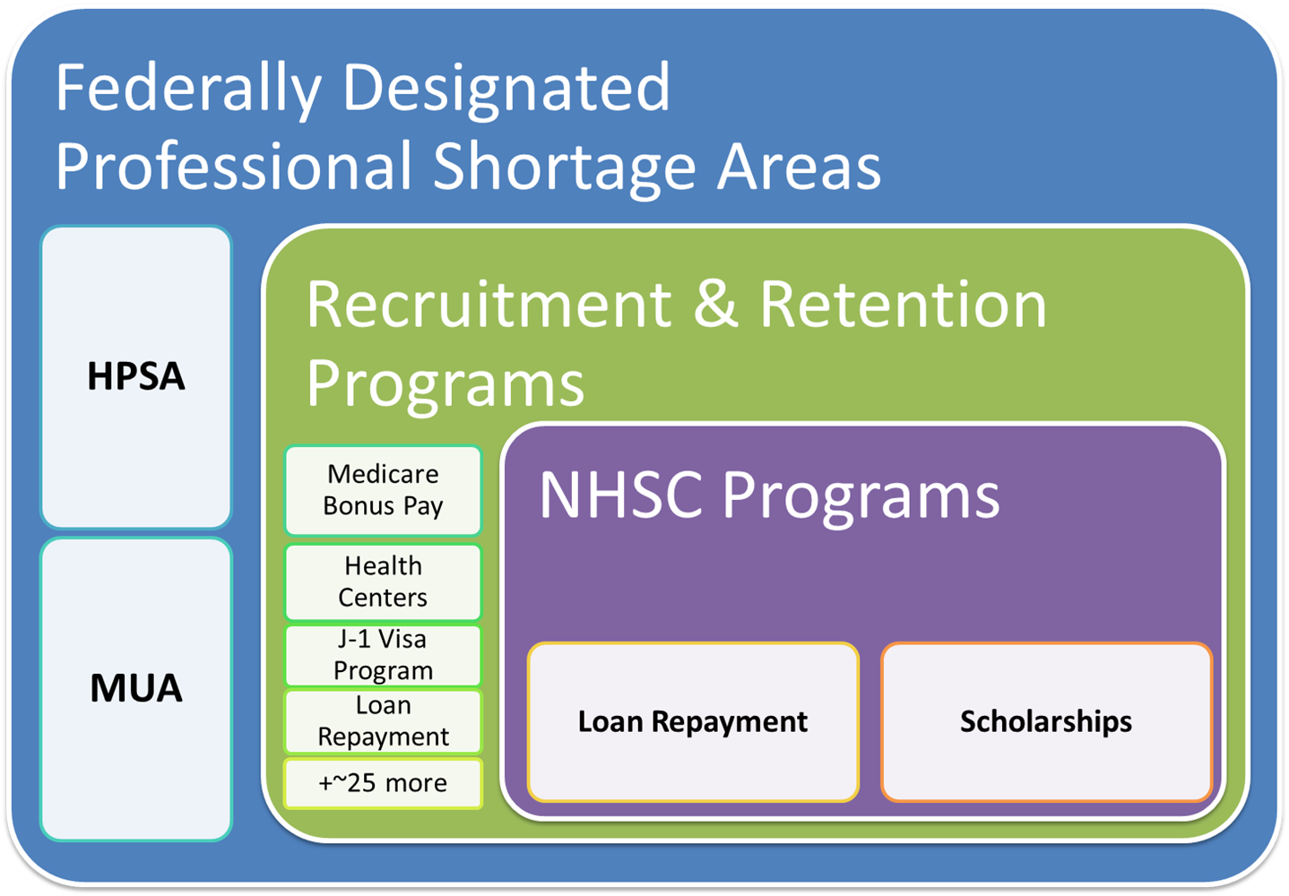

Slide 35
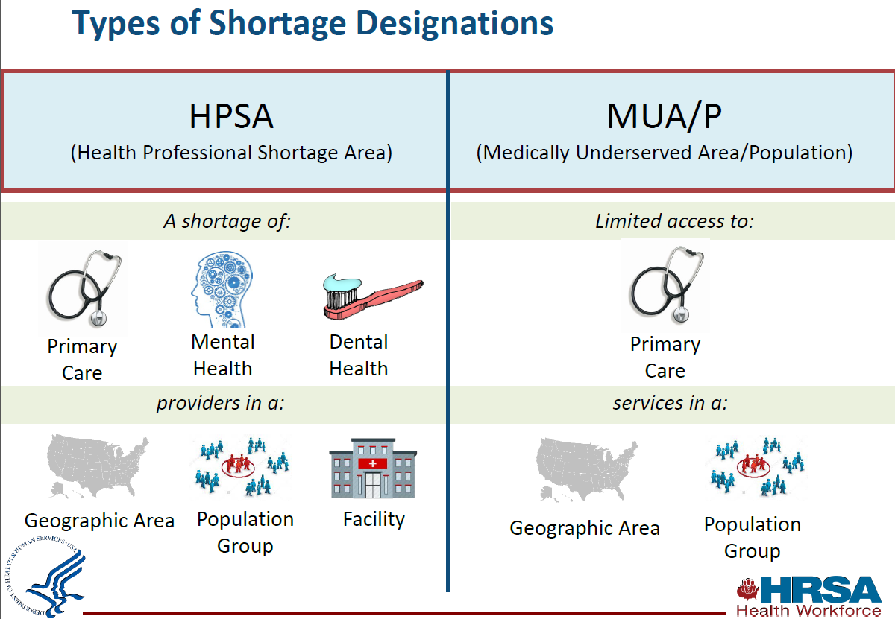


Slide 36
Eligible Facilities
Auto-HPSAs
  Federally Qualified Health Centers
  FQHC Look-a-likes
  Rural Health Clinic
Eligible by Application
  State Correctional Facilities
  State Mental Hospitals
  Community Mental Health Centers (CSBs)
  Other public/non-profit facilities

Slide 37
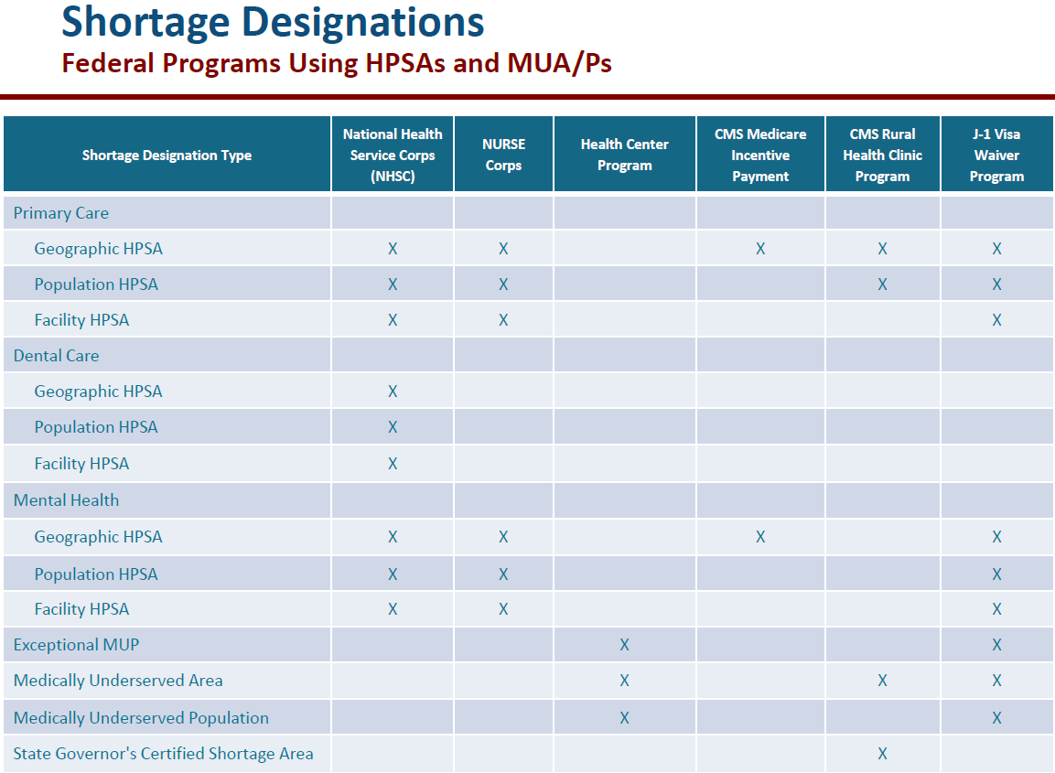


Slide 38
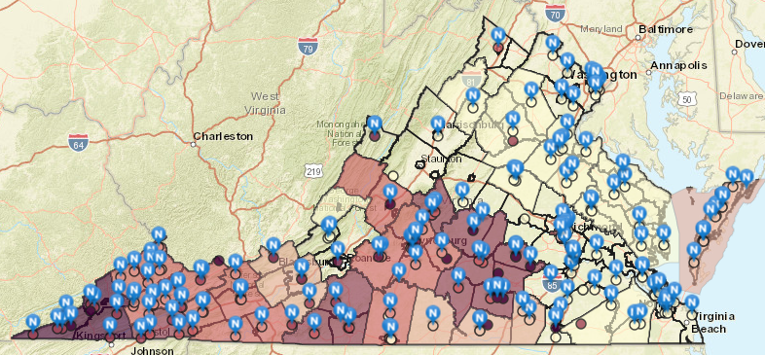
Mental Health HPSAs & NHSC Sites
http://www.vdh.virginia.gov/health-equity/shortage-designations-and-maps/

Slide 39
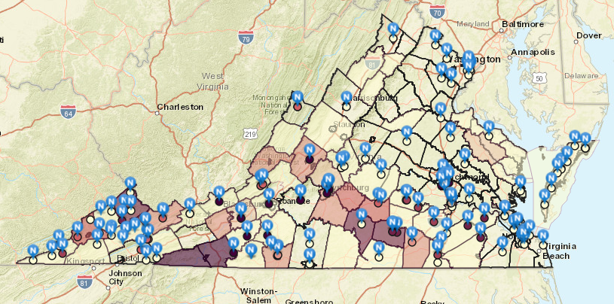
Dental Health HPSAs & NHSC Sites
http://www.vdh.virginia.gov/health-equity/shortage-designations-and-maps/

Slide 40
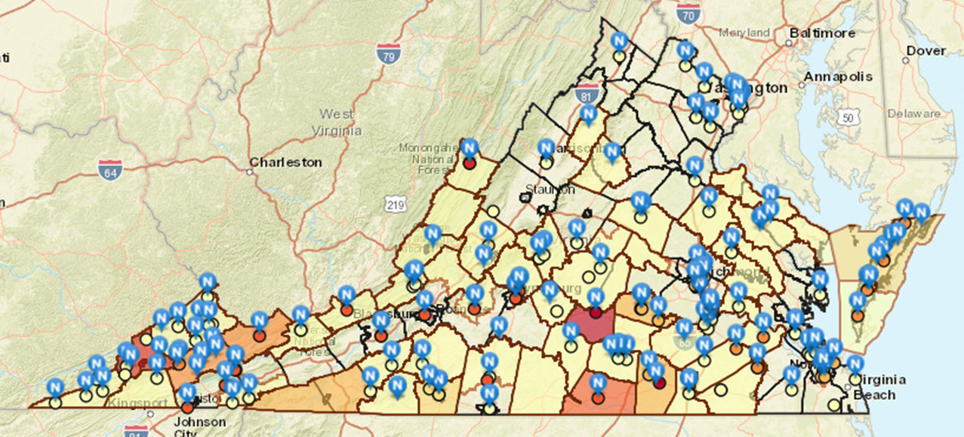
Primary Care HPSAs & NHSC Sites
http://www.vdh.virginia.gov/health-equity/shortage-designations-and-maps/

Slide 41

Thank you!!
Justin Crow, MPA
Justin.crow@vdh.virginia.gov
http://www.vdh.virginia.gov/health-equity/
Additional Contacts:
HPSA & NHSC Programs
Anna Riggan
Anna.Riggan@vdh.virginia.gov
Rex Anson-Dwamena
Rexford.dwamena@vdh.virginia.gov
Virginia State Loan Repayment Program:
Olivette Burroughs
Olivette.Burroughs@vdh.virginia.gov

