Slide 1
A crash course on health equity
Dr. Lauren Powell
Director, Office of Health Equity
October 17, 2018
https://careset.com/austin-to-host-inaugural-national-health-equity-hackathon-this-october/

Slide 2
Common terms in health equity work
Race: a socially constructed way of grouping people, based on skin color and other apparent physical differences which has no scientific basis (Boston Public Health Commission)
Disproportionate: over- or under-representation of a particular group or race in a public system (i.e.-criminal justice system), compared to their representation in the general population (CommonHealth ACTION)
-isms: systems of privilege and oppression based on social identities, including race (racism), sex (sexism), class (classism), age (ageism), ability (ableism), and sexual identity (heterosexism). All are rooted in doctrines of superiority and inferiority (CommonHealth ACTION, adapted from Xavier University n.d.)

Slide 3
Health disparity vs. Health inequity
Health disparity: differences in presence of disease, health outcomes, or access to health care between groups. (Boston Public Health Commission)
Health inequity: differences in health that are systemically rooted; they are unnecessary and avoidable. (CommonHealth ACTION)

Slide 4
Social Determinants of Health: social + life conditions

Slide 5
What is Health Equity?
When all people and communities have the opportunity to attain their full potential and highest level of health
(CommonHealth ACTION, Braveman and Gruskin, 2003).
Equality ≠ Equity

Slide 6
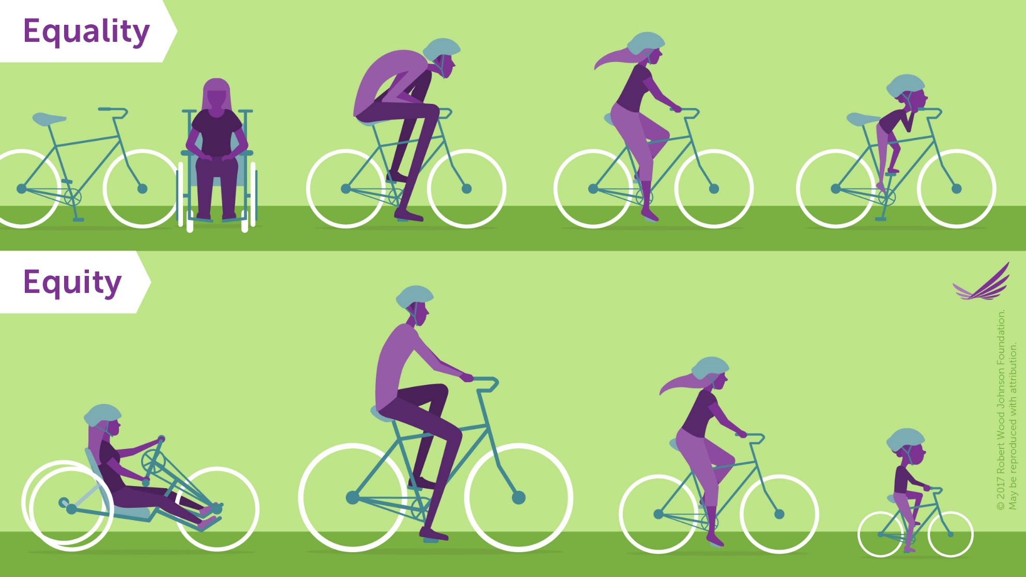
Equality vs. Equity
https://www.rwjf.org/en/library/features/achieving-health-equity.html

Slide 7
Aiming for Health Equity
http://www.health.state.mn.us/divs/opi/community/advancingequity.html

Slide 8
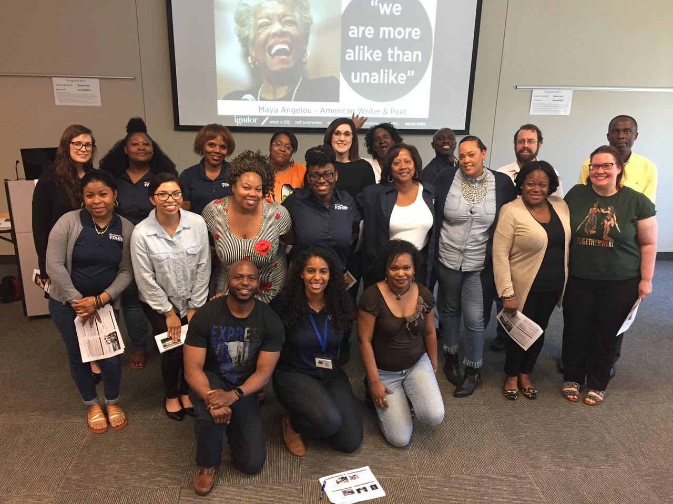
The Office of Health Equity
Health equity for all Virginians
Social Epidemiology & Data
Primary Care & Rural Health
Multicultural Health & Community Engagement

Slide 9
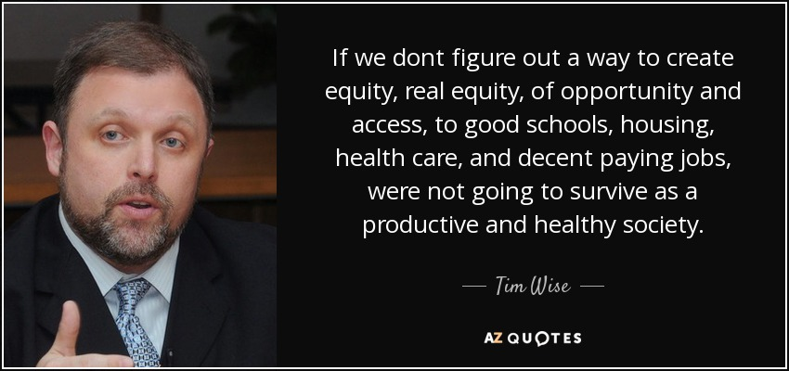
Why does health equity matter?

