Slide 1
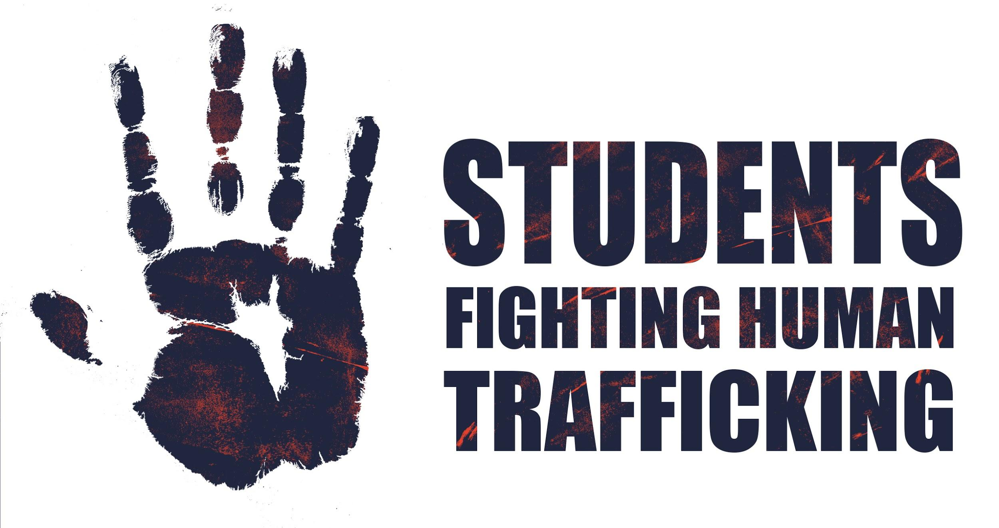
Officers:
Hannah Rak: Logistical chair
Sarah Poirer: Co-Research Chair
Tawany Almeida: Co-Research chair
Sid Hariharan: Fundraising chair
Alina Naqvi: Outreach Liason
Caitlin Hauser: Advertising chair
Advisors:
Dr. Rigby
Fay Chelmow RN
Cheryl Bodamer PhD, RN
Notes:
Welcome!
Organization formed ein 2019 with the goal to educate medical students and healthcare professionals about Human Trafficking in the clinical environment and how to appropriately respond when a patient is suspected of being trafficked.

Slide 2
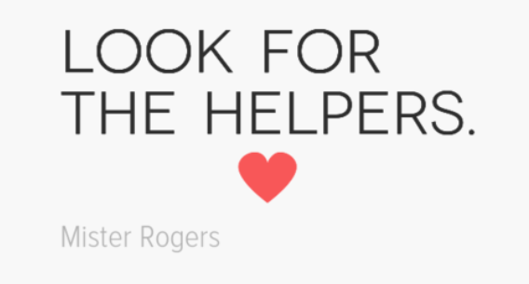
Notes:
We will be discussing some difficult topics today and it’s possible that some of you may feel uncomfortable. Whether our discussions remind you of something from before or, as we’re going to learn today, vicarious traumatization, please feel free to reach out to me or our moderator for help if you feel you need support in any way.

Slide 3
Human Trafficking 101
Presented by Students Fighting Human Trafficking
Caitlin Hauser
Incoming OB/GYN Resident at VCU Health
Notes:
Goals of presentation: What Human Trafficking is and is not, who is at risk for being trafficked, what our role is as healthcare providers to help combat trafficking.
Human Trafficking has been in the news a lot since the me too movement, Jeffrey Epstein case etc.

Slide 4
Human trafficking is the illegal trade of human beings. Force, fraud or coercion are used to compel another person to provide labor or commercial sex. It is the business of stealing a person’s freedom for profit.
Notes:
Lets start with a definition of Human Trafficking.
“Force, fraud and coercion” are very important and we will go over them individually in a few slides
When you buy and sell a person they become commodities .. “property” that can be sold on the same websites where can sell your furniture or car.
humans generate a lot of money for the trafficker because, unlike drugs and guns, humans can be sold over and over again. Humans are an easy supply to replenish; trafficking people have low start-up costs unlike trafficking drugs and guns.
Traffickers lie, assault, threaten or manipulate people into working under inhumane, illegal or otherwise unacceptable conditions. In some cases, traffickers’ trick, defraud or physically force people into providing commercial sex.
Human trafficking is not smuggling. Smuggling is a violation against international borders. Human Trafficking is a violation against a person. A person does not have to cross state lines to be considered trafficked. A person can be trafficked without even leaving their neighborhood.

Slide 5
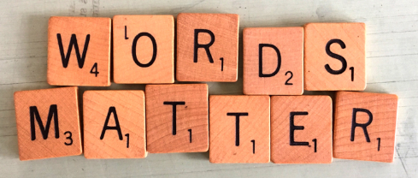
Notes:
Within my talk you’ll notice I try to avoid using certain words. In the medical community we try to use the word Survivor, not victim
Not “slave” but rather “enslaved person”

Slide 6
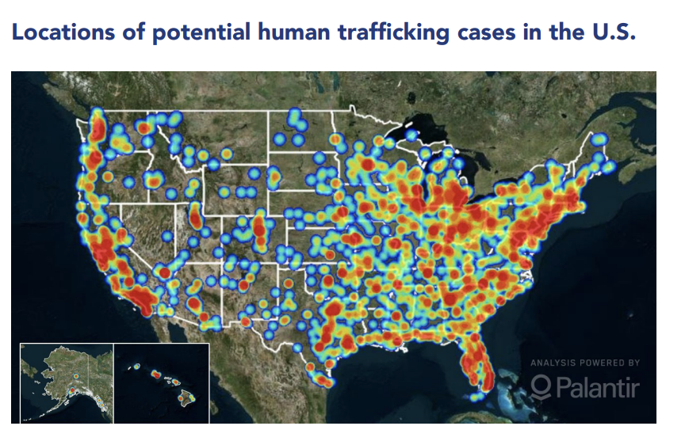
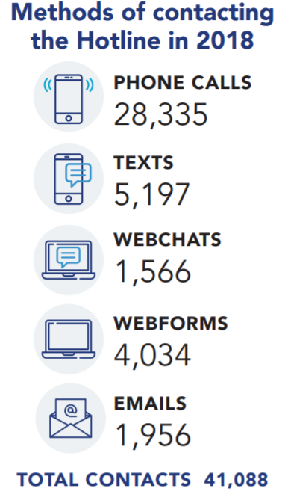
2018 Hotline Statistics - POLARIS
Notes:
Polaris is a wonderful organization that aims to serve survivors of human trafficking through the 24/7 National Human Trafficking Hotline and coordinating referral partners nationwide. They collect data and release statistics about human trafficking in the US to capture the extent of the problem.
Human Trafficking is everywhere. Law enforcement has found it in all 50 states. ; is estimated to be a $150 billion per year industry
This crime is happening to both U.S. Citizens and foreign nationals.
Men, women, children, trans, LGBTQ.
Predominantly affecting women and girls.
More Polaris statistics:
· No official estimate of number of human trafficking cases in US, but estimated in the hundreds of thousands
· More than 49,000 total cases of human trafficking have been reported to the hotline
· The hotline receives on average 150 calls/ day
In 2016 -- International Labour Organization estimates that there are 40.3 million people being trafficked globally.
a. 81% of them are trapped in forced labor.
25% of them are children.
75% are women and girls.

Slide 7
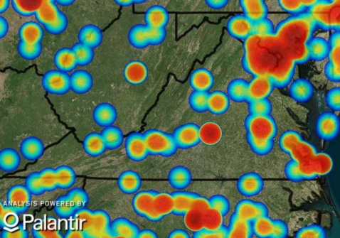
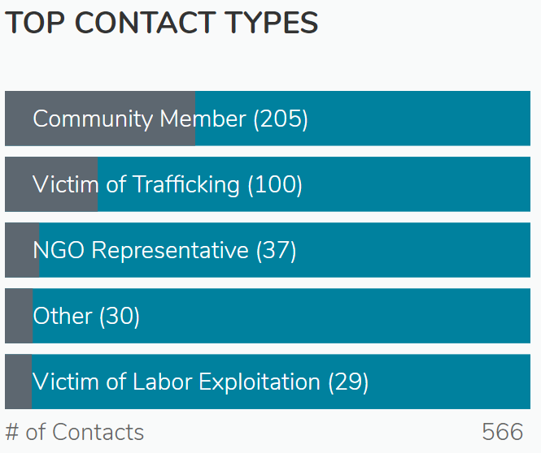
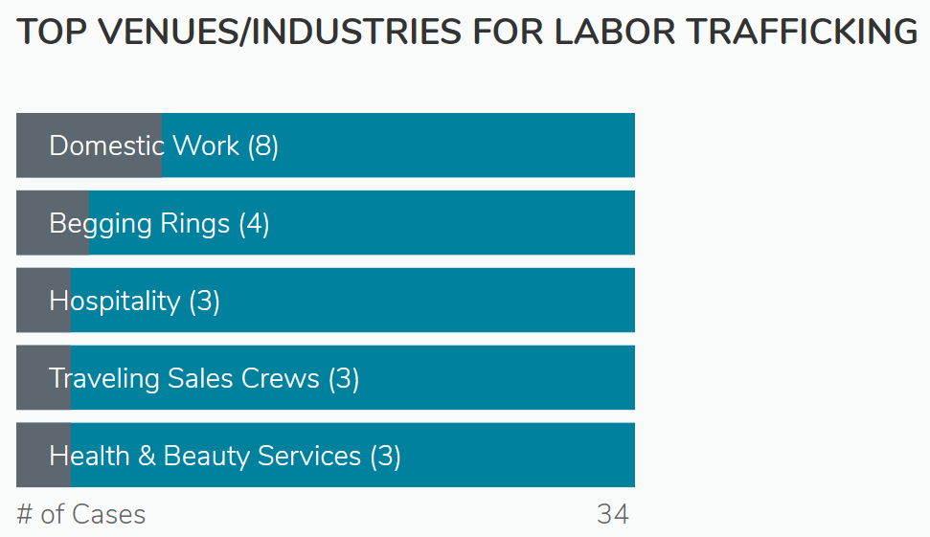
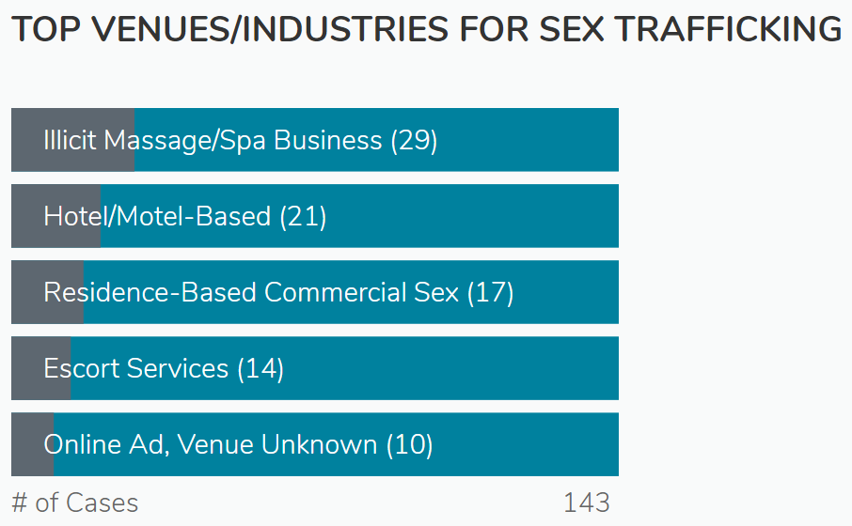
Virginia Hotline Statistics
Since 2007: 5,518 contacts
2018: 566 contacts
2019 (up until 6/30/19): 279 contacts
Notes:
I wanted to give more specific data for what we are facing in Virginia
Since 2007 the national hotline has received over 5,000 calls in reference to Virginia and have Identified1,333 cases of human trafficking
On the heat map you can see where the majority of calls in Virginia are coming from
Along the bottoms I have pasted some charts that have been created from the 2018 POLARIS data collected by the hotline in Virginia
Community members were the top contact types in Virginia
Top venues for labor trafficking were domestic work in Virginia
Top industries for sex trafficking were spa businesses and hotel/motel based in Virginia

Slide 8
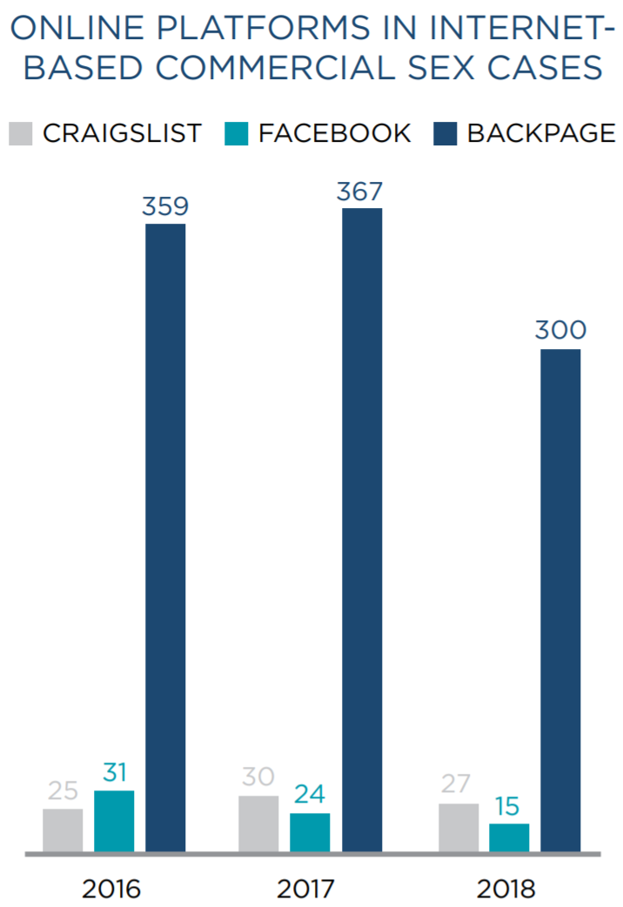
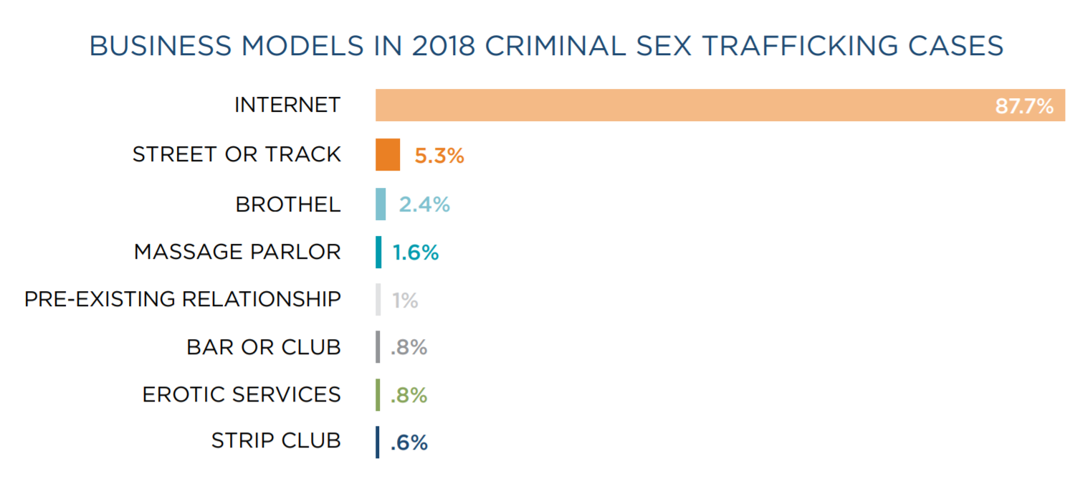
Statistics:
2018 Federal Human Trafficking Report
From the 2018 Federal Human Trafficking Report
Notes:
I was reading the 2018 Federal Human Trafficking report and I found these figures very alarming. People are being sold predominately on the internet and seemingly as easy as selling furniture, used clothes, or cars.
Backpage was a classified advertising website that had become the largest marketplace for buying and selling sex by the time that federal law enforcement agencies seized it in April 2018.
Other websites are emerging

Slide 9
“I felt like a slave working for someone, getting beat and not getting paid, not having control
over my life.”
Survey Respondent
Survivor Insights: The Role of Technology in Domestic Minor Sex Trafficking
Thorn, January 2018
Notes:
Now that we understand what human trafficking is and the scope of the problem in our country and state Id’ like to move on to a survivors quote. Survivors have shared their stories and are the best source of information we have about what it is like to be trafficked and how we as healthcare providers can intervene.
This is part of a survivors definition of human trafficking. I will read the entire quote.
“I was groomed very well at the beginning and then my abuser switched on me in a very mean way and at that time I thought that I loved him and then it came to the point where I was deathly afraid of him. I felt like a slave for working for someone, getting beat and not getting paid, not having control over my life. For a long time I did not realize that I was trafficked. I thought that because he gave me a choice to stay or go and I chose to stay, that it made it my fault and responsibility.”

Slide 10
Common promises traffickers use to lure vulnerable people into trafficking
Love, family, belonging
Money and fame
Work
Education
Freedom
The American Dream
Financial help to the family
A better life
A promising future
Notes:
Just as the quote I just read mentions, the grooming phase is the beginning…
Traffickers are masters at selling dreams…… they lure their people by selling dreams that people typically crave….. Fame, wealth, popularity, stability, security, happiness, sense of belonging and being valued
This is a list of common promises traffickers use to trap people. Once trust is gained, the switch is flipped

Slide 11
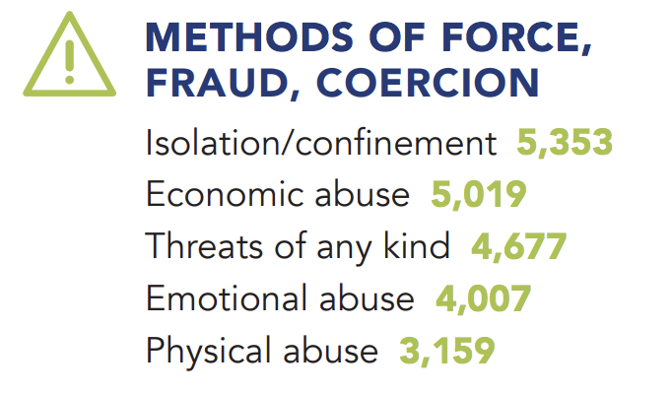
Force
Exertion of physical power or
force to prohibit certain behaviors
Notes:
https://humantraffickinghotline.org/sites/default/files/Polaris_National_Hotline_2018_Statistics_Fact_Sheet.pdf
Like I mentioned before, force fraud and coercion are the tools traffickers employ to trap people. We will now go through each one and I will provide some examples to help you understand .
Force can look like a person being subjected to beatings unless the person continues to earn money for the trafficker.
Force typically involves forced drug use, confinement, physical restraint, torture practices,like food and sleep deprivation, starvation, isolation, Slapping, choking, burning, beating with objects like hot irons, being scalded with hot water, forced to witness violence or murder, repeated sexual assault, rape, gang rape
COMPLEX TRAUMA! Symptoms of …….
Treated like a commodity to be repeatedly bought and sold / raped my an untold number of buyers unknown to the victim
They are unaware of the exploitation because they are deceived into believing that it was their fault or they chose to be prostituted
Traffickers use on-going humiliation to destroy their victim’s self-esteem and anything that gives them reason to want to leave; they make the victim feel that the trafficker is the only person who cares about them;
Shaming or guilt, trauma-bonding ~ fears the trafficker yet feels relieved / grateful to be taken cared of or allowed to live; “seasoning tactics” such as with-holding food, water, sleep, or social contact to increase dependence and reduce resistence; psychological entrapment prevents victim from escaping even if the opportunity arises; suffer multiple psychological conditions, including C-PTSD, stress disorder, rape trauma syndrome (the series of emotional, physical, and behavioral reactions experienced by rape victims), and child sex abuse accomodation syndrome ( in which kids go through 5 stages of response to ongoing abuse ~~ secrecy, helplessness, accomodation, delayed disclosure, and retraction), anxiety and nervous disorders, psychosomatic syndromes, eating disorders, personality disorders, depression, coping substance abuse (and subsequent addiction), anf thought of self-harm, suicide
PHYSICAL TRAUMA: face, head, neck trauma; oral lesions, teeth and jaw fractures and mandibular dislocations;
Cuts, bite marks, bruises, strangulation, chronic pain, muscle tension, bone fractures, older broken bones that did not heal properly, respiratory and GI disorders from chronic stress, internal injuries including stab or gunshot wounds, bladder damage, injury or infection, unexplained scars and burns, facial and dental injuries, poor dental hygiene, drug related health issues, asthma, HEP C, skin infections, hearing loss from head trauma, concussions and other traumatic brain injuries, TB, malnourishment, DRUG and ETOH dependency,
Reproductive health issues like vaginal, perineal, and rectal injuries, traumatic fistulas, menstral pain and irregularities, impacted sponges, condoms, tampons, or baby wipes; vaginal discharge and infection from using items inserted into the vagina to block menstration; miscarriages, STIs, HIV; PID, andother diseases due to untreated STIs; forced sterilization or use of contraceptive devices; unplanned and high-risk pregnancies,

Slide 12
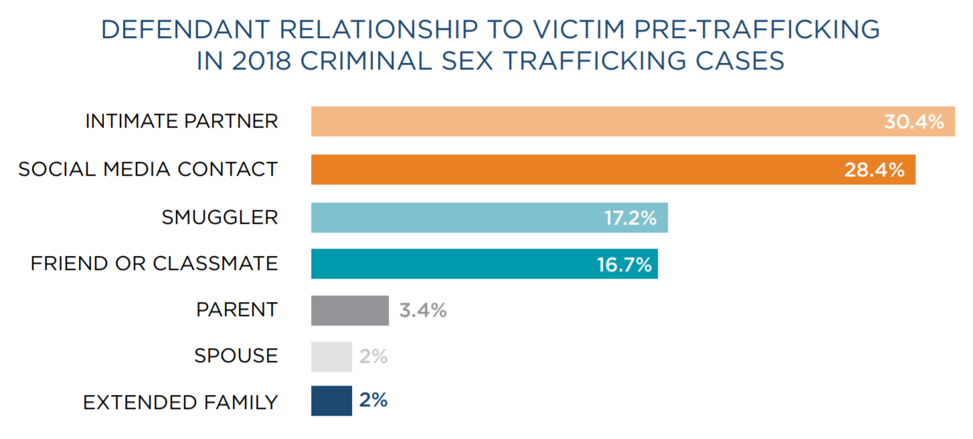
Fraud
Deception
From the 2018 Federal Human Trafficking Report
Notes:
Luring someone under false premise; tricking someone into a situation
This can look like a person convincing another to attend a new training course, or go to a better job opportunity ONLY LATER TO BE passed on to another person who commits violent acts against them, sells them to others, or exploits and degrades them.
An employer luring someone from overseas to come to work for his / her business with the false promise of a green card if they work for $10/day for 6 months.
Fraud can look like a person being tricked into believing that his or her trafficker loves him:
This is a quote from a former sex trafficker (Justaskprevention.org)
“I build their self-esteem through compliments and listening to them. I act as if we’re dating and say “I love you.” I give her money, gifts, alcohol, and drugs to get her hooked on our relationship.”
Fraudulent statements include:
“If you truly love me, you will do this for me. I promise this will be the only time. I will never ask you to do it again”
Fraud typically involves false promises, deceitful enticing and affectionate behavior, lying about working conditions, Blackmail or extortion, lying about promises for a better life, Preying upon desperation or poverty
Many child or teen victims of sex trafficking describe their pimps as the first person who ever loved them. Many of them don’t understand how healthy relationships work, therefore are easily deceived.

Slide 13
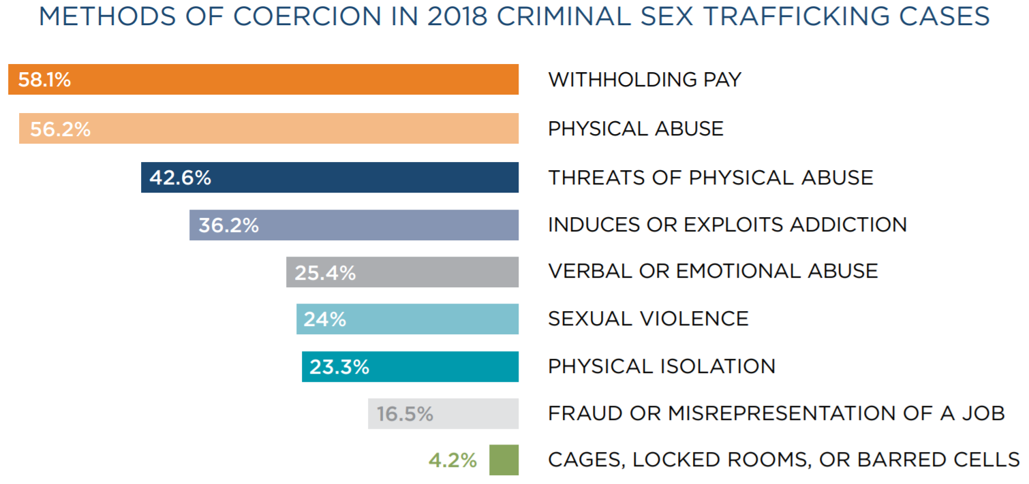
Coercion
From the 2018 Federal Human Trafficking Report
Notes:
Coercion: This is the trafficker’s primary weapon.
This method is critical to a trafficker’s success.
Because they do not leave physical scars.
Extortion, blackmail, use of addiction to manipulate or compel someone to engage in commercial sex or labor activities; threats
High levels of fear and continuous suffering
are an effective methods at preparing victims for total control.
These methods are extremely effective at forming trauma bonds.
This is why traffickers can often relax their level of coercion as time passes,
knowing that victims will continue to feel psychologically incapable of reacting to escape opportunities.
That’s why it is common to see victims return to their trafficker even after escaping. A victim will return to her trafficker an average of 7 times before finally deciding to leave her trafficker for good.
The psychological bonds of this relationship,
and the trauma that can result from it,
often endure well beyond the point
at which the victim leaves the control of the trafficker.
“I’m going to show these photos to your pastor and your parents if you don’t do as I say”
“I’m going to find your brother. I know where his bus stop is.”
“I’m going to tell your family what type of work you’re really doing.”
“I’m going to call immigration authorities if you complain again.”
Coercion includes verbal, emotional and subtle psychological violence like
Constant surveillance, a climate of fear and punishment characterized by unpredictable and unsafe atmospheres aimed at destabilizing the victim and creating extreme uncertainty.
The psychological violence can be overt like murder threats, mock executions, intimidation and humiliation through rape and gang rape; enforcement of dehumanizing trivial demands, controlling daily life skills, creating dependency, establishing quotas, abuse of the legal process, an increase of their debt and re-trafficking.
false promises about later payment of wages or about regularizing the residence
status.
When the trafficker threatens to harm the family of the victim if the
victim tries to resist, the victim of trafficking in human beings
has to choose between his/her own safety and the safety
of the family. "is situation is called ‘impossible choice’
in the literature on psychological torture. Regardless of the
actions she or he chooses, something aversive will happen
to the victim and/or another person. In this situation the
person has no capacity of self-determination and is left in
a State of ‘mental defeat’. In case of trafficked women it is
shown that threats against children were especially effective.
73
COERCION ALSO INCLUDES Occasional indulgences and showing affection - this tactic of alternating affection and violence creates a psychological tendency in the victim to bond with their exploiter; to identify or sympathize with his or her exploiter / captor. This common survival mechanism is called Stockholm Syndrome. This syndrome can develop when people are placed in a situation where they no longer have any control over their fate, feel intense fear of physical harm and believe all control is in the hands of their tormentor, so a psychological response to survive can include sympathy and support for their captor's plight. This bond is extremely difficult to break and can takes years for a survivor to heal from this psychological bondage.
The name Stockholm Syndrome was derived from a 1973 bank robbery in Stockholm, Sweden, where four hostages were held for six days.Throughout their imprisonment and while in harm's way, each hostage seemed to defend the actions of the robbers and even appeared to rebuke efforts by the government to rescue them.Months after their ordeal had ended, the hostages continued to exhibit loyalty to their captors to the point of refusing to testify against them, as well as helping the criminals raise funds for legal representation.

Slide 14
Who is at greatest risk for being trafficked?
Anyone with a vulnerability.
Human Trafficking is all about exploiting vulnerability.
Notes:
Everyone could potentially be trafficked, but risk factors have been identified and those with the greatest risk is anyone with a vulnerability.
Vulnerabilities include
age ~ the younger the person, the easier it is for the trafficker to manipulate and control
low self-esteem, need to for acceptance and sense of belonging
history of being abused or neglected, child sex abuse
Poverty, war, homelessness
History with CPS, Foster Care
identifying as LGBTQ, trans- isolated from support networks
https://sharedhope.org/the-problem/
https://www.acf.hhs.gov/otip/training/nhttac

Slide 15
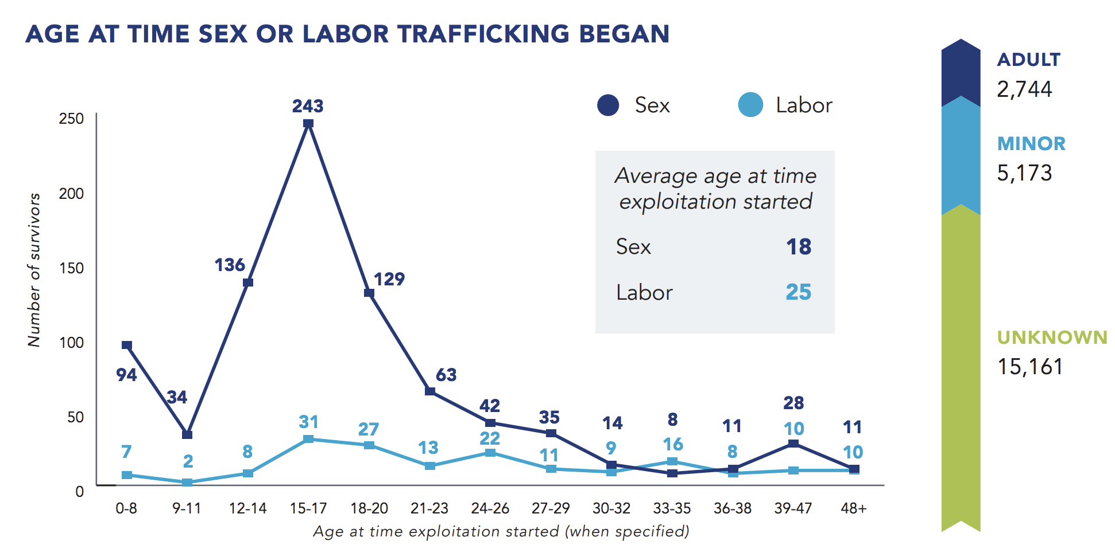
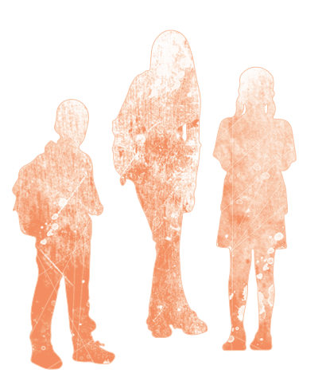
In 2016, Polaris reported that 74% of trafficked individuals in the US were trafficked between childhood and age 23.
Notes:
Age is a big vulnerability...
In 2017, an estimated 1 out of 7 endangered runaways reported to the National Center for Missing and Exploited Children were likely child sex trafficking victims.
One in three adolescents living on the street is recruited for sexual exploitation within 48 hours of becoming homeless
https://humantraffickinghotline.org/sites/default/files/Polaris_National_Hotline_2018_Statistics_Fact_Sheet.pdf

Slide 16
According to federal law, any minor introduced into the commercial sex industry has been trafficked regardless if force, fraud, or coercion are present.
No exceptions.
Notes:
This means any person under the age of 18 who is involved in commercial sex like prostitution, stripping, pornography, escort services, and other sex services, are automatically victims of human trafficking, deserving of protections under the law, not criminalization.
It is important to know that anyone who has sex with a minor who is trying to meet their needs (survival sex) is committing the crime of sex trafficking. The minor is a victim of a crime. The criminality lies in the buyer.
Some definitions:
The term “commercial sex act” is the giving or receiving of anything of value (money, drugs, shelter, food, clothes, etc.) to any person in exchange for a sex act. Force, fraud or coercion need not be present for a minor to be considered a victim of human trafficking.
Please note that sex trafficking is not prostitution or sex work. In sex trafficking, or commercial sexual exploitation, there are elements of force, fraud, or coercion present and the person cannot leave their situation safely or freely. This is true for both adults and minors. People being sex trafficked are prostituted people, not prostitutes or sex workers.

Slide 17
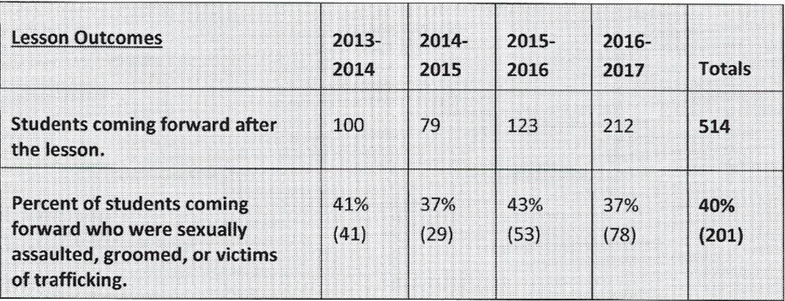
The role of Schools- here in VA
Prince William County Public Schools: 1st school district in the state to put prevention education on human trafficking into curriculum
Notes:
As I said in the last slide, Age is a big vulnerability and to hammer home this point I think this data shows that this is occurring to our children in our own communities.
Prince William County Public Schools became the 1st school district to put prevention education into curriculum.
They piloted a 90-minute education curriculum in the 9th grade. The outcomes of this can be seen in the table.
This district is also the only school district in the state that provides their own wrap around services for identified students.

Slide 18
Notes:
NOTE: We have been talking about sex trafficking predominately so far but other types of trafficking exist. Sex trafficking cases typically get more attention from law enforcement, federal prosecutors, and the media, making it seem like it is the only form of human trafficking in the U.S. but labor trafficking is just as prevalent, if not more so, than sex trafficking.

Slide 19
“In general, there is so much more attention paid to the sex trafficking of minors. That’s where the media coverage is and that’s where law enforcement dollars are focused … Labor trafficking is mostly an afterthought, if a thought at all.”
Amy Fleischauer, the Director of Survivor Support Services at the International Institute of Buffalo. Quote from FRONTLINE:
Why Labor Trafficking is so hard to Track. April 2018.
Notes:
Please remember that people who are labor trafficked could number in the hundreds of thousands. Experts agree that there are probably more people being labor trafficked in our country than being sex trafficked.
Many of the people being labor trafficked are immigrants, both with legal AND without legal status, and are trapped in situations where traffickers have taken away their passports, threatened to call federal immigration enforcement or have forced them into debt. - Bradley Myles, Executive Director, Polaris Project.
https://www.pbs.org/wgbh/frontline/article/why-labor-trafficking-is-so-hard-to-track/
Please remember that labor trafficking victims could number in the hundreds of thousands. Experts agree that there are probably more victims of labor trafficking in our country than victims of sex trafficking.
Many of these victims are immigrants, both with legal AND without legal status, and are trapped in situations where traffickers have taken away their passports, threatened to call federal immigration enforcement or have forced them into debt. - Bradley Myles, Executive Director, Polaris Project.

Slide 20
Four fields or sectors where workers are likely to encounter a survivor without their trafficker:
Law enforcement
School staff
Medical Provider
Clergy
Crane, Patricia A. and Moreno, Melissa (2011) “human trafficking: What is the role of the health care provider?” Journal of Applied research on Children: Informing Policy for Children at Risk: Vol 2: iss. 1, Article 7.
Notes:
Now we know the definition of HT, the scope of the problem, who is at risk of being trafficked, but what is our role as a physician? We are among the top 4 fields where we are likely to encounter a survivor without their trafficker. As are law enforcement, school staff, and clergy. This makes faith communities uniquely positioned to help patients access the safety net.
Crane, Patricia A. and Moreno, Melissa (2011) “human trafficking: What is the role of the health care provider?” Journal of Applied research on Children: Informing Policy for Children at Risk: Vol 2: iss. 1, Article 7.

Slide 21
Human Trafficking is a hidden crime.
Unless you’re looking for it,
you’re not going to find it.
Notes:
There are a few important things to understand if you want to help combat human trafficking
1. Human Trafficking is a hidden crime because
if you don’t know the red flags, you’re not going to see it.
Human Trafficking can look like
DV, IPV, SA, CA, it can hide behind status offenses like running away, truancy, skipping school, loitering, violating curfew. It can look like trespassing, disorderly conduct, presenting false ID, possession of a controlled substance. It can hide behind homelessness, lost and found reports, community complaints, traffic stops. It can look like a labor dispute, kidnapping, false imprisonment, theft, robbery, assault and battery, drug addiction. It can look like prostitution and pornography.
Hollywood tends to depict human traffickers as these shadowy figures who go about randomly abducting people. Or they depict trafficking victims as young women who have been kidnapped, drugged and bound then transported across borders. This is the Hollywood version, In reality, this is usually not the case. Human Trafficking is Not always snatch and grab; and for the most part, not about stranger danger. Most likely the trafficker is someone the victim is very close to OR someone they just met. Don’t look for people like in the movie TAKEN, because you are definitely not going to see the red flags there.

Slide 22
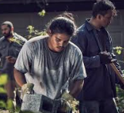
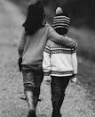
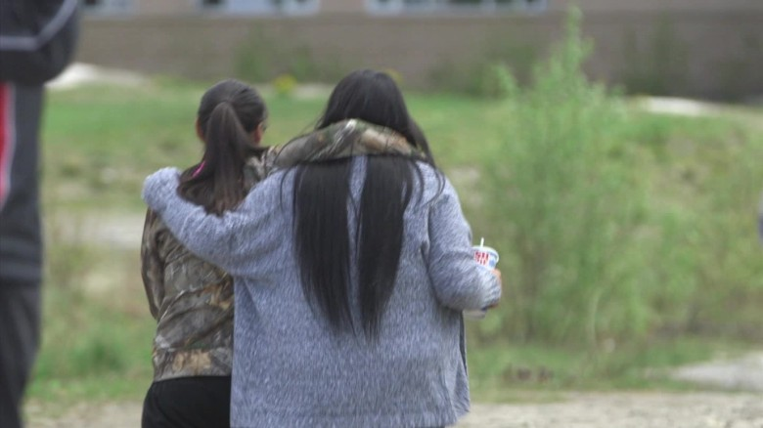
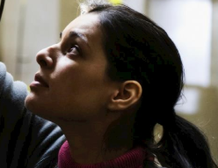
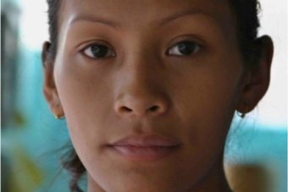
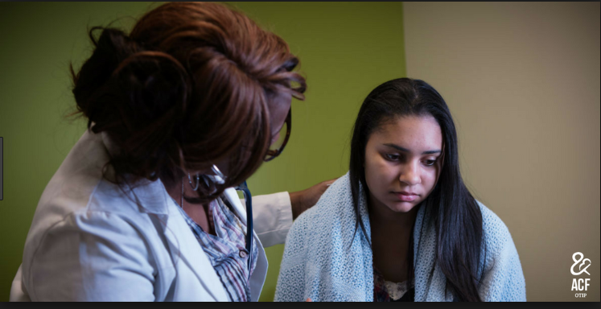
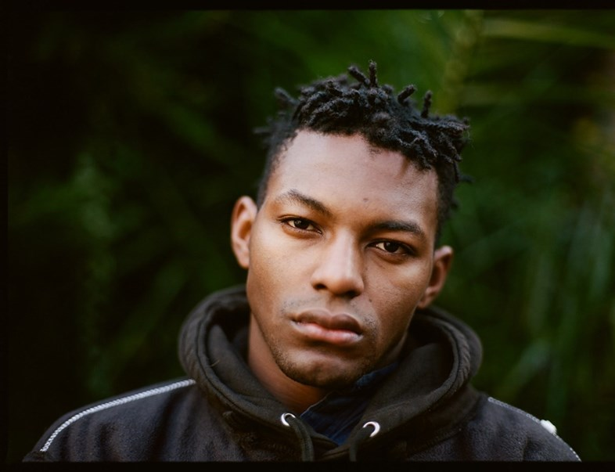
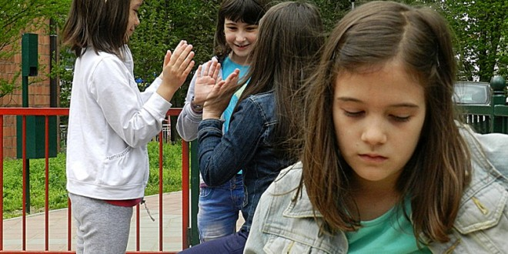
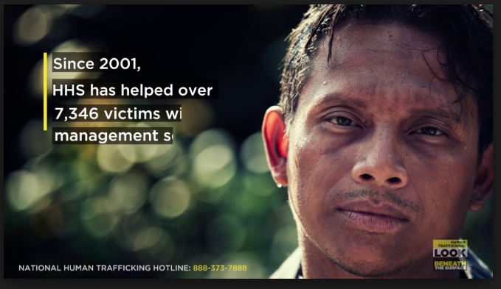
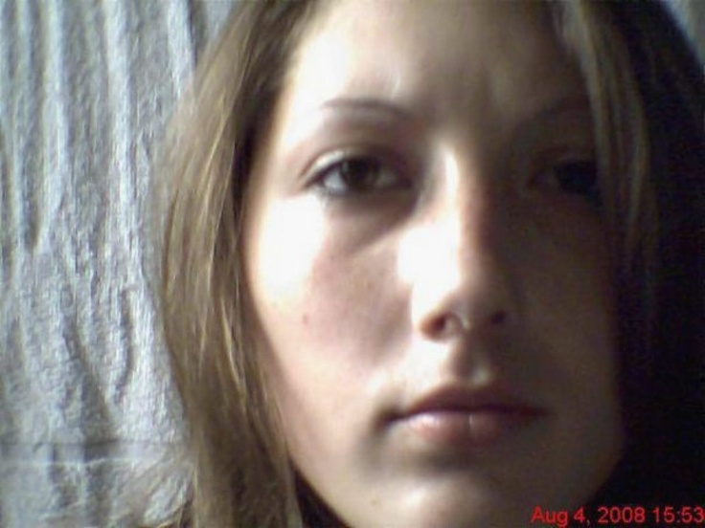
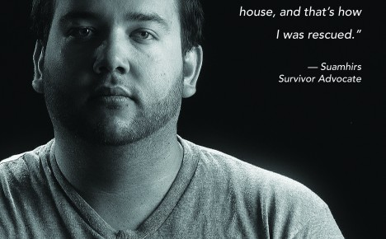
People may not know
they are in a trafficking
situation.
Notes:
Number 2: Human trafficking is a hidden crime because patients may not know they are a victim of a crime.
Most likely, they have never even heard of the word human trafficking..
Other reasons victims may not know they are a victim of a crime --
maybe they have a disability
they are just too young to comprehend what is happening
they think the trafficker loves them and is their BF / GF
they believe it is an acceptable lifestyle choice, especially in family-controlled human trafficking
They believe it is a better lifestyle than the lifestyle that they had
they may feel they deserve the treatment they are receiving
Experts say they have met survivors who said they had no idea they were victims of sex trafficking until they read that article in the paper or saw a program on television or in the news.
I was told about a college student who learned of her exploitation at an awareness event at UVA and realized she had been trafficked throughout her years in high school …. didn’t even know she was a victim of a crime. She thought it was just her fault.

Slide 23
Why Don’t They Leave? Or “just run away?”
The Trafficked
Feels shame
Distrusts law enforcement and people in authority
Lacks resources; no ID or personal documents
Fears for their life
Fears for their family
Believes they have lost value and worth
misidentified
The Trafficker
Emotional manipulation
Preys on need for love & affection
Provides security, basic needs and lodgings
Brainwashing
Threatens and invokes fear
Ongoing, unpredictable abuse and violence
Notes:
Number 3: understanding why survivors cannot leave easily or safely
ACOG: Traffickers may make physical threats against the trafficked individual and their family, may pose as a loved one to gain initial trust, and may take away passports and other essential documentation from victims. As in other cases of abuse, it becomes very difficult to come forward and to escape trafficking once involved in this abusive relationship. Victims often experience self-blame and shame that prevent them from seeking help. Traffickers manipulate and reinforce these feelings. Isolation and internalized propaganda often make victims distrust law enforcement and other authorities.
To sum up this list into 5 major reasons:
They don’t see themselves as victims
They do not have the developmental capacity to understand what is happening; too young; or they have a disability;
They feel they really love their trafficker (BF) and they feel their trafficker really loves them
Many young victims feel that the love of the trafficker is the only love that they have known. They feel that their trafficker is the only person who can be trusted.
3) There is fear of leaving because there is no safe way to leave
(can be an actual fear or a perceived fear; a physical fear or psychological fear)
(victims are often kept compliant with psychological tactics, as well as language barriers, drugs, disorientation, threats and violence)
Survivor: “My trafficker used to say that if I left him or went back to another pimp, he would send a video tape of me to my dad. He would videotape me in a hotel room without me knowing with a john, and if I didn’t do what he wanted, he would put it on Facebook or share it with everyone I loved.” - Christina
4) Apathy / helplessness: the brutality has convinced them that they cannot control their destiny because former attempts to escape proved futile; Over time, the exploitation may come to seem “like normal” in a victim’s mind, which reduces the chance that he /she will self-identify
5) Lack of self-worth, shame, and guilt keep victims from looking for a way to be helped. They may not feel worthy of being helped. If they were abused or neglected as children, the entry into trafficking may seem a likely consequence to them. If they were misidentified as a CRIMINAL or CO-CONSPIRATOR with their trafficker, they will not leave.
People who have suffered interpersonal violence in trafficking for various forms of exploitation may display passivity and an inability to control their own destiny, as well as an underlying inability to form normal emotional attachments. This can be the result of their habituation to systems of subjugation and brutality which have repeatedly shown them that self-preserving responses and reactions are futile. It isa reason why they may feel unable to try and initiate escape even after the physical constraints of their captivity have been relaxed, remaining psychologically rather than physically controlled by their traffickers.

Slide 24
Action Steps for Faith-based Organizations
Educate
learn and share the facts about labor and sex trafficking
Welcome
Create a welcoming environment for trafficking survivors
Partner
Build partnerships with anti-trafficking organizations
Report
Call the National Human Trafficking Resource center
Notes:
The national human trafficking resource center has developed 9 action steps for faith-based organizations. I have included the pdf in the resources at the end of this PowerPoint
Educate: learn and share the facts about labor and sex trafficking
This is an excellent start by listening in today!
Try to find opportunities to educate your faith community
Ideas: sharing educational resources, discussing documentaries about human trafficking etc., Promote the NHTRC by posting hotline number and include in community resource lists
Welcome: Create a welcoming environment for trafficking survivors
Cultivate a welcoming environment for survivors, whether or not they has disclosed.
Be aware that survivors have been coerced in the past and it is important to avoid judgement about the survivors experiences if they do disclose to you. Be a listening ear and someone to lean on.
Partner: Build partnerships with anti-trafficking organizations
Last year we hired a human trafficking response coordinator in virginia “Angella Alvernaz” and she is compiling a list of community resources in the state of Virginia
Here in Richmond we have “ImpactVA” a non-profit that my group Students Fighting Human Trafficking works closely with to organize the human trafficking health symposium, we have safe houses such as Safe Harbor and Latishas House for survivors to stay and get back on their feet, we have Richmond justice initiative a non-profit that educates communities on how they can take actions,
Report: Call the National Human Trafficking Resource center
If you believe you have information about a potential trafficking situation call the national human trafficking resource center 1-888-3737-888
All reports are confidential and you may remain anonymous

Slide 25
Action Steps for Faith-based Organizations
Prevent
Engage in prevention work for human trafficking
Advocate
Advocate for stronger protections for survivors
Volunteer
Volunteer your time and skills to local organization’s
Donate
support anti-trafficking organizations financially
Purchase
shop fair trade and support ethical business practices
Notes:
Prevent: Engage in prevention work for human trafficking
Well equipped to support prevention of trafficking by addressing root causes of trafficking (poverty, barriers to employment)
Advocate: advocate for stronger protections for survivors
Advocate for strengthened legislation. Demonstrate trafficking is a priority by contacting your legislators
Volunteer: volunteer your time and skills to local organization’s
Encourage members of your faith community to volunteer time and talents for anti-trafficking initiatives
Many are in need of tutors, mentors, teachers, clinicians, attorneys, drivers and more
Donate: support anti-trafficking organizations financially
Local shelters need supplies like toiletries, books, etc.
Purchase: shop fair trade and support ethical business practices
Shop with businesses who are known to have products made without slavery

Slide 26
Notes:
http://revenue.louisiana.gov/NewsAndPublications/NationalHumanTraffickingResourceCenter
The number of cases being reported every year is increasing.
One way you can help victims is to call when you are suspicious.
If you SEE SOMETHING SAY SOMETHING. Even if you are not sure!
Law enforcement cannot fight this crime alone. It is too pervasive and too covert.
Citizen complaint about this predatory crime will push our leaders into action to advocate for the best policies and best care for victims and survivors of human trafficking.
Legislative response is driven by citizen complaint.
Put this number in your phone.
Commit it to memory!

Slide 27
Resources for Faith Communities
Community Resources
VCU Childrens Hospital Community resource pdf
https://vcu.cloud-cme.com/assets/VCU/Presentations/5400/ChildSexTraffickingVirginiaResources.pdf
Education
Faith based NHTRC handout
Https://humantraffickinghotline.org/sites/default/files/Faith-Based%20Partnerships%20to%20Combat%20Human%20Trafficking.pdf
Human trafficking Hotline statistics
https://humantraffickinghotline.org/states
Polaris
https://polarisproject.org/
Hotline Virginia Statistics
https://humantraffickinghotline.org/state/virginia

Slide 28
Questions?

