Slide 1


Drug Overview
La’Risa P. McLennon, MPH
Community Outreach Specialist
Demand Reduction
Washington Division

Slide 2
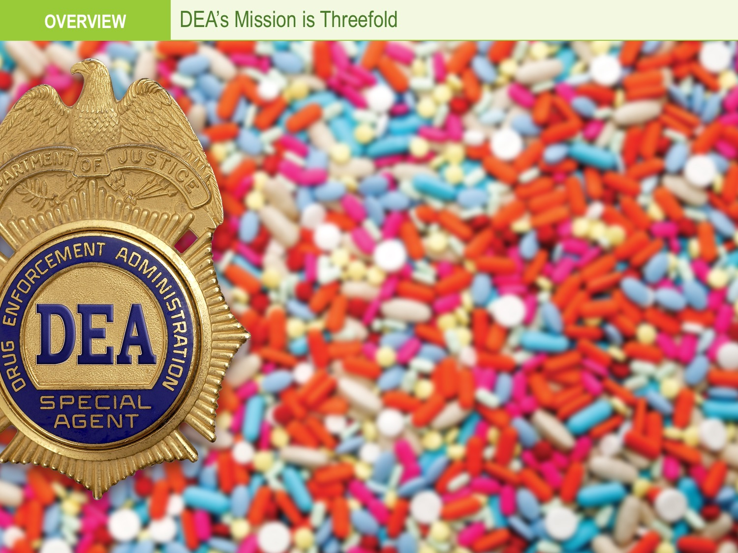

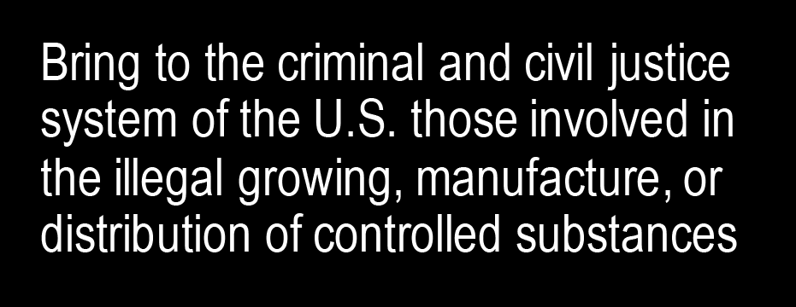

The DEA Mission
Notes:
Who we are
Established in 1973 by President Nixon
Only single mission federal drug law enforcement agency
Headquarters located in Arlington, Virginia
Overview: DEA’s Mission
DEA’s mission is threefold:
• [Enforcement]
• [Regulatory]
• [Prevention]

Slide 3
DEA: Who We Are
Forensic
Chemists
347
Intelligence Research Specialists
969
Professional and Administrative Staff
3,476
Diversion Investigators
704
Special Agents
5,053
$3.4 billion for Fiscal Year 2018
Notes:
Budget: $3.4 billion for Fiscal Year 2018
Employees: Approximately 10,500 staff members, including more than:
5,000 Special Agents
3,400 Professional and Administrative Staff
900 Intelligence Research Specialists
700 Diversion Investigators
300 Forensic Chemists

Slide 4
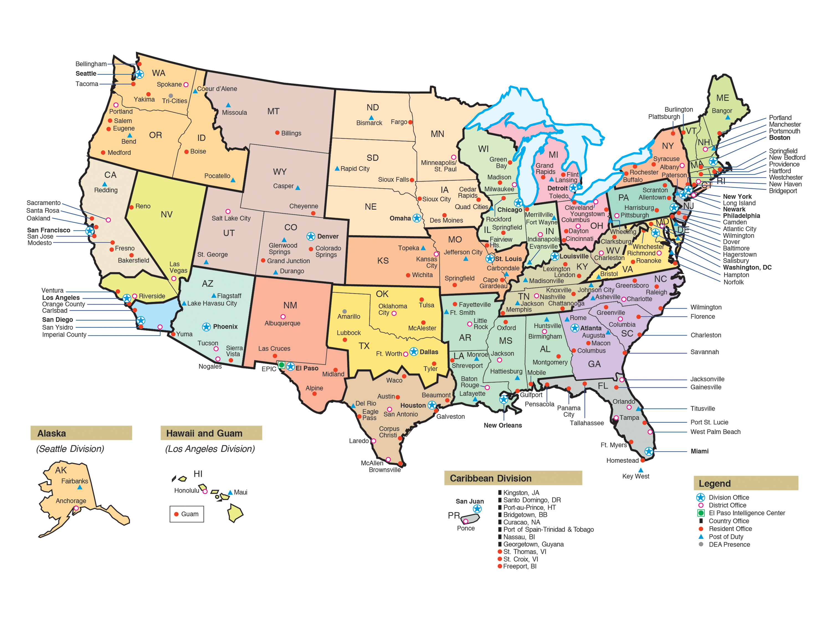
DEA: Who We Are
www.dea.gov
Notes:
Domestic Offices: 222 offices
Divisions: 23

Slide 5
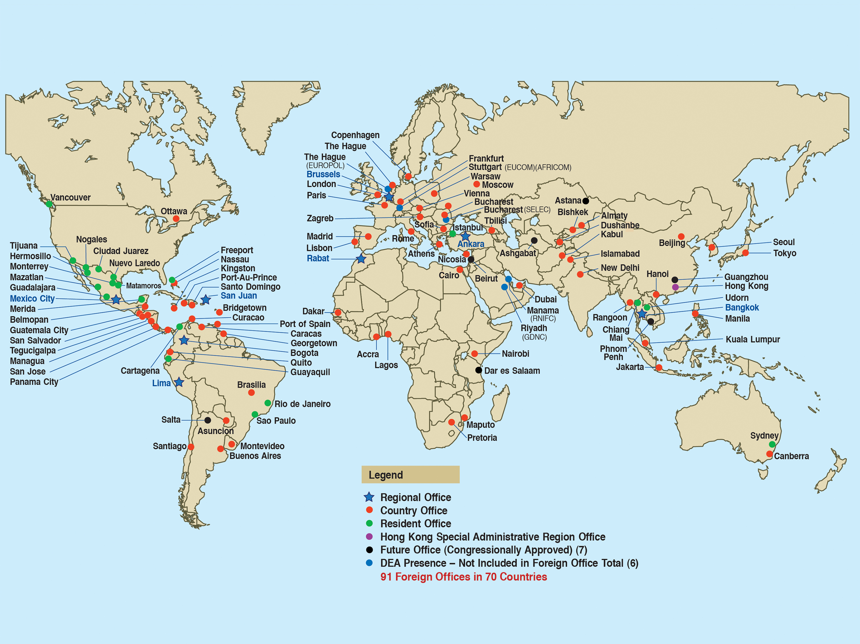
DEA: Who We Are
Notes:
International Presence: 91 offices
Countries: 70 countries

Slide 6
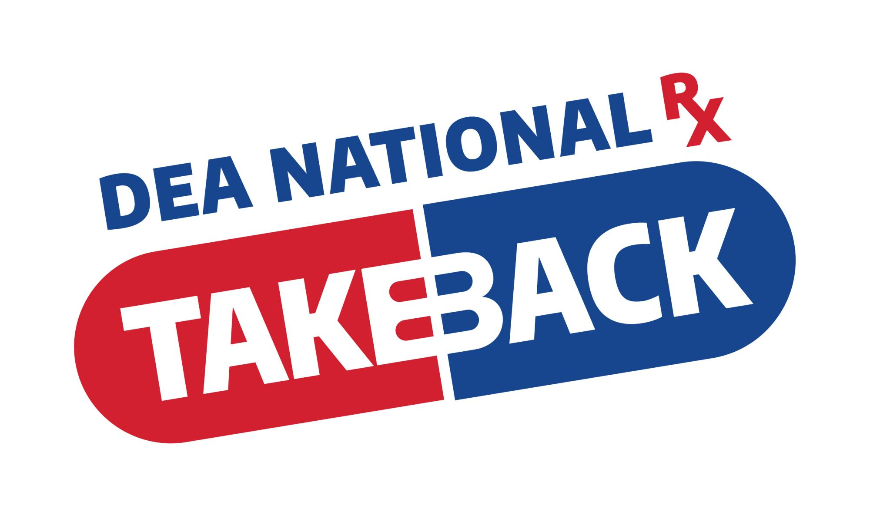
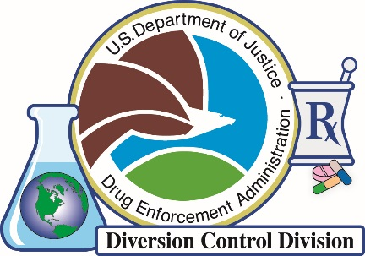
19
17th National Take Back Day
April 25, 2020
DRUG ENFORCEMENT ADMINISTRATION
DIVERSION CONTROL DIVISION
www.TakeBackDay.DEA.gov
Notes:
Some of you may have heard of the DEA through its nationwide efforts.
Essentially cutting off or slowing down the flow of Rx drugs.
TakeBackDay.DEA.Gov

Slide 7
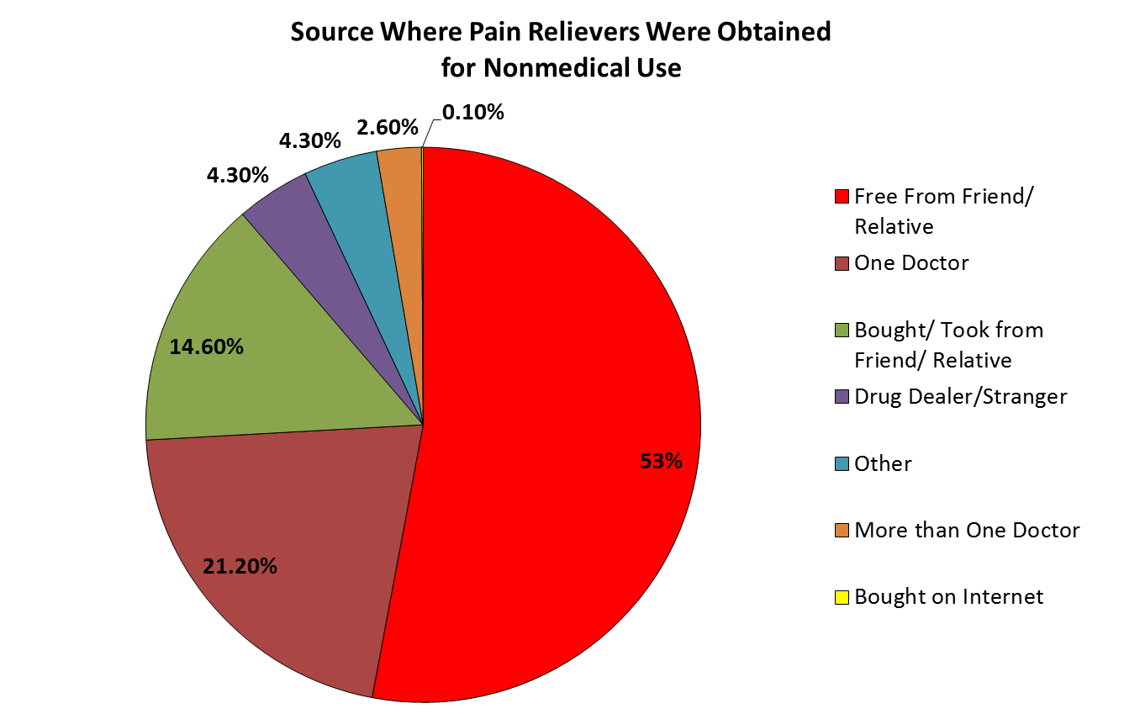
DEA
Primary Diversion of CPDs
Source: NSDUH
Notes:
Controlled Prescription Drugs
Almost two-thirds of teens (73%) indicate that it’s easy to get prescription drugs from their parent’s medicine cabinet.
CPDs are diverted in many ways. According to the NSDUH, the primary method of acquiring CPDs is from a relative or friend for free.
The second method is a prescription from an individual doctor.
Opioids continue to be the major controlled substances distributed.
Over the past nine years, hydrocodone and oxycodone products were the two major opioid products sold.
In addition, two stimulants, amphetamines and Ritalin®, have also maintained an established trend.

Slide 8
906 Tons
932 Tons
910 Tons
812 Tons
Notes:
Amounts collected from 2016 to 2019
Grand total collected over the last 18 events: 6,349.7 Tons

Slide 9
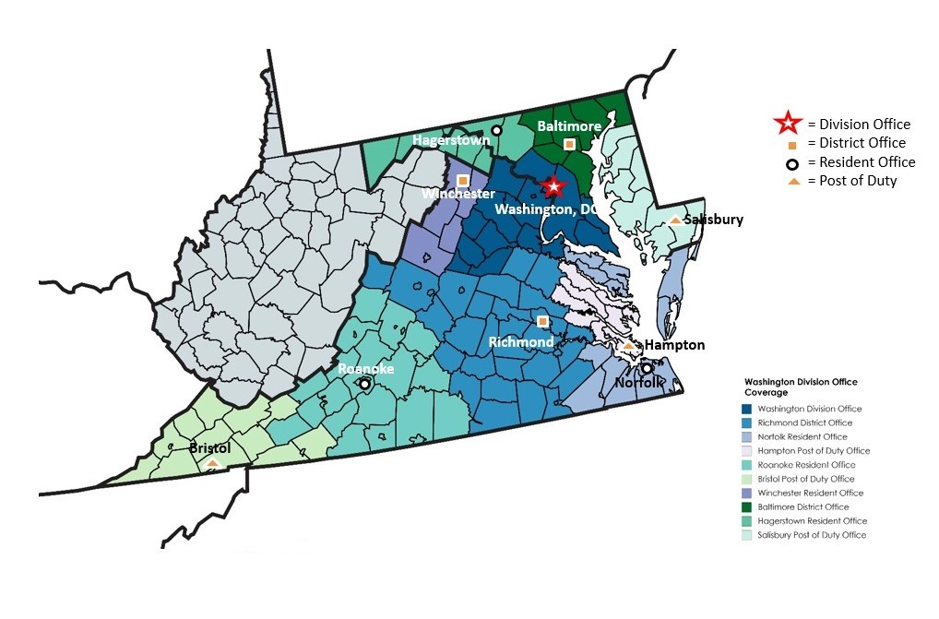
Area of Responsibility
DEA
Square Miles: 56,014
Population: 15,452,400
Notes:
The Washington Field Division’s area of responsibility consists of DC, VA, MD and the West VA counties of Berkley, Jefferson, and Morgan.
7 offices and 3 duty posts
an end-user market for illicit drugs, but sometimes supplies other parts of Division
opioid overdose deaths tripled between 2014 and 2017
more than 70 percent of deaths involved fentanyl or its analogues
more than 80 percent of victims were black
Division Summary:
The drug trafficking situation reflects the diversity of these areas.
Cocaine availability remains high.
Crystal meth abuse, traditionally limited to Western VA is spreading to central VA and the Tidewater area
Controlled prescription drugs are available throughout the AOR and pose a particularly significant threat in Baltimore and Southwestern VA.
Synthetic cannabinoid overdoses in DC were higher on average with spikes in 2018.
Many areas within the division are also experiencing a growing trend of street-level synthetic cannabinoids sales.
PCP availability and abuse is significant but stable in DC metropolitan area.

Slide 10




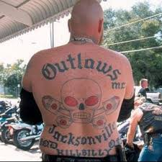
Drug Trafficking Organizations (DTO)
DEA
Mexican, Central American, and Dominican poly-drug DTOs supply kilogram quantities of cocaine, fentanyl, heroin, and methamphetamine.
Violent trafficking groups, some gang-affiliated, play a significant role in the distribution and retail sales of all major street drugs in the Washington Division AOR.
These organizations terrorize local communities through violence and intimidation while distributing drugs.
MS13
Black Guerilla Family
Outlaw Motorcycle Gang
Notes:
1. Mexican, Central American, and Dominican poly-drug DTOs supply kilogram quantities of cocaine, fentanyl, heroin, and methamphetamine.
Operation bases out of operation in Atlanta, Houston, Los Angeles, and New York; North Carolina; and the U.S. Southwest Border (SWB).
2. Violent trafficking groups, some gang-affiliated, play a significant role in the distribution and retail sales of all major street drugs in the Washington Division AOR.
Street "crews" are the most common.
Maryland: Black Guerilla Family, national Crips- and Bloods-affiliated gangs, and MS-13
Virginia: Bloods- and Crips-affiliated crews, MS-13, and Outlaw Motorcycle Gangs
3. These organizations terrorize local communities through violence and intimidation while distributing drugs.
e.g., MS-13 members are increasingly involved in wholesale drug distribution and employ violence and intimidation to promote their business, particularly in Montgomery and Prince George's Counties in southern Maryland.

Slide 11
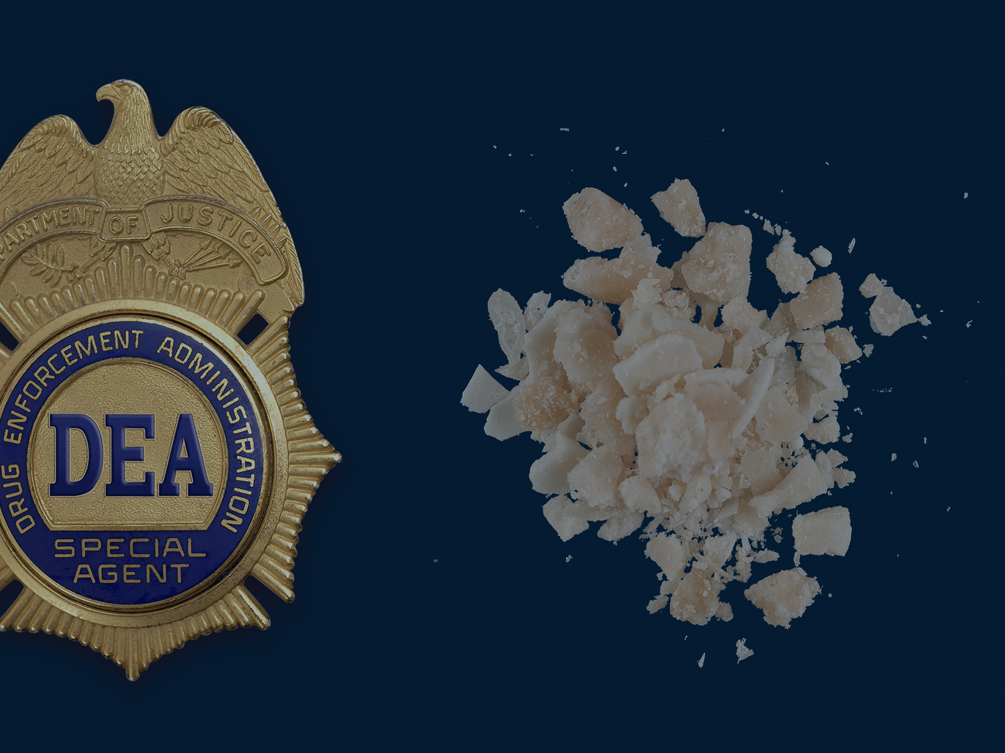
DEA’s Mission
OVERVIEW
Current Drug Trends
DEA:

Slide 12
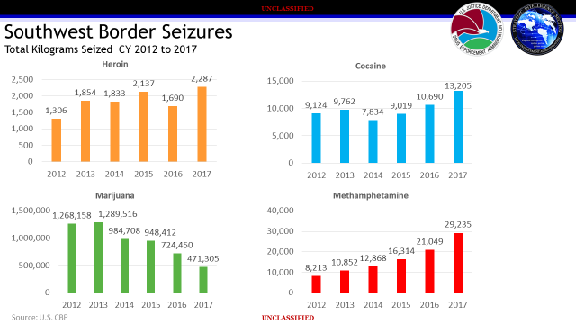
Notes:
Due to its geographical location, the Division AOR serves as a transit point between drug source cities, while rural and remote areas offer favorable sites for outdoor marijuana cultivation and clandestine meth laboratories.
The transportation infrastructure includes large commercial-industrial seaports (Baltimore, MD and Norfolk, VA); major international airports (Baltimore, Dulles, Reagan) and several regional airports; and multiple interstate highway networks, especially I-95 that serves as a gateway to southeastern and northeastern drug hubs, such as Atlanta, Miami, and New York.
Most of the drugs in the U.S. market are trafficked through legitimate ports of entry (POEs), while marijuana is primarily trafficked between ports of entry along the SWB.
Increased seizure rates over the past 5 years:
Heroin 75%
Meth 256%
Cocaine 45%
Marijuana 34%

Slide 13
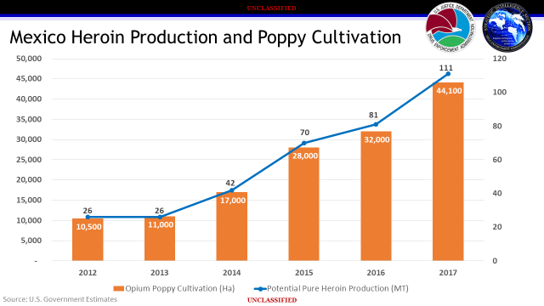
Notes:
In 2017, heroin from Mexico accounted for 91 percent (by weight) of the heroin analyzed through the DEA’s Heroin Signature Program.
Heroin from South America accounts for most of the remainder, with less than one percent, by weight, produced in Southwest Asia.
Southwest Asia, while a dominant producer, represents a very small portion of the U.S. heroin market. Southeast Asian heroin is rarely encountered in U.S. markets.
In 2017, there were significant increases in opium poppy cultivation and heroin production in Mexico. Heroin production increased 37% between 2016 and 2017 as poppy cultivation increased 38% during the same timeframe. Continued increases in poppy cultivation and heroin production in Mexico help ensure a reliable supply of heroin is available for Mexican TCOs to traffic into the United States.
Note: Heroin is available in the United States in various forms; fine powder, tar, granular or chunky, gummy/pasty, or a rock-like black substance that shatters like glass. Powder heroin sold in the United States varies in color and can be smoked, snorted or injected. Varying diluents may contribute to its color and appearance. Heroin is also sold in pill form and is typically marketed as pharmaceutical pills that are counterfeit.

Slide 14
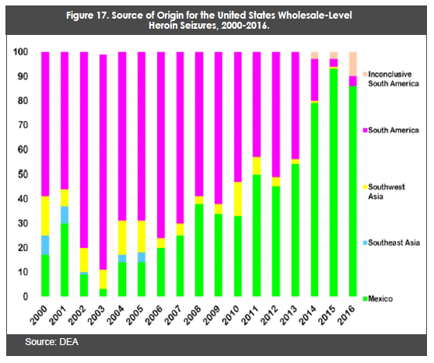
U.S. Wholesale- Level Heroin Seizures 2000-2016
Notes:
Mexican Heroin is taking over the market.

Slide 15
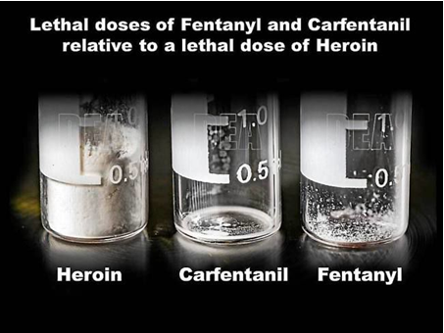
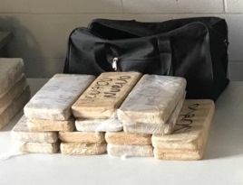
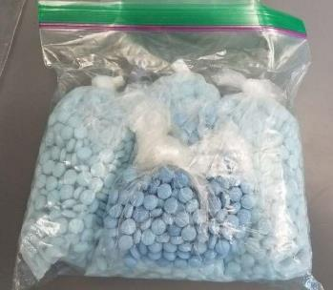
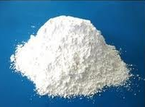
U.S. Drug Situation
DEA
We continue to see the traditional drugs:
  Marijuana
  Cocaine
  Methamphetamine
  Heroin
Current threats: Opioid threat increased
  Controlled Prescription Drugs (CPDs)
  Heroin
  Fentanyl / Mixtures
Psychoactive Substances (NPS)
  Synthetic Cannabinoids (K2, Spice)
  Synthetic Cathinones (Bath Salts)
  Flakka
Notes:
The drug landscape in the United States continues to evolve.
Transnational criminal organizations and domestic gangs are more intertwined with the end goal to fund their organizations.
Drug sales continue to account for billions of dollars in illicit proceeds annually with organizations increasingly laundering money through virtual currencies like Bitcoin.
The opioid threat, consisting of controlled prescription drugs, fentanyl, and heroin, remains at epidemic levels and continues rising.
The methamphetamine threat remains prevalent, but the production source shifted from domestic to foreign.
The cocaine threat is rebounding, approaching levels not seen in a decade, and surpassing previously established benchmarks.
The marijuana threat continues to evolve due in part to the discussions surrounding legalization efforts, while domestic production is increasing.
The New Psychoactive Substances threat is challenging for law enforcement and policy makers, with synthetic cannabinoids and synthetic cathinones being marketed to a larger user base.

Slide 16
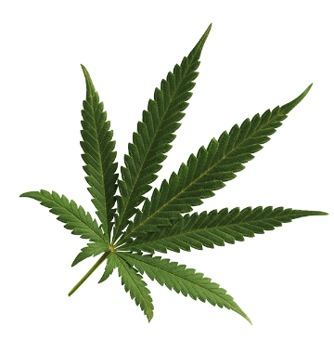
Marijuana
DEA
Mexican DTOs are responsible for much of the marijuana importation
and distribution.
High-potency marijuana, concentrates, and “edibles” are trafficked with more frequency, smuggled from states with legalized recreational marijuana programs, such as California, Colorado, and Washington.
Limited amounts of marijuana are cultivated in indoor and outdoor grows in rural and semi-rural parts of the Division AOR.
Recent state legalization efforts include:
  The Maryland Cannabis Commission approved a proposal in December 2018 to regulate cannabis advertising and marketing.
  The Maryland General Assembly’s House and Government Operations Committee voted against adding Opioid Use Disorder as a qualifying condition for treatment with medical cannabis.
  Virginia lawmakers expanded a 2017 medical marijuana law to allow doctors to recommend CBD or THC-A cannabis oil for any condition, and not just restricted to patients with “intractable epilepsy.”
Notes:
Mexico is the primary source for commercial-grade marijuana imported to the Mid-Atlantic Region via southwestern states (i.e., Arizona, California, and Texas).
Mexican DTOs are responsible for much of the marijuana importation and distribution.
High-potency marijuana, concentrates, and “edibles” are trafficked with more frequency, smuggled from states with legalized recreational marijuana programs, such as California, Colorado, and Washington.
Local marijuana traffickers frequently travel to the southwestern United States to pick up multi-pound quantities or have it sent by parcel services.
Limited amounts of marijuana are cultivated in indoor and outdoor grows in rural and semi-rural parts of the Division AOR.
Recent state legalization efforts include:
The Maryland Cannabis Commission approved a proposal in December 2018 to regulate cannabis advertising and marketing.
The Maryland General Assembly’s House and Government Operations Committee voted against adding Opioid Use Disorder as a qualifying condition for treatment with medical cannabis.
Virginia lawmakers expanded a 2017 medical marijuana law to allow doctors to recommend CBD or THC-A cannabis oil for any condition, and not just restricted to patients with “intractable epilepsy.”

Slide 17
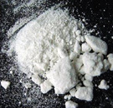
Cocaine
DEA
Cocaine is readily available, and prices remain stable throughout most of the Division.
New York/New Jersey-based traffickers supply significant quantities of cocaine.
Mexican DTOs are increasingly involved in the wholesale trafficking of cocaine directly to the Baltimore, Norfolk, Richmond, Roanoke, and Washington, DC areas.
Central American cocaine traffickers maintain a presence in the AOR. Multi-kilogram quantities of cocaine have been transported from Central America by mail and courier into the Baltimore, Richmond, and Washington, DC areas.
Local African-American DTOs, often affiliated with violent gangs, still control a large proportion of retail-level sales throughout the AOR.
Most crack cocaine is produced locally for quick sale or distribution after production by street gangs or independent traffickers.
Notes:
Cocaine is readily available and prices remain stable throughout most of the Division.
Cocaine-related overdose deaths continue to increase each year; many are the result of ingesting drug mixtures.
Cocaine/fentanyl mixtures have been confirmed in the AOR.
New York/New Jersey-based traffickers supply significant quantities of cocaine.
Mexican DTOs are increasingly involved in the wholesale trafficking of cocaine directly to the Baltimore, Norfolk, Richmond, Roanoke, and Washington, DC areas.
Most Mexican traffickers operating in Virginia are based in North Carolina and Atlanta.
Many wholesale-level traffickers in Arizona, California, and Texas supply Baltimore and Washington, DC.
Mexican traffickers also engage in retail-level distribution in western Virginia and Baltimore.
Central American cocaine traffickers maintain a presence in the AOR. Multi-kilogram quantities of cocaine have been transported from Central America by mail and courier into the Baltimore, Richmond, and Washington, DC areas.
Local African-American DTOs, often affiliated with violent gangs, still control a large proportion of retail-level sales throughout the AOR.
Most crack cocaine is produced locally for quick sale or distribution after production by street gangs or independent traffickers.

Slide 18

Methamphetamine
DEA
Mexico-produced crystal methamphetamine and local clandestinely-produced methamphetamine are available in the AOR.
Since 2017, the trafficking and availability of Mexico-produced crystal methamphetamine continues to increase throughout Virginia and, to a lesser extent, in Washington, DC suburbs and Maryland.
Independent dealers are the primary distributors of methamphetamine. Some distributors also work with Mexican DTOs at the local level.
Crystal methamphetamine is smuggled into Washington, DC and Richmond by the gay community largely for personal use.
Powder methamphetamine is produced locally in clandestine “one pot” laboratories, typically discovered in southwestern Virginia.
  Lab seizures have decreased in recent years as the potency and availability of Mexico-produced crystal methamphetamine has risen and prices have dropped.
Notes:
Mexico-produced crystal methamphetamine and local clandestinely-produced methamphetamine are available in the AOR.
Since 2017, the trafficking and availability of Mexico-produced crystal methamphetamine continues to increase throughout Virginia and, to a lesser extent, in Washington, DC suburbs and Maryland.
Traffickers smuggle crystal methamphetamine into the AOR from Mexico through the SWB to Atlanta, North Carolina, or directly to Virginia.
Historically, methamphetamine trafficking in Maryland is limited; however, there is a base level of use for potential exploitation, given recent reports of ounce-quantity seizures en route from the Philadelphia area.
At the retail- and mid-levels, independent dealers are the primary distributors of methamphetamine, although there is an increase in direct relationships with Mexican wholesale traffickers. Some distributors also work with Mexican DTOs at the local level.
Crystal methamphetamine is smuggled into Washington, DC and Richmond by the gay community largely for personal use. Methamphetamine is usually obtained from West Coast suppliers via parcel delivery service.
Powder methamphetamine is produced locally in clandestine “one pot” laboratories, typically discovered in southwestern Virginia.
Lab seizures have decreased in recent years as the potency and availability of Mexico-produced crystal methamphetamine has risen and prices have dropped.

Slide 19

Controlled Prescription Drugs (CPDs)
DEA
The primary CPDs available on the illicit market are:
  Oxycodone
  Suboxone
  Percocet
  Alprazolam (Xanax)
  Adderall
The most common methods of diversion include:
  Unlawful medical prescribing/ dispensing
  Fraudulent prescriptions
  Traffickers obtaining CPDs across state lines for sale
The Division AOR also serves as a source of CPDs, as doctor-shoppers travel from other states to buy prescriptions from doctors throughout the Mid-Atlantic region.
Counterfeit prescription pills, most often containing fentanyl or heroin, have been noted across the AOR. In Virginia, counterfeit pills containing opiates have increased since 2016.
Notes:
CPD availability remains a serious threat and abuse is widespread throughout the AOR.
The primary CPDs available on the illicit market are:
Oxycodone
Suboxone
Percocet
Alprazolam (Xanax)
Adderall
The most common methods of diversion include:
Unlawful medical prescribing/ dispensing
Fraudulent prescriptions
Traffickers obtaining CPDs across state lines for sale
Unfortunately, our area makes it easier to doctor shop for CPDs.
Counterfeit prescription pills, most often containing fentanyl or heroin, have been noted across the AOR. In Virginia, counterfeit pills containing opiates have increased since 2016.

Slide 20
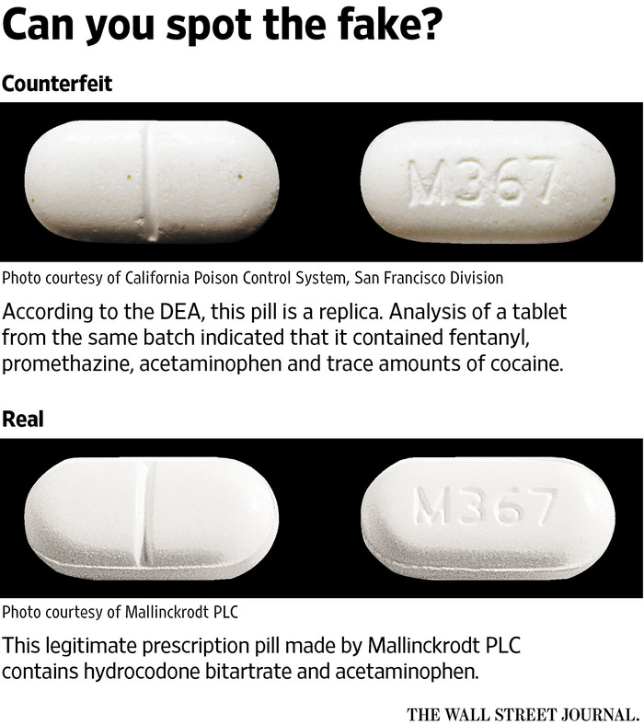
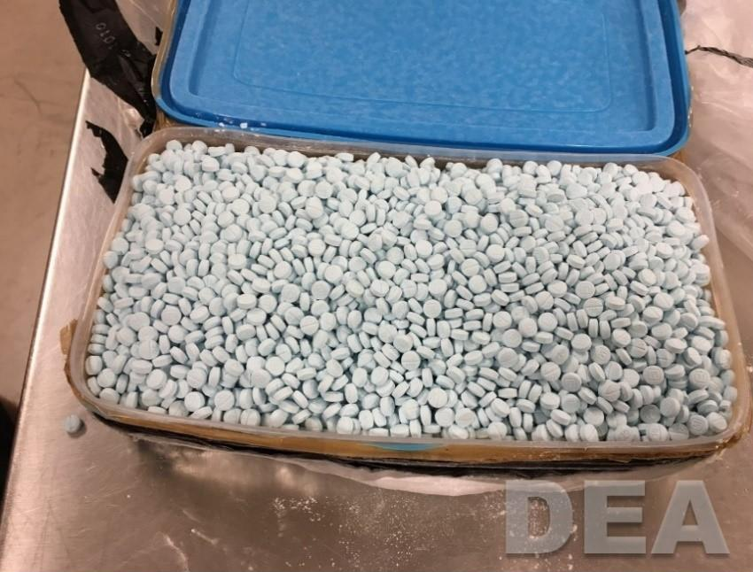
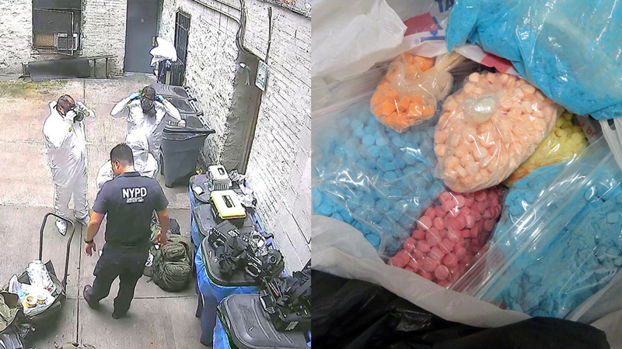
DEA
Washington DC
Bronx, NY
Notes:
Top: Pill containing Fentanyl, promethazine, acetaminophen and trace amounts of cocaine
Legislation helps law enforcement identify counterfeit pill makers and shut them down: The bipartisan STEER Act allows the U.S. Attorney general to create and maintain a registry of tableting or encapsulating machine owners, track machines imported or exported to of from the US and requires the Department of Justice to provide a report to Congress detailing the registration and accounting of any machines used in criminal activity and seized by the DEA.

Slide 21
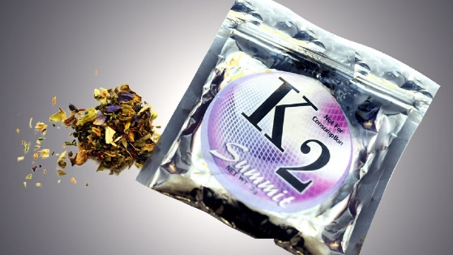
Synthetic Cannabinoids/ Cathinones
DEA
Synthetic cathinones are less frequently reported,
although lab reports indicate they are initially reported as something else.
Abuse of synthetic cathinones/cannabinoids is most prevalent in central and southern Virginia, western Maryland, and Washington, DC.
In July 2018 and September 2018, unusually high incidences of suspected synthetic cannabinoid overdoses occurred in Washington, DC, which may be a result of new synthetic cannabinoid analogues.
Cannabinoids/ cathinones are sold in retail stores or purchased through internet websites although there is a growing shift towards street sales, often as unpackaged cigars, cigarettes, or chemically treated loose plant material in clear bags.
Notes:
Synthetic cannabinoids are widely available throughout the Washington Division.
Synthetic cathinones are less frequently reported, although lab reports indicate they are initially reported as something else.
Abuse of synthetic cathinones/cannabinoids is most prevalent in central and southern Virginia, western Maryland, and Washington, DC.
In July 2018 and September 2018, unusually high incidences of suspected synthetic cannabinoid overdoses occurred in Washington, DC, which may be a result of new synthetic cannabinoid analogues.
Cannabinoids/ cathinones are sold in retail stores or purchased through internet websites although there is a growing shift towards street sales, often as unpackaged cigars, cigarettes, or chemically treated loose plant material in clear bags.

Slide 22
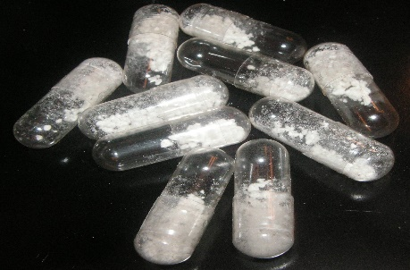
Phencyclidine (PCP)
DEA
Washington, DC and surrounding counties are the
principal markets for PCP in the Division. Relevant indicators suggest PCP use remains stable with an uptick in availability.
Long-established dealers in Washington, DC maintain connections to Southern California and mid-level suppliers in Philadelphia. There are reports of significant quantities being produced in Philadelphia.
PCP is primarily transported to the AOR by mail and commercial parcel services.
Several prominent seizures in northern Virginia in 2018 point to PCP expansion into the state.
  In August 2018, City of Alexandria authorities reported three PCP overdoses. It is suspected that the victims used PCP laced with an opioid.
Notes:
Washington, DC and surrounding counties are the principal markets for PCP in the Division. Relevant indicators suggest PCP use remains stable with an uptick in availability.
Washington, DC is one of the few U.S. cities with significant abuse of PCP
Long-established dealers in Washington, DC maintain connections to Southern California sources of supply or mid-level suppliers in Philadelphia. There are reports of significant quantities being produced in Philadelphia.
PCP is primarily transported to the AOR by mail and commercial parcel services.
Several prominent seizures in northern Virginia in 2018 point to PCP expansion into the state.
In August 2018, City of Alexandria authorities reported three PCP overdoses. It is suspected that the victims used PCP laced with an opioid.

Slide 23
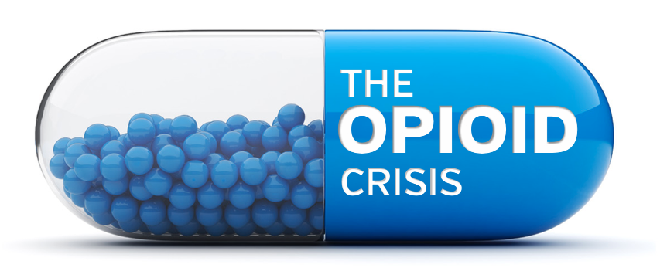
Opioid Crisis
DEA

Slide 24
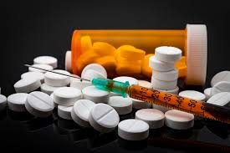
Illicit Opioids
DEA
Overdose deaths and emergencies continue to rise,
although at a slower rate.
New York City and Newark are the predominant heroin sources for the Division AOR
Baltimore has become a significant regional hub with traffickers increasingly supplied directly by sources in Houston, Los Angeles, and the southwestern United States.
Most of the heroin trafficked within the Division originates in Mexico and South America, mirroring national trends.
According to toxicology reports, the trafficking of synthetic opioids, such as fentanyl and fentanyl analogues, now outpaces heroin in most areas.
  Most wholesale traffickers receive heroin already mixed with a fentanyl, or just a fentanyl (in lieu of heroin) mixed with a cutting agent.
  Some local traffickers, however, purposely request and mix a fentanyl into their heroin at the cutting table or distribute a fentanyl+ cut mixture.
Notes:
Illicit opioids are readily available throughout the Washington Division AOR, from the region's large cities (which act as tertiary hubs) to the smallest towns and rural areas.
Overdose deaths and emergencies continue to rise, although at a slower rate.
New York City is the predominant heroin source city for the Division AOR, with wholesale-level traffickers in Philadelphia and Newark as secondary suppliers.
Baltimore is a significant regional hub with traffickers supplied directly by sources in Houston, Los Angeles, and the southwestern United States.
Most of the heroin trafficked within the Division originates in Mexico and South America, mirroring national trends.
Limited amounts of Southwest Asian heroin are available in the Baltimore and Washington, DC areas, usually shipped via mail or transported by couriers on direct international flights.
According to toxicology reports, the trafficking of synthetic opioids, such as fentanyl and fentanyl analogues, now outpaces heroin in most areas.
It is unlikely that local traffickers initially made this switch deliberately.
Most wholesale traffickers receive heroin already mixed with a fentanyl, or just a fentanyl (in lieu of heroin) mixed with a cutting agent.
Some local traffickers, however, purposely request and mix a fentanyl into their heroin at the cutting table or distribute a fentanyl+cut mixture.
Limited evidence and sporadic reporting suggest that some local dealers order synthetic opioids directly from China.

Slide 25
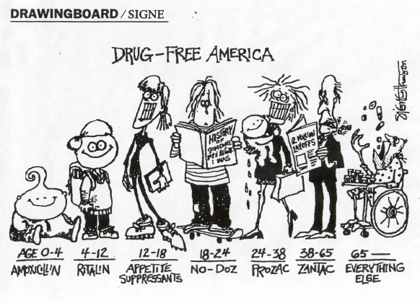
How Did We Get Here
DEA
Notes:
Let's take a moment to ask ourselves, “How did we get here?”
This cartoon is meant to illustrate the cycle of prescription drugs in different age brackets.
It starts from birth -- we learn and teach our kids that there is a pill for everything. The pills are safe—nonthreatening!!
Users prefer pharmaceuticals to illicit drugs because commercial manufacturing ensures reliable dosage and purity levels (made in America).

Slide 26
The Road to Heroin/Fentanyl
DEA
Hydrocodone
Euphoria
Tolerance
More Drug
Greater Cost
Change Drug
Greater Cost
Heroin
Fentanyl

Slide 27
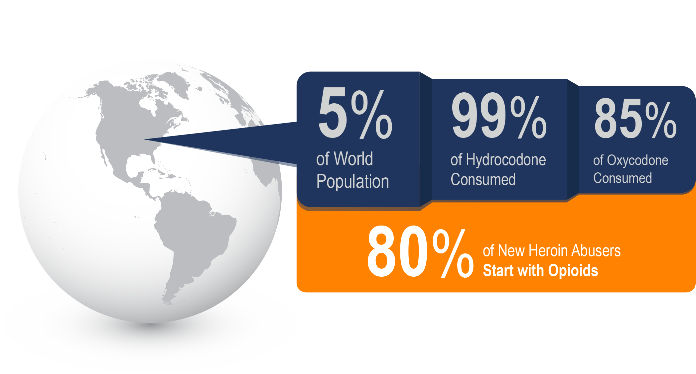
Targeting the Supply and Demand Problem
DEA
Notes:
We have a vicious appetite for prescription opioids.
The US makes up 5% of the world population but consumes 99% of the world's hydrocodone. Do you see a problem?
DEA Diversion is uniquely positioned. Over 1.6 Million registrants are regulated by the DEA- Every point on the chain is checked.
OxyContin costs approximately $25-80 per pill
Heroin is about $10 a bag

Slide 28


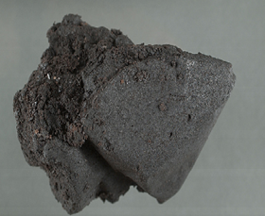
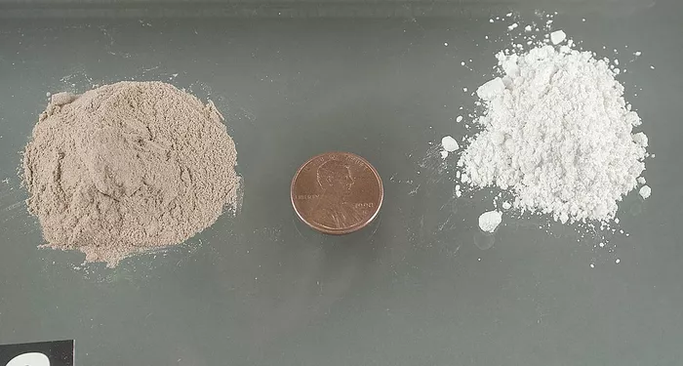
Heroin
DEA
White Heroin
Brown Heroin
Asian Heroin
Black Tar
Notes:
Heroin is an addictive drug processed as morphine in the body.
It is injected, snorted, or smoked.
Some street names for heroin are Smack, H, ska, junk or Mexican Horse.
Short term effects of heroin include a surge of euphoria and clouded thinking followed by alternately wakeful and drowsy states.
Heroin depresses breathing and overdose can be fatal.
Sharing heroin needles is also extremely dangerous – individuals have contracted diseases such as HIV/AIDS.

Slide 29
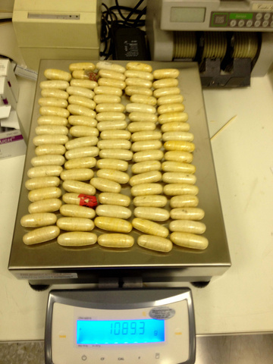
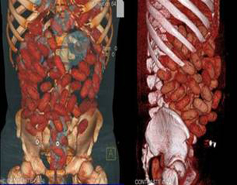
Southwest Asian Sourced Heroin
DEA
Dulles Airport, VA
Source: NBC Washington, 2012
Notes:
In March 2012, a 52 year old Nigerian woman was arrested by Customs and Border Protection for smuggling heroin concealed in her stomach which was a new record for the Dulles Airport in Virginia. CBP seized 4lbs and 12 oz (180 thumb sized pellets = $150,000). Customs and Border Protection officers became suspicious when she told officers she was coming to the U.S. to visit her brother but couldn’t describe him. A routine pat-down found her stomach to be abnormally rigid. An X-ray revealed the pellets and she was taken to the hospital. She remained in the hospital expelling the suspected drugs for about three days. She’s been charged with drug smuggling in federal court in Alexandria.
A mule is someone who personally smuggles contraband across the border. The risks and consequences vary depending on the amount and type of drug and the way it was packaged.
Drugs may be placed in condoms or in packets enclosed by several layers of polyethylene or latex, sometimes covered with an outer layer of wax. Rupture of one or more packets can abruptly cause toxicity and overdose.
Symptoms depend on the drug:
Cocaine: intractable seizures, tachycardia, hypertension, and hyperthermia
Heroin: Coma, respiratory depression, intestinal obstruction, rupture or peritonitis
Source: https://www.nbcwashington.com/news/local/Heroin-Seizure-Dulles-Customs.html

Slide 30
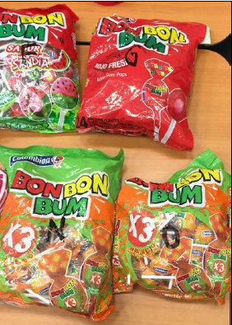
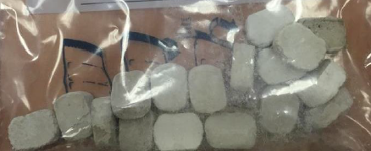
Guatemala Sourced Heroin
DEA
BWI Airport, MD
Source: New York Times, 2014
Notes:
Baltimore:
Special Agents from Immigration and Customs Enforcement received a tip that a drug courier was about to land at BWI with a large shipment. Hours later Edgar Franco Lopez was asked for a search of his 3 large duffle bags as he was loading into a vehicle. Agents only found food, so they bluffed saying they had found evidence of drugs in the bags.
The driver, Edwin Quintana Carranza a Mexican in the US illegally who had claimed the bags were his and consented to the search confessed. The drugs were hidden in the sugar wafers he said.
These 2 men were key links in a drug smuggling network that stretched thousands of miles from Guatemala to Baltimore. They used factory sealed products such as sugar wafers, brownies, soups, lollipops and other candies.
Traffickers will try anything to avoid camera, drones, drug dogs and agents. They will use mail parcels, UPS, FedEx, air cargo, travel on transit systems with low security (Amtrack).
Source: https://www.nytimes.com/2017/12/02/us/politics/drug-cartels-border-security-traffickers.html

Slide 31
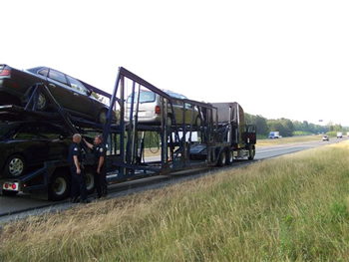
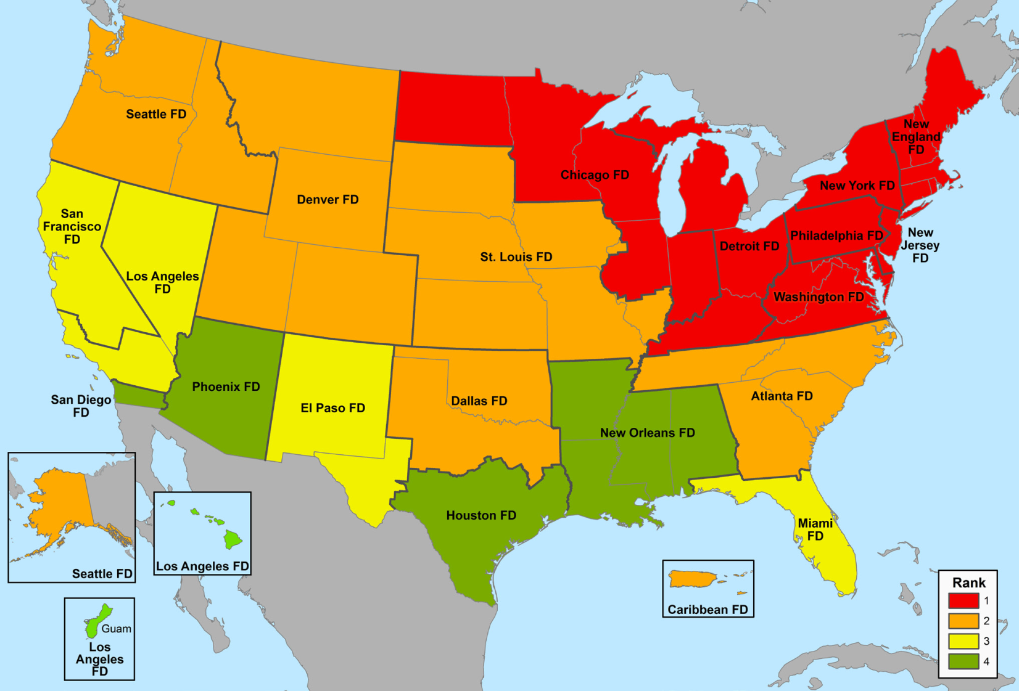
Heroin Threats as Ranked by the DEA Field Divisions, 2014
DEA
Source: DEA Field Division Reporting
Notes:
Most of the flow is through entering the United States at legal ports of entry, followed by tractor-trailers, where the heroin is co-mingled with legal goods. Body carriers represent a smaller percentage of heroin movement.
A very small percentage of heroin is seized through the Northern Border between the US and Canada. Heroin is also seized on the ferry from the Dominican Republic to Puerto Rico.
Also used: Private vehicles, rentals, commercial vehicles, courier on flights, package delivery services, air freight and sea cargo
Mexican drug trafficking organizations compete with Dominicans, Jamaicans, Colombians, and Vietnamese for business

Slide 32
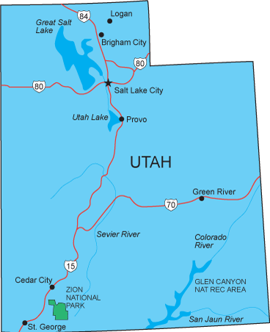
Utah for Example
DEA
Drug cartels love business in Utah
  Cartel employees throughout the state
  High demand & pay more
  Target: White kids
  North to South & East to West highways
  Better drug runners after jail time
  “They make fun of Americans because we have an insatiable appetite for drugs” – DEA Tapped phone lines
Source: CBS 2 Salt Lake City, 2019
Notes:
Drug cartels know Utah is an easy place to sell cocaine, heroin prescription pills and meth.
A man accused of working for the Sinaloa Cartel provided 2News inside information of the criminal network.
Cartel members operate all over Utah in rural parts and busy downtown areas
Best place for business- high demand and they pay more
Business done in parking lots & side of the road (cars with traps)
Main target- White kids. They have money to buy and often distribute to friends
Utah has North to South and East to West Highways = cartel friendly
Some people learn to become better drug runners while in jail, which the cartels bank on
Tapped phone lines “More than just an appetite, the judicial system (judges, prosecutors, police officers, defense attorneys) are making money of this problem
The system rarely provides proper rehabilitation or second chances, so unfortunately a lot of good kids get caught up with cartels and those involved kind of have an incentive to NOT fix this problem.
(Source CBS 2 Salt Lake City 5/24/19)-

Slide 33
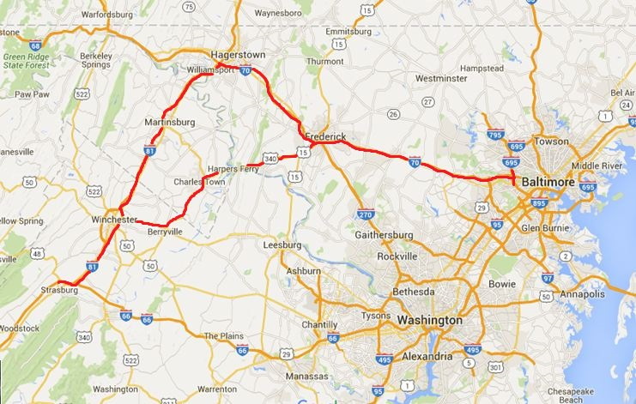
Heroin Highway
DEA
Notes:
Heroin Highway is the nickname for the corridor along Interstates 70 and 81 that begin in Baltimore and run through Maryland, West VA, and VA.
While Baltimore is not the reason why heroin use is exploding in local communities, police across the area say their heroin addicts are driving to Baltimore to buy the deadly drug, sometimes even twice a day.

Slide 34
DMP Heroin Purity
DEA
2015
Notes:
Domestic Monitor Program
Heroin is produced from morphine by a chemical process.
The morphine is extracted from opium, which is derived from the opium poppy plant.
Adulterants are pharmacologically active substances such as caffeine, procaine, and quinine, which are added to the heroin conversion process.
Diluents are pharmacologically inactive substances (i.e. cutting agents) such as lactose, mannitol, starch, and sucrose, added to the heroin to increase bulk/ quantity

Slide 35
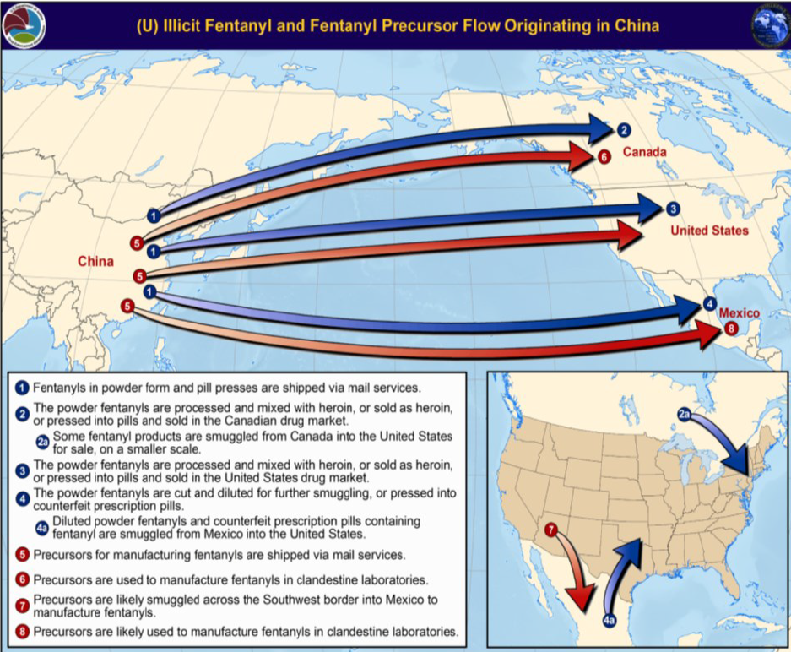
Fentanyl Flow From China
DEA
Notes:
Purity from China is 90% or higher
Fentanyl pipeline:
Most of the fentanyl in the country comes from China, but it’s not always a direct route. Sometimes China ships to less-suspicious countries like Canada or Tonga before mailing to the US.
Direct China to US mail: buyers purchase pure fentanyl or precursor chemicals over the web from illicit suppliers in China. Small quantities are mailed.
Some is shipped from China to the US for the Mexican cartels because the U.S mail system is more reliable. It’s then smuggled south to Mexico for production before coming back up to the US in its finished form.
Fentanyl had been found in bogus Xanax pills sold on the street.
Fentanyl street names: Apache, China Girl, China White, Dance Fever, Friend, Goodfellas, Jackpot, Murder 8, Tango & Cash
One Kilogram of pure Fentanyl from China, can be turned into diluted powder sold on San Diego Streets at $300 value- According to the DEA.
After drugs are shipped internationally, they are mixed into the heroin supply or combined with other non-opioid drugs and pressed into a tablet form. This practice partially explains why overdoses with these substances are often misidentified as heroin overdoses or pinned on other prescription opioids present in the body at the time of the overdose.

Slide 36
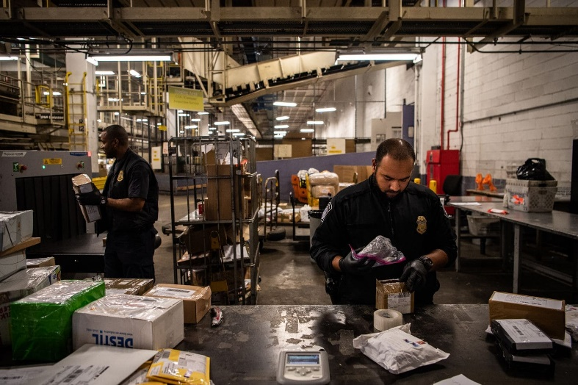

What are Authorities doing to Deal with Drug Shipped by Mail?
DEA
Congress and U.S. Customs and Border Protection, the main federal agency dealing with preventing contraband from entering the country, have been working to crack down on drug trafficking through the mail for years. But it hasn’t been easy.
Synthetics Trafficking and Overdose Prevention (STOP) Act
Source: Time, 2019
Notes:
These sellers’ preferred method of shipping is the U.S. Postal Service because the risk of seizure by Customs & Border Protection (CPB) is small and delivery is basically guaranteed.
Part of the Synthetics Trafficking and Overdose Prevention Act (STOP), includes legislation passed in 2018 to help combat the opioid crisis in the United States, mandates that the USPS collects information on all mail sent from China, including details on the sender and the package’s contents.
Source: https://time.com/5660390/trump-china-fentanyl-mail-drug-trafficking/
In 2018, the USPS Inspection Service (a federal law enforcement agency tasked with keeping mail safe) seized over 96,000 pounds of mailed narcotics.
USPS offers up to $50,000 for information that leads to the arrest and conviction of people who mail prohibited items. USPS is a federal agency, whereas FedEx and UPS are private companies.
DEA Administration issued a temporary emergency ban on Schedule I Fentanyl analogues, due to expire on February 6, 2020, which helped the DEA expedite investigations of new analogues without first having to chemically analyze and classify each one. Since the temporary ban, there has been a 40% reduction in instances of new drugs coming into the country. (update: January 2020, the ban was extended another 15 more months)

Slide 37
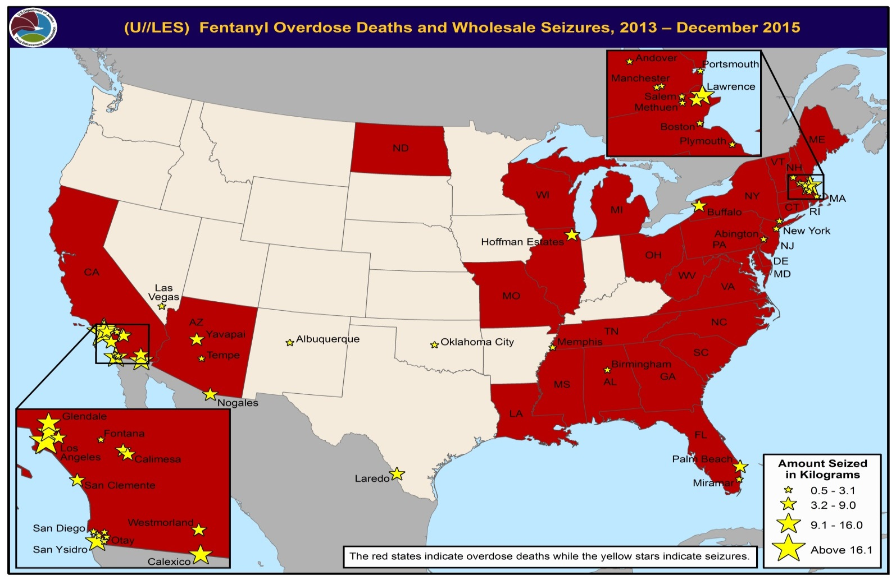
Fentanyl Overdose Deaths and Wholesale Seizures
DEA
Notes:
Red States = Overdose deaths
Stars = Seizures
Nationally there were 7% fewer deaths involving heroin in the year ending in September 2018 than there were in the previous year- CDC 2019
Overall, from 2017 to 2018, heroin overdoses treated in emergency departments in 22 states and Washington, D.C., decreased almost 22%. Some locations that have historically been hardest hit -- such as West Virginia, Ohio and Washington, D.C. -- saw their numbers plummet by more than 50%, the researchers found.
Seven other states -- Kentucky, Maryland, Massachusetts, New Hampshire, Pennsylvania, Rhode Island and Wisconsin -- had significant declines in hospital-treated heroin overdoses.
Likely reasons:
First, some of the states now seeing decreases were those that witnessed increases earlier in the epidemic, it’s possible that early intervention and localized responses are starting to pay off
The shift in supply chain may be a factor.
Wider access to Naloxone/Narcan
Still, law enforcement officials are continuing to seize heroin coming across the border. From January through April 2019, Customs and Border Protection officers seized 1,585 pounds of heroin at official ports of entry, along with 921 pounds of fentanyl.

Slide 38
The Narco Superhighways
DEA
“Los Cincos” “Los Dos Laredos” “Traps, Mules & Ants”
5
85
35
Notes:
Route 5- Tijuana/ San Diego
Route 85- Juarez/ El Paso
Route 35 – Nuevo Laredo/ Laredo
Areas affected most by overdoses and seizures mirror certain routes
Heroin crosses the border and mostly floods eastward towards the users

Slide 39


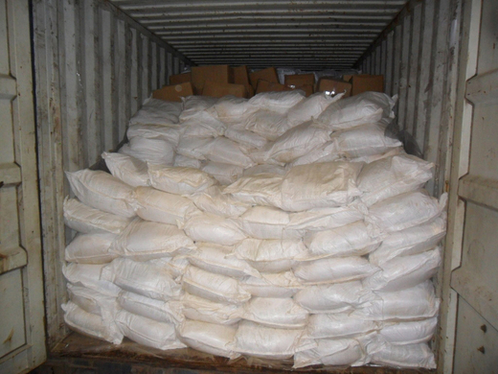

Fentanyl & Economics
DEA
Dealers make more money selling fentanyl
Poppy Fields
Harvest
Shipment
Buy online
Notes:
The reason fentanyl is everywhere is because it’s economic. Instead of waiting months for poppy fields to grow, harvest and refine into powder and then ship North, traffickers anywhere can order fentanyl from China, or precursor chemicals to make it in clandestine labs; More doses/ less labor
In 2018, the DEA BDO seized $28 million worth of assets, that’s more than some divisions that have double, even triple the population size of Baltimore.
“We’re consistently coming across six-figure seizures- $100,000, $200,000, $300,000 and in some cases millions in drug profits just laying around apartments and homes in Baltimore. But a seizure can sometimes have a devastating fallout: crushing one drug shop leaves a neighborhood short on opioids that could potentially spark a turf war over the demand that remains- who fills that void?” Don Hibbert ASAC
Telegrams: encrypted message systems are hard for police to monitor
FBI: Joint Criminal Opioid Dark net Enforcement Team (J-Code)
Bitcoin
Crytonia
Monero

Slide 40
Potential for Wave 4?
DEA
Prediction From Historical Trends
Underlying stimulant epidemic may be emerging, which we are potentially ill-equipped to respond.
The time is now to focus on strategies for rising stimulant use
Cocaine Epidemic 1890’s
Heroin Epidemic 1970’s
Powder Crack Cocaine Epidemic 1980’s
Opioid Epidemic Starts (Civil War 1861-1865)
Notes:
Historical trends in substance use provide further warning signs. The first nationwide drug epidemic began with opioids around the time of the Civil War. This epidemic overlap was quickly followed by a cocaine epidemic in the late 19th and early 20th centuries. (For reference, this was the time period of Sigmund Freud and the founding of Coca-Cola.) Similarly, the heroin epidemic of the 1970s was followed by the powder and crack cocaine epidemic of the 1980s.
Both time periods were similar to today: The culmination of an extended period of war marked by an opioid epidemic followed by an increase in stimulant use.
We must remain vigilant of substance use beyond opioids. Both historical and current trends present a clear warning that an underlying stimulant epidemic may be emerging for which we are potentially ill-equipped to respond.
The time is now to begin focusing on prevention and response strategies that address rising stimulant use. While resources are stretched thin in our efforts to curb drug overdose, failure to address this emerging crisis now may lead to more complicated effort in the coming years.
Methamphetamine use appears to be making a comeback as the county continues to grapple with the opioid epidemic.
Stimulants include
Amphetamines
Caffeine
Cocaine
Diet Pills
Methamphetamines
Ritalin
Ecstasy
Anabolic Steroids
Adderall

Slide 41
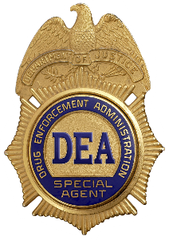
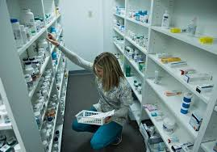
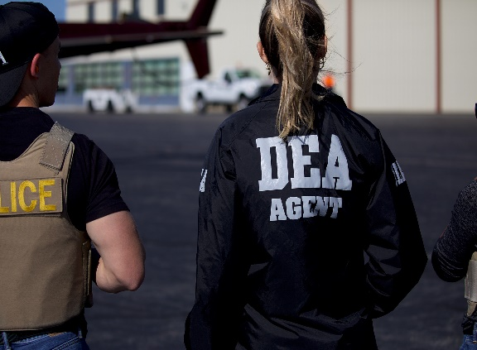
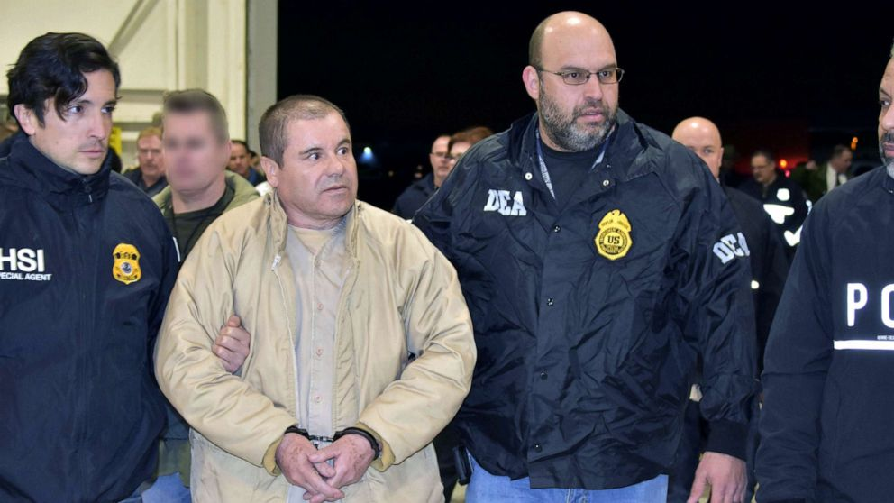

Recent Highlights
DEA
2019 the amount of opioid pills prescribed in the U.S. declined nearly 30% since 2016
In July Joaquin “El Chapo” Guzman was sentenced to prison.
First time since 2013, we saw a net increase in the number of Special Agents joining the ranks
DEA 360 Program
Notes:
We are working!
2019 decline in opioid pills- largely due to efforts of DEA’s diversion control program to reduce aggregate production quotas and educate healthcare providers on indicators of diversion.
El Chapo- This was the culmination of decades of work by DEA and our partners. While many challenges remain, his downfall ushers a new ear in the fight against Mexican cartels and underscores DEA’s steadfast commitment to bring the worse offenders to justice.
The 360 Strategy takes an innovative three-pronged approach to combating heroin/opioid use through Law Enforcement, Diversion, and Community Outreach. It is a comprehensive approach tackling the cycle of violence and addiction generated by the link between drug cartels, violent gangs, and the rising problem of prescription opioid and heroin abuse in U.S. cities. (16 cities)

Slide 42

What Can We Do?
DEA
Notes:
We covered a lot of information, and you may be wondering “What can I do?”

Slide 43
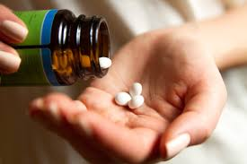
As a Consumer, Ask Questions
DEA
How will my pain be managed before during and after surgery/ injury?
How much discomfort is usually associated with this procedure/ injury?
What non-narcotic pain control options do I have?
What side effects can I expect?
How will I manage long-term pain?
How do I safely dispose of unused medicine?
Notes:
What can you do?
ASK QUESTIONS!!!
Seek alternatives, develop a plan with you doctor etc.
According to the CDC, Risks are greater with:
History of drug misuse, substance use disorder, or overdose
Mental Health Conditions (Such as depression or anxiety)
Sleep Apnea
Older age (65+)
Pregnancy

Slide 44
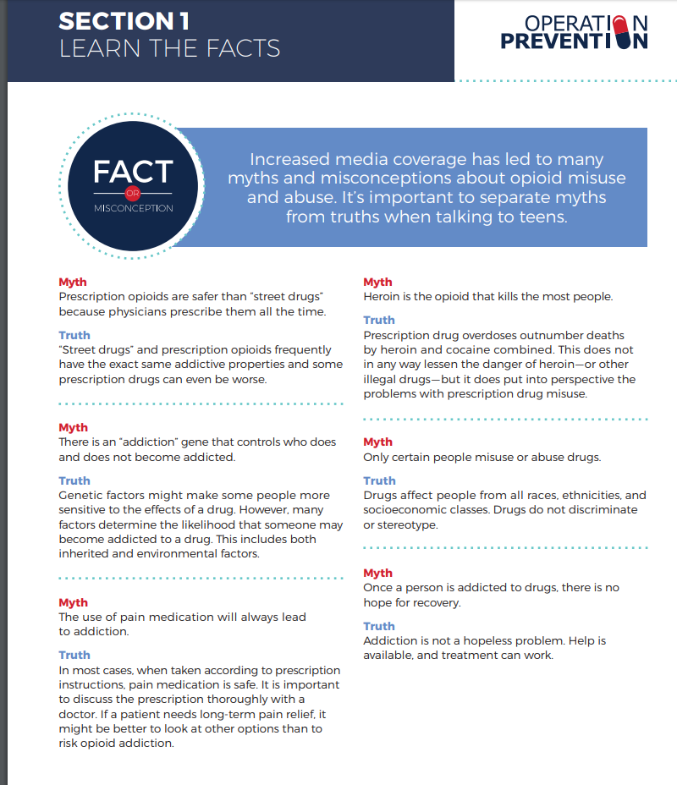
As a Parent or Caregiver
DEA
Learn the facts
Understand how medication works
Monitor & secure medications
Start the discussion
Safely dispose of expired or unused medicine
Notes:
I brought resources!

Slide 45

As a Community Member
DEA
Call/ text Samaritan Crisis Care Helpline 24/7 at 877-870-4673 for crisis, grief support, treatment and referrals.
Know the signs of an overdose.
Have Narcan available, and someone who can administer it, in case of an overdose.
Do not use drugs- period.
In the event of an overdose, call 911 immediately.
Submit anonymous tips at www.dea.gov
Notes:
While there is no safe way to use illegal drugs, it is important that drug users, their friends and family, and the public are aware of steps they can take to help reduce the risk of death.

Slide 46

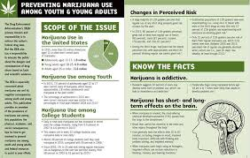
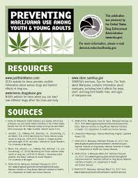




Community Outreach Prevention Support
DEA
Notes:
DEA leads the following efforts:
Preventing Marijuana use among youth- overview of MJ prevalence; tips on how far to get involved
Operation Prevention - digital resources for teachers and parents in partnership with Discovery Education

Slide 47



















Community Outreach Prevention Support
DEA
Notes:
DEA leads the following efforts:
Publications - brochures, fact cards, and prevention guides
Red Ribbon Week - the nation’s oldest and largest drug prevention awareness program
Red Ribbon Week is an annual opportunity for children, teens, and adults to show they are committed to being healthy and drug free. The nationwide event occurs on October 23-31.
Drugs of Abuse- clear scientific drug facts about drug classes, scheduling and concern for designer/synthetic drugs
Currently out of stock, should have new edition by summer 2020
Prescription for Disaster- Helps parents identify medication/OTC misuse of drugs
Preventing with Purpose- Road-map for college drug prevention programs
Chasing the Dragon- Documentary + Educators guide
Keep the Ball Poster- high school student athletes vulnerable population to Rx painkiller misuse

Slide 48




Community Outreach Prevention Support
DEA
DEA Websites
  www.getsmartaboutdrugs.com: parents, educators, and caregivers
  www.justthinktwice.com: teens
  www.campusdrugprevention.gov: higher education
Hotlines for alcohol and drug abuse, such as:
  Centers for Substance Abuse Treatment Hotline: 800-662-HELP (4357)
  Girls and Boys Town National Hotline: 800-448-3000
  National Alcohol and Substance Abuse Information Center: 800-784-6776
Notes:
Websites
www.getsmartaboutdrugs.com: parents, educators, and caregivers
www.justthinktwice.com: teens
www.campusdrugprevention.gov: professionals working to prevent drug abuse among college students

Slide 49

Questions
DEA
You Are a Resource for the DEA.
We Need Your Help to Prevent Drug Abuse.
Get Educated. Get Involved.
www.dea.gov
La’Risa McLennon, MPH
202-816-0470
LaRisa.P.McLennon@usdoj.gov

