Slide 1
COVID-19 Updates and Resources for Faith and Community Leaders
April 16, 2020

Slide 2
Virginia Department of Health
Veronica Cosby
Virginia Partners in Prayer and Prevention (P3) facilitates partnerships between marginalized communities, faith and interfaith organizations and the state public health agency.
Veronica Cosby, MAHS, MS, Office of Health Equity

Slide 3
Housekeeping
All lines muted to start meeting
Please feel free to type your question or comment in the chat box. A follow-up FAQ will answer those questions.
This webinar will be recorded

Slide 4
Pastor William Ward
Bethel Church of God In Christ
Charlottesville, VA

Slide 5
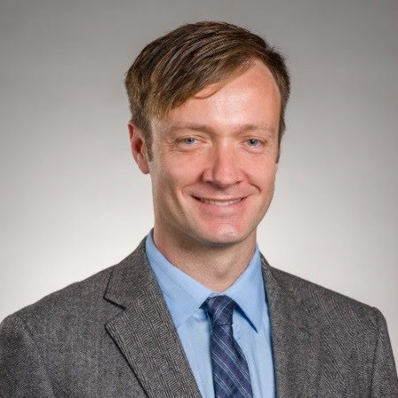
Stephen Wade, MUP
Health Equity Project Manager
Virginia Department of Social Services

Slide 6
Webinar Purpose
To provide faith and community leaders with:
Resources for the operations of their community services,
Guidance for how to answer their members’ VDSS-related concerns,
A space to virtually discuss ongoing and emerging challenges as a result of the COVID-19 pandemic.

Slide 7
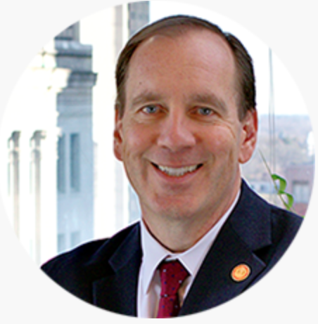
Commissioner S. Duke Storen
“Our work has never been more important or needed than it is now.”

Slide 8
Mission
The Mission of the Virginia Department of Social Services (VDSS) is to design and deliver high-quality human services that help Virginians achieve safety, independence and overall well-being.

Slide 9
Topics
2-1-1 Virginia
Benefits
Nutritional Assistance, Monetary Assistance, Medicaid
Family Services
Child Care, Assisted Living Guidance
Adult and Child Protective Services
Child Support
Other Resources
Housing and Energy, Substance Use Disorder

Slide 10
2-1-1 VIRGINIA
2-1-1 VIRGINIA is a free service that can help individuals find the local resources they need. 2-1-1 is available 24/7.
Visit our web site at www.211virginia.org where you can search for resources, email, or chat with a 2-1-1 Call Specialist; or
Dial 2-1-1 where a Call Specialist will assess your needs and provide referrals to services. All calls are confidential.

Slide 11
2-1-1 VIRGINIA
You can call, email, or chat with a Call Specialist who will help you find information and referrals for needs such as:
Supplemental food or meal programs
Shelter and housing options and utility assistance
Public benefit programs such as SNAP, TANF, and Medicaid
Child care options
Services for veterans

Slide 12
2-1-1 VIRGINIA
Things to remember:
2-1-1 Call Specialists do NOT have medical training and cannot answer questions related to health symptoms or testing. They will refer callers to their primary health provider, their local health department or the Virginia Department of Health at www.vdh.virginia.gov/coronavirus
2-1-1 does not provide direct financial assistance to anyone.
2-1-1 answers calls 24 hours a day, seven days a week. All calls are confidential.

Slide 13
SNAP
March Emergency allotments for current SNAP households were issued on March 25th and April 1st. The April Emergency allotments will for current SNAP households will be issued on April 16th.
Regular SNAP allotments will still be distributed and will follow the regular issuance schedule
Local Department of Social Services offices may be closed, but business will still operate virtually
Online eligibility screening and application can be completed at www.commonhelp.virginia.gov or via the Enterprise Customer Call Center at 1-855-635-4370
Those who are experiencing layoffs or reduction in hours are encouraged to apply for SNAP benefits as soon as possible
Notes:
claudia and andrea comment resolved

Slide 14
WIC
Women, Infants and Children (WIC) is a supplemental nutrition program for pregnant women, breastfeeding women, women who had a baby within the last six months, infants, and children under the age of five. The WIC program provides breastfeeding support, nutrition education, referrals to appropriate health agencies, and nutritious foods for eligible applicants. Click here to apply to WIC.
You are eligible to apply to Virginia WIC if you...
Are pregnant, breastfeeding, just had a baby or are a mother, father, grandparent, foster parent, or other legal guardian of a child under the age of 5.
Are a resident of Virginia.
Have a nutritional need (this is determined at your local WIC clinic)
Meet the income guidelines (click here)
Due to COVID-19, most WIC clinics are temporarily closed to visitors. Call your local WIC Office or 1-888-942-3663 for assistance with your benefits.

Slide 15
Area Agencies on Aging
25 local area agencies on aging across the state bring support and resources closer to home
These agencies provide food delivery for individuals ages 60 and older amongst other services
Visit www.vaaaa.org to view resources and find your local agency

Slide 16
Food Access, Nutritional Assistance
The Federation of Virginia Food Banks is standardizing low- and no-touch distribution, pre-boxed items, and drive-through distribution mechanisms
Pantries, soup kitchens should work with their local food banks
www.vafoodbanks.org
For children 18 and under, text FOOD or COMIDA to 877-877 for more information on meal sites
Organizations like Blessings in Backpacks will continue feeding Virginia children in partnership with the local school districts

Slide 17
TANF
TANF - Emergency Assistance
Families with children who are eligible for TANF or are currently receiving TANF
One-time assistance payment of up to $500 for families that have been impacted by COVID-19
The family must include a dependent child
TANF - Diversionary Assistance
Families with children who are not currently receiving TANF assistance
Provides a one time lump sum assistance payment to families to pay for emergency needs
Must have a reduction, loss or delay in starting to receive income
Visit www.commonhelp.virginia.gov to apply

Slide 18
Employment Assistance
If an individual has been out of work at least one (1) full day, they can file a claim for unemployment compensation benefits.
Visit www.vec.virginia.gov, or
Dial 866-832-2363 Monday through Friday 8:15am – 4:30pm
One week waiting period and weekly job search requirement temporarily suspended

Slide 19
Medicaid
Medicaid covers testing and treatment for COVID-19
Medicaid and FAMIS co-pays eliminated
Medicaid members can fill a 90-day supply of many prescriptions
Behavioral health services now offered through telehealth and by telephone
Visit www.commonhelp.virginia.gov to apply

Slide 20
Child Care Facility Guidance
VDSS is closely monitoring guidance for child care facilities from federal level
See VDSS FAQ regarding key topics, e.g.
Social Distancing in Child Care Settings
Infection Control and Sanitation Practices
Licensing Requirements and Modifications
Recommendations for Programs that Remain Open
Staff Mental Health
Contract Issues

Slide 21
Child Care for Families
Child Care Aware, Virginia’s resource and referral agency, assists parents and guardians in finding child care that meets the needs of each family
Staff stands ready to help families find care if their normal care arrangements have closed
If a family’s care needs change based on the essential nature of their job in order to serve the community
Call 866-KIDS-TLC or visit vachildcare.com for more information

Slide 22
CARES Act Funding for Child Care
The federal CARES Act provides an estimated $70 million in funding to support and sustain child care in Virginia, the Governor’s plan for this funding is as follows:
Providers that serve essential personnel will be eligible for an incentive grant program that will provide direct cash assistance
Licensed child day centers, religious-exempt child day centers, family day homes, voluntarily-registered family day homes as well as subsidy providers are eligible for this incentive
Families in the Child Care Subsidy Program will not have to make copayments through June 30th
Subsidy providers that are closed may request absence payments for additional days for participating children through June 30th

Slide 23
Assisted Living Facility Guidance
VDSS is closely monitoring guidance given by the Centers for Disease Control and the Centers for Medicare and Medicaid Services.
Strongly encouraging assisted living facilities to follow these guidelines.
Closely working with Virginia Department of Health to ensure residents’ health, safety and welfare remain top priority during this pandemic.
Visit dss.virginia.gov/geninfo/corona.cgi for more information on how assisted living facilities can help protect the health, safety, and welfare of residents in the Commonwealth.
Visit the National Center for Assisted Living (www.ahcancal.org) for further national information regarding assisted living facilities.

Slide 24
Adult Protective Services
APS receives and investigates reports of abuse, neglect, and exploitation of adults 60 years of age or older and incapacitated adults age 18 or older.
To report suspected adult abuse, neglect, or exploitation, call the local department of social services or the 24-hour APS hotline at 888-832-3858
Notes:
APS receives and investigates reports of abuse, neglect, and exploitation of adults 60 years of age or older and incapacitated adults age 18 or older. Local APS staff may arrange for a wide variety of health, housing, social and legal services to stop the mistreatment or prevent further mistreatment.

Slide 25
Child Protective Services
CPS identifies, assesses and provides services to children and families to protect children, preserve families, whenever possible, and prevent further maltreatment.
How to report Child Abuse or Neglect:
Virginia: 1-800-552-7096
Out-of-State: 804-786-8536
Notes:
The goal of Child Protective Services (CPS) is to identify, assess and provide services to children and families in an effort to protect children, preserve families, whenever possible, and prevent further maltreatment. Child Protective Services is non-punitive in its approach and is directed toward enabling families to provide adequate care for their children.

Slide 26
Domestic Violence
Local domestic violence programs provide for the safety of individuals and families, including teens and children, through the provision of emergency housing and transportation, crisis intervention, peer counseling, support, advocacy and information and referral.
Family Violence & Sexual Assault Statewide Hotline: 1-800-838-8238
Individuals can chat 24/7 with an advocate at 1-804-793-9999
Notes:
As stay at home orders expand to contain the spread of the virus, women with violent or abusive partners increasingly find themselves isolated from the people and resources that can help them. The number of women and children exposed to family violence is likely to increase as security, health, and money worries heighten tensions and strains are accentuated by cramped and confined living conditions. - UN infographic

Slide 27
Child Support
Child Support payments can be made online at mychildsupport.dss.virginia.gov or through MoneyGram at participating locations
To discuss a case:
call 1-800-468-8894
email askdcse@dss.virginia.gov

Slide 28
Housing and Energy
The State Corporation Commission issued an order directing utilities it regulates, such as electric, natural gas, and water companies in Virginia to suspend services disconnections of utilities for 60 days.
Additionally, the Supreme Court of Virginia has suspended all evictions until at least April 26, 2020. Courts are not hearing any eviction cases and sheriffs are not scheduling or carrying out evictions. It is illegal for a landlord to evict a tenant without a court order and a sheriff’s notice.
Federal Mortgage Assistance: Federal Housing Finance Agency
Eviction Legal Helpline: 1-833-NoEvict
Virginia Legal Aid Helpline: 1-866-LEGL-AID
Visit VaLegalAid.org for more information

Slide 29
Virginia Refugee Resettlement Program
Assists refugees, asylees, Afghans and Iraqis with special immigrant visa status and their families to gain economic self-sufficiency and social integration into their new communities.
Services may be provided up to five years and include employment assistance, English language training, and assisting youth and older clients access services.
During the COVID-19 crisis, service providers are ensuring basic needs are being met (both directly and through community resources) and are communicating with clients via phone and online platforms that are linguistically appropriate.
For further information visit:
VDSS Public Site
Cultural Orientation Resource Exchange

Slide 30
Substance Use Disorder
SAMHSA Disaster Distress Hotline: If you need to speak with a trained crisis counselor immediately:
Call 1-800-985-5990 or
Text TalkWithUs to 66746
Connections App - Free research-based app to support people in recovery during COVID-19
DBHDS Virtual Meetings and Live Supports List
In the Rooms: Global Recovery Community
Notes:
APP from DBHDS resource page*

Slide 31
Virginia Medical Reserve Corps
The Virginia Medical Reserve Corps (MRC) is a force of dedicated volunteers who stand ready to support the community in the event of a public health emergency. Now more than ever, volunteers are needed to help actively improve and protect their community’s public health during the COVID-19 crisis by providing support for the immediate surge in hospitals, long-term care facilities and alternate care sites through the Commonwealth.
Nurses, nurse practitioners and nursing students are encouraged to apply
Non-medical volunteer positions in logistics, communications, coordination, technology and other support
For more information and to become a VA Medical Reserve Corps Volunteer, please submit an application in the Virginia Volunteer Health System www.vvhs.vamrc.org/
“The success of our COVID-19 crisis response depends on our ability to mobilize a dedicated health care workforce, and we are counting on Virginians across the Commonwealth to lend a hand” - Governor Ralph Northam
Notes:
APP from DBHDS resource page*

Slide 32
Veronica Cosby
Thank you!
Click here to visit the Virginia Department of Health - Health Equity page
Click here to watch a recorded Webinar regarding the Federal Emergency Management Agency (FEMA) Public Assistance (PA) ﻿Grant Program

Slide 33
Q&A

Slide 34
For More Information
For general information, please visit the VDSS COVID-19 Updates and Resources page at www.dss.virginia.gov/geninfo/corona.cgi
or
www.211virginia.org

Slide 35
Thank you for Joining Us!

