Slide 1
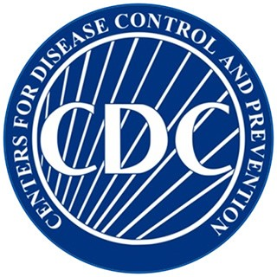
Spot a Stroke Stop a Stroke Save a Life
Margaret Probst
Northern Virginia EMS Council
Stroke Smart Coordinator and Paramedic
Alan Stillman
Founder: Stroke Smart Virginia

Slide 2
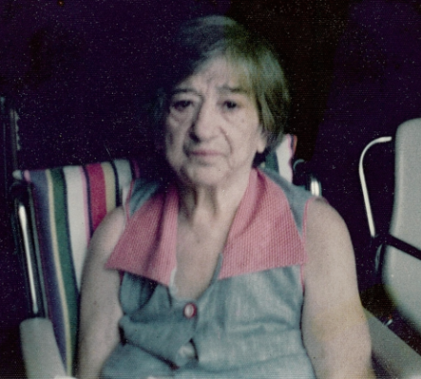
Why Am I Doing This?
Grandma Rose

Slide 3
Strokes touch us all
Has any one close to you has a stroke?
Would you have spotted it?

Slide 4
Stroke Smart
What is a Stroke ?
Spot a Stroke
Stop a Stroke
STAY STROKE SMART

Slide 5
Stroke Smart FBO
Clergy Stroke Smart
Congregation Stroke Smart
Community Stroke Smart
STAY STROKE SMART

Slide 6
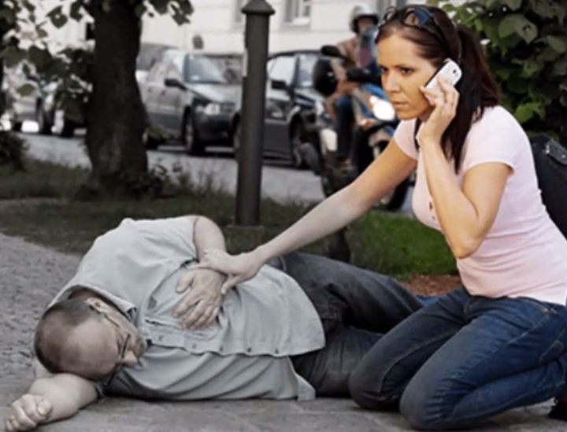
Cardiac Arrest vs Stroke

Slide 7
Cardiac Arrest vs Stroke
Cardiac Arrest:
One Clear Sign
Obviously a Medical Emergency
911 is Called Immediately
Stroke:
Many Subtle Signs
Not an Obvious a Medical Emergency
911 is rarely called immediately

Slide 8
Stroke Awareness and Prevalence
How many signs do you know?
How prevalent are strokes?

Slide 9
It is easy to get
Stroke Smart.
Lets do it!

Slide 10
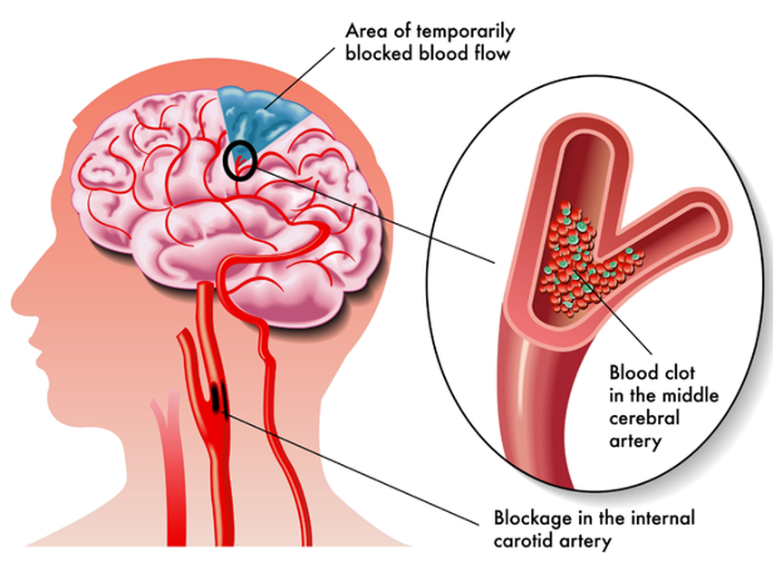

Slide 11
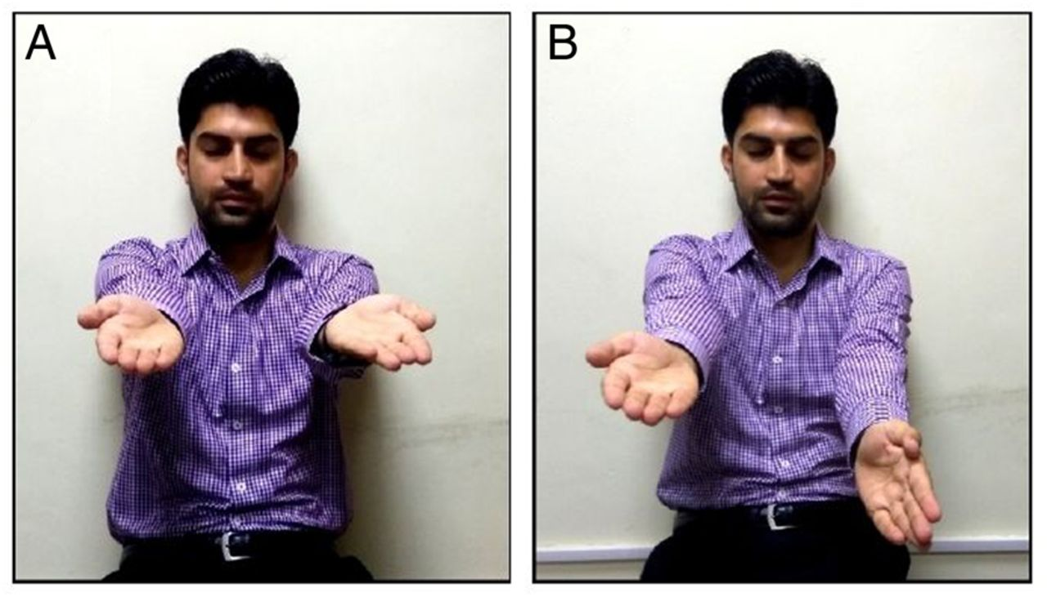
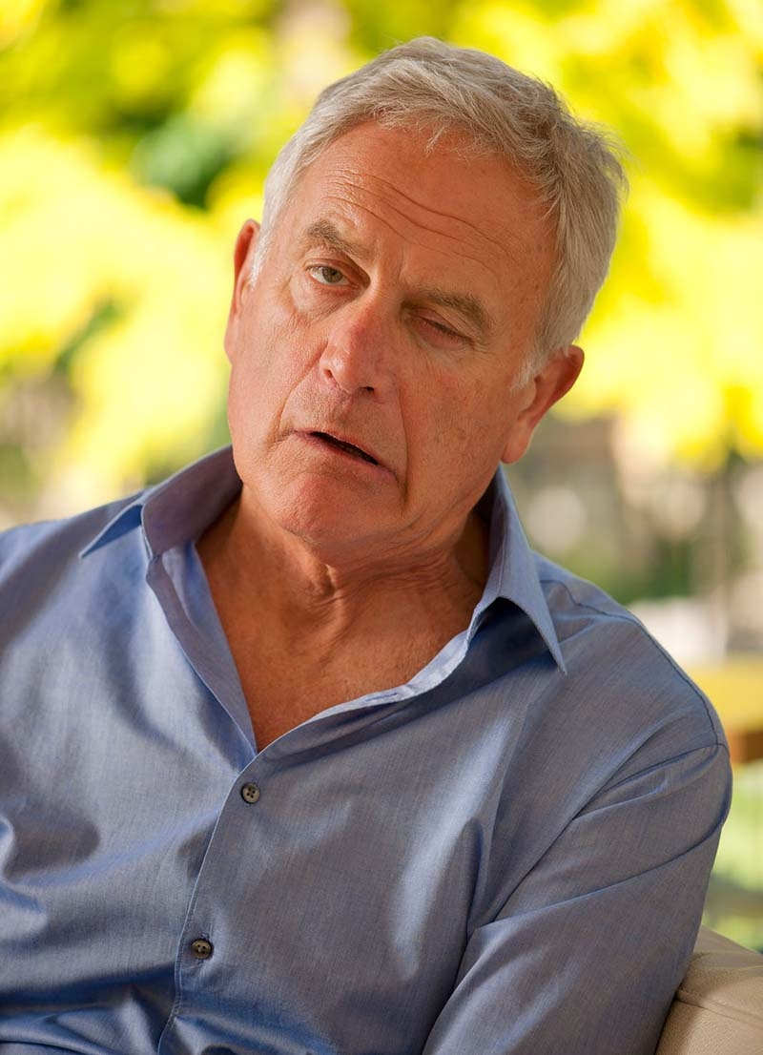
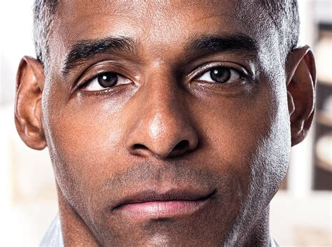
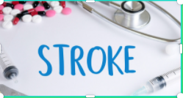

Slide 12
Spot a Stroke!
Sudden Onset, Unexplained Signs
Numbness on one or both sides of the body
Loss of balance/dizziness
Confusion
Difficulty understanding or forming words
Vision changes
Facial drooping
Weakness on one or both sides of the body
Notes:
Although no two strokes are the same, here are some telltale signs a person is experiencing a stroke. The stroke patient often cannot call 9-1-1 themselves, so it is CRUCIAL that you recognize the symptoms to spot a stroke.
Symptoms vary based on the location of the brain that is affected.

Slide 13
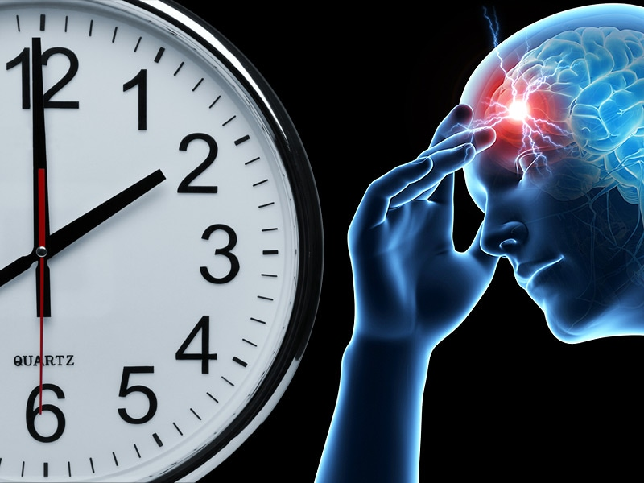
Time is Brain
Notes:
2 million brain cells die every minute during a stroke; lying down to take a nap or waiting to see if the symptoms will pass allows more brain cells to die. Treatment is time sensitive—it can only be administered for about 4 hours after symptoms begin…after that the risks begin to outweigh the rewards as so much brain has already died. More than 90% of people arrive AFTER the treatment window closes!

Slide 14
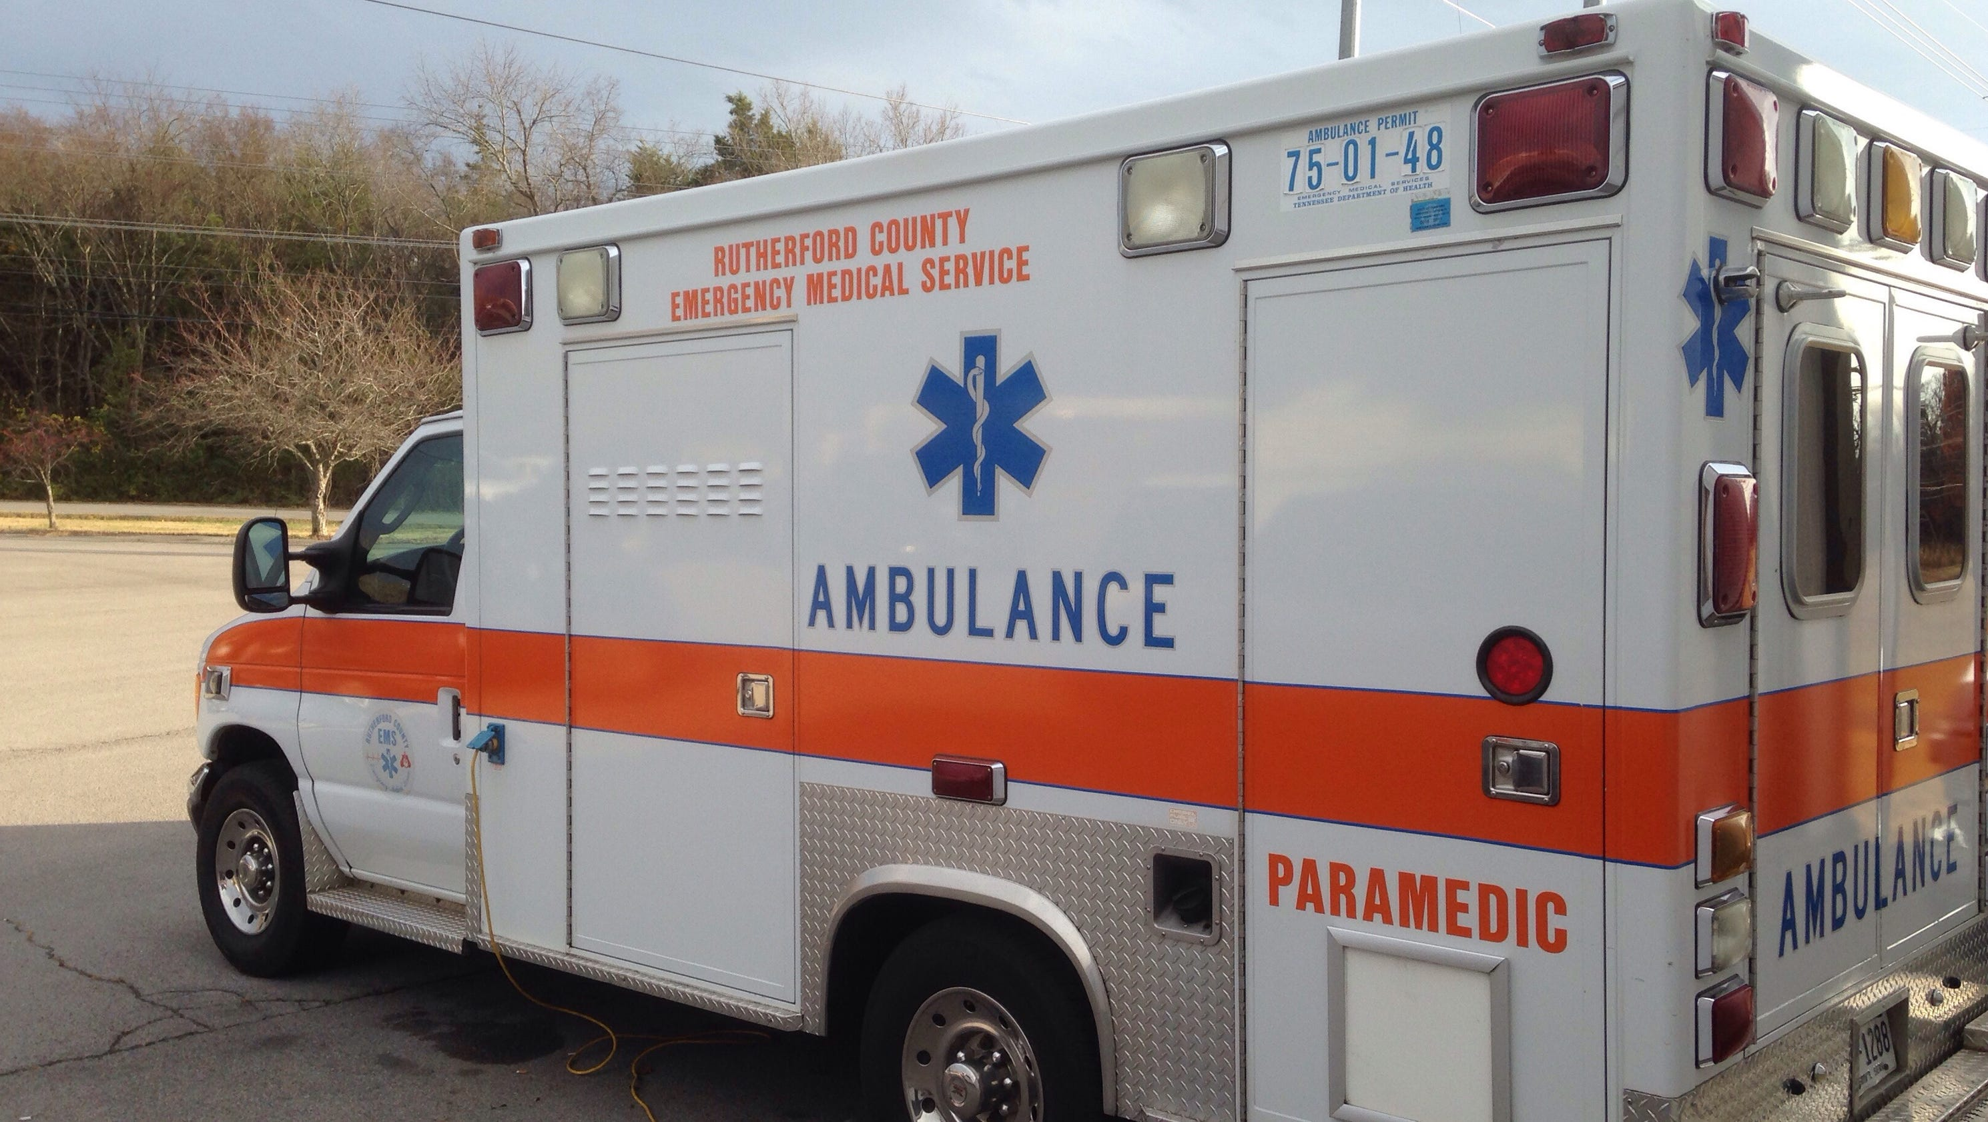
Call 911
Call 911
Call 911
Notes:
No cost to call—Cost of not calling is much higher than even the cost of accepting transport. Don’t drive yourself—your brain is suffering! Don’t have someone else drive you—not all hospitals have the meds to treat stroke. Don’t lie down thinking this will pass—time is brain! Don’t call your primary doctor—that doctor will just call 911!

Slide 15
How to we
Stay
Stroke Smart?

Slide 16
Stay Stroke Smart
Clear Message
Retention
Repetition
Access
Community Education
Teach if Forward
Take Care of Each Other

Slide 17
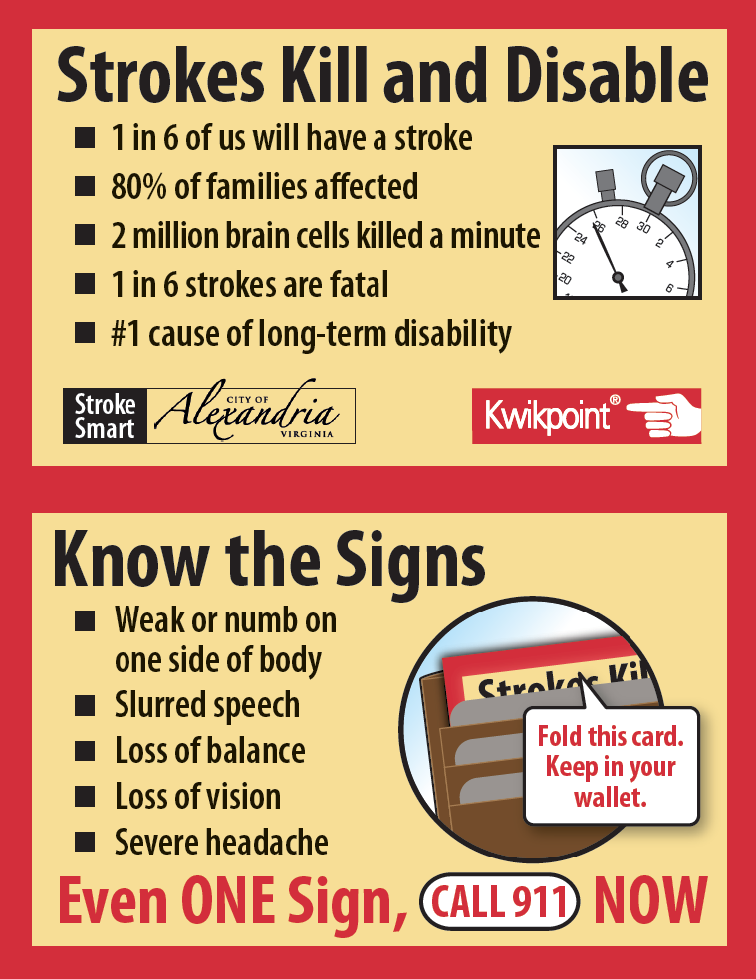
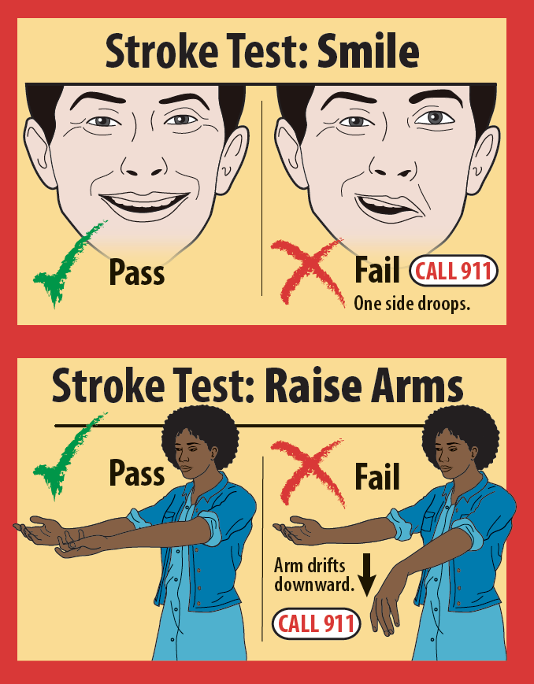
Clear Message
Two visual tests for easy comprehension and memorization
Scary statistics to motivate need
Any sign or test of stroke, call 911

Slide 18
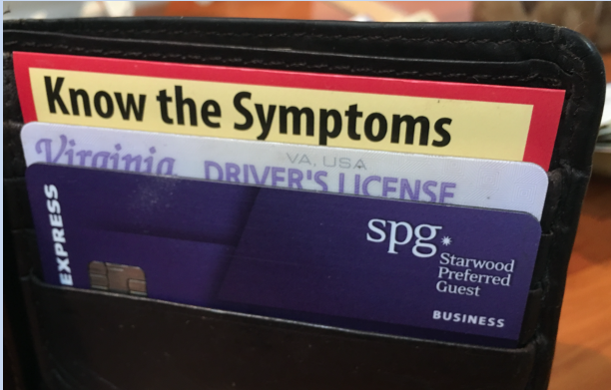
Wallet Card
For retention, repetition and access
Tear-proof, waterproof, long-lasting substrate
Tad larger than a credit card with a red border

Slide 19
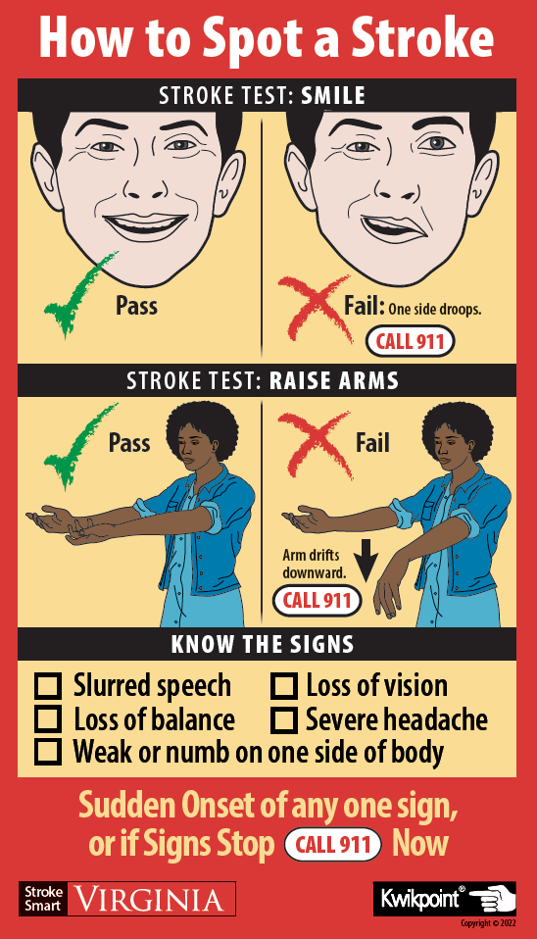
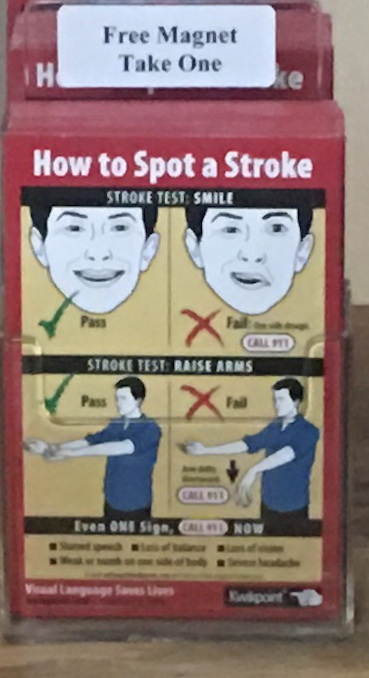
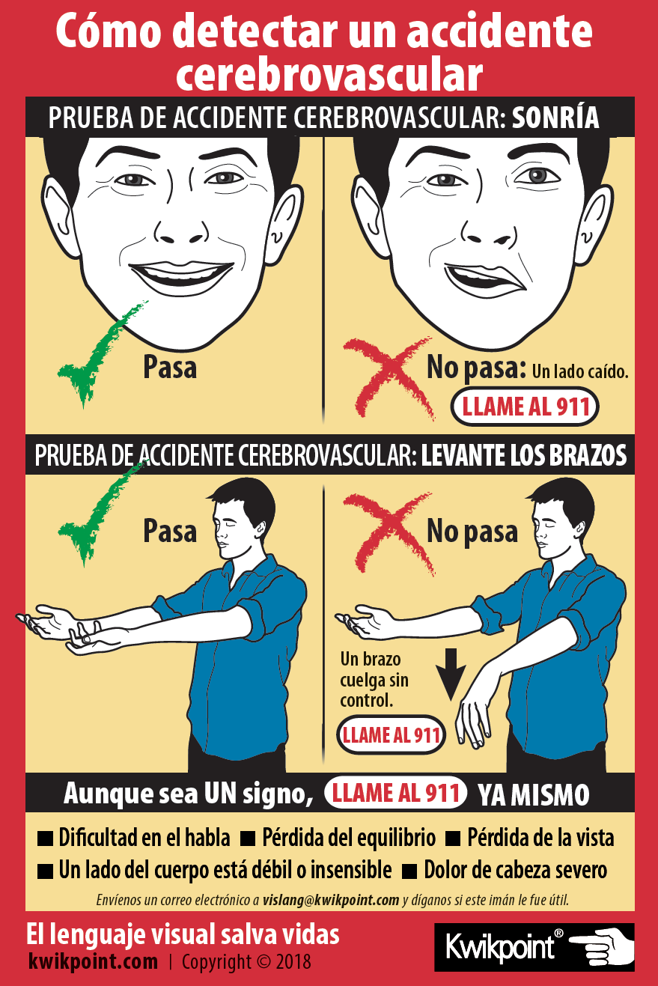
Fridge Magnet
For retention, repetition and access
In English
In Spanish
Counter Display

Slide 20
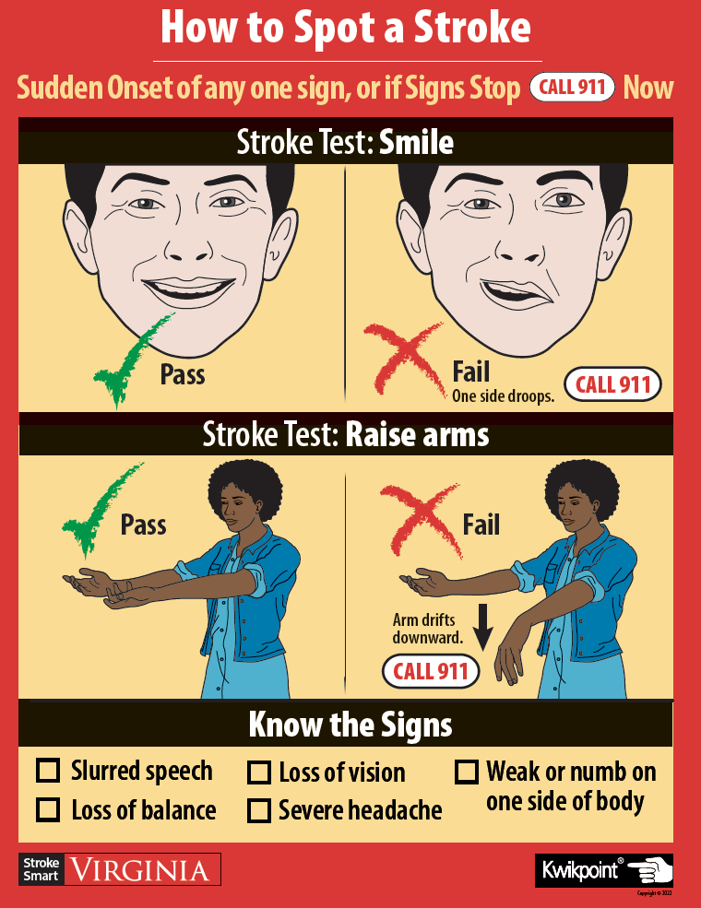
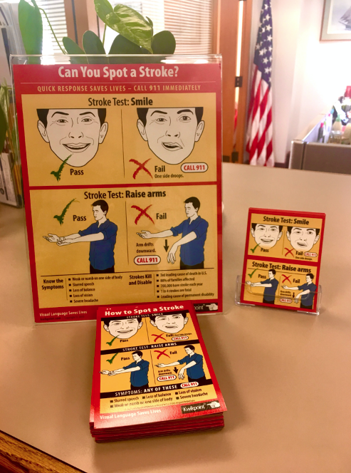
Poster
For sustained community exposure and saturation

Slide 21
Community Education
Clergy Becomes Stroke Smart
Clergy Educates Congregation
Congregation: Community Stroke Champions

Slide 22
Stroke Smart FBO
St. Mary’s Episcopal Portsmouth, Rhode Island

Slide 23
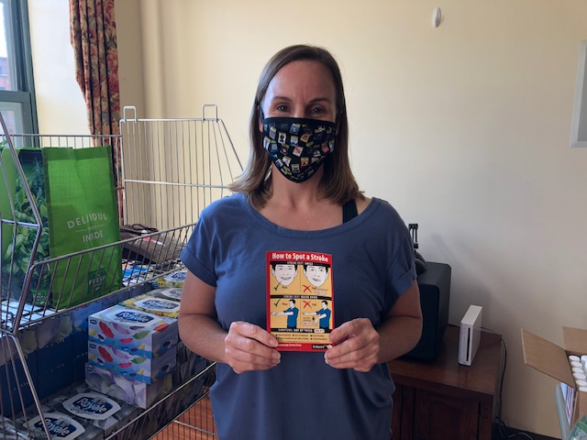
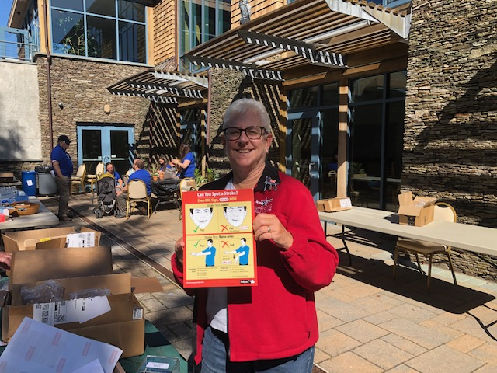
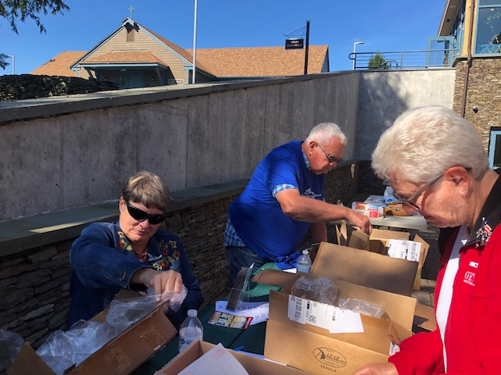
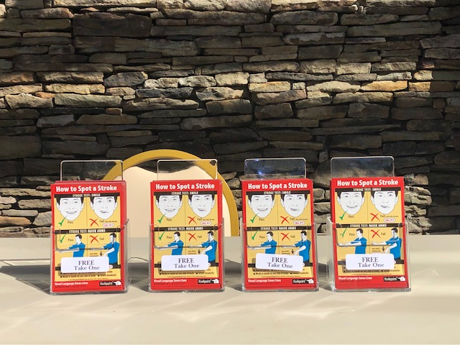
St. Mary’s Episcopal:
Stroke Smart Service Team

Slide 24
Stroke Champion: Teach it Forward
Service to your community
Self Reinforcement (Stay Stroke Smart)
Take Care of Each Other
STROKE SMART HERD LITERACY

Slide 25
Stroke Smart FBO Steps:
Identify a lead at your FBO
Healthcare Professional
Stroke Survivor or Caregiver
Teacher
Health Minister
Stroke Awareness Month May 2022
All materials donated by VDH

Slide 26
Stroke Smart Virgina
Alan Stillman Alan@Kwikpoint.com
Margaret Probst Margaret@vaems.org

