Slide 1
Mental Health First Aid (MHFA)
Alisha Jarvis, MPH
State MHFA Coordinator
Office Of Behavioral Health Wellness

Slide 2
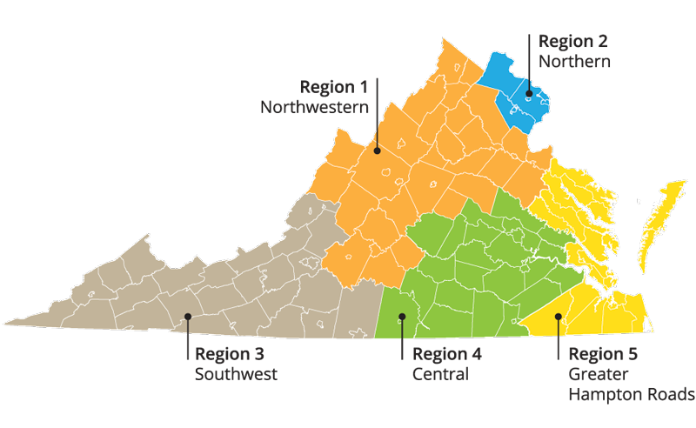
Regional Suicide Prevention Initiatives
Notes:
In an effort to increase capacity to address suicide prevention and promote mental health wellness, DBHDS OBHW provides funding for regional suicide prevention plans that implement evidenced based initiatives and strategies.

Slide 3
Community Services Board
Community Services Board (CSB) are the point of entry into the publicly funded system of services for behavioral health and intellectual disabilities. As the behavioral health and wellness experts, CSBs strive to improve the quality and productivity of lives of individuals who experience intellectual disabilities, challenges associated with mental health, substance use and thoughts of suicide.
They are our partners!
There are 40 Community Services Boards

Slide 4
What do CSBs do?
Promote resiliency in youth and communities through prevention and education activities.
Meet the residential, outpatient, employment, and day support service needs of individuals with severe mental illness.
Effectively treat individuals with substance use disorders.
Respond to psychiatric emergencies, 24 hours a day.
Insure the growth and development of infants who are or at risk of development disabilities, birth to age three, as well as supporting their families.
Enable children and youth with behavioral health and developmental disability service needs to remain in their homes, schools and communities.
Offer opportunities for occupational and residential independence for individuals with developmental disability.
Support the efforts of schools, Departments of Social Services, law enforcement agencies and courts in a coordinated manner.
Prevent further incidence of behavioral health and developmental disability service needs.
Support the care of older adults with behavioral health and developmental disability service needs and their families.
Assist families in caring for members with behavioral health and developmental disability service needs.

Slide 5
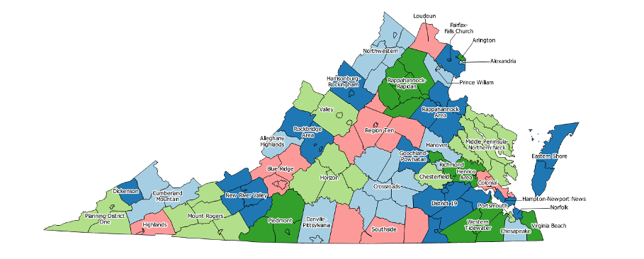
CSB Jurisdictions
Notes:
http://www.dbhds.virginia.gov/community-services-boards-csbs
Here is a map to show were all the CSBs are located
As I mentioned earlier they are split into 5 regions

Slide 6
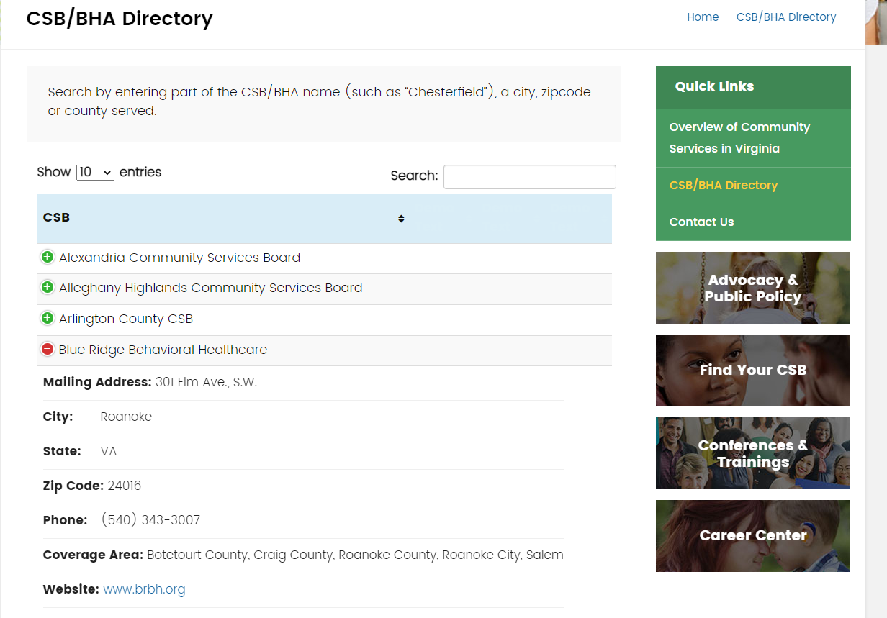
Notes:
https://v
If you go to the VACSB.org Directory page you can search your city or county by name or click on each CSB to see what counties/cities they cover. This is an example of how that would look. acsb.org/csb-bha-directory/

Slide 7
Mental Health Facts from the Mental Health First Aid
“Each year, people belonging to racial and ethnic minority groups experience worse behavioral health status and treatment outcomes, along with more difficulty accessing services, than their peers in other groups.”
For example:
Black Americans are 20 percent more likely to experience serious mental health problems
Black adults are more likely to report feelings of sadness, hopelessness and worthlessness than white adults, but less than 9% of Black adults receive mental health services, compared to 18.6% of white adults.
Stigma can be one of the many reasons that some chose not to seek care.
“Black Americans are also more likely to be exposed to factors that increase the risk for developing a mental health condition, such as homelessness and exposure to violence.”
Adverse Childhood Experiences (ACES) can contribute to those factors
Over 25% of Black youth who have been exposed to violence have been shown to be at high risk for post-traumatic stress disorder (PTSD).
(Mental Health First Aid, 2021)
Notes:
https://www.mentalhealthfirstaid.org/2021/02/supporting-the-black-community-as-a-mental-health-first-aider/

Slide 8
Impact of Mental Health
Mental Health can affect a person’s thinking, emotional state and behavior.
Disrupts the person’s ability to:
Work or attend school.
Carry out daily activities.
Engage in satisfying relationships
What can I do to help? How can I be of support?

Slide 9

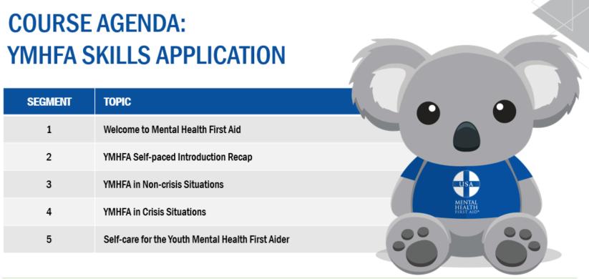
Get trained in MHFA!

Slide 10
MHFA in VIRGINIA
Virginia has:
Over 84,539 consumers trained as Mental Health First Aiders
Over 700 Certified MHFA Instructors
The main curriculums taught are Adult and Youth (both in English and Spanish).
Per the code, the Virginia Department of Behavioral Health administers the Mental Health First Aid (MHFA) Program to provide training by certified trainers to individuals residing or working in the Commonwealth on how to identify and assist individuals who may be developing or experiencing a mental health problem or substance misuse crisis.

Slide 11
Mental Health First Aid
Mental Health First Aid (MHFA) teaches you how to identify, understand and respond to signs of mental health and substance use challenges among adults and youth.
Risk factors and warning signs of mental health problems.
Gives you guidance on how to approach someone in a crisis or non-crisis situation
Information on depression, anxiety, trauma, psychosis (disconnection from reality) and addiction disorders.
Where to go for help (professional and peer) and self-help resources.
ALGEE- a 5-step action plan to help someone developing a mental health problem or who may be in crisis.
A – ASSESS for risk of suicide or harm
L – LISTEN non-judgmentally
G – GIVE information and encouragement
E – ENCOURAGE appropriate professional help
E – Encourage self help or other support
Notes:
https://www.mentalhealthfirstaid.org/about/

Slide 12
curriculums for specific target audiences offered
Adult and Youth are most popular and most often facilitated
Additional curriculums for specific target audiences offered:
Higher Education
Fire/EMS
Public Safety
Older Adult
Veterans
Spanish
Rural
Teen (offered in schools not at the local Community Services Board)

Slide 13
How It Is Facilitated
In-person – Learners will receive their training as an 8-hour, Instructor-led, in-person course.
Blended (Virtual) – Learners complete a 2-hour, self-paced online course, and participate in a 4.5- to 6.5-hour, Instructor-led training on Zoom.
Blended (In-Person) – Learners complete a 2-hour, self-paced online course, and participate in a 4.5- to 6.5-hour, Instructor-led training in-person.

Slide 14
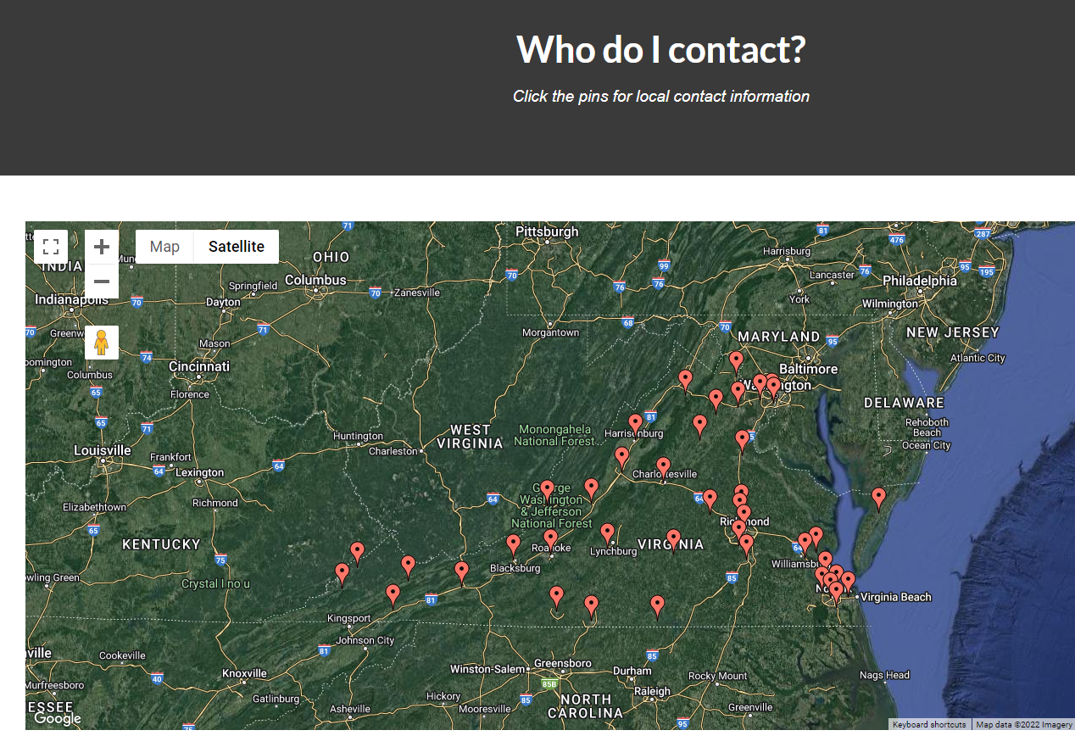
How do I find a trainer?
Notes:
Https://lockandtalk.org/about/
You can find trainers on Lock an Talk. Org on their about page. It has a map that has each CSB linked.

Slide 15
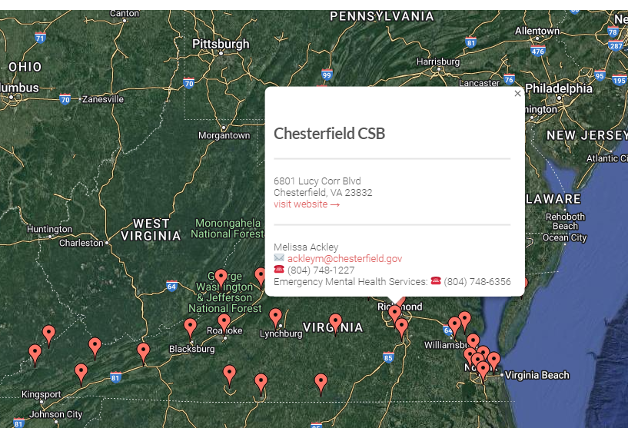
Click the Red Pin for CSB Address and Contact Information
Notes:
When you click on the red pin it pulls up the name, address, and the prevention managers contact information. So that Is the just of MHFA, but next I am going to share additional programs and resources.

Slide 16
Additional DBHDS Trainings and Resources

Slide 17

Suicide Prevention Interagency Advisory Group
Notes:
SPIAG:
DBHDS/VDH coordinates activities of agencies in the Commonwealth to promote comprehensive suicide prevention strategies that address public awareness, health development promotion, early identification, intervention and treatment, and support to survivors. The Suicide Prevention across the Lifespan Plan for the Commonwealth of Virginia serves as the framework for our efforts.
To join SPIAG please email: Alisha.Anthony@dbhds.Virginia.gov and she can get you connected.

Slide 18


The Suicide Prevention Plan for Virginia
Effective suicide prevention efforts require the engagement and commitment of multiple sectors and agencies.
Collaborative efforts are necessary to raise awareness of community risk factors for suicide and to reduce the associated stigma of mental health issues.
Presents seven goals to reduce and prevent suicide.

Slide 19
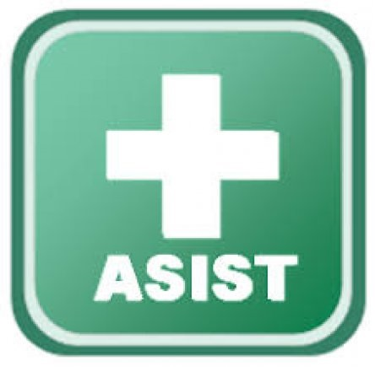

Suicide Prevention Trainings
Notes:
safeTALK: You'll learn how to prevent suicide by recognizing signs, engaging someone, and connecting them to an intervention resources
ASIST: ASIST is a 2-day training program that teaches participants how to assist those at risk for Suicidal Thinking, Behavior, Attempts.

Slide 20
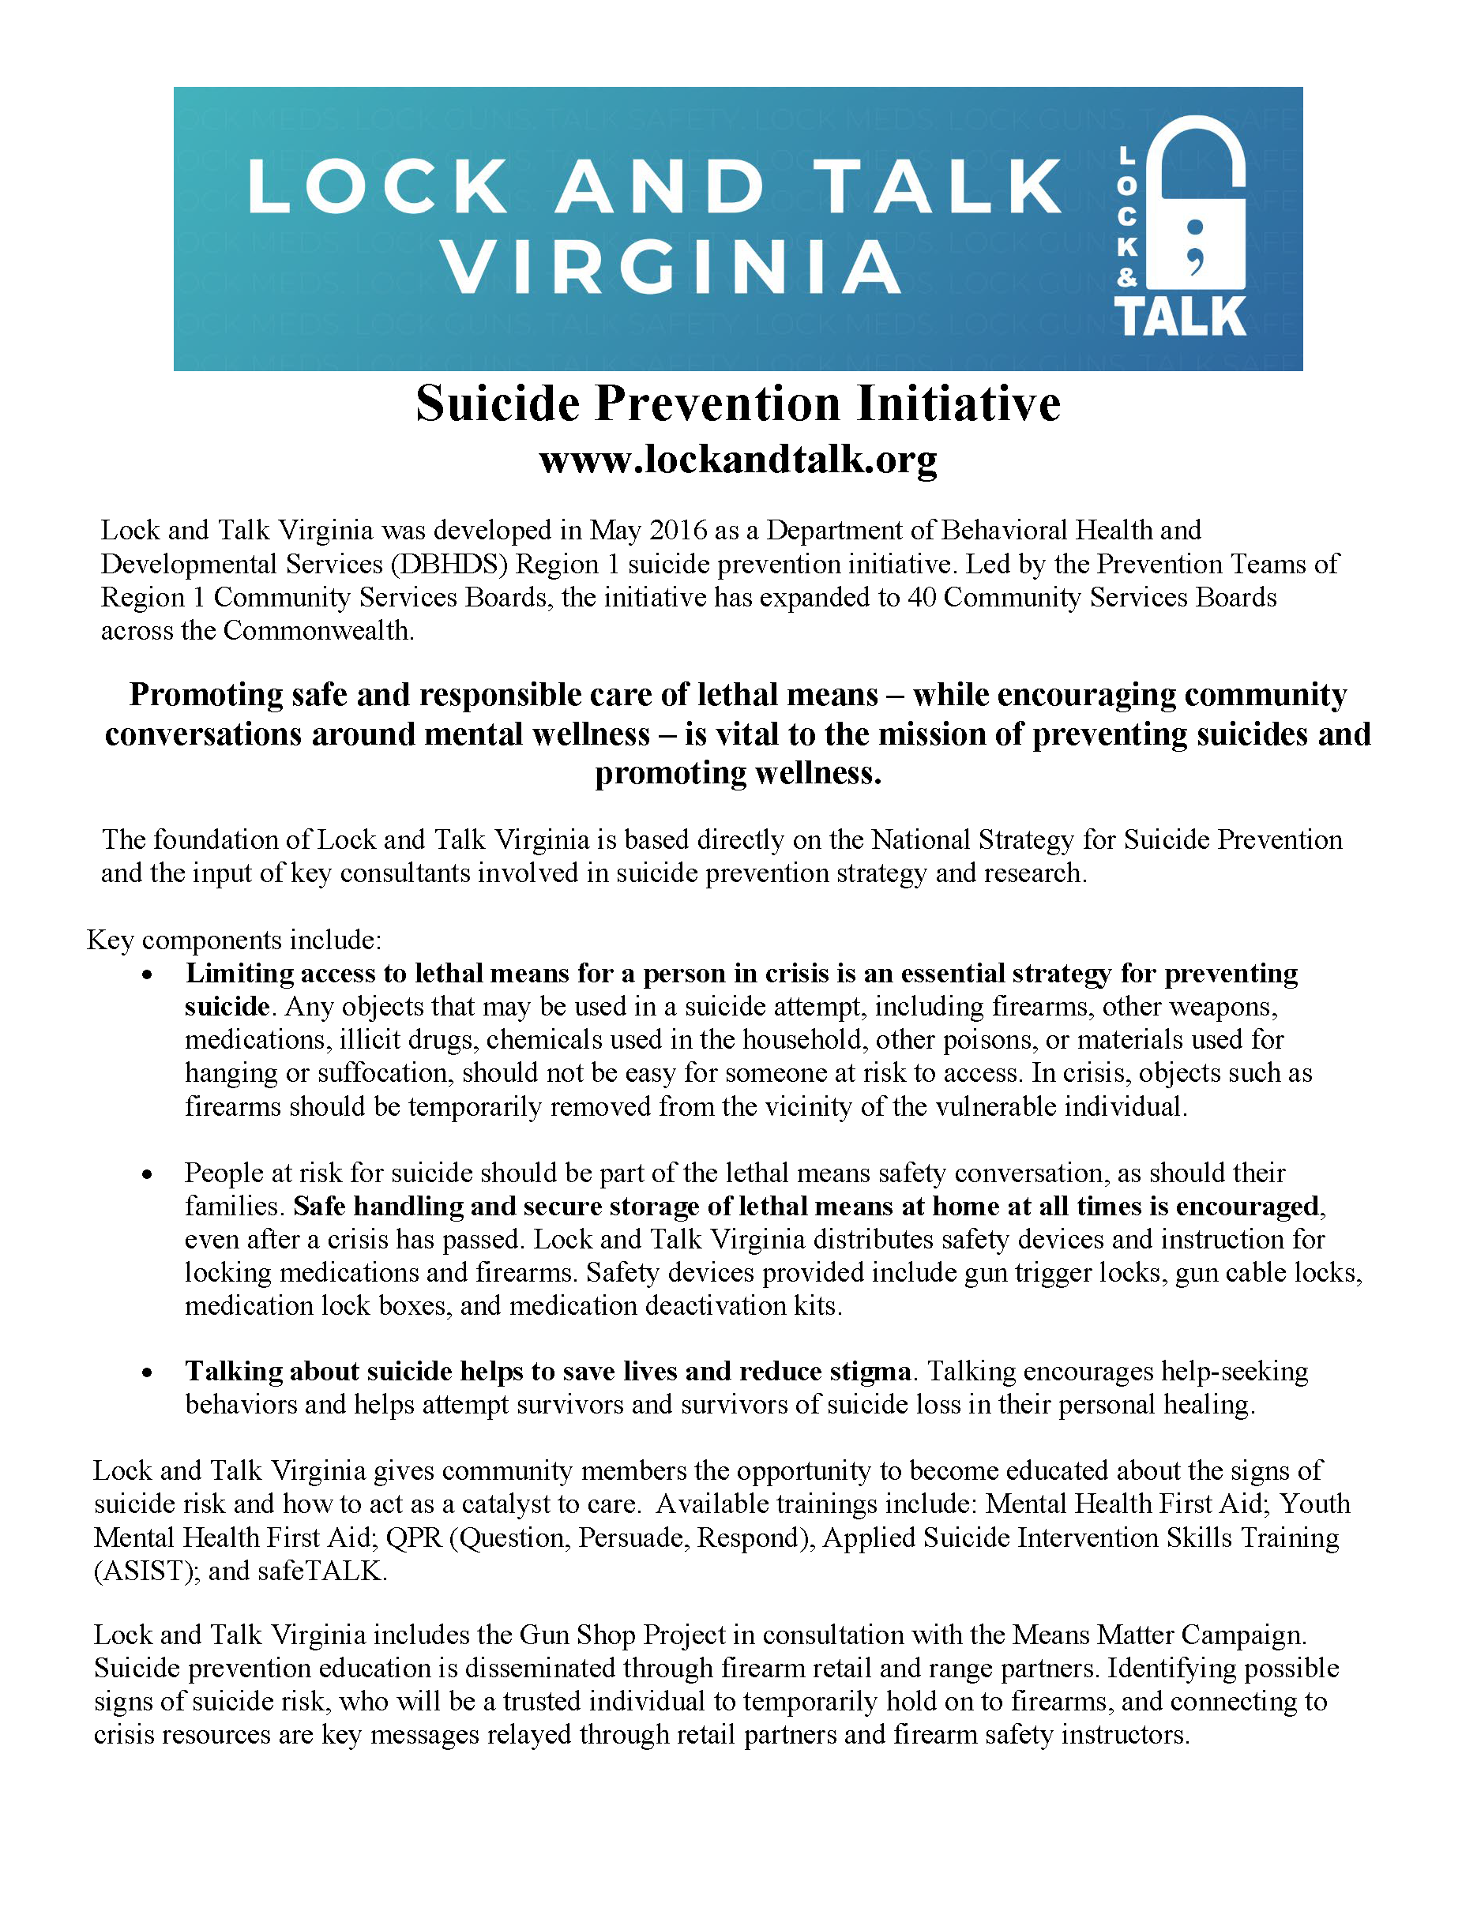
Lock and Talk Virginia
Promoting safe and responsible care of lethal means – while encouraging community conversations around mental wellness – is vital to the mission of preventing suicides and promoting wellness.

Slide 21

Lock and Talk Virginia
Promote mental health wellness and suicide prevention trainings.
Provide gun locks and med lock boxes
Implement the Gun Shop Project.
Promote the “We are a Lock and Talk Family Campaign.

Slide 22
Black Mental Health Matters: Resource Guide created by the National Council for Wellbeing
Social Media Resources
Black Male Mental Health on Instagram
Bio Breakdown: “Our perspective, our stories, our brilliance, our healing.”
Black Mental Health Alliance on Instagram and Twitter
Bio Breakdown: “Trusted forum for culturally-competent mental health programs and services for marginalized communities.”
Alkeme Health on Instagram
Bio Breakdown: “Alkeme is a digital health platform designed to empower, heal, and inspire – creating a legacy of generational health.”
The Loveland Foundation on Instagram
Bio Breakdown: “Loveland Foundation is committed to showing up for communities of color in unique and powerful ways, with a particular focus on Black women and girls.”
Inclusive Therapists on Instagram
Bio Breakdown: “Therapy directory that celebrates ALL: Identities, Abilities & Bodies”
Melanin & Mental Health on Instagram and Twitter
Bio Breakdown: “Promoting mental wellness of Black/Latinx people”
Depressed While Black on Twitter
Bio Breakdown: “Black-affirming mental health nonprofit founded by Imadé”
Main website for all resources listed: https://www.mentalhealthfirstaid.org/2022/02/black-mental-health-matters-a-resource-guide/
Notes:
Additional resources from the National Council for wellbeing: https://www.mentalhealthfirstaid.org/2022/02/black-mental-health-matters-a-resource-guide/

Slide 23
Black Mental Health Matters: Resource Guide created by the National Council for Wellbeing Resources continued…
Websites
Black Mental Wellness provides access to evidence-based information and resources about mental and behavioral health topics from a Black perspective. Check out the site’s Coping & Wellness tab for actionable strategies like how to discuss race, discrimination and racial trauma with youth.
Therapy for Black Girls was developed to present mental health topics in a way that feels more accessible and relevant to Black women, who are often discouraged from taking steps to see a therapist due to stigma.
Therapy for Black Men is working to dismantle the stigma that asking for help is a sign of weakness. The organization provides free therapy for men in a judgment-free, multiculturally competent setting.
Racism and Anti-Racism in America – A free online training series from the University of Michigan on dismantling systemic racism.
Black Emotional and Mental Health Collective (BEAM) is removing barriers that Black people experience getting access to or staying connected with emotional health care and healing and offers a nationwide directory of Black therapists who are available virtually.
African American Behavioral Health Center of Excellence (AABH CoE), from the Substance Abuse and Mental Health Services Administration, is determined to help transform mental health and substance use care for African Americans, making it safer, more effective, more accessible, more inclusive, more welcoming, more engaging and more culturally appropriate and responsive.
Main website for all resources listed: https://www.mentalhealthfirstaid.org/2022/02/black-mental-health-matters-a-resource-guide/
Notes:
Main website for all resources listed: https://www.mentalhealthfirstaid.org/2022/02/black-mental-health-matters-a-resource-guide/

Slide 24
Mental Health America -BIPOC Mental Health Month 2022
BIPOC Mental Health Month 2022 - Toolkit Download
These materials have been designed for desktop printing, but they are high enough quality to send to a professional printer. If you have questions, please email Allissa Torres, Director of Mental Health Equity at atorres@mhanational@org.
Download The Full BIPOC Mental Health Month Toolkit
Full Toolkit (PDF)
Download Individual Toolkit Items
Handouts
Worksheet: Talking to Your Loved Ones About Mental Health (PDF)
Worksheet: Choosing the Right Mental Health Care for You (PDF)
(Printer-Friendly) Resources List (PDF)
Social Media Materials
Shareable Social Media Images (Zip File)
To unzip a folder, locate the zipped (or compressed) folder that you want to get the files from. You can either open the compressed folder and drag each item to a new location, OR you can right click the folder and select "Extract All.." and choose a location, like on your network or desktop.
This campaign is supported by contributions from Alkermes, CVS Health, Janssen: Pharmaceutical Companies of Johnson & Johnson, and Otsuka America Pharmaceutical, Inc.
Notes:
https://mhanational.org/bipoc-mental-health-month-2022-toolkit-download

Slide 25
Contact Information
Mental Health First Aid
Alisha Jarvis : Alisha.Anthony@dbhds.viriginia.gov
Lock and Talk Virginia
Rebecca Textor: rebecca.textor@dbhds.virginia.gov
Suicide Prevention
Nicole Gore: Nicole.gore@dbhds.Virginia.gov

