Slide 1
Gifts that Keep on Giving:
Education and Resources for Better Health
Virginia Partners in Prayer and Prevention – December 15, 2022

Slide 2
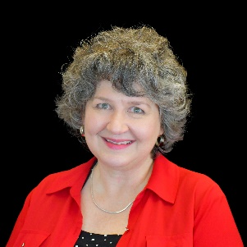
Today’s Speakers
Carla
Carla Thomas
Cindy Warriner
Carla
Director/Consulting Manager
Senior Consultant Pharmacist

Slide 3
About HQI
Independent, nonprofit consulting organization helping health care providers and communities improve care delivery and patient outcomes since 1984
Federal contractor for over 35 years
HQI-led programs have improved outcomes for millions of Americans
Headquarters in Richmond, Virginia
Staff are located throughout the U.S. in 27 states19

Slide 4
More About HQI
Our Team Includes:
Former hospital executives
Nursing home administrators and practice managers
Nurses
Behavioral health clinicians
Health information managers
Health communicators
Pharmacists
We Are:
Experts in care delivery improvement, population health management, and health information technology optimization

Slide 5
What We Do
Population Health Management
Make communities healthier by identifying, reaching and caring for people at risk of developing chronic disease or its consequences.
Care Delivery Improvement
Streamline processes, adopt best practices, improve performance and create a culture that supports and sustains quality.
Health IT Optimization
Reap the benefits of technology through approaches that put patient care first and minimize the burden on providers.

Slide 6
Share
What type of health program do you have in your church?
Health-related staff position
Volunteer health committee
Partnerships with community organizations
Parish Nurse program
Other
None

Slide 7
Medicare Initiative Topics
Chronic Conditions
(Diabetes, High Blood Pressure, Chronic Kidney Disease)
Opioids
Medication Safety
Vaccinations (COVID, Flu, Pneumonia)
Care Coordination
(Frequent ER Visits, Hospital Readmissions)

Slide 8
Share
Which health topics are of most interest to you or your congregation?
Diabetes
Blood Pressure
Medication Safety
Opioids
Vaccines
Care Coordination
Other

Slide 9
We can help…
No-cost support for your health-related efforts:
Education
Resources
Project support
Consultation
Connections

Slide 10
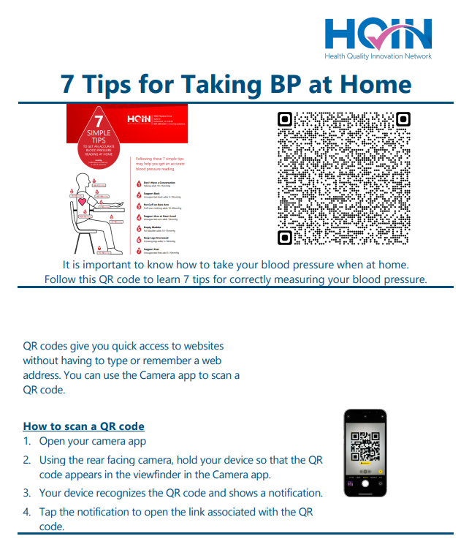
Blood Pressure Resources
Examples
Preparing for Doctor’s Visit
DASH Diet
Fact Sheets
Blood Pressure Basics
High BP Calculator Tool
Lower Your Risks
ABCS of Heart Health
… and many more!
QR Code Resource link:
https://hqin.org/resource/qr-code-resources-for-providers-to-display-for-patients/

Slide 11
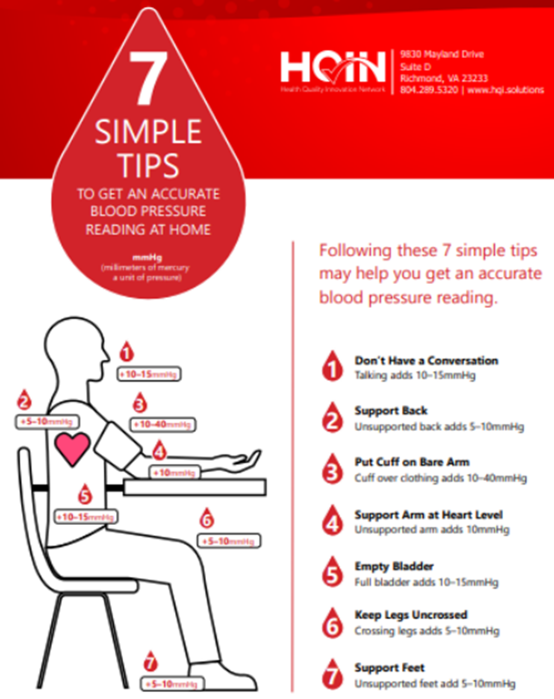
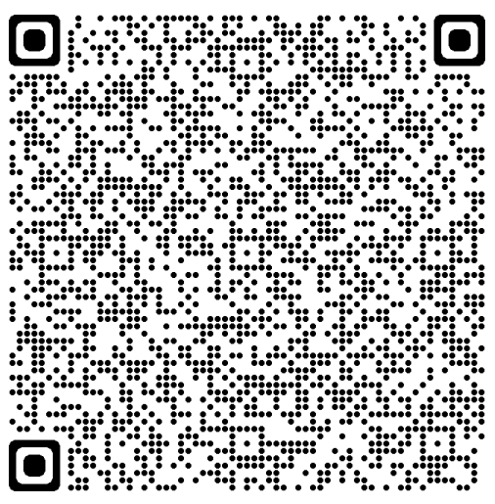
BP Resource Example

Slide 12
Additional BP Resource Links
Using Medicines to Control Your High Blood Pressure (hqin.org)
Blood Pressure and Kidney Disease (hqin.org)
Control Your Blood Pressure (hqin.org)
Blood Pressure Tips At Home Infograph (hqin.org)

Slide 13
Another Idea…
A 4-month long CDC-approved lifestyle change program that supports adults with high blood pressure lower and manages blood pressure.

Slide 14
Diabetes
Diabetes Prevention Programs (DPP)
Diabetes Self-Management Education Programs (DSME)
Chronic Care Management (CCM)
Resources

Slide 15
Diabetes
Key HQIN Resources
Educational Diabetes Resource List | HQIN
For People with Diabetes Blood Sugar Diary (hqin.org)
It's Good to Know About Your Diabetes From Head to Toe (hqin.org)
It's Important to Watch Your Glucose (hqin.org)

Slide 17
Medication Safety
Opioids and beyond….
Mind Your Meds: Safe Opioid Medication Use and Disposal | SeniorNavigator
-Controlled Substance Public Disposal Locations - Search Utility (usdoj.gov)
-REVIVE! Opioid Overdose and Naloxone Education (OONE) program for the Commonwealth of Virginia - Virginia Department of Behavioral Health and Developmental Services

Slide 18
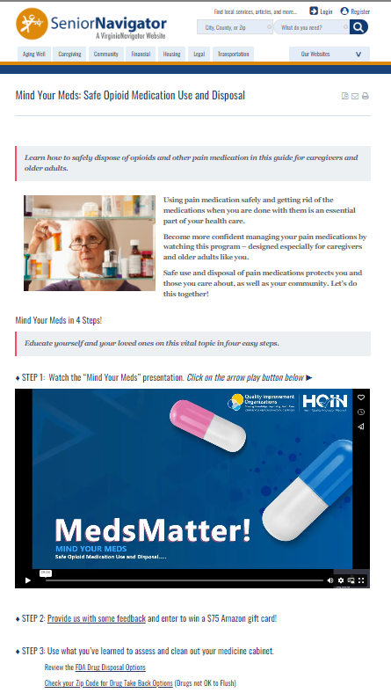
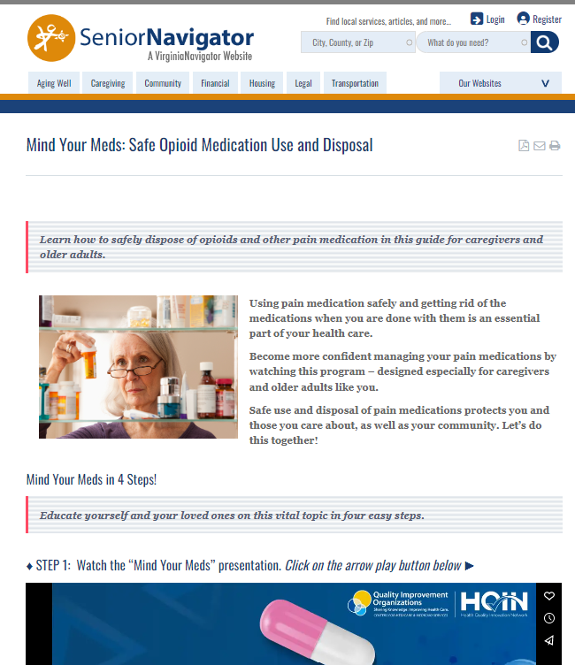
“Mind Your Meds”
Short, recorded education video with resource links.

Slide 19
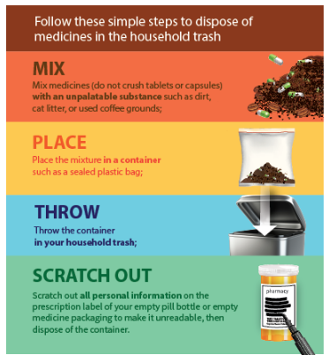
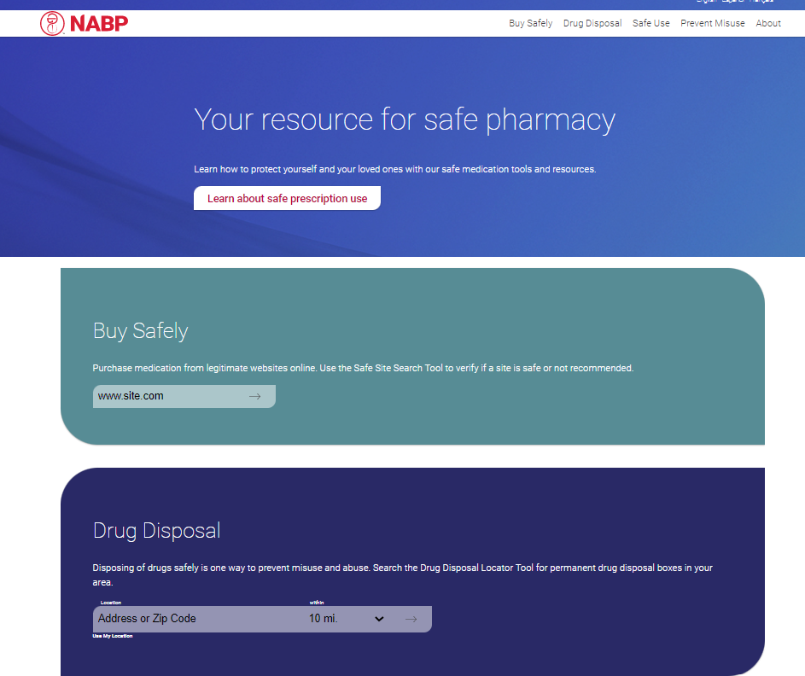
Safe Disposal Resources
Safe Website
Purchase
Resources
Home - Safe.Pharmacy

Slide 20
Medication Log | HQIN

Slide 21
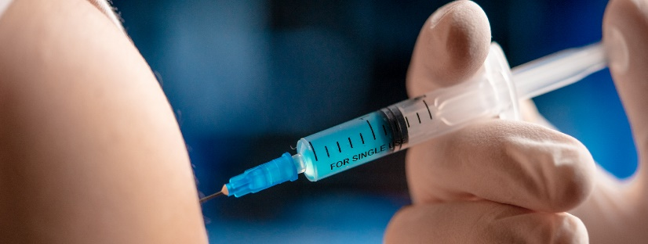
Vaccination Resources
Free Items and Links to Share
Flu or COVID-19? (hqin.org)
7 Questions About the COVID Bivalent Vaccine (hqin.org)
Bivalent Booster Graphic (hqin.org)
Simple Strategies for Resident Flu and Pneumococcal Vaccines (hqin.org)
COVID Exposure Infographic (hqin.org)
I-Got-a-Booster-Poster_animal_508.pdf
Myths and Facts about COVID-19 Vaccines | CDC
Misconceptions about Seasonal Flu and Flu Vaccines | CDC
Take 3 Actions to Fight Flu (cdc.gov)
essential-worker-flyer-8.5x11.pdf (cdc.gov)

Slide 22
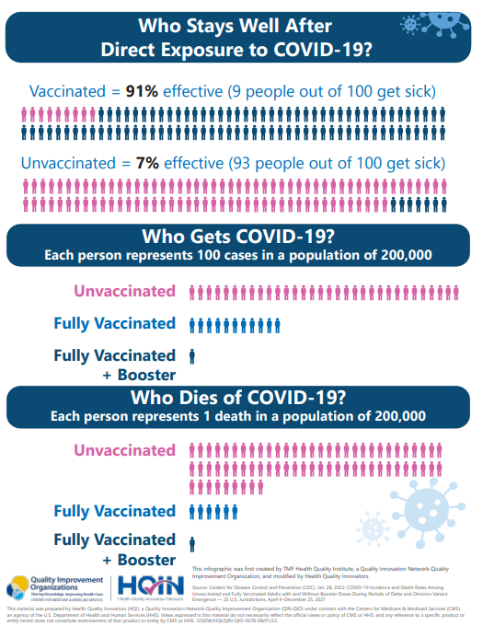

Slide 23
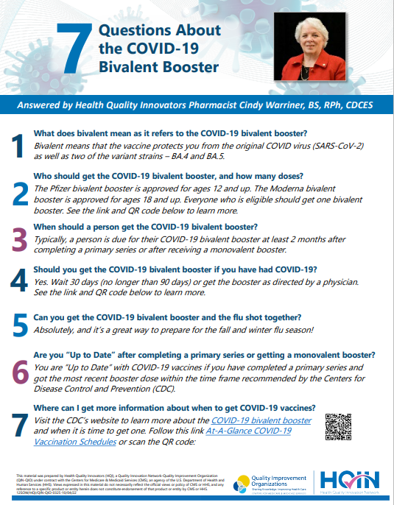
Vaccine Resources - continued
Q&A Resources
Q&A Sessions with local Pharmacists
Myth-busting!

Slide 24
Care Transitions
Work with community partners to support great community-based care
Locate local partners and programs to support your congregation after hospitalization to reduce avoidable returns.
Empower individuals to identify their healthcare advocate or become a stronger advocate for themselves.
Conduct education about resources.

Slide 25
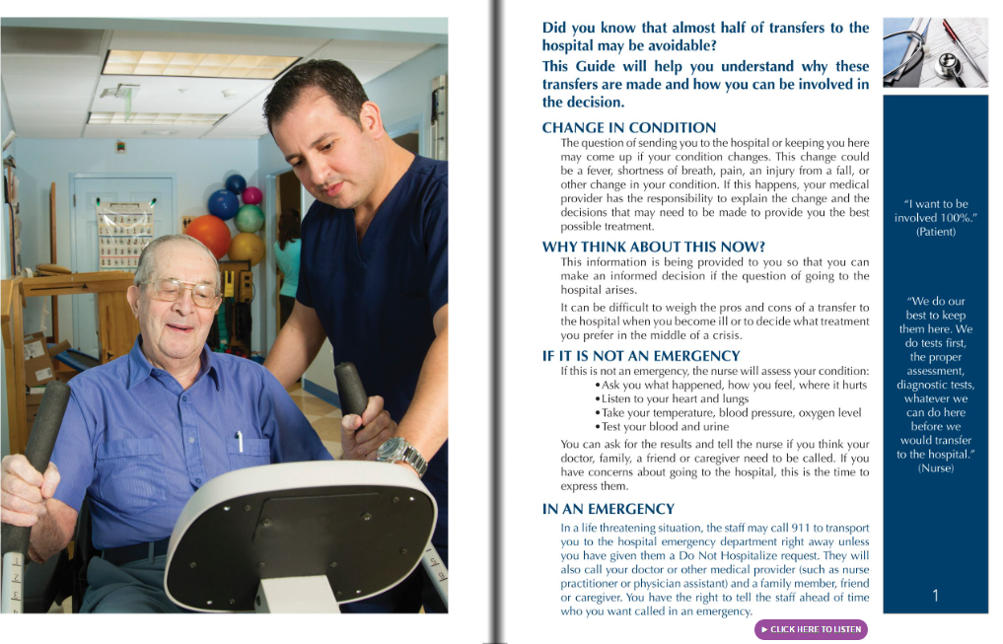
www.decisionguide.org
Go to the Hospital or Stay Here Decision Guide

Slide 26
Please share….
What resources shared today are of most interest to you?
QR Codes
Blood Pressure
Diabetes
Vaccines
Medication Resources
Care Coordination/Readmissions

Slide 27
Next Steps
What gifts are you going to open?
I have identified at least one resource I can use
I want to meet with Carla or Cindy to talk about my church programs
I want to share what I’ve learned today with my pastor and church leadership
I will review the shared resources
I’m not sure where to start and would like some assistance

Slide 28
Questions?

Slide 29
CONNECT WITH US
Call 877.731.4746 or visit www.hqin.org
Carla Thomas, cthomas@hqi.solutions
Cindy Warriner, cwarriner@hqi.solutions
@HQINetwork
Health Quality Innovation Network
This material was prepared by Health Quality Innovators (HQI), a Quality Innovation Network-Quality Improvement Organization (QIN-QIO) under contract with the Centers for Medicare & Medicaid Services (CMS), an agency of the U.S. Department of Health and Human Services (HHS). Views expressed in this material do not necessarily reflect the official views or policy of CMS or HHS, and any reference to a specific product or entity herein does not constitute an endorsement of that product or entity by CMS or HHS. 12SOW/HQI/QIN-QIO-0377-12/13/22

