Slide 1

Financial Assistance Programs for Dialysis and Transplant Patients
April 20, 2023
Erick Guerra, Patient Support Operations Manager

Slide 2

Our Mission
We achieve our mission by providing financial support to patients in need, and by delivering programs that educate, build awareness and drive advocacy, resulting in greater public understanding and ultimately the prevention of kidney disease.
We help people fight kidney disease and live healthier lives.
Notes:
The American Kidney Fund was created in 1971 to help just one patient since then we have helped hundreds of thousands of patients. Through our mission, we help people fight kidney disease and live healthier lives. We provide financial support, we educate, build awareness about kidney disease through our advocacy programs. We hope that our actions also create greater public understanding in the hopes to ultimately prevent kidney disease.

Slide 3
AKF’s Financial Assistance Programs
ADVOCACY
AWARENESS
FINANCIAL
ASSISTANCE
PREVENTION
Provide low-income ESRD patients financial assistance to ensure that they have access to lifesaving medical treatment, including dialysis and transplantation.
We assist 1 in 6 dialysis patients nationwide; we make about 100 kidney transplants possible each month—7.5% of all kidney transplants in the U.S.—and we continue assisting patients post-transplant.
FINANCIAL ASSISTANCE
RESEARCH
PUBLIC EDUCATION
PROFESSIONAL ENGAGEMENT
Notes:
As noted, AKF was started to help one patient and over the last 50 years, we've continued to expand our grant programs. Our financial assistance programs provide low income ESRD patients with grants to ensure that they have access to life saving medical treatment including dialysis and transplants. Currently a AKF is assisting one out of every six dialysis patients nationwide. Assisting with insurance premiums helps us to make about 100 kidney transplants possible every month - that's about 7.5% of all transplants nationwide.

Slide 4
2023 AKF Financial Assistance Programs Eligible dialysis and transplant patients may not exceed a documented gross annual income of up to 500% of the Federal Poverty Level (FPL) .
Health Insurance Premium Program (HIPP)
Disaster Relief
Safety Net
Safety Net (DMV)
Notes:
Here is a list of AKFs current financial assistance programs. There are 4 active ones. Our Health Insurance Premium Program, the Disaster relief Program which provides help to patients impacted large disasters such as floods and hurricanes. We most recently assisted patients impacted by both Fiona and Ian.) Our Safety Net Program and the subsidiary of the Safety Net Program which is specifically for patients who reside in Maryland Virginia and the District of Columbia, and we have our Post-transplant Testing Program. To be eligible for each of these programs, dialysis and transplant patients may not exceed a documented gross annual income of 500% of the Federal Poverty Level, also know as FPL. They also may not have more than 30,000 dollars in liquid assets.

Slide 5
Grant Assistance Eligibility Criteria
Qualified patients may not exceed a household income of 500% of the Federal Poverty Level (FPL) and may have liquid assets of up to $30,000 (excluding IRAs/retirement accounts).
Patients already enrolled in Low-Income Home Energy Assistance Program (LIHEAP), Temporary Assistance for Needy Families (TANF), HUD housing assistance, or Supplemental Nutritional Assistance Program (SNAP) will automatically qualify for AKF financial assistance once their documentation is approved by AKF.
Notes:
To qualify for AKF financial assistance dialysis patients may not exceed a household income of 500% of the federal poverty level and their liquid assets may not exceed $30,000. We do not include retirement accounts in the liquid asset maximum. If the patient is already enrolled in LIHEAP, TANF, HUD or SNAP, they're automatically qualified because those programs do fall within an our income levels. They will need to provide documentation of the stated financial income.

Slide 6
Safety Net Program
AKF was founded in 1971 when a group of neighbors came together to help pay the cost of dialysis for a member of their community. Since then, the Safety Net Program (SNP) has been AKF’s flagship program.
SNP can assist dialysis patients and recent transplant patients with treatment-related costs, such as transportation to and from dialysis, lodging for a transplant workup, medication co-pays, and nutritional supplement purchases. $200 maximum available per grant request once a year.
Maryland, Virginia, and DC have their own SNP programs with $250 grants.
Notes:
Firstly, I'd like to talk about our safety net program. In 1971, AKF was founded when a group of neighbors reached out to help one patient with the cost of their dialysis. This is our flagship program. Our safety net program assists dialysis patients and recently transplanted patients with treatment-related costs, such as transportation to get to and from treatment,, lodging to go for a transplant workup medication copays, the purchase of nutritional supplements. Patients may apply for up to $200 once per year. Maryland, Virginia, and DC patients have their own similar self funded program which will provide a grant of up to $250 per year.

Slide 7
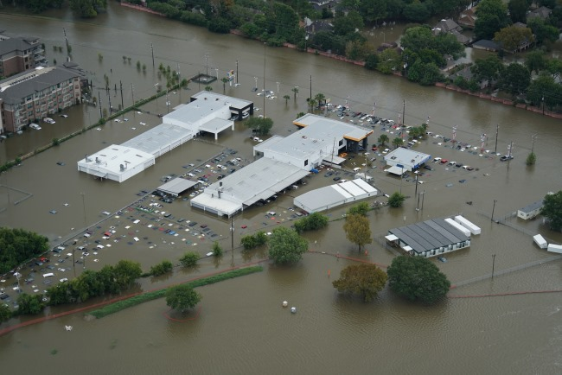



Disaster Relief Program
Helping kidney patients rebuild their lives
“It’s a sign of hope that people are being generous in a time of national and financial crisis.”
William, Dialysis patient
When a disaster occurs, the Disaster Relief Program (DRP) can help dialysis patients with grants for areas of need such as transportation, temporary lodging, home repair, and food replacement.
Following a natural disaster, AKF will reach out to the Kidney Community Emergency Response (KCER) Coalition, as well as the area ESRD networks, to gauge patient need. If the need is great enough and sufficient funding is available, AKF will open the program.
The Disaster Relief Program (DRP) has provided millions in assistance to help dialysis patients rebuild their lives following natural disasters.
Notes:
The disaster relief program assists with large disasters for expenses such as transportation (because we know that often transplant patient or dialysis patients may be may have to stay somewhere further away from their treatment center, lodging, if they've been displaced from their home, home repairs, and food replacement. AKF will reach out to the Kidney Community Emergency Response coalition to assess emergent needs so that we can open the program very quickly and get assistance out for our patients. AKFs Disaster Relief Program has provided millions in assistance to help dialysis patients to continue to have treatment and rebuild their lives during natural disasters. This program is also open to try to do that too recently transplanted patients. Grants are generally $200 per request.

Slide 8
AKF’s Health Insurance Premium Program (HIPP)
HIPP was established in 1997 and operates under an Advisory Opinion from the Department of Health and Human Services (HHS) Office of the Inspector General (OIG). Opinion 97-01 governs HIPP and may be found on the HHS website.
HIPP pays premiums for Medicare Part B, COBRA, Medigap, EGHP, commercial policies (Exchange/Off-Exchange ACA plans) and in some cases, Medicaid premiums.
Notes:
AKF’s Health Insurance Premium Program was established in 1997 and it operates under advisory opinion 97-1 to ensure strict compliance. The program does assist with premiums for Medicare Part B, COBRA, medigap, EGHP plans, commercial policies such as exchange or off exchange plans, and in some cases Medicaid premiums, if there is a any sort of a premium attached.

Slide 9
HIPP Eligibility for Dialysis Patients
Applicants must:
Permanently reside in the U.S. or its territories.
Receive regular dialysis treatment for ESRD in the U.S. or its territories.
Patients receiving dialysis for acute kidney injury (AKI) are not eligible for assistance.
Applicants must meet the eligibility qualifications of the insurance coverage for which
premium assistance is being requested.
AKF does not assist in choosing insurance plans.
Notes:
To be eligible for insurance assistance, applicants must permanently reside in the US or one of its territories and must be receiving dialysis treatment. In the case of a transplanted patient - must have already been on the program to start the program We don't help acute injury patients. AKF does not dictate the insurance eligibility and patients seeking HIPP assistance must qualify for the insurance coverage for which they are requesting grant assistance. We don't help patients to pick the insurance or give out any kind of recommendations. These rules ensure that HIPP remains legally compliant under our advisory opinion 97-1.

Slide 10
How Do I Apply for Financial Assistance?
AKF’s Online Grants Management System
The Grants Management System (GMS) is AKF’s online portal through which all AKF grant requests are entered. AKF does not accept paper applications. Patient profiles, containing financial and other individual information are required to determine eligibility.
Renal professionals, caregivers, and patients can use GMS to apply for grant assistance, review payments, as well as to communicate with the Patient Support team through GMS Messaging.
The “Information” tab in GMS provides links to helpful resources, as well as archives of recent Patient Support webinars.
Notes:
AKF does not use paper applications. Everything is done online, in the database. Documents and forms can be uploaded into a patient’s file.
The messaging feature in GMS allows for free-flowing information between external users and AKF staff.
The information tab is a library of sorts and contains helpful guides and tools for education and training for GMS use.

Slide 11

Who can use GMS?
Understanding GMS
Patients: Dialysis and transplant patients may register as GMS users to submit their own grant requests, or to track the status of their grant payments. To receive post-transplant HIPP assistance, most patients will need to register and assume control of their account or have a family caregiver register.
Family Caregivers: Caregivers (Authorized with POA) may register for GMS and either claim their family member’s existing profile or enter a new one, then submit requests on the patient’s behalf.
Renal Professionals: All dialysis center/transplant center employees who register in GMS must register as Renal Professionals with their company email address.
Notes:
With the latest version of GMS, patients and family caregivers may enter their own grant requests for the first time.
While we have observed that most patients still prefer to enter grant requests through their renal professional, the option to enter their own requests is available for patients and caregivers who feel comfortable doing so.

Slide 12
How Do I Find AKF and GMS Online?
Website Information
More information about these programs and other educational information can be found on our website at www.KidneyFund.org.
The Grants Management System (GMS) can be found online at GMS.KidneyFund.org.

Slide 13
Contacting the Patient Support Team
For assistance and guidance:
Schedule An Appt
Schedule a 30-minute call appointment at gmsassist.com.
GMS Message
Send the Patient Support department a message through your GMS account.
Review GMS
Review the resource information under the GMS learning tab.
Live Call
Call 1-800-795-3226 to speak to a representative (Mon-Thurs 11AM – 2:30 PM Eastern).
Notes:
The Patient Support Team at AKF can be reached in 4 different ways….

Slide 14
American Kidney Fund Education and Outreach and Strategic Partnerships (OSP)
April 20, 2023
Eric Vicks, Director of Patient Advocacy

Slide 15



Addressing Health Disparities in Kidney Disease
Taking an Actionable Approach to Address Kidney Disease in Black and Latino Communities
American Kidney Fund Health Equity Coalition
CKD Prevention & Awareness
Participation in Clinical Trials
Access to Transplant
Home Dialysis Utilization
Notes:
The committee’s work will inform later phases which will be guided by a broader coalition of stakeholders made up of key steering committee participants, as well as supporting corporate partners. Possible project recommendations may include further study, a survey, or a programmatic recommendation to directly address identified issues and project goals.

Slide 16
AKF and Health Equity
Established priority of AKF since 1971
Since 2006, AKF has committed approximately $1.3 million of its annual budget toward outreach, education and prevention programs
In 2021, AKF secured an additional $350,000 sponsorship from AstraZenca to support AKF’s efforts to address health disparities related to kidney disease:
Kidney Disease Health Equity Coalition to advise and guide development of this initiative.
Data collection/evaluation to help inform various aspects of the campaign and AKF’s strategic plan
Microsite that will serve as a comprehensive communications and information hub to address the issue of health disparity through enhanced education, promotion and audience engagement for minority patients and the professionals responsible for their care.
Promotion and Media Relations

Slide 17
American Kidney Fund Public Education Prevention and Awareness Kidney Health Coach Kidney Kitchen®

Slide 18

DIGITAL RESOURCES: WEBINAR & VIDEO
WEBINARS
Navigating Your Transplant
Nutrition Resources
Depression and Kidney Disease
Humanizing Dialysis
VIDEOS
Patient to Patient
Cooking Demonstrations
Animated Videos on Nutrition
Tutorial Videos
KIDNEY KITCHEN
Over 500+ recipes
Nutrition facts for CKD patients

Slide 19

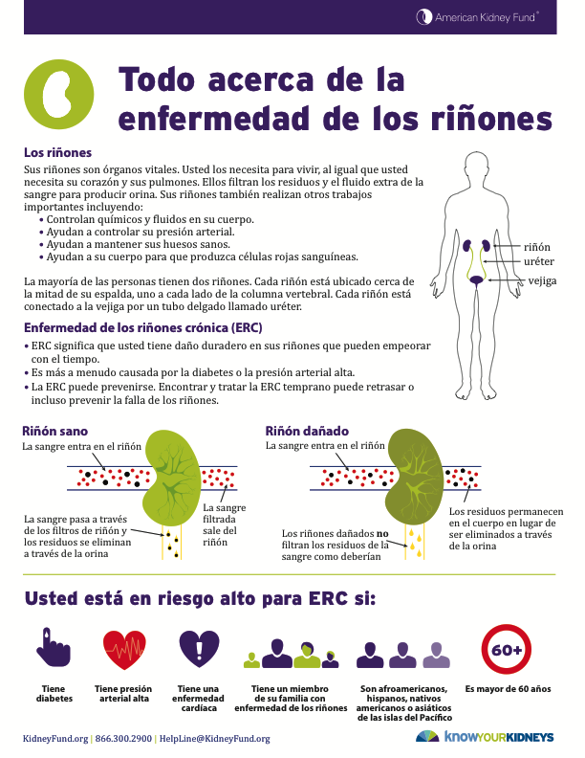
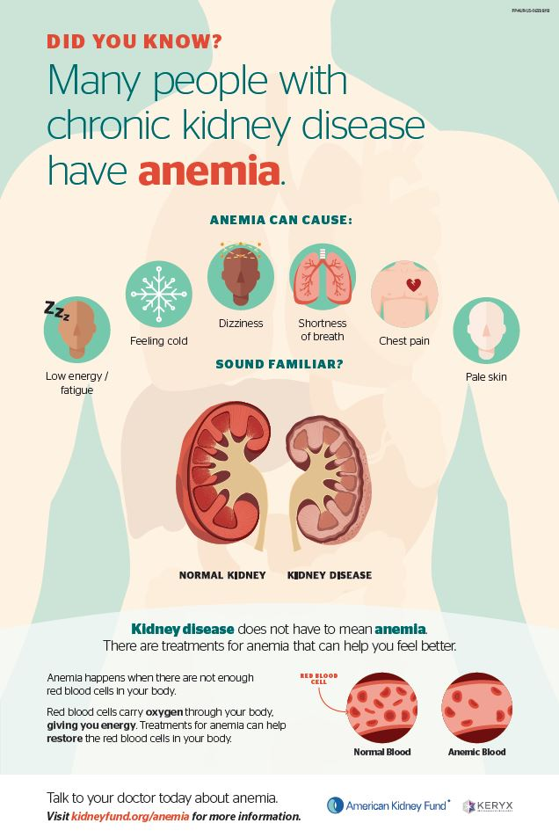
PRINTED MATERIALS
CONTENT CREATION
Reviewed by Medical Advisory Committee for clinical accuracy
Informed by patients
Adherence to principles of health literacy, and CDC and NIH guidelines on language
DISTRIBUTION
Award winning website
Screenings
Kidney Health Coach
Targeted partnerships

Slide 20

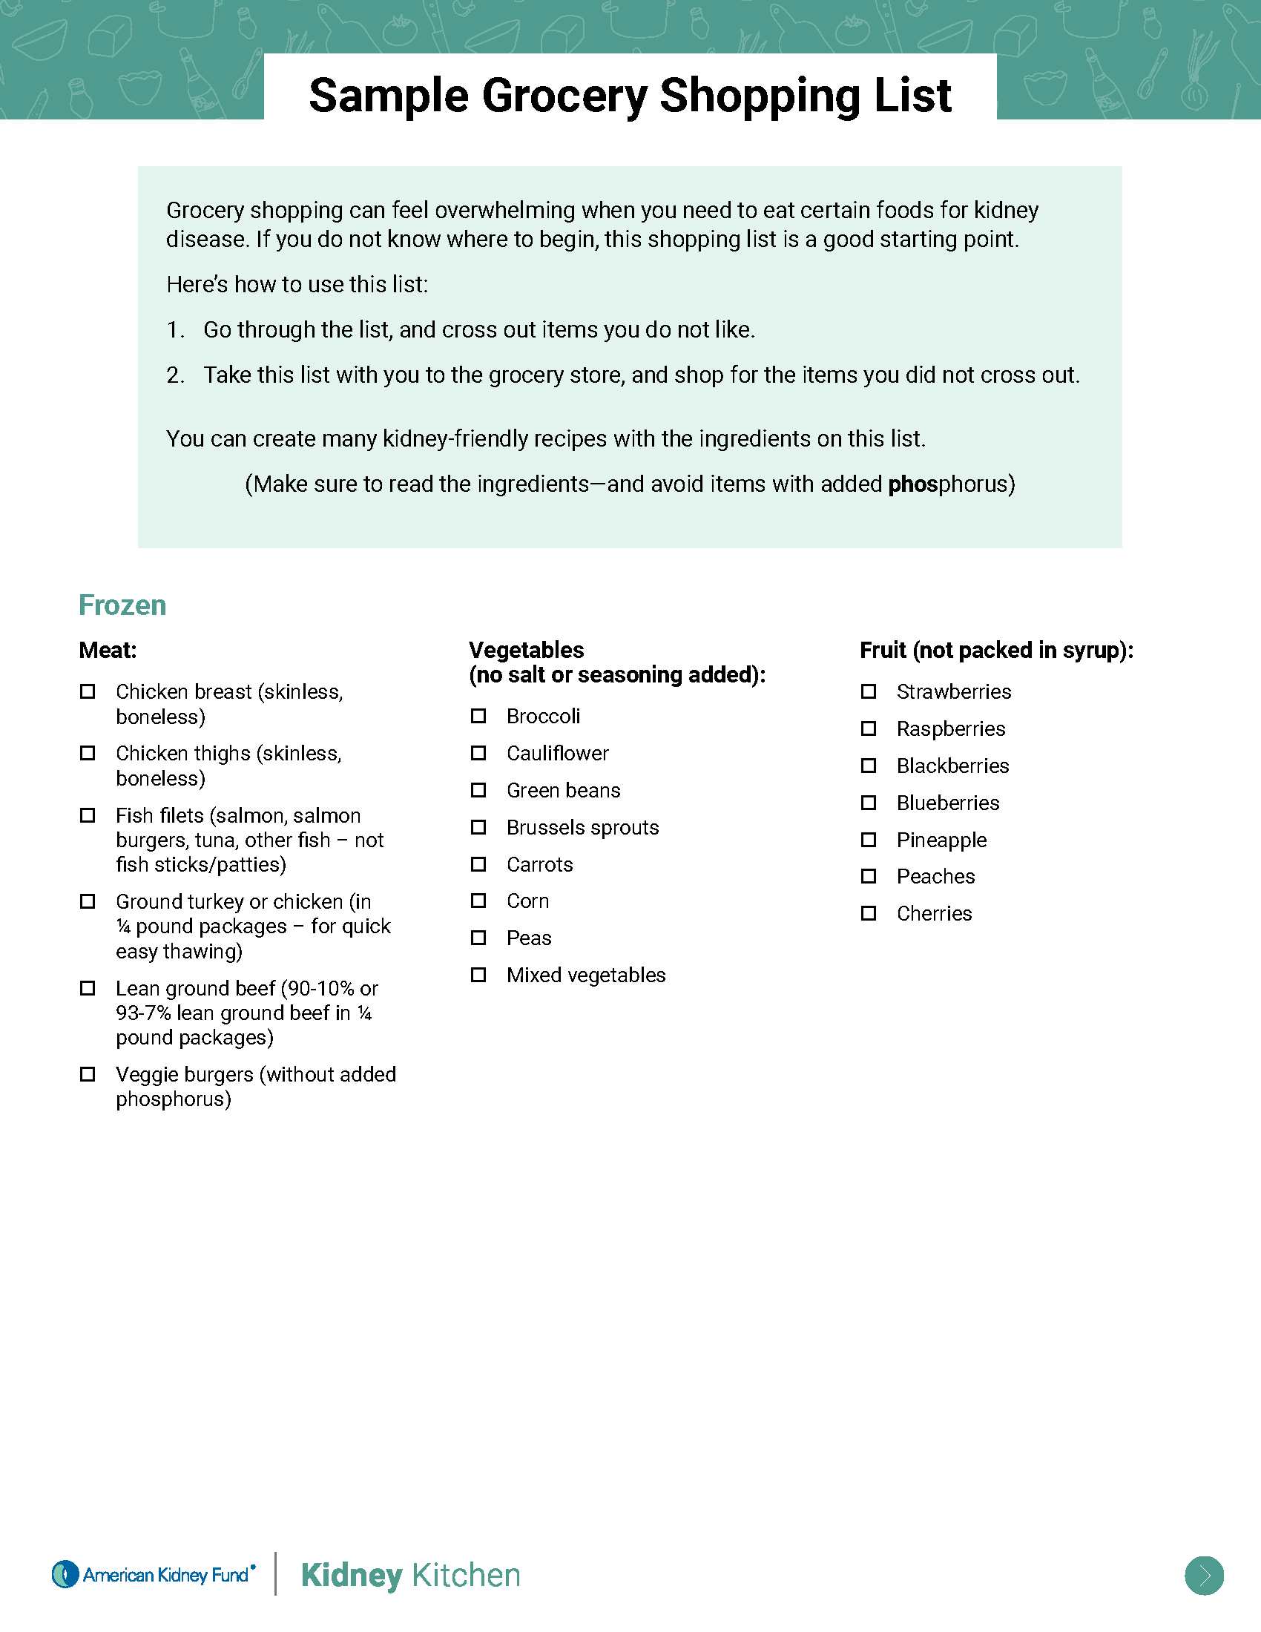
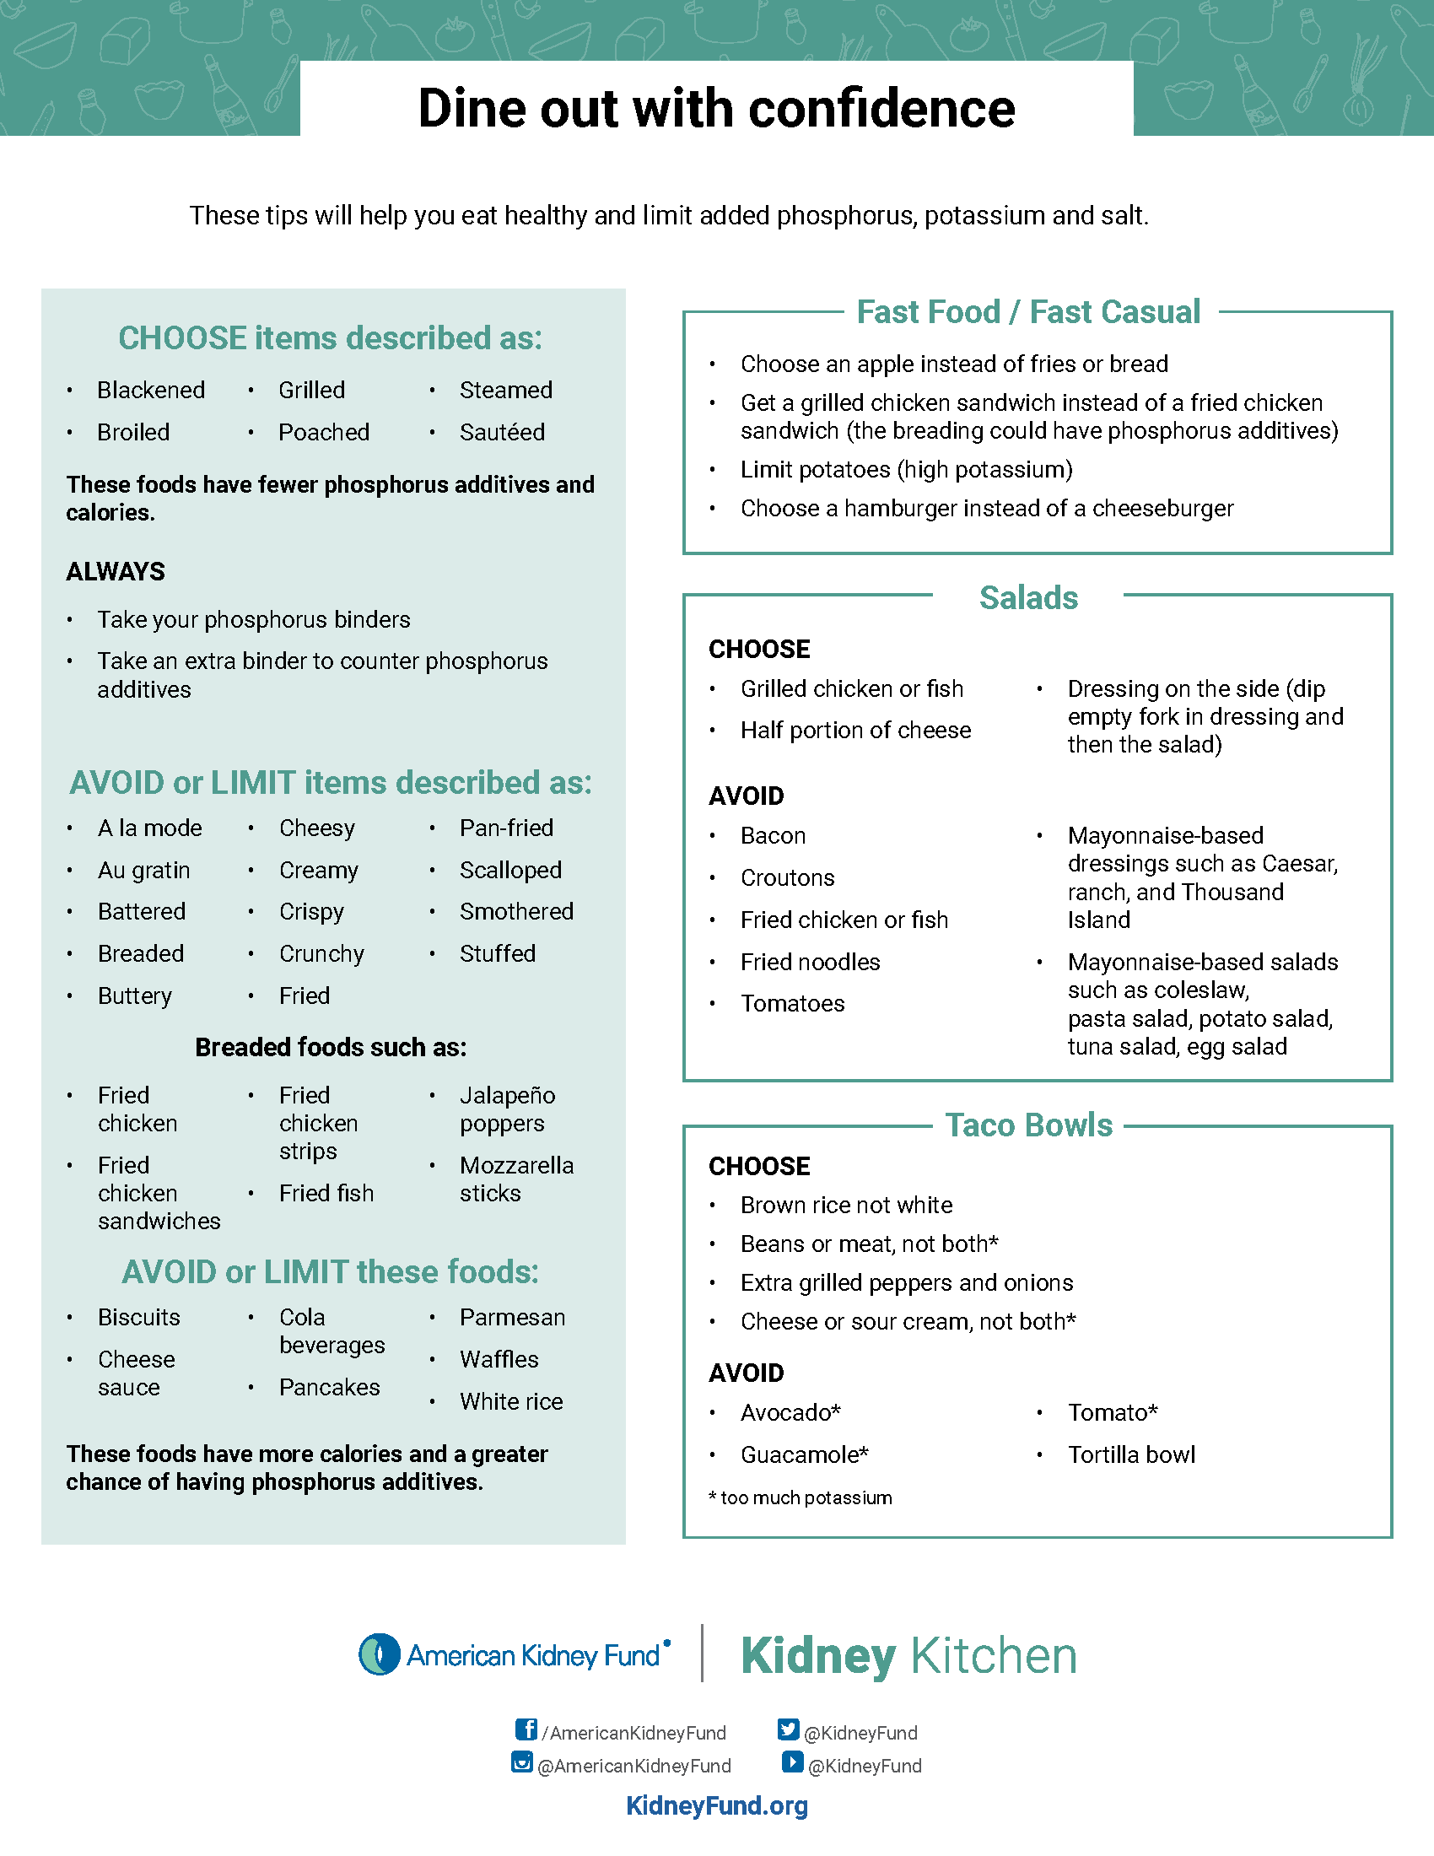
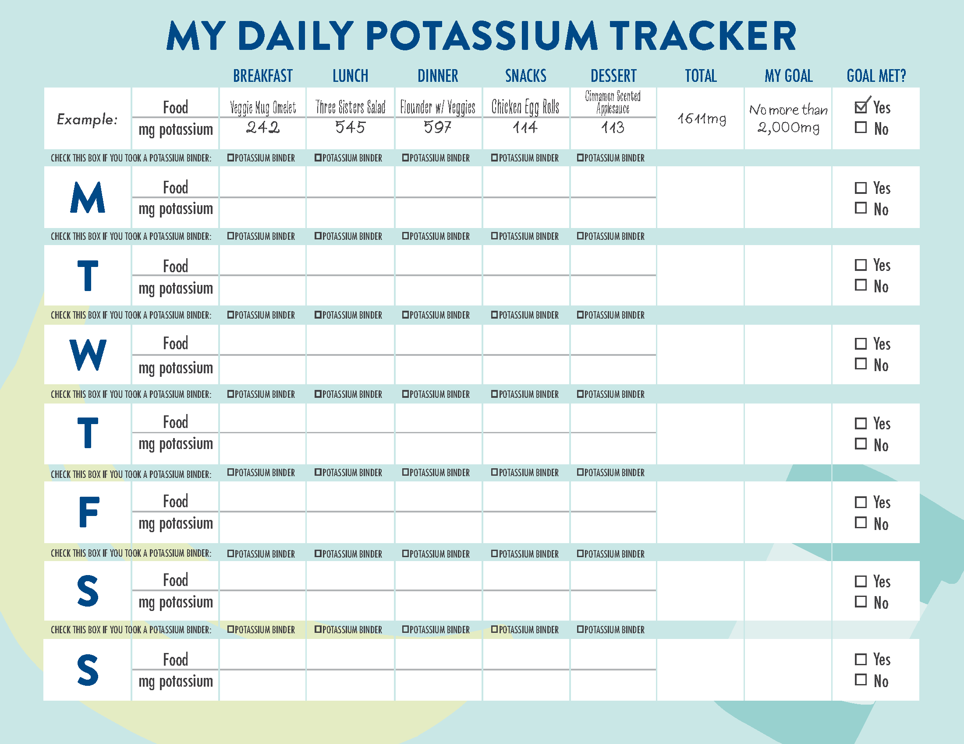
Kidney Kitchen® + Pro
A One-Stop Resource for Kidney-Related Nutrition Information
800+ kidney-friendly recipes
Healthy eating guides
Cooking tips and pantry lists
Nutrient guidelines
Cooking videos
Ask a Dietitian
AKF Dietitian Advisory Group (DAG)

Slide 21
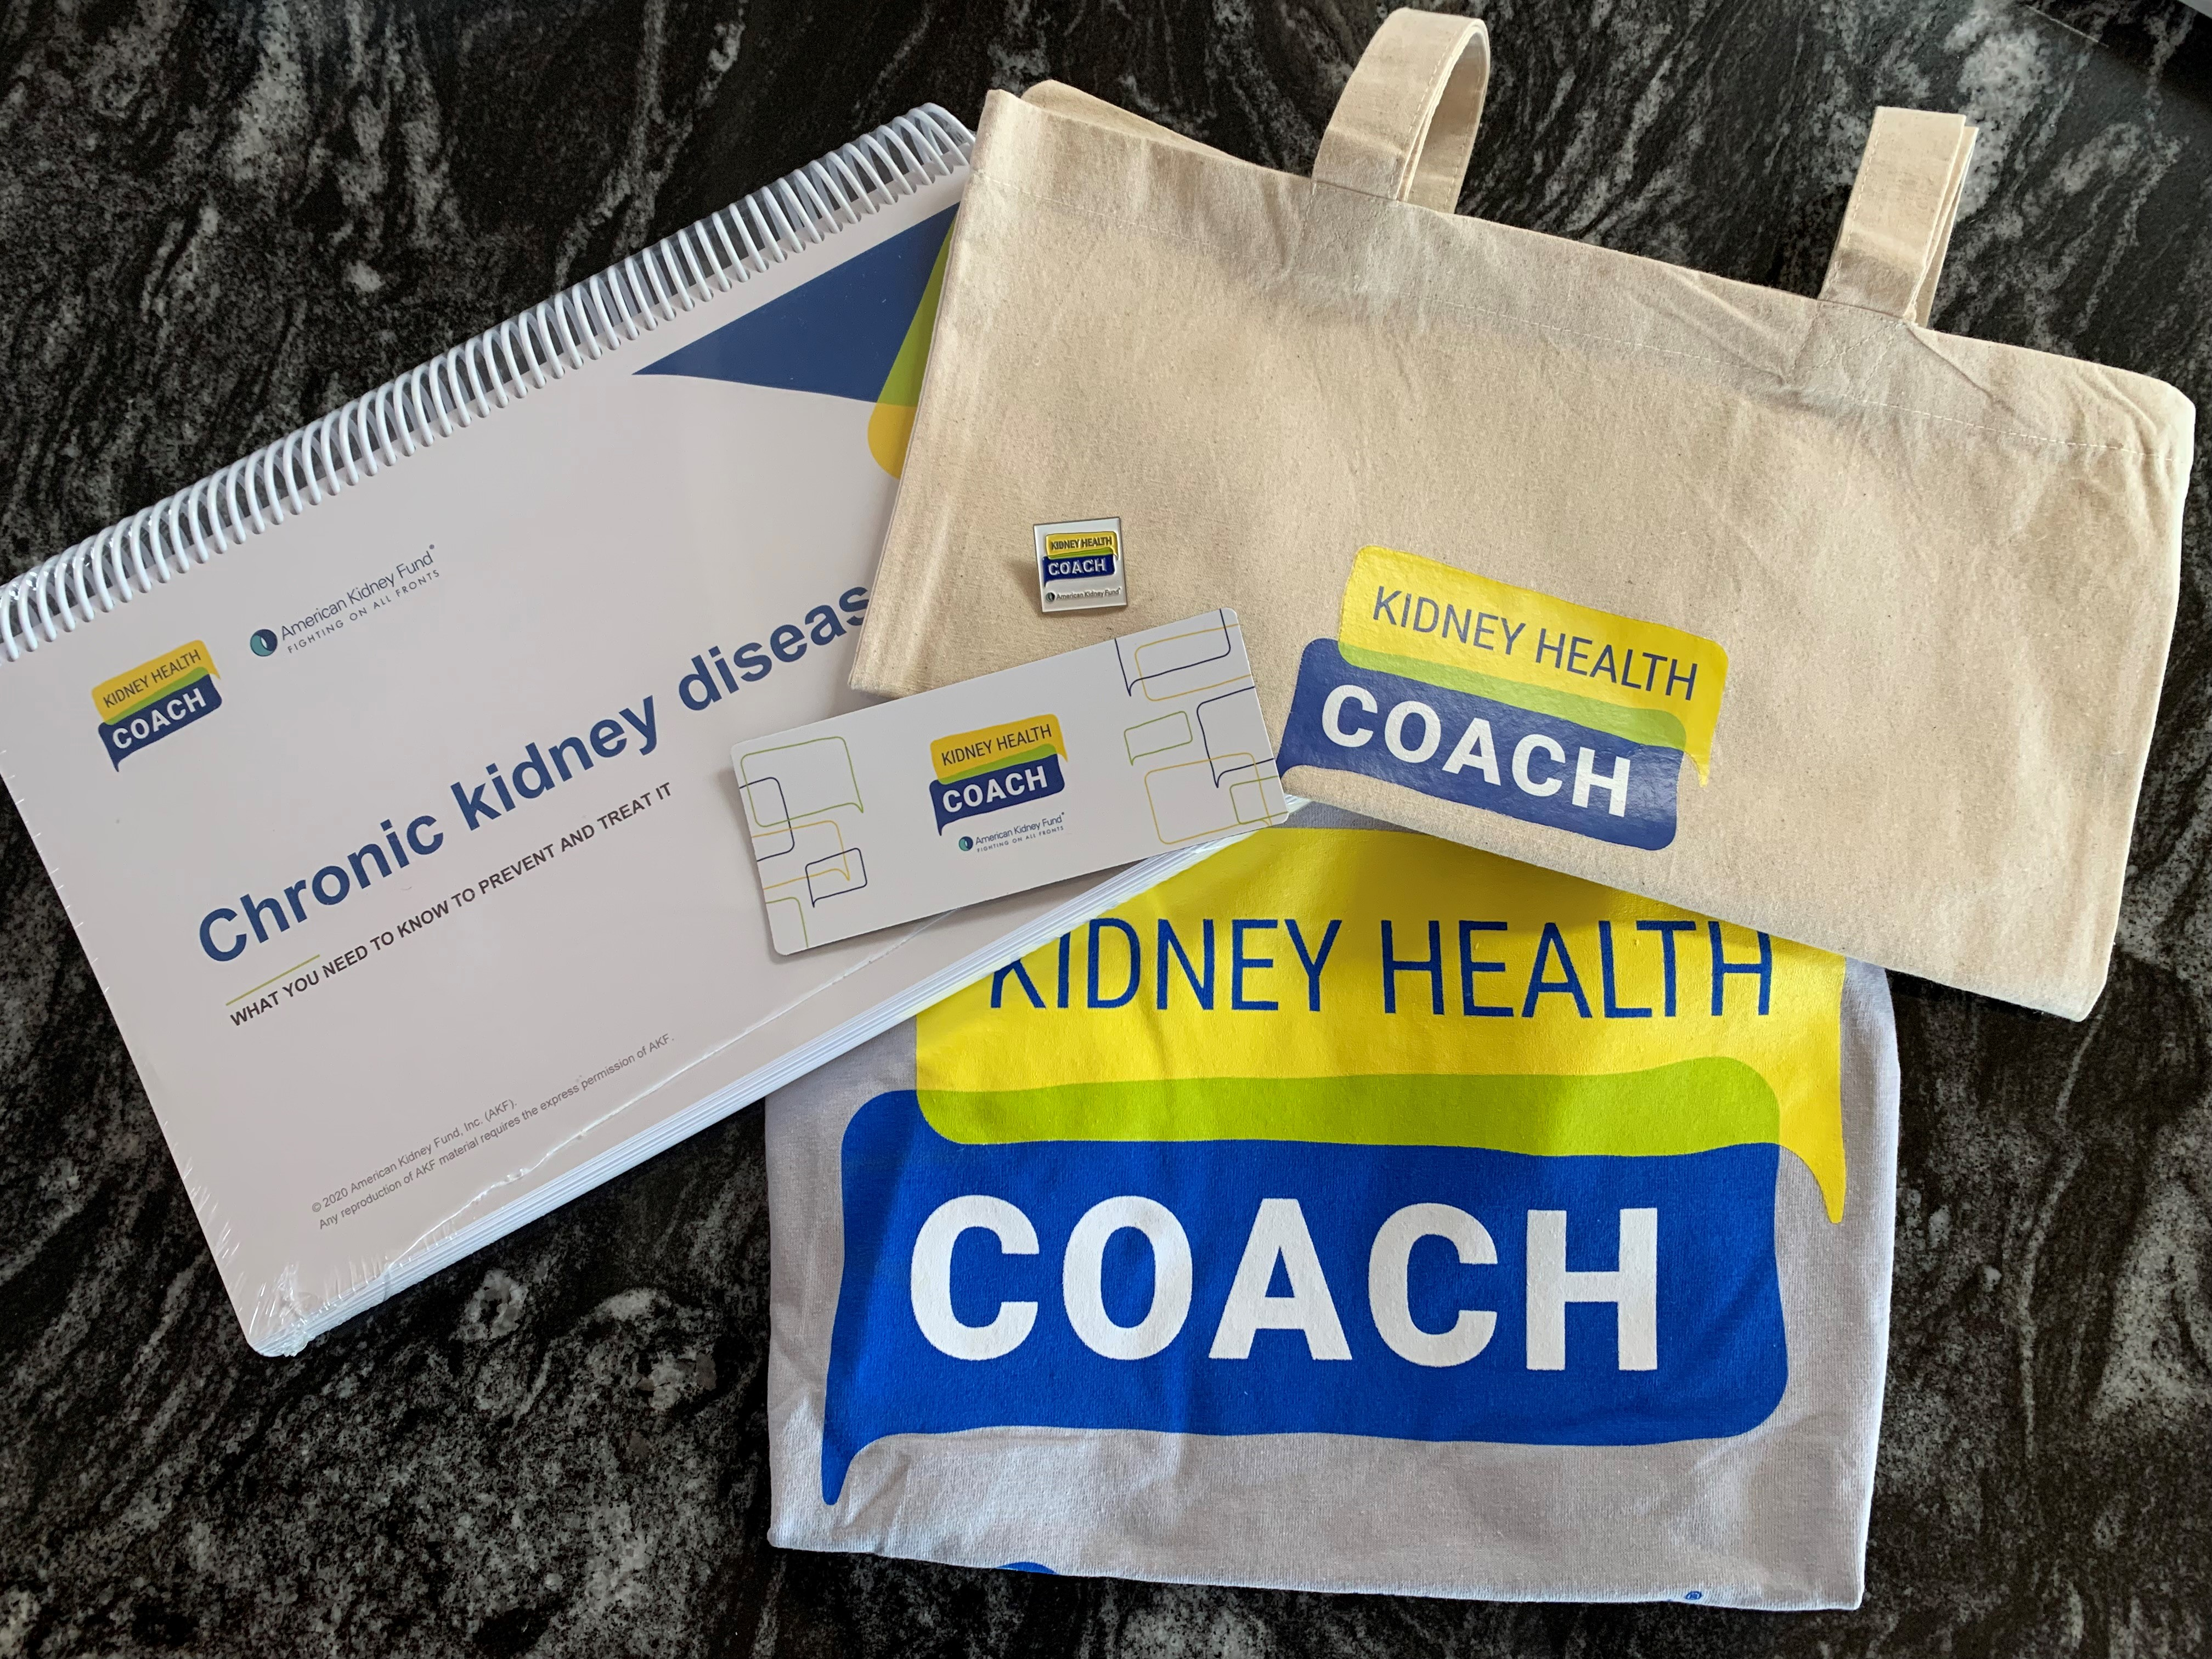
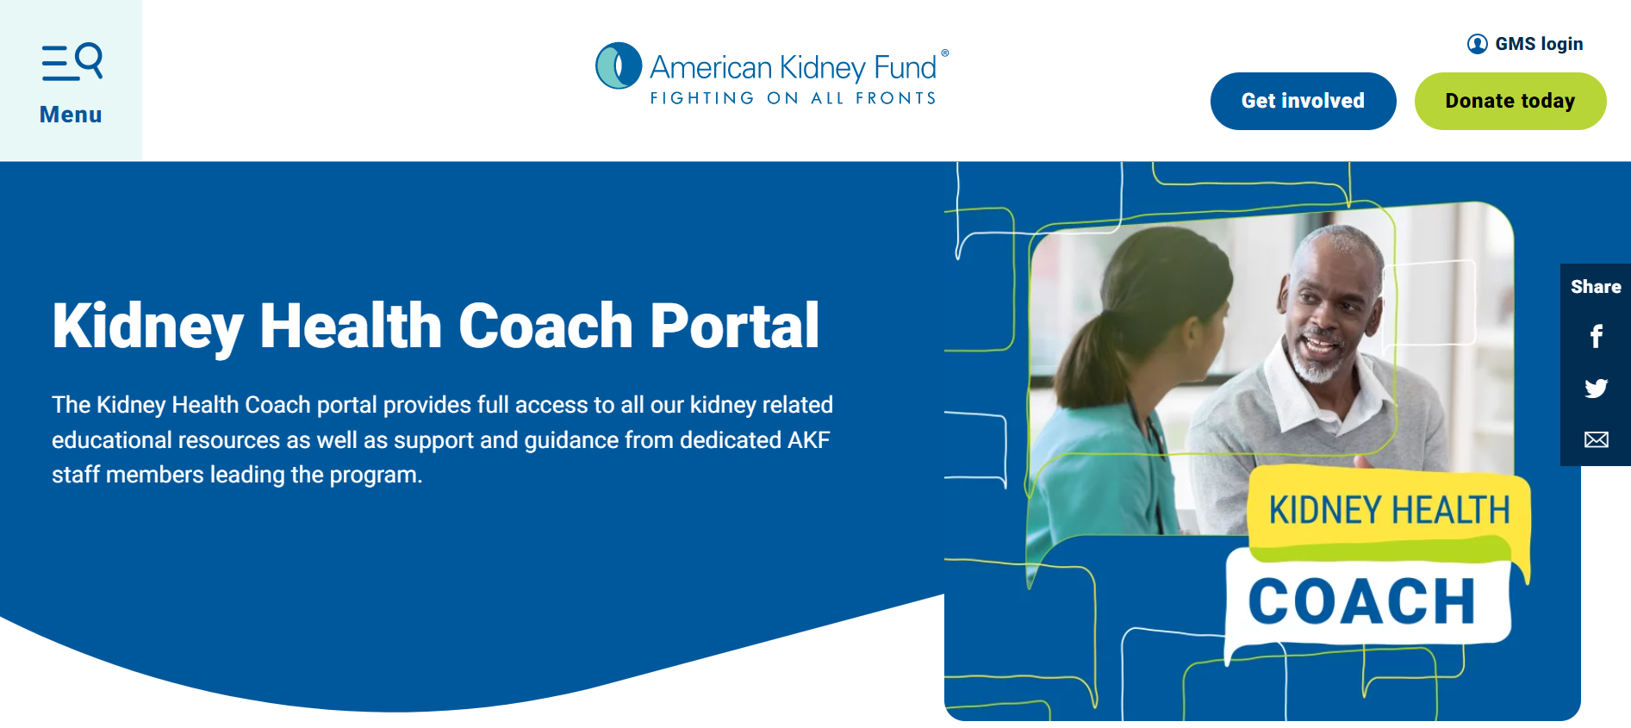

Kidney Health Coach
AKF’s no-cost, basics of chronic kidney disease education outreach training course and curriculum
Training course and curriculum in both English and Spanish
Offers continuing education credits (CE)
Promotes awareness and early detection of CKD
Supplies coaches with education tools, materials and sample activities to encourage people at risk to take action to prevent kidney disease
More than 3,200 Kidney Health Coaches
Over 8,600 people educated by Kidney Health Coaches

Slide 22
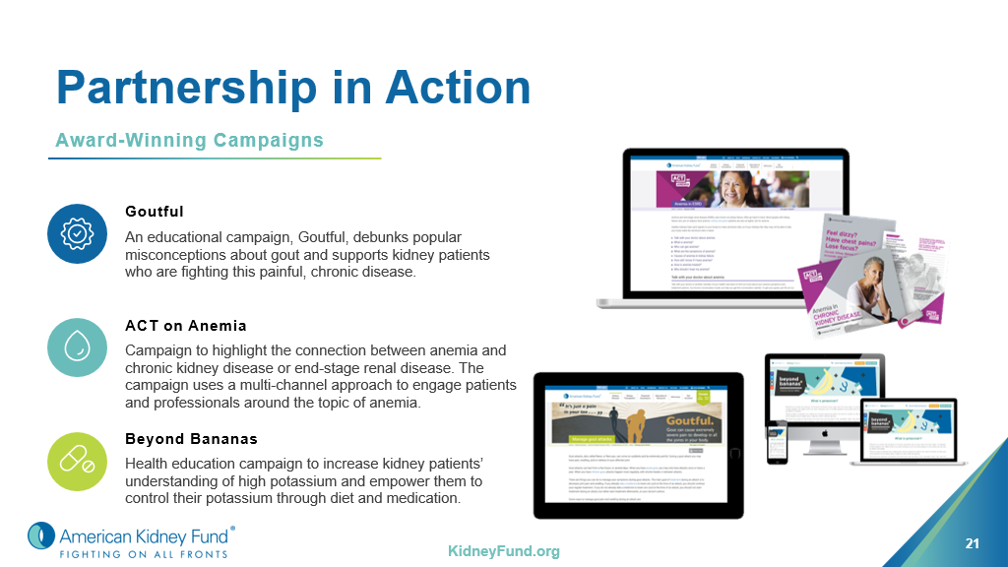

Slide 23
Professional Education Continuing education Clinical Scientist in Nephrology Unknown Causes of Kidney Disease

Slide 24


Continuing Education
Free CEU and CME online courses designed to enhance and elevate the knowledge of renal professionals to ensure optimal patient care
Applicability for primary care, endocrinology and other specialties
Content aligned with latest treatment guidelines
Informed by focus groups and leading SMEs
Accreditations
Dietitians
Social workers
Dialysis techs
Nurses
Health educators
Physicians & prescribers
Course topics
Disease Management
Best Practices
Comorbidities
Psychosocial

Slide 25


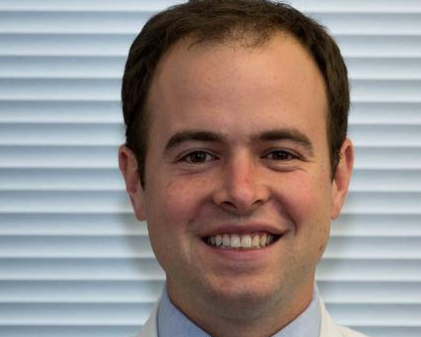
Research
Since 1974, AKF has invested over $5 million in kidney disease research
More than 40 distinguished fellows have become leaders in nephrology
Glen Chertow, MD, MPH - Norman S. Coplon/Satellite Healthcare Professor in Medicine and Chief, Division of Nephrology, Stanford University School of Medicine
Gary Curhan, MD, ScD - Editor-in-chief, Clinical Journal of the American Society of Nephrology
Carmen Peralta, MD, MAS - co-founder, Kidney Health Research Collaborative at University of California, San Francisco
Ravi Thadhani, MD, MPH - Vice Dean, Research & Education, Cedars-Sinai Medical Center; Chief, Nephrology Division, Massachusetts General Hospital; Professor, Harvard Medical School
CLINICAL SCIENTIST IN NEPHROLOGY
Fellowship program to improve the quality of care provided to kidney patients and to promote clinical research in nephrology
Supports emerging nephrologists in academic medicine and clinical research

Slide 26

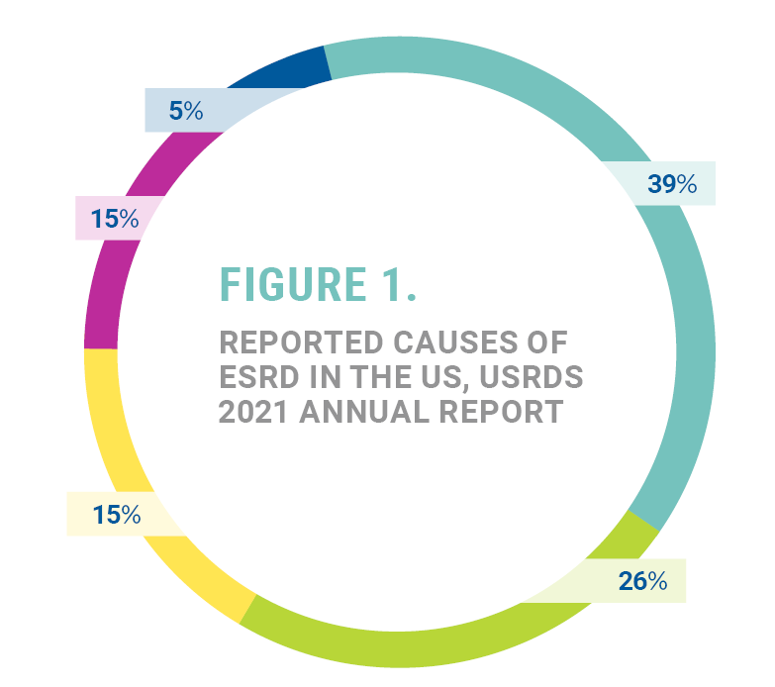
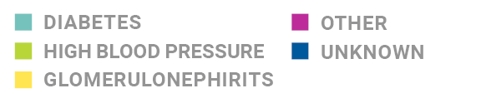
Addressing Health Disparities by Pursuing Earlier Testing and Accurate Diagnoses
Notes:
To help further equity in kidney care, we must do a better job of properly diagnosing at risk patients by encouraging earlier screening and the access to additional genetic testing where appropriate.
This slide shows data from the CDC and US Renal Data System. We see that diabetes and high blood pressure make up about 2/3 cases of kidney failure. Glomerulonephritis, listed third. The other causes are a collection of more rare diseases. And 5% are listed as without a confirmed diagnosis as to what caused their kidney failure. But given that high blood pressure can be a cause as well as a symptom of kidney disease, it is quite possible that this subset includes undiagnosed rare or genetic conditions. In fact, additional studies show estimates of UCKD higher –even up to 15%, leaving many patients who do not know the cause of their kidney disease.
The impact of an improper diagnosis cannot be understated as it can influence a patient’s healthcare outcomes, as well as the survivability of a transplanted kidney, if an underlying condition has not been identified prior to transplant.

Slide 27
Additionally…

Slide 28
Fighting On All Fronts
Awareness & Advocacy
We are a strong and independent voice advocating for policies that improve access to health care and strengthen quality of care for patients with kidney disease. We work with Congress, the Administration, and local governments to make kidney disease a national priority.
Our goal is to draw attention to chronic kidney disease as a national health crisis while also effectively engaging patients, professionals and caregivers with our mission and vision.

Slide 29
How Do You Get Involved?
Join the AKF Ambassador Facebook page
Sign-up for AKF text messages: text the word "KIDNEY"
to the number 52886 to join our text alerts.
Refer new members to join the AKF Advocacy Network

Slide 30












QUESTIONS?

