Slide 1
protecting faith-based institutions

Slide 2
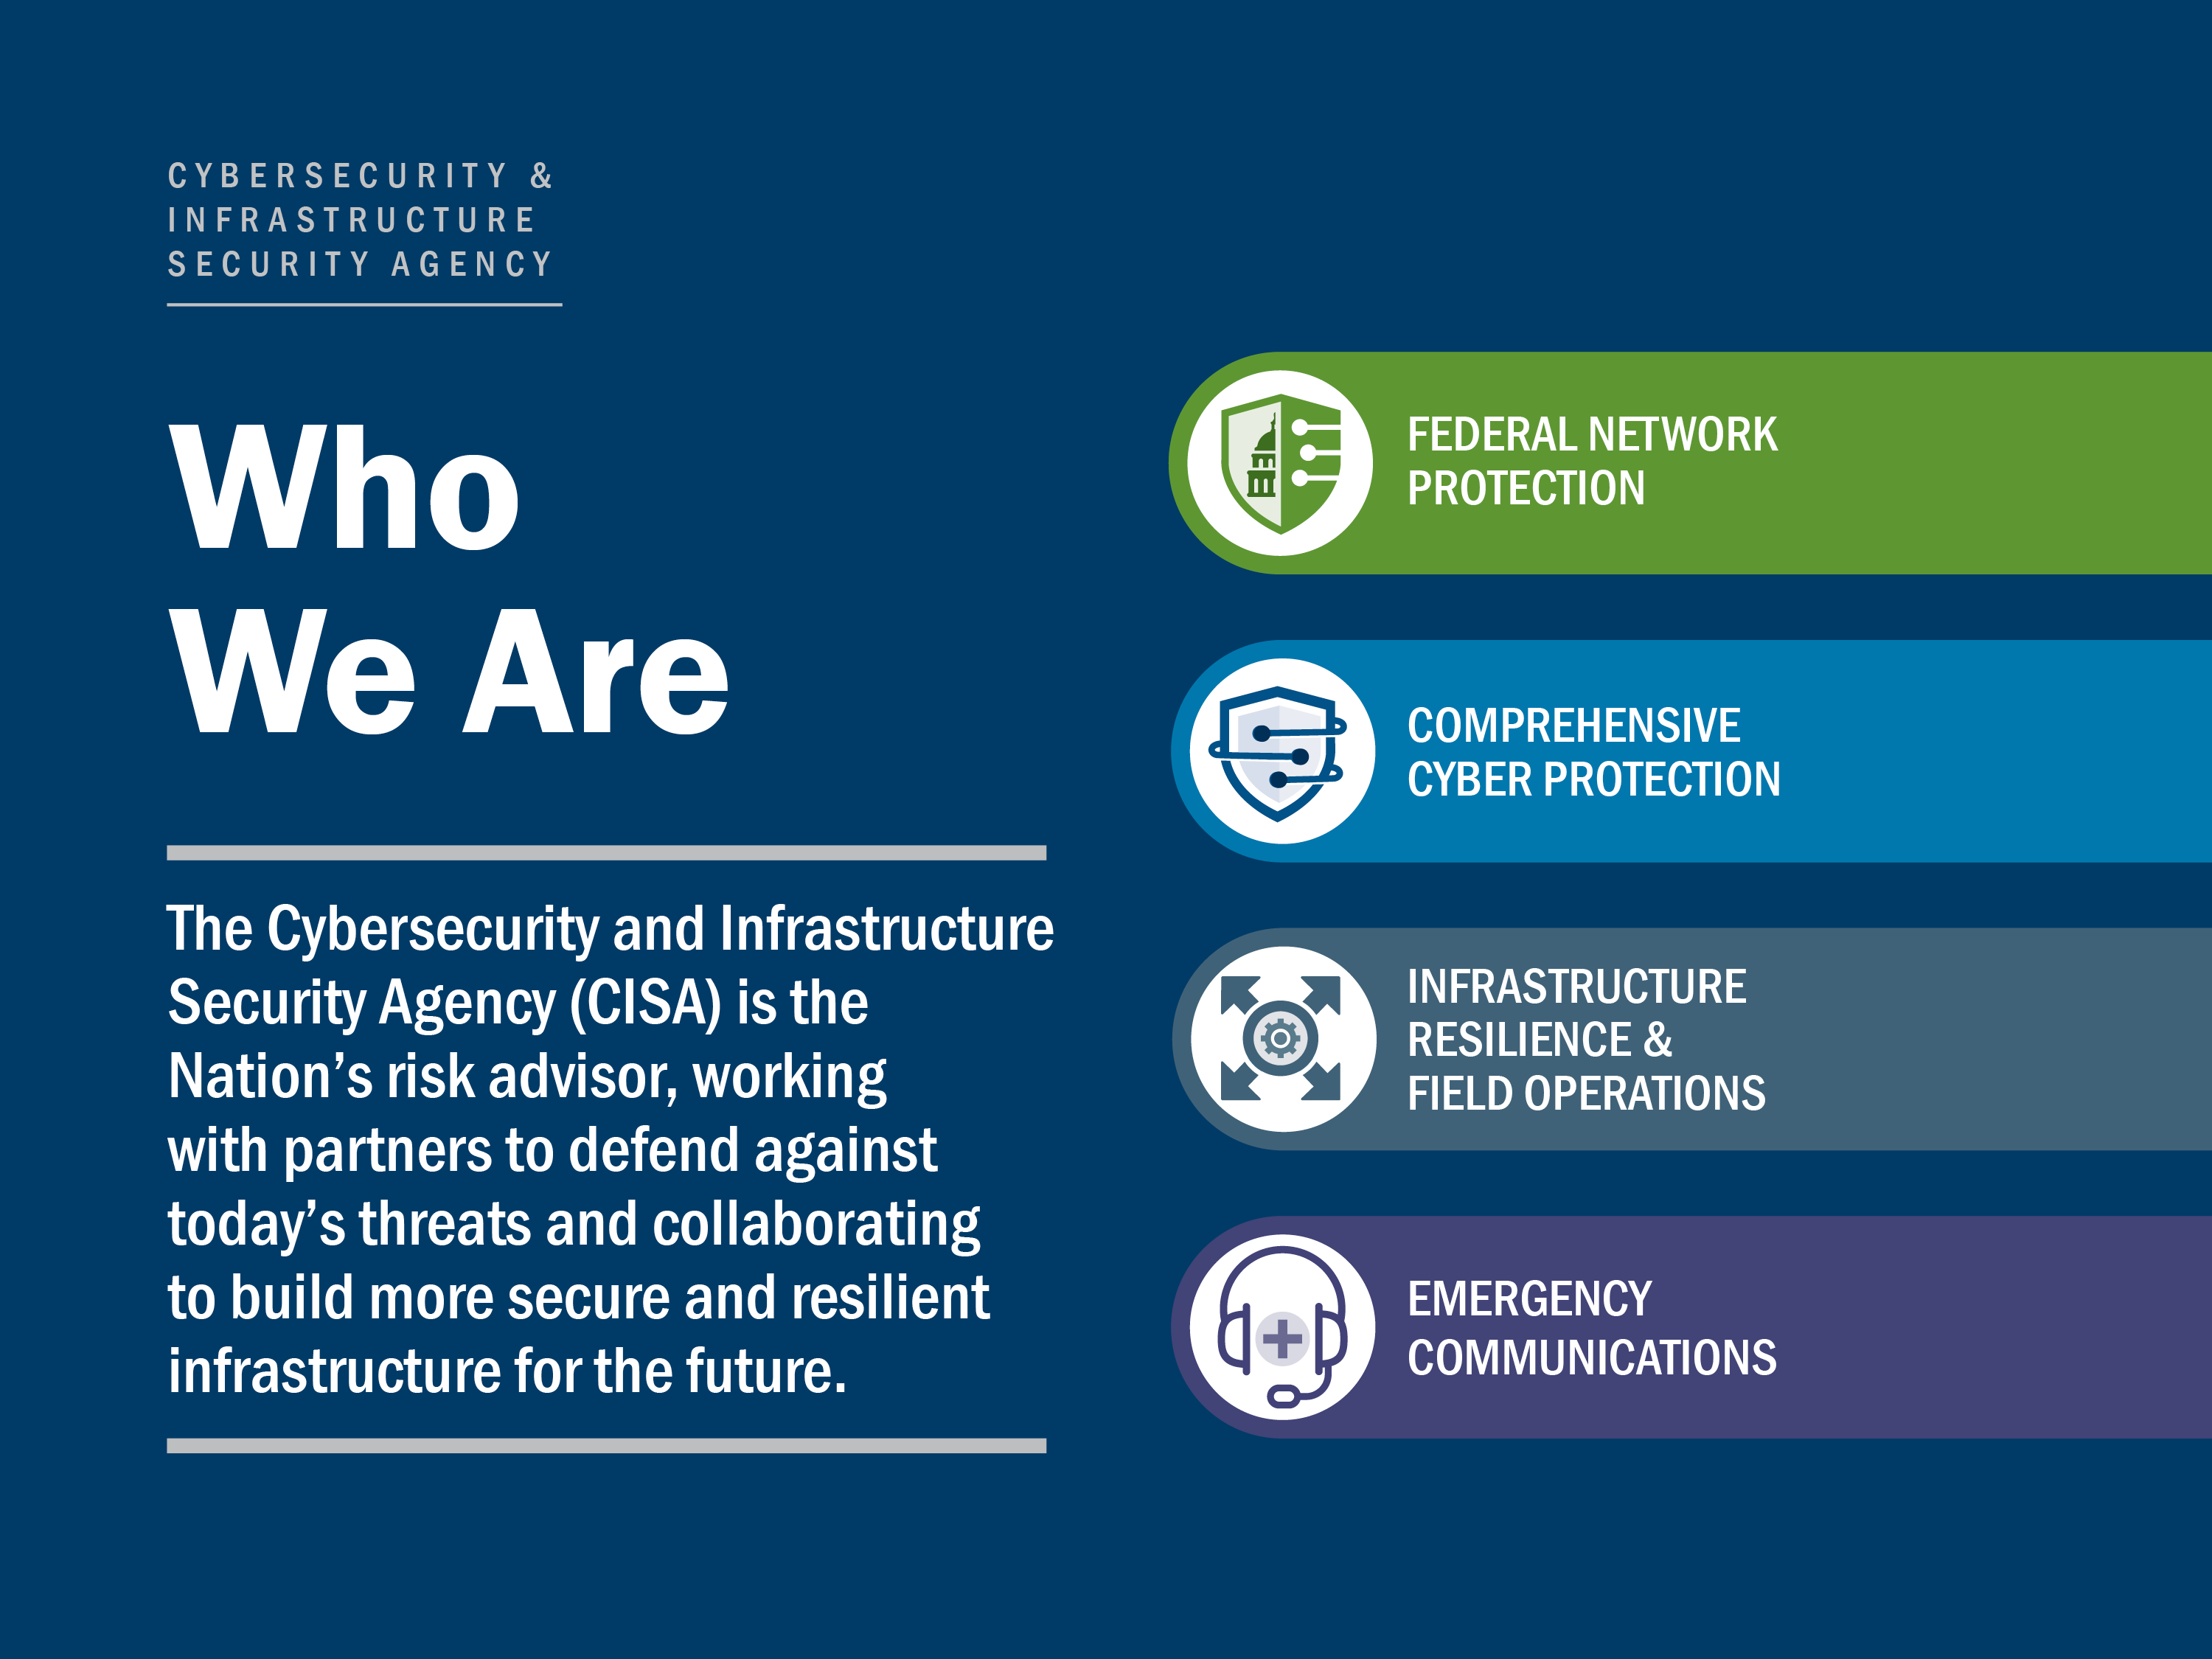
Notes:
Suggested Talking Points for Slide 4:
CISA’s work gathers the best of cybersecurity and infrastructure security knowledge and practices, shares that knowledge to enable better risk management, and puts it into practice to protect the nation’s essential resources.
CISA provides the unifying framework for national infrastructure protection that presents a common understanding of risk and enables the necessary collaboration among diverse stakeholders.

Slide 3
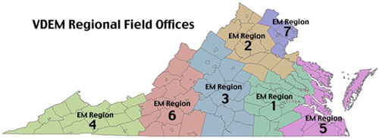
PSA Locations

Slide 4
Protective Security Advisors (PSAs)
PSAs are field-deployed personnel who serve as critical infrastructure security specialists
State, local, tribal, and territorial (SLTT) and private sector link to DHS infrastructure protection resources
Coordinate vulnerability assessments, training, and other DHS products and services
Provide a vital link for information sharing in steady state and incident response
Assist facility owners and operators with obtaining security clearances
During contingency events, PSAs support the response, recovery, and reconstitution efforts of the States by serving as pre-designated Infrastructure Liaisons (IL) and Deputy ILs at the Joint Field Offices
Notes:
I am a 10-year veteran of the Department of Homeland Security, with 15 years of government service. I have served in numerous positions across DHS, with a background in emergency management, counterterrorism, intelligence, and federal law enforcement. I am currently the DHS Protective Security Advisor assigned to Cincinnati, Ohio.
Protective Security Advisors perform vulnerability and security assessments on a variety of critical infrastructure, as well as coordinating training opportunities, information sharing, special events planning, and incident management support.
So what does that mean…? (Go to paper notes)

Slide 5
SAFE Tool
The Security Assessment at First Entry (SAFE) tool is designed to assess the current security posture and identify options for facility owners and operators to mitigate relevant threats
SAFE may be better suited for facilities such as rural county fairgrounds, houses of worship with only weekend services and few members, and small health clinics
Notes:
A SAFE may be the first step toward an effective security program. It is generally intended for facilities that have little or no security measures or planning in place
A Protective Security Advisor may find that it is appropriate to conduct a more detailed assessment using the Infrastructure Survey Tool (IST) at a facility after a SAFE visit has been completed and after the facility has implemented some of the identified options for consideration, for example, by assigning a security manager, developing a security

Slide 6



CISA Resources
Mitigating Attacks on Houses of Worship Security Guide
CISA developed a security framework that can be tailored to houses of worship of all sizes and denominations
Web page dedicated to houses of worship security
cisa.gov/faith-based-organizations-houses-worship
Houses of Worship Self-Assessment Tool
Baseline security self-assessment to inform security planning and improvement, may be used for the NSGP investment justification
CISA Protective Security Advisors
Security experts who provide on-site vulnerability assessments, can help with security plans and local resources

Slide 7
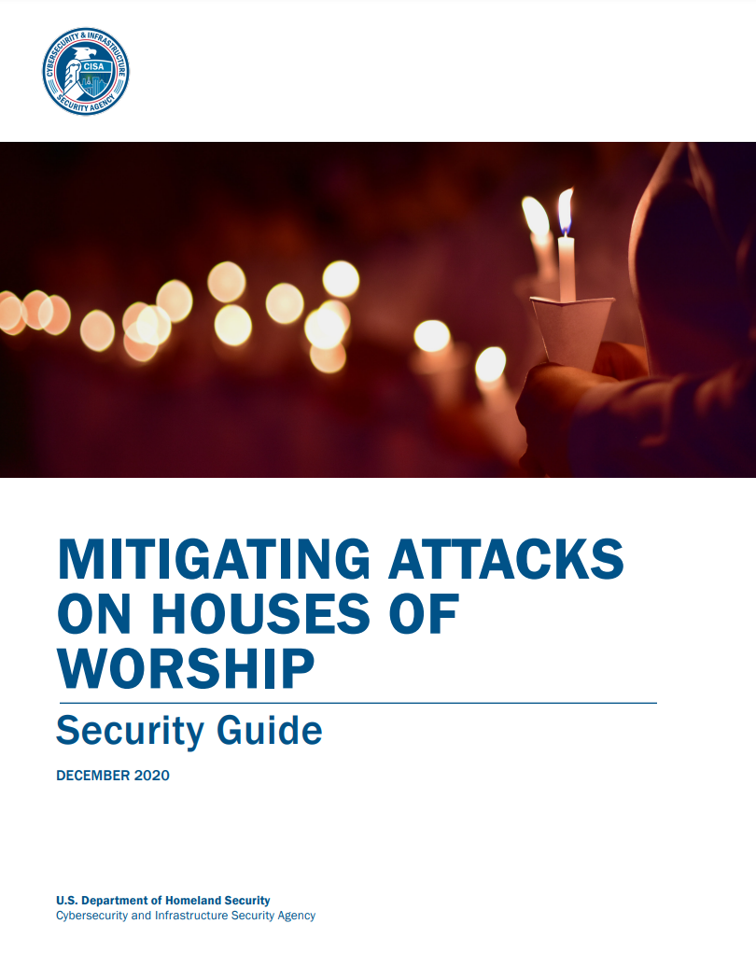



Mitigating Attacks on Houses of Worship Security Guide
CISA analyzed ten years of targeted attacks on houses of worship between 2009 and 2019
Take a holistic approach to security by assigning clear roles and responsibilities and creating a multi-layered security plan
A robust security plan should be tailored to the specific needs and priorities of the house of worship
Conduct a vulnerability assessment to understand the risks to the house of worship from which you may prioritize implementing any subsequent safety measures.
cisa.gov/mitigating-attacks-houses-worship-security-guide
Notes:
-Establish a multi-layered plan for security, identifying clear roles and responsibilities for developing and implementing security measures.
-Apply physical security measures to monitor and protect the outer, middle, and inner perimeters, while respecting the purpose of each area of the house of worship.
cisa.gov/mitigating-attacks-houses-worship-security-guide

Slide 8
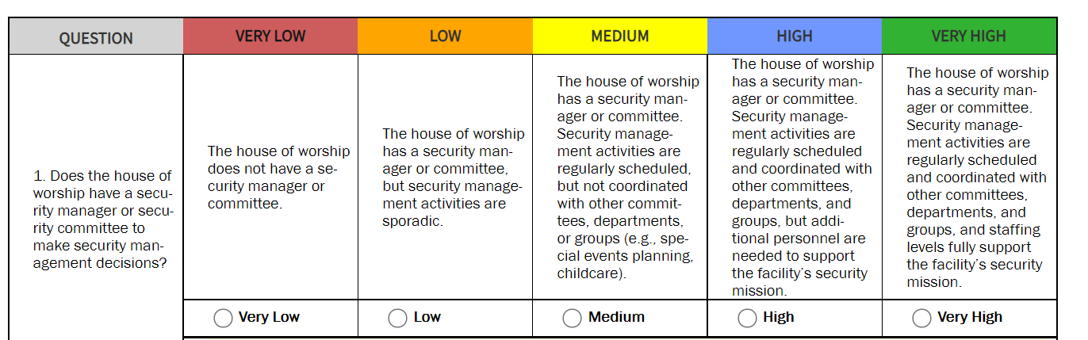



Houses of Worship Self-Assessment Tool
An easy to use, interactive, security-focused self-assessment tool that assists stakeholders in understanding potential risks and identifying corresponding risk mitigation solutions.
cisa.gov/houses-of-worship
Results of the assessment can assist organizations in improving security and managing identified risks through the ability to:
Review best practices and available resources
Develop investment justifications for internal budgeting processes or external grant requests
Prioritize potential security measures
cisa.gov/houses-of-worship
Notes:
cisa.gov/houses-of-worship
cisa.gov/houses-worship-security-self-assessment

Slide 9




Focus Areas
FBO-HOW Security Self-Assessment
The assessment, when completed, will provide an easy to follow road map for implementing suggested voluntary options for consideration. These options are based on current best practices designed to improve facility security and preparedness:
The focus areas of the assessment include the following.
central@cisa.dhs.gov
Security and Safety/Emergency Management
Perimeter Security/ Delineation
Parking and Barriers
Access Control/ Entry Control
Closed-circuit Video (CCV)/ Video Surveillance Systems (VSS)
Notes:
The focus areas are limited to 49 questions that focus on the following subject areas
Security / Safety Management- Emergency Management
Perimeter Security
Parking and Barriers
Access / entry control
Intrusion detection and video surveillance

Slide 10
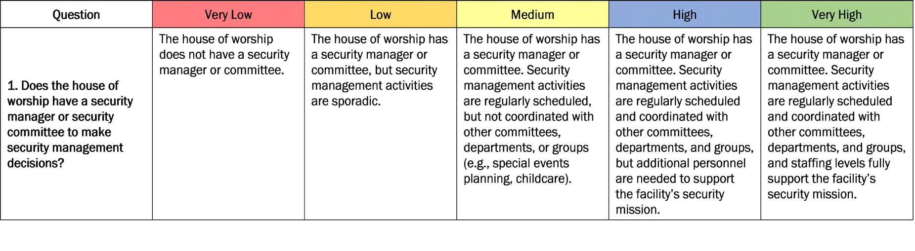
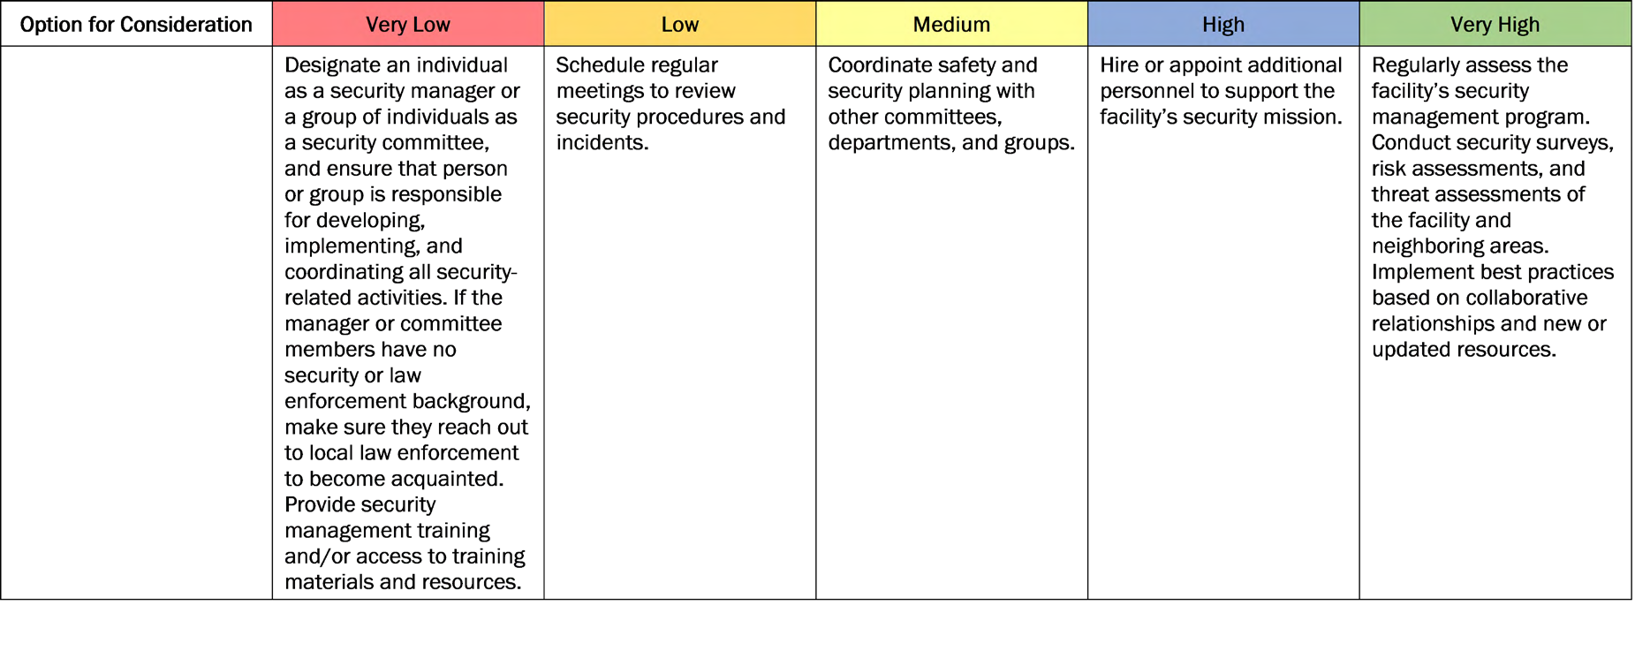
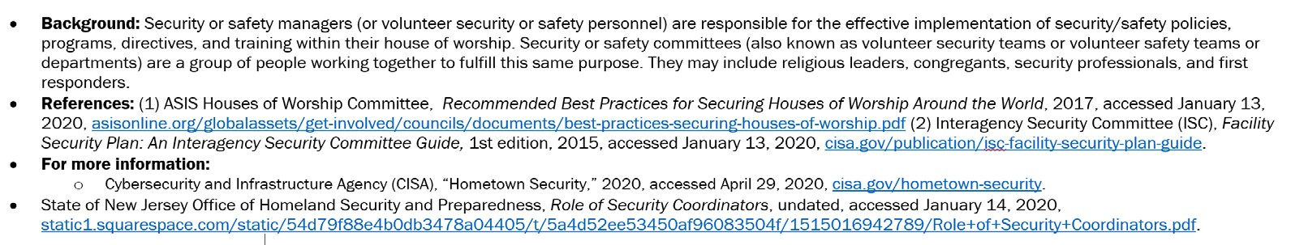




Behind The Curtain
THE SELF-ASSESSMENT IN ACTION
Your self-identified level of security
^{Your starting point} Continual Improvement Approach
for improving security
cisa.gov
Central@cisa.gov
LinkedIn.com/company/cisagov
@CISAgov | @cyber | @uscert_gov
Facebook.com/CISA
@cisagov
Notes:
Behind the curtain
For your awareness this is a screen shot of the pdf version of the assessment and what I hope to do here is show what's going on behind the scenes as you answer the questions in the tool.
Each question has either three or five answers.
The answers and options for consideration are arranged from the lowest level of security that offers a very low level of protection (red) to a very high level of security that provides a greatly enhanced level of protection (green). None of this infers priority of actions to implement.
For each relevant question, identify the answer that most accurately represents your facility. This along with addition of clarifying information(when needed) at the bottom of each section will provide you with corresponding starting for improving your security.

Slide 11
SAFE Tool
The Security Assessment at First Entry (SAFE) tool is designed to assess the current security posture and identify options for facility owners and operators to mitigate relevant threats
SAFE may be better suited for facilities such as rural county fairgrounds, houses of worship with only weekend services and few members, and small health clinics
Notes:
A SAFE may be the first step toward an effective security program. It is generally intended for facilities that have little or no security measures or planning in place
A Protective Security Advisor may find that it is appropriate to conduct a more detailed assessment using the Infrastructure Survey Tool (IST) at a facility after a SAFE visit has been completed and after the facility has implemented some of the identified options for consideration, for example, by assigning a security manager, developing a security

Slide 12
Protected Critical Infrastructure Information Program
The Protected Critical Infrastructure Information (PCII) Program protects critical infrastructure information voluntarily shared with the federal government for homeland security purposes
PCII protects from release through:
Freedom of Information Act disclosure requests
State, local, tribal, territorial disclosure laws
Use in civil litigation
Use for regulatory purposes

Slide 13



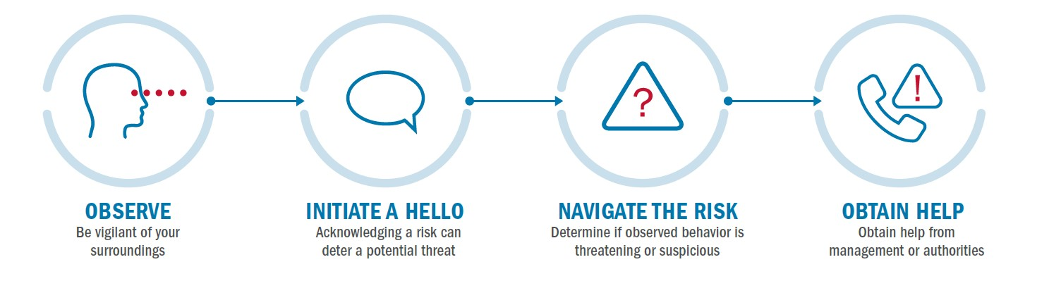
Power of Hello for Houses of Worship
Promotes vigilance for houses of worship stakeholders
Alert personnel can spot suspicious activity and report it
Power of Hello placemat translated in 17 languages
The OHNO approach – Observe, Initiate a Hello, Navigate the Risk, and Obtain Help – helps employees observe and evaluate suspicious behaviors, empowers them to mitigate potential risk, and obtain help when necessary.
cisa.gov/employee-vigilance-power-hello
Notes:
cisa.gov/employee-vigilance-power-hello

Slide 14

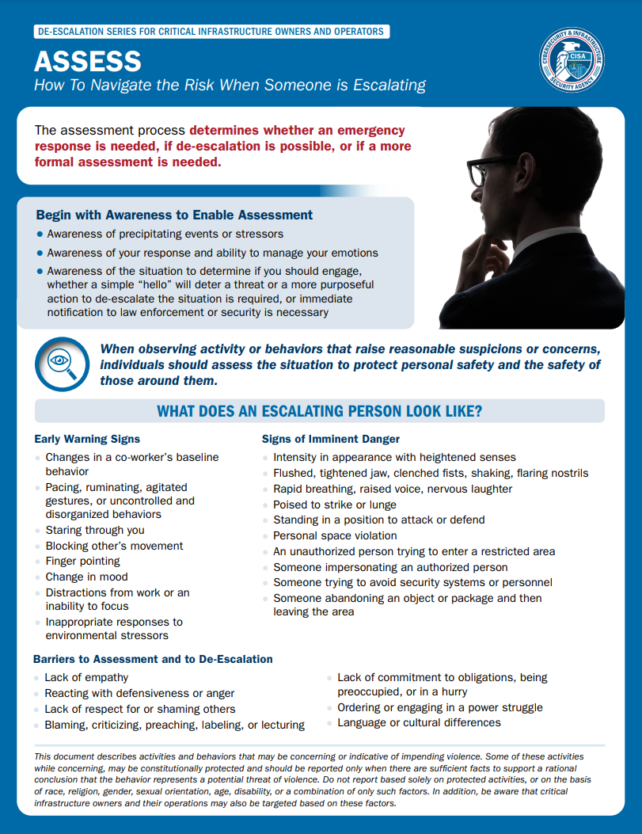
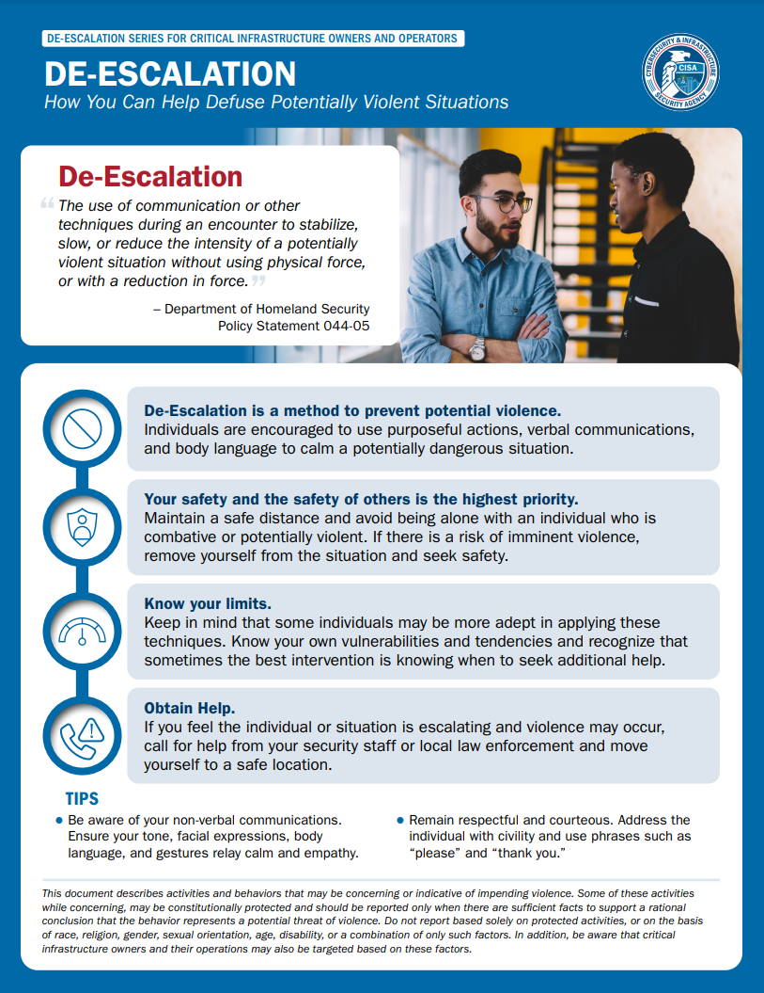
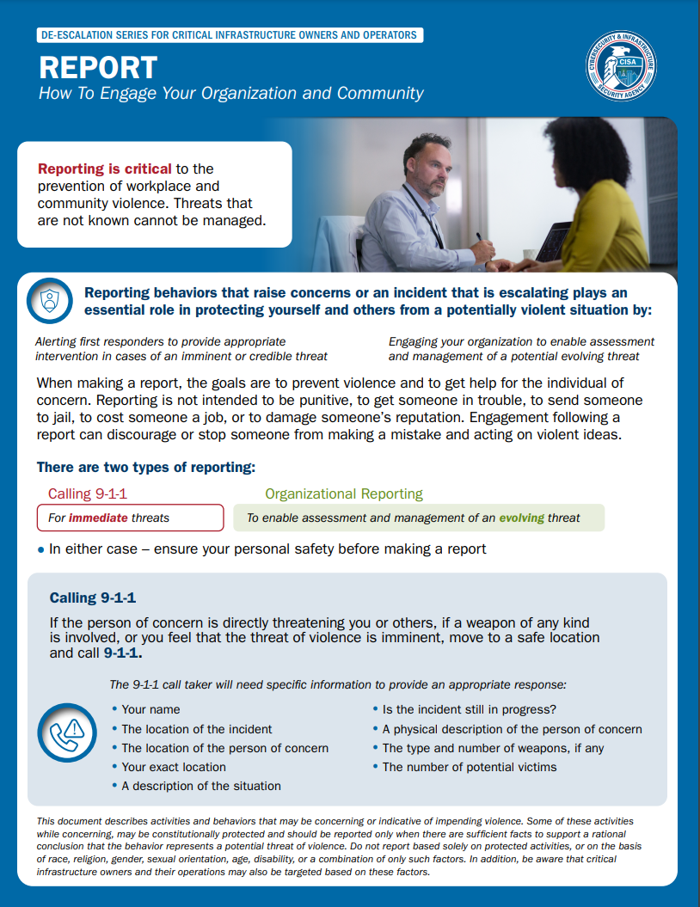
De-Escalation Series
Recognize - the warning signs for someone on a path to violence, identify stressors, changes in baseline behavior, and observable behavioral indicators.
Assess - the situation to protect personal safety and the safety of those around you. Identify what an escalating person may look like and warning signs.
De-Escalation - Individuals are encouraged to use purposeful actions, verbal techniques, and body language to calm a potentially dangerous situation. Safety is the highest priority, know your limits and obtain help immediately if needed.
Report - concerning behavior or an escalating incident through organizational reporting to enable assessment and management of an evolving threat, and 9-1-1 for immediate threats.
cisa.gov/de-escalation-series
Notes:
-The use of communication or other techniques during an encounter to stabilize, slow, or reduce the intensity of a potentially violent situation without using physical force, or with a reduction in force.
-It is important to create a holistic assessment of the person of concern’s circumstances and stressors; this begins with awareness of one’s self, precipitating events or stressors, and the situation unfolding.
-Remember when making a report, the goals are to prevent violence and to get help for the individual of concern.
cisa.gov/de-escalation-series

Slide 15




Best Practices for Houses of Worship Security
Establish a multi-layered plan for security, identify clear roles and responsibilities
Conduct a vulnerability assessment to understand the risks specific to your house of worship
Assess current doors, ensure they can withstand a determined intruder for up to ten minutes
Develop an emergency action plan - coordinate, train, and exercise the plan with local law enforcement and first responders
Outer, middle, and inner perimeter security considerations Lights, CCTV, windows, access control
A welcoming environment does not mean a defenseless one.
Notes:
Conduct a vulnerability assessment to understand the risks specific to your house of worship, prioritize implementing safety measures
Test and exercise the plan in collaboration with local law enforcement, PSAs, neighbors. CISA tabletop exercise program fact sheet for HoWs, videos to assist exercise.

Slide 16
Homeland Security Starts with Hometown Security
Security starts here.
connect plan train report
For more information, visit https://www.cisa.gov/topics/physical-security
Notes:
Homeland Security Starts with Hometown Security
CONNECT: Reach out and develop relationships in your community, including local law enforcement. Having these relationships established before an incident occurs can help speed up the response when something happens.
PLAN: Take the time now to plan on how you will handle a security event should one occur. Learn from other events to inform your plans.
TRAIN: Provide your employees with training resources and exercise your plans often. The best laid plans must be exercised in order to be effective.
REPORT: “If You See Something, Say Something™” is more than just a slogan. Call local law enforcement.

Slide 17
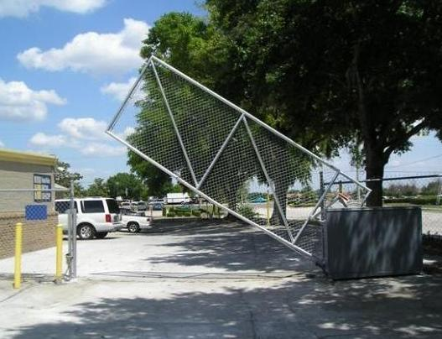
Security Planning – Your Perimeter
Control your perimeter
Control who and what comes in
Control vehicles and parking
Install barriers, planters to protect the building from vehicle ramming (gathering areas & main entrances)

Slide 18
Surveillance
Increase site surveillance and monitoring capability and or patrols
CCTV should be utilized to monitor entry points, site perimeter and gathering areas
Lighting
Windows facing streets and alleys
Locate vulnerable areas near activity
Locate staff to monitor high-risk areas
Remove window clutter/visual obstructions
See-through fencing
Mixed use parking
VISITOR CHALLENGES by staff

Slide 19
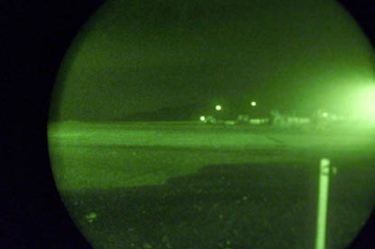

Lighting
Improve nighttime lighting as appropriate for the area and local ordinances
Lighting surveys should be conducted at night to verify adequate intensity and coverage of shadowed areas
Patrolman should be encouraged to report inoperable lighting
Lighting should be installed in a manner that considers camera placement and the two complement each other

Slide 20
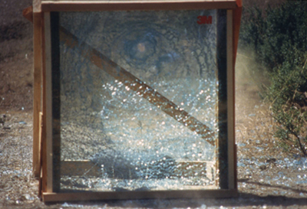
Building Perimeter
Mark all entrances in coordination with first responders
All perimeter doors should be locked during school hours
Prohibit doors from being propped open
Install blast film on exterior windows

Slide 21
Access Control
Use as an access control technique (video doorbell at entrance)
Visual inspection and identify purpose of visit prior to granting entry
Use an electronic visitor management system
Establish different forms of identification for employees, visitors, contractors, messengers and delivery people
Use Smart Cards with Pin (2 factor authentication) for employee badges

Slide 22
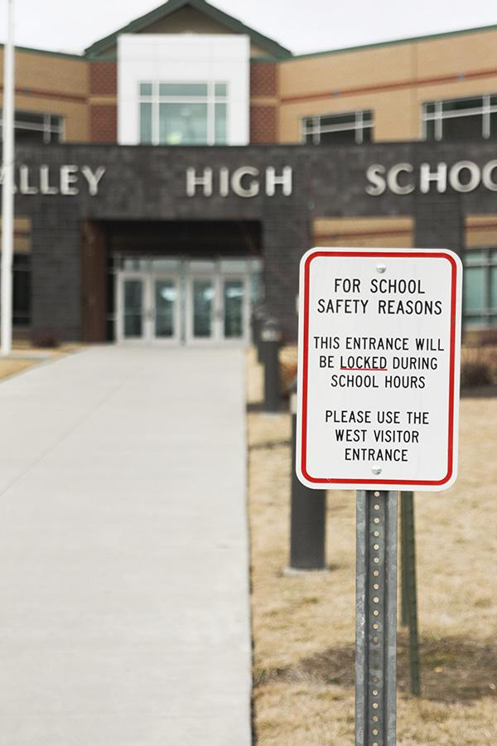
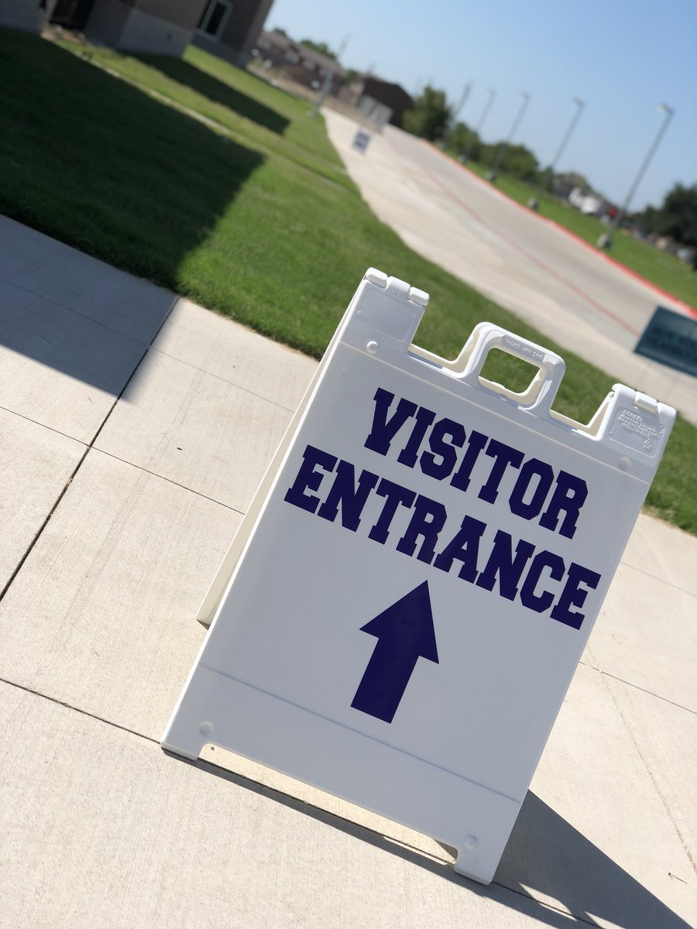
Signage

Slide 23
Building Interior
Classroom doors should be lockable from inside
Technology should be consistent with Fire Regulations
Install low tech means of covering door windows during lockdown
Public Address (PA) system

Slide 24
Preparedness
Create an Emergency Operations Plan
Define roles and responsibilities
Notification of incident
Evacuation, lockdown, and shelter-in-place policies and procedures
Plans for diverse needs of children and staff
Consider necessary equipment and supplies
Common vocabulary
Accountability and reunification system
Communication with external entities
Emergency drills
Notes:
An EOP should contain (but certainly not limited to) all of the components listed above.
Roles and Responsibilities - Define what should happen, when, and at whose direction—that is, create an organizational system.
Notification of Incident - One of the first steps in planning is to develop a mechanism to notify students and staff that an incident is occurring and to instruct them on what to do. Schools should consider implementing a mass notification system.
Evacuation, Lockdown, Shelter-In-Place - Develop plans and procedures for all possible incident responses and PRACTICE them.
Plans for Diverse Needs - Emergency operation plans should provide for the needs of students, staff, and visitors with disabilities and other functional and access needs
Consider Necessary Equipment and Supplies – Provide staff with the necessary equipment to respond to a crisis.
Common Vocabulary – Create a common vocabulary that school staff and emergency responders both understand so communication during an incident is clear.
Accountability and Reunification System – Create a system to account for all students, staff, and visitors during an incident. Additionally, develop plans for tracking student release to parents and other authorized individuals after an incident.
Communication with External Entities - Plan how to communicate with families, community members, and the media during/after an incident.
Emergency Drills – PRACTICE your emergency operations plan. Identify problems in the plan that need to be addressed.

Slide 25
Response
Broad action list for teachers, administrative staff, and other school staff:
Determine whether a crisis exists, and if so, the type of crises, the location of the crisis, and the magnitude of the crisis
Notify appropriate emergency responders
Notify administrative staff so all students and staff can be notified of the incident
Determine whether students and staff need to be evacuated, locked down, or assume shelter-in-place
Account for all students; make note if students are missing
Stay in communication with school staff
Follow all emergency response instructions
Notes:
These action lists are broad overview of how to respond. Each list can be modified and edited to reflect the specific action plans outlined for each school. More detailed lists can be developed by school assessment teams in coordination with community partners.

Slide 26
For more information:
cisa.gov
VDEM 1 & 5
Email: Robert.Mooney@hq.dhs.gov
Phone: 202-306-9448
VDEM3,4 & 6
Email: James.Finney@hq.dhs.gov
Phone: 434-942-9269
VDEM 2 & 7
Email: Joseph.Kluczynski@cisa.dhs.gov
Phone: 202-642-0006
Email:Benjamin.Gilbert@CISA.DHS.GOV
Phone: 202-631-2483

Slide 27
For more information:
cisa.gov
Questions?
Robert.Mooney@cisa.dhs.gov
Cell: 202-306-9448

