Slide 1
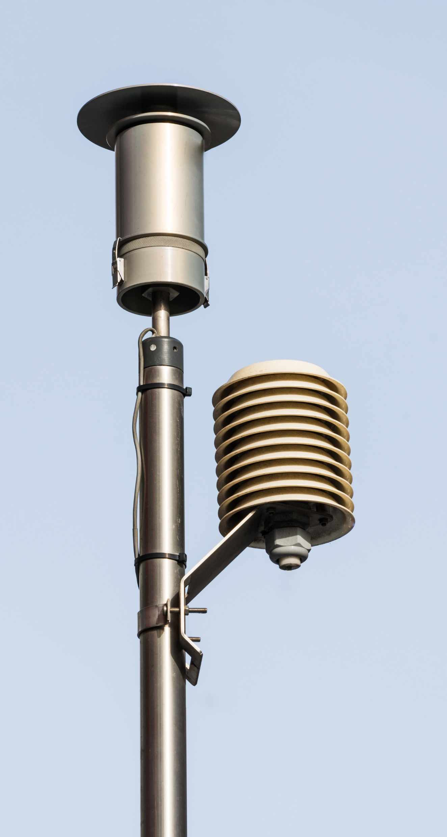
Outdoor Air Quality and Health
Amy Hayes, Ph.D.
Public Health Toxicology
Office of Environmental Health Services

Slide 2
Contributors to Air Quality
Local/site-specific pollutants—H₂S, ethylene oxide, mercaptans, various volatile organic compounds (VOCs)
Common Pollutants
Ozone
Irritant gases--NO₂, SO₂
Carbon monoxide
Particulate matter
PM10—Pollen, dust, mold spores, mold fragments, bacterial fragments
PM2.5—Extremely variable! Tiny particles that may be made of carbon, metallic compounds, organic compounds. Can have a solid core with a liquid coating, or be a tiny droplet of liquid, or be solid material.

Slide 3
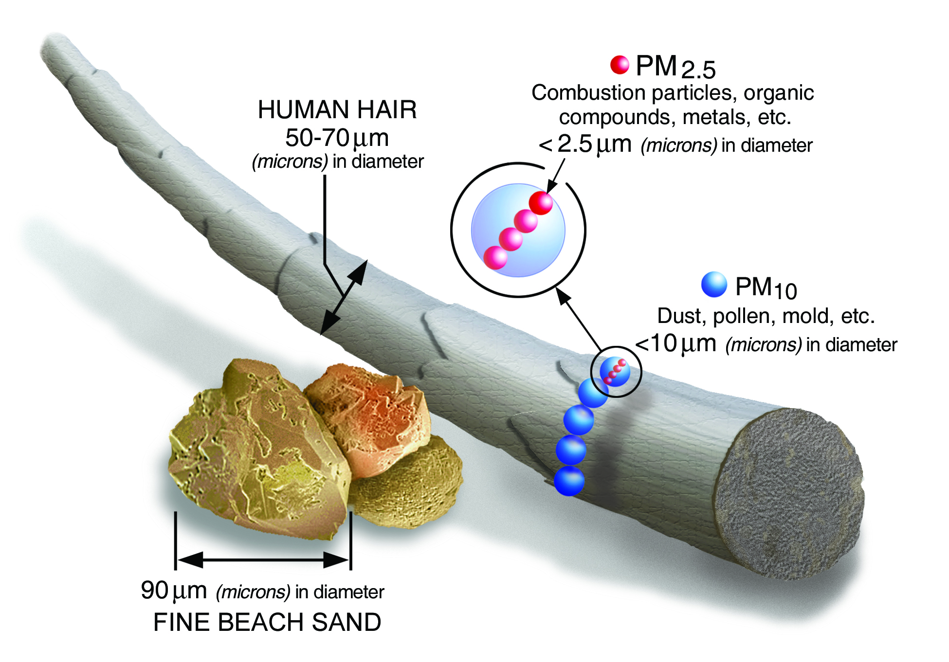
US EPA. https://www.epa.gov/pm-pollution/particulate-matter-pm-basics

Slide 4
Sources of Particulate Matter

Slide 5
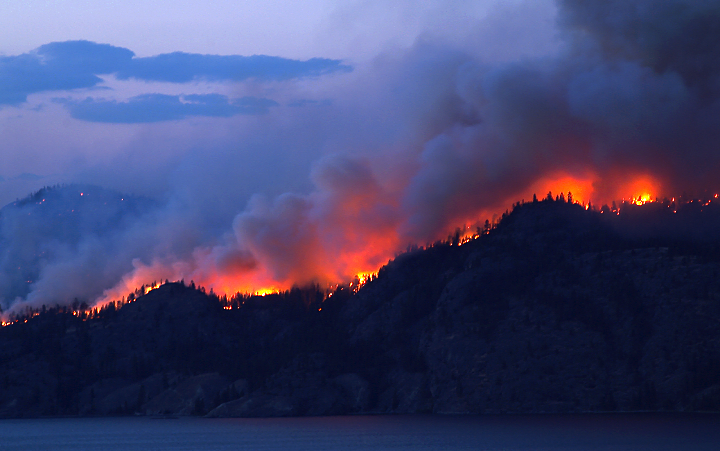
Canadian Wildfires and Air Quality
June 7—air quality reached Unhealthy to Very Unhealthy in states affected by Canadian wildfires (AirNow.gov)
Primary component PM2.5—major contributor to health effects in vulnerable people

Slide 6
Dangers of PM_{2.5}
Health effects of exposure
Eye, nose, and throat irritation
Bronchitis
Asthma attacks
Headache
Aggravation of COPD
Increased blood pressure
Heart attack
Stroke
Vulnerable groups
Children
People with chronic lung conditions
People with cardiovascular disease
People who work outdoors

Slide 9
Protecting People from Unhealthy Air
Clean household air
MERV-13 HVAC filters
Room HEPA filters (no ionizer/ozonizer)
“Clean room”
A room that can be closed off from the rest of the home
Use a room HEPA filter or DIY filter
Keep it cool
Visit a public area with cleaner air
Libraries
Commercial buildings with air conditioning
Community cleaner air shelters
For those who cannot keep the air in their homes clean
A place people can go where the air is cleaner than the outdoors
May be the same place as a community cooling center or warming center

Slide 10
For More Information
Virginia Department of Environmental Quality’s Air Quality & Forecast
AirNow.gov
US EPA’s Air Quality
US EPA’s Create a Clean Room to Protect Indoor Air Quality During a Wildfire
National Weather Service’s Air Quality Index
VDH Office of Environmental Health Services’ Public Health Toxicology Program
Tox Line: (804) 864-8182
toxicology@vdh.virginia.gov

