Slide 1

Quit Now Virginia Services
Gina Roberts
Regional Coordinator
VDH Tobacco Control Program

Slide 2
Why are we still Talking about Tobacco?
Tobacco is STILL the leading preventable cause of death and disease in the U.S.
Kills more people than AIDS, alcohol, accidents, murder, suicide… combined.
Notes:
Although smoking rates have gone, down, according to the CDC– still leading preventable cause of death and disease. Tobacco disproportionately affects those with lower levels of education and lower socioeconomic status.

Slide 3
Smoking Risks

Slide 4
Cigarette Smoking Rates
Overall, cigarette smoking rates in Virginia are headed in the right direction.
Vast contrasts can be identified in the prevalence of people smoking cigarettes depending on where one lives geographically. → Northern vs Southwestern Health Region.

Slide 5
E-Cigarettes and Vaping
*
*
Rates of e-cigarette use have increased across almost all of Virginia’s health regions.
Notes:
*Some unstable rates include: 2017 – Northern(43) and Northwestern(49); 2019 – Central(31), Northern(22), Northwestern(31), and Southwestern(45); 2020 – Central(47) and Northwestern(36);

Slide 6
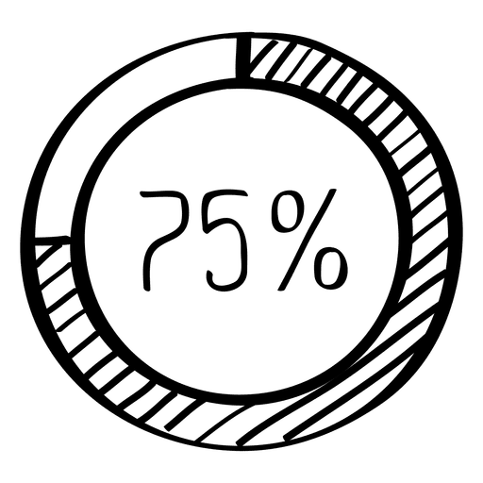
Desire to Quit
75 % of Virginian tobacco users WANT to quit…
Notes:
AND Two-thirds tried to quit within the past year

Slide 7
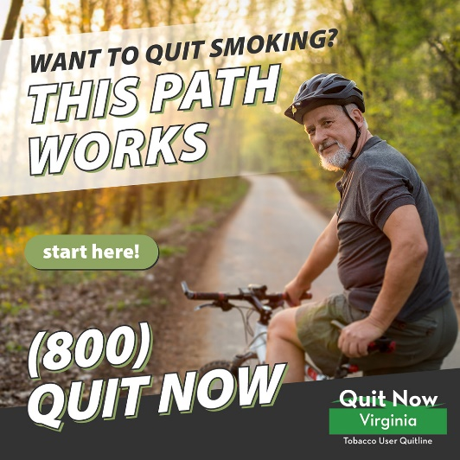
Quit Attempts
Often takes multiple quit attempts before quitting for good.
Only 3% of Cold Turkey attempts are successful.
Try practice quits.
Mindfully use tobacco products before your quit.
Get the RIGHT tools to support your quit!
Notes:
Two thirds of VA Tobacco Users TRIED to quit last year.
Only 7.5 % of those who tried to quit last year (nationwide) were successful.
Only 3 % of Cold Turkey attempts are successful.

Slide 8
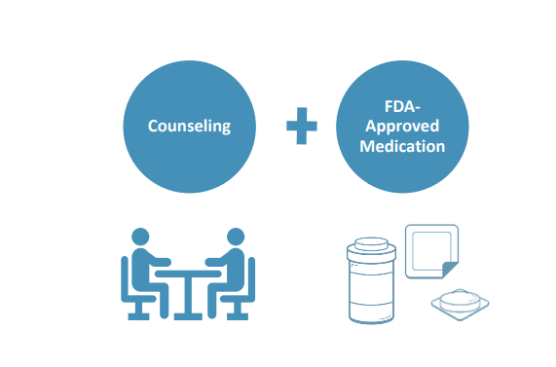
Quit YOUR Way
Counseling:
Individual 1-1
Phone counseling 1-800-QUIT NOW
Online counseling www.quitnowvirginia.org
Group counseling in person or QNV
Nicotine Replacement Therapies (NRT):
Patch
Gum
Lozenge
Inhaler
Nasal Spray
AND/OR – COMBO.
Cessation Medications:
Buproprion
Varencline
Notes:
Research has shown that the best way to set yourself up for success is to get some type of counseling…. And to use some type of Nicotine Replacement Therapy and/or Medication.
Quit aids/ tools. We talked about nicotine IS an addiction. FDA has approved 7 quit aids including these 5 that have nicotine in them. Talk to your doctor about what would work best for you. If one hasn’t worked in the past, try a different one. There are more options than just the patch!
Combo: Example: Nicotine patch (long-acting) + Nicotine gum (short-acting)
Linda Hancock– you wouldn’t give up on wearing shoes if one pair of shoes didn’t work out or gave you blisters. KEEP Trying these to get the right support for YOU.

Slide 9

Connect with a Quit Coach to find YOUR personal motivation for quitting!
FREE and Confidential
24 hours/day
7 days/ week
Phone, text and web support
Bilingual coaches
Translation Services in 140 languages
Quit ANY tobacco use: smoking, cigars, vaping, smokeless
Notes:
What worked for your sister, your neighbor, your cousin MAY NOT work for you. Important to find personal motivation and come up with individual/unique plan.
QUIT SERVICES: If you have seen the TIPS ads, that is NOT how the quit coaches will talk to you. They are well trained quit coaches who want to help you succeed!

Slide 10
Quit Now Virginia Services
Phone, Web or Text based Counseling
Free Nicotine Replacement Therapy
  At least 2 weeks, up to 12 weeks if eligible
Personalized Dashboard
Personalized Plan
Group sessions
Quit Services can even support spouses, parents, friends with tips on how to talk about quitting with their loved ones!

Slide 11
Quit YOUR Way
Counseling:
Individual 1-1
Phone counseling 1-800-QUIT NOW
Online counseling www.quitnowvirginia.org
Group counseling in person or QNV
Nicotine Replacement Therapies (NRT):
Patch
Gum
Lozenge
Inhaler
Nasal Spray
AND/OR – COMBO.
Cessation Medications:
Buproprion
Varencline
Notes:
FDA Approved NRT and Medication

Slide 12

E-Cigarettes, Vapes, JUULs
NOT an FDA Approved Cessation Tool
Electronic Nicotine Delivery Systems (ENDS), also called e-cigarettes, JUULs, personal vaporizers, vapes, vape pens, e-cigars, e-hookah, or vaping devices, are products that produce an aerosolized mixture containing flavored liquids and nicotine that is inhaled by the user.
Notes:
NOTE: These were not listed when we talked about QUIT MY WAY. We know they may help some adult cigarette smokers quit, but we also know that many e-cigarette users who are trying to quit actually become dual users. And we know that many youth and young adult NON SMOKERS start using these products.
E-cigarettes can resemble tobacco products like cigarettes, cigars, pipes, or common gadgets like flashlights, flash drives, or pens. They go by MANY names and there are MANY products.
What they have in common is that they use liquid nicotine derived from a tobacco plant – add it to a device that heats the liquid nicotine instead of burning it. They are heated with batteries and the user inhales aerosol from the device.

Slide 13
Notes:
The aerosol is NOT harmless water vapor like the name implies. A vape. It is closer to aerosol – like hair spray.

Slide 14
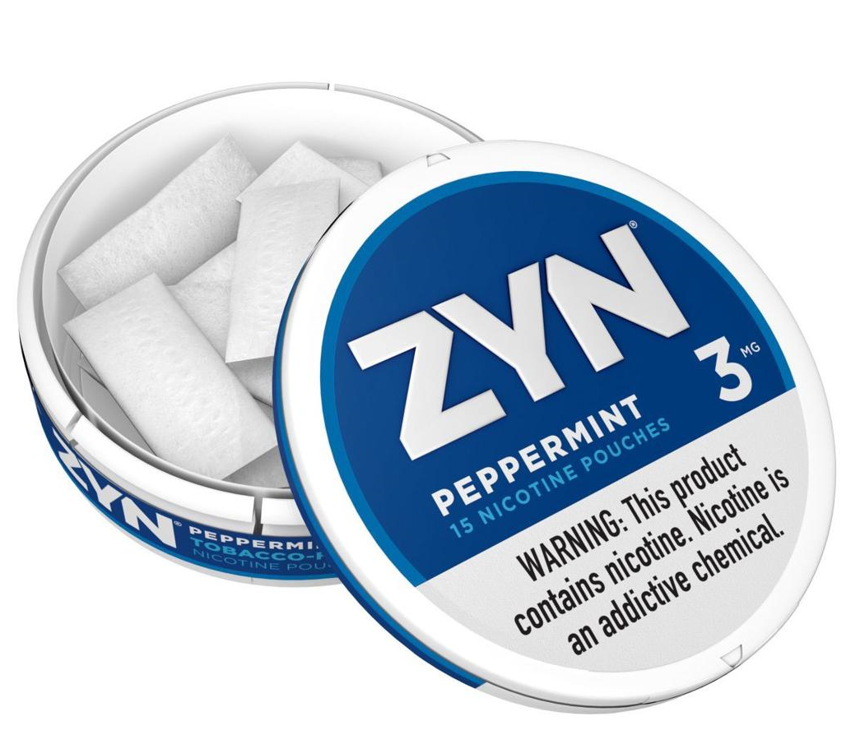
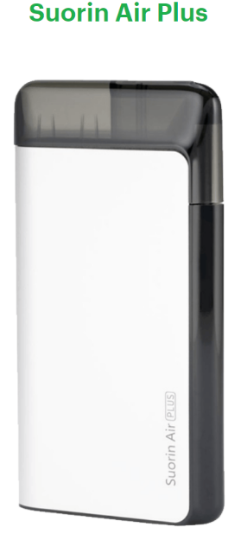
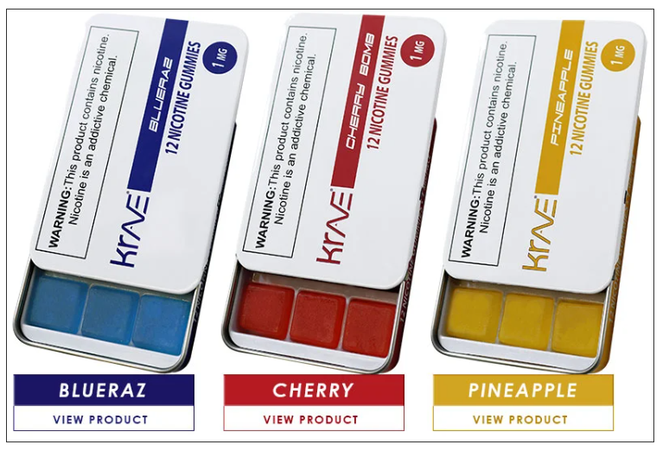
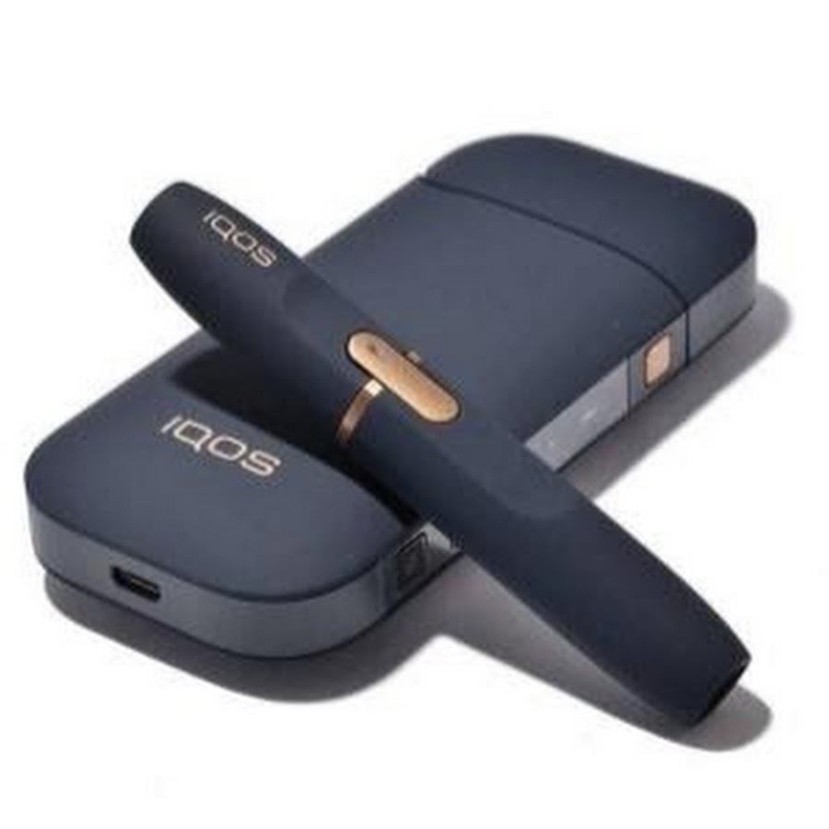
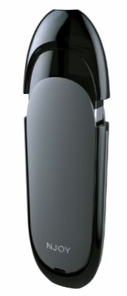
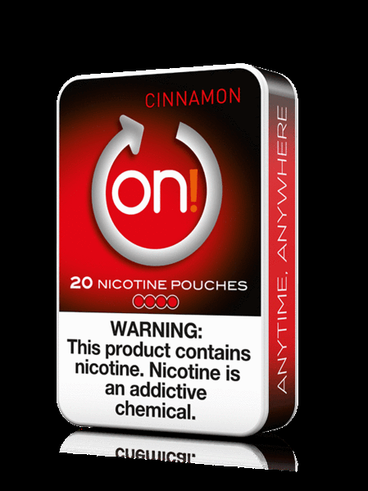
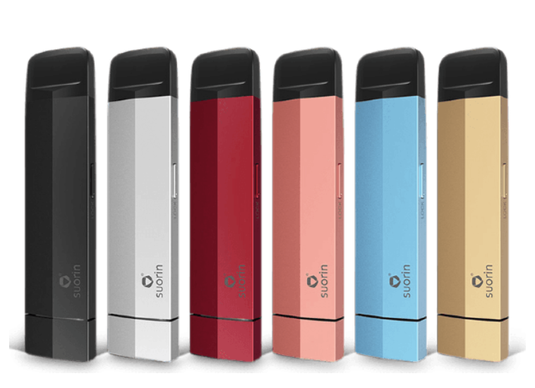
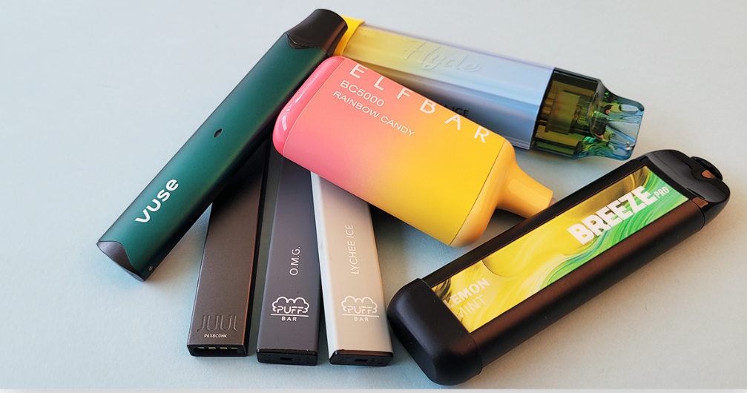
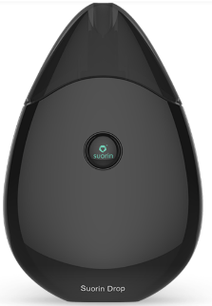
Emerging Products
Images from Google Searches
Notes:
https://truthinitiative.org/research-resources/emerging-tobacco-products/what-zyn-and-what-are-oral-nicotine-pouches
Krave Nic Gummies (FDA sent warning letter since they did not submit premarket authorization)
Elf Bar, Hyde and Breeze—latest disposables

Slide 15
Reimagined Services

Slide 16
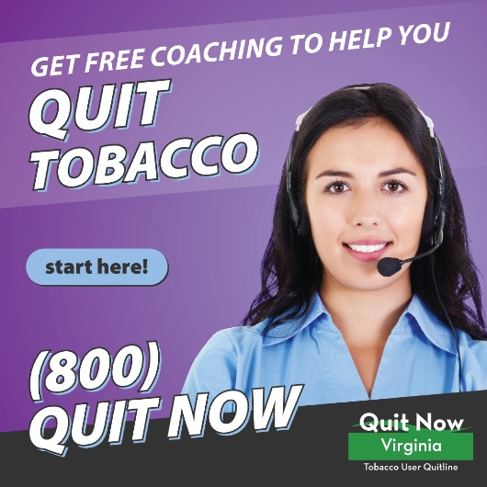
COACH: What do you get when you call?
General Population who call 1-800-QUIT NOW (1-800-784-8669) Or are referred through e-portal, but do not identify as one of the priority populations
  One full session = 3 incoming calls + 2 group sessions
  NRT Starter Kit= 2 weeks patch OR gum
  Personalized Quit Plan
  Digital Dashboard to guide them through the program
Notes:
Quit Services are now divided by Coach and Coach+
Quit Services will make outbound (proactive calls by the coach) calls to members eligible for Coach+, but not for Coach. Think of Coach+ as the former multi-call program for priority populations, where coaches proactively called the members.
For both Coach and Coach+, callers/members will not be assigned to the same coach, but any coach will be able to see the member’s enrollment information and summaries of past sessions completed.
Phone calls are scheduled for members eligible for Coach+ (like they are now with multi-call), but not for members eligible for Coach; as with the current one-call program, they’ll leave their first session with a quit plan.
Every member will be assigned a ‘digital dashboard’ that will help guide them through their program. Especially beneficial to encourage them to attend group sessions (see below) and otherwise initiate a call/chat/text with a coach to complete the rest of their sessions.
All members are eligible to participate in a pre-quit group session and a post-quit group session. Coaches will encourage and assist members in scheduling both, but members can also sign up for group sessions on the digital dashboard (the dashboard will be particularly important for members with Coach/no outbound calls)
Members have the option of not participating in the group session

Slide 17

COACH+: What do you get when you call?
Priority Populations = Uninsured, 18-20 year olds, Behavioral Health, Pregnant/ Family Planning/ Postpartum, Youth
Population
Insured/21+ | 5 sessions +2-wks NRT (patch or gum) | COACH (formerly one call)
Uninsured or 18-20 yrs. | 5 sessions +12-wks. NRT (patch or gum) | COACH+ (formerly multi-call)
Pregnancy & Postpartum | 7 sessions +12 wks. NRT- *medical override (patch or gum) | COACH+ (formerly multi-call)
Behavioral Health | 7 sessions +12 wks. combo NRT (patch, gum or patch & gum) | COACH+ (formerly multi-call)
Youth support | Access to online dashboard and option to chat with coach (no NRT) | COACH+ (formerly multi-call)

Slide 18
Three Clicks and Done! Quitline E-Referral
Find your state and confirm patient lives in VA
1
Find your facility
2
Complete in entirety the Patient/Client Information form
3
Click SUBMIT

Slide 19
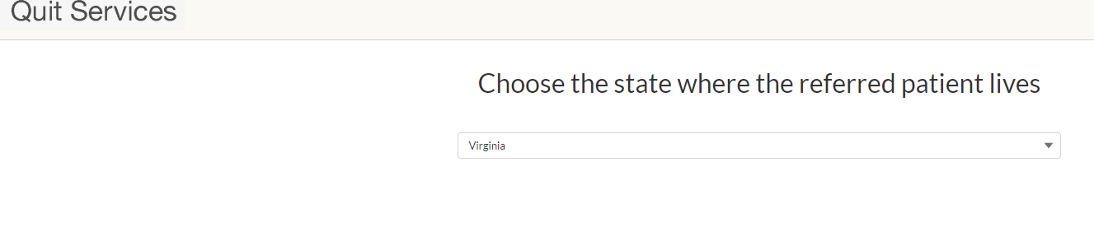
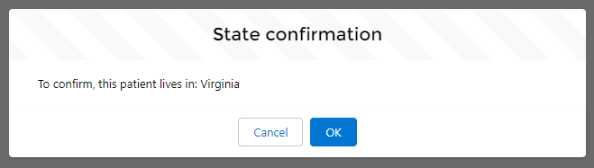
Quitline E-Referral: Step 1
Go to: https://rallycoaching.my.site.com/
Find your state.
Confirm Patient lives in VA
Notes:
Go to the website. Then, find your site by typing in the site name and choosing the right one.

Slide 20
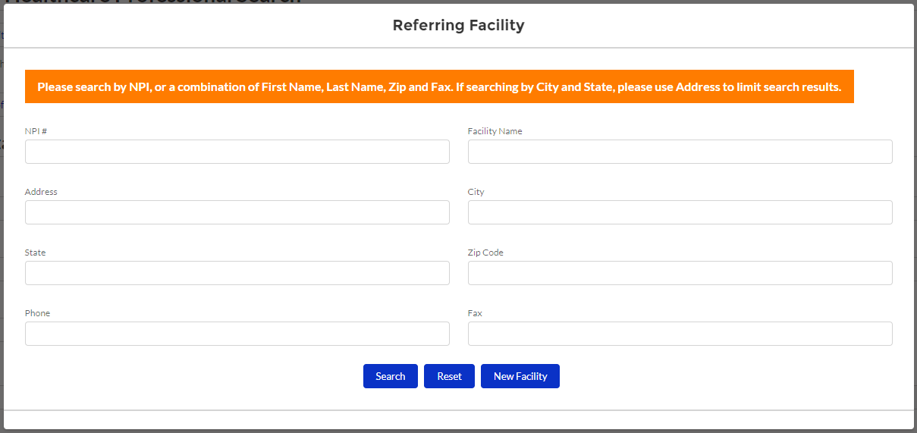
Quitline E-Referral: Step 2
Search by facility or healthcare professional
Sites can search via NPI#, name or fax
New sites can now register themselves via this portal
Sites are able to request changes to their site information (changes in site name, contact person information etc. to contact-supportservices@rvohealth.com
Notes:
Confirm the information. Click Next.

Slide 21
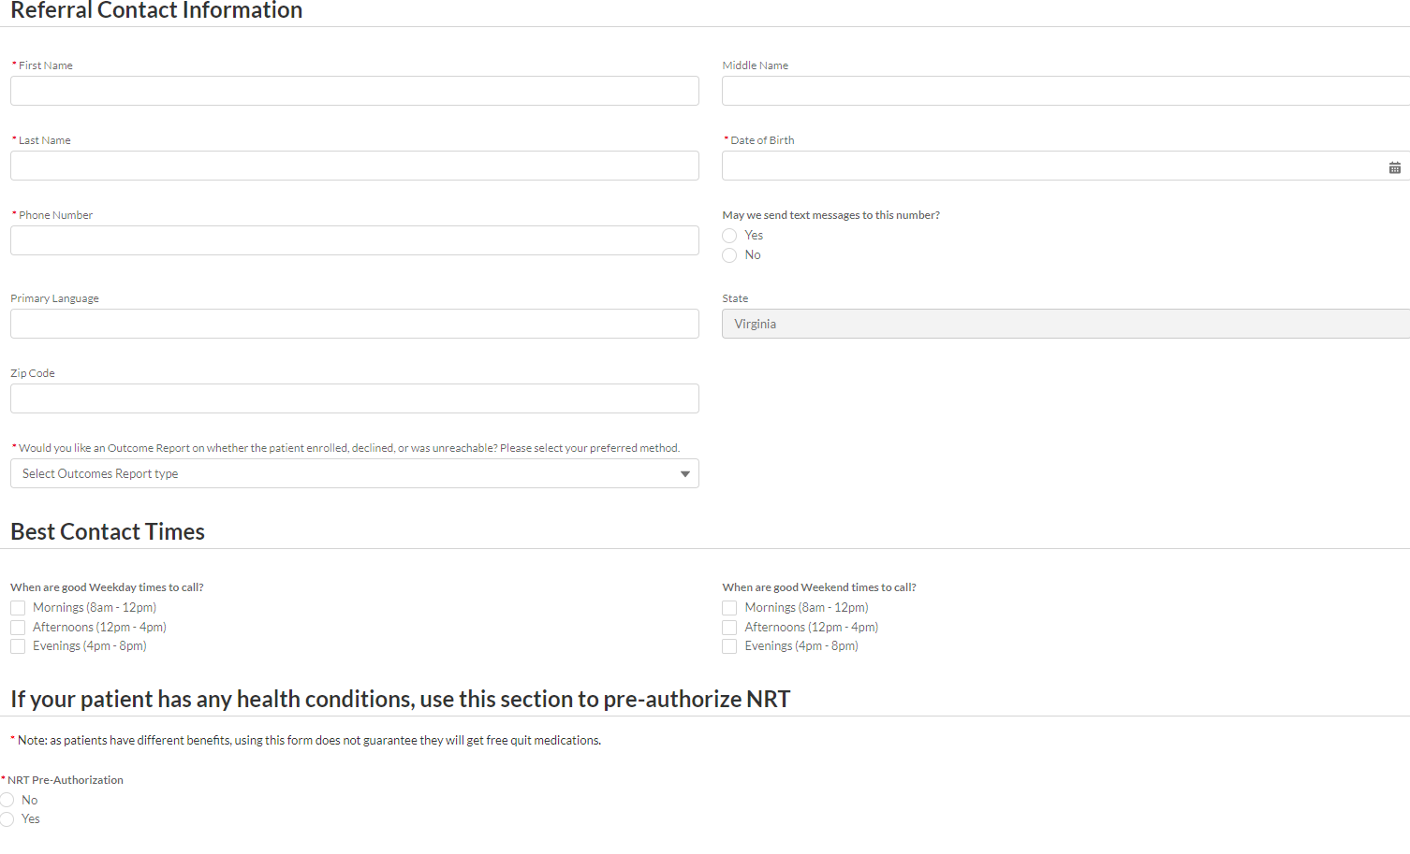
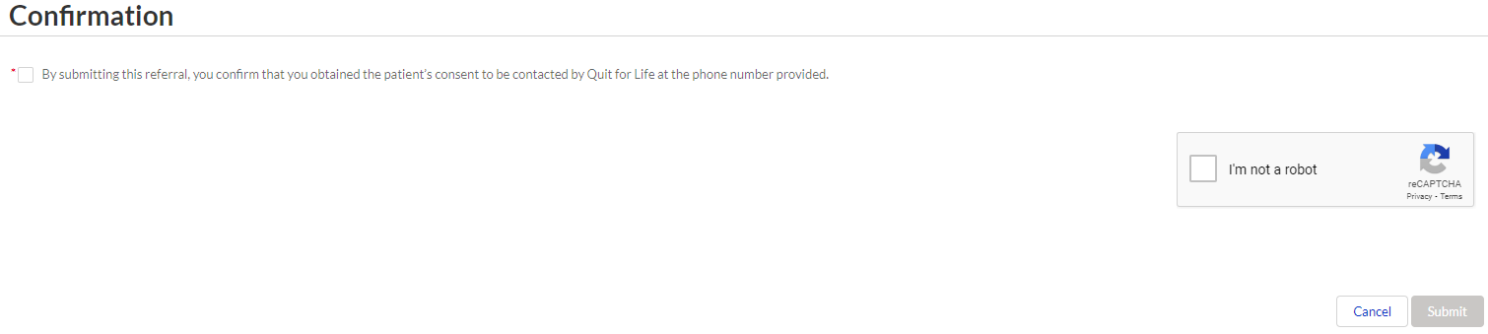
Quitline E-Referral: Step 3
Enter the client’s information and click Submit.
The referral is complete!
Once the referral is received a coach will outreach enrollee with in 24hrs,serval attempts are made to connect.
To receive outcome reports can choose, fax, email or no outcome report.

Slide 22
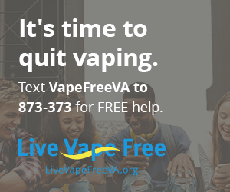
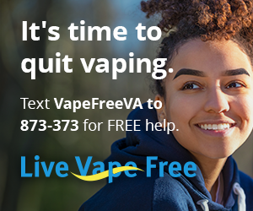
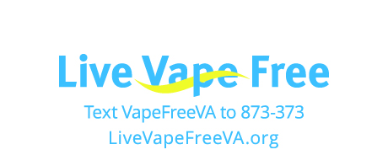
Live Vape Free
  Two-thirds of youth who vape WANT to quit.
  We can help.
  Web and Texting Support for youth
  Information and coaching for parents and adults

Slide 23

QuitNowVirginia.org

Slide 25



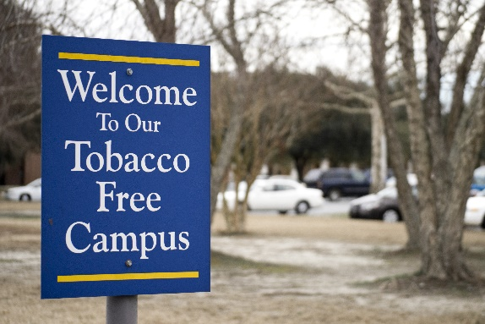
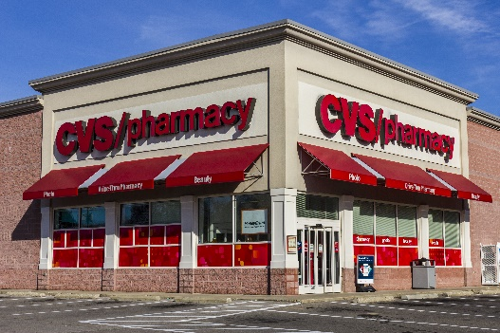
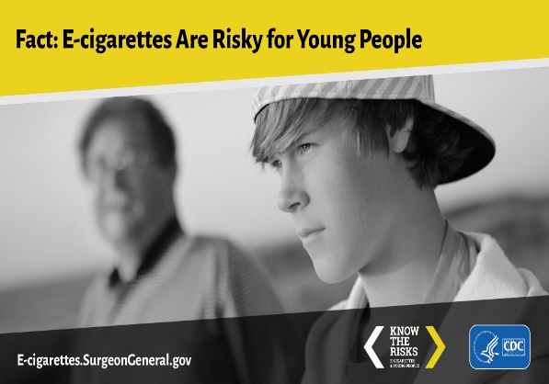

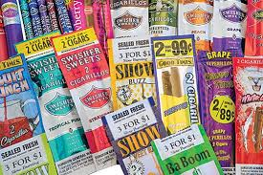
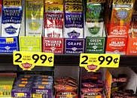


Tobacco Control Vaccine Booster
Opportunities to Modernize Proven Interventions
Tobacco 21 |  | Smoke-free Multiunit Housing |  | Tobacco-free Colleges |  | E-cigarettes |  | Tobacco-free Pharmacies
E-Referrals |  | Tobacco-free Sports |  | Digital Media |  | Restrictions on Flavors |  | Alternative Pricing Policies

Slide 26

Today is:
Great American Smokeout!

Slide 27
Lung Cancer Awareness Month
https://content.govdelivery.com/accounts/USEPAIAQ/bulletins/377643c

Slide 28
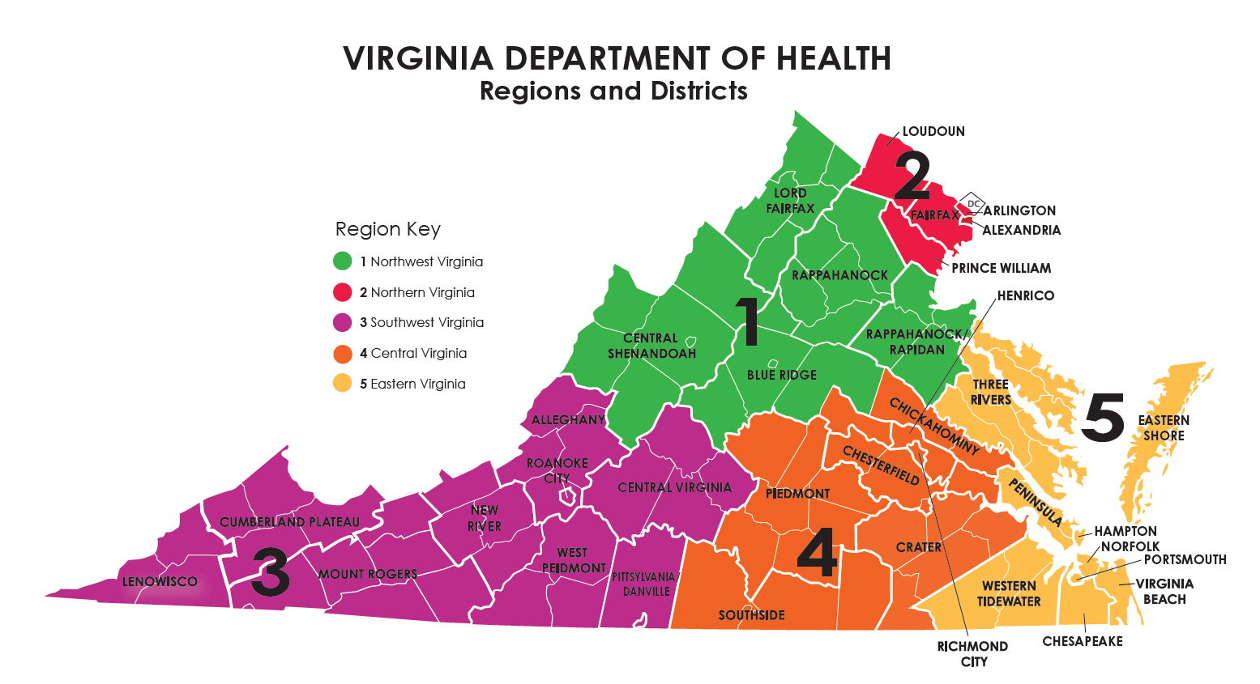
Questions? Keep in Touch!
Region 3: Gina Roberts
Trainings, Tobacco Free Policies
Gina.Roberts@vdh.Virginia.gov
(434) 944-3356
QuitNowVirginia.org TobaccoControl@vdh.virginia.gov
Notes:
Sarah– trainings for providers
Rita– materials or a new site

Slide 29
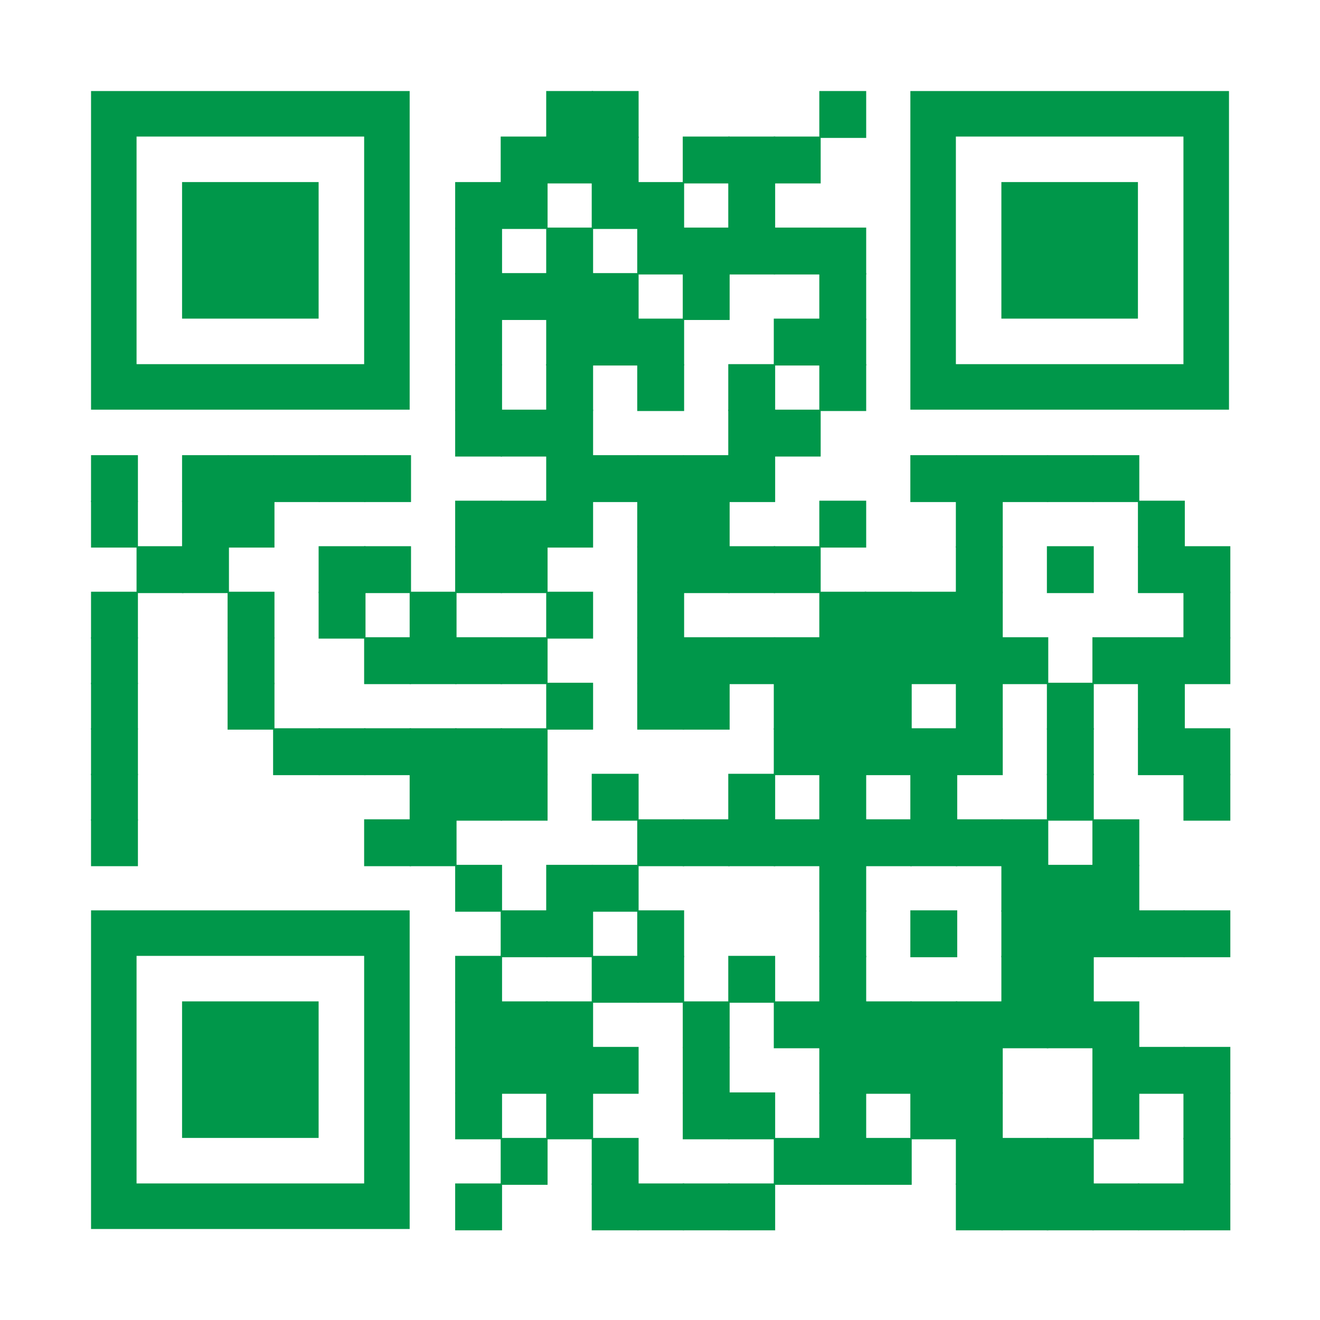
Any Questions?

