Slide 1

Virginia Family Nutrition Program
Virginia Partners in Prayer & Prevention
February 2024
Stephanie Diehl, MS, RD
Program Manager

Slide 2
Mission
The Virginia Family Nutrition Program’s mission is to teach limited-resource households how to make healthier food choices and become better managers of available food resources for optimal health and growth. Our programs focus on basic nutrition, physical activity, safe food handling, and thrifty food shopping. The Family Nutrition Program is offered through Virginia Cooperative Extension, an educational outreach partnership between Virginia Tech and Virginia State University.

Slide 3
Virginia Family Nutrition Program
Supplemental Nutrition Assistance Program – Education (SNAP-Ed)
Expanded Food and Nutrition Education Program (EFNEP)
Coordinated through Virginia Tech & Virginia Cooperative Extension
State employees housed in HNFE in CALS at Virginia Tech
Field staff located in Extension offices, food banks, and school board offices around the state

Slide 4
EFNEP & SNAP-Ed
EFNEP
$1,760,922 (FY2024)
Launched 50 years+ ago
Funded through USDA National Institute for Food and Agriculture (NIFA), Smith-Lever Act
SNAP-Ed
$8,961,929 (FY2024)
Launched 30 years ago
Funded through USDA Food & Nutrition Service (FNS), then Virginia DSS SNAP Division

Slide 5
Staffing
Peer Educators (Program Assistants) (49)
Direct education
Not expected to have a nutrition background
SNAP-Ed Agents (10)
Volunteer-based nutrition education – primarily school teachers (50%)
Policy, systems, and environmental (PSE) change (50%)
MS-degree required in nutrition or health
Social Media Coordinator (1)

Slide 6
Staffing
PSE Coordinator and Assistant Coordinators (3)
Policy, systems, and environmental change at state level
State Faculty & State/District Staff (13)
Curricula design, management and distribution of resources
Program and fiscal integrity
Leadership Team (Area Coordinators, Program Manager, Trainer) (7)
Program integrity and support
Partnerships

Slide 7


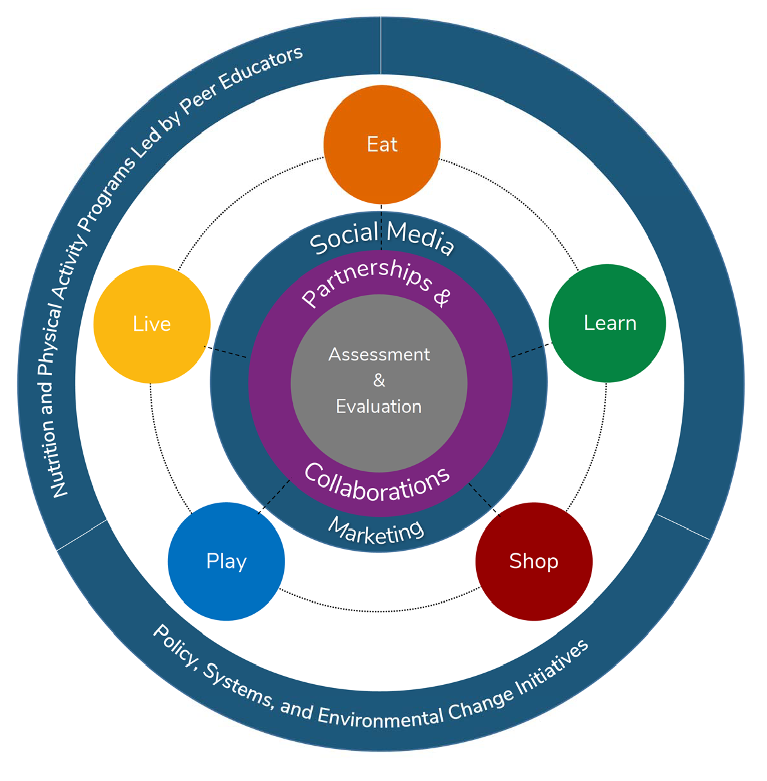













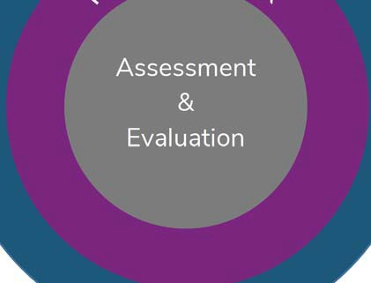







Approaches
Individual or Group-Based Nutrition Education
Adults
Youth
Policy, Systems, and Environmental Change (PSE) Initiatives
Social Media

Slide 8

Direct Nutrition Education

Slide 9
Policy, Systems, Environmental (PSE) Change Work
Food Pantries, Food Banks
Online education and training for food pantries to create “neighbor-centered” food pantries that promote dignity
Technical assistance on procuring more nutritious options
Promotion of nutritious foods, nutrition education
Farmers Markets that Accept SNAP
SNAP at Farmers Market Environmental Assessment to promote SNAP redemption at farmers markets

Slide 10
PSE Change Work
SNAP-Authorized Food Retailers
Use of choice architecture to increase sales of low-cost, nutritious options
School Wellness
Development of local (school) wellness policies
Classroom challenges to promote class-level physical activity and healthy eating
Employee wellness
Community Gardens

Slide 11
Who We Work With
Youth
Schools with 50% or more of students eligible for free or reduced (F/R) school meals
Adults
200% of federal poverty level income
Categorical eligibility (SNAP-Ed):
SNAP participation
Public housing
Food banks and food pantries
Referrals from SNAP, TANF, and WIC offices
PSEs require justification to ensure a high proportion of SNAP-eligible audiences

Slide 12
Social Media
Coordinated social media messages offered on the eatsmartmovemoreva.org website and numerous social media platforms help complement direct education and PSE change efforts by reinforcing key nutrition and physical activity messages.
By using multiple channels of communication, there are more opportunities for multiple exposures to key messages.

Slide 13
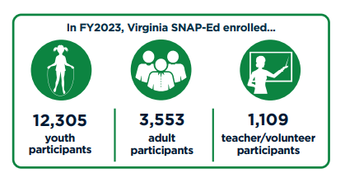
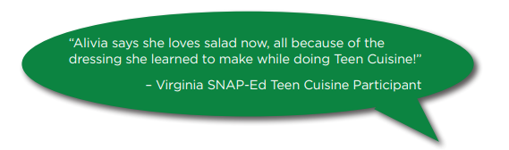


Slide 14
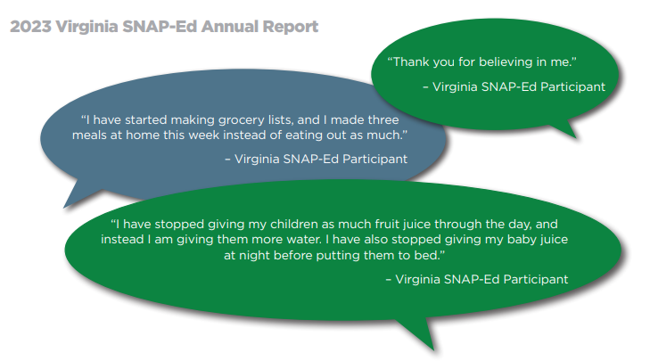

Slide 15
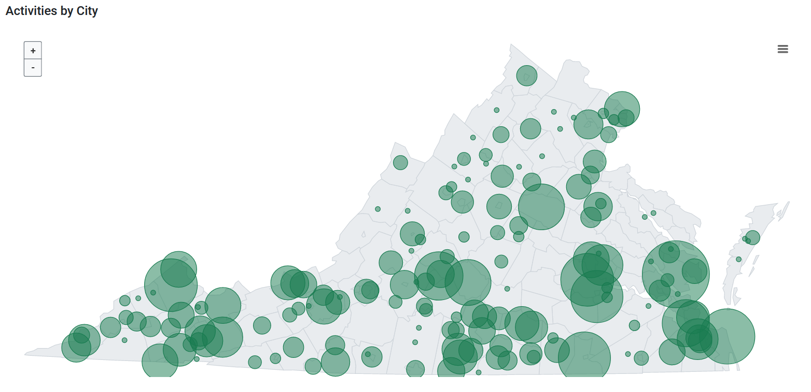
Work Around the State
Notes:
Programming presence across the state

Slide 16
How To Work With US
Volunteer to:
teach nutrition education
conduct food demonstrations
provide education at a retail partner
staff an education booth at the farmers market
teach food preparation
…and more!!!

Slide 17
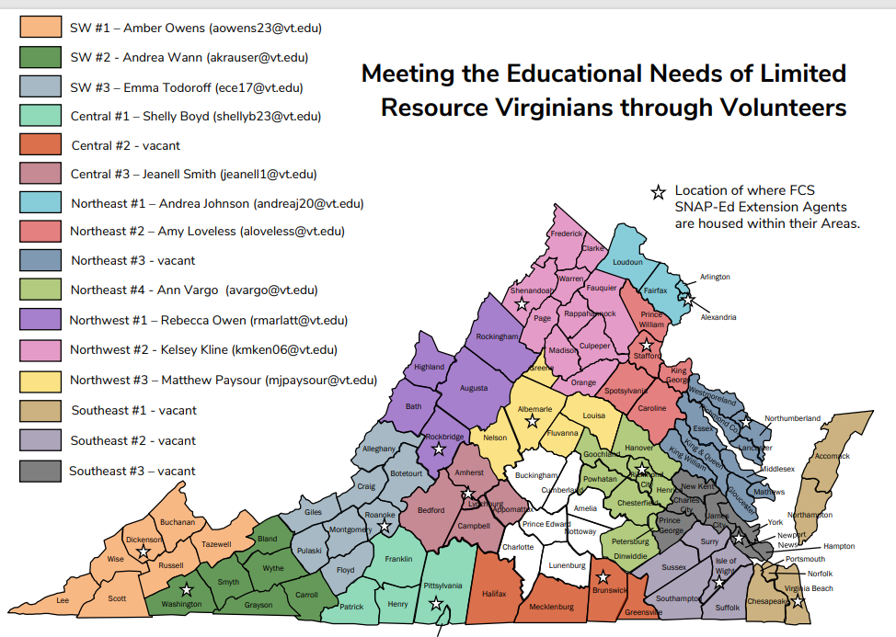

Slide 18
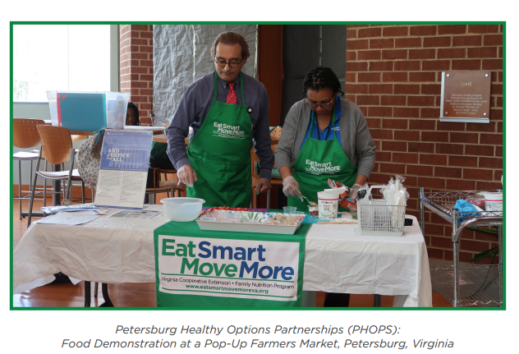
Thank you! Questions?

