Slide 1
The Virginia Diabetes Prevention & Management Program Virginia Partners in Prayer and Prevention
Nina Rodriguez, MPH, RN, CDE
November 21, 2024

Slide 2
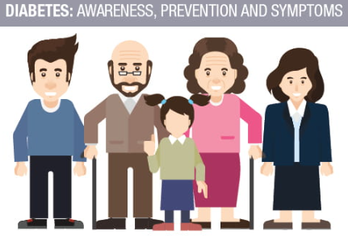

Prediabetes and Diabetes – why are these important topics?
2,208,000 people in Virginia, 33.3% of the adult population, have prediabetes
Approximately 743,024 people in Virginia, or 10.9% of the adult population, are living with diabetes
Diagnosed diabetes costs an estimated $8.4 billion in Virginia each year. Some complications of diabetes include heart disease, stroke, infections leading to amputation, end-stage kidney disease and dialysis, vision loss and blindness, poor oral health and loss of teeth, vascular dementia, and Alzheimer’s.
Risk Factors
Being overweight or obese
Being 45 or older
Being physically active less than three times a week
African American, Alaska Native, American Indian,
Asian American, Hispanic/Latino, Native Hawaiian,
or Pacific Islander American
Having high blood pressure, high cholesterol,
non-alcoholic fatty liver disease (NAFLD), or
metabolic syndrome
Parent or sibling with type 2 diabetes
Symptoms
Feeling thirsty
Urinating frequently
Blurred vision
Fatigue and unintentional weight loss
Slow-healing sores
Dry skin, frequent infections
numbness or tingling in the hands or feet
Complications
Heart disease
Stroke
Infections and amputations
Kidney disease and dialysis
Vision loss and blindness
Poor oral health and loss of teeth
Dementia and Alzheimer’s

Slide 3
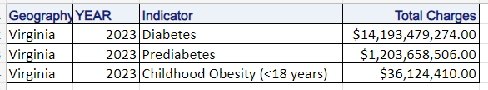

Type 2 diabetes tends to develop in adulthood and accounts for around 90% of all diabetes cases. It can often be managed or prevented with a healthy lifestyle, including increased physical activity and healthy diet.
Prediabetes in the US
Total: 97.6 million people aged 18 years or older have prediabetes (38.0% of the adult U.S. population)
65 years or older: 27.2 million people aged 65 years or older (48.8%) have prediabetes
Diabetes in the US
Total: 38.4 million people have diabetes (11.6% of the U.S. population)
Diagnosed: 29.7 million people, including 29.4 million adults
Undiagnosed: 8.7 million people (22.8% of adults with diabetes are undiagnosed
2023 Hospital Costs Related to Diabetes

Slide 4




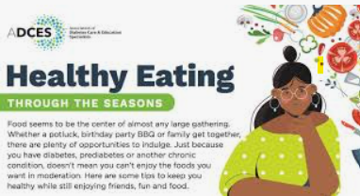
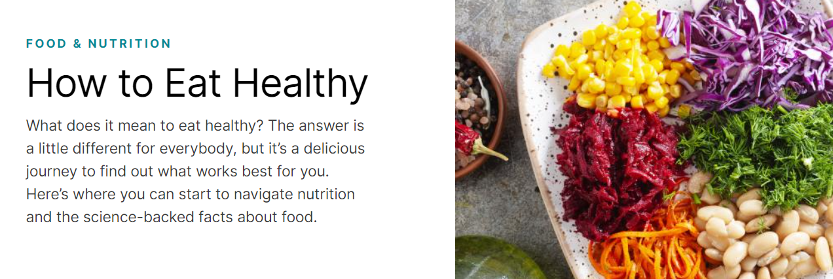

What does it mean to Eat Healthy?
AHA Eat Smart
AARP Food and Wellness
ADA Food and Nutrition
CDC Healthy Eating Tips
ADCES Healthy Eating Guide

Slide 5
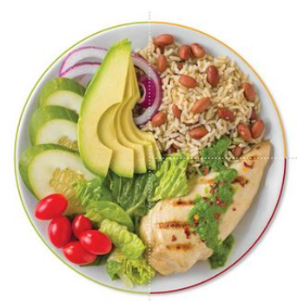
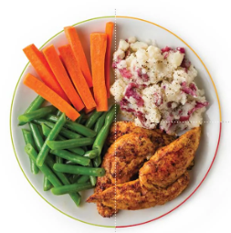

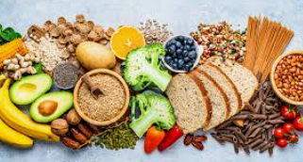


The Plate Method

Slide 6
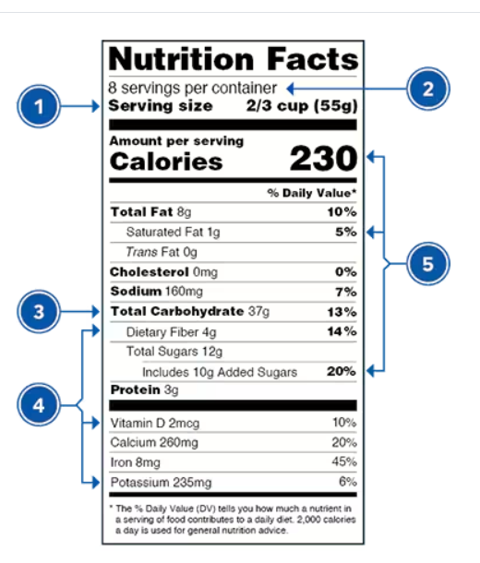

Food Labels
Oh, Sugar. How do I love thee?
‍Basic Simple Sugars:
Dextrose
Fructose
Galactose
Glucose
Lactose
Maltose
Sucrose
Solid or Granulated Sugars:
Beet sugar
Brown sugar
Cane juice crystals
Cane sugar
Castor sugar
Coconut sugar
Confectioner's sugar (aka, powdered sugar)
Corn syrup solids
Crystalline fructose
Date sugar
Demerara sugar
Dextrin
Diastatic malt
Ethyl maltol
Florida crystals
Golden sugar
Glucose syrup solids
25. Grape sugar
26. Icing sugar
27. Maltodextrin
28. Muscovado sugar
Let me count the ways.
29. Panela sugar
30. Raw sugar
31. Sugar (granulated or table)
32. Sucanat
33. Turbinado sugar
34. Yellow sugar
Liquid or Syrup Sugars:
Agave Nectar/Syrup
Barley malt
Blackstrap molasses
Brown rice syrup
Buttered sugar/buttercream
Caramel
Carob syrup
Corn syrup
Evaporated cane juice
Fruit juice
Fruit juice concentrate
Golden syrup
High-Fructose Corn Syrup (HFCS)
Honey
Invert sugar
Malt syrup
Maple syrup
Molasses
Rice syrup
Refiner's syrup
Sorghum syrup
Treacle
.
Check the Serving size first. All the numbers on this label are for a 2/3-cup serving.
This package has 8 servings. If you eat the whole thing, you are eating 8 times the amount of calories, carbs, fat, etc., shown on the label.
Total Carbohydrate shows you the types of carbs in the food, like sugar and fiber.
Choose foods with more fiber, protein, vitamins, and minerals.
Choose foods with lower calories, saturated fat, sodium, and added sugars. Avoid trans fat.

Slide 7
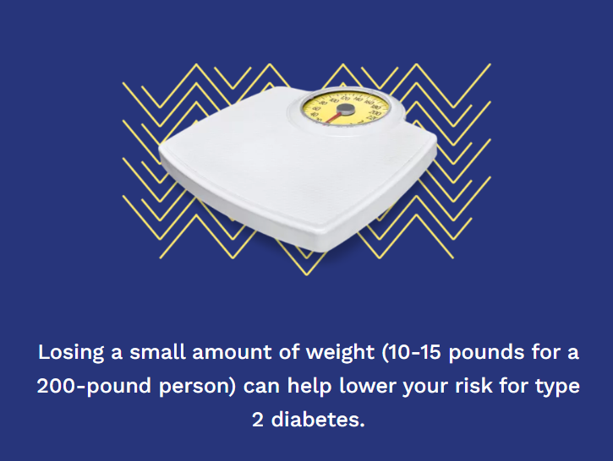
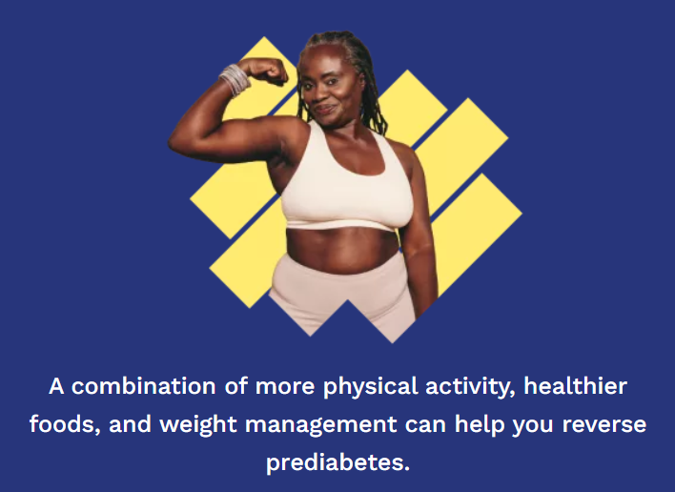




Helpful Resources
Walk With Ease Program
Tai Chi
Chronic Disease Self-Management Program
Diabetes Prevention Program
Balanced Living with Diabetes – contact your local Cooperative Extension Office
Diabetes Self-Management Program
Do I Have Prediabetes Risk Test

Slide 8
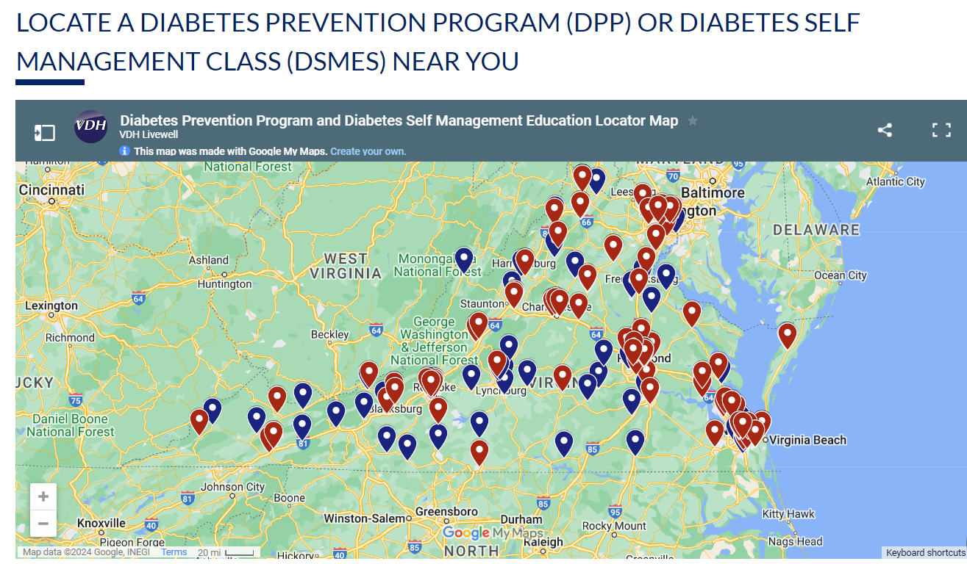
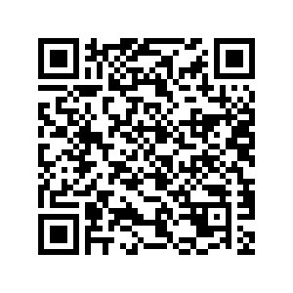

VDH Diabetes Class Locator Map

Slide 9
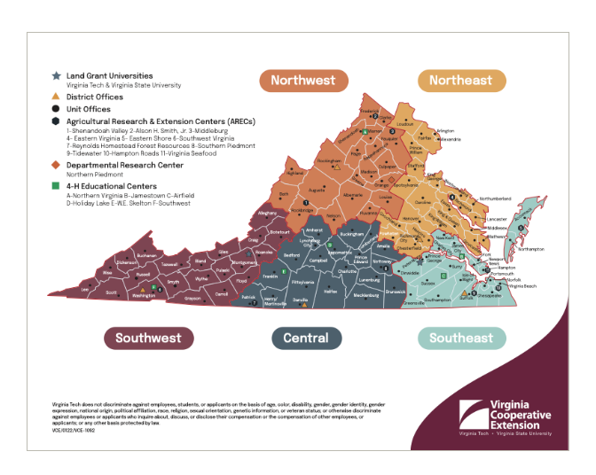
Virginia Cooperative Extension
Diabetes Prevention Program
https://www.ext.vsu.edu/dpp
Virginia Cooperative Extension
Chronic Disease Control Programs
https://ext.vt.edu/food-health/chronic-disease.html

Slide 10
Questions?
Nina Rodriguez
Diabetes Program Coordinator
nina.rodriguez@vdh.virginia.gov

