Slide 1
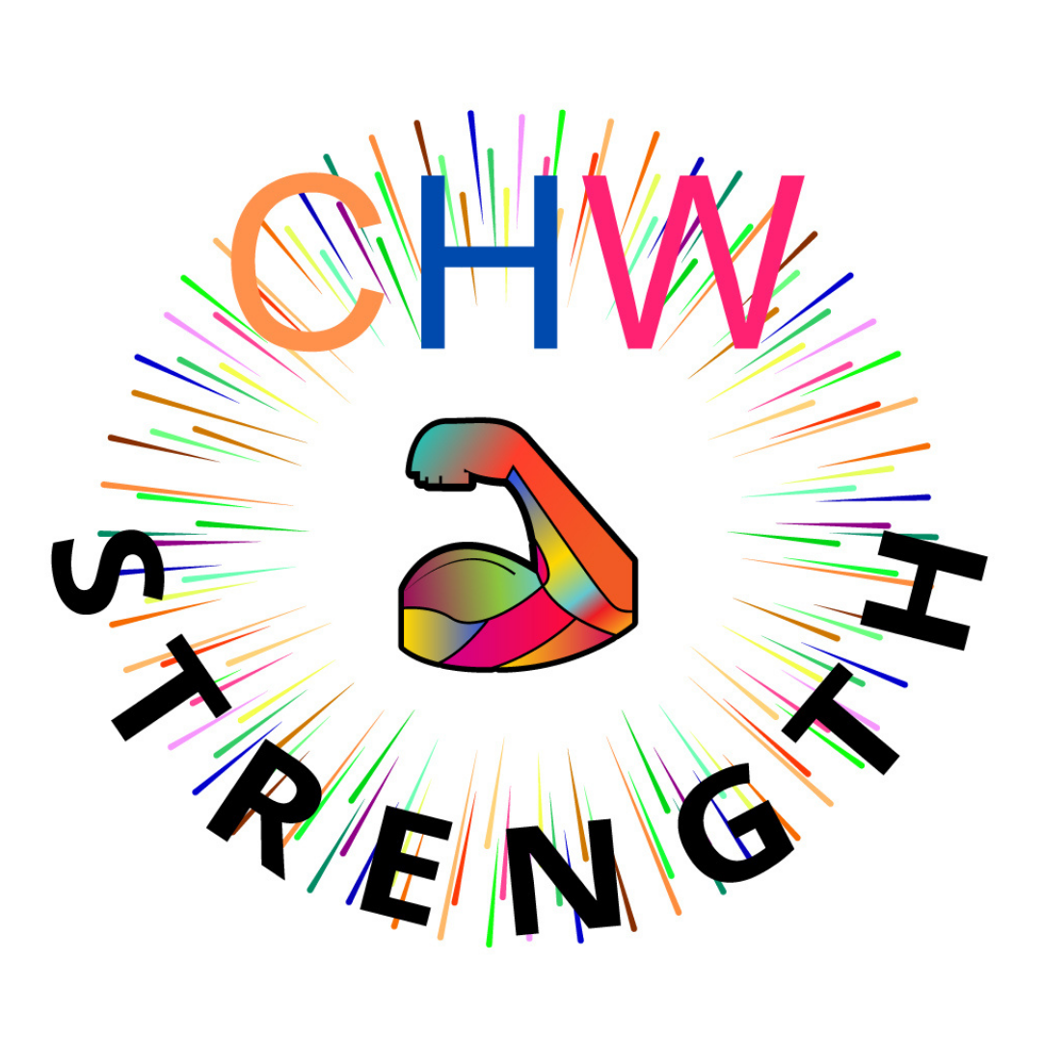

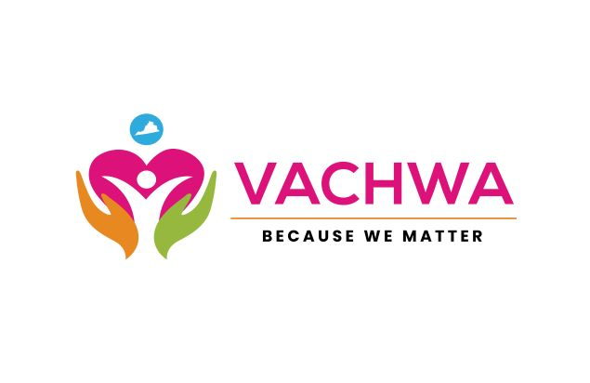
Introducing CHWs to VAP3 Partners & Highlighting Benefits to Faith‑Based Organizations
May 21, 2026

Slide 2
Welcome & Introductions
Does your organization currently work with CHWs?
Purpose:
To strengthen collaboration with Virginia Partners in Prayer & Prevention (VAP3) partners by deepening understanding of Community Health Workers (CHWs) and how they can support Faith‑Based Organizations (FBOs).
Introductions
VDH Office of Family Health Services and Office of Community Health Services: Kiara Christian, Camille McCray
VACHWA: Shanteny Jackson, Stephanie Carrington
CHW Strength: Stephanie Toney, Marco Thomas, Sandra Johnson
Notes:
Kiara: Today, our goal is to strengthen collaboration with our Virginia Partner in Prayer & Prevention (VAP3) partners by deepening our shared understanding of Community Health Workers, or CHWs. We want to highlight who CHWs are, the value they bring, and how their work can directly support Faith‑Based Organizations.
You’ll hear examples throughout the session that show how CHWs help bridge gaps between community members and systems, and how their role aligns with the mission of many faith‑based groups.
Introductions
To help us get a sense of the room and tailor the conversation, we’d like to ask a quick question: Are you currently working with CHWs in any capacity? This could be through a formal CHW program, or it might be volunteers or ministry staff who regularly serve the community in a way that aligns with CHW work.
(Write a 1 in the chat if you have a CHW on the team, Write a 2 in the chat if you have not)

Slide 3
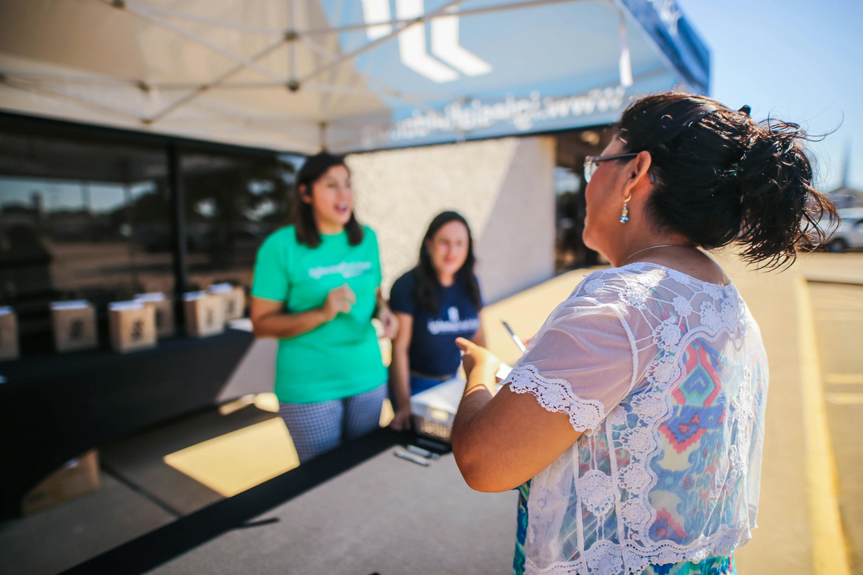
Who Are Community Health Workers?
Virginia State Definition of a CHW​
Uses understanding of the experience, language, and culture of the populations they serve to promote healthy living and help people take greater control of their health and lives.​
Provide culturally appropriate health education and information​
Connect individuals to health and social services​
Offer informal support and guidance​
Advocate for community needs and strengths​
Help build individual and community capacity​
Community Health Workers are:​
Trusted community members who understand the people and communities they serve​
Bridges between individuals, healthcare systems, and community resources​
Frontline public health workers who help identify and address community needs​
Certified or non-certified individuals with lived experience and community trust​
CHWs in Faith and Community Settings​
CHWs are like ministry workers who support outreach programs and community services.​
Many ministry volunteers are already carrying out CHW responsibilities, even if they do not officially hold the title.
Notes:
Camille
On this slide, we want to highlight what Community Health Workers really are, in a way that connects directly to the work many of you are already doing in your faith communities.
First, CHWs are very similar to ministry workers who serve in food pantries, outreach programs, or other community‑focused ministries. Many of the people already doing this work in your congregations or programs are essentially doing CHW tasks, even if they don’t hold the formal title.
One of the defining characteristics of a CHW is that they are trusted community members. They know the people they serve, understand the community’s strengths and challenges, and have relationships that make them effective.
CHWs act as bridges between systems and people. They help individuals navigate healthcare, social services, and community resources, things that can often feel overwhelming or confusing.
They’re also recognized as frontline public health workers. CHWs are often the first to hear about needs, concerns, or emerging issues because they are so connected to the community.
And finally, it’s important to note that CHWs can be certified or non‑certified. Certification is one pathway, but many individuals doing this work bring lived experience, and community trust that already align with the CHW role.

Slide 4
What’s Happening in Virginia
History of CHWs in Virginia
CHW Workforce Council
Current landscape
Notes:
Shanteny
From 2013–2014, leaders from IPHI, VCU, local health departments, CHWs, and community stakeholders came together to form the CHW Advisory Council and begin building a stronger CHW workforce in Virginia. Through the leadership of dedicated advocates like Ms. Denise Wise and many pioneering CHWs, conversations turned into action, leading to the creation of the Virginia Community Health Worker Association (VACHWA) in 2014.
Early CHW leaders developed bylaws, committees, and a framework focused on workforce development and certification. After researching national models and gathering feedback directly from CHWs through focus groups, Virginia established the foundation for today’s CHW certification process.
Beginning in 2018, CHW leaders renewed efforts toward legislation and workforce recognition. Although initial legislation in 2019 did not pass, continued advocacy led to successful legislation establishing title protections for CHWs and identifying the Virginia Department of Health as the oversight agency for certification.
Today, the CHW workforce in Virginia continues to grow in visibility and impact, with more than 390 certified CHWs, over 1,380 active CHWs statewide, and more than 450 VACHWA members committed to serving as trusted community leaders across the Commonwealth.

Slide 5

CHW Role and Responsibilities
What services can a CHW provide?
Outreach and Engagement
Health Education and Promotion
Care Coordination and System Navigation
Advocacy
CHWs can work under various titles such as:
Outreach Worker
Patient Navigator
Peer Support Worker
Care Coordinator
Community Resource Specialist
Ministry/Outreach Worker
Notes:
Stephanie C.
This slide highlights the core roles of Community Health Workers. These roles are grounded in two key standards: the National C3 Framework and the Virginia CHW Core Domains. Together, they outline what CHWs are trained to do and how they deliver support within their communities.
Outreach & Engagement: This aligns with the C3 roles of outreach, community mobilization, and relationship‑building. In Virginia, this fits within the Advocacy, Outreach, and Engagement domain. CHWs build trust, make connections, and meet people right where they are; in religious settings, neighborhoods, food pantries, or community programs.
Health Education & Promotion: This lines up with the C3 focus on providing culturally relevant health education. In Virginia, this links to Health Promotion & Prevention and Community Health Concepts and Approaches. CHWs make complex topics understandable and relatable, helping people take steps toward better health.
Care Coordination & System Navigation: This is a core C3 responsibility, helping individuals navigate healthcare and social service systems. In Virginia, this aligns with the Service Coordination & System Navigation domain. CHWs help with appointments, referrals, follow‑up, paperwork, and connecting people to the right services.
Advocacy: Advocacy is central to both frameworks. For Virginia, this connects to Advocacy, Outreach & Engagement, Communication, and Ethical Responsibilities & Professionalism. CHWs advocate for individuals and communities, uplifting needs, identifying gaps, and helping organizations understand real community barriers.
It’s important to recognize that Community Health Workers don’t always carry the title “CHW”. Many organizations use different job titles, even though the role and responsibilities align with the CHW profession. You might hear titles like outreach worker, patient navigator, peer support worker, care coordinator, or health promoter. In faith‑based settings, this can include ministry workers or outreach ministry staff; individuals who spend their time supporting community members and connecting them to services.
What’s important is not the title, but the work they do. The core competencies come from nationally recognized standards like the C3 Framework and from the Virginia CHW Domains. This flexibility is one of the strengths of the CHW workforce. It allows CHWs to be embedded in many different settings, clinics, community organizations, and faith‑based programs, while still operating from the same shared foundation of skills and values

Slide 6

Why CHWs Matter for VAP3 Partners
Improve access to care and services
Build trust in community and faith-based settings
Increased participation
Address barriers (transportation, education, follow-up)
Notes:
Stephanie T.
CHWs help improve access to care and services. They know where resources are, they can help people understand what’s available to them, and they support individuals who may struggle to connect with traditional systems.
They also help increase participation. When community members hear about programs from someone they know and trust, they are far more likely to engage, attend, and follow through.
Another key strength of CHWs is their ability to build trust in both community and faith‑based settings. CHWs often live, worship, or serve in the same communities as the people they support, which allows them to connect in ways that formal systems sometimes can’t.
And finally, CHWs help address real, everyday barriers. This includes things like transportation challenges, housing needs, difficulties understanding health information, or simply needing a reminder or some encouragement to follow up on care. These small actions make a big difference in outcomes.

Slide 7

How CHWs Can Support Faith‑Based Organizations (FBOs)
Strengthen Relationships with Congregants and the Community
Expand Health and Wellness Programming
Provide Navigation and Resource Support
Support Community Events and Ministries
Serve as a bridge between FBOs and Public Health
Notes:
Marco
CHWs can strengthen relationships with faith-based organizations because many CHWs are already trusted community members, congregants, ministry leaders, volunteers, or neighbors. That existing trust helps open doors for deeper conversations around health, wellness, and community needs.
Faith-based organizations are often trusted gathering places where people already come for support, guidance, encouragement, and connection. CHWs can build on that trust by helping connect people to practical health and social resources.
CHWs can serve as a bridge between ministry and public health. We help faith-based organizations recognize how health, wellness, prevention, and resource navigation can support the whole person and the whole community.
CHW Strength has a ministry training that empowers CHWs to see service as ministry. This helps CHWs understand that supporting people through education, advocacy, navigation, and relationship-building can be part of a larger calling to serve.
CHWs can support wellness programming within faith-based spaces through workshops, health conversations, screenings, prevention education, outreach events, and follow-up support that connects people to needed resources.
From my own experience, becoming a CHW strengthened how I served as a Bible study teacher. I began incorporating what I learned about health, wellness, prevention, and community support into lessons in a way that helped people connect faith, life, and practical care.

Slide 8
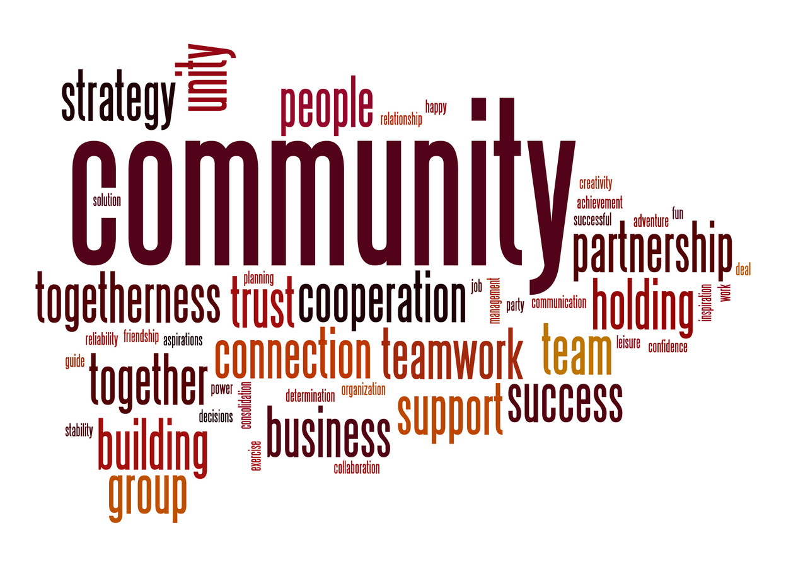
Examples of CHW–FBO Collaborations
CHW-led health education sessions hosted at places of worship.
FBOs partnering with CHWs or existing CHW led organizations to support food pantries and clothing ministries.
CHWs helping FBOs support seniors, families, and people with chronic disease.
Partnerships that increase preventive screening or help families access resources.
Hire or integrate a CHW into your organization
Notes:
Sandra
CHW-led health education sessions hosted at places of worship
Example Note: A CHW leads monthly workshops at a church on topics like blood pressure, diabetes prevention, and mental wellness in a trusted community setting.
FBOs partnering with CHWs or existing CHW-led organizations to support food pantries and clothing ministries
Example Note: While families receive food or clothing assistance, CHWs help connect them to Medicaid, housing support, and other community resources.
CHWs helping FBOs support seniors, families, and people with chronic disease
Example Note: CHWs provide wellness check-ins, help manage appointments and medications, and connect seniors and families to healthcare services.
Partnerships that increase preventive screening or help families access resources
Example Note: Churches and CHWs can host community health fairs that offer screenings, vaccinations, and direct connections to healthcare providers.
Hire or integrate a CHW into your organization
Example Note: A CHW can serve as a bridge between the congregation and community resources by providing education, referrals, and ongoing support.

Slide 9
Training and Certification
Foundational CHW VA Certification Training Requirements.
  Community Health Experience: One (1) year of full-time or 2000 hours of part-time volunteer or paid employment within the last 3 years of application date.
  Current Volunteer/Job Description: Copy of current community health worker volunteer/job description, obtained from current organization, and which must be signed by both the applicant and their immediate supervisor.
  Supervision: 50 hours of supervision of qualifying work experience in the community health worker domains.
  Education/Training: 60 total hours specific to all the domains within the last three years. All 60 hours must be from a VCB accredited CHW training provider.
Continuing education
  30 hours relevant to community health including 3 hours in ethics
VCB training providers list: Certified Community Health Worker (CCHW) | Virginia Certification Board
CHW Strength Ministry Collaborative: https://www.chwstrength.com/workforce/chw300-registration
Notes:
Stephanie T.
Certification recognizes lived experience and community leadership
Virginia values both volunteer and paid experience in the CHW pathway
Many ministry leaders, outreach workers, and volunteers may already qualify for portions of the experience requirement
CHWs are trained to support outreach, advocacy, communication, health education, and system navigation
Training gives CHWs tools to better support the people they already care about

Slide 10

Call to Action
Connect with professional & regional associations and VACHWA
Training, networking, conferences, social media
VACHWA website, VCB website
Notes:
Shanteny
We encourage CHWs and partners to stay connected through professional associations like VACHWA, participate in trainings, conferences, networking opportunities, and continue building community through social media and collaboration.
We also encourage everyone to use resources available through the VACHWA and Virginia Certification Board websites to stay informed about certification, workforce opportunities, and professional growth.
Most importantly, continue advocating for Community Health Workers and the communities we serve. Together, we can strengthen the workforce and advance health equity across Virginia.

Slide 11
Q&A
Notes:
Kiara

Slide 12
Let’s Stay Connected!
VACHWA: Community Health Worker Hub | Access to Health Services
  Shanteny Jackson, Executive Director : ed@chwofva.com
  Stephanie Carrington, President : president@chwofva.com
CHW Strength: CHW Strength | CHW Training
  Stephanie Toney, Visionary : visionary@chwstrength.com
  Marco Thomas, Mentor : mentor@chwstrength.com
  Sandra Johnson : FBO-CHW, blueprint4kingdomministry@gmail.com
VDH: CommunityHealthWorker@vdh.virginia.gov
  Camille McCray, CHW Coordinator (Internal), VDH Office of Community Health Services
  Kiara Christian, CHW Coordinator (Statewide), VDH Office of Family Health Services
Notes:
Camille

