Slide 1

Dr. Anika Hines
President, Central VA Board
Notes:
Dr. Hines- I have been so excited to see the work being done in the community since we last met, to address blood pressure and CPR/AED Awareness, maternal health, and more.

Slide 2
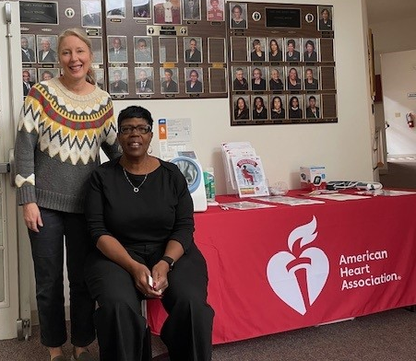
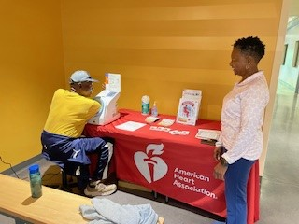
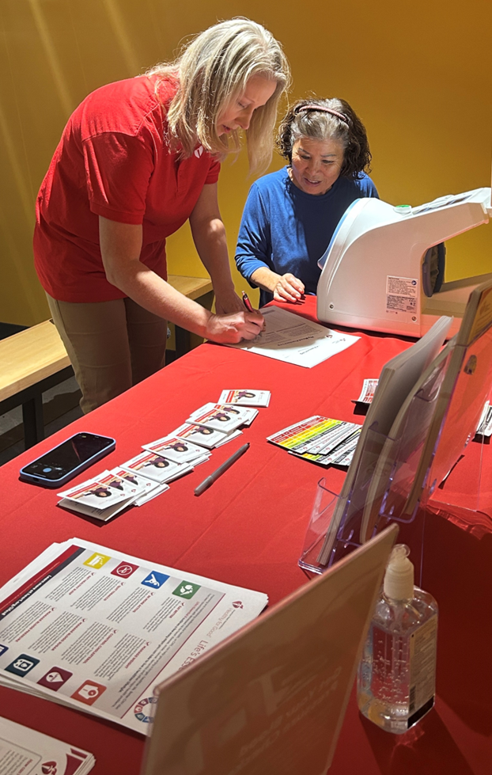
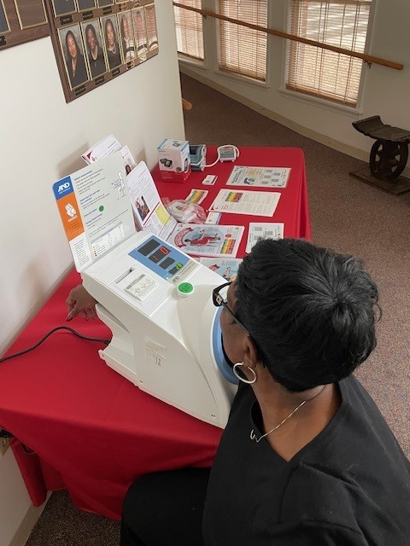
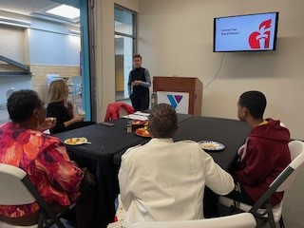
Number of Blood Pressure Stations Continues to
Grow Across Central VA
Notes:
These slides have photos of just a few of the community activities recently…. We launched blood pressure stations in three YMCAs, revamped the library resources with our new Libraries Have Heart brand and the updated blood pressure levels charts, places blood pressure stations at St. James Baptist Church and provided cuffs to the Health Brigade, held a CPR training at Atlantic Union, Capital Square, Genworth and Henrico County Schools, held a gratitude event at CoStar, delivered CPR Training Resources to Louisa County and Chesterfield County Schools, trained in infant CPR and gifted BP cuffs at a baby shower for expectant moms in Colonial Heights, and much more.

Slide 3
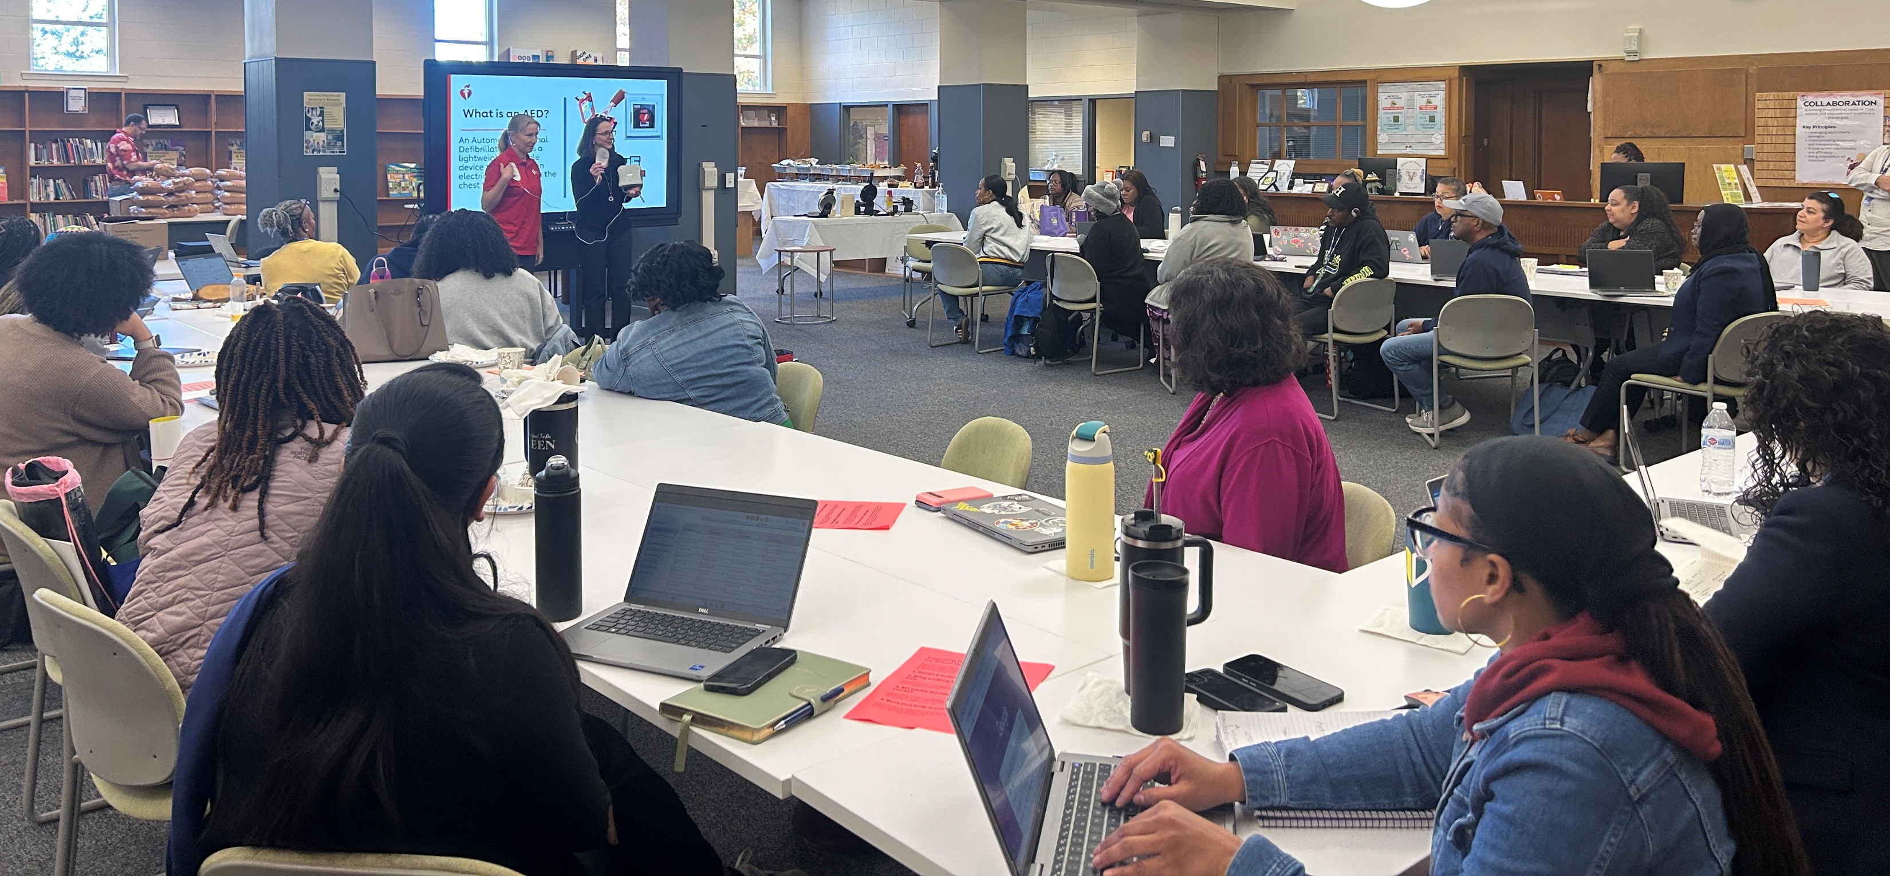
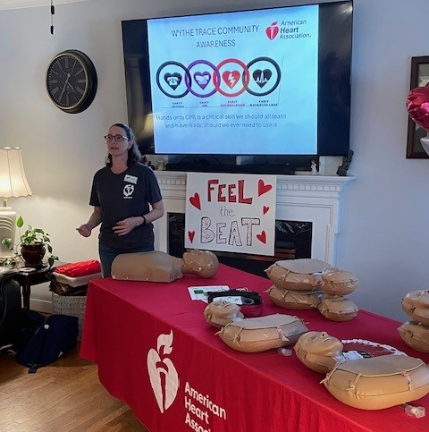
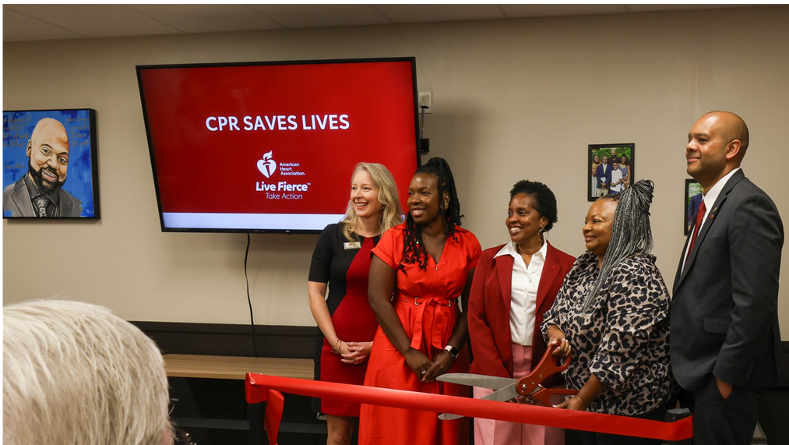
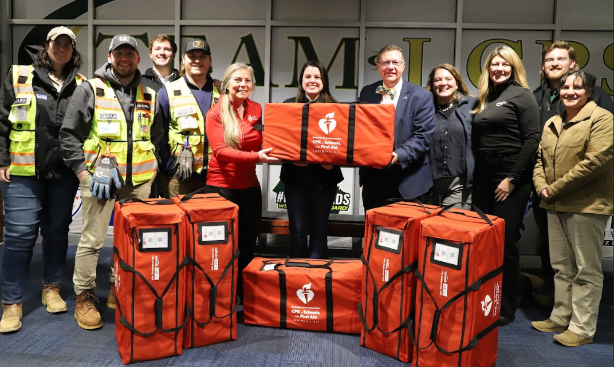
CPR and AED Training and CPR Kiosk Launches!!!
Notes:
We have been working hard to train as many people as we can to be ready to jump in and help in a cardiac emergency. Our CPR Kiosk has finished three months stay at the Market at 25th and launched last week at the VCU Student Commons. We are providing training resources to schools and providing awareness to companies, community organizations, faith-based groups, and much more. Anyone can learn to save a life!

Slide 4
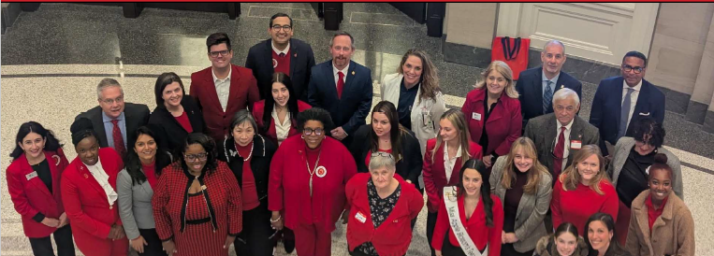
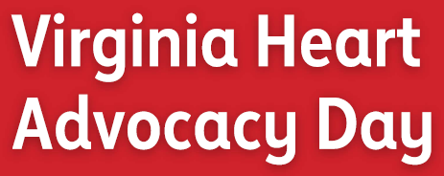
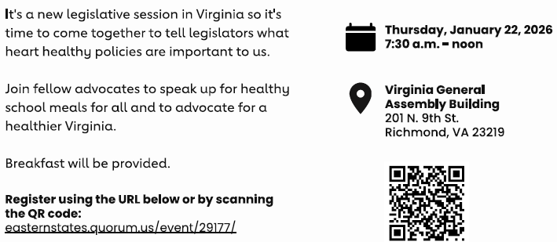

Slide 5



The Problem
Every day, 1 in 8 American children are food insecure. This means they don’t always know where their next meal is coming from.
During the pandemic, Congress provided waivers to programs to implement Healthy School Meals for All regardless of poverty levels in the area.
Studies have shown that this program was liked by schools, students, and families. However, the program was ended in 2022.

Slide 6
Healthy School Meals for All
Keeping our kids fed for success.
Healthy school meals ensures every child has access to healthy meals at school every day.
Where students have had healthy school meals for all, all students benefit. Memory retention, classroom behavior and overall class performance improve.
School meals must meet nutrition standards. This means every child eating a school meal is eating a nutritious meal.
School meal standards help schools promote a positive food environment and establish a foundation for a lifetime of healthy behaviors.
Providing all students with meals decreases administrative burdens for food service professionals.

Slide 7
Healthy School Meals for All
How does school meal access help externally?
Food banks and other food access programs are reporting an increase of need from families this year.
Healthy school meals helps remove barriers to food. When children have access to school meals, the whole family is more food secure.
Why do all kids need access to school meals?
  A family’s circumstances can change throughout the year. This shouldn’t impact a child ability to eat at school.
  Many families fall in the middle – they make too much to qualify for free/reduced lunch but not enough to keep food secure.
  Stigma. When all students can receive the same food at school at no cost, it removes the stigma.

Slide 8

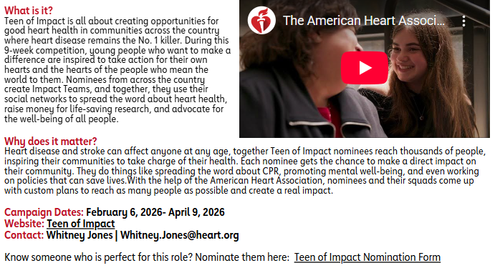

Slide 9

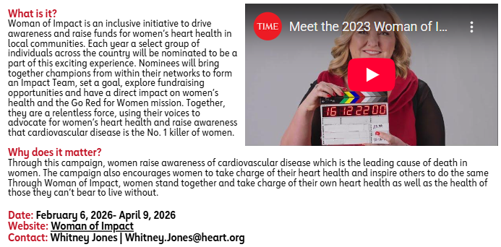

Slide 10
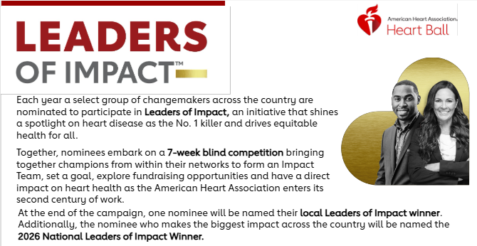
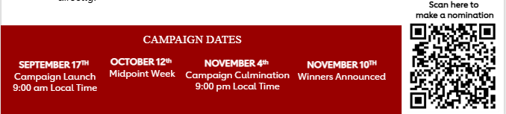

Slide 11


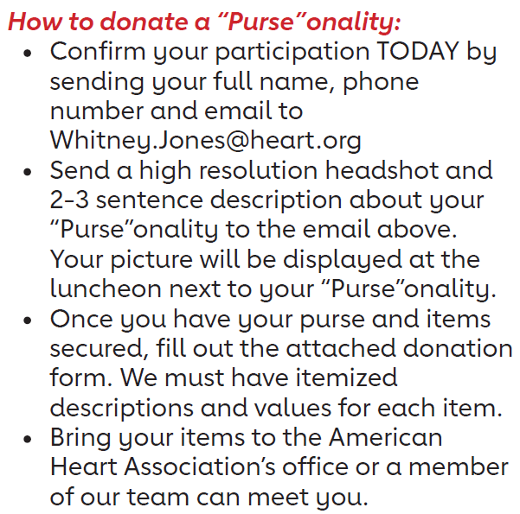


Slide 12
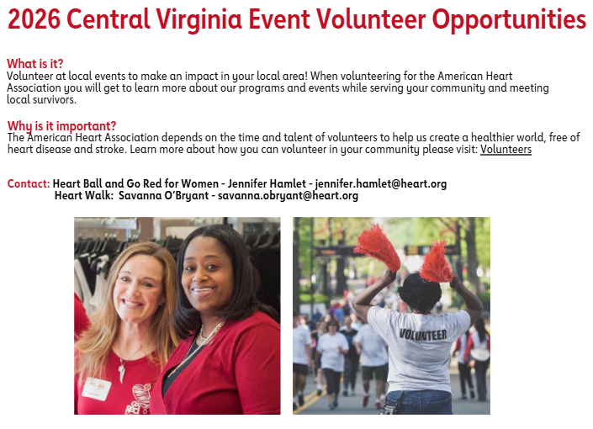

Slide 13
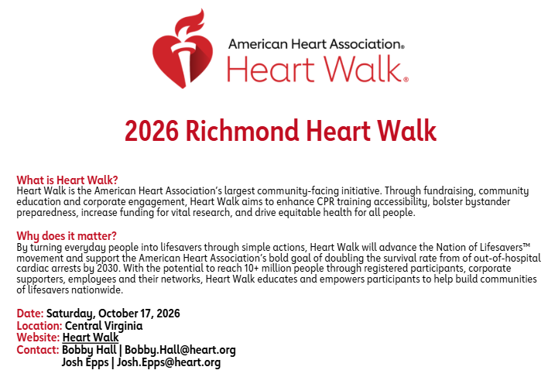

Slide 14

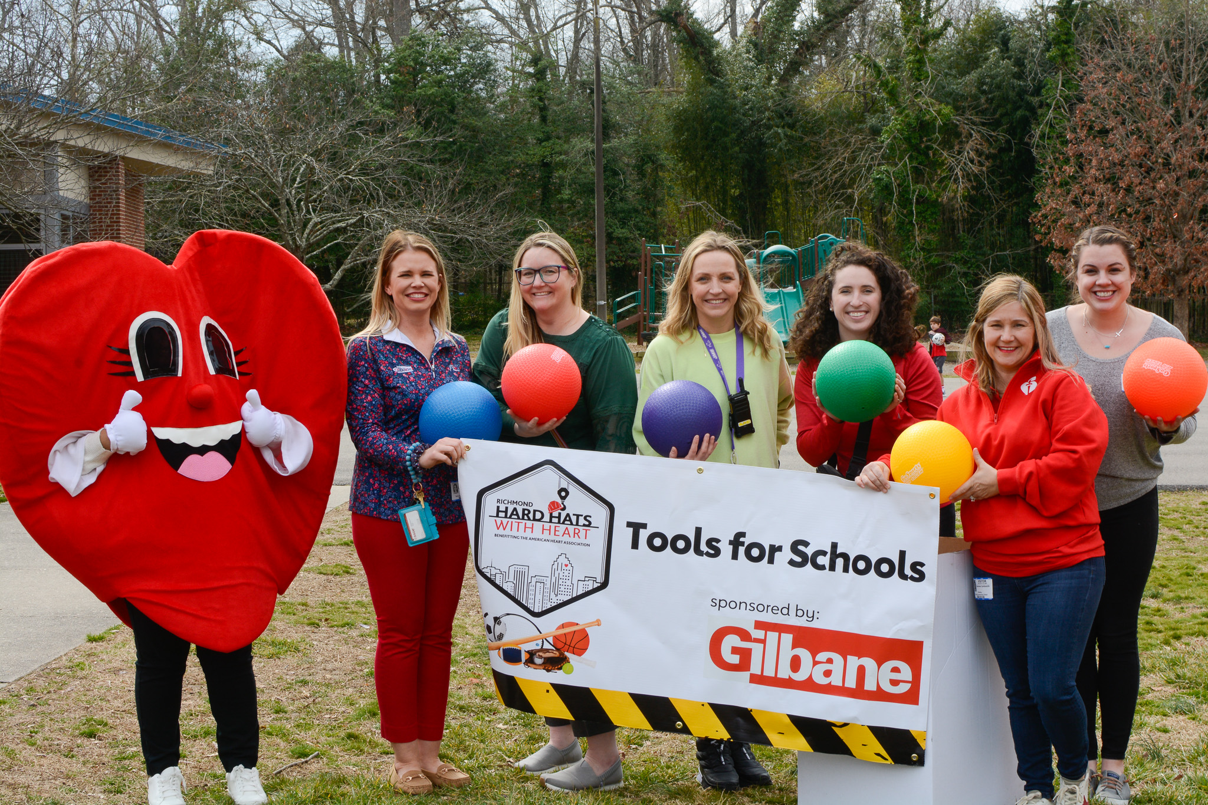
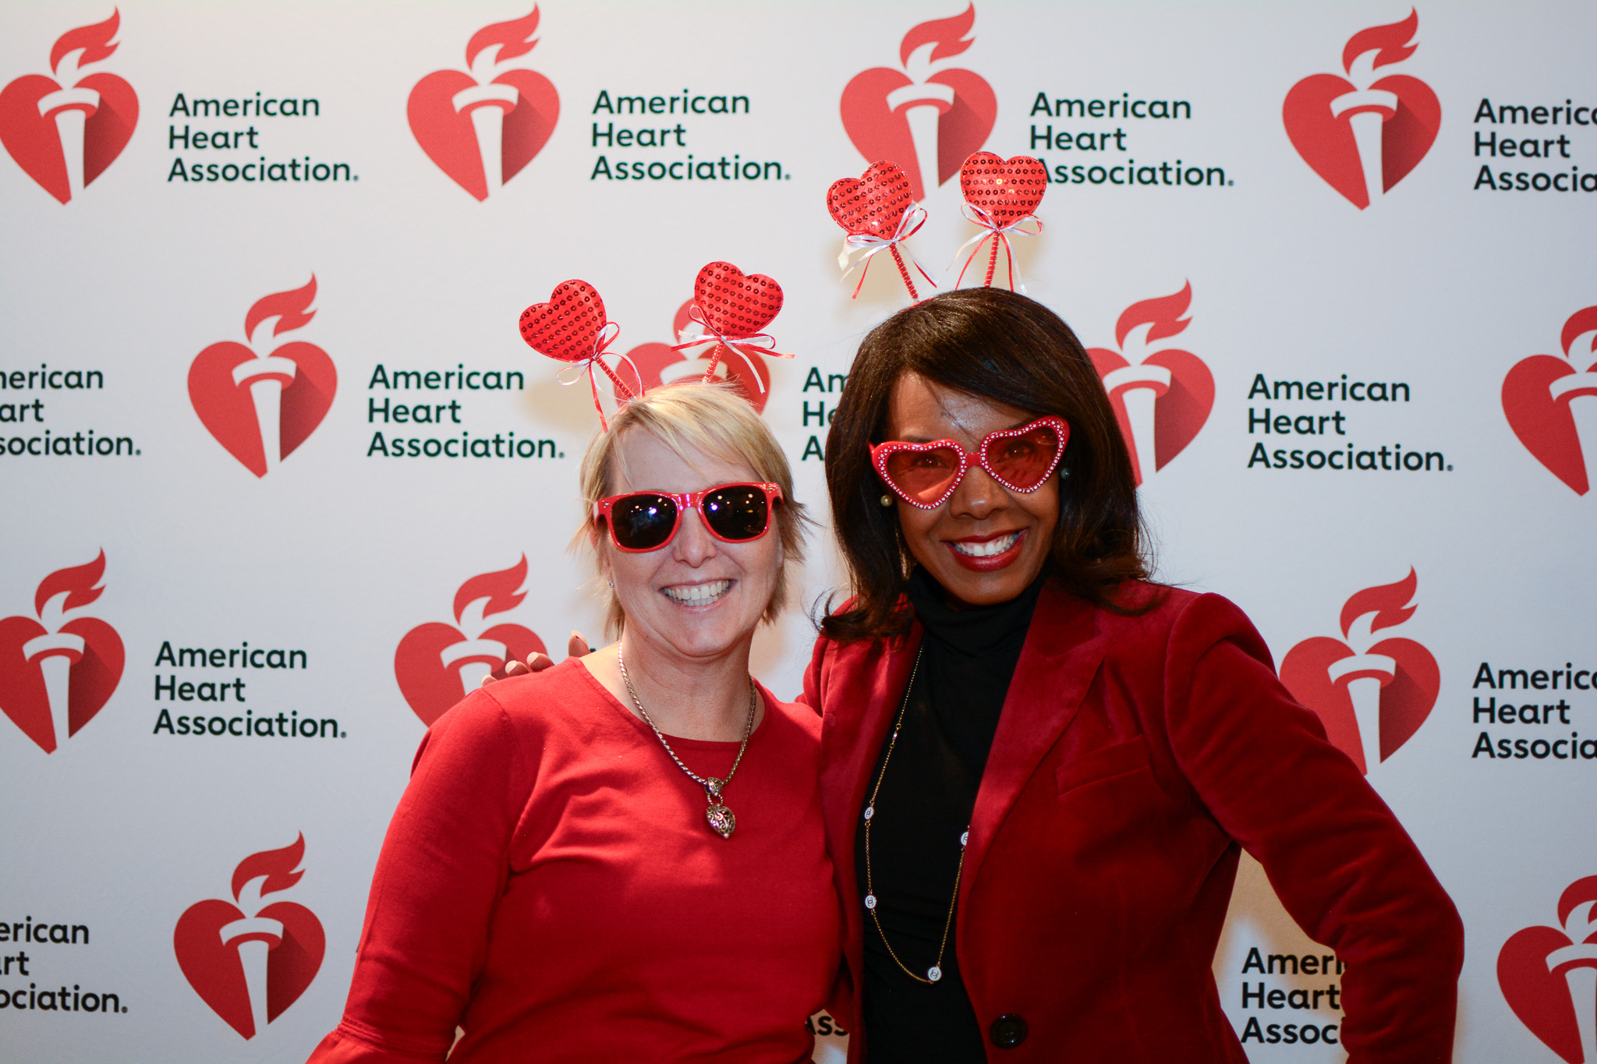
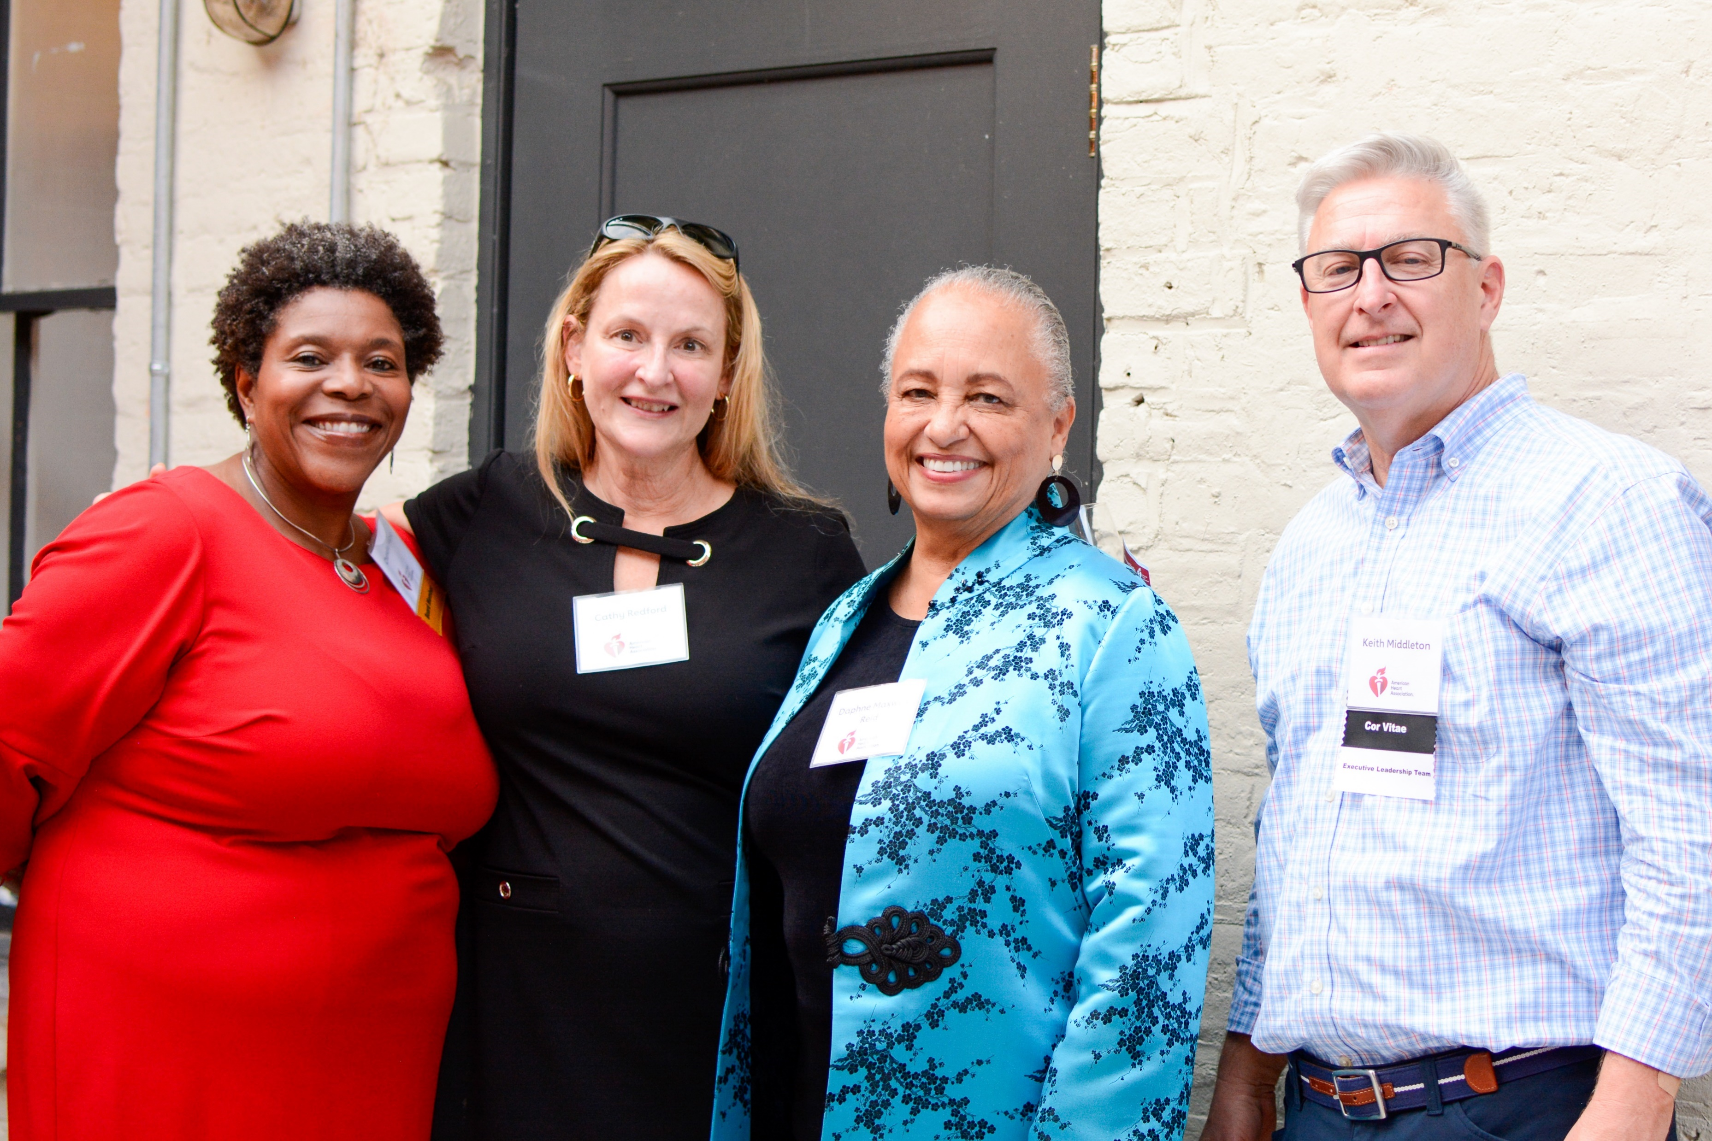
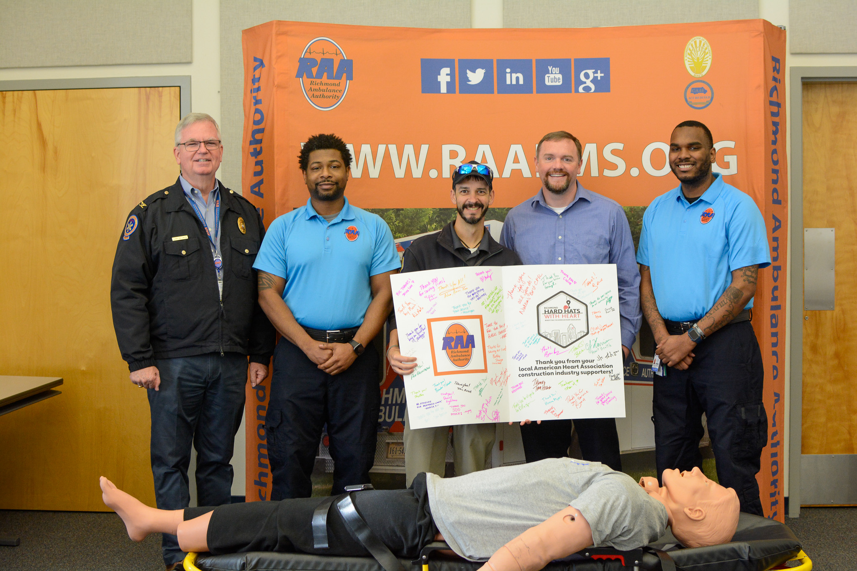
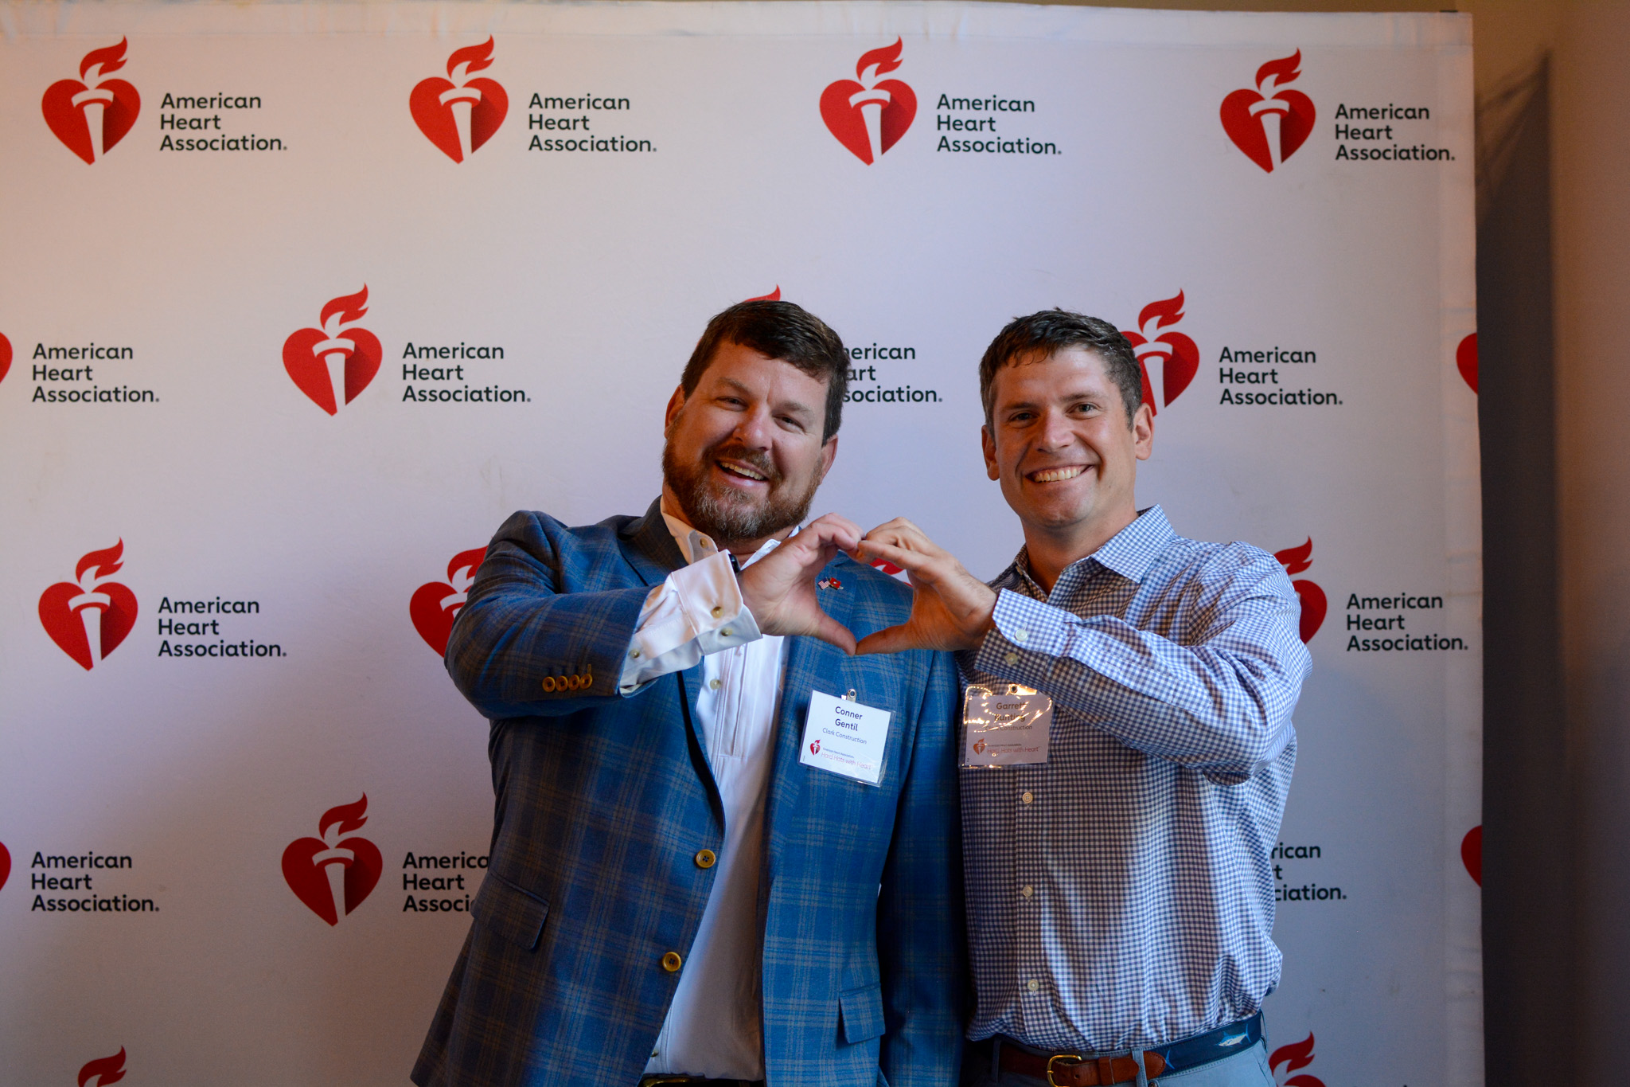
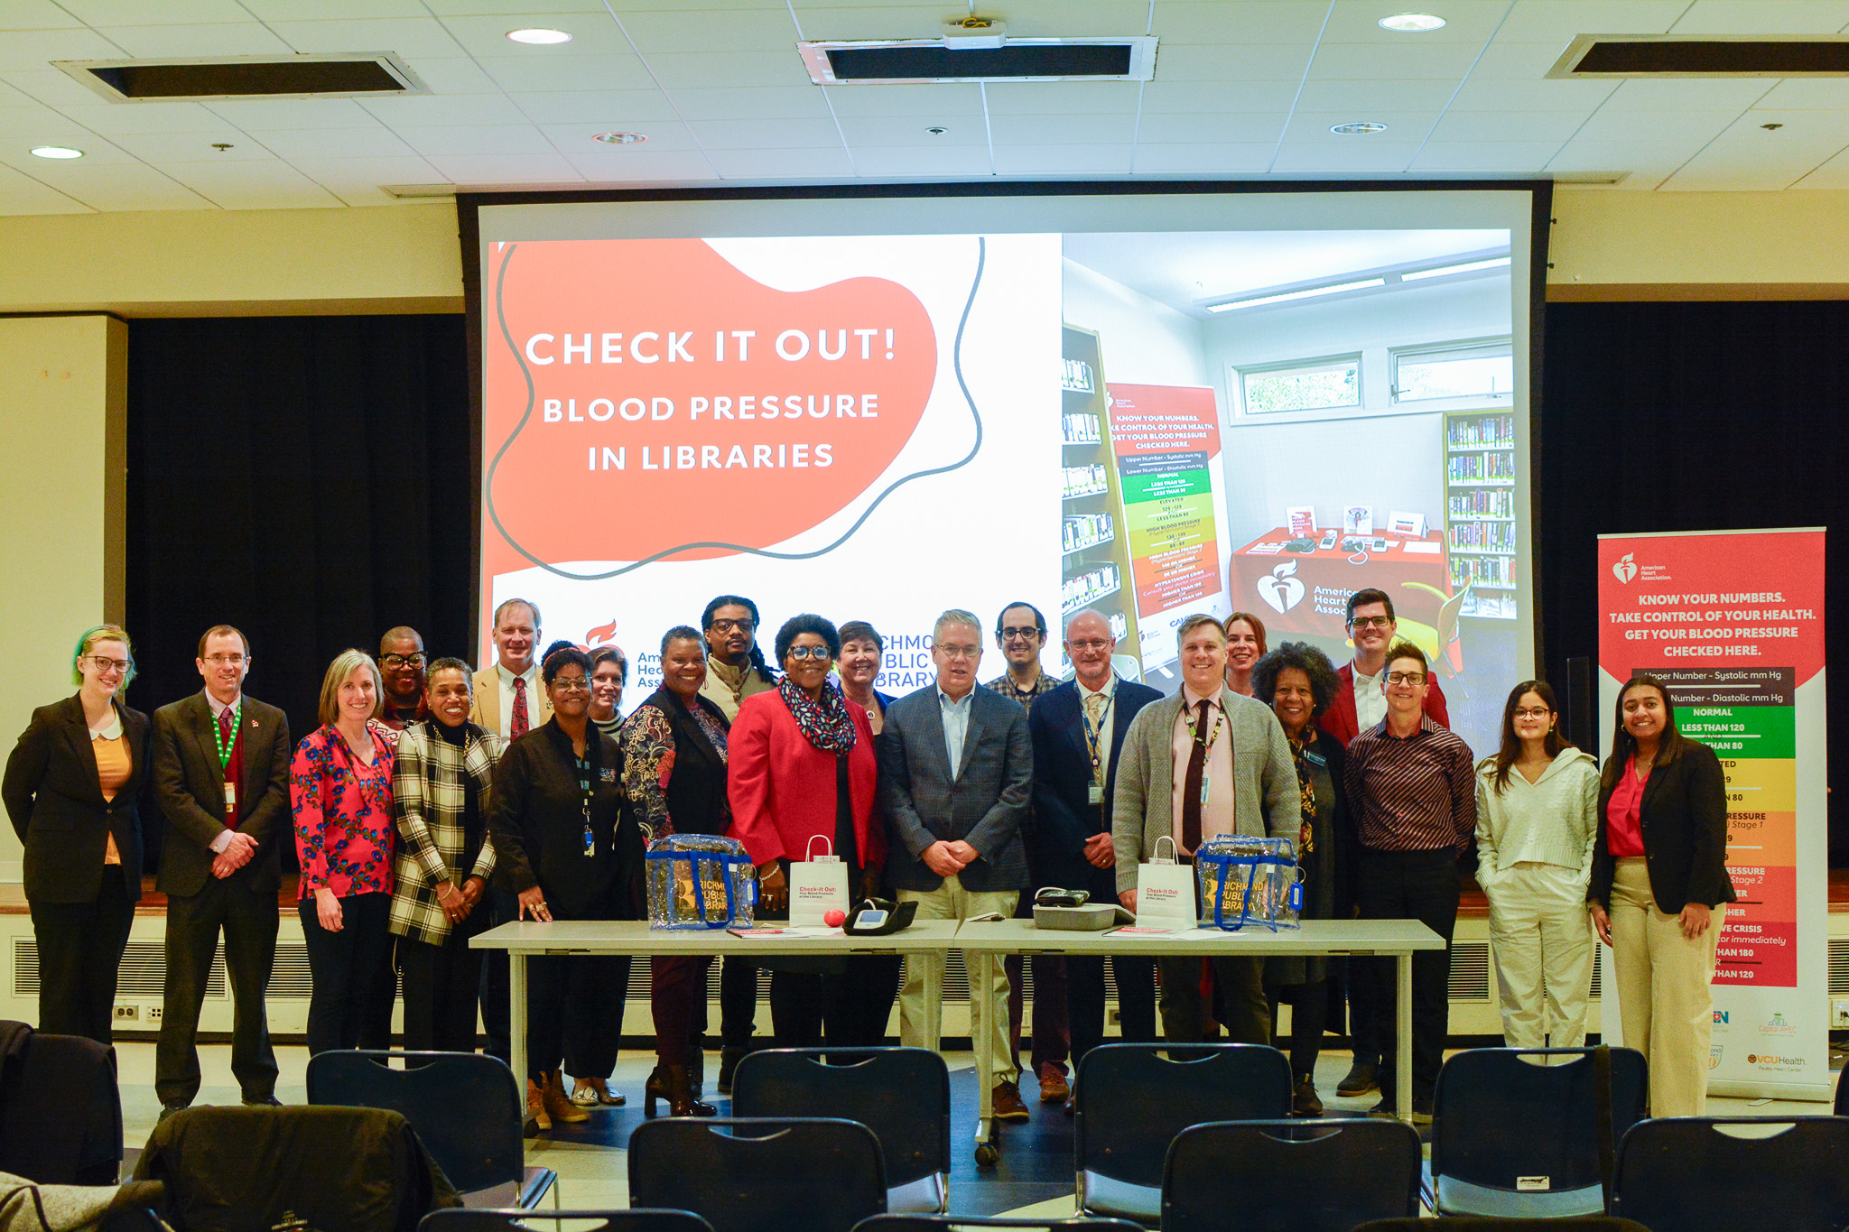
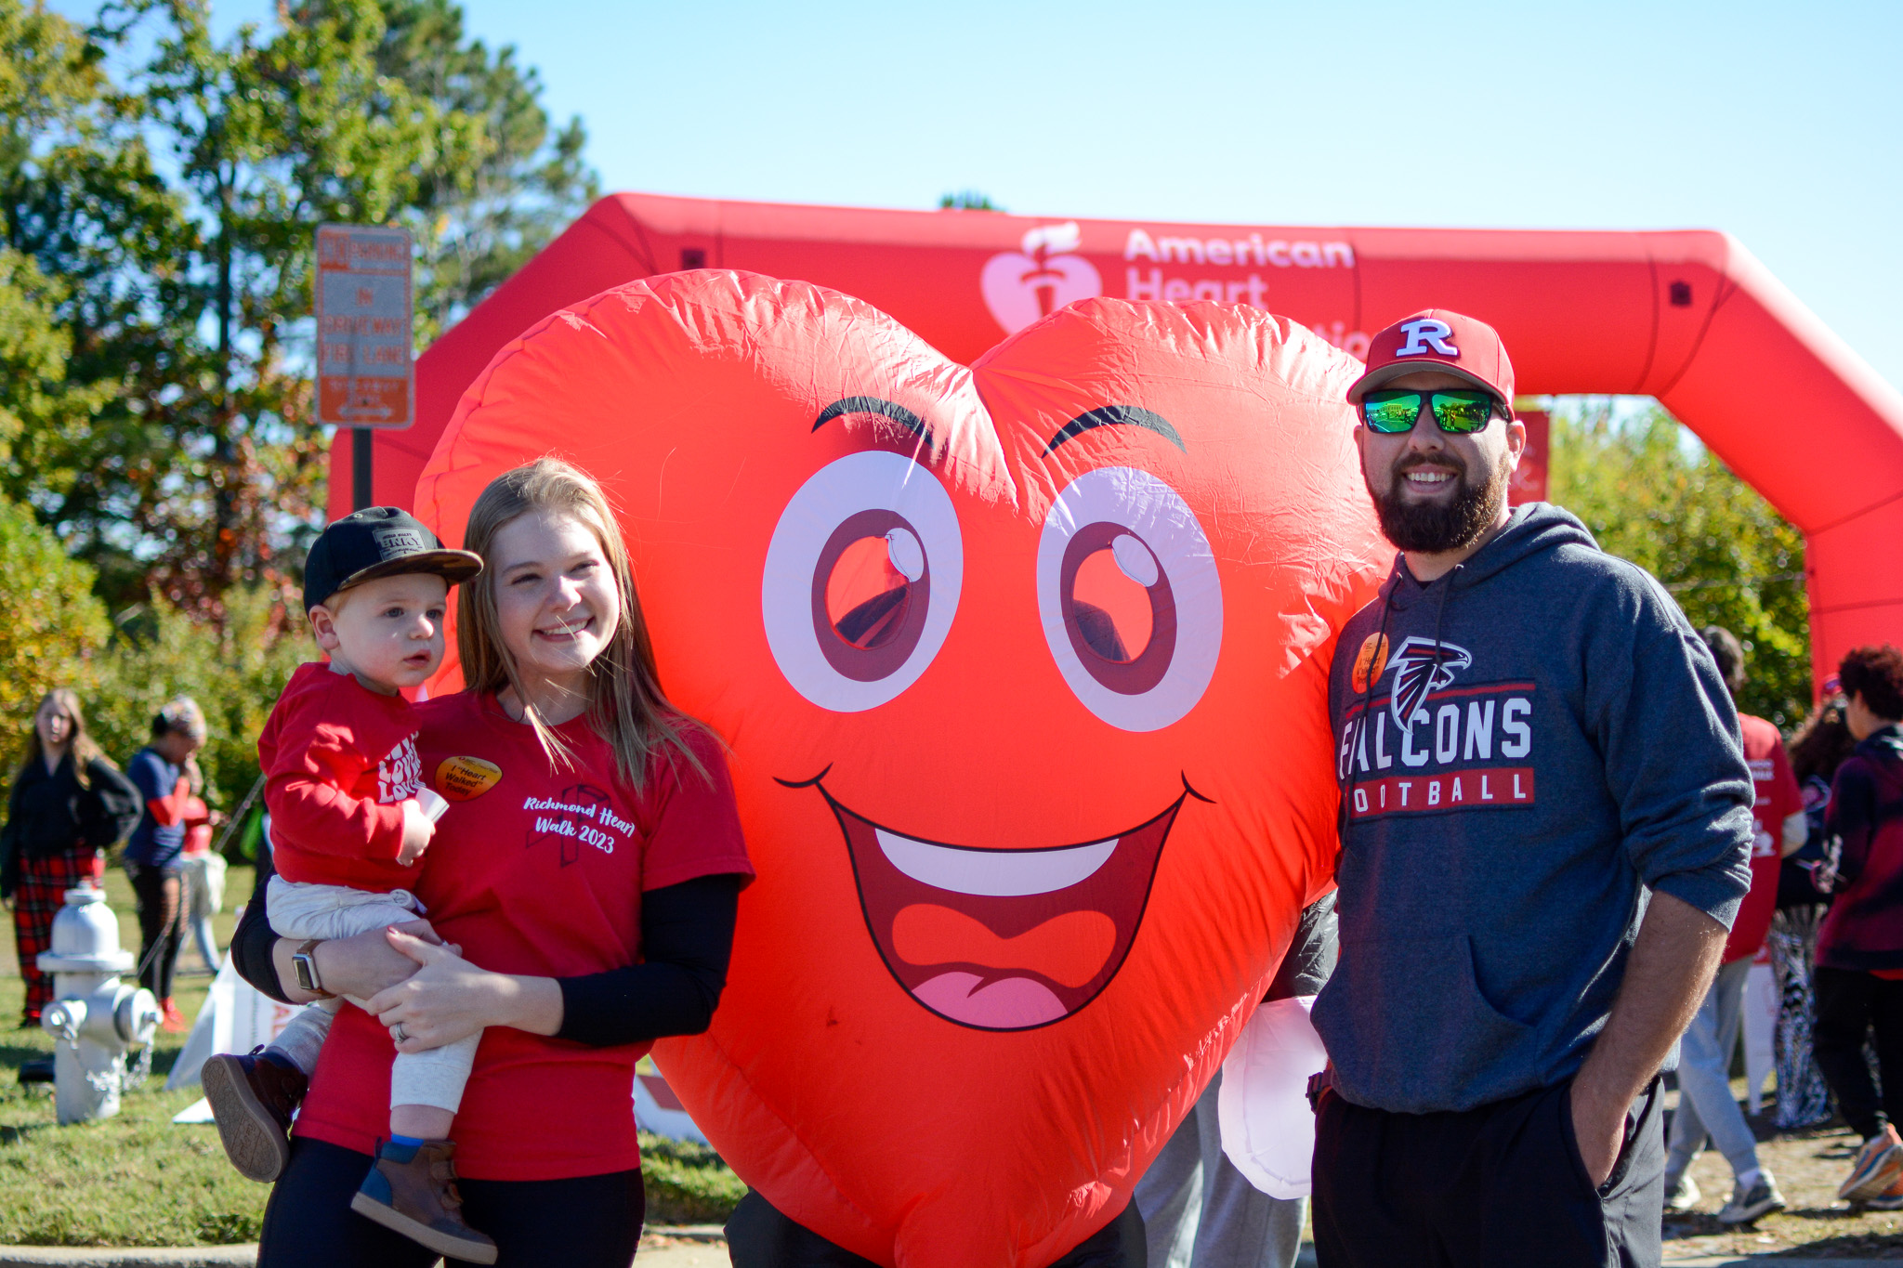

Follow Us @AmericanHeartVA
Twitter (X)
Instagram
Facebook
Notes:
Finally, a great way to help us reach out awareness goals and expand our visibility in the market is to like and share our posts on these social media platforms, and on LinkedIn, and please tag your related posts with our handle so we can share. Thanks so much for your support!

