Slide 1

Quarterly PCO Stakeholders Office Hours 2
Introduction to Publicly Available Data Sources
January 12, 2026
Anna Riggan
Acting Primary Care Office Director/ Shortage Designation Manager
Liza Root
National Health Service Corps and HPSA Specialist
Office of Health Equity
Primary Care Office

Slide 2
Etiquette & Reminders
This webinar is being recorded.
Please keep your microphone muted to minimize background noise.
Use the chat for questions and technical support.
Office of Health Equity
Primary Care Office
Notes:
Welcome everyone! This webinar is being recorded.
Please keep your microphone muted to reduce background noise.
Feel free to use the chat to share questions or let us know if you need technical assistance. Thank you!

Slide 3
Agenda
HPSA Find and HPSA Find by Address: Comparison and demonstrations
HRSA Data Warehouse: Introduction, features, and demonstrations
Virginia-made data sources
    HPSA Dashboards
    Incentive Program Dashboards
    Health Opportunity Index (HOI)
    Data Commons
Vetting of contractors
Office of Health Equity
Primary Care Office

Slide 4
HPSA Find vs HPSA Find by Address
HPSA Find and HPSA Find by address are both managed by HRSA. They are the closest we have to a real-time HPSA status resources.
https://data.hrsa.gov/topics/health-workforce/shortage-areas/hpsa-find
    Search based on county
    Best for searching Auto HPSAs (FQHCs, FQHC-LALs, ITUs, designated RHCs)
      Expand for full list of sites.
https://data.hrsa.gov/topics/health-workforce/shortage-areas/by-address
    Only shows related community level HPSAs
    Use the county level HPSA Find for Auto-HPSAs
Office of Health Equity
Primary Care Office

Slide 5

Pause for Questions

Slide 6
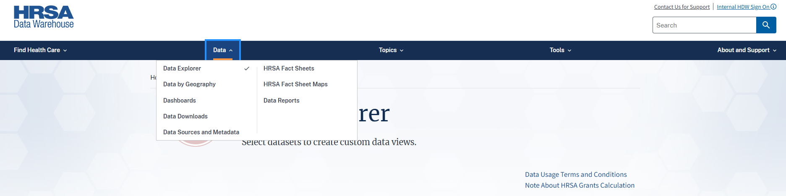
Demonstration of HRSA Data Warehouse:
Data Sources and Metadata https://data.hrsa.gov/

Slide 7
HRSA Data Warehouse
Data Sources and Metadata https://data.hrsa.gov/
*Always double check that the data tools you are using current data sources.
Office of Health Equity
Primary Care Office

Slide 8
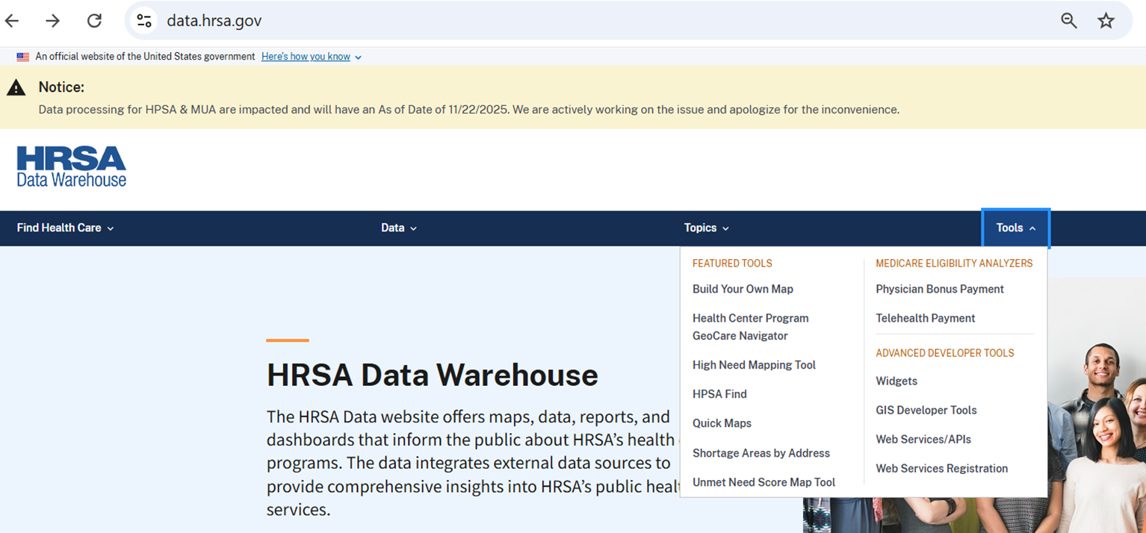
HRSA Data Warehouse
Tools https://data.hrsa.gov/
Office of Health Equity
Primary Care Office

Slide 9
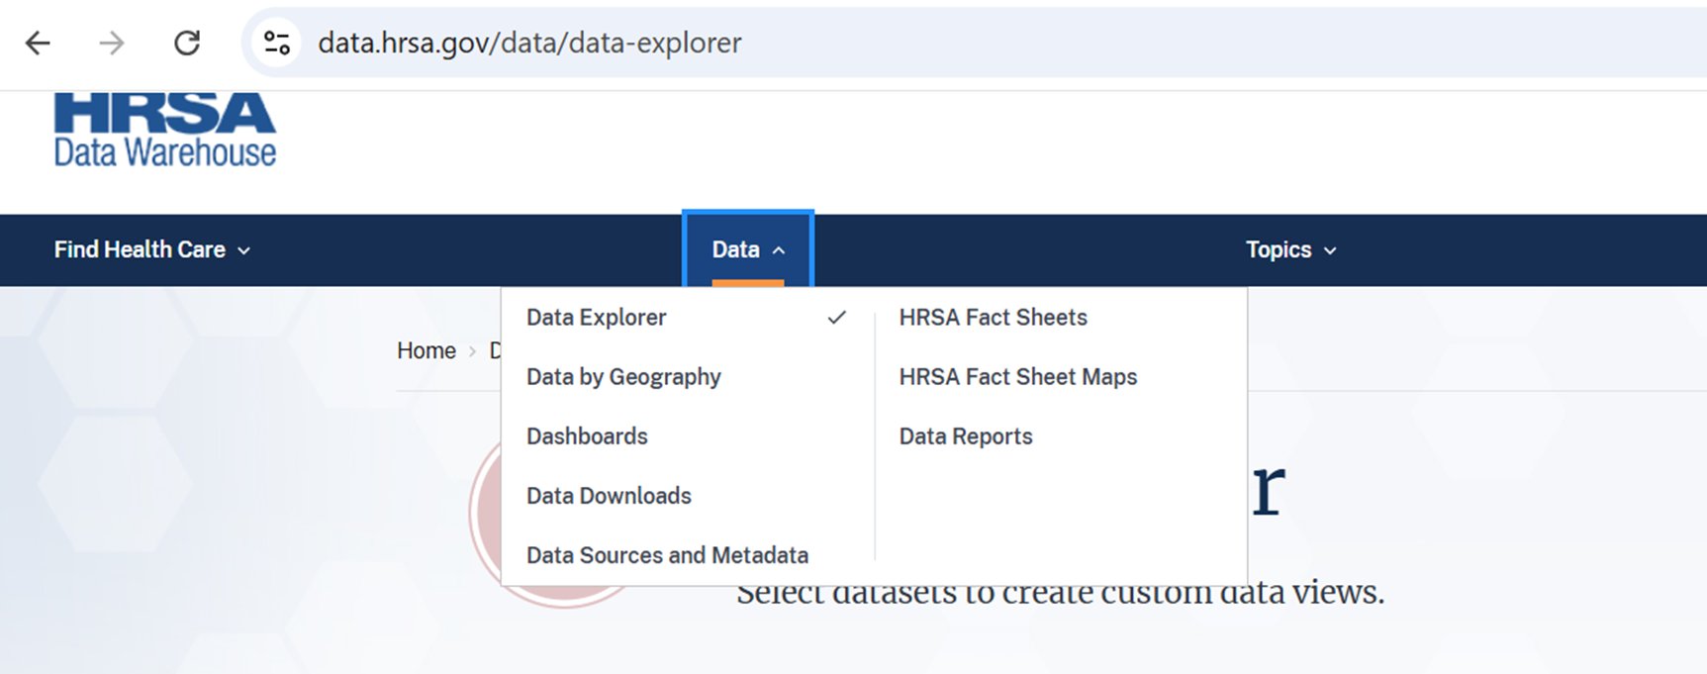
Demonstrations of HRSA Data Warehouse
Data Explorer https://data.hrsa.gov/
Office of Health Equity
Primary Care Office

Slide 10

Demonstrations of HRSA Data Warehouse
Dashboards https://data.hrsa.gov/
Office of Health Equity
Primary Care Office

Slide 11
Pause for Questions

Slide 12
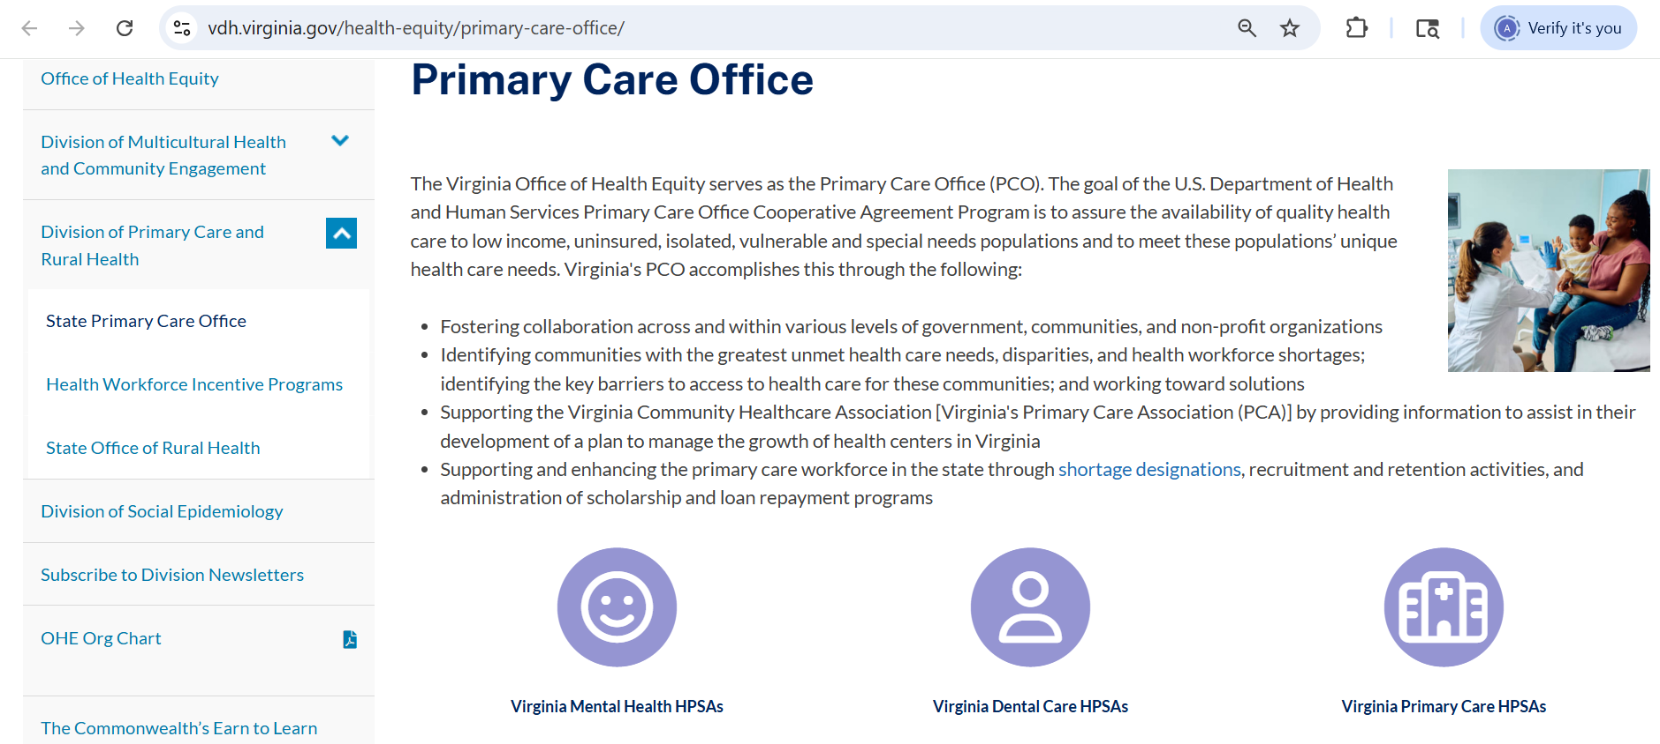
Virginia Data Sources
HPSA Dashboards
https://www.vdh.virginia.gov/health-equity/primary-care-office/
Office of Health Equity
Primary Care Office

Slide 13
Pause for Questions

Slide 14
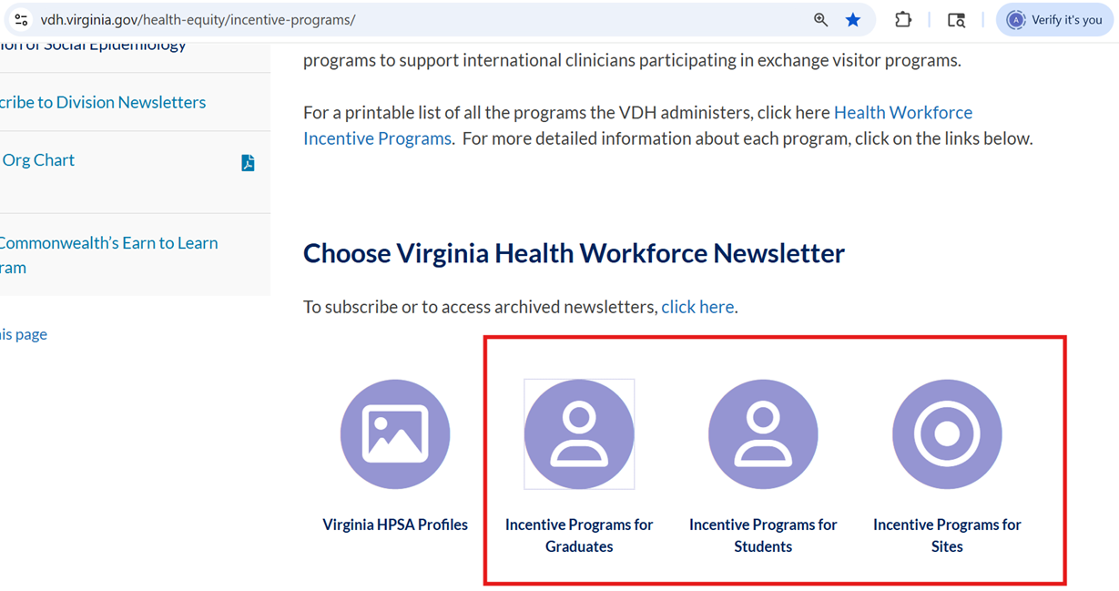
Virginia Data Sources
https://www.vdh.virginia.gov/health-equity/incentive-programs/
Office of Health Equity
Primary Care Office

Slide 15
Pause for Questions

Slide 16

Virginia Data Sources
Health Opportunity Index (HOI) Dashboards
https://apps.vdh.virginia.gov/omhhe/hoi/
Office of Health Equity
Primary Care Office

Slide 17
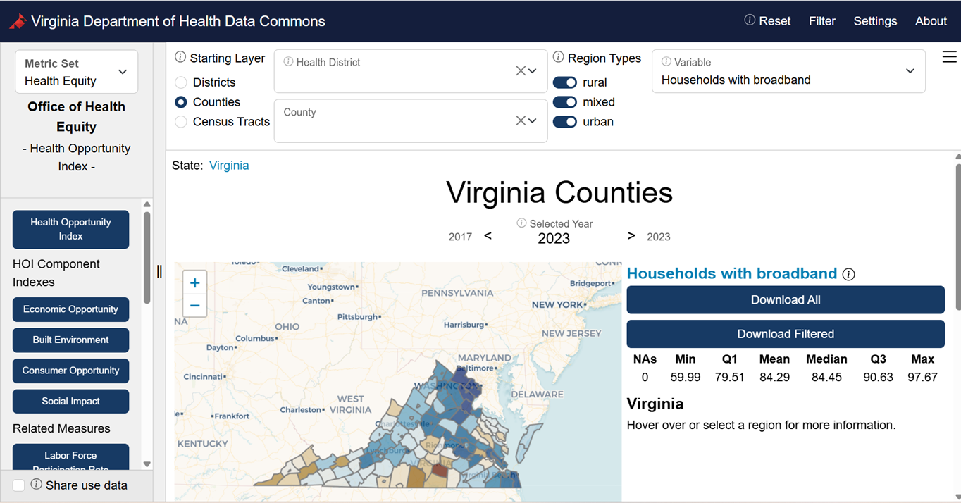
Virginia Data Sources
Data Commons https://uva-bi-sdad.github.io/vdh_rural_health_site/
Office of Health Equity
Primary Care Office

Slide 18
Vetting of Contractors
Potential Red Flags
Charge for maps and data tools that have already been compiled and visualized by the state
2. Manufactured urgency
3. Discouraging clients from contacting Primary Care Office (PCO) or State Office Rural Health (SORH) directly
4. Guaranteeing a certain type of HPSA or HPSA score before they’ve even looked at the data
5. Unfamiliar with the technical basic
a. Contiguous areas
b. Not using the current vintage of HRSA’s prepopulated data (2023)
c. CMS rules (ex. Medicare Bonus payments; Rural Health Clinic certification)
Office of Health Equity
Primary Care Office

Slide 19
Pause for Questions

Slide 20

Stay Connected
Anna Riggan
Acting Primary Care Office Director/ Shortage Designation Manager
anna.riggan@vdh.virginia.gov
Liza Root
National Health Service Corps and HPSA Specialist
Liza.Root@vdh.virginia.gov
​www.vdh@virginia.gov/health-equity/primary-care-office/
https://data.hrsa.gov/
Office of Health Equity
Primary Care Office

