Slide 1

Quarterly PCO Stakeholders Office Hours 3
National Health Service Corps (NHSC) New Site Certification and Introduction to HPSA Strategies
April 28, 2026
Anna Riggan
Acting Primary Care Office Director/ Shortage Designation Manager
Liza Root
National Health Service Corps and HPSA Specialist
Office of Health Equity
Primary Care Office

Slide 2
Etiquette & Reminders
This webinar is being recorded.
Please keep your microphone muted to minimize background noise.
Use the chat for questions and technical support.
Office of Health Equity
Primary Care Office
Notes:
Welcome everyone! This webinar is being recorded.
Please keep your microphone muted to reduce background noise.
Feel free to use the chat to share questions or let us know if you need technical assistance. Thank you!

Slide 3
Agenda
National Health Service Corps (NHSC): Advice and Updates
Application process for site certification
Examples of appropriate documentation
Introduction to HPSA Strategy
Brief history of shortage designation
Breakdown HPSA types
Stakeholder considerations
HPSA application process
Invitation to participate in the PCO Needs Assessment
Office of Health Equity
Primary Care Office

Slide 4
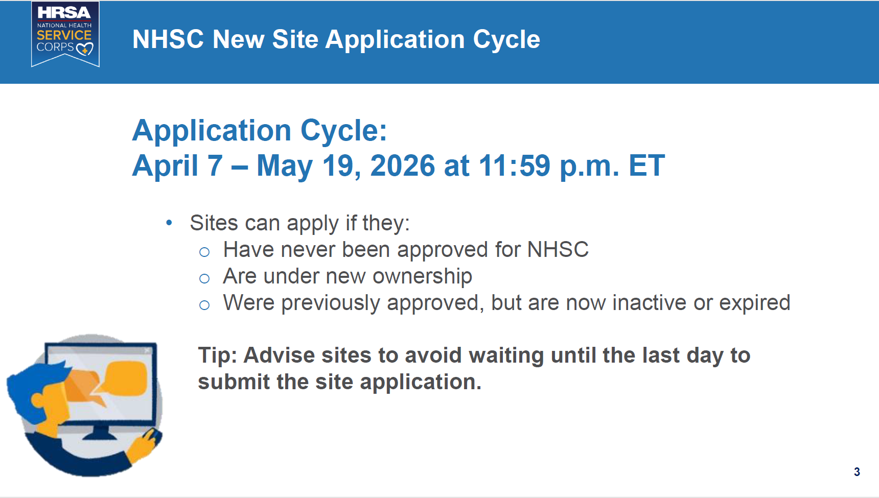

MFA Required
https://support.google.com/accounts/answer/1066447?hl=en&co=GENIE.Platform%3DAndroid&sjid=4636782500599490221-NA

Slide 5
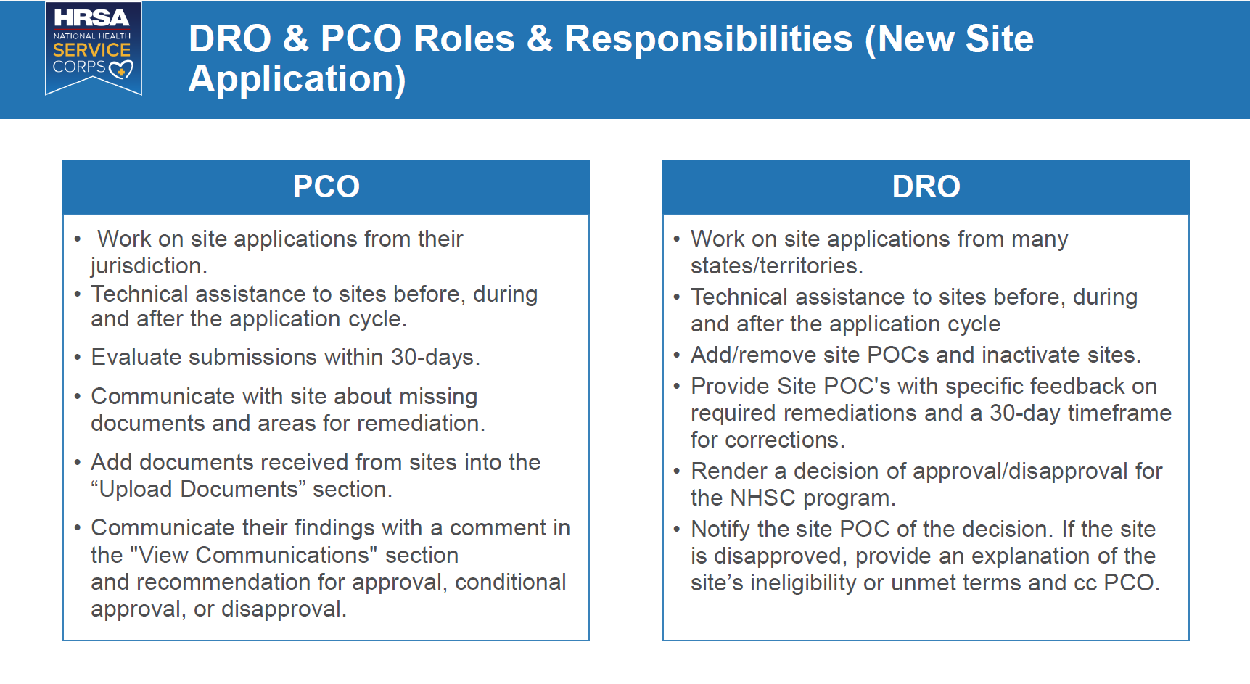
*Full Review process will take about 3 months
Regional DRO Mailbox:
BHWRegion3@hrsa.gov

Slide 6
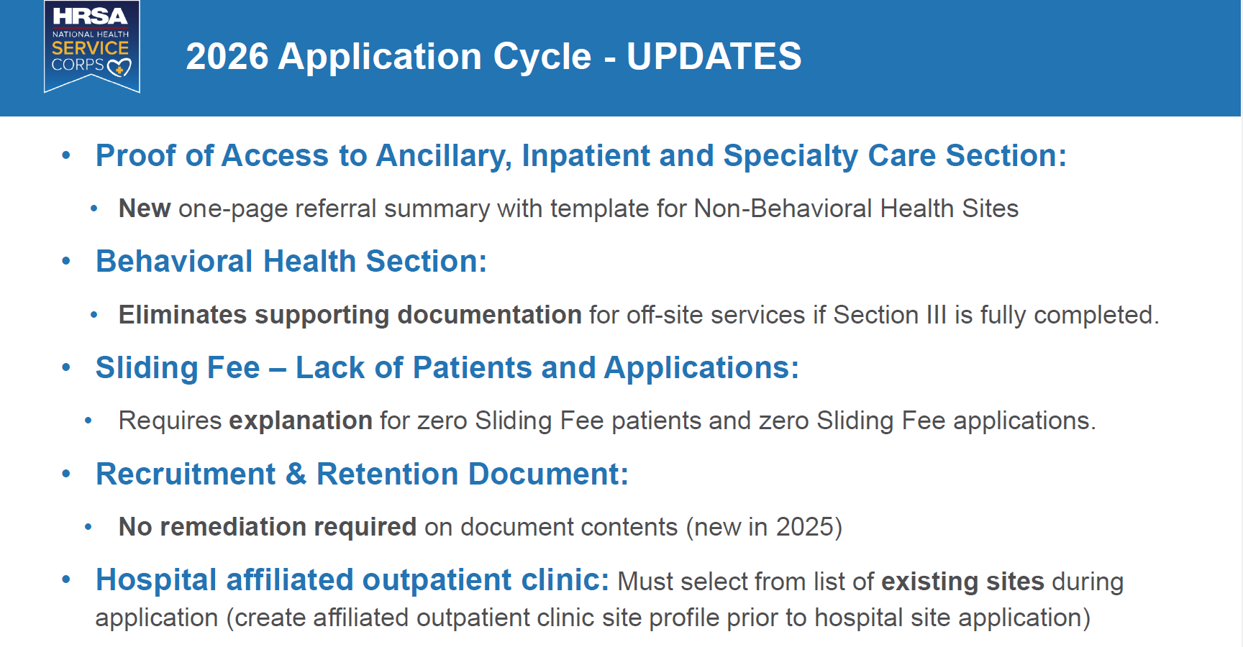

Slide 7
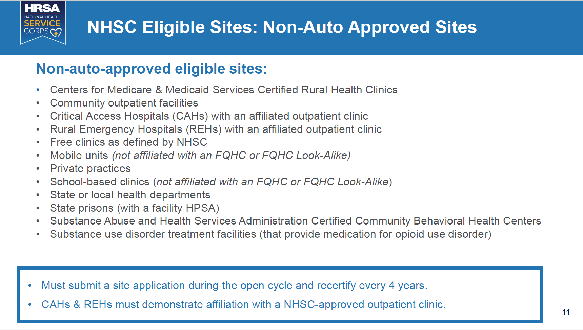

Slide 8
NHSC Resource Links
Application Instructions and Email Blasts:
https://nhsc.hrsa.gov/sites/how-to-apply
https://nhsc.hrsa.gov/subscribe-to-emails
New Recertification Cycle Schedule:
https://nhsc.hrsa.gov/sites/current-sites/site-recertification
Approved | Recertify
2022 | 2026
2023 | 2027
2024 | 2028
2025 | 2029
Office of Health Equity
Primary Care Office

Slide 9

Featured NHSC Application Pain Points

Slide 10
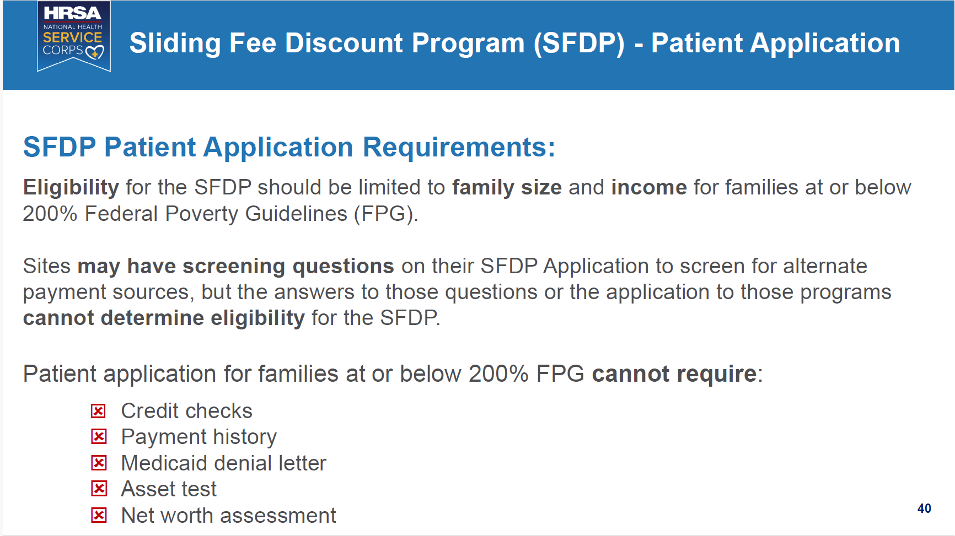

Slide 11
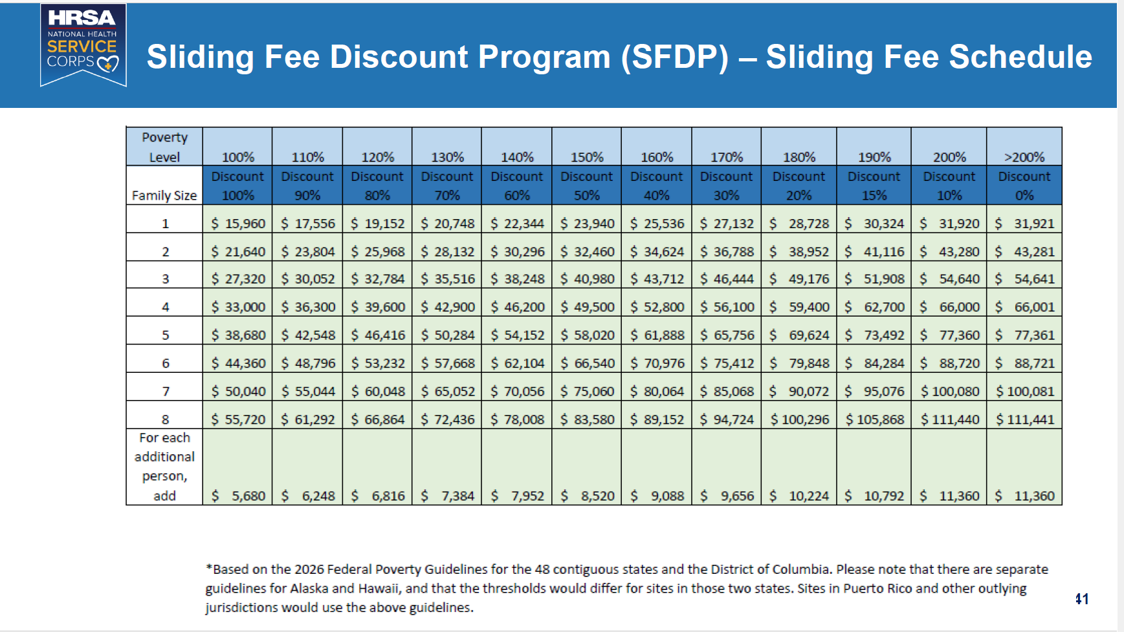

Slide 12
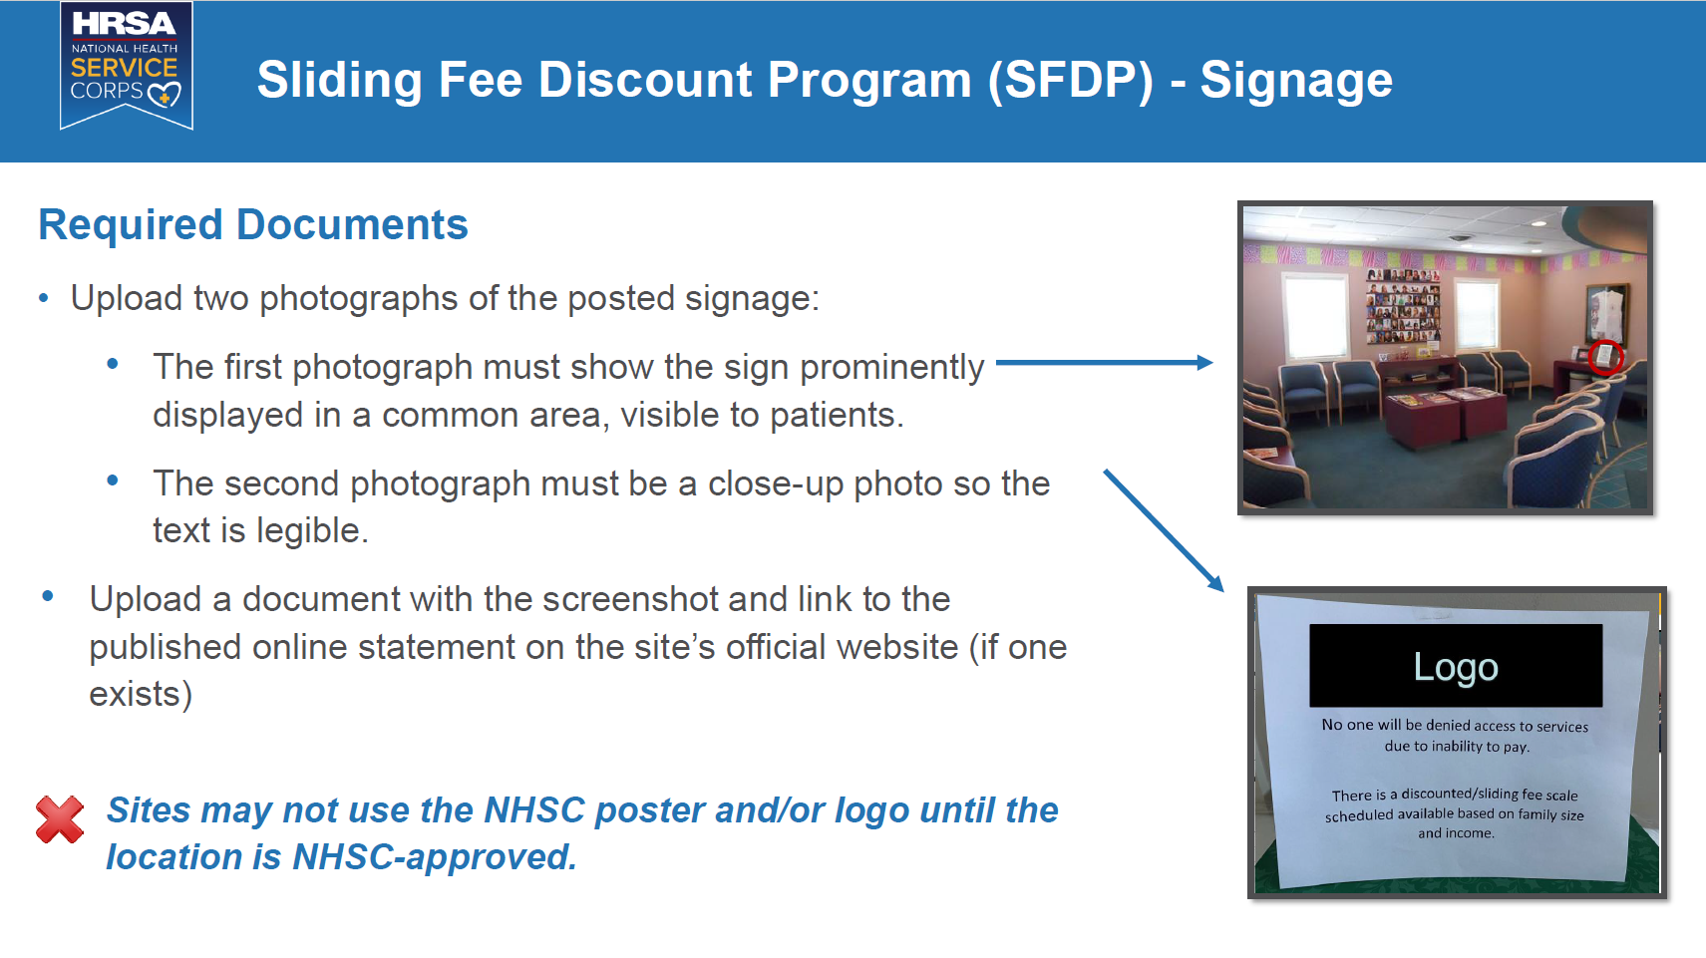

Slide 13
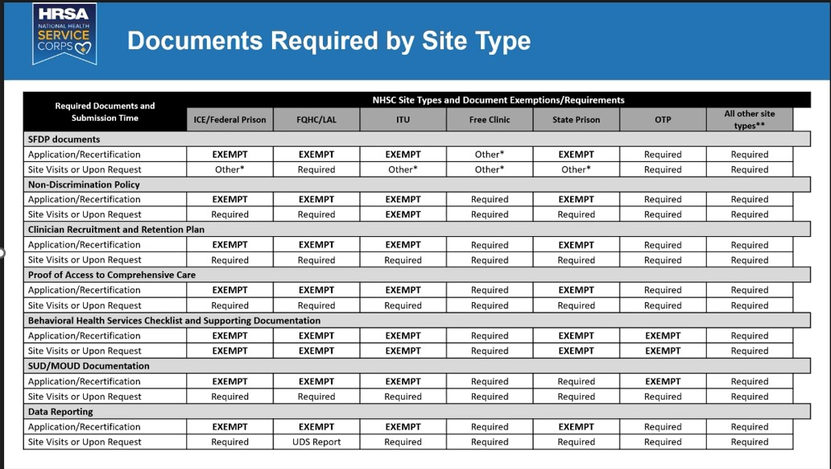
Agenda
Office of Health Equity
Primary Care Office

Slide 14
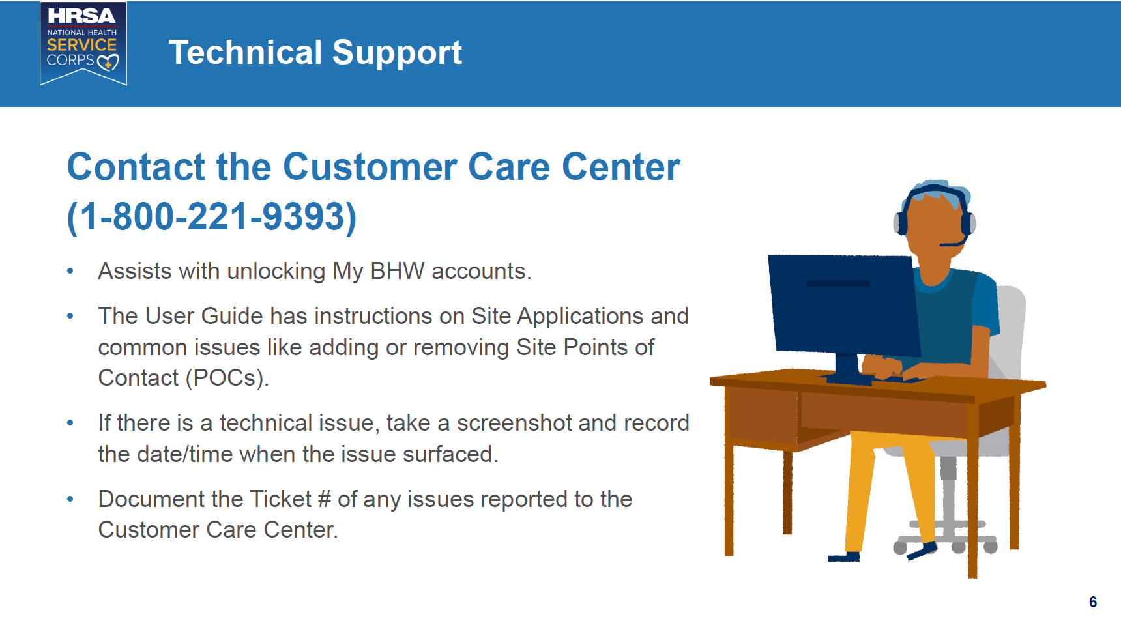
*Longest wait times
on Mondays

Slide 15

Pause for Questions
Office of Health Equity
Primary Care Office

Slide 16

Introduction to HPSA Strategy

Slide 17
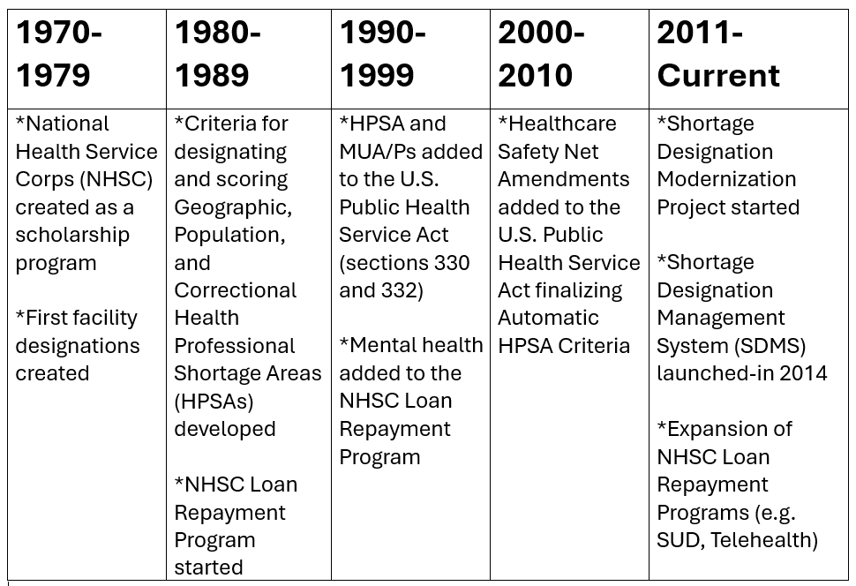
History of Shortage Designation
Notes:
https://www.shepscenter.unc.edu/wp-content/uploads/2014/10/WP30.pdf
https://bhw.hrsa.gov/workforce-shortage-areas/shortage-designation/modernization-project

Slide 18
Stakeholders Impacted by HPSAs
Outpatient Clinics
Federally Certified Clinics: Federally Qualified Health Centers (FQHCs), FQHC Look-a-Likes, Rural Health Clinics, Indian Health Service Clinics (ITUs)
Privately-owned Outpatient Clinics: Stand alone clinics, Hospital-affiliated clinics, skilled nursing facilities
Free or charitable clinics
Community Service Boards and Community Mental Health Clinics
Correctional Facilities
State prisons (Maximum or Medium Security only)
Federal prisons (including ICE detention)
Juvenile detention centers
Local or Regional Jails
Hospitals
Critical Access Hospitals
For-profit or non-profit
Short term or Long term
State Mental Hospitals
https://public.tableau.com/app/profile/anna.riggan2894/viz/IncentiveProgramsforSites/Dashboard1

Slide 19







About Health Professional Shortage Areas
HPSA
Health Professional Shortage Area
Health professional shortage
Providers
Discipline/field
Dental Health
Primary Care
Mental Health
Care setting
Geographic Area
Facility Type
Population Group

Slide 20
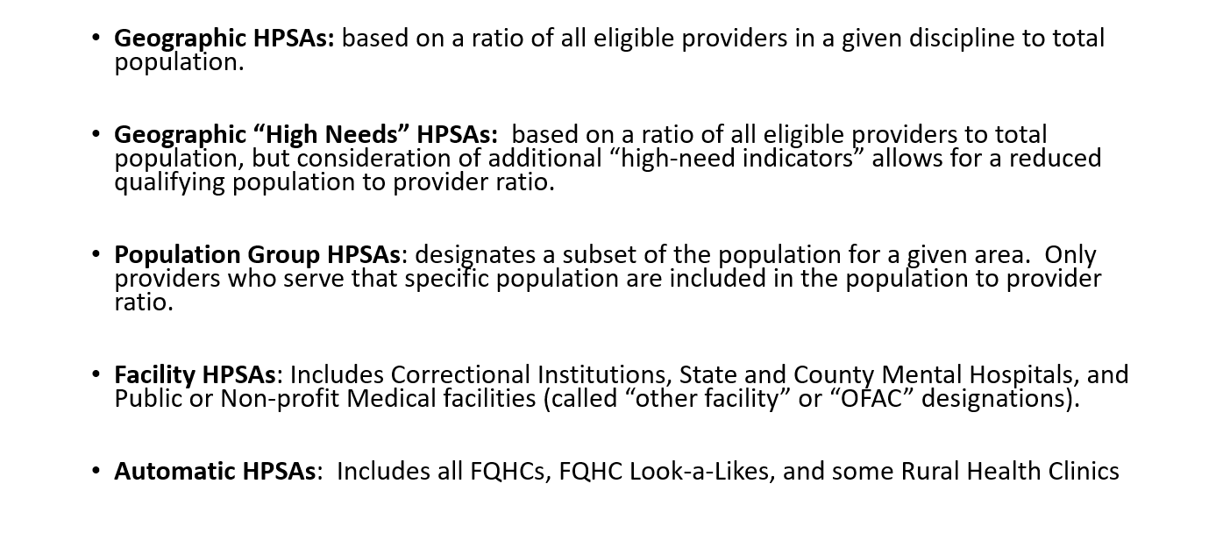
HPSA Types
https://bhw.hrsa.gov/workforce-shortage-areas/shortage-designation
Office of Health Equity
Primary Care Office

Slide 21
Geographic/Geographic High Need HPSA Benefits
Facilities located within Geographic and Geographic High Needs HPSAs receive a 10% Medicare bonus, from CMS, on physician services (including inpatient and specialist).
Only for Mental and Primary Care
HPSA scores for prisons located with a Geographic or Geographic High Needs HPSAs are increased.
Prisons still must have their own HPSAs
Office of Health Equity
Primary Care Office

Slide 22
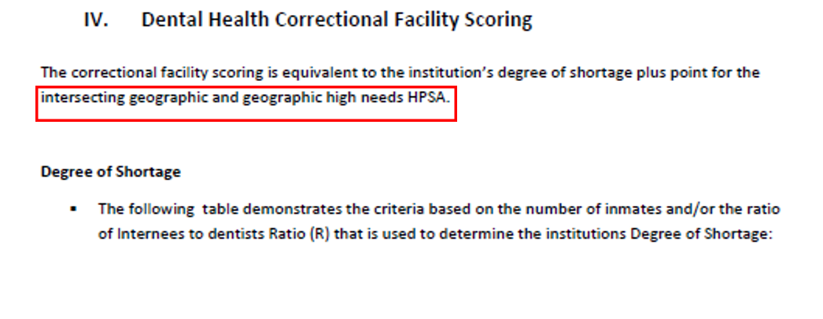
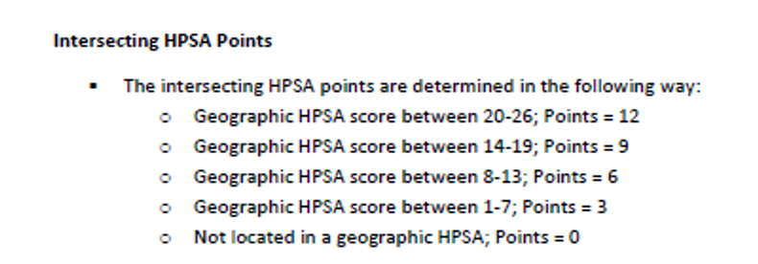
Geographic HPSA Benefits: Prison Scoring
The maximum score for prison HPSAs is 12 without an intersecting Geographic and Geographic High Needs HPSA
Office of Health Equity
Primary Care Office

Slide 23
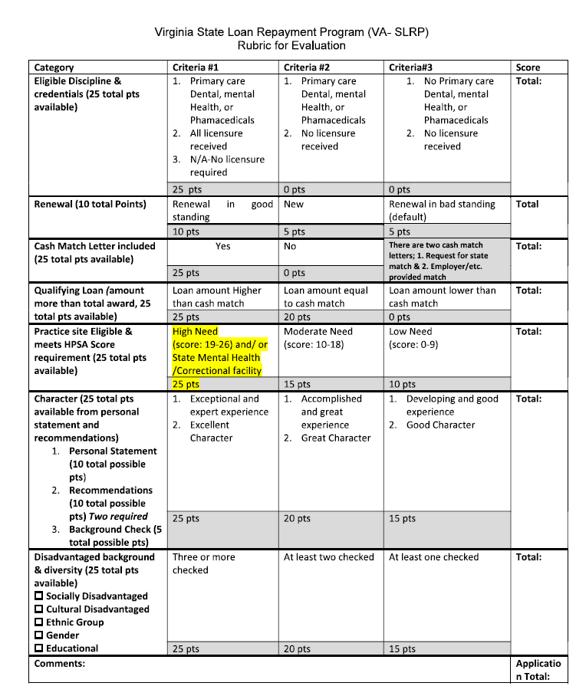
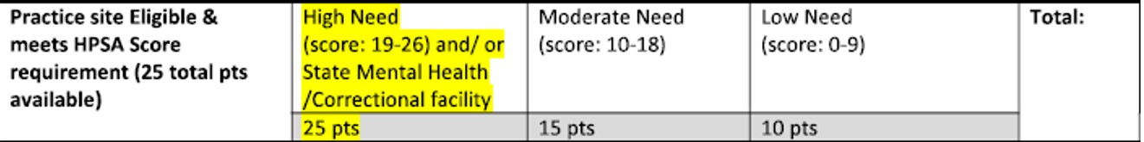

Slide 24
Population HPSA Benefits
The analysis is focused on identifying an inequity in health access within the Rational Service Area (RSA).
The severity of this inequity within the community often results in a higher HPSA score for the area.
Even though a specific population is designated often the entire community benefits.
HPSAs require meeting a threshold of need. If you can’t do that with the total population a sub-population designation might be the best option. (except for the prison population)
Office of Health Equity
Primary Care Office

Slide 25
Stakeholders to Consider: Virginia Observations
NHSC sites
Federally Qualified Health Centers or look-a-likes
Rural Health Clinics (CMS certified or not)
School Based Clinics
Free Clinics
Community Service Boards
State Mental Hospitals
Independent Outpatient Practice sites
Prisons
Hospital Outpatient Clinics
Inpatient Hospitals
More likely to support placing a
Population HPSA (more NHSC recruitment
Focused; tend to be majority staff of nurses)
Case-by-Case
More likely to support placing a Geographic
or Geographic High Needs HPSA (more CMS direct
funding/ score-boost focused)

Slide 26
Rural vs. Non-Rural
Rural Areas
Rural areas are more likely to have Prisons or Small/Critical Access Hospitals that can benefit from the placement of a Geographic or Geographic High Needs HPSA
Rural HPSAs tend to be designated at the county level
Rural infrastructure can make recruitment make difficult for providers that aren’t already familiar with the structure and culture of these areas. Most medical schools are in urban areas, so rural residency programs are critical.
If a rural area contains both prison and a hospital, I tend submit a Geo or High Needs HPSA.
Non-Rural Areas
Non-Rural areas tend have higher incomes, but higher income inequity and higher costs of living.
Urban areas tend to be designated at the neighborhood because the population thresholds are of percentages. (ex. 30% of the population of a proposed designation must be at or below 200% FPL to be eligible for a Low-Income HPSA)
Higher population means more diverse infrastructure, but an area can still need dedicated providers to serve underserved populations.
Geographic and Geographic High Needs are rare in Urban areas.
Notes:
Virginia GO just received $15 million in funding from the General Assembly
https://govirginia3.org/
https://govirginia6.org/
2. Southwest Virginia Graduate Medical Education Consortium https://swvagmec.com/

Slide 27
Circumstances to Consider
Public Health Events
Virginia Example: In 2020, COVID-19 was causing a disproportionate number of deaths among 65+yo age groups so I identified the Virginia population HPSAs that more than 25% of population Medicare eligible (at least 65 years old). Then I switched those to Geographic or Geographic High Needs HPSAs to ensure hospitals had the financial support of the CMS Medicare bonuses.
Other Examples: Hurricane Maria for PR and USVI; Lahaina fires in HI; Malaria emergence in FL; Hurricane Helene in NC, WV, TN, KY, SWVA.
Additional funding for incentive programs like the NHSC
Most current examples: American Rescue Plan allowed provider recruitment to NHSC sites with lower HPSA scores.
Office of Health Equity
Primary Care Office

Slide 28
Weighing the Options
Conditions Favoring a Geographic or High Needs HPSA
The threshold for at least one high needs indicator is met
There is a high scoring FQHC clinic in the proposed designated area that can be a recruitment hub
There is a hospital or prison located within the proposed designated area.
More that 25% of the population is aged 65 or older (Medicare eligible)
Conditions Favoring a Population HPSA
The Low Income or Medicaid Eligible Populations make up at least 30% of the total population of the proposed designation
A population HPSA would meet a current score threshold for incentive programs where a Geo or HN HPSA would not:
14 for Nurse Corps or NHSC S2S
18-19 to be competitive for NHSC LRP
21 for 2026 NHSC PC or Mental scholars
There is a drastically low number of physicians relative to the population (desperately need to recruit providers).
Notes:
Critical Access hospitals are eligible for the CMS Physician Medicare bonus
FQHCs are ineligible for the Medicare physician bonus

Slide 29
Final Thoughts on HPSA Strategies
From a PCO perspective, it is worthwhile to do both Population and Geographic HPSA analyses for a proposed HPSA and weigh the implications of both.
There is no substitute for direct input from the communities in question, when assessing need and making sure they get the most out of their designations (faith-based organizations, community health workers, school advocates have been especially amazing partners for me).
You can leverage the fact that area can be designated 3 different times (Primary Care, Mental, and Dental) to achieve the maximum benefit for the community at large.
Office of Health Equity
Primary Care Office

Slide 30
Pause for Questions
Office of Health Equity
Primary Care Office

Slide 31
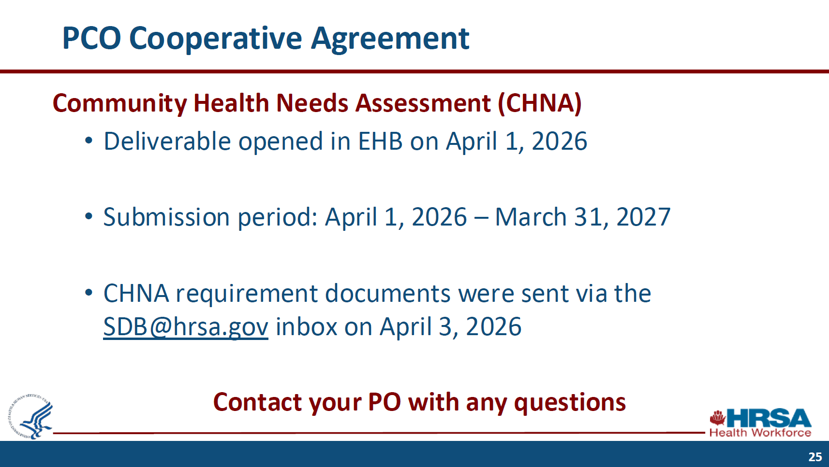
https://www.whitehouse.gov/wp-content/uploads/2026/04/ERP-2026-11.
-Making-America-Healthy-by-Unleashing-Competition-in-Physicians-Markets.pdf

Slide 32

Stay Connected
Anna Riggan
Acting Primary Care Office Director/
Shortage Designation Manager
anna.riggan@vdh.virginia.gov
Liza Root
National Health Service Corps and HPSA Specialist
Liza.Root@vdh.virginia.gov
​www.vdh@virginia.gov/health-equity/primary-care-office/
https://data.hrsa.gov/
Office of Health Equity
Primary Care Office

Slide 33
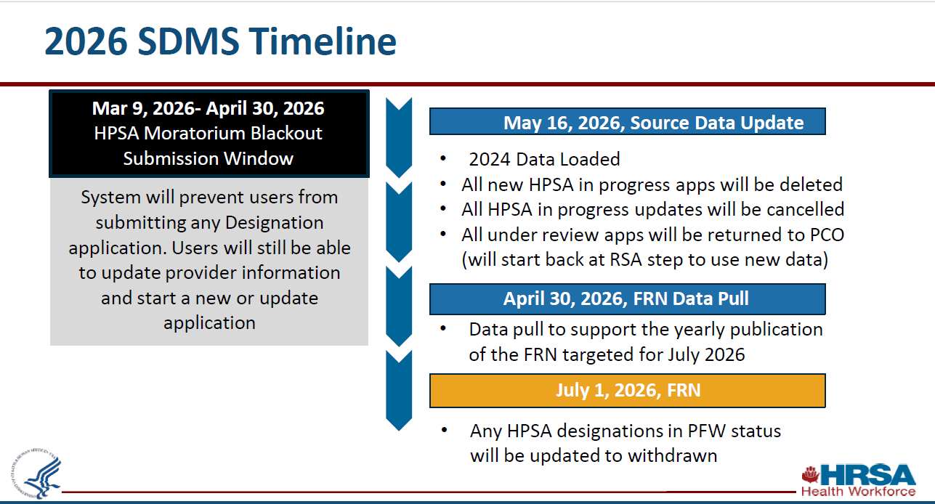
Office of Health Equity
Primary Care Office

