Slide 1
Quarterly PCO Stakeholders Office Hours 4
Community Health Needs Assessment and Partner Highlight:
Aug. 25, 2026
Anna Riggan
Acting Primary Care Office Director/ Shortage Designation Manager
Liza Root
National Health Service Corps and HPSA Specialist
Office of Health Equity
Primary Care Office

Slide 2
Reminders
This webinar is being recorded.
Participants are muted, but there will be pauses for questions.
Use the chat for questions and technical support.
Office of Health Equity
Primary Care Office
Notes:
Welcome everyone! This webinar is being recorded.
Feel free to use the chat to share questions or let us know if you need technical assistance. Thank you!

Slide 3
Agenda
PCO 2026 National Conference Highlight
Community Health Needs Assessment
  Background
  Goals
  Focus Areas
Partner Spotlight: VA-AHEAD
Office of Health Equity
Primary Care Office

Slide 4
PCO 2026 National Conference Highlights
Office of Health Equity
Primary Care Office

Slide 5
PCO 2026 National Conference Highlights
Maternity Care Target Area (MCTA) Updates
Guidance for the Rural Health Transformation Program and Loan Repayment Recipients
The Federal Office of Rural Health Policy (FORHP) is tracking a ton of funding opportunities
New multifactor authentication rules for the Federal portal coming November 21, 2026 (affected programs: NHSC, Nurse Corps, STAR-LRP, Pediatric Specialty LRP)
Virginia recognized for Primary Care Advocacy
Office of Health Equity
Primary Care Office

Slide 6
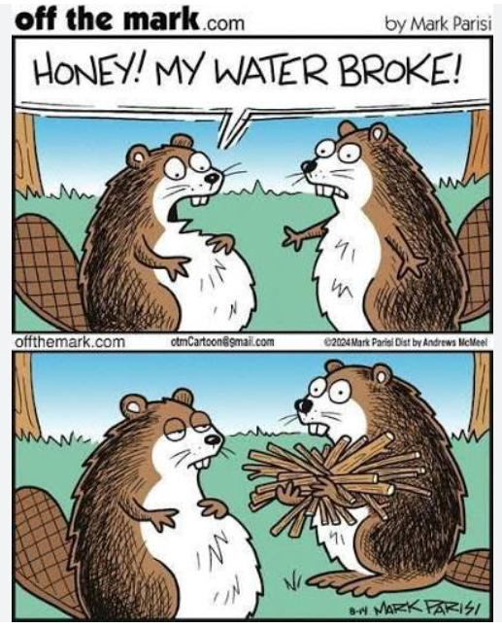
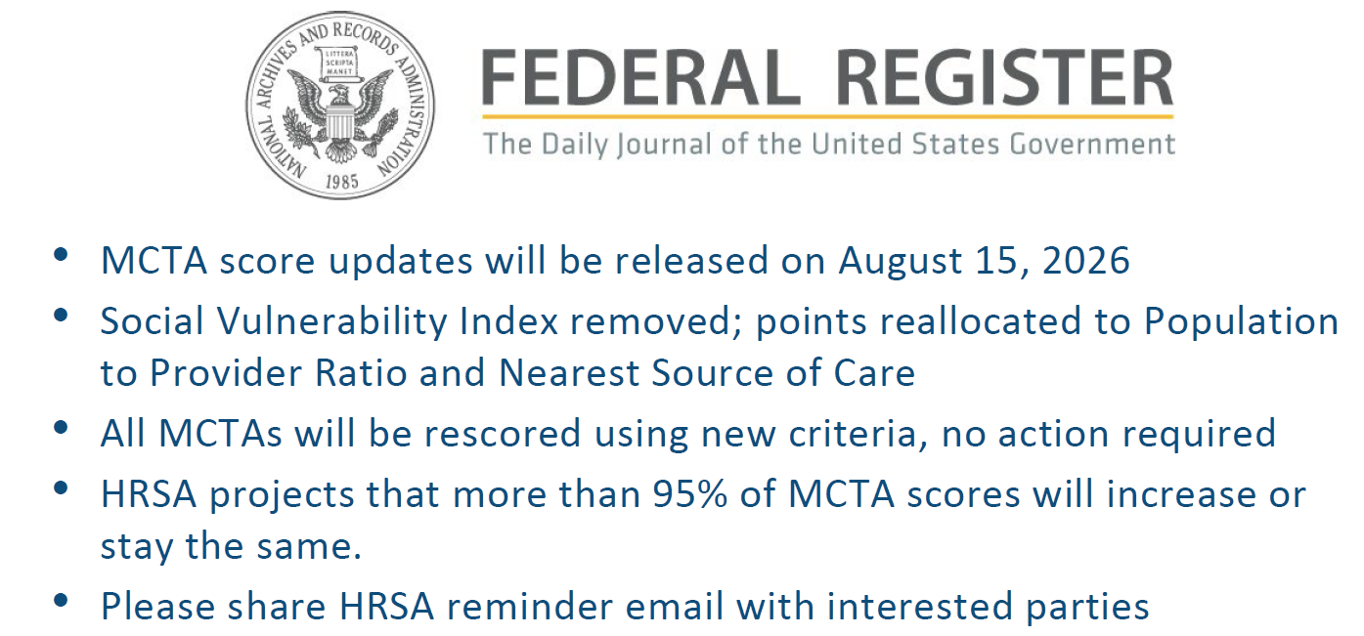
Maternity Care Target Area (MCTA) Updates
Office of Health Equity
Primary Care Office

Slide 7
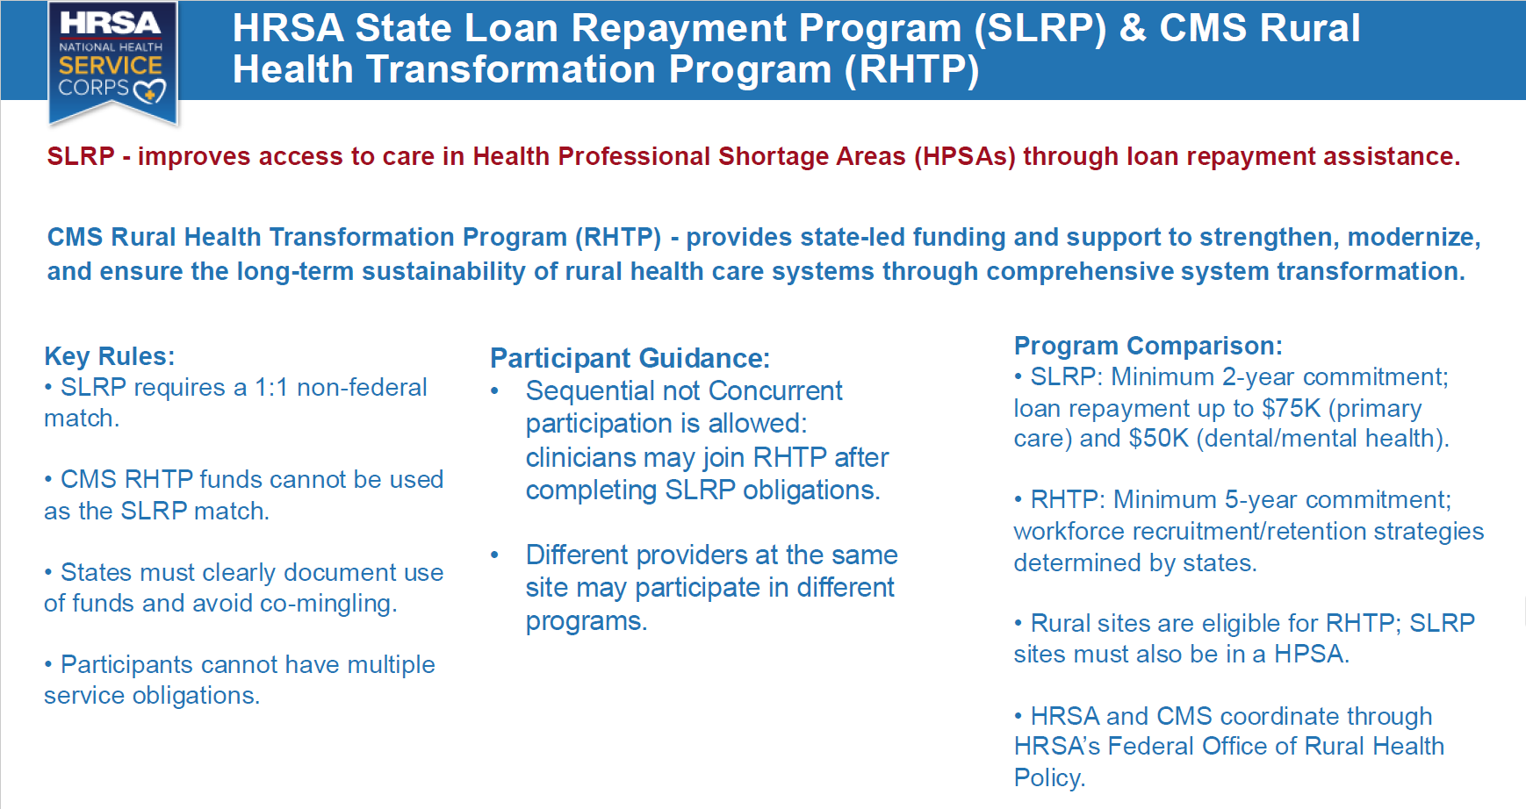
https://public.tableau.com/app/profile/anna.riggan2894/viz/Student-in-SchoolResources/Dashboard2#2

Slide 8
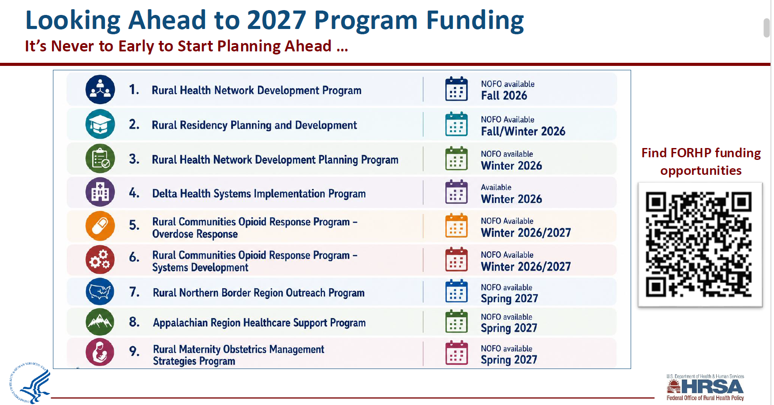

Slide 9
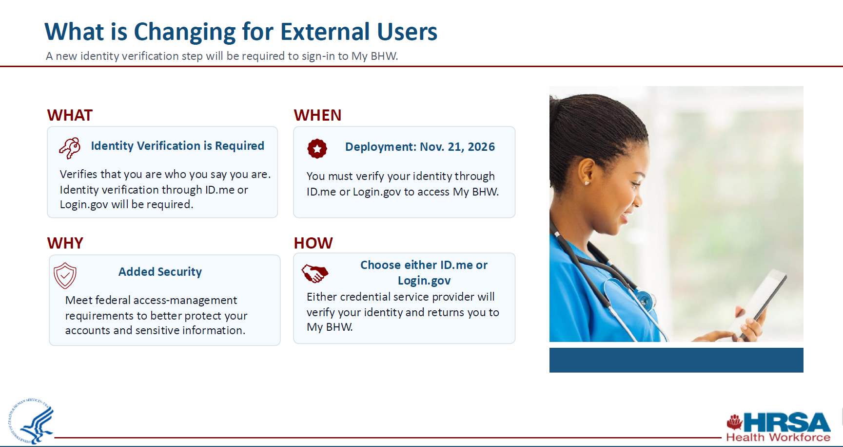
New MFA Protocols for Federal Incentive Programs

Slide 10
HRSA Resources
Email Notifications: https://public.govdelivery.com/accounts/USHHSHRSA/subscriber/new?qsp=HRSA-
Grant Resources: https://www.hrsa.gov/grants/apply-for-a-grant
Funding Opportunities: https://www.hrsa.gov/grants/find-funding
Office of Health Equity
Primary Care Office

Slide 11


Slide 12
Pause for Questions
Office of Health Equity
Primary Care Office

Slide 13

https://www.whitehouse.gov/wp-content/uploads/2026/04/ERP-2026-11.-Making-America-Healthy-by-Unleashing-Competition-in-Physicians-Markets.pdf

Slide 14
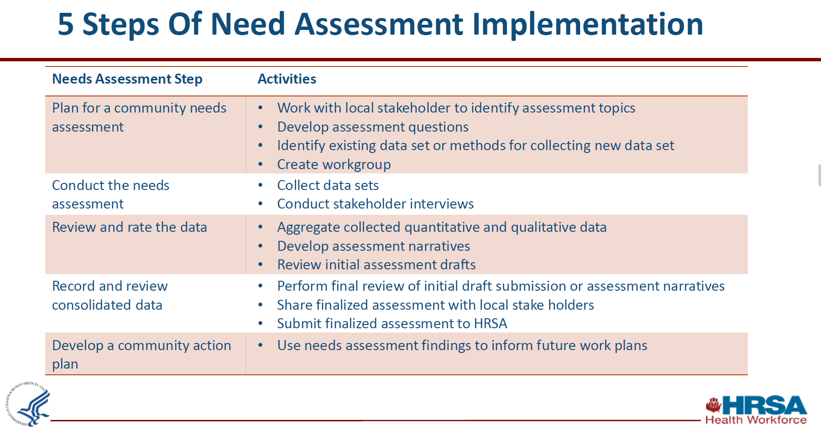

Slide 15
Essential Components of the 2027 CHNA (per HRSA)
Examining Target Populations and Unmet Needs
Examining Barriers to Care
Collaboration with Stakeholders
Commitment to Continuous Monitoring

Slide 16
Focus Areas
1.) Navigating the increased administrative burden for Medicaid
2.) Maintaining continuity of care during natural disasters
3.) Addressing closures of rural hospitals and primary care clinics
4.) Examining technical challenges and potential solutions for the increase in telehealth, EMR, and AI.
5.) Special Populations with unmet needs
6.) Improving access to early behavioral health intervention
7.) Oral Health barriers to care and fluoridation messaging
Office of Health Equity
Primary Care Office

Slide 17
1.) Navigating the increased administrative burden for Medicaid (Barriers to Care)
Starting in 2027:
Medicaid recipients will be expected to recertify twice a year rather than once a year.
Work requirements will be expanded for previously-exempted recipients 55-64 years old.
https://www.narhc.org/News/33229/Medicaid-Work--Community-Engagement-Increased-Eligibility-Check-Requirements-Begin-in-5-Months
3. Federal instructions for maintaining disability protections are unclear (i.e. “Medical Frailty”).
Relevant Case Study:
During the COVID-19 pandemic, annual Medicaid recertifications became automatic for safety reasons, until May 2023.
There are numerous recent publications exploring not only the benefits of the decreased administrative burden, but the hardship caused when it was restored post-Pandemic.

Slide 18
2.) Maintaining continuity of care during natural disasters (Analysis/Continued Monitoring)
Objective:
There are varied factors that effect the resiliency of a community to natural disasters. I would like to highlight Virginia’s current emergency preparedness and propose our next steps through a continuity of care lens.
Strategy:
Examining Healthcare travel patterns and access to alternate routes for seeking care
Relevant Data sources:
Climate Vulnerability Index out Texas A&E: https://climatevulnerabilityindex.org/
Virginia Health Opportunity Index: https://apps.vdh.virginia.gov/omhhe/hoi/
Notes:
CVI : https://www.sciencedirect.com/science/article/pii/S0160412023000454?via%3Dihub
HOI: Built Environment Profile
Examining alternate routes for travel: https://www.sciencedirect.com/science/article/abs/pii/S0967070X25001878

Slide 19
3.) Addressing closures of rural hospitals and primary care clinics (Barriers to Care/Collaborations)
Collaboration Opportunity:
There is a project staring at the VCU Wright Center examining the closure of Primary Care clinics
Relevant Case Study:
Some states have already been adversely affected by Rural hospital closures
Office of Health Equity
Primary Care Office

Slide 20
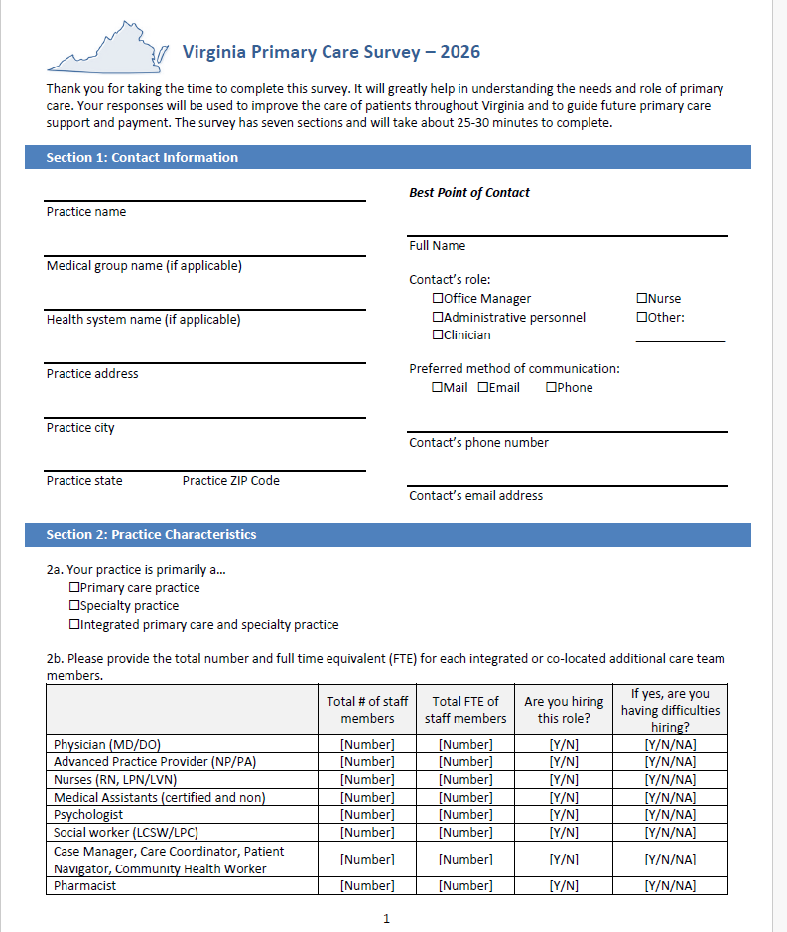
4.) Examining technical challenges and potential solutions for the increase in telehealth, EMR, and AI. (Direct Data Collection/Interviews)
The VA-AHEAD team is conducting a survey to learn about experiences of patient-facing providers
Office of Health Equity
Primary Care Office

Slide 21
5.) Special Populations
We will likely focus on calculated populations:
Examples:
ALICE (Asset Limited, Income Constrained, Employed)
  https://www.unitedforalice.org/national-overview
Medically Indigent/Underinsured
Medicaid Eligible (we expect to see a broader divide between the enrollees and those that are eligible)
Office of Health Equity
Primary Care Office

Slide 22
6.) Improving Access to Early Behavioral Health Intervention (Barriers to Care)
Looking into the Mental Health Parity regarding provider payment rates and administrative burden.
https://www.cms.gov/marketplace/private-health-insurance/mental-health-parity-addiction-equity
https://www.dol.gov/sites/dolgov/files/ebsa/pdf_files/warning-signs-plan-or-policy-nqtls-that-require-additional-analysis-to-determine-mhpaea-compliance.pdf
2. Looking into the burden of SUD treatment needs on Primary Care providers, particularly in Rural areas
Office of Health Equity
Primary Care Office

Slide 23
7.) Oral Health (Barriers to Care)
Leads on key informant interviews.
Fluoridation messaging
https://www.canada.ca/en/health-canada/services/environmental-workplace-health/reports-publications/water-quality/expert-panel-meeting-effects-fluoride-drinking-summary.html

Slide 24
Pause for Questions
Office of Health Equity
Primary Care Office

Slide 25


Stay Connected
Anna Riggan
Acting Primary Care Office Director/
Shortage Designation Manager
anna.riggan@vdh.virginia.gov
Liza Root
National Health Service Corps and HPSA Specialist
Liza.Root@vdh.virginia.gov
​www.vdh@virginia.gov/health-equity/primary-care-office/
https://data.hrsa.gov/
Office of Health Equity
Primary Care Office

Slide 26





HELPING VIRGINIA HEAL
Primary Care Practice Survey
A statewide collaboration...

Slide 27
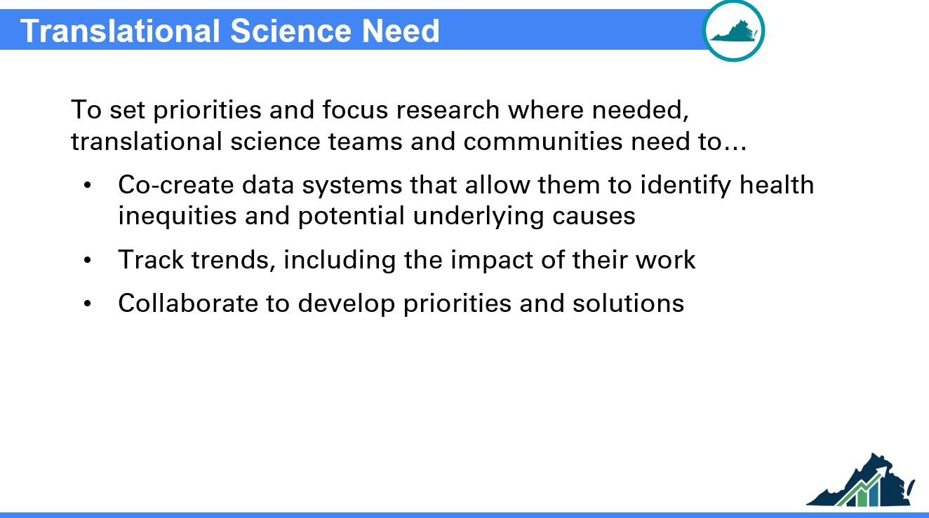

Slide 28
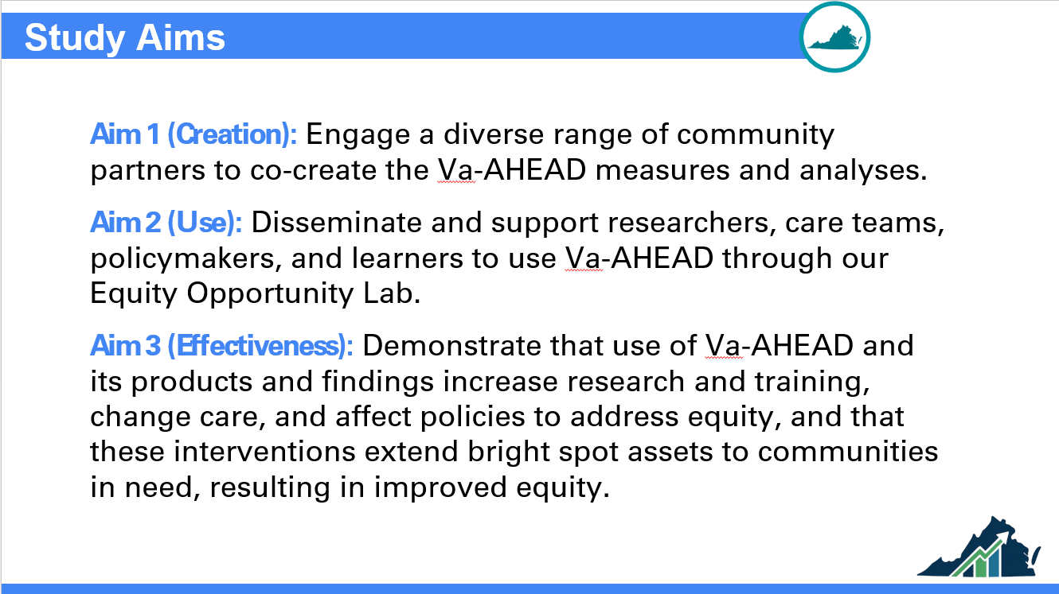

Slide 29
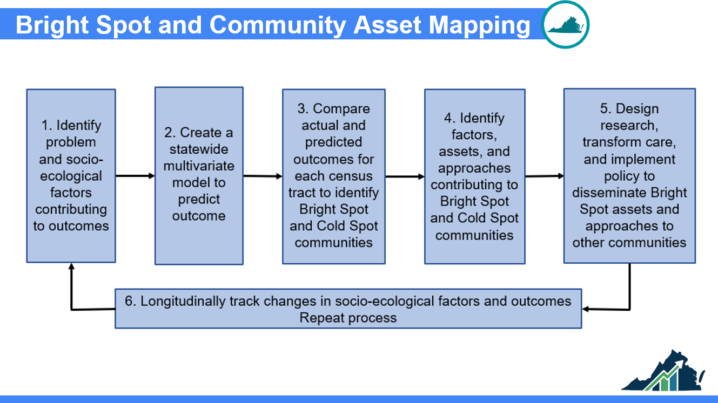

Slide 30
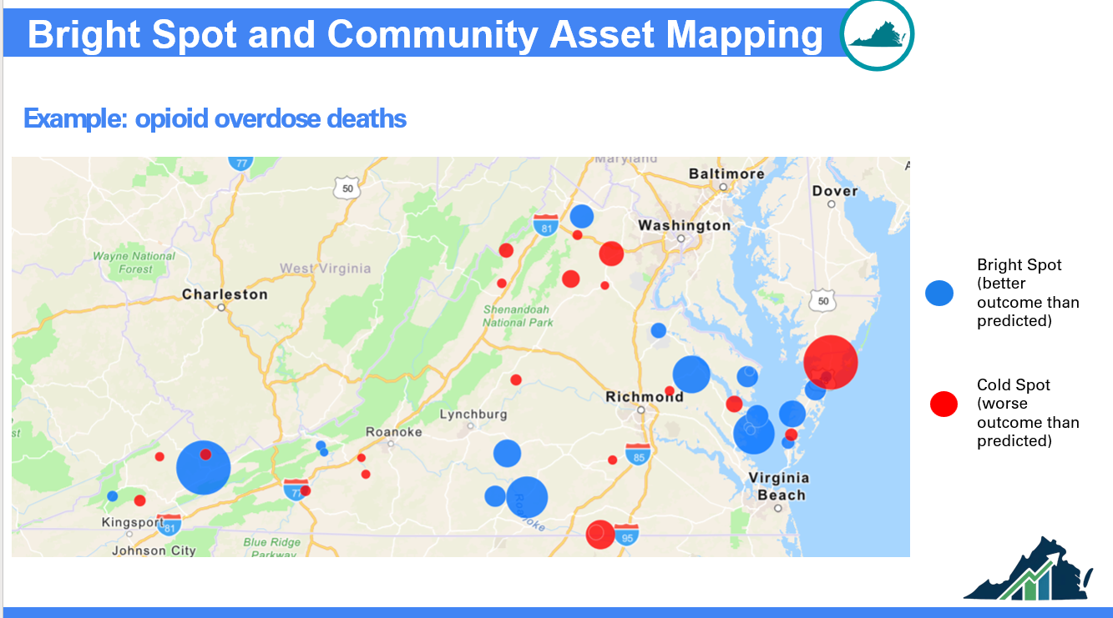

Slide 31
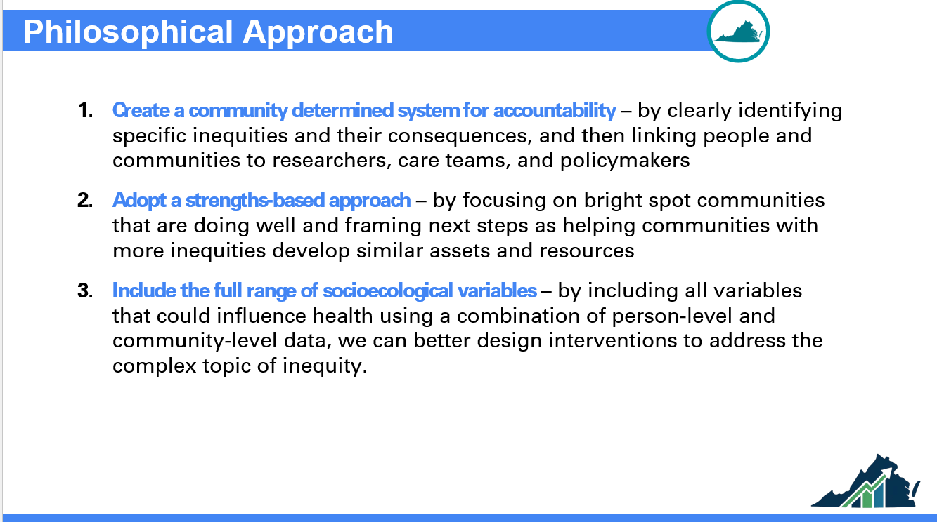

Slide 32
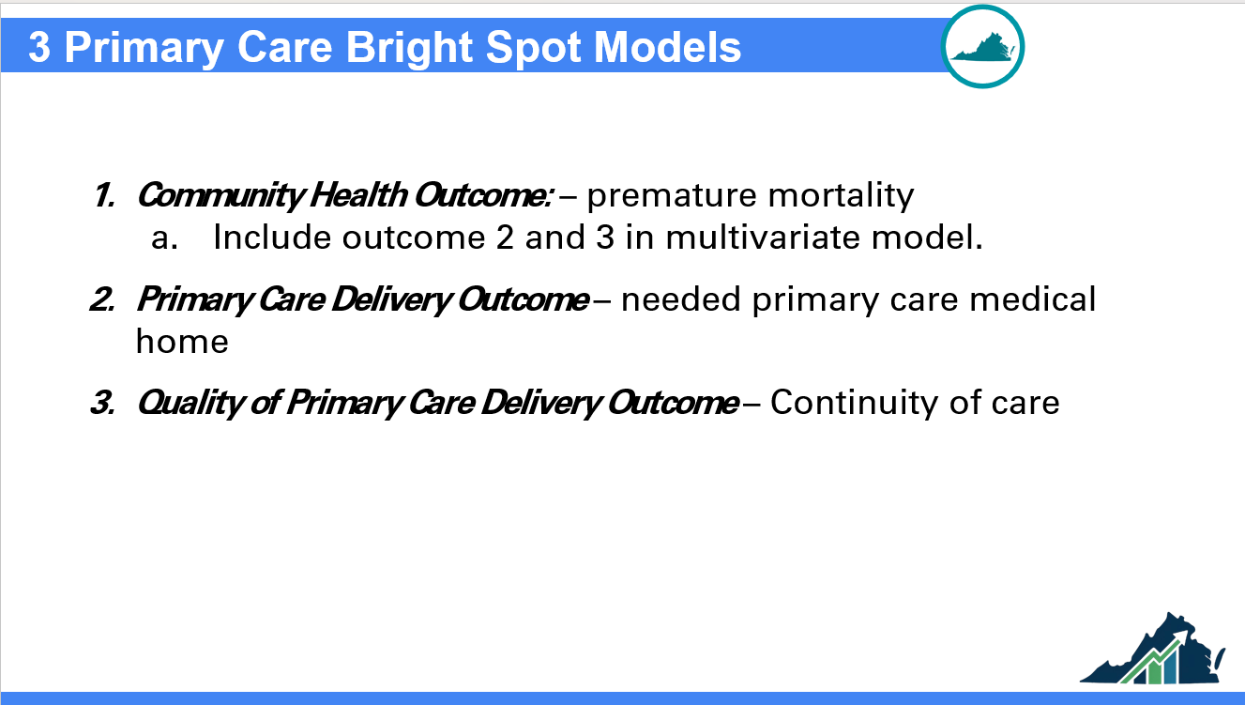

Slide 33
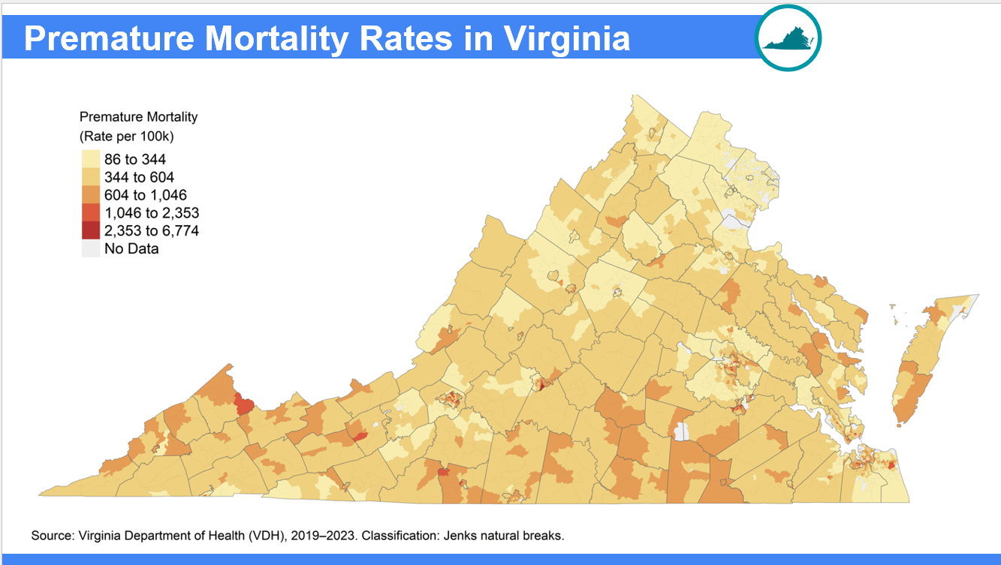

Slide 34
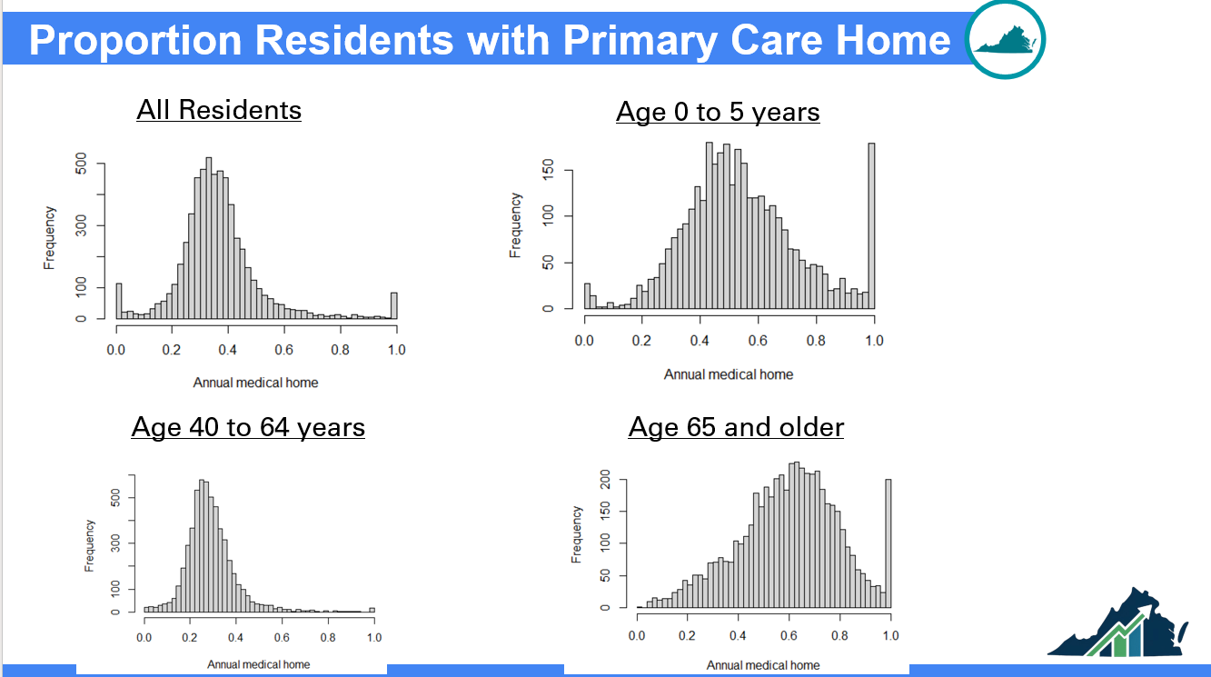

Slide 35
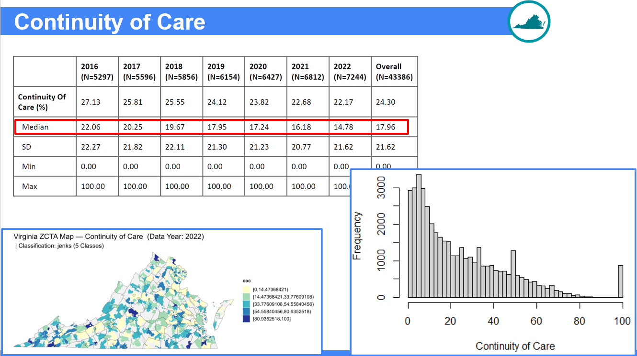

Slide 36
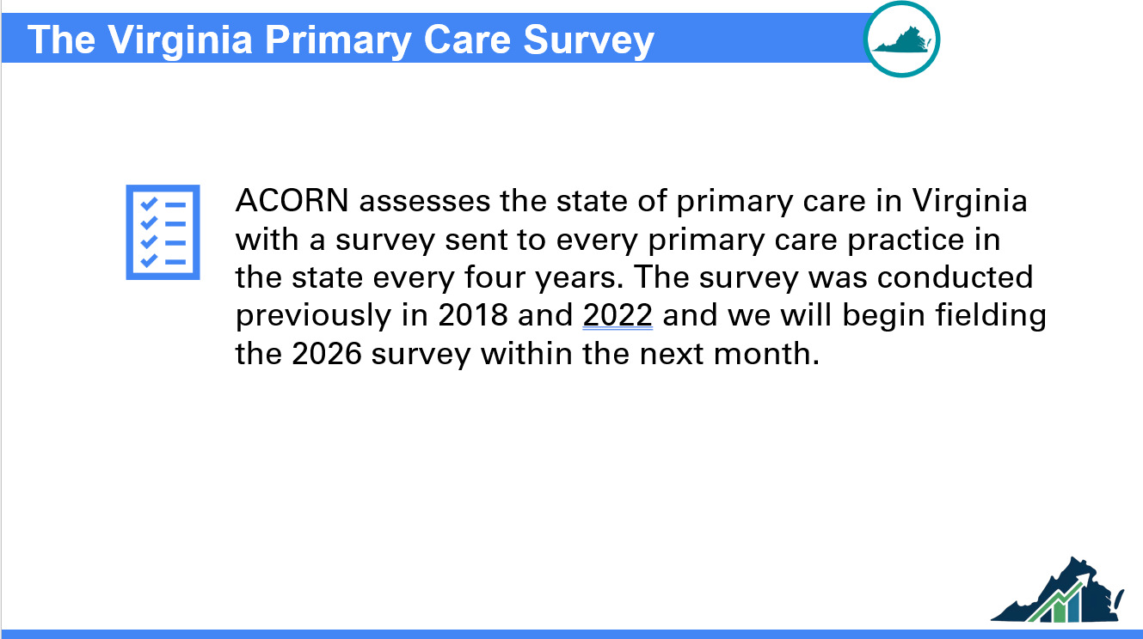

Slide 37
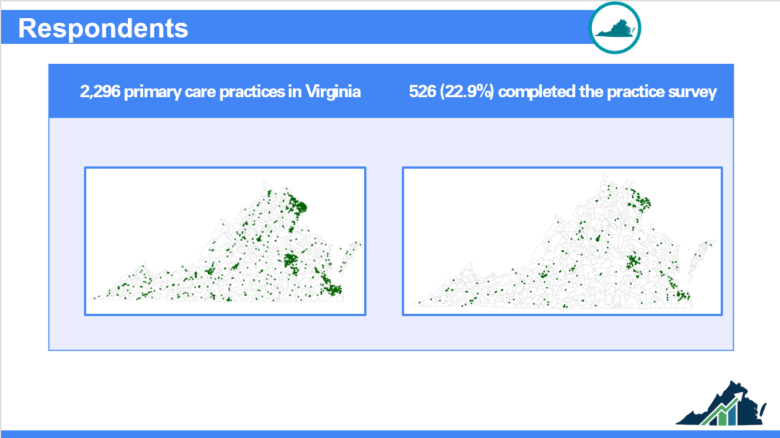

Slide 38
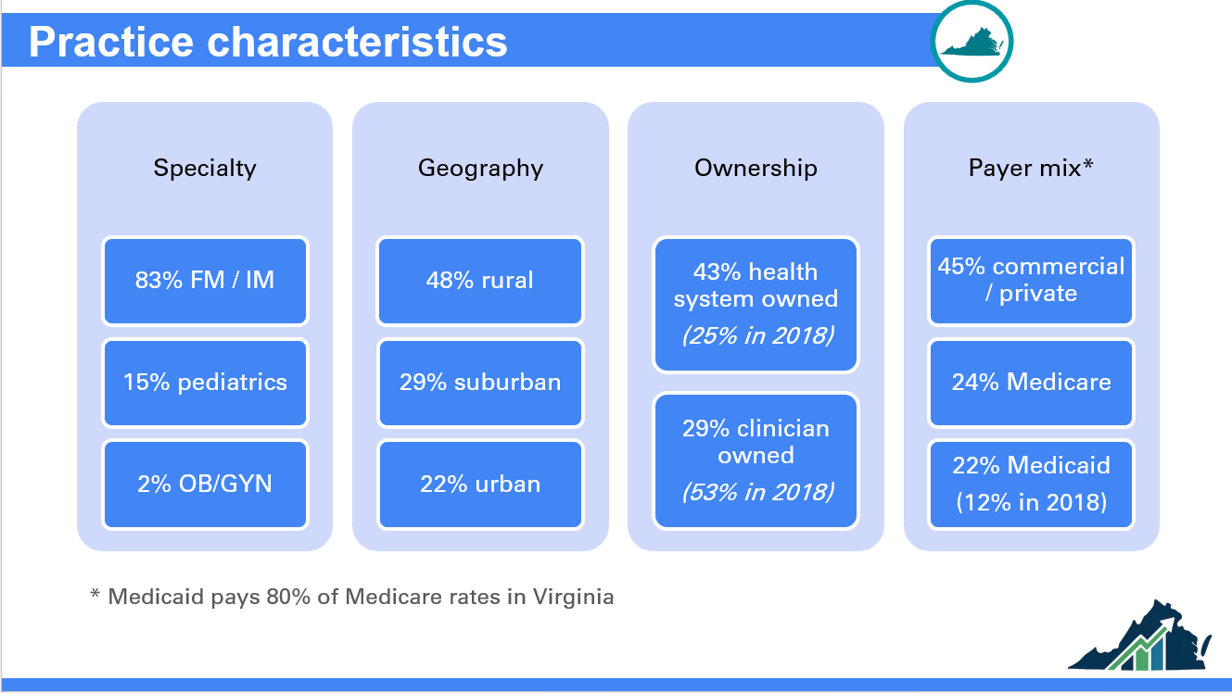

Slide 39
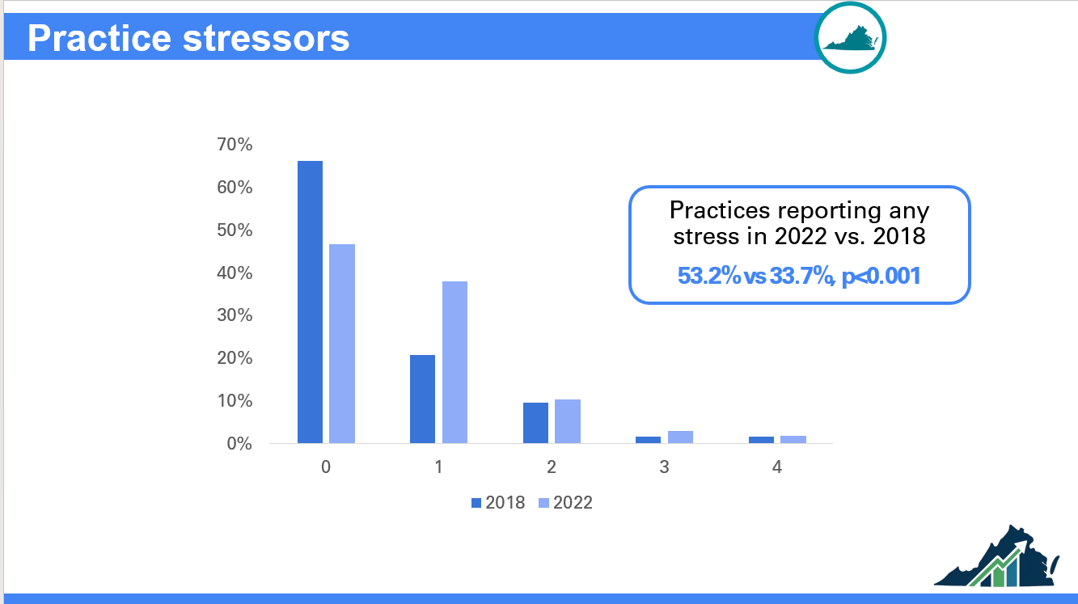

Slide 40
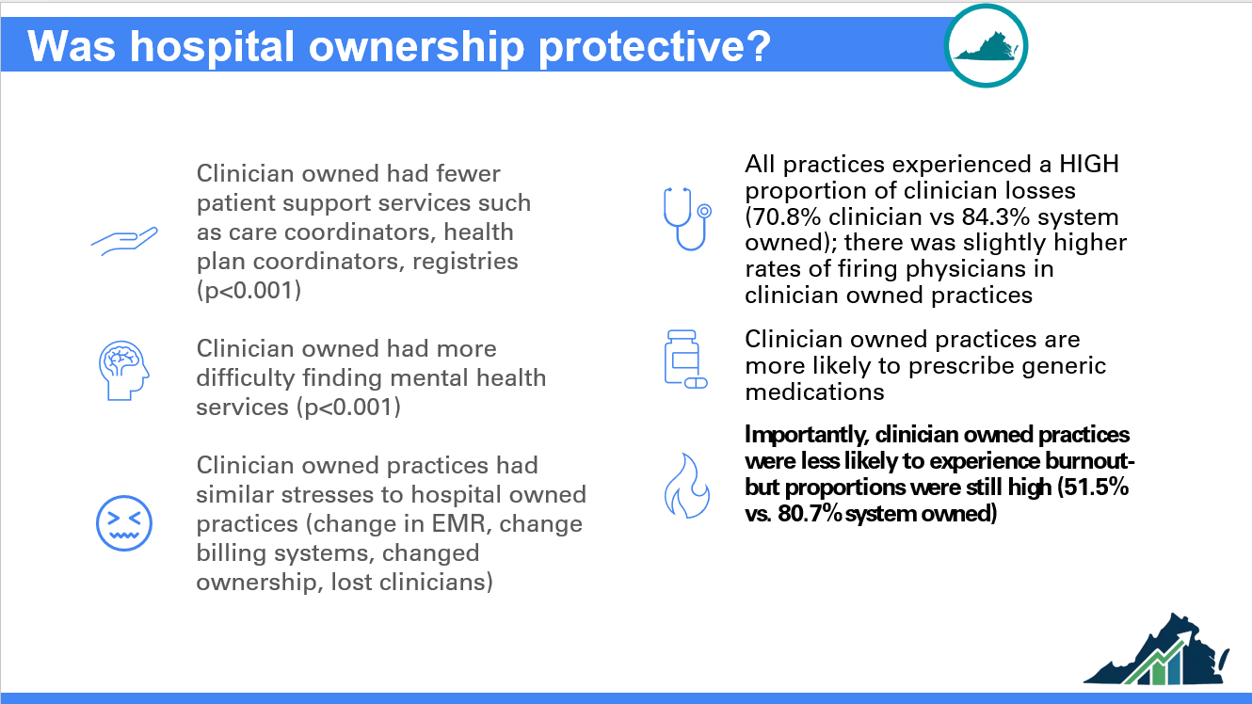

Slide 41
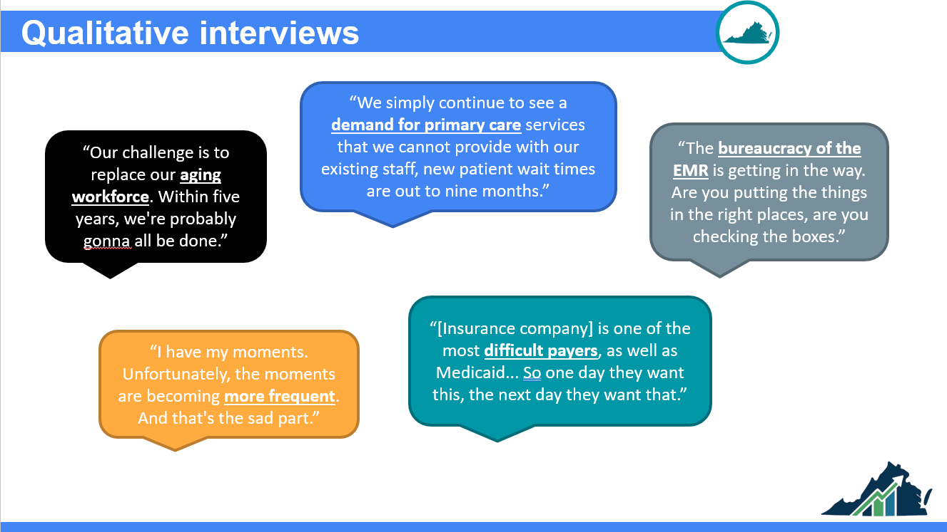

Slide 42
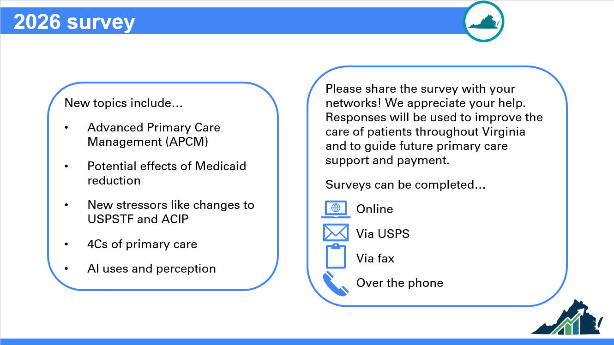

Slide 43


