Slide 1
Measles Overview, Prevention, and Planning in Virginia
February 24, 2026
Meredith Robinson
Vaccine-Preventable Disease Coordinator
Office of Epidemiology
Virginia Department of Health

Slide 2
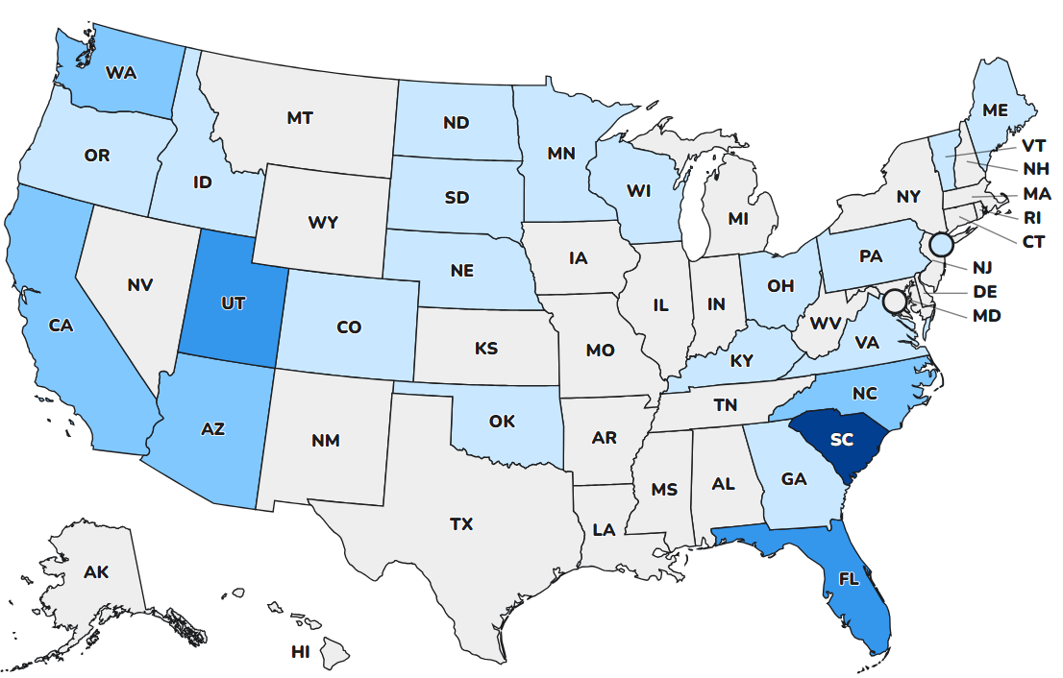
Measles in the United States
As of February 19, a total of 982 measles cases have been reported this year across 26 states and territories.
For the full year of 2025, a total of 2,280 measles cases were reported in the US.
7 new outbreaks have been reported (defined as 3 or more related cases). The largest ongoing outbreak is in South Carolina (962 cases). ​
94% of patients are unvaccinated or report unknown vaccination status.
4% of patients have been hospitalized.​
Source
Notes:
https://www.cdc.gov/measles/data-research/?CDC_AAref_Val=https://www.cdc.gov/measles/cases-outbreaks.html

Slide 3
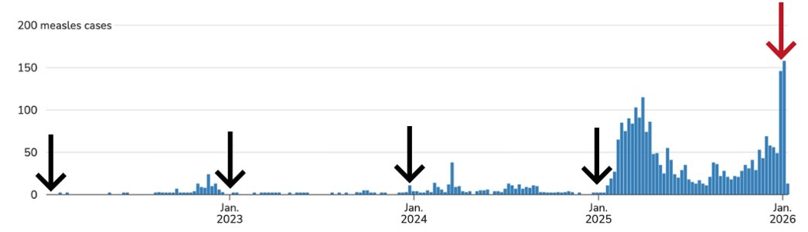
Measles in the United States
Source
Notes:
https://www.cdc.gov/measles/data-research/?CDC_AAref_Val=https://www.cdc.gov/measles/cases-outbreaks.html

Slide 4
Measles in Virginia
So far this year, ten measles cases have been reported in Virginia. This far surpasses the five cases reported in 2025.
  All cases reported international or domestic travel prior to the onset of measles symptoms.
  Most patients are residents of Northern Virginia.
  Over half of patients are under 4 years of age.
VDH has also responded to four measles exposures related to out-of-state visitors who traveled while sick.
    Two airport exposures (DCA and IAD)
    One community exposure (Washington Metro)
    One place of worship exposure
There is no evidence of a measles outbreak or community transmission in Virginia at this time.

Slide 5
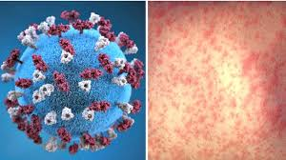
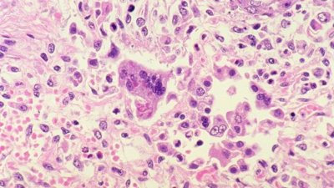
How Does Measles Spread?
Measles is a highly contagious illness caused by the measles virus. Over 90% of people exposed to the virus will develop measles if they are not immune.
Transmission: Measles spreads from person to person through the air or by direct contact with nose or throat discharges.
  Anyone on the same air handling system as someone who is sick is considered exposed.
  Measles virus can survive in the air for up to 2 hours.
Infectious period: 4 days before to 4 days after rash onset
Source
Source

Slide 6
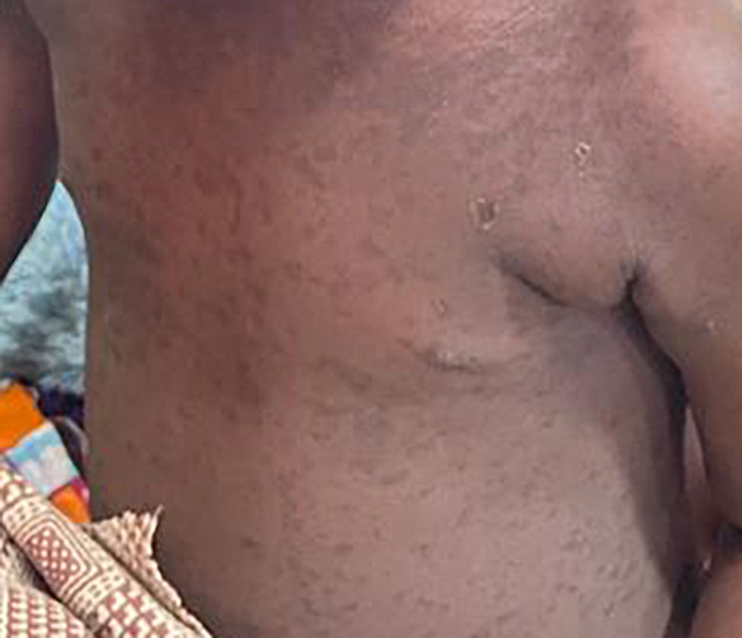
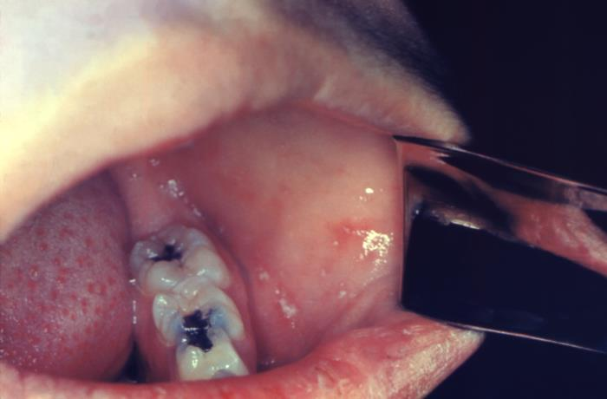
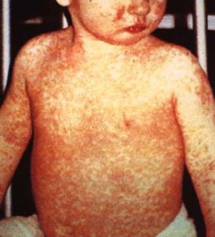
Measles Symptoms
Symptoms typically develop 7-14 days after someone is exposed but can appear up to 21 days later.
  1) Early Symptoms:
    High fever (≥101°F)
    Cough
    Runny nose
    Conjunctivitis (red, watery eyes)
    Koplik spots (white spots in mouth)
  2) Rash:
    Red and blotchy, not itchy
    Often begins on the face near the hairline and moves down
Source
Source
Source

Slide 7
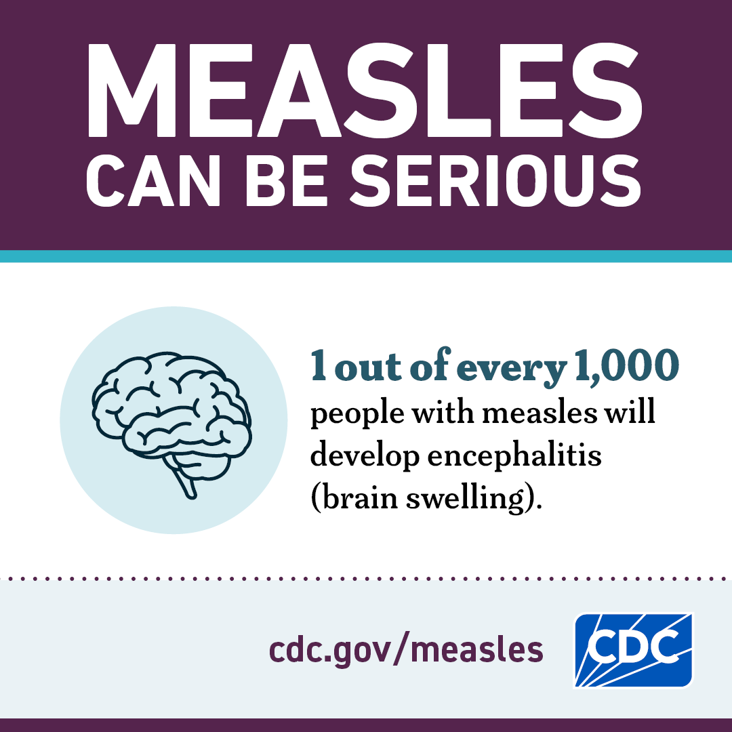
Measles Complications
1 in 5 measles patients will require hospitalization.​
Common complications from measles include:​
  Ear infections
  Diarrhea
  Pneumonia
  Encephalitis
Measles infection can also cause immunity amnesia, which is damage to the immune system's memory cells that makes it harder to fight future infections.
Several age groups that are more likely to suffer measles complications:​
  Children younger than 5 years of age​
  Pregnant women​
  People with weakened immune systems​
There is no specific antiviral therapy for measles. Medical care is supportive and involves treatment to relieve symptoms.
  Vitamin A cannot prevent measles and should only be administered under the care of a healthcare professional.
Source

Slide 8
Measles Vaccine
Measles-mumps-rubella (MMR) vaccine:
  Highly effective at providing lifelong protection against measles
  Boosters are not needed for people who received two doses of measles-containing vaccine according to the U.S. vaccination schedule.
All children are recommended to receive 2 doses of MMR vaccine at 12-15 months and 4-6 years of age.
High rates of vaccination have made measles less common in the United States, though cases have surged in recent years in communities with low vaccination rates.
Most cases in Virginia are a result of unvaccinated individuals traveling internationally or to parts of the U.S. where measles is circulating.
Pockets of low vaccination increase the chance of an outbreak in Virginia.

Slide 9
Am I Protected?
You are considered immune if you meet one or more of the following criteria:
  Received one or more doses of a live measles-containing (MMR) vaccine administered on or after the first birthday
    Two doses is required for healthcare workers
  Previously diagnosed with measles
  Documentation of measles immunity (titers)
  Born before 1957 - considered immune due to likely natural exposure.
Vaccination provides lifetime immunity to measles.

Slide 10
Who Is At Risk of Becoming Sick?
A measles patient can spread the virus from 4 days before the rash begins to 4 days after.
A contact is:
  Anyone who has been in a shared airspace at the same time as someone who is sick or up to 2 hour after they have left the area. This includes areas on the same air handling system.
  Anyone who has direct contact with nose or throat discharges of someone who is sick
People who have never received MMR vaccine are at risk of developing measles if they are exposed to a measles patient.
  Infants <12 months who are too young to receive MMR vaccine
  People who are unable to receive MMR vaccine due to an underlying health condition
  People with immunocompromising conditions
Notes:
Potentially exposed contacts include:
Patients and staff members at healthcare facilities the case visited
All household members
Family, friends, coworkers, classmates, etc.
People seated near the case on a plane
People who rode in a vehicle or public transit with the case
People who have been in public locations around the same time (e.g., airports)
VDH might issue a news release to identify additional contacts from public spaces.

Slide 11
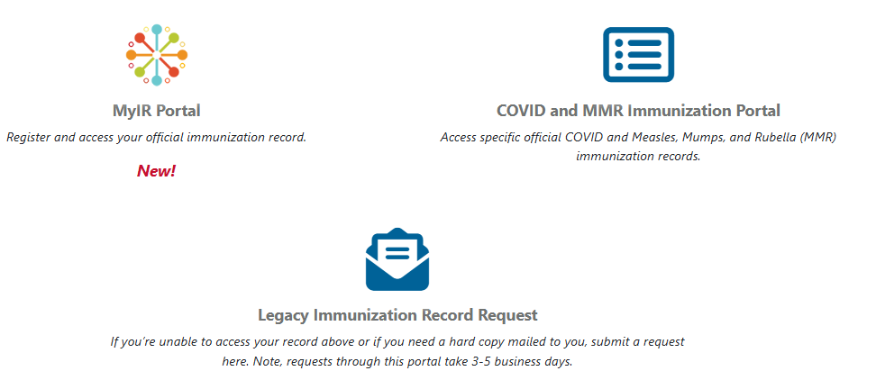
Accessing Your Vaccine Record
Virginia residents can now securely access their immunization records through confidential, HIPPA-compliant electronic portals managed by VDH. These portals allow you to view, download, and print immunization records for yourself or your family – anytime, from a home computer or a mobile device.
Request your MMR record here!

Slide 12
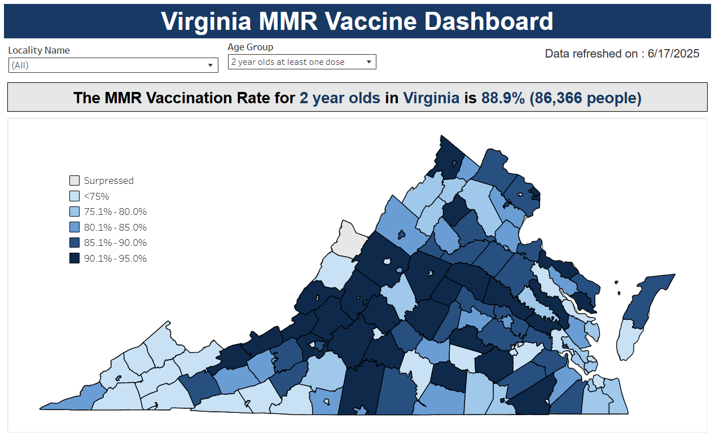
Source: Virginia Immunization Information System https://www.vdh.virginia.gov/immunization/datamanagement/mmr/

Slide 13

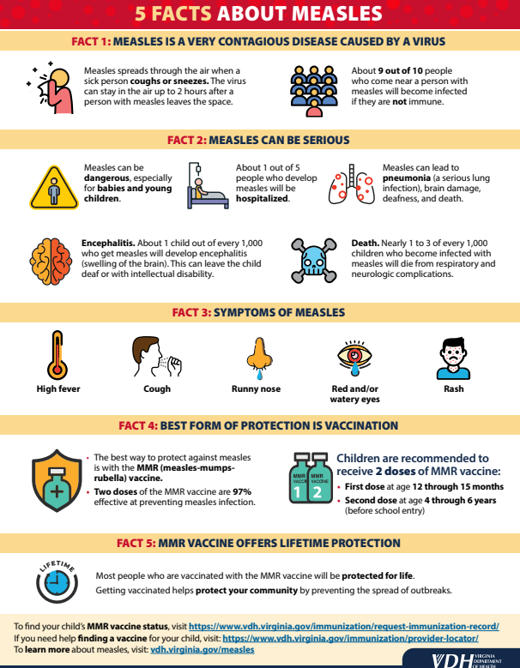




Be Prepared for Measles
Maintain staff vaccination records and encourage measles vaccination for all personnel, particularly those working with infants, children, and immunocompromised people.
Collaborate with building engineering and be aware of all areas on the same shared air-handling systems (e.g., hallways, atriums, classrooms).
Provide signs and supplies to encourage proper hand hygiene and use of face coverings when ill.
Know how to contact your local health department to ensure swift communication during a measles response.
Disseminate measles educational resources in your community:
  VDH 5 Facts About Measles
  VDH Measles Recommendations for Childcare Centers
  VDH Measles Recommendations for K-12 Schools
  VDH Measles Recommendations for Colleges and Universities
  CDC Measles Checklist for Congregate Shelters

Slide 14
How Can We Support You?
Have congregants expressed concerns regarding measles activity in Virginia / the United States?
Are there specific educational resources VDH can develop on measles and MMR vaccination that would be beneficial for your community?
What barriers are you aware of that limit members of your community from accessing care or vaccine?
Questions for VDH?

Slide 15
Thank you!
Meredith Robinson
Vaccine-Preventable Disease Coordinator
Virginia Department of Health
meredith.robinson@vdh.virginia.gov
(804) 517-9284

