Slide 1


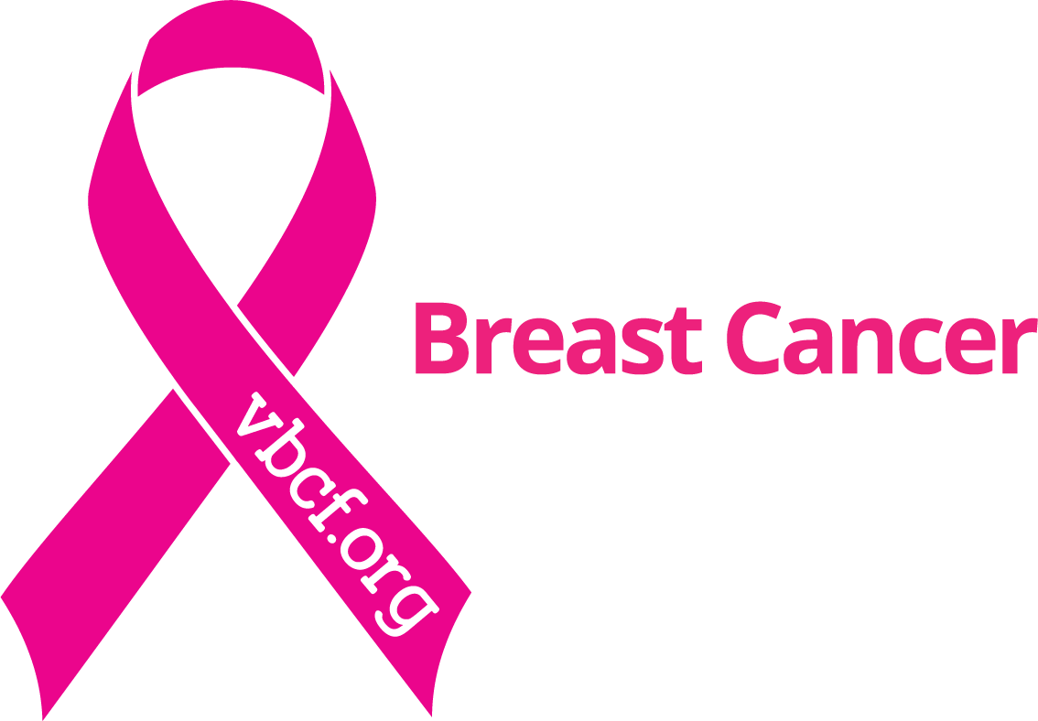
Sponsored by the Virginia Breast Cancer Foundation
Presented by: Erin Steigleder, MSW

Slide 2
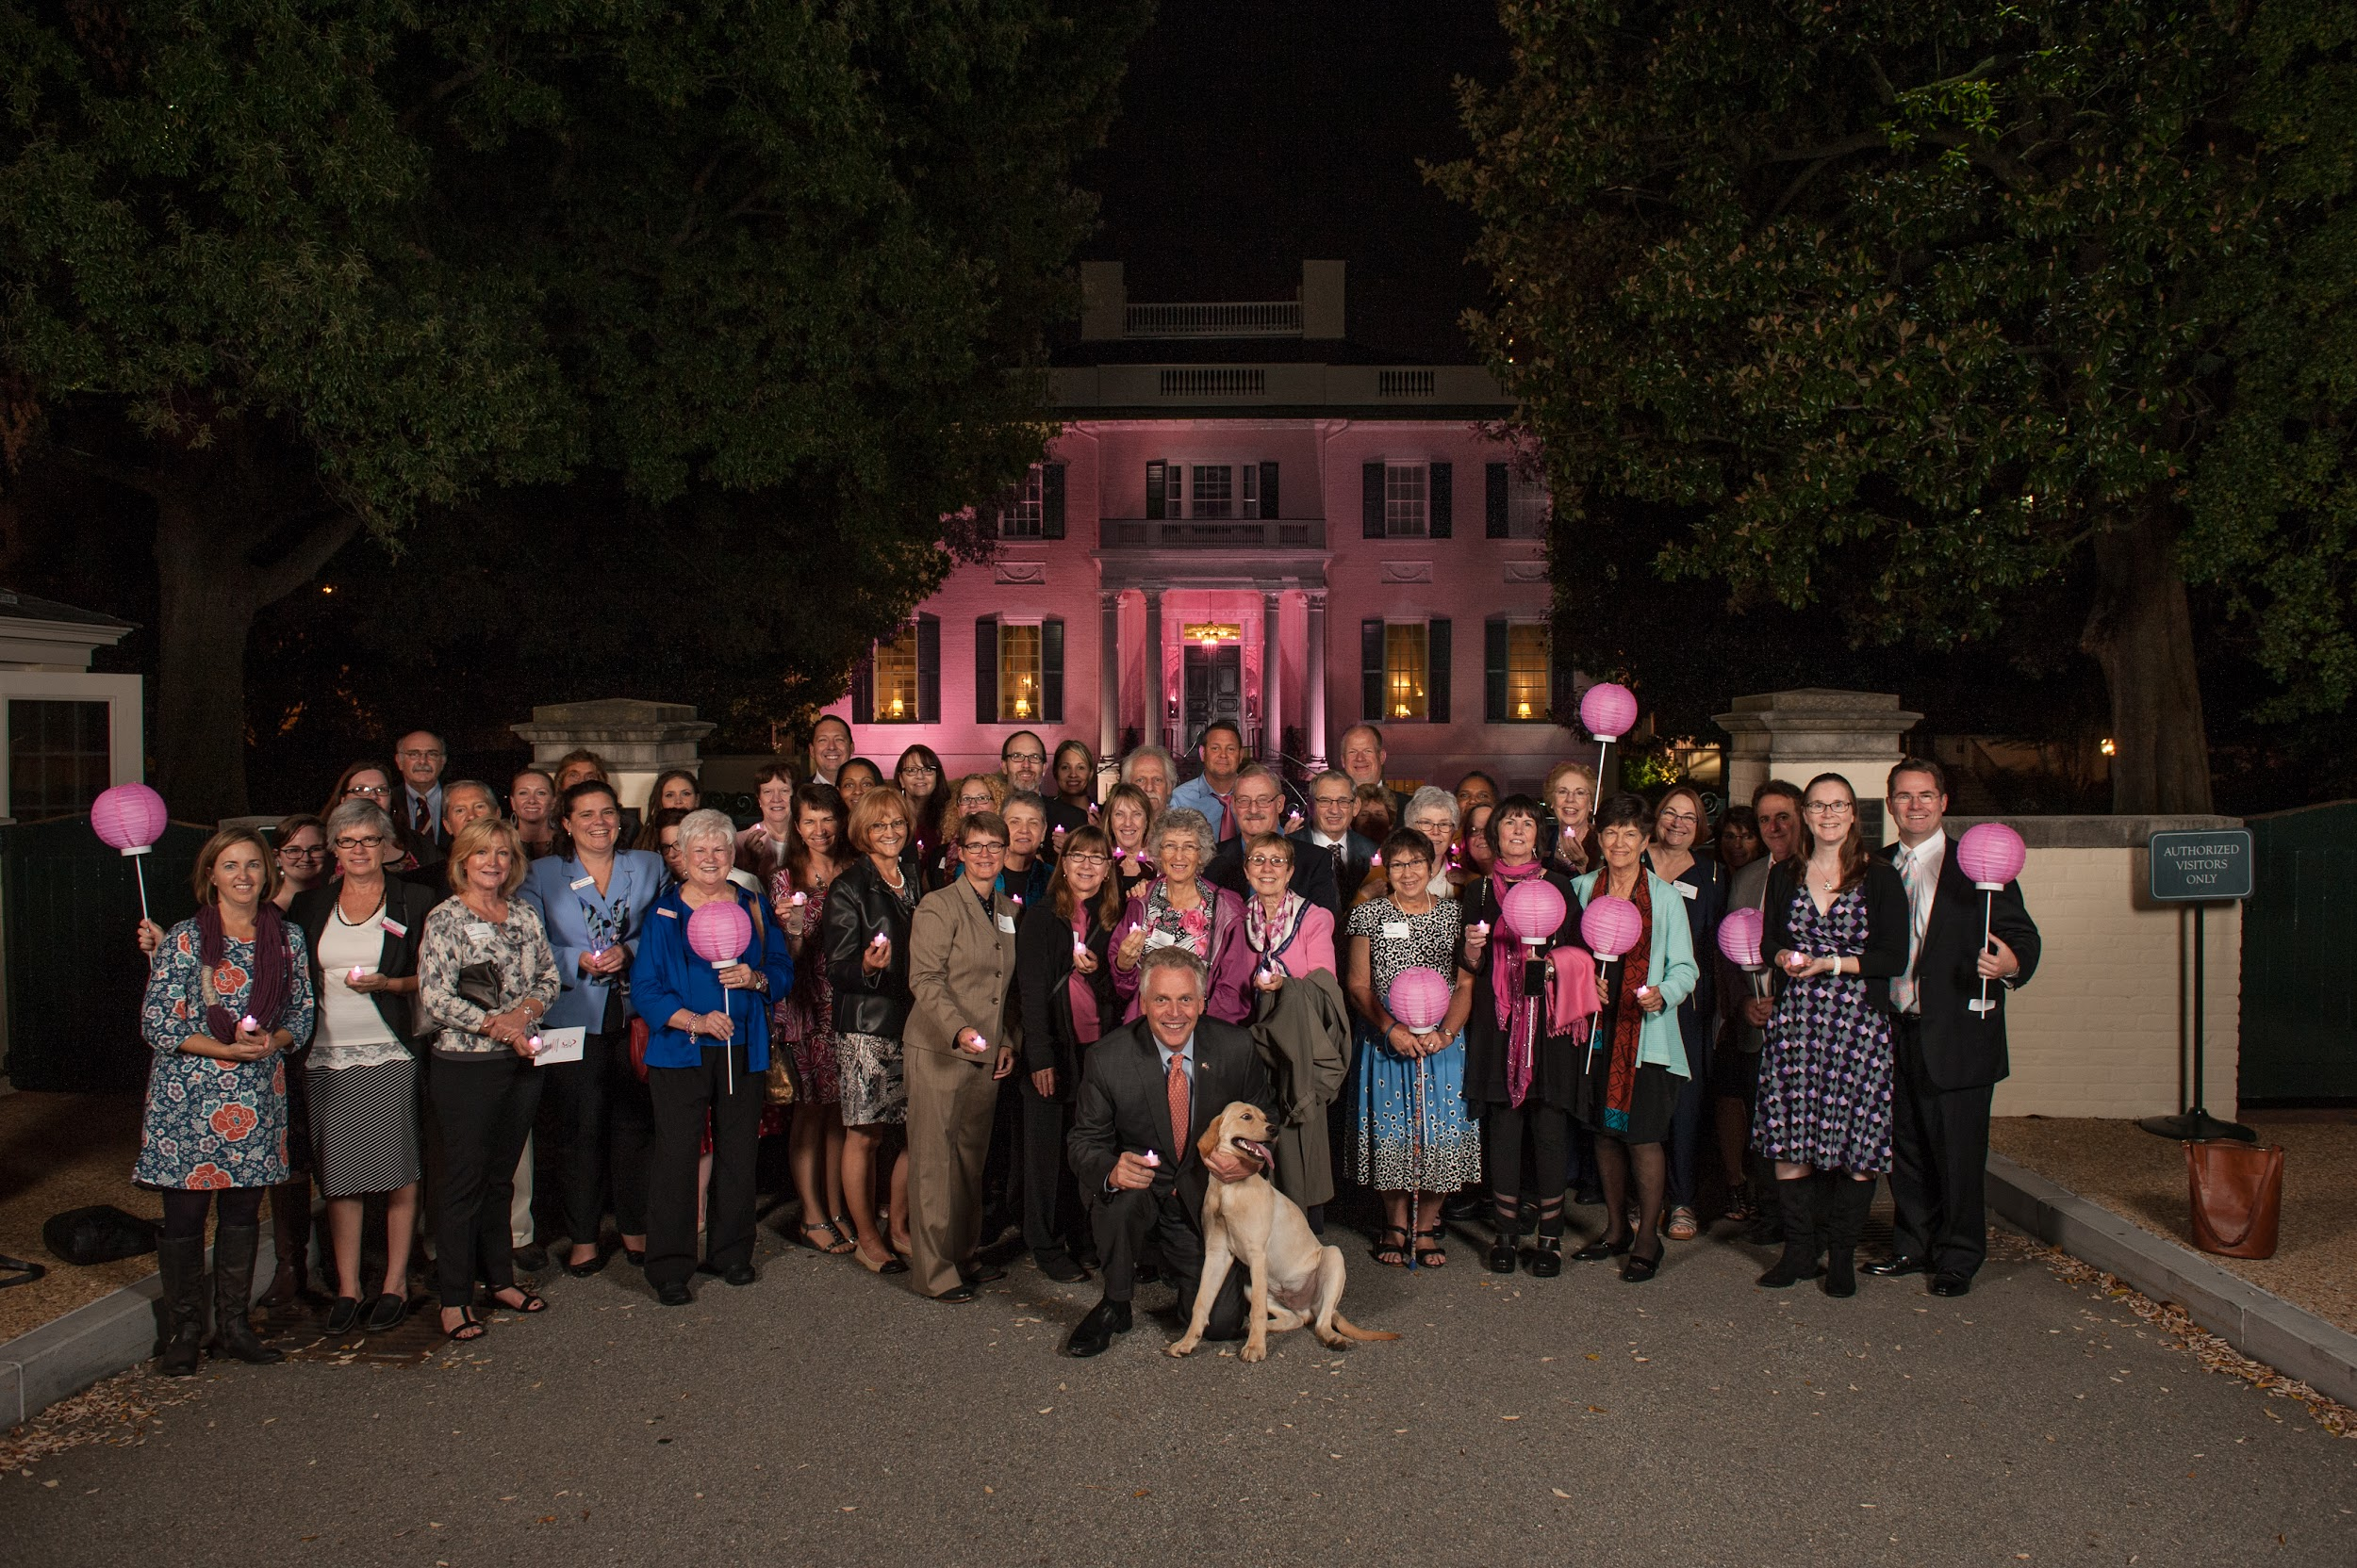
Overview:
About VBCF
Education
Access
Advocacy + Community Action
Notes:
I’ll begin our time today by giving you an introduction to VBCF, then we will go over some information about breast health and breast cancer. After that, we will go into ways that VBCF works to improve the lives of women with breast cancer in Virginia and hopefully to eradicate the disease altogether. I will also let you know ways you can help us in that fight!

Slide 3
VBCF’s Mission
We empower Virginians impacted by breast cancer through access, advocacy, education, and community action.

Slide 4
Founding of VBCF
Notes:
VBCF was founded in 1991 by 5 women who were frustrated by lack of state and local resources available for women with breast cancer. Many of them were receiving the same treatments for breast cancer that their mothers had received decades earlier. Thankfully, the landscape of breast cancer has changed drastically since we were formed over 30 years ago, but there is still much work to do. We are home-grown, and Virginians are our priority. We keep that same fire that our founders had for making sure that people knew the warning signs of breast cancer and for making the system accessible so people can get the help they need, when they need it.

Slide 5
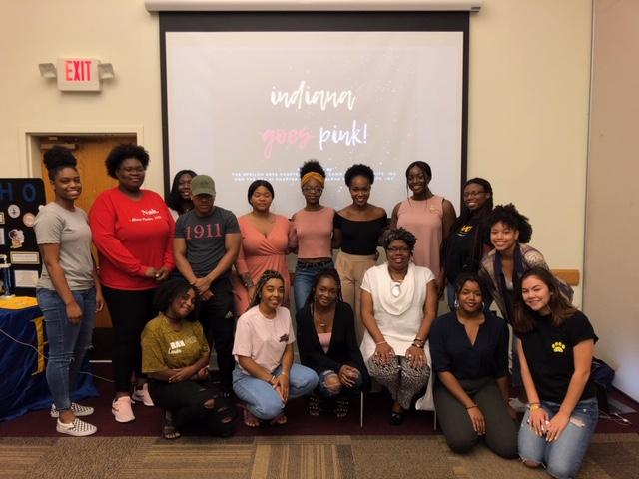
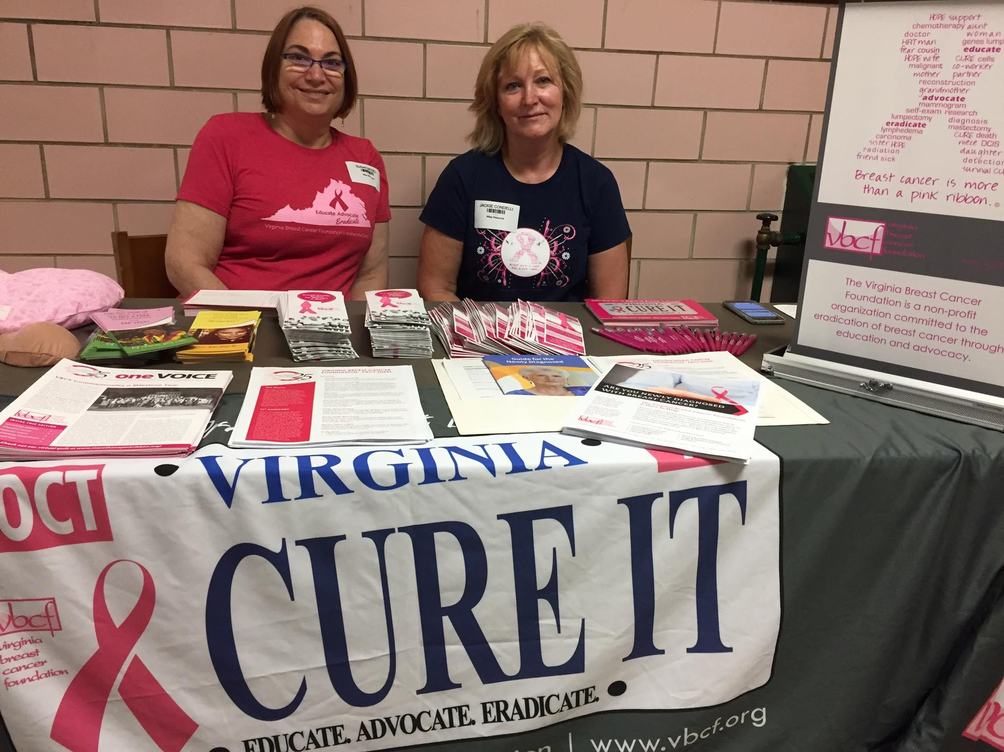
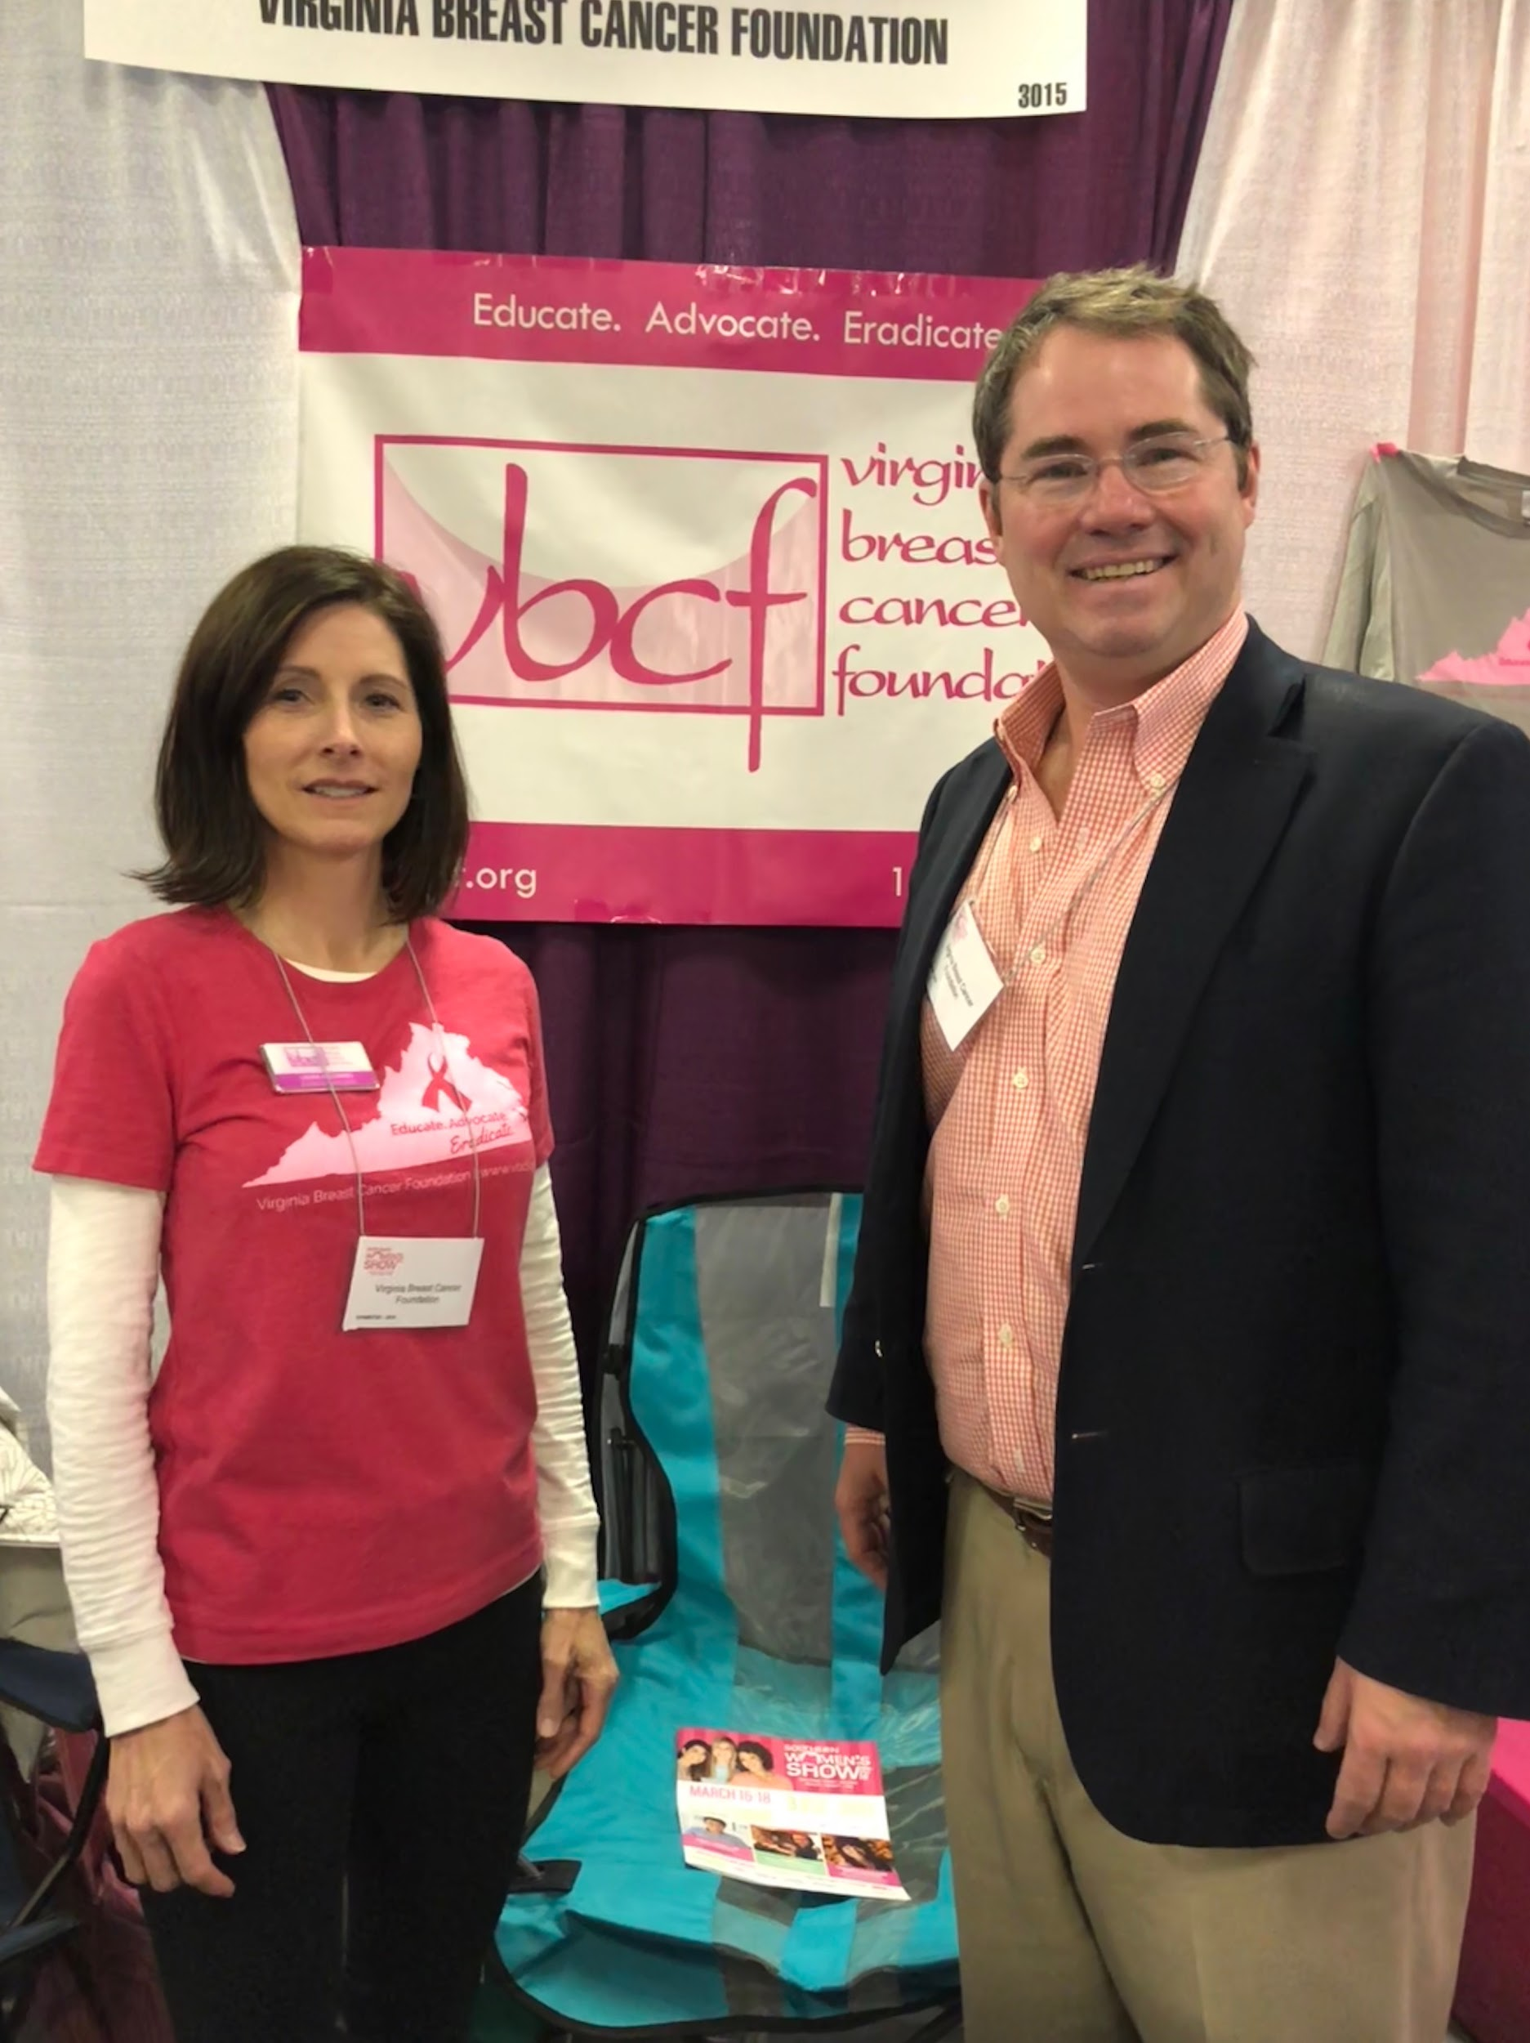
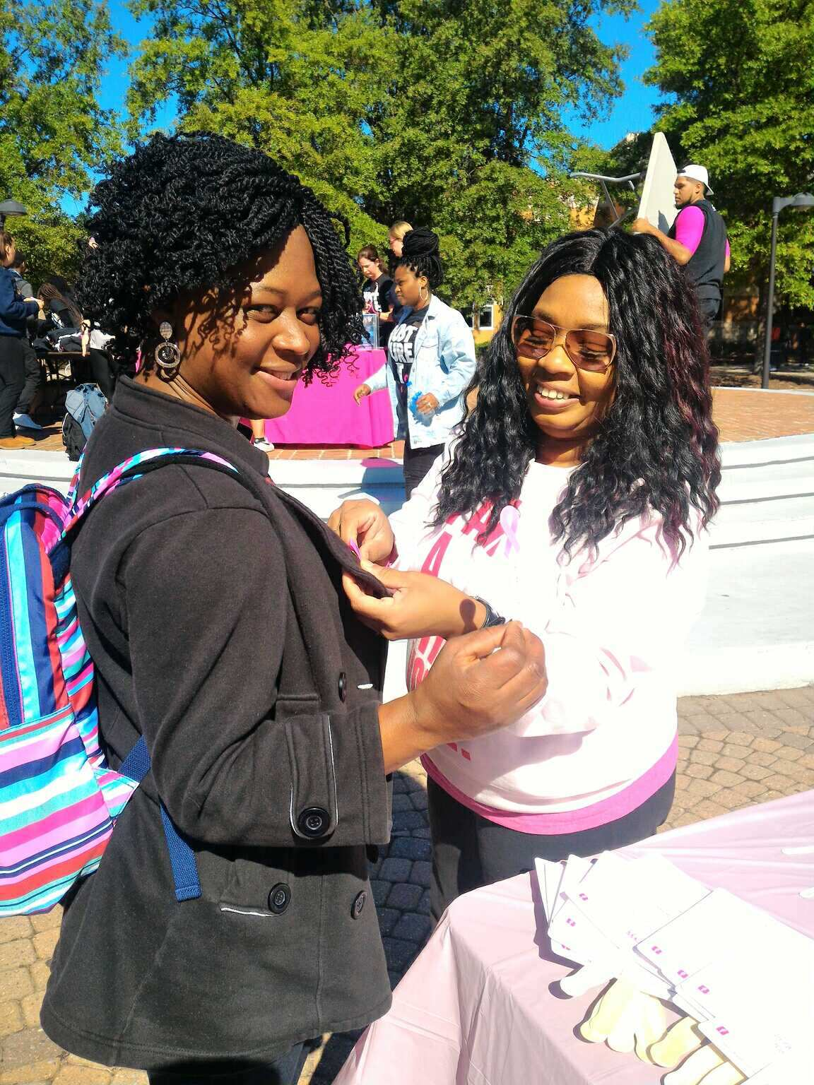
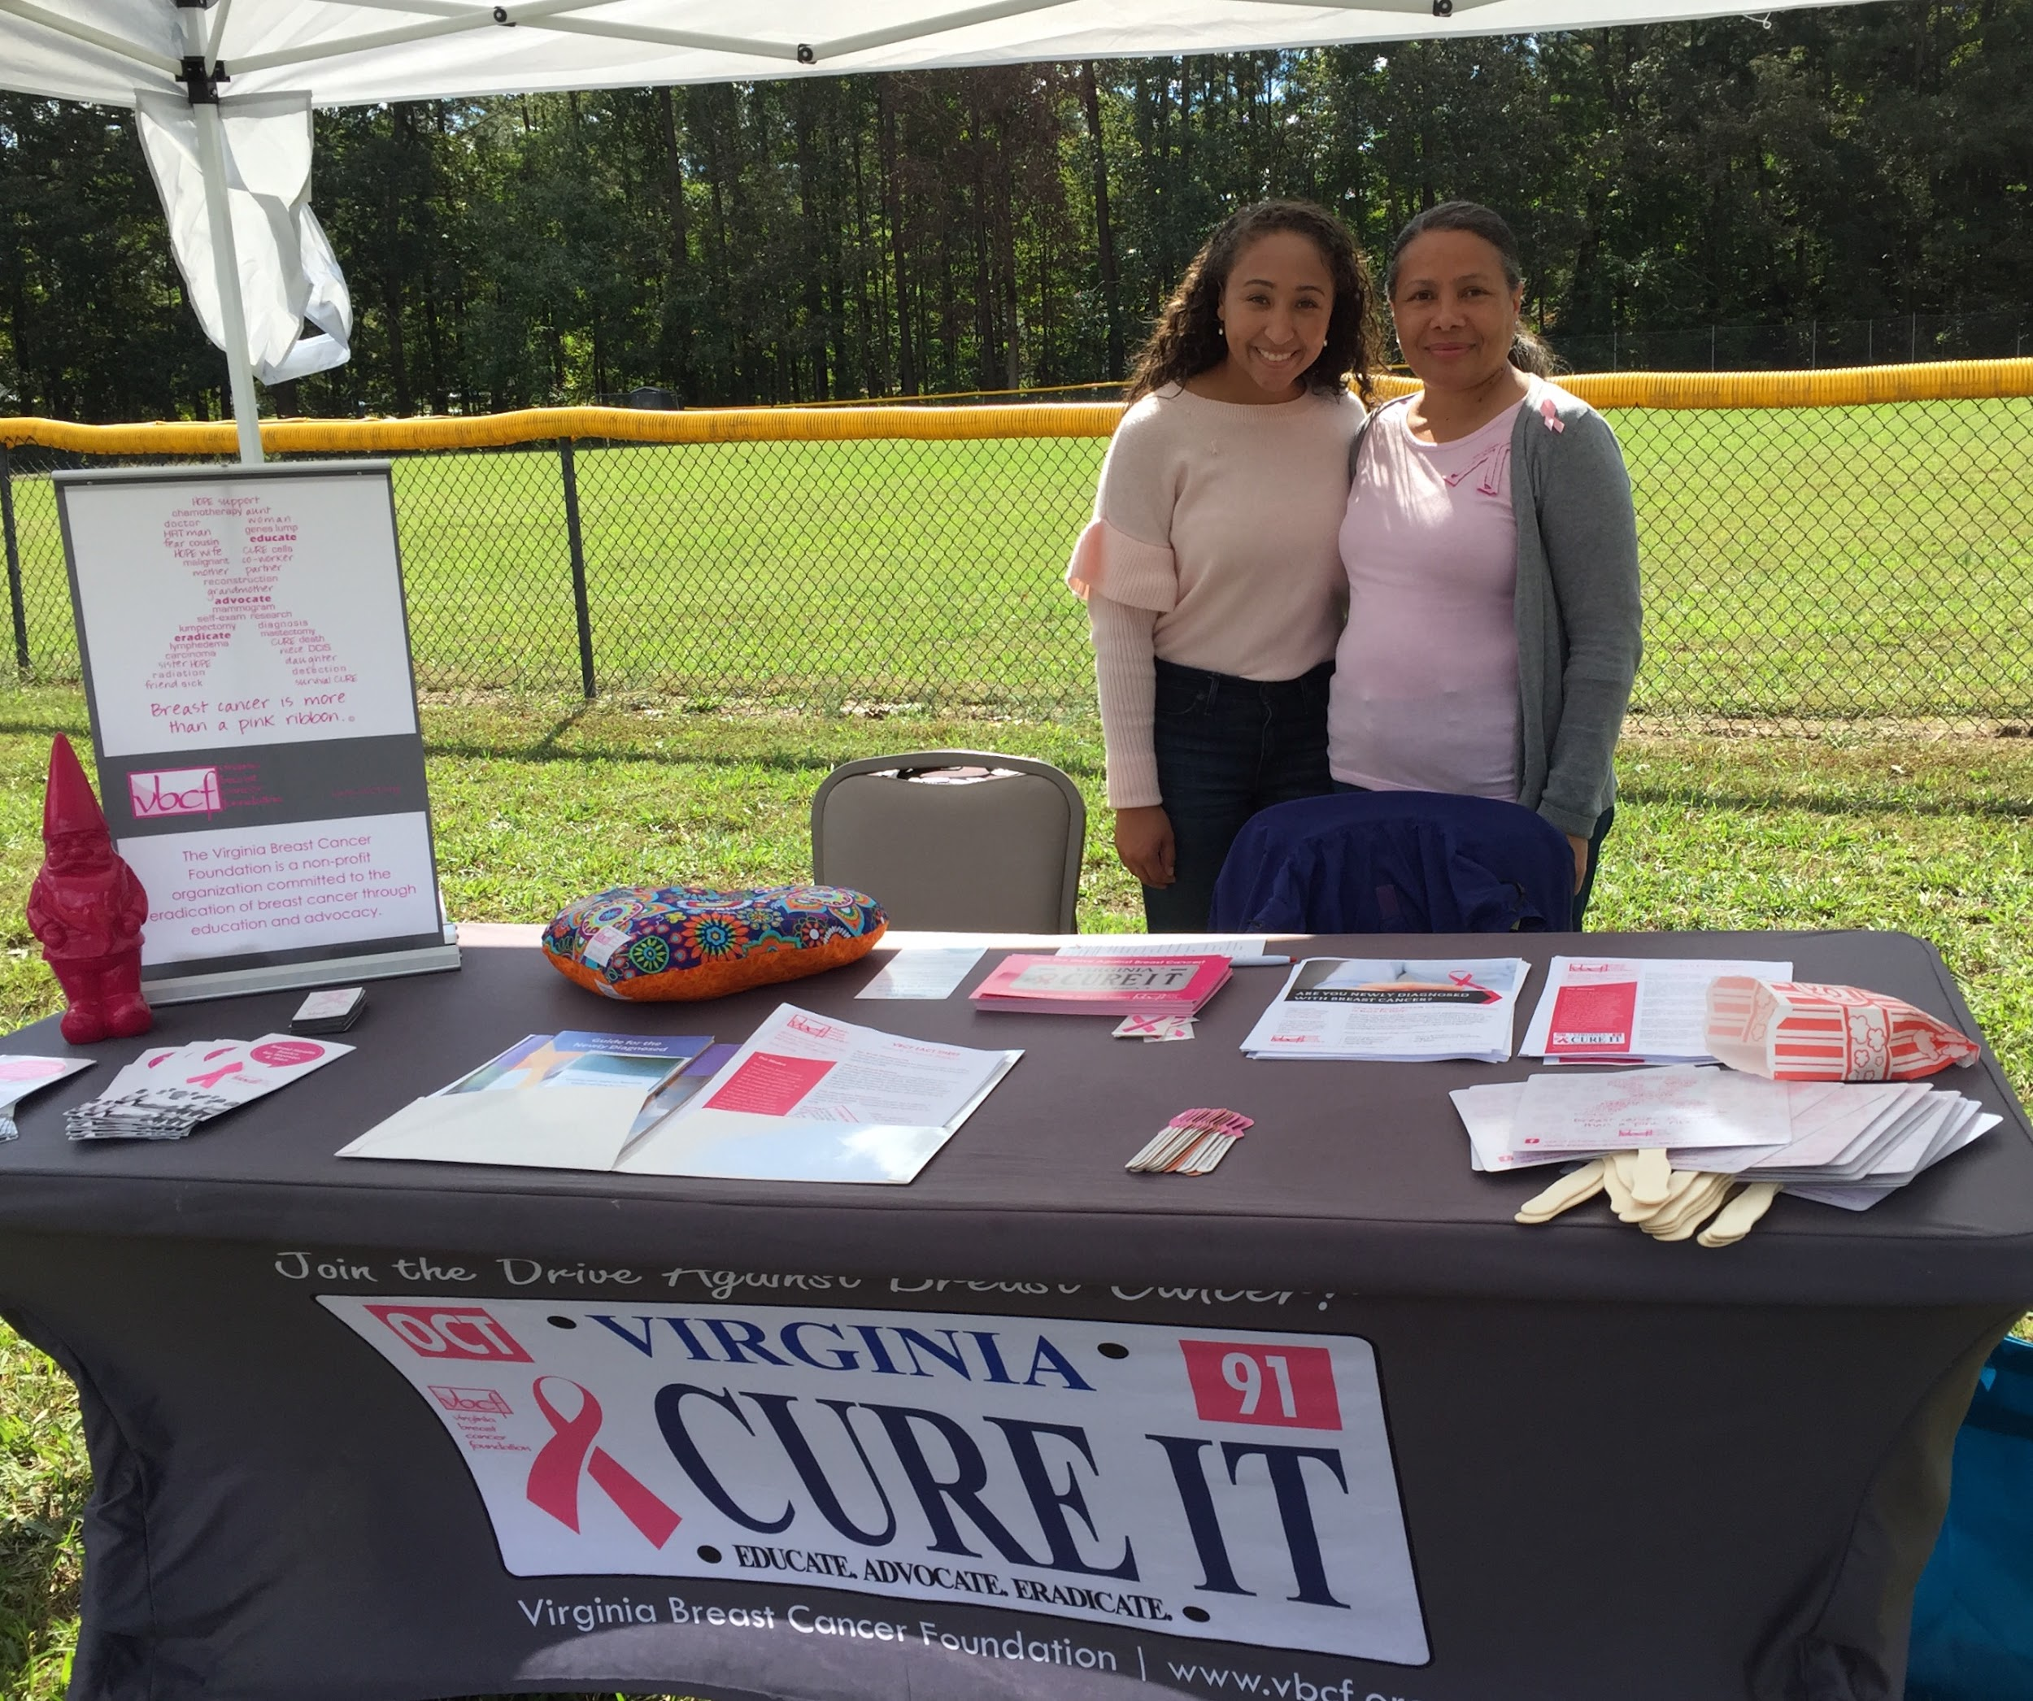
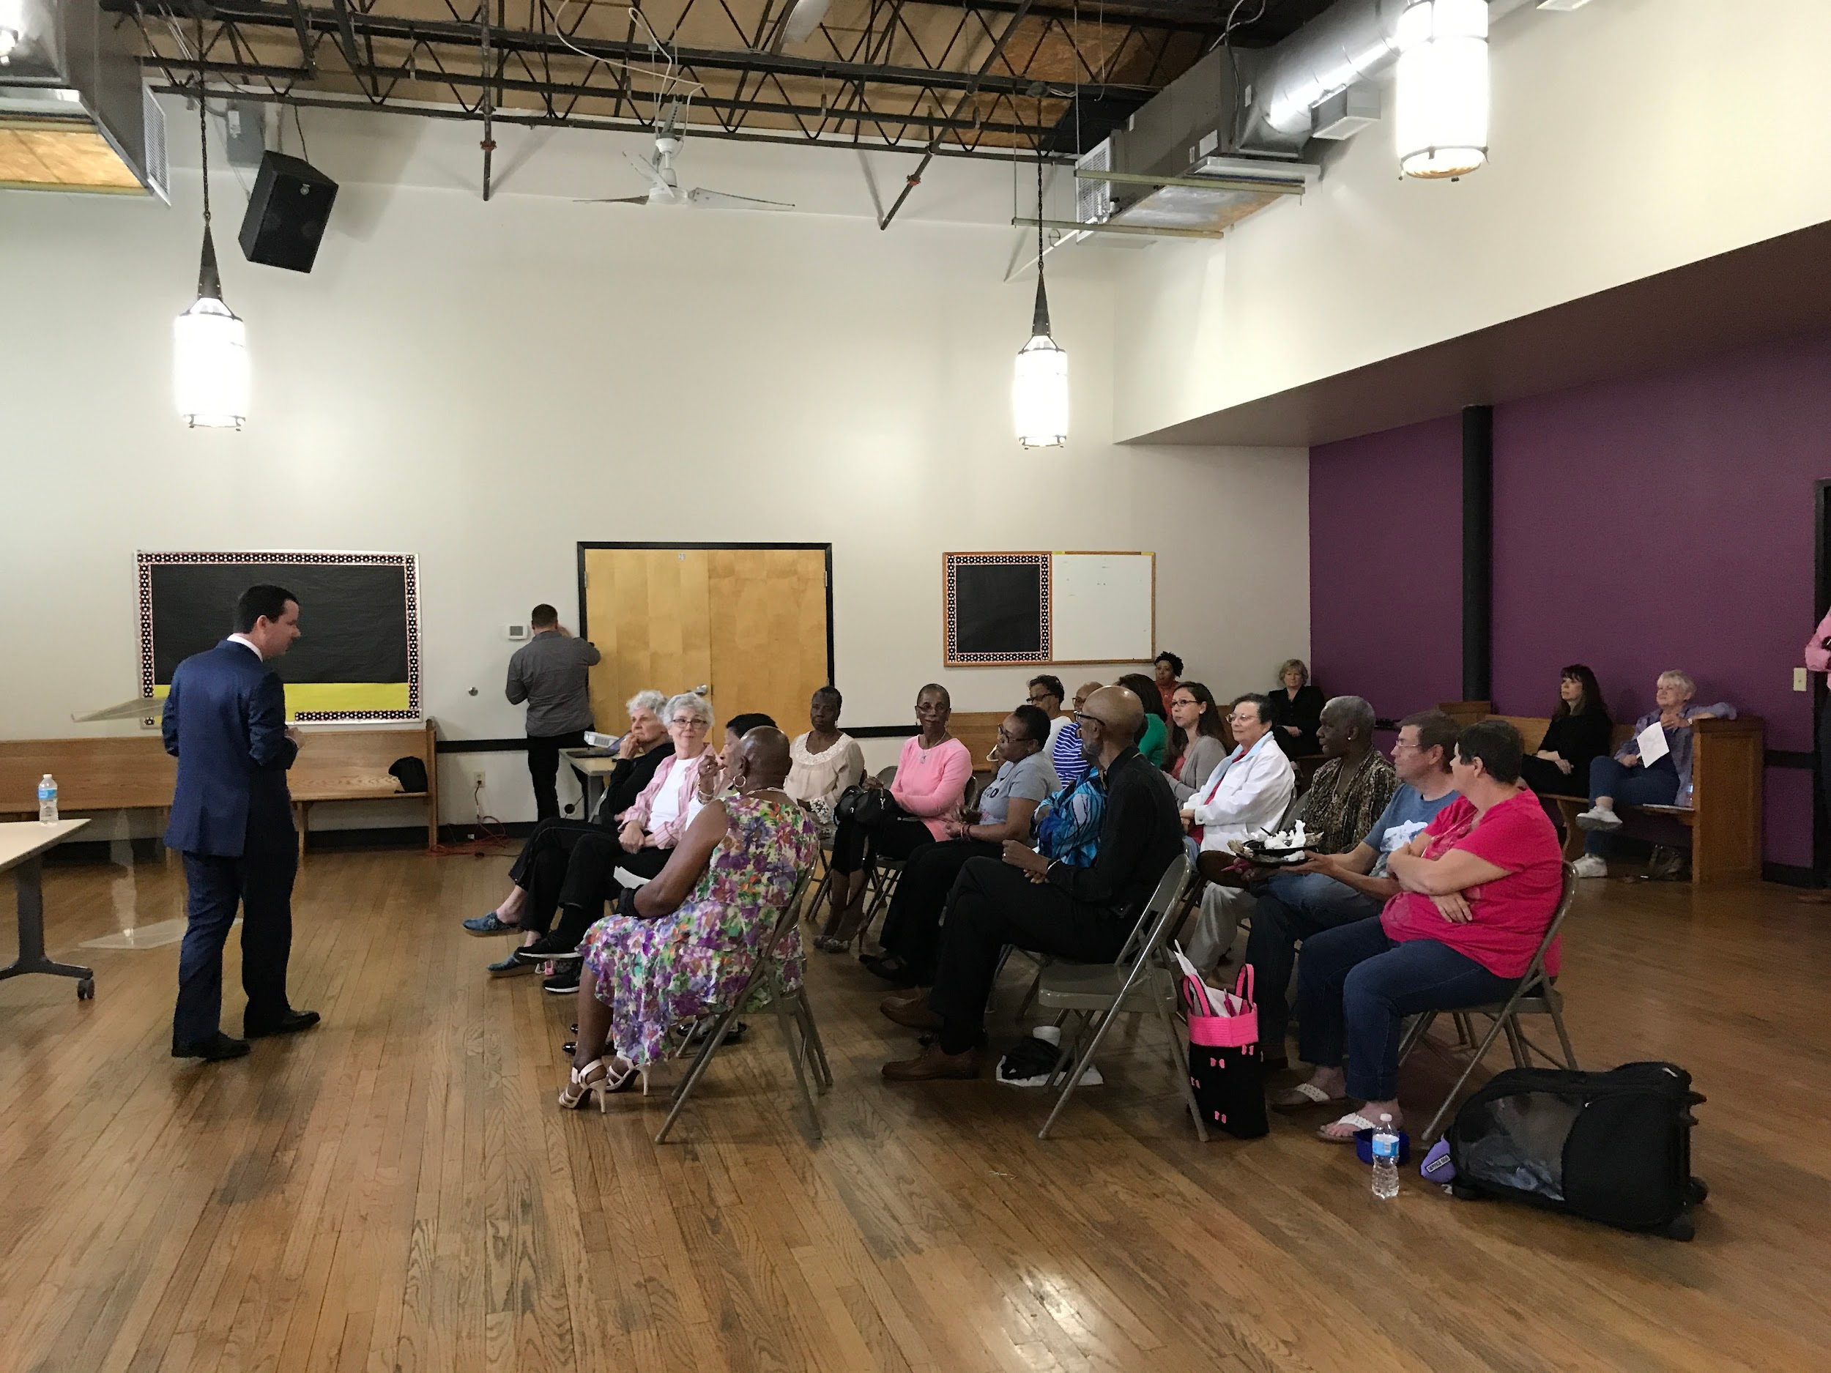
EDUCATION
Notes:
Here are some pictures of volunteers and board members from educational events across the state

Slide 6
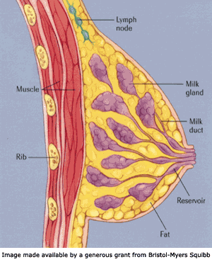
What is Breast Cancer?
Notes:
Definition of breast cancer: Cancer occurs when cells in the body grow, change and multiply out of control. Usually, cancer is named after the body part in which it originated; thus, breast cancer refers to the erratic growth of cells that originate in the breast tissue. Breast cancer can spread to other parts of the body, but will still be referred to as “breast cancer”. For example, if someone has breast cancer that spread to their bones, that doesn’t mean they also have bone cancer. They have breast cancer that has metastasized, or spread, to the bones.

Slide 7
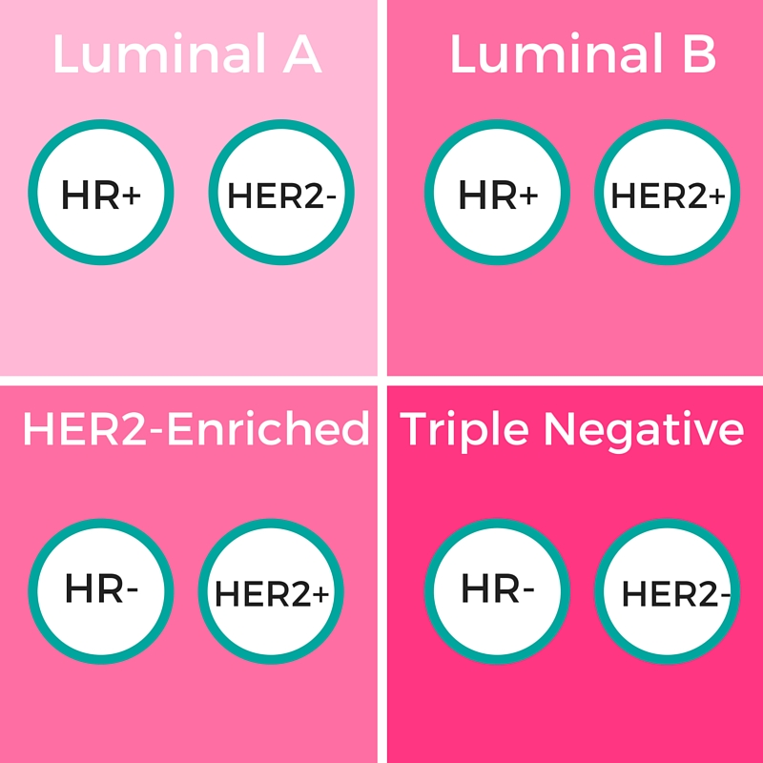
Types of Breast Cancer
Notes:
These are the 4 main types of breast cancer. I know the words and symbols can be intimidating, but what is helpful for you to know is pretty basic. The top two types of breast cancer are hormone sensitive, meaning that they are stimulated by estrogen and/or progesterone, hormones that are present at a high level in the female body. These cancers can actually be treated in part by taking a pill, and maybe no chemotherapy or radiation at all. There is also a protein called HER2 that can cause breast cancers to be more aggressive, but now we also have a medicine that can essentially starve tumors of HER2. The last type of breast cancer is triple negative, meaning it doesn’t have the hormonal receptors or the growth factor receptors of the previous cancer types. You would think that would be a good thing because it means it doesn’t have these known chemicals that make tumors more aggressive, but it’s actually not because we don’t have anything specific to target with triple negative cancer. This type of cancer leads to a poorer prognosis because there are no targeted therapies for it. It is also two times more common in African American women than white women in the US, and more common in women with the BRCA1 gene mutation. There is a lot of research happening now with triple negative, but we still don’t have a lot of specific treatments for this type of breast cancer.

Slide 8

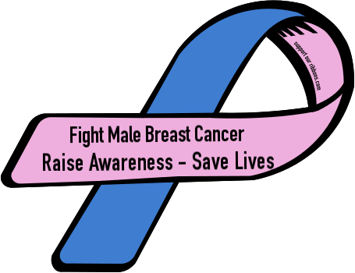
Breast Cancer Statistics 2024
Women: (US)
310,720 new invasive cases
42,250 deaths nationwide
8,180 cases in Virginia; 1,160 deaths
Men: (US)
2,790 new cases
530 deaths
Notes:
Number of diagnoses keeps going up, predicted deaths from breast cancer have actually gone down in 2024.
Invasive case: “Invasive” breast cancer means that the cancer has started to emerge outside of the duct where it originated. Cancers that haven’t left the duct are “noninvasive” and often called ductal carcinoma in situ, or DCIS

Slide 9
How Breast Cancer Is Usually Detected
Self and/or Partner Detection–We ALL have a role to play
Clinical Breast Exam
Mammography
When should you get a mammogram?
Whenever you and your doctor decide!
Breast Ultrasound *
Breast MRI *
Notes:
Know YOUR body. A good time to do this is while you are in the shower or getting dressed. Or, your partner may discover a lump or a change in your breasts.
It is important to know what is “normal” for you.
For certain women at high risk for breast cancer based on the previously outlined criteria, a screening MRI is recommended along with a yearly mammogram.
Breast MRI and ultrasound are not usually used in place of mammography for screening, but as additional tests.
Ultrasound is used to complement other screening tests.
MRI is used in screening high-risk women; to gather more information on an area of suspicion; and to monitor for recurrence after treatment
If you are at a higher risk, talk to your doctor about what screening tools are right for you and when to begin regular screenings

Slide 10
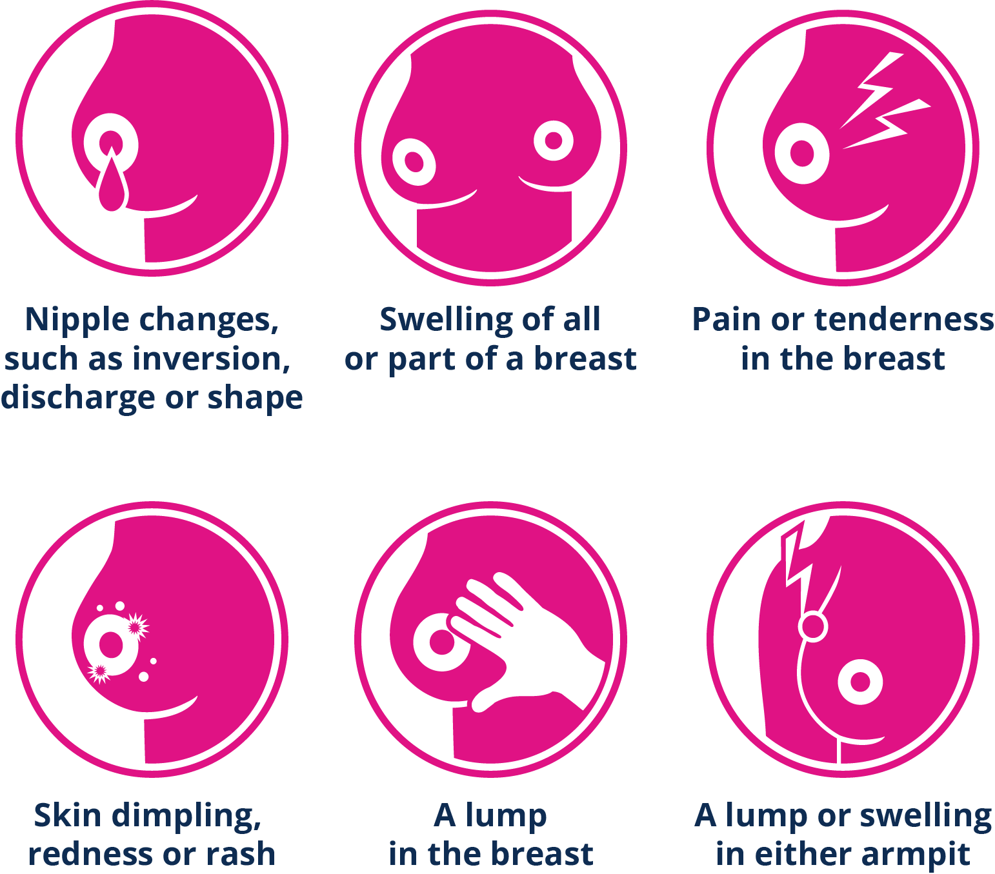
What am I Looking For?
Notes:
A lump or thickening in your breast or under your arm.
Nipple changes: Inverted, crusty, spontaneous bloody discharge, point in different direction.
Dimpling, indentation or orange peel appearance.
Change in breast size, shape or skin color.
A wound, sore spot or break in skin that does not heal.
Change or difference from one breast to the other.
If you notice a change, have it checked by your doctor. Lobes & ducts may become enlarged before each menstrual cycle & during pregnancy in younger women, which is normal, so know your cycle and how your body typically behaves. Most breast tissue is somewhat lumpy or nodular. You just need to know what lumps are usually there and if there is anything new. Also, breast tissue isn’t confined to just your breast. Pretty much everywhere a sports bra touches (except your back) is breast tissue. Trust your intuition. Don’t be embarrassed. Be your own advocate.

Slide 11
What are the Risk Factors for Breast Cancer?
#1 Risk Factor – Being born biologically female!
Genes
Menstrual Factors
Alcohol Use
Body Fat
Notes:
Being born biologically female means that there is a higher level of estrogen and progesterone in the body, which remember are the two major hormonal drivers of breast cancer. Male bodies have these hormones too, just at a much lower concentration.
Even though genetic mutations are no a major factor in breast cancer for everyone, they can make a huge difference for some people. The most common genetic mutations are in the BRCA1 and BRCA2 genes, but they also aren’t the only ones. If you have a lot of premenopausal breast cancer in your family (relatives diagnosed under or around the age of 50) and/or a male relative with breast cancer, make sure your doctor knows about it to see if you qualify for genetic testing.
Having your first menstrual period before the age of 11 or entering menopause before 40 or after 55 can all increase risk of developing breast cancer due to your exposure to estrogen. Some menstrual disorders can also increase risk of developing the disease.
Drinking alcohol can increase the levels of estrogen in our bodies. And it doesn’t matter what “type” of alcohol you drink, wine, beer, etc., because ethanol is in all of them, and ethanol is what increases estrogen levels.
Particularly after menopause, when the ovaries stop producing so much estrogen, our fat cells are the largest source of estrogen in our bodies. There is a lot of research happening in this area, but it seems the type of fat and location of the fat make a difference. Belly fat seems to have the most impact on breast cancer risk.

Slide 12
Risk Factor: Age
Chances that a woman will develop
breast cancer in the next 10 years of her life*
1 in 8
1 in 14
1 in 26
1 in 24
1 in 209
At Age At Age At Age At Age
39 59 69 70 & Older
From Birth to Death
Notes:
This chart illustrates that as women get older, the chance of developing breast cancer increases. This is why it is suggested that women start getting mammograms around age 40, right before the risk of developing breast cancer skyrockets. And this is why those mammograms are so important. Breast cancer is the leading cause of cancer death for women between 20-59.
Age to stop mammograms? Until recently, there was a belief that the benefits of mammography did not outweigh the risks of a false positive after a woman reaches 75. A recent study of 7 million mammograms shows that might not be true. The risk of false positive actually decreases with age, so women should continue to get them after 75, especially if they are generally healthy. For example, my grandmother is 95 and has dementia, she should no longer be getting mammograms. My other grandmother is 84 and generally in good health (in addition to being a breast cancer survivor). She should still be getting mammograms.

Slide 13
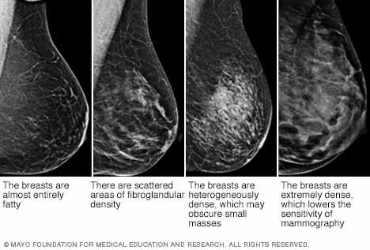
Risk Factor: Dense Breasts
50% of tissue shows “white” on mammogram
Harder to spot cancerous tissue
Increases risk of cancer
3D mammography (tomosynthesis)
Notes:
Having dense breast tissue can also increase risk for developing breast cancer, and make any potential cancer harder to find. The issue is that healthy, fibrous breast tissue shows up white on a mammogram, but so does potentially cancerous tissue. The breast on the far left is made almost completely out of fatty tissue. The breast on the right is very dense. When we are younger, our breasts are more dense, but transition into mostly fatty tissue as we age. Breast density is another reason why mammograms aren’t really recommended until age 40 for most people: if your breasts are very dense, a mammography screening may not be able to show anything, meaning you will need further testing, and that just isn’t necessary if you aren’t at higher risk for the disease and you aren’t experiencing symptoms. For women with dense breasts, 3D mammograms or tomosynthesis is recommended. The patient experience doesn’t change much, but the machine takes pictures in a different way that makes it easier for the radiologist to tell the difference between healthy, fibrous tissue and potentially cancerous tissue.
-3D mammograms have a 40% decrease in callbacks and an increase in the detection of invasive cancer compared to 2D mammograms
-3D mammograms covered by Tricare under provisional coverage until 2024

Slide 14

Differences Between Groups
Racial/ethnic differences
Sexual and Gender Minorities
Notes:
For a long time, white women had the highest chance of developing breast cancer, now diagnosis of African American women has risen to almost the same rate as White women. This rise of African American women being diagnosed has been particularly apparent in the South
African Americans: African American women are often diagnosed younger and at a more advanced stage of cancer than white women. We now know that African Americans also are more likely to get a more aggressive form of breast cancer called Triple Negative Breast Cancer for which there is no targeted therapy, but does seem to respond well to chemotherapy. African Americans are 41% more likely to die from breast cancer than white women. They are also more likely to experience a delay between consultation and diagnosis, and diagnosis and treatment, though why is not entirely clear. Black cancer survivors may be more likely than white survivors to wind up in debt or forego treatment due to cost. Most of these differences don’t have anything to do with the physical state of being Black, but the how society affects people who are Black in the US. African American girls also tend to begin menstruation earlier than white girls. In Virginia, African American women and white women get their mammograms at the same rate, yet African American women are still more likely to die.
Asian Americans: In the past there has been the idea that Asian American women are at lower risk for breast cancer, but “Asian Americans who immigrated to the US at least 10 years ago, the risk of BC is 80% higher than that of new immigrants. Those born in US, risk is similar to Caucasian women. “ (from National Asian Women’s Health Organization)
Hispanic women: Breast cancer is the most commonly diagnosed cancer among Hispanic/Latina women. Though they are diagnosed 40% less often than non-Hispanic women, their cancer is frequently found at a later stage and is more aggressive and invasive. Leading cause of cancer death in Hispanic women. Though cancer incidence and death rate due to cancer among Hispanic people is lower than non-Hispanic, evidence shows that among Hispanic people who migrate to U.S., subsequent generations have cancer rates similar to non-Hispanics. (from American Cancer Society)
In fact, in the last 30 years the gap in mortality from breast cancer between racial groups has widened.
There has not been a lot of research on breast cancer in transgender people, but people from the Sexual and Gender Minority community have historically, and continue to, have difficulty when interacting with the medical community. This can affect consistency of treatment, emotional well being of patients, and even if the person seeks medical care in the first place. For people who are transgender, for example, there are questions as basic as whether they should receive regular mammograms and the emotional implications of that decision.

Slide 15
These things DO NOT cause breast cancer...
Deodorant/anti-perspirant
Wearing/not wearing a bra
Underwire bras
Binding breasts
Abortions
Having larger breasts
Caffeine
Living near power lines
Tattoos on/near chest
Cell phones
Notes:
These have all been studied many times and there has been no correlation found between these activities, products, or situations and the diagnosis of breast cancer.

Slide 16
Reduce Your Risk
There is no way to PREVENT breast cancer, but these things could help:
Exercise regularly
Get enough sleep
Maintain a healthy waist/hip ratio (better measure than BMI)
Eat plenty of fruits, vegetables and foods with fiber
Don’t smoke
Limit alcohol intake to no more than 3 drinks /week
Breastfeeding
Medications to reduce risk if high risk
Avoid exposure to pesticides & chemicals
Notes:
Exercise: It’s not just the weight; it’s the fat and the physical activity. Exercise keeps your cells healthy, which makes it easier for your cells to shut down abnormal growth
Get a good night’s sleep. Some experimental studies have shown that melatonin can inhibit tumor growth, and people with frequently disrupted sleep, like night shift workers and flight attendants, have a higher incidence of breast cancer
The American Medical Association is moving away from BMI as a personal health indicator because it honestly doesn’t make much sense. Long story short, it was based on white men in Europe and just applied to everyone else and was never meant to be a health indicator in the first place. Having a “healthy” waist to hip ratio is seen as a better indicator of health as it measures the amount of belly fat, which is correlated with increased rates of disease.
Eating plants can also keep our cells healthy
Smoking in general is bad for our health, and in particular can make surgical outcomes after breast cancer worse because smoking inhibits the healing process after surgery
It is recommended that if you do drink alcohol to try and limit it to no more than 3 drinks per week. I will also tell you that my grandmother, who was a breast cancer survivor, had a gin and bitter lemon every day at 5pm for about 60 years. If we could somehow discover that it was her daily drink that gave her breast cancer, I doubt she would have changed a thing.
Breastfeeding for at least 12 months has been shown to lower risk of breast cancer. This can be over multiple births as well, so if you have 3 babies and breastfeed each of them for 4 months, that counts!
There are medications that you can take to reduce your risk of developing breast cancer, particularly if you are at high risk.
Exposure to pesticides and chemicals–most applicable to people who have industrial exposure, people like hair stylists, janitorial workers, landscaping, etc. Unfortunately there has not been a lot of research into environmental causes of breast cancer, so if you have a job that regularly exposes you to harsh chemicals, take all the precautions you can.

Slide 17
Access

Slide 18
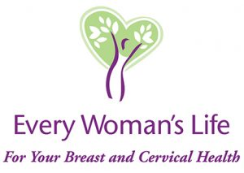
Having a mammogram is uncomfortable,
BUT having one too late can really hurt.
Every Woman’s Life Program
1-866-EWL-4YOU (1-866-395-4968)
Notes:
If you have health insurance, mammograms are generally available for free. If you don’t have health insurance, Virginia has a program called Every Woman’s Life where people who are uninsured can receive free breast and cervical cancer screenings. Program may also cover treatment if diagnosed with breast or cervical cancer.

Slide 19
Diagnostic Testing
Mammograms are free, follow-up tests are not
Southwest Diagnostic Fund
Richmond Diagnostic Fund–Coming Soon!
Diagnostic funds are a Band-Aid, we are working to solve the problem through policy change
Notes:
Breast cancer can’t be diagnosed from just a mammogram. A second, diagnostic mammogram is usually required, as well as a biopsy, and sometimes ultrasound and MRI. These tests together can cost hundreds of dollars, even $1,000, even with health insurance. When faced with this cost some women might say “I don’t have a lot of cancer in my family, I don’t feel a lump, I’m probably fine” and will wait. We don’t want people to wait, so VBCF has created a diagnostic fund where we partner with providers to cover the costs of diagnostic testing for people who can’t afford the testing. Most of our partners are in Southwest or Western Virginia, but we are hopeful to announce a Richmond partnership soon. This diagnostic fund is a short-term fix, so we are working to change state policy and require insurance companies to cover diagnostic tests at no out-of-pocket costs, just like they do with mammograms.

Slide 20
Join the Fight! Volunteer -
YOU CAN make a difference!
www.vbcf.org | 800-345-VBCF
Notes:
Help VBCF achieve our goals – there is something for everyone!
Join us at our state and national advocacy days
Volunteer your time – serve on a committee, join a chapter, become an education volunteer, help raise awareness locally, help us raise funds, etc.
Distribute educational materials
Make a donation – VBCF accepts in memory of and in honor of donations, general donations, special event proceeds, etc.
get a pink ribbon license plate
(Add in quilt stuff when launched)
All funds donated to VBCF stay in Virginia to help Virginians
VBCF will make good use of your time, talents and treasures. Join VBCF today and help us fight breast cancer!

Slide 21
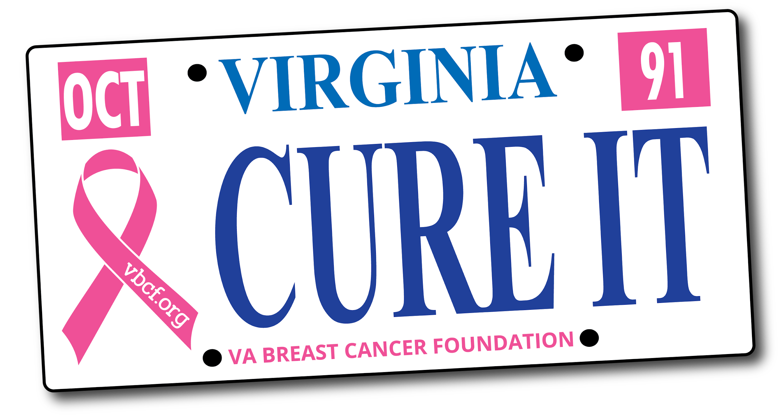
Available at the DMV now!
Notes:
The pink ribbon license plates you see driving around actually help to fund us! We get $15 for every license plate registered, so you can give back and spread awareness at the same time!

Slide 22
“Grant me the serenity to accept the things I cannot change, the courage to change the things I can, and the wisdom to know the difference.”
Reinhold Niebuhr
“If I am not for myself, who will be for me? But if I am only for myself, what am I? And if not now, when?” Hillel the Elder
“I’m no longer accepting the things I cannot change. I am changing the things I can no longer accept.” Angela Davis
Notes:
Here are some inspirational quotes that you can take with you and inspire you to do what you can

Slide 23
Thank you! Questions?
Erin Steigleder, MSW
(804) 285-1200
erin@vbcf.org

