Slide 1
Virginia PCO Stakeholder Office Hours
October 21, 2025
Anna Riggan
Acting Primary Care Office Director/ Shortage Designation Manager
Liza Root
National Health Service Corps and HPSA Specialist

Slide 2
Agenda
Health Professional Shortage Area Refresher
T/A for monitoring clinic designations in the Shortage Designation Management System (SDMS)-Demo
National Shortage Designation Update – Information and Effects
T/A for Collecting Poverty Data for UDS
Proposed Changes to MUA/Ps
Contact Information
Questions/Answers
Let’s talk about…

Slide 3
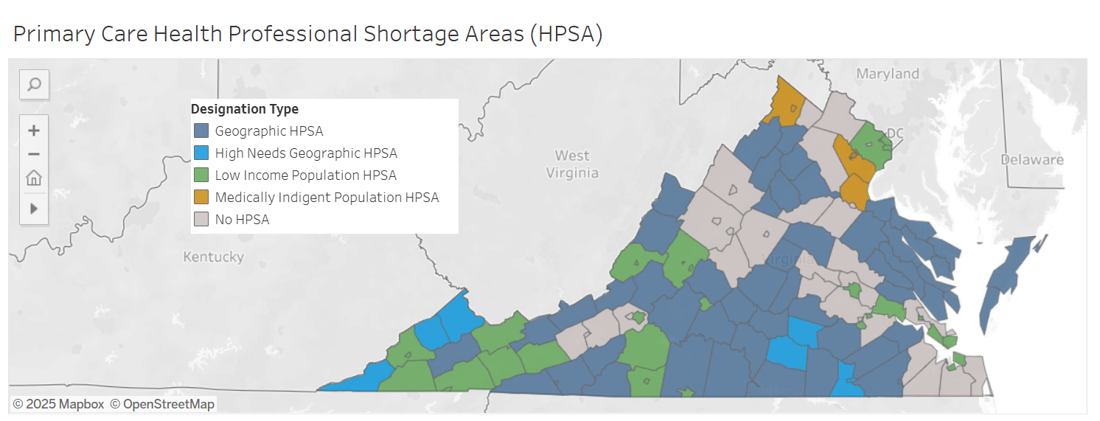
Federal shortage designation addresses health care workforce shortages and access to care
Virginia uses federal designation processes to identify areas and population groups that are experiencing a shortage of health professionals.
Virginia’s Primary Care Office (PCO) collaborates with health facilities and communities to submit designation applications.
The federal government approves designations and uses them to distribute resources to improve access to care.
https://public.tableau.com/app/profile/anna.riggan2894/viz/VirginiaPrimaryCareHPSAs-2025/Dashboard1#1
https://public.tableau.com/app/profile/anna.riggan2894/viz/VirginiaMentalServicesHPSAs-2025/Dashboard1#1
https://public.tableau.com/app/profile/anna.riggan2894/viz/VirginiaDentalHPSAs-2025/Dashboard1

Slide 4

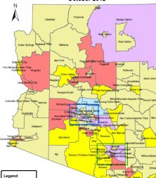







Shortage Designation At a Glance
Congress
State PCOs
State Health Departments
State PCOs
Communities seeking designations
Shortage Designation Branch
Communities, Healthcare Delivery Sites, and Providers
BPHC
Grants Management Specialists
Government Stakeholders

Slide 5
The PCO supports practices, providers, and communities in federal designation processes
Provides technical assistance and other tools to help collect data.
Conducts assessments on what options are available.
Determines the best designation strategy.
Prepares requests and updates for review.
Follows up on the application submission.
Informs those affected by any changes in the designation status.
Provides information on any changes in the federal rules or state programs and services to determine their impact on practices and communities.

Slide 6







About Health Professional Shortage Areas
HPSA
Health Professional Shortage Area
Health professional shortage
Providers
Discipline/field
Dental Health
Primary Care
Mental Health
Care setting
Geographic Area
Facility Type
Population Group

Slide 7
Federal programs use HPSA scores to distribute health care workforce resources
Primary Care
Shortage Designation Option | National Health Service Corps (NHSC) | Nurse Corps | Health Center Program | IHS Loan Repayment Program | CMS HPSA Bonus Payment Program | CMS Rural Health Clinic Program | J-1 Visa Waiver
Geographic HPSA | x | x |  | x | x | x | x
Population HPSA | x | x |  | x |  | x | x
Facility HPSA | x | x |  | x |  |  | x
Dental Care
Shortage Designation Option | National Health Service Corps (NHSC) | Nurse Corps | Health Center Program | IHS Loan Repayment Program | CMS HPSA Bonus Payment Program | CMS Rural Health Clinic Program | J-1 Visa Waiver
Geographic HPSA | x |  |  | x
Population HPSA | x |  |  | x
Facility HPSA | x |  |  | x
Mental Health
Shortage Designation Option | National Health Service Corps (NHSC) | Nurse Corps | Health Center Program | IHS Loan Repayment Program | CMS HPSA Bonus Payment Program | CMS Rural Health Clinic Program | J-1 Visa Waiver
Geographic HPSA | x | x |  | x | x |  | x
Population HPSA | x | x |  | x |  |  | x
Facility HPSA | x | x |  | x |  |  | x
https://public.tableau.com/app/profile/anna.riggan2894/viz/IncentiveProgramsforSites/Dashboard1

Slide 8
HPSA Designations Consider:
All the people in a geographic area (geographic designation)
A particular population in an area:
Low Income (under 200% of federal poverty level)
Migrant and Seasonal Farmworkers
Homeless
Medicaid Eligible Populations
A certain type of facility: Federally Qualified Health Centers (FQHC), some Rural Health Clinics, Federal and State Correctional Facilities and Tribal Health Facilities.
Notes:
FQHCs and LALs are scored based on the low-income population (200% of the Federal Poverty Level) for the service area identified via the UDS.

Slide 9
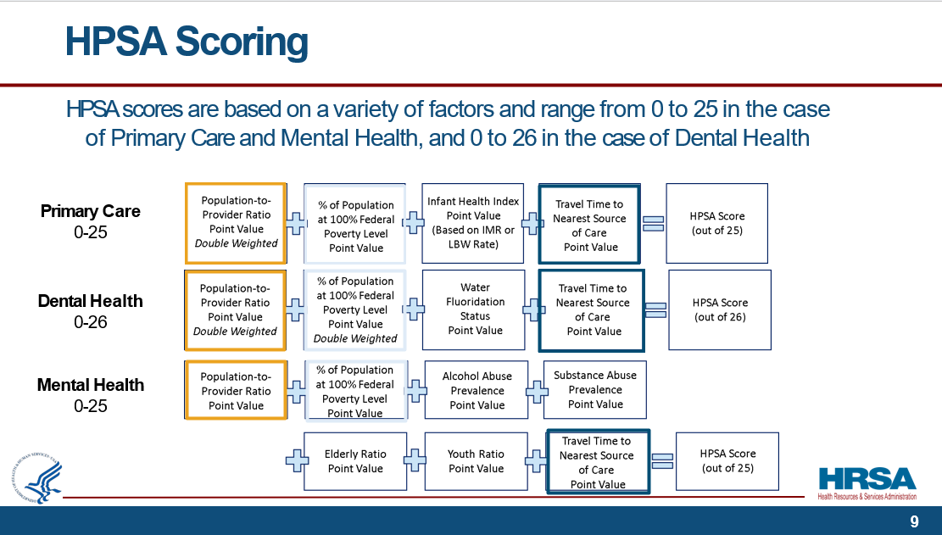
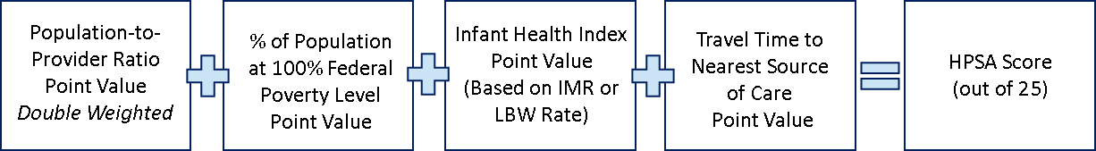
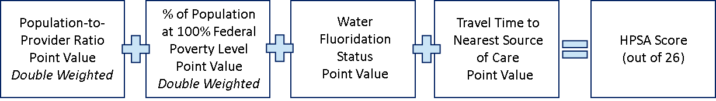
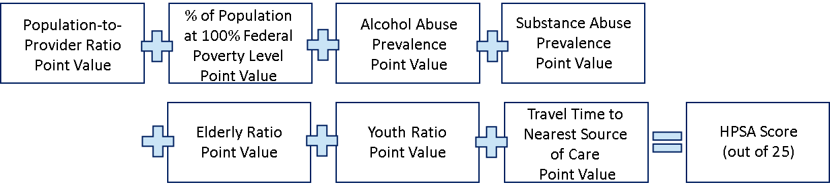
HPSA Scoring
HPSA scores are based on a variety of factors and range from 0 to 25 in the case of Primary Care and Mental Health, and 0 to 26 in the case of Dental Health
Primary Care
0-25
Dental Health
0-26
Mental Health
0-25
Notes:
The higher the score the greater the need.

Slide 10
Community Level vs. Auto-HPSA: Populations and Service Areas
https://bhw.hrsa.gov/workforce-shortage areas/shortage-designation/scoring
Community Level HPSAs (Geographic, Population, and High Needs) populations are determined by the PCO based on the needs of the community and likelihood of approval by HRSA.
The proposed HPSA must be a census designated area, no smaller than a census tract.
FQHCs and LALs are scored based on the low-income population (population living at or below 200% of the Federal Poverty Level) for the Service Area identified via the UDS.
The Service Area is drawn based on the patient zip codes as reported by the FQHCs and LALs. A ZCTA crosswalk is applied to fit the map into the census tract convention.

Slide 11

Pause for questions?

Slide 12


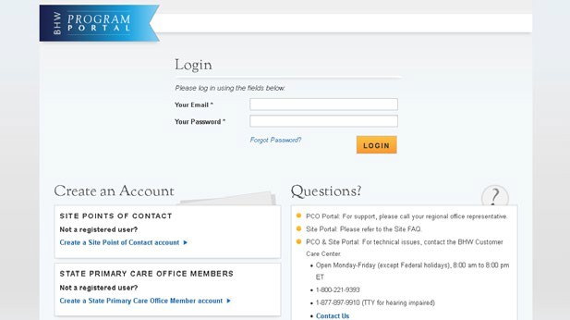
Shortage Designation Management System
ACS
CMS
CDC
DATA
… is an application tool used to manage designations.
… uses standard data sets to calculate designations.
… is written based on regulations.
Notes:
SDMS is HRSA' database used to manage, create, and update designations, and to manage and update provider records in support of designations.

Slide 13
What is the Source Data Update (SDU)?
HRSA updates the datasets we use to designate and score HPSAs on a regular basis.
Census, Centers for Disease Control and Prevention, ESRI ARC GIS maps, and Uniform Data System (UDS)
Current data sets: 2023
Not automatically applied to designated HPSAs
Data
PCOs – update/apply
HRSA – NSDU
Maps
Reports
SDU

Slide 14

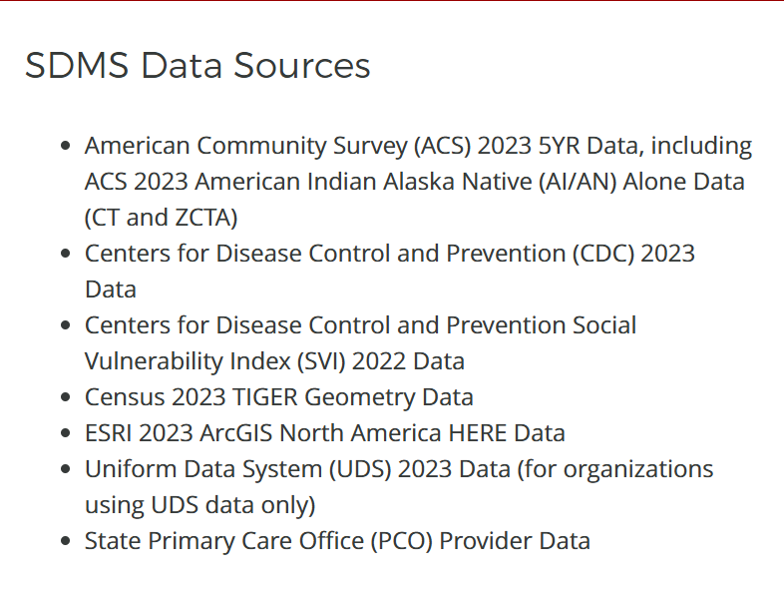
Checking clinic status and accessing data in SDMS: Demo
https://programportal.hrsa.gov/extranet/public
https://support.google.com/accounts/answer/1066447?hl=en&co=GENIE.Platform%3DAndroid&sjid=4636782500599490221-NA

Slide 15
Pause for questions?

Slide 16







What is the National Shortage Designation Update (NSDU)?
HRSA initiated update of Health Professional Shortage Areas Includes Primary Care, Dental Health, and Mental Health HPSAs
Geographic, Geographic High Needs, Low Income Population, and Automatically Designated Facility HPSAs
Uses new source data
Previews of affected designations released in the Shortage Designation Management System (SDMS) monthly
Completed: September 23, 2025

Slide 17
NSDU By the Numbers: Scope For Virginia
Of the 390 active HPSAs in Virginia 306 needed to be reviewed for the NDSU:
~9,500 Provider updates (started in September of 2024)
189 Geographic, High Needs, and Low-Income community level HPSAs (review started after March 2025 the HRSA Source Data Update)
117 Auto-HPSAs (review started after March 2025 the HRSA Source Data Update)
81 FQHCs and FQHC-LALs
18 Rural Health Clinics
18 ITUs (provider updates only)

Slide 18
How might the NSDU affect Auto-HPSAs in my area?
Regulatory Criteria Analysis
Designation Status Update
New Census, CDC, ESRI, UDS
Data Analysis
HPSA Score Update
Not affected: HPSA ID
18

Slide 19
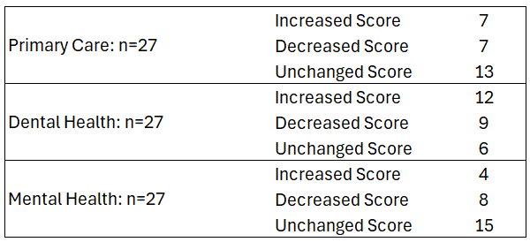
NSDU By the Numbers: Breakdown of Virginia Results
FQHCs and FQHC-LALs (27 Clinic Networks; 3 HPSAs each; total of 81)
Notes:
Geo, HN, and Low-Income Population HPSA results: Proposed for Withdrawal Yes = 13 No = 176; Passes NSDU based on provider Record updates only Yes = 93 No = 96

Slide 20
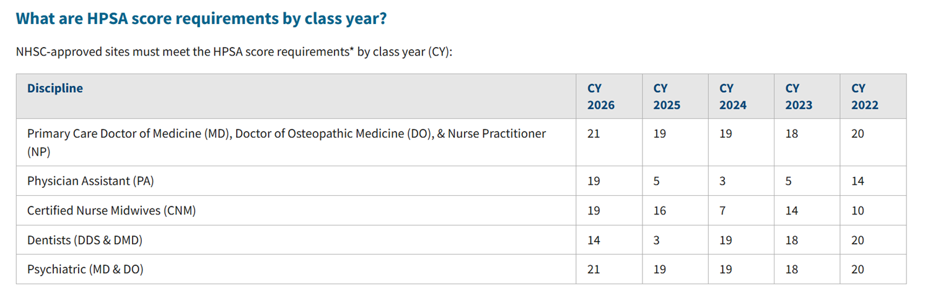
HPSA Score Thresholds: NHSC Scholar Service
https://nhsc.hrsa.gov/scholarships/requirements-compliance/jobs-and-site-search/hpsa-score-class-year
https://nhsc.hrsa.gov/scholarships/requirements-compliance/jobs-and-site-search

Slide 21
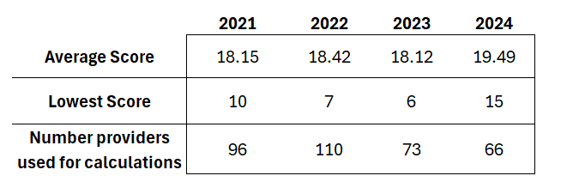
NSDU By the Numbers: NHSC Estimated Competitive Scores
*Based on start of obligation start date of June to May in annual NHSC Field Strength Report

Slide 22
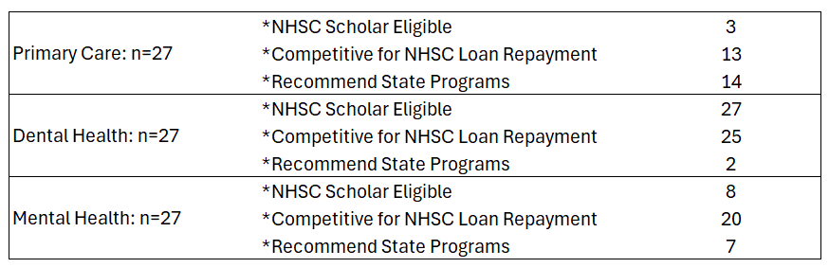
NSDU By the Numbers: NHSC Eligibility
FQHCs and FQHC-LALs (27 Clinic Networks; 3 HPSAs each; total of 81)

Slide 23
Helpful Reminders for Federal Incentive Programs
FQHCs can use either their facility score OR the community level HPSA score for the surrounding area, whichever is higher.
NHSC-LRP has sub-programs that support borderline scores:
https://nhsc.hrsa.gov/loan-repayment/nhsc-all-loan-repayment-programs-comparison
NHSC Substance Use Disorder Workforce Loan Repayment Program
NHSC Rural Community Loan Repayment Program
NHSC Student to Service Program only requires a HPSA score of 14 for service eligibility: https://nhsc.hrsa.gov/loan-repayment/nhsc-students-to-service-loan-repayment-program
Nurse Corps Scholarship and LRP only require a HPSA score of 14 (for Primary Care OR Mental Health) https://bhw.hrsa.gov/funding/apply-loan-repayment/nurse-corps

Slide 24
Pause for questions?

Slide 25

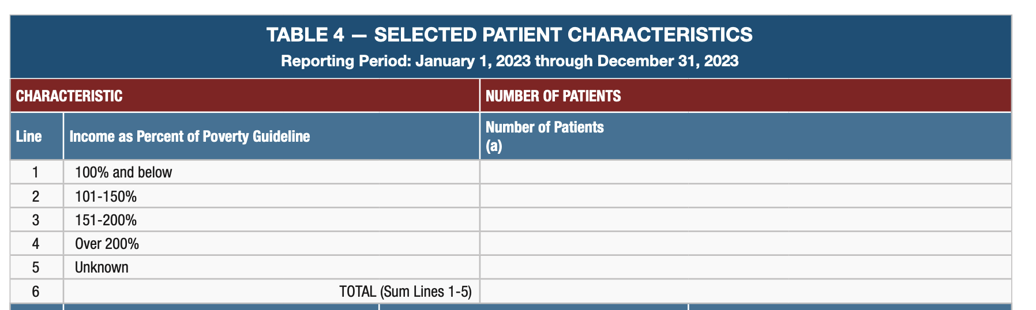
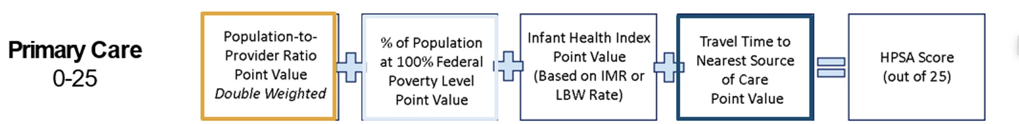
UDS used to calculate poverty levels in HPSA scores

Slide 26
Pause for questions?

Slide 27
Proposed MUA/P Changes
https://paragoninstitute.org/private-health/where-are-provider-shortages-reassessing-outdated-methodologies/

Slide 28

What can communities and stakeholders do?
Gather information
Continue to learn about HPSAs
Talk to your State’s Primary Care Office
Write to HRSA
Visit the HRSA Data Warehouse
Join Association of Clinicians for the Underserved (ACU) https://clinicians.org/
25

Slide 29
Helpful links
Website | URL
HPSA Regulations | https://www.ecfr.gov/current/title-42/chapter-I/subchapter-A/part-5
HPSA Scoring | https://www.federalregister.gov/documents/2003/05/30/03-13478/criteria-for- determining-priorities-among-health-professional-shortage-areas https://www.federalregister.gov/documents/2012/01/10/2012-223/criteria-for- determining-priorities-among-correctional-facility-health-professional-shortage-areas https://www.vdh.virginia.gov/health-equity/hpsa-101/
HPSA Find | https://data.hrsa.gov/tools/shortage-area https://data.hrsa.gov/tools/shortage-area/by-address

Slide 30
Final questions?

Slide 31
Contact Information for the Virginia Primary Care Office
Anna Riggan
Acting Primary Care Office Director/
Shortage Designation Manager
anna.riggan@vdh.virginia.gov
Liza Root
National Health Service Corps and HPSA Specialist
Liza.Root@vdh.virginia.gov
31

Slide 32






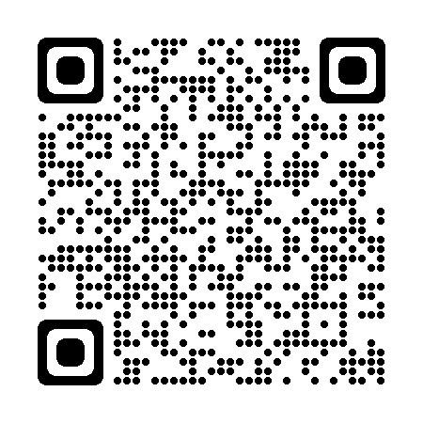
Connect with HRSA
www.HRSA.gov
Sign up for the HRSA eNews
FOLLOW US:
View current HRSA openings:
32

