Slide 1
Virginia Secure Commonwealth Panel Health and Human Resources Subpanel
December 13, 2016

Slide 2
Epidemiology Updates
Zika status update
Hepatitis A Outbreak
Influenza

Slide 3
General Zika Virus Updates
On November 18, 2016, the World Health Organization declared the end of the Public Health Emergency of International Concern stating that Zika remains a “significant enduring public health challenge requiring intense action.”
As of December 7, 2016,
there have been 4,575 cases of Zika virus disease in the United States and DC.
there has been one case of locally acquired Zika virus disease reported in Texas. All other locally acquired cases (N=184) have been reported in Florida.
Notes:
On Nov 18, 2016: WHO declared the end of the Public Health Emergency of International Concern. Because research has now demonstrated the link between Zika virus infection and microcephaly, the Emergency Committee felt that a robust longer-term technical mechanism was now required to manage the global response. As a result, the Emergency Committee felt that Zika virus and associated consequences remain a significant enduring public health challenge requiring intense action but no longer represent a Public Health Emergency of International Concern as defined under the International Health Regulations. http://www.who.int/mediacentre/news/statements/2016/zika-fifth-ec/en/
On November 28th, 2016, Texas reported its first case of locally acquired Zika virus disease. As of December 7th, no other locally acquired cases have been reported in Texas, all other locally acquired cases (N=184) have been reported in Florida. Further, as of December 7th, there have been 4,575 cases of Zika virus disease in the United States and DC.

Slide 4
Zika Virus Updates in Virginia
Virginia’s local health districts ceased targeted mosquito surveillance for Zika virus on October 31, 2016.
On November 30, 2016, the Virginia Department of Health adopted CDC’s new definition of Zika virus disease cases.
Zika Virus Clinician Forum scheduled for May 2017
Continued response efforts to focus on
Pregnancy registry coordination
Infant testing criteria
Travelers going to Zika-affected areas
Notes:
On October 31st, 2016, Virginia’s local health departments ceased targeted mosquito surveillance for Zika virus. Currently, VDH is preparing for next season by developing trainings for environmental health staff, purchasing supplies to support mosquito trapping at local health districts, and securing funding to continue support for mosquito surveillance efforts across the state.
On November 30th, VDH adopted CDC’s new case definition for Zika virus disease and Zika virus infection. The new case definition has been applied to all Virginia residents tested for Zika virus. This information will be updated to the VDH external website by the 7th of each month. The following slide shows the case counts for all residents tested for Zika virus.
VDH is scheduled to hold a Zika Clinician Forum in May of 2017. The primary focus of this forum will be to provide clinicians with the guidance and resources needed to assist with the care and treatment of patients with Zika virus and also to address the risk associated with Zika virus, including family planning.
VDH continues to focus response efforts on coordination with pregnant women with Zika virus, addressing risk to infants, including ensuring infants affected by Zika virus receive appropriate testing, and lastly, continued efforts are focused on travelers going to Zika-affected areas.

Slide 5
Testing Virginia Residents for Zika Virus
2,022
Virginia Residents being Tested for Zika Virus Infection between 1/29/2016 and 12/03/2016*
Virginia Residents being Tested by Region
Disease Case Status† | Num | %
Confirmed/Probable Case | 105 | 5
Not a case | 1,645 | 81
Test results pending | 272 | 13
Sex and Pregnancy Status§ | Num | %
Male | 239 | 12
Female | 1,783 | 88
Pregnant | 1,548 | 87
Non-pregnant | 235 | 13
* This excludes 76 (4%) Virginia residents who were approved for, but then declined testing
† Disease case status is based on 2016 CDC/CSTE Zika Virus Disease and Zika Virus Infection Case Definition
§If pregnancy status was unknown, then pregnancy status was classified as non-pregnant.
Notes:
This slide shows the 2,022 Virginia residents being tested for Zika virus infection as of December 3, 2016. Excluded from this analysis are those who had been approved for testing, but then declined testing (n=76).
By region, the Northern Region has the majority (57%) of residents tested, followed (distantly) by Central (15%), Eastern (15%), Northwest (9%), and Southwest (4%).
Among these 2,022 Virginia residents tested, 105 (5%) were classified as confirmed or probable cases of Zika virus disease, 1,645 (81%) were classified as not a case of Zika virus disease, and test results are pending for 272 (13%) people.
In addition to the 105 cases of Zika virus disease, 24 (1%) cases of Zika virus infection have been identified; these involved people with laboratory evidence of infection, but who did not have Zika-defining symptoms.
Most people being tested (70%) were asymptomatic.
88% of all those being tested are females – and, most are pregnant (which is driven by our testing algorithm).

Slide 6
Mosquito Surveillance and Testing
Figure 1: Zika Virus Testing in Mosquitoes by Jurisdiction Updated: December 12, 2016
 | County/City | Total Pools Tested | Total Mosquitoes Tested | Zika Positive Pools
 | Accomack Co. | 3 | 103 | 0
 | Alexandria | 272 | 7,814 | 0
 | Chesapeake | 98 | 3,675 | 0
 | Chesterfield Co. | 18 | 770 | 0
 | Fairfax Co. | 529 | 13,994 | 0
 | Hampton | 72 | 2,571 | 0
 | Hanover Co. | 2 | 58 | 0
 | Henrico Co. | 144 | 6,454 | 0
 | Newport News | 38 | 1,512 | 0
 | Norfolk | 135 | 5,582 | 0
 | Northampton Co. | 1 | 25 | 0
 | Orange Co. | 2 | 66 | 0
 | Portsmouth | 19 | 745 | 0
 | Prince William Co. | 201 | 8,130 | 0
 | Richmond City | 29 | 1,223 | 0
 | Suffolk | 146 | 7,151 | 0
 | Virginia Beach | 111 | 3,676 | 0
 | Winchester | 1 | 28 | 0
 | York Co. | 37 | 1,158 | 0
 | Total Ae. albopictus tested | 1,858 | 64,735 | 0
0
Zika positive Aedes albopictus pools
64,735
Total Aedes albopictus tested
54%
Notes:
(Figure 1). This data represents mosquito pool testing that is conducted by three different laboratories including Virginia’s Division of Consolidated Laboratory Services (DCLS), the Fairfax County Health Department’s Public Health Laboratory, and a laboratory at George Mason University. These tested mosquito pools were collected as part of mosquito surveillance efforts at sites throughout the state either by local mosquito control programs, or by the Virginia Department of Health mosquito surveillance personnel. These results do not represent statewide mosquito surveillance efforts, and are only representative of mosquito activity detected at the surveyed sites. The Division of Environmental Epidemiology (DEE) compiles data received from its partners weekly and produces the following report. As of December 12, 2016, no Aedes albopictus mosquitoes have tested positive for Zika. A total of 64,735 Aedes albopictus mosquitoes have been tested. Mosquito surveillance was discontinued at the end of mosquito season, on October 31, 2016.
(Figure 2). From May to October, local health districts and Virginia Department of Health mosquito surveillance personnel conducted targeted surveillance for potentially viremic patients in Virginia. Local health departments are notified by the Division of Surveillance and Investigation that mosquito surveillance may apply based on the patient’s clinically compatible symptoms and/or lab results. As of 10/31/2016, 148 cases were flagged, 46% (N=68) had mosquito surveillance conducted at the patient’s home, and 54% (N=80) did not mosquito surveillance conducted. The majority of cases where surveillance was not conducted were households where the patient tested negative, the patient was not exposed to mosquitoes, or the patient was not in Virginia at the time they were viremic. Of the 68 households where surveillance was conducted, mosquito control was recommended for 15% of households (N=10).

Slide 7
Zika Planning-Epidemiology
Web-based testing approval tool
Data management, reclassification of cases
Planning for Summer 2017 (Mosquito Season)

Slide 8
Virginia Zika Task Force
November 30, 2016
Office of the Governor
Commissioner VDH
Virginia Zika Task Force
VDEM
VDH OEP
Governor’s Office Representative
Lt. Governor’s Office Representative
Clinician Outreach Task Group
Communications Task Group
Human Surveillance Task Group
Maternity Health Task Group
Mosquito Control Task Group
Blood/Tissue Safety Task Group
Others
Lead: VDH ORCE
DVS
Lead: VDH OEPI
Lead: VDH OEPI
Lead: Virginia Mosquito Control Association
Lead: American Red Cross
DBHDS
Input from all Task Groups
DGS DCLS
VDH Office of Family Health Services
Virginia Blood Services
DOE
LEGEND:
BHDS: Virginia Department of Behavioral Health and Developmental Services
DCLS: Division of Consolidated Laboratory Services
DCR: Virginia Department of Conservation and Recreation
DGS: Virginia Department of General Services
DOE: Virginia Department of Education
DVS: Virginia Department of Veterans Services
OEP: Office of Emergency Preparedness
OEPI: Office of Epidemiology
ORCE: Office of Risk Communications and Education
SCHEV: State Council of Higher Education for Virginia
VACO: Virginia Association of Counties
VCU Health: Virginia Commonwealth University Medical Center
VDEM: Virginia Department of Emergency Management
VDH: Virginia Department of Health
VDOF: Virginia Department of Forestry
VDGIF: Virginia Department of Games and Inland Fisheries
VHHA: Virginia Hospital and Healthcare Association
VML: Virginia Municipal League
SCHEV
VDACS
VDH OEPI
DGS
VDGIF
VHHA
VDOF
DCR
MSV
VACO
State agency
Private Sector
VML
Non-governmental organization

Slide 9
Hepatitis A Outbreak

Slide 10
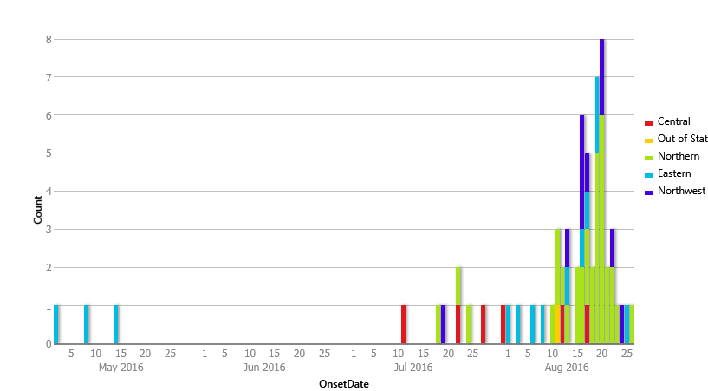
Hepatitis A Outbreak Associated with Smoothies
70 cases as of 9/6/2016; 39 Northern, 10 Northwest, 14 Eastern, 7 Central, 0 Southwest
Notes:
This is the epidemic curve that illustrates the outbreak of Hepatitis A that was associated with the consumption of contaminated strawberries imported from Egypt; most of these strawberries were consumed as part of smoothie products from a restaurant chain.

Slide 11
Investigation Steps
Case reporting and interviews
Confirmation of smoothie exposure and description of ingredients from each person
Collaborations:
within VDH (epidemiology, environmental health, risk communication, districts),
with VDACS on product identification and withdrawal and with DCLS on specimens,
with CDC on outbreak tracking and with FDA on product tracing and food testing (no positive food yet)
with the corporation on locations and recommendations

Slide 12
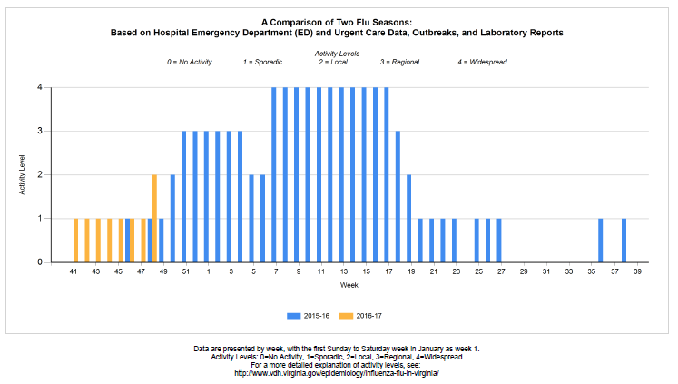
Influenza
Notes:
The Division of Surveillance and Investigation in the Office of Epidemiology conducts flu surveillance each year to track trends and patterns in influenza activity across the Commonwealth. The three main sources of surveillance information are:
Emergency Room and Urgent Care Data which capture the number of visits to Eds and Urgent Care Centers for Influenza Like Illness or ILI in Virginia
The second source of information is laboratory data on the types of influenza that are being seen in patients
The third important source of data is reports of outbreaks. Influenza in and of itself is not a reportable condition in Virginia, but outbreaks of influenza are a reportable event, as are influenza-associated deaths?
This chart will change over time, and you can see its progression throughout the season on our Influenza iNFormation website. The yellow bars are from this season, as compared to the blue bars which are the activitiy levels each week that we saw last flu season.

Slide 13
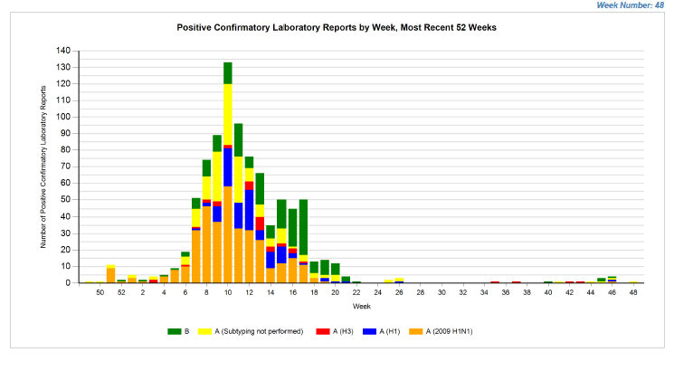
Influenza-Laboratory Data

Slide 14
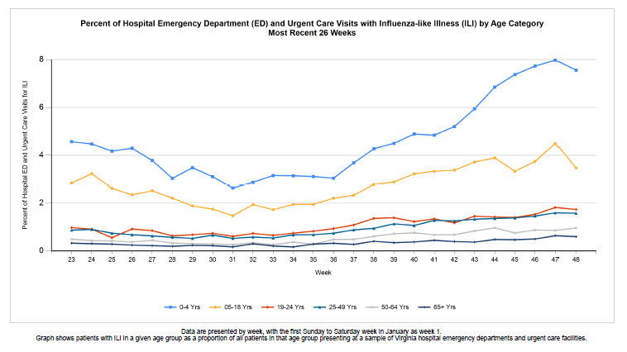
Enhanced Surveillance
Notes:
This is an example of graph that is built from our enhanced surveillance system, which is data captured at emergency rooms and urgent care centers across the state. This particular chart is broken down by age groups, and as expected, the number of visits for preschool aged children is more than the other groups. The curve is the shape we would expect it to be this time of year.
Of note another data point that is tracked is the percentage of health care workers who have rec eived an immunization. 87.6% of healthcare workers in Virginia hospitals received the influenza vaccination for the 2014-2015 flu season

Slide 15
Acknowledgements
Zika Epidemiology Team
Foodborne Disease Team
Influenza Surveillance Epidemiologist
District and Regional Epidemiologists

Slide 16
Addiction in Virginia
Public Health Perspective

Slide 17
What Public Health Data is Available?
VDH:
Overdose Death Data (OCME)
Syndromic Surveillance Data
Naloxone Administration Data (OEMS)
Reportable Disease Surveillance Data (e.g., Hepatitis C, HIV)
Other Agencies/Sources:
Substance Abuse Treatment Admission Data
Hospital Discharge Data
All Payers Claims Database (APCD)

Slide 18
Total Number of Prescription Opioid (Excluding Fentanyl), Fentanyl, and/or Heroin, and All Opioid Overdoses by Year of Death, 2007-2016
Notes:
This slide illustrates the total number of overdoses in Virginia, by year, broken down in to three categories:
Those due to any opioid,
Those due to Prescription Opioids excluding Fentanyl, and
Those due to Fentanyl and/or Heroin.
Clearly the trend in general, is upward.
When looking at the data at the state level, it is heroin and fentanyl, not prescription opiates, that are driving the increase in OD deaths. If one looks at this same data at a lower geographical level (Regional, County, etc) one will see that prescription opiates are driving the deaths due to overdose in certain regions of the state (i.e. Southwest Virginia)

Slide 19
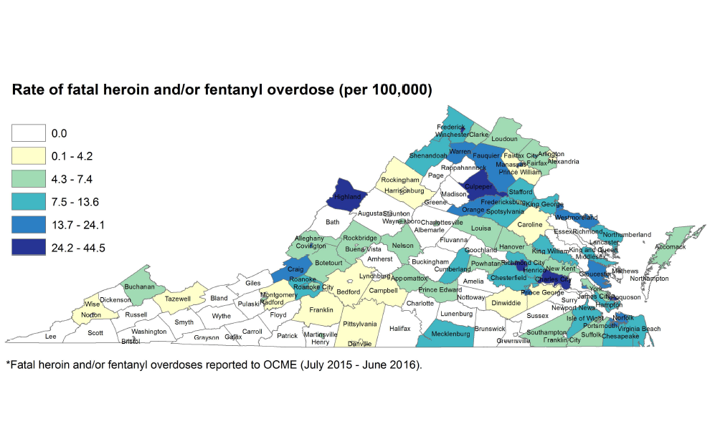
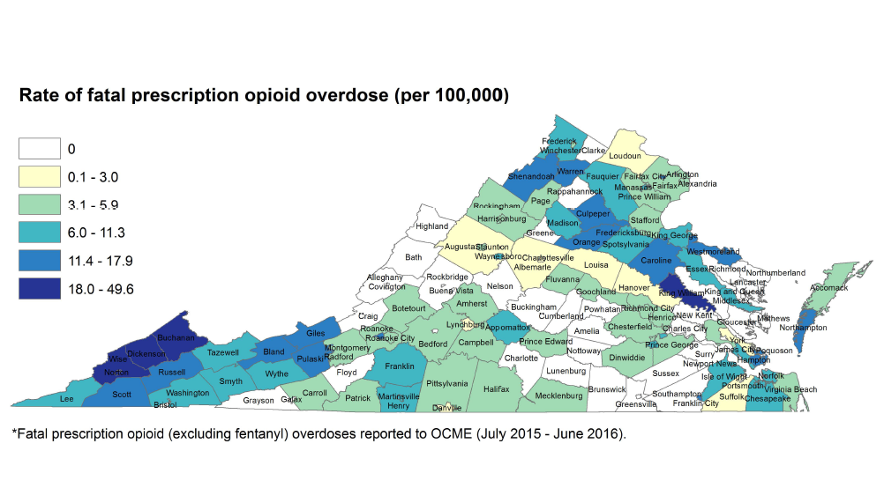
Notes:
These two maps illustrate the overdose data in a different way– they allow visualization of the rate of overdose due to heroin/fentanyl OR overdoses due to prescriptions.
TOP MAP: Takeaway: Fatal heroin and/or fentanyl overdose rates have been highest in the urban Richmond and Hampton Roads areas and the more rural Northwest/Shenandoah region.
Illicit opioids--- Fatal fentanyl and/or heroin overdoses in this graphic are obtained from the Office of the Chief Medical Examiner. These data are analyzed from any fatal overdose in which heroin (no fentanyl), fentanyl (no heroin), or both fentanyl and heroin caused or contributed to death. Geographic data on the locality of the fatal overdose and not the locality of residence of the decedent. Additional information on this topic can be found at: http://www.vdh.virginia.gov/medical-examiner/forensic-epidemiology/
BOTTOM MAP: Takeaway: Rx opioid map excludes fentanyl because, after 2015, most fatal fentanyl overdoses involved illicit fentanyl. Prescription opioid overdose rates are highest in far Southwest Virginia and the Shenandoah region.
Rx opioid map--- Fatal prescription opioid overdoses in this graphic are obtained from the Office of the Chief Medical Examiner. These data are analyzed from any fatal overdose that included one or more prescription opioids that caused or contributed to death. Prescription opioids that were detected but didn’t play in a role in the fatal overdose are not included. Prescription Opioids analyzed in this report include Buprenorphine, Codeine, Hydrocodone, Hydromorphone, Levorphanol, Meperidine, Methadone, Morphine, Oxycodone, Oxymorphone, Pentazocine, Propoxyphene, Tapentadol, and Tramadol. Given that most fatal fentanyl overdoses from 2015 forward are from illicitly produced fentanyl and not pharmaceutically produced fentanyl, fentanyl in not included in the category of prescription opioids and is therefore analyze separately. Geographic data on the locality of the fatal overdose and not the locality of residence of the decedent. Additional information on this topic can be found at: http://www.vdh.virginia.gov/medical-examiner/forensic-epidemiology/

Slide 20
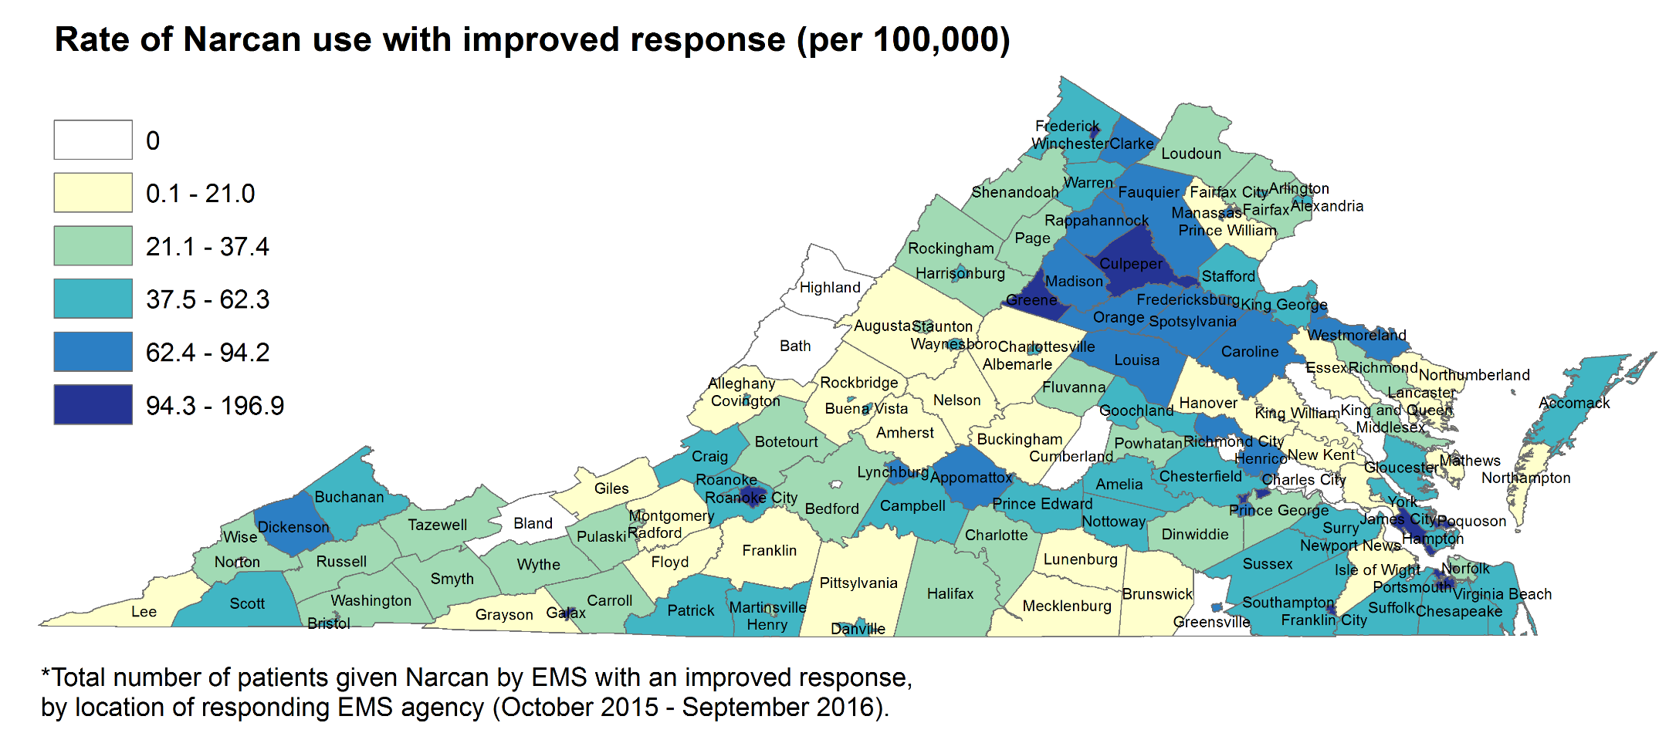
Notes:
Narcan administration by EMS is only counted if the patient exhibits a positive response to the medication. These data are mapped based on the location of the responding EMS agency.
This map only looks at Narcan use per total population. For Narcan use relative to fatal opioid overdose, see the next map.

Slide 21
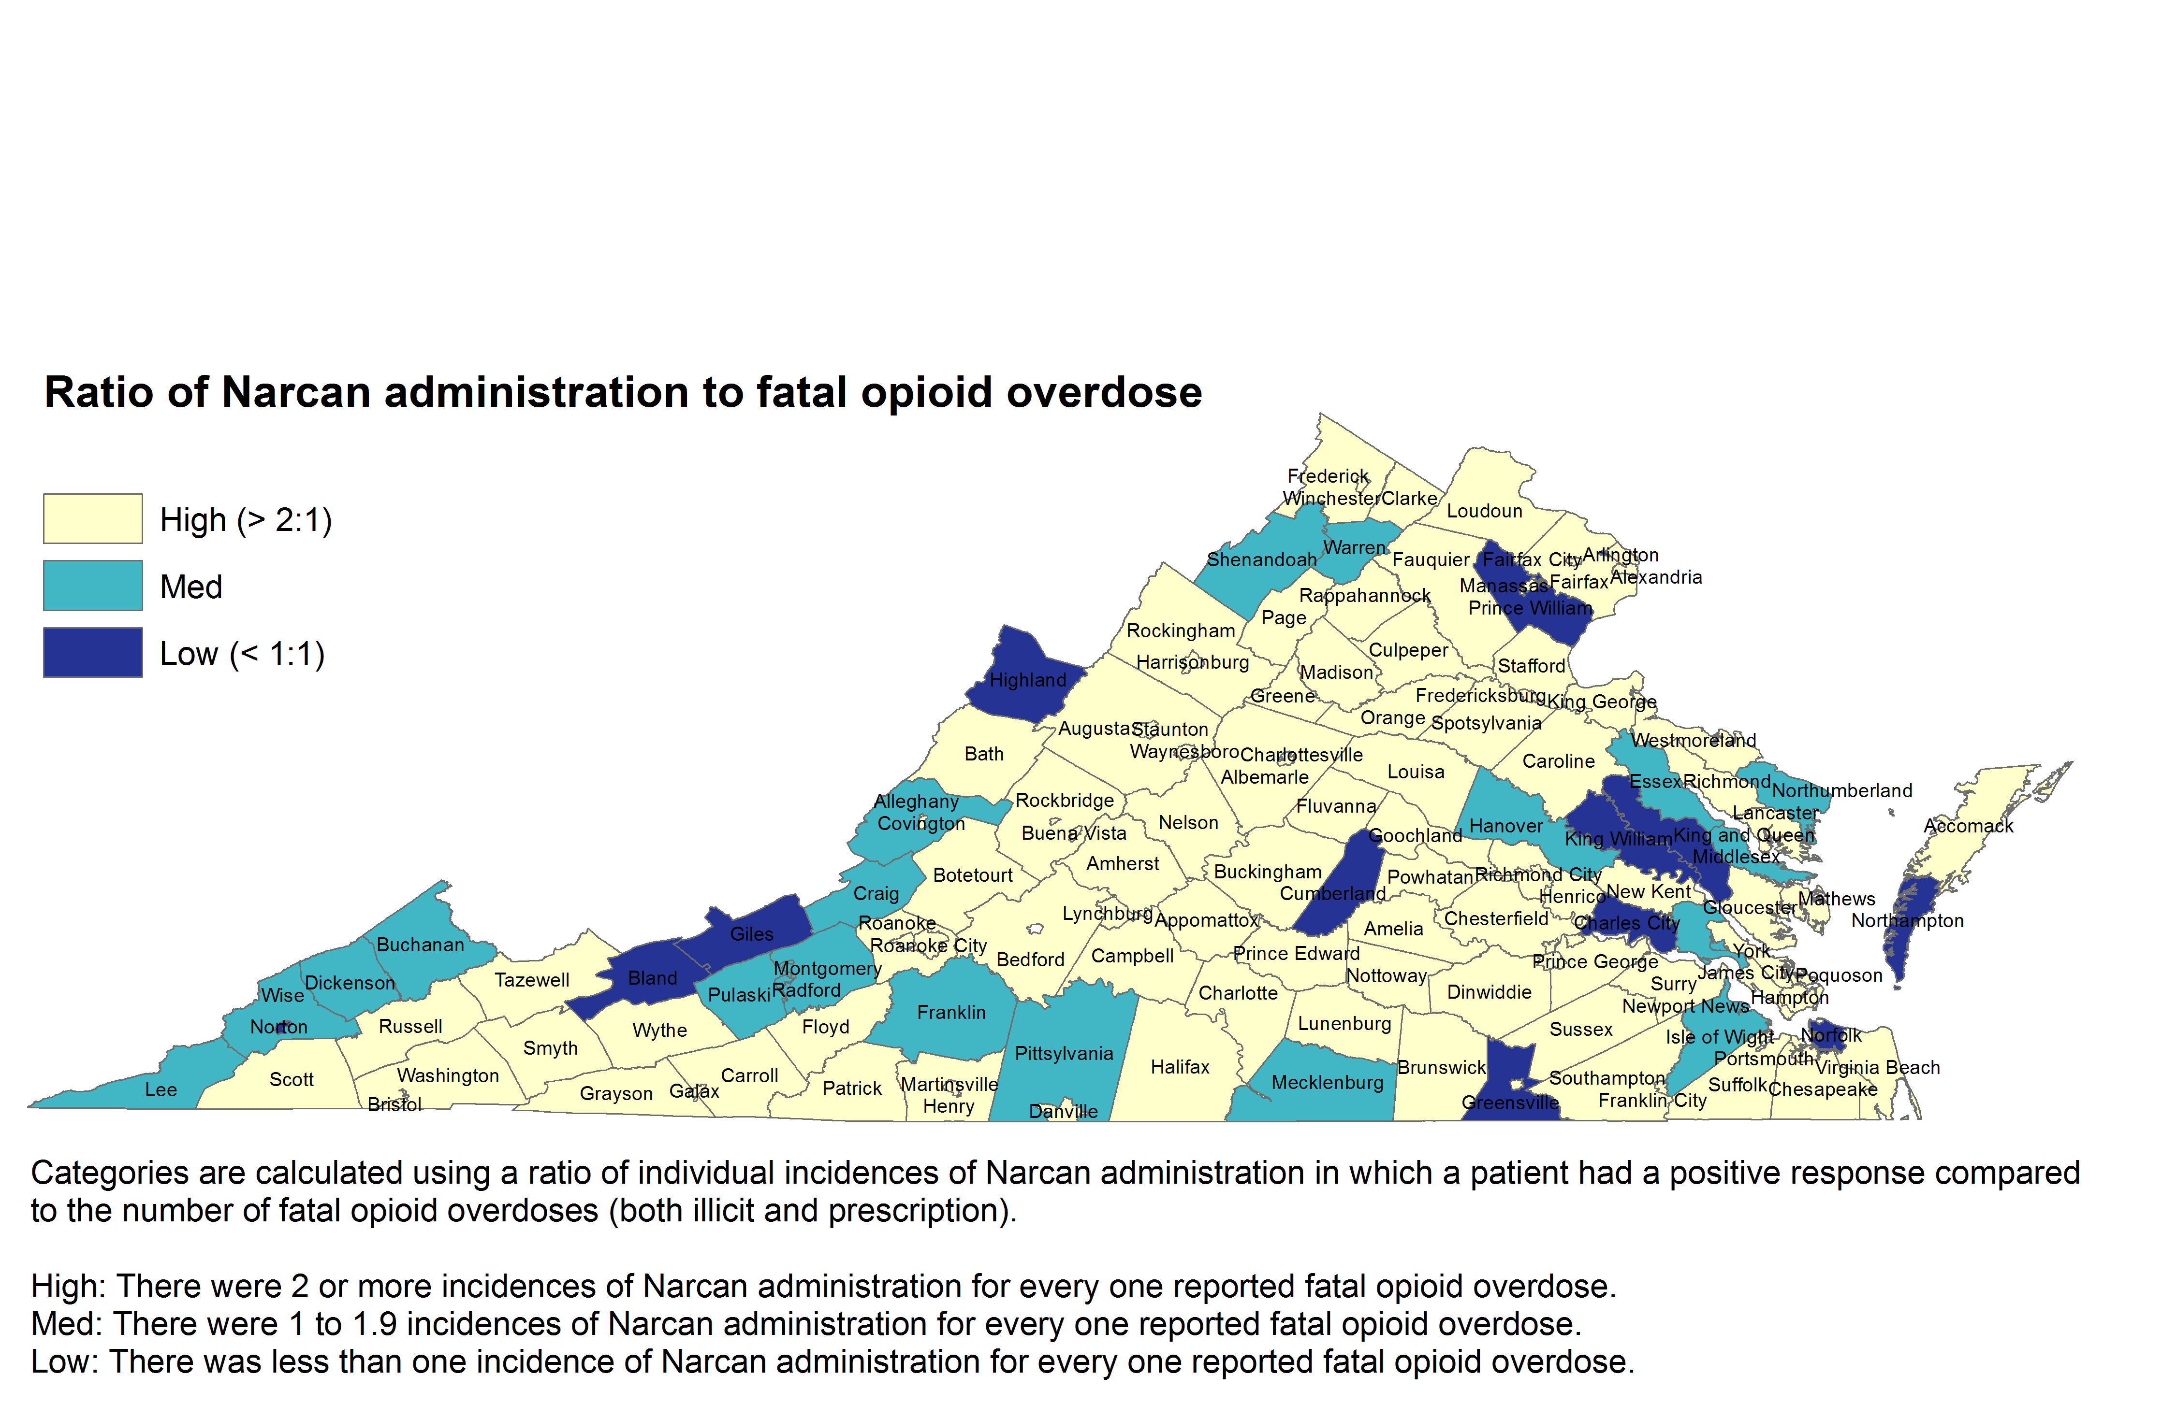
Notes:
Takeaway: In most counties in Virginia, successful Narcan administration by EMS is more frequent than fatal opioid overdose. However, some localities have disproportionately high rate of fatal opioid overdose compared to Narcan use. These localities (dark and medium blue) could potentially benefit from more frequent administration of Narcan.
The ratio of Narcan administration to fatal opioid overdose is intended to identify areas in which Narcan may be underutilized; i.e., where fatal opioid overdose is more common than Narcan administration by EMS (the dark blue or “low” category).
Narcan administration data is from OEMS and is mapped by the locality of the responding EMS agency.
Fatal opioid overdose is from OCME and is mapped by the locality in which the decedent died, not the decedent’s residence.
Early next week, Dr. Levine will be signing a statewide standing order for Naloxone, which will authorize pharmacists to dispense this life saving medication in accordance with the Drug Control Act and with the current Board of Pharmacy protocol. This is an important strategy to increase access to this life saving opioid reversal medication.

Slide 22
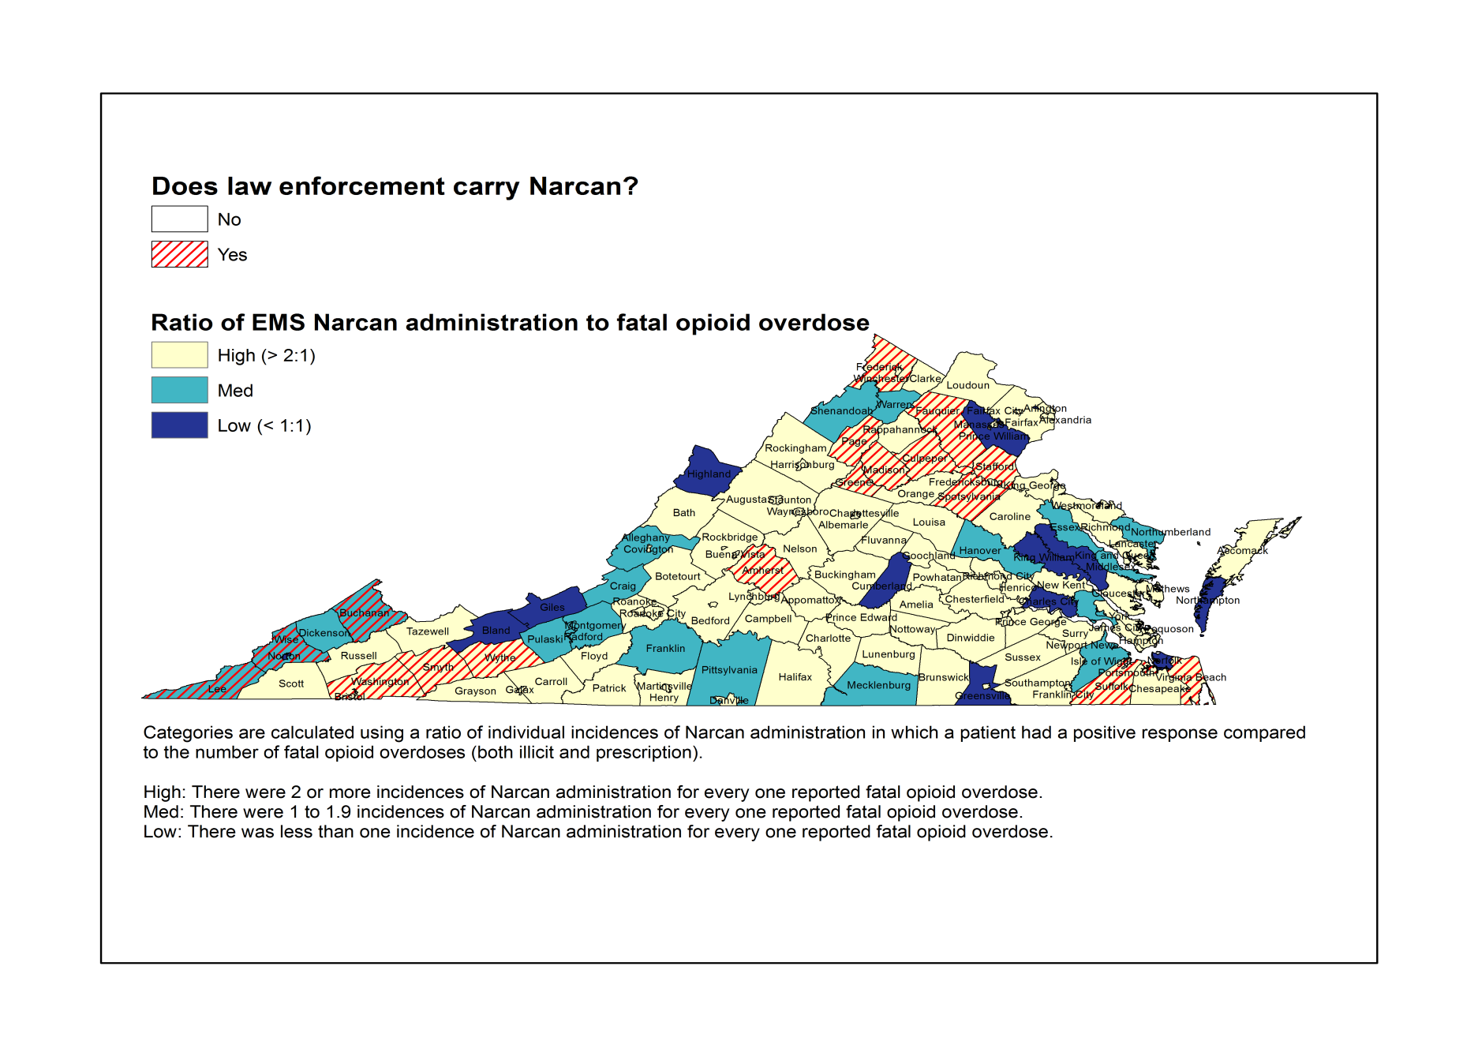
Notes:
In most counties in Virginia, successful Narcan administration by EMS is more frequent than fatal opioid overdose. However, some localities have disproportionately high rate of fatal opioid overdose as compared to Narcan use.
These localities (dark and medium blue) could potentially benefit from more frequent administration of Narcan.
The ratio of Narcan administration to fatal opioid overdose is intended to identify areas in which Narcan may be underutilized; i.e., where fatal opioid overdose is more common than Narcan administration by EMS (the dark blue or “low” category).
The localities with red stripes are those localities in which Law Enforcement personnel also carry Naloxone
Narcan administration data is from OEMS and is mapped by the locality of the responding EMS agency.
Fatal opioid overdose is from OCME and is mapped by the locality in which the decedent overdosed, not the decedent’s residence.
On Monday November 21, Dr. Levine signed a statewide standing order for Naloxone, which authorized pharmacists to dispense this life saving medication in accordance with the Drug Control Act and with the current Board of Pharmacy protocol. This is an important strategy to increase access to this life saving opioid reversal medication.

Slide 23
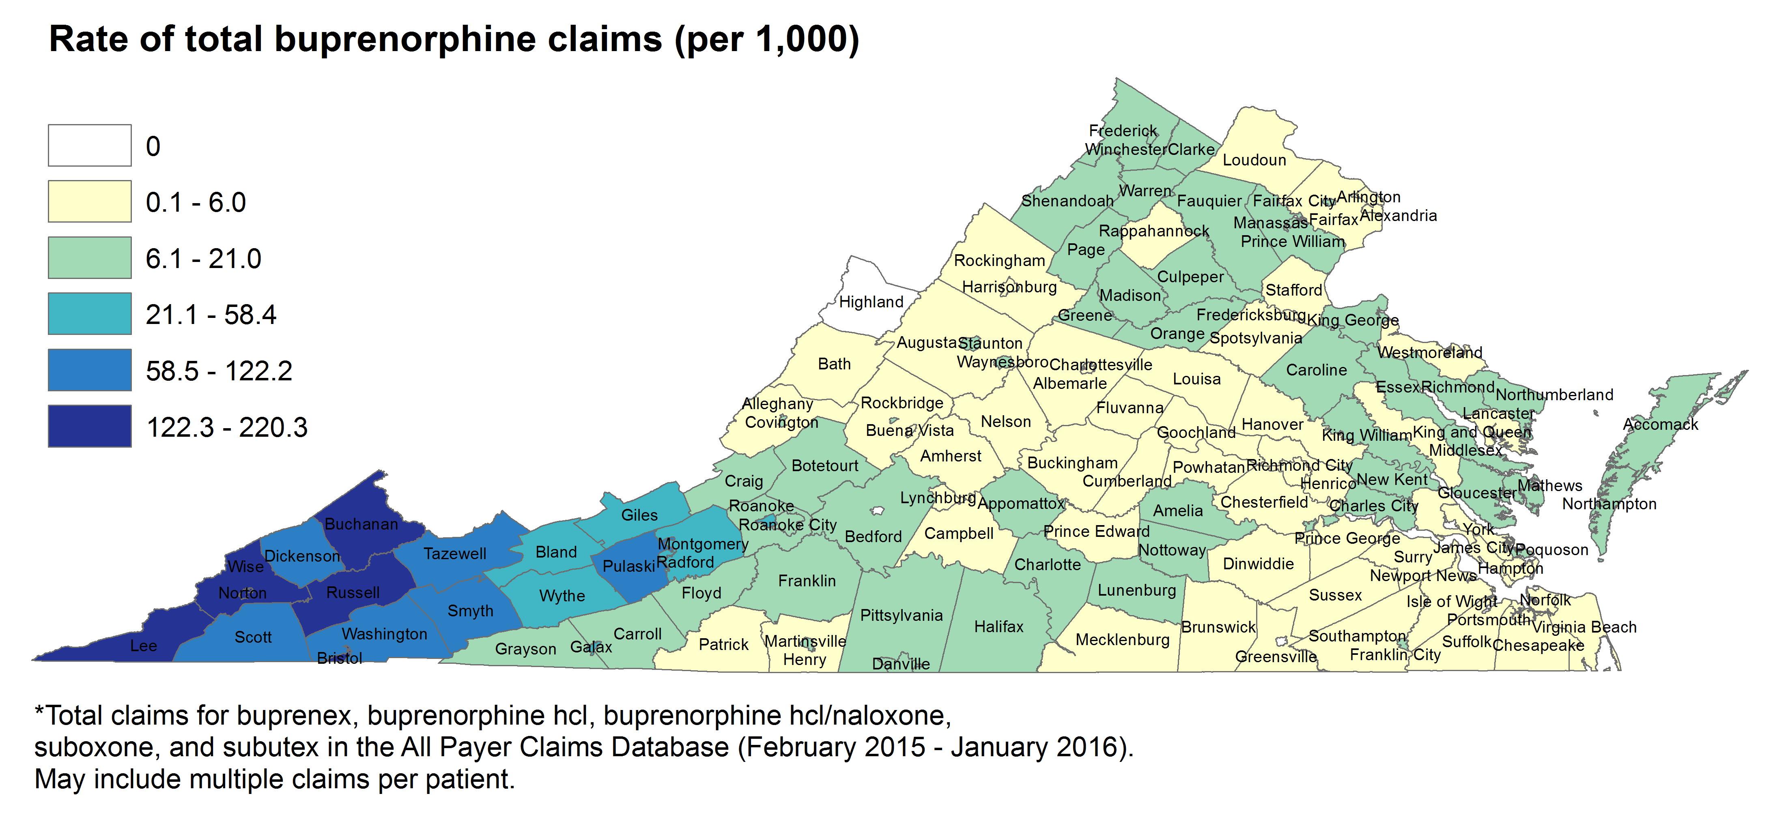
Notes:
Takeaway: Buprenorphine claims represented in the APCD are disproportionately high in Southwest Virginia.
Data is pulled from the All Payer Claims Database and includes claims for buprenex, buprenorphine hcl, buprenorphine hcl/naloxone, suboxone, and subutex.
Persons with more than one prescription are counted multiple times.
APCD includes more than 90% of Medicaid data and 60-65% of commercial data. The following organizations voluntarily submit to the Virginia APCD: Aetna, Anthem, Carefirst, Cigna, INTotal, Kaiser, Optima, UnitedHealth Care, Virginia Premier and the Virginia Department of Medical Assistance Services (DMAS)
Medicare fee‐for‐service (FFS) claims are expected to be included in the future. The APCD does not include care for the uninsured, Workers’ Compensation, TRICARE or the Veterans Health Administration. Medicaid and/or Medicare fee-for-service is not included in APCD.

Slide 24
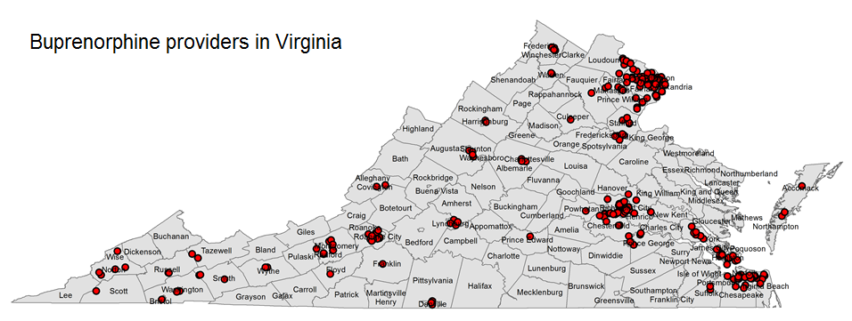
Notes:
Buprenorphine providers were geocoded from SAMHSA:
http://www.samhsa.gov/medication-assisted-treatment/physician-program-data/treatment-physician-locator

Slide 25
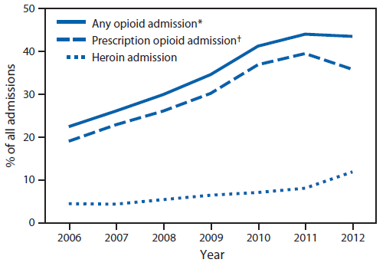
FIGURE 2. Percentage of all admissions to substance abuse treatment centers by persons aged 12–29 years (N = 217,789) attributed to the use of opioids, prescription opioids, and heroin, by year — Kentucky, Tennessee, Virginia, and West Virginia, 2006–2012
Notes:
In May 2015, a report was published in CDC’s MMWR illustrating increases in Hepatitis C related to Injection Drug Use in 4 states, including Virginia.
The figure above is a line chart from that report, showing the percentage of all admissions to substance abuse treatment centers by persons aged 12-29 years (N = 217,789) attributed to the use of opioids, prescription opioids, and heroin, by year, in Kentucky, Tennessee, Virginia, and West Virginia during 2006-2012.
Opioid admissions increased by 21%
Prescription opioid abuse accounts for 1/3rd of all substance abuse treatment admissions (heroin accounts for 8%)
In 2011-2012, heroin admissions increased from 8.6% to 12% and the proportion of prescription opioid admissions decreased
* Any opioids include heroin and prescription opioids.
† Prescription opioids includes buprenorphine, codeine, hydrocodone, hydromorphone, meperidine, morphine, opium, oxycodone, pentazocine, propoxyphene, tramadol, illicitly obtained methadone, and any other drug with morphine-like effects.

Slide 26
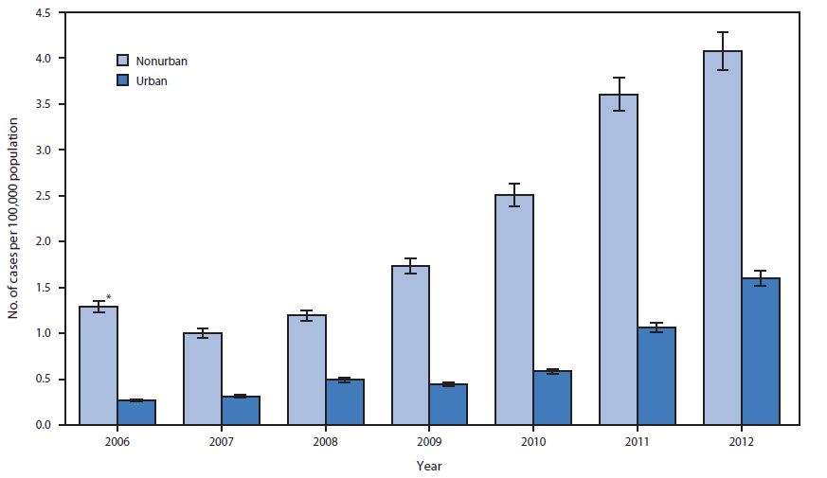
Incidence of acute hepatitis C among persons aged ≤30 years, by urbanicity and year — Kentucky, Tennessee, Virginia, and West Virginia, 2006–2012
IGURE 1. Incidence of acute hepatitis C among persons aged ≤30 years, by urbanicity and year — Kentucky, Tennessee, Virginia, and West Virginia, 2006–2012
Notes:
* 95% confidence interval.
The report went on to describe the concerning increases in Hepatitis C in this region.
The figure above is a bar chart (MMWR) showing incidence of acute hepatitis C among persons aged ≤30 years, by urbanicity and year, in Kentucky, Tennessee, Virginia, and West Virginia during 2006-2012.
44.8% of acute HCV infections were among persons aged ≤30 years
Note –there was a 364% increase in the number of cases of acute HCV infection among persons aged ≤30 years (increase in incidence higher in nonurban areas)

Slide 27
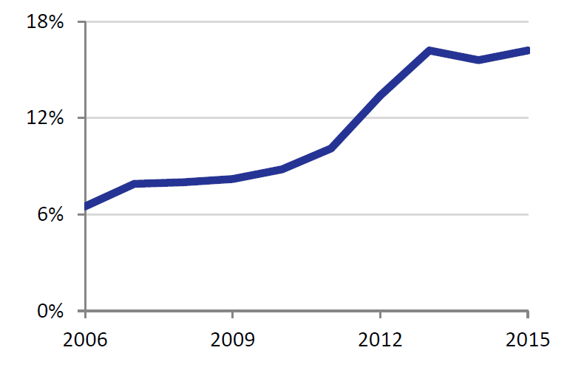
Percent of reported hepatitis C occurring in individuals under 30 years of age (VEDSS)
Notes:
Recent increases in reports of acute hepatitis C among persons under 30 years old in central Appalachia have drawn attention to hepatitis C in young individuals, particularly those who are White, inject drugs, and reside in non-urban communities. Virginia was one of four states highlighted in a 2015 CDC report that illustrated the emerging triad of opioid abuse, injection drug use, and hepatitis C infection among persons aged 30 years or younger.
Over the last decade, the percentage of acute and chronic hepatitis C cases which are newly reported in persons under 30 years old in Virginia has increased, as illustrated by this slide. This trend highlights the need for development and implementation of health services tailored to this age group and vulnerable population.

Slide 28
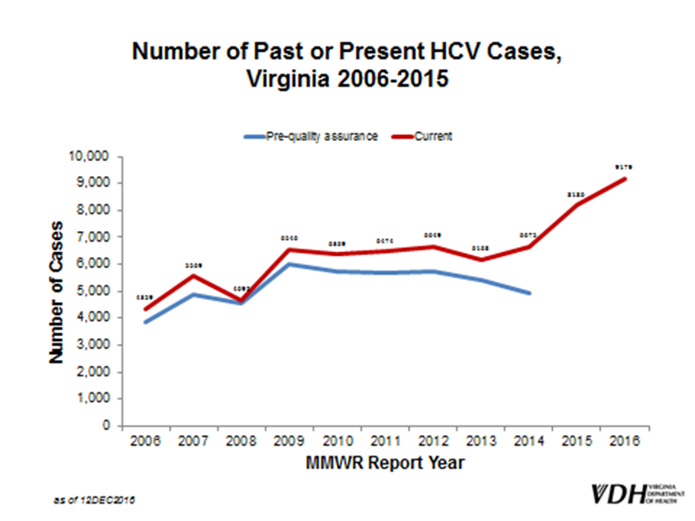

Slide 29
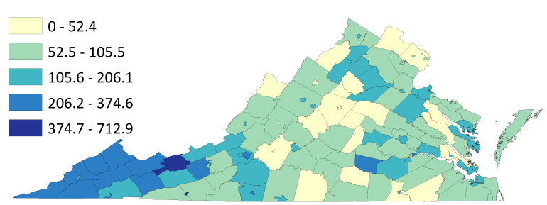
Reported hepatitis C per 100,000*
*This map excludes results from hepatitis C testing performed at correctional facilities to prevent false clustering of cases. Incarcerated individuals are not included in census population data for the counties where correctional facilities are located. Trends in hepatitis C in the incarcerated population are described separately
Notes:
This map illustrates the rate of cases of acute and chronic hepatitis C per 100,000 persons by city/county of residence. The southwestern Applalachian region of Virginia has the highest incidence of newly reported chronic and acute hepatitis C.
Further, eight Virginia counties in Southwest Virginia (Buchanan, Lee, Patrick, Dickenson, Wise, Wythe, Russell, and Tazewell) were identified by CDC as being among the top 220 counties in the nation (representing the top 5% in the US) that are most vulnerable to an HIV/HCV outbreak associated with injection drug use.

Slide 30
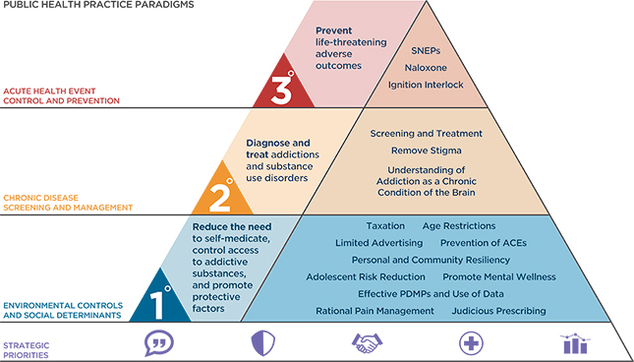
Addiction: A Public Health Response

Slide 31
Health Department’s Response
Primary: Declaration of a Public Health Emergency
Secondary: Addiction Disease Management Sessions
Tertiary: Naloxone Standing Order
Surveillance of adverse health impacts of opioid addiction: Death, Injury due to Overdose, Hepatitis B and C infections, HIV
Draft legislative proposal to establish Syringe Services Programs as part of comprehensive harm reduction

Slide 32
VDH Addiction IMT – 12/12/2016 (rev 2)
Incident Commander Dr. Marissa Levine
PIO
Maribeth Brewster
Liaison Officer Joe Hilbert
Liaison – External Partners
VSP, VDEM, DBHDS, VDSS
D R A F T
Planning Chief
Bob Mauskapf
Operations Chief
Dr. Hughes Melton
Administration/Logistics/Finance Chief
Richard Corrigan
Exercise Branch
Suzi Silverstein
CHS Branch
Bob Hicks
Data and Intelligence Branch
Dr. Laurie Forlano
Disease/ED Data
Finance
Beth Franklin
HR
Rebecca Bynum
Access/Functional Needs Planning
Ofc of Health Equity
(Dr.Adrienne McFadden)
35 Local Health District Directors
EMS/Naloxone Data
OEMS
Procurement/ General Services
Steve VonCanon
Death Data
OCME
IT
Debbie Condrey
National Abstinence/ PMP Data
OFHS
Primary Prevention Branch
Lead: OFHS (Dr. Vanessa Walker Harris)
Secondary Prevention Branch
Lead: EMS (Gary Brown)
Tertiary Prevention Branch
Lead: OEPI (TBD)
Regional Response Branch
Lead: CHS/OEP
Training
Lisa Wooten
Hospital/Medical Community
Kelly Parker
DDP (Diana Jordan, RN)
Education
Carole Pratt

Slide 33
Overview
33
Notes:
SHHR and SHSPS Response

Slide 34
Thank you

