Slide 1
Hepatitis A Cluster in Central Shenandoah Health District
Central Shenandoah Health District
Hilary Jacobson, MS, NRP, Emergency Coordinator
Virginia Public Health and Healthcare Preparedness Academy
June 1st, 2017

Slide 2
Background
There was a cluster of acute hepatitis A in the Craigsville area of Central Shenandoah Health District (CSHD) in 2016.
In July 2016, 11 out of 17 confirmed cases for CSHD have been loosely linked to the Craigsville community.
Six additional cases in two other health districts are also suspected to be associated with this cluster.
By end of 2016 Craigsville – 15 linked cases; 3 confirmed & 2 not confirmed that may have been linked.
Regional and state level epi assisted with the investigation and determining the source of the cluster. CDC assisted with genotyping Hepatitis A samples which were found to be of a separate genotype from the Tropical Smoothie HepA.

Slide 3
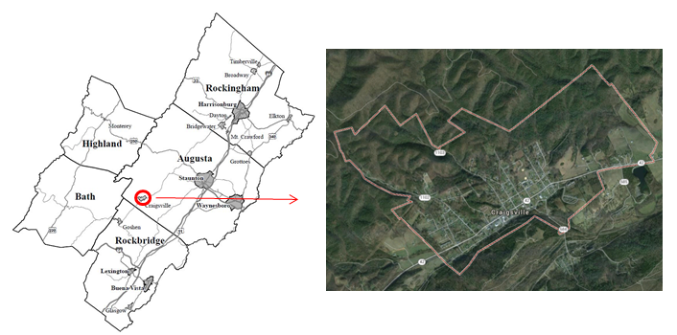
Craigsville
Craigsville is an incorporated town with the 2014 census report of a 925 person population (100% rural) with a mean household income in 2013 of $26,607 (as compared to the Virginia median of $62,666).

Slide 4
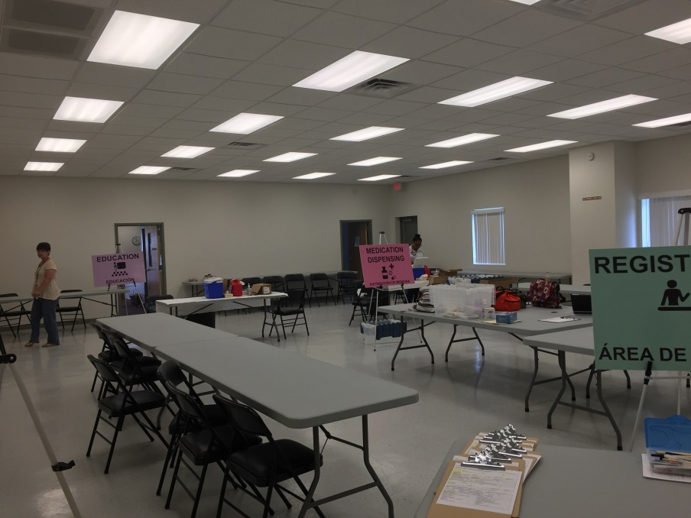
Result – 5 Hepatitis A Vaccine PODs
Determine ability to provide Hepatitis A Vaccination clinic every Wednesday evening for the month of August at Craigsville Community Center
Announce presence of Hepatitis A Vaccination Clinic in Craigsville Water Bill for local notification.
Recruited MRC and EMS Volunteers to assist in Craigsville Community Clinic as support personnel and vaccinators utilizing EventBrite.
Total of 123 Vaccines Dispensed
August 20 – Virginia Health Officials warn of risk with
Tropical Smoothie

Slide 5
Strengths
Partnerships with Medical Reserve Corp and Emergency Medical Services
Partnership with CSEMS allowed for a targeted e-mail to District’s Intermediates and Paramedics (300 persons) with 3 signing up to volunteer to administer vaccines
POD Action Plan
Eventbrite
Contacting Division of Immunization early. Free vaccine (would have been large cost)
Clinic would likely not have been successful if cost would have to be passed along to clients
Collaboration with surrounding Health Districts (Page County & Central Virginia HD)

Slide 6
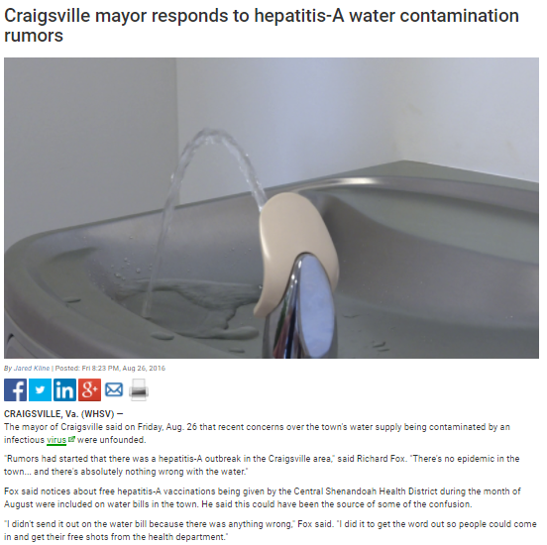
Areas for Improvement
Utilization of Water Bill for messaging per recommendation of Craigsville Mayor
Lack of a affirmed procedure for EMS and MRC Vaccinators
Leftover vaccine
Need to charge an administration fee – many persons did not return for second dose.

