Slide 1
Integrating Medical Reserve Corps and Community Partners Into Real Events and Exercises
Central Shenandoah Health District
Hilary Jacobson, MS, NRP, Emergency Coordinator
Christopher Rini, MPH, MRC Coordinator
Virginia Public Health and Healthcare Preparedness Academy
June 1st, 2017

Slide 2
Objectives
Describe how Community Partners, including Emergency Medical Service (EMS) and Medical Reserve Corps (MRC) personnel can be successfully integrated into a public health exercise or event
Describe how the public health department ensures competency of EMS and MRC Volunteers in a public health exercise

Slide 3
Why Partnerships are Important
Preparedness exercises test how we can scale up and react in a real world situation
Utilizing volunteers in exercises prepares us and them on how we would be able to staff community health operations
Continuity of Operations
Allow public health staffing to continue essential operations.
Increases interactions of public health, healthcare community, and the public

Slide 4
Utilizing the Whole Healthcare Community
Exposes healthcare volunteers to public health operations and concerns.
Builds relationships and improves trust
Valuable assets during an actual event
Improves planning efforts as the full resources of the community are involved
Shared understanding of community needs and capabilities
Greater empowerment and integration of resources from across the community
Increased individual and collective preparedness
Greater resiliency at the community and regional levels

Slide 5
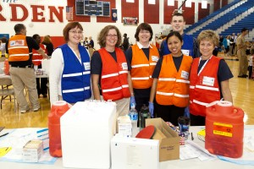
Medical Reserve Corps and Public Health
The Virginia Medical Reserve Corps (MRC) is a force of dedicated volunteers who stand ready to support the community in the event of a public health emergency.
Each of the 27 local MRC units is comprised of teams of medical and public health professionals who, along with interested community members, volunteer their skills, expertise and time to support ongoing public health initiatives and assist during emergencies throughout Virginia.

Slide 6
Integration of MRC with Public Health
Nearly all MRC units in Virginia housed in a LHD
Allows for seamless integration with public health staff
Public health staff + MRC volunteers = Partnership
E P & R ⬄ Daily Public Health
Volunteer Engagement = Strong Response
MRC Coordinator works closely with LHEC
Familiarity with local resources is key

Slide 7
Medical Reserve Corps & Epidemiology Team
Training Provided – Co-Developed with CSHD Epidemiologist Jonathan Falk, MPH
Medical Reserve Corps Epidemiology Training
Northwest Epi Strike Team Training Plan
“Epi in the context of public health” – classroom overview
Goals of the Team – support district epi in surveillance, investigation, and health information efforts to reduce
How it assists CSHD, TJHD, LFHD
Horizontal Integration
Modeled after Loudoun and New River MRC Units
Goal to use in Non-Emergency situations
Build confidence and competencies
Understand communication routes with community partners
Health Education
Volunteer engagement strengthens emergency response

Slide 8
MRC Vaccinator Knowledge, Skills, & Abilities
Competencies – Vaccinator Curriculum
CDC Pinkbook Chapters or MMWR Prevention and Control of Seasonal Influenza with Vaccines: Recommendations of the Advisory Committee on Immunization Practices (ACIP) — United States, 2014–15 Influenza Season August 15, 2014 / 63(32);691-697 if administering only influenza. (http://www.cdc.gov/mmwr/preview/mmwrhtml/mm6332a3.htm)
Centers for Disease Control and Prevention (CDC) Training and Continuing Education Online http://www.cdc.gov/vaccines/ed/epivac/default.htm and complete the activities needed to get a certificate.
Take the 10-item vaccine specific module test. Passing score of 80% on the test.
Undergo skills assessment certification.
The skills assessment certification will be performed by the districts IAP or SME RN.

Slide 9
MRC Provider KSA in 2017
MRC Vaccinator Knowledge Assessment: Training Plan on TRAIN – Complete one course per section
Principles of Vaccination
General Vaccination Recommendations
Vaccine Storage & Handling and Administration
Influenza Vaccine OR Diphtheria, Pertussis and Tetanus / TDAP
Developed by VDH Office of Public Health Nursing in partnership with VAMRC
Now with TDAP!

Slide 10
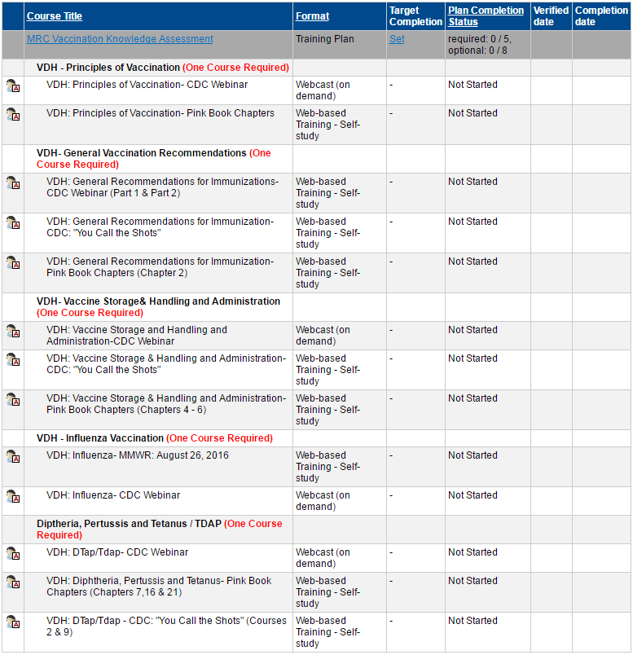
MRC Vaccination Knowledge Assessment

Slide 11
Fellow MRC Coordinators…
Get to know the health department staff in your district!
They are key to building an engaged MRC unit.

Slide 12
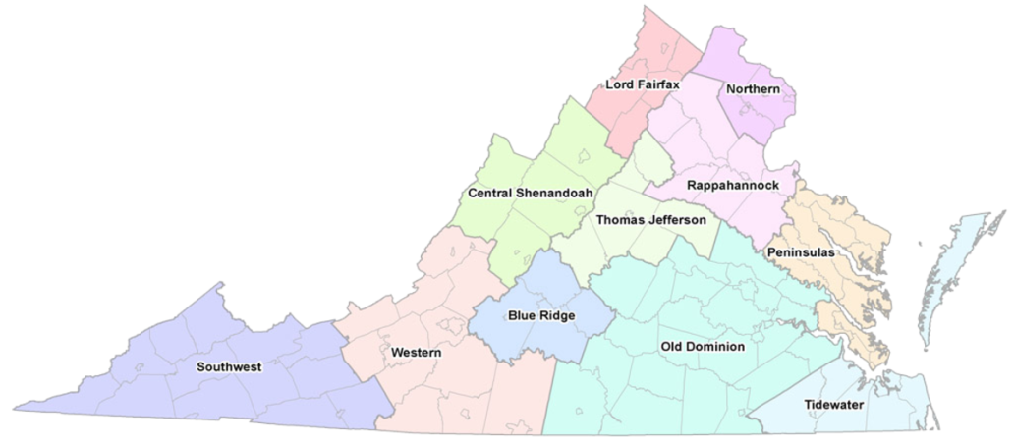
Partnering with EMS – Case Study for Central Shenandoah Health District
Local Health Department (CSHD) and EMS Council (CSEMS) have a close collaborative relationship
Attend each other’s meetings
Assist with plan review (Infectious Diseases, Mass Casualty/Mass Fatality, Disaster Preparedness)
Act as subject matter expertise for questions regarding EMS or Public Health
Councils can provide their Annual Report and greater understanding of EMS assets in district
Concerns of EMS Agencies in District
Staffing
Most providers are members of multiple agencies
Career and volunteer, Fire and EMS
Understanding motives of EMS Involvement
Volunteers and/or Career
VDH Local Health Districts
Virginia EMS Councils

Slide 13
Observed Benefits of Partnership Between LHD & EMS Council
Involvement with PI & MCRC
Development of Protocols
Including EMS Vaccinator Protocol
Increased awareness of available resources
Surge of volunteers staff available in public health emergencies
Opioid epidemic
Narcan Initiatives
Rapid communication with EMS partners
Local communication routes

Slide 14
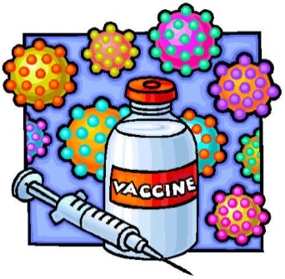
EMS as Vaccinators
In 2010 the General Assembly passed legislation to allow EMS providers (Intermediates & Paramedics) to provide vaccines under the direction of their OMD.
§ 32.1-46.02. Administration of influenza vaccine to minors.
§ 54.1-3408. Professional use by practitioners.
To be considered for participation in a vaccination program, EMS providers must:
Have valid Virginia certification as an EMT-Intermediate or EMT-Paramedic
Be affiliated with an ALS agency licensed in Virginia
Be individually authorized to administer vaccine under a specific protocol approved by their Operational Medical Director
Must follow protocols approved by their OMD for vaccine administration
Prescribers developing a vaccination program must ensure that:
The vaccine is properly stored and maintained
Vaccinators are properly trained in the administration of the specific vaccine being given
Vaccinators are trained to provide appropriate pre- and post-vaccination education and educational materials to vaccine recipients
Appropriate records are kept concerning vaccine administration and any adverse occurrences
CSEMS Vaccination Protocol
Notes:
Virginia
Immunization Information System.

Slide 15
EMS as Vaccinators & Local Health Districts
This process is per the Virginia Department of Health Policy for Vaccine Administration by Emergency Medical Services Providers in Virginia and follows Amendments to the Code of Virginia, recognizing certain EMS providers as vaccine administrators. “Just in Time” is defined as training immediately prior to a vaccine event. As soon as the training is completed, EMS providers can vaccinate.
The EMS agency will be responsible for:
Providing an Operational Medical Director who is affiliated with the EMS agency. The OMD serves as the “prescriber” and is a licensed practitioner in the Commonwealth authorized to issue to a prescription.
Determining which EMS providers are qualified to participate as a vaccinator.
Providing the Health Department with a list of all qualified EMS providers prior to training.
Ensuring all qualified EMS providers receive and are checked off on just in time training prior to administering Influenza vaccine.
Ensuring all EMS providers adhere to the protocol as set forth by the Health Department.
The Health Department will be responsible for:
Procurement of vaccine and other supplies necessary for Influenza vaccine administration.
Emergency medical kit for allergic reactions.
Ensuring appropriate storage, handling, and transport of vaccine.
All forms necessary for administration of influenza vaccine.
Just in time training to qualified EMS providers by Licensed Registered Nurses.
Entering the encounters into VIIS.
Reporting Adverse Reactions

Slide 16
Volunteer Vaccinator Procedure Utilized by Central Shenandoah Health District
The Nurse will review the following material with the qualified EMS providers:
Verify TRAIN Course Completion and OMD Authorization Letter
VDH – Annual Skills Checklist for Immunization
Inactivated Influenza Vaccine Information Statement.
This must be given to every person before they are vaccinated.
Contraindications and precautions to Inactivated Influenza Vaccine for adults and children.
How to report an Adverse Vaccine Event.
Informed Consent Form with screening questionnaire for Influenza Vaccination
Confidentiality of all client information
Just in Time Materials are reviewed prior to EMS personnel being allowed to operate in exercise or event; and available for reference as needed
CSHD - Drug Formulary

Slide 17
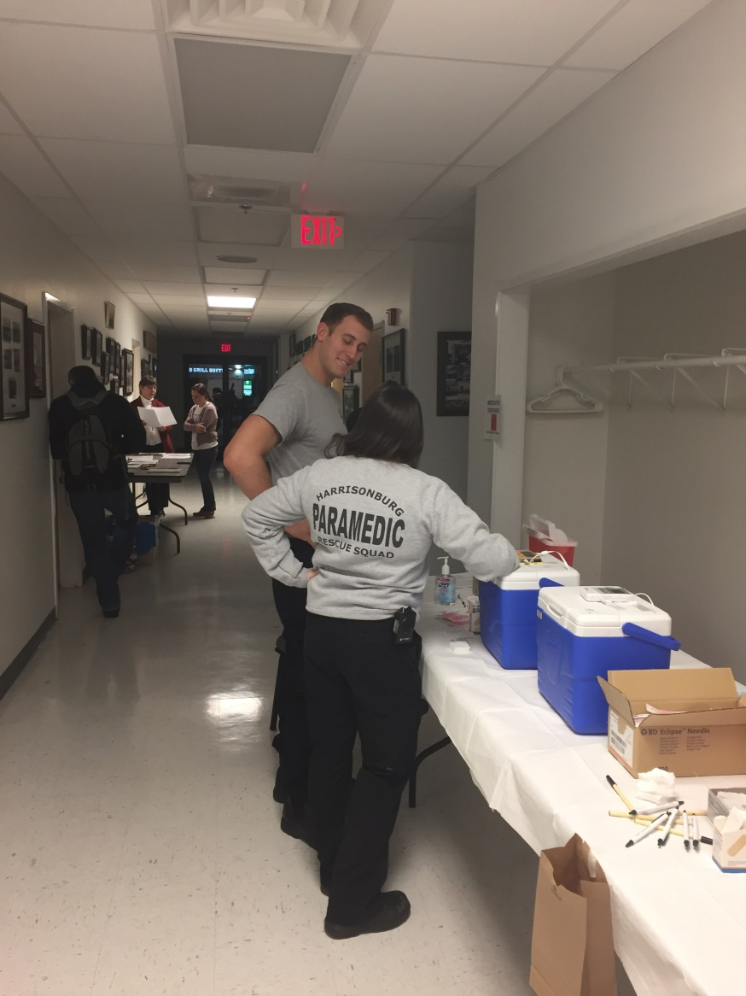
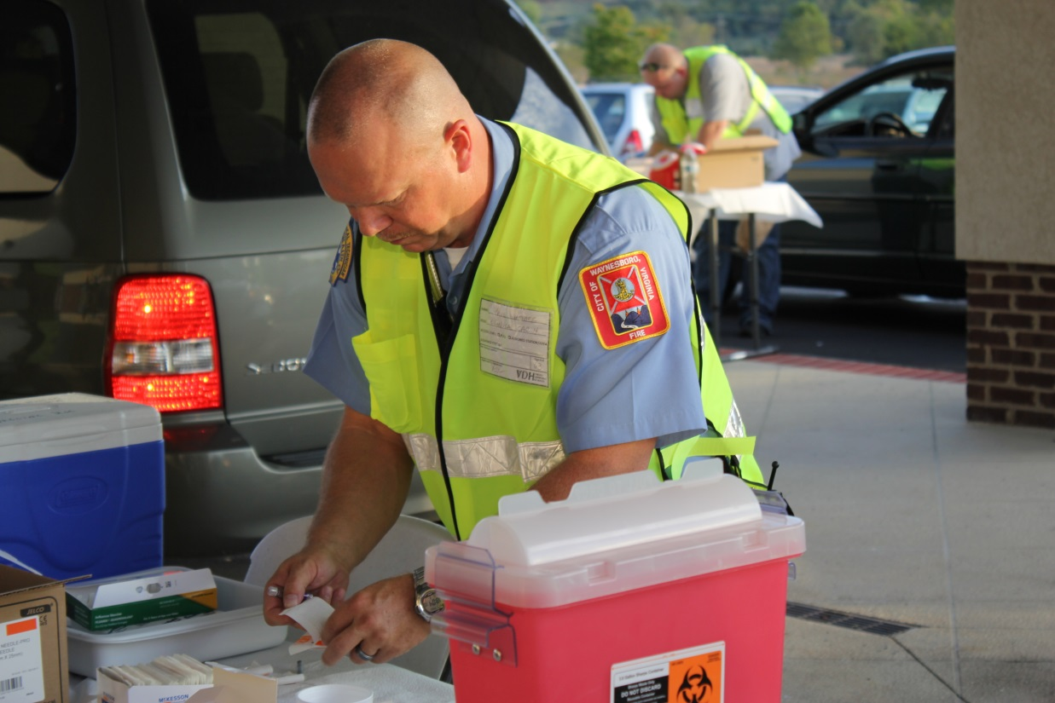
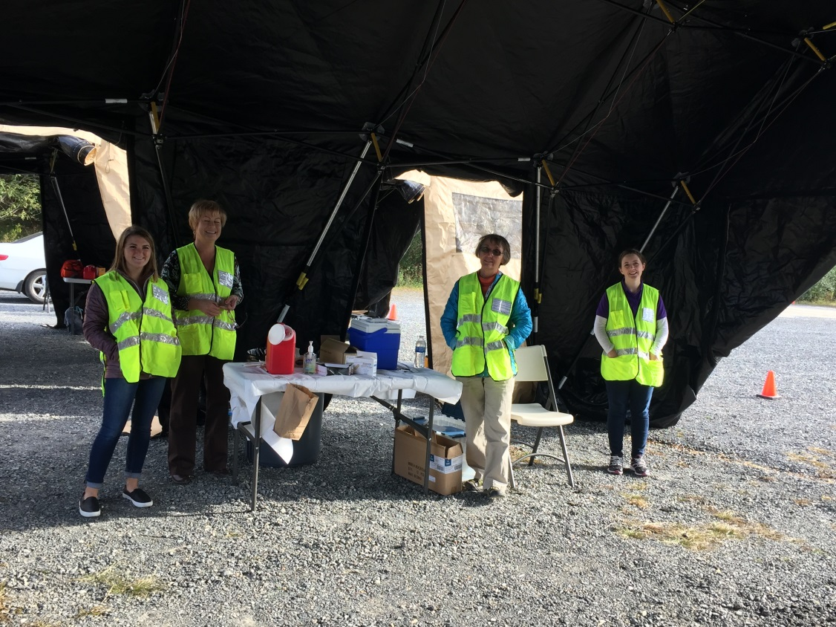

Slide 18
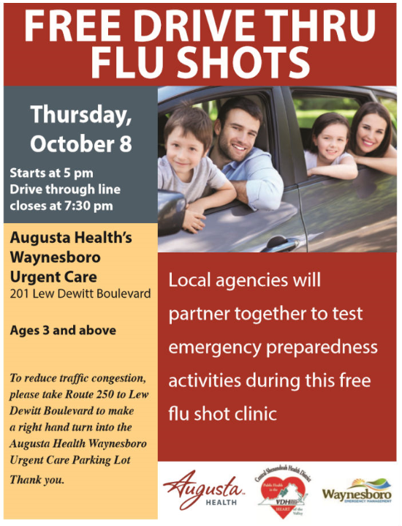
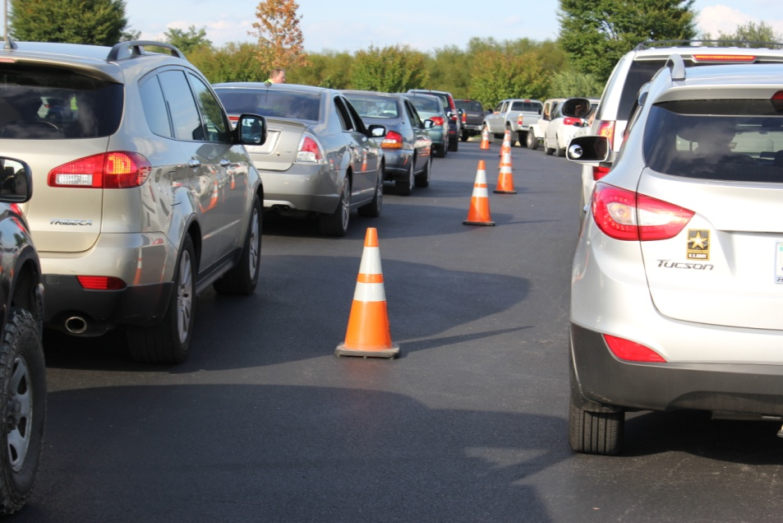
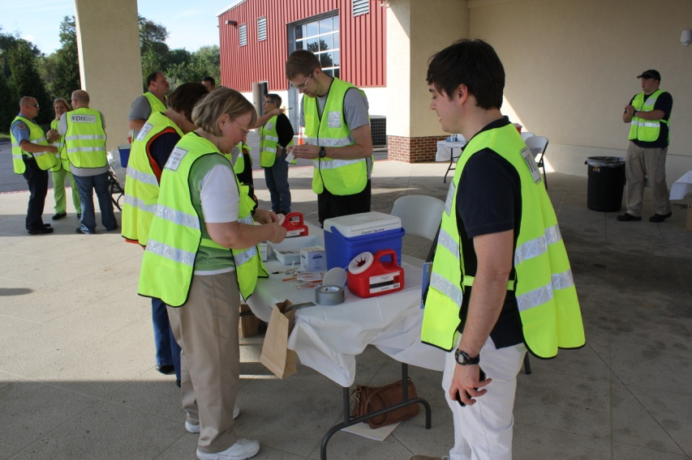
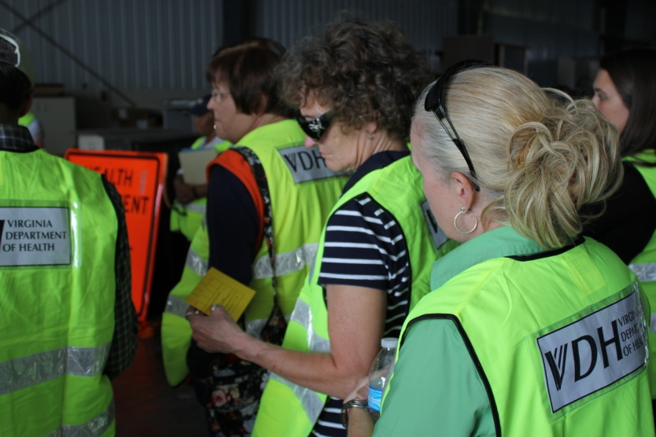
Case Study: Augusta Health FluEx Event Date: October 8, 2015

Slide 19
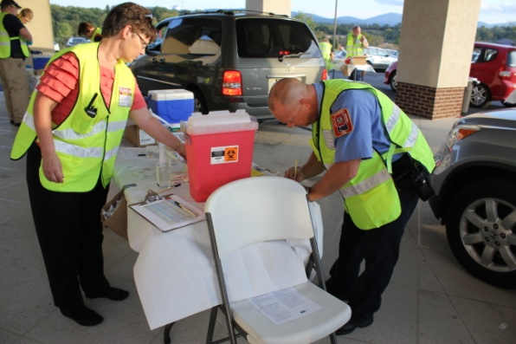
Case Study – 2015 Augusta Health FluEx
MRC Volunteers activated via Virginia Volunteer Health System Alert
10 volunteers responded as available – 4 Responded
Registration: 1 volunteer worked with CSHD clerical team
Traffic Director: 1 volunteer worked with team of CERT volunteers to coordinate traffic flow into and out of POD site
Vaccination: 2 volunteers went through knowledge and skills assessment
Some MRC volunteers deployed as CERT (different “hats”)
3 cancelled (1 no-show)
EMS Volunteers activated via Waynesboro Emergency Manager and LHEC’s
10 volunteers responded
4 Agencies Represented
Included Standby Unit
8 Vaccinated, 1 Registration, 1 Logistics
Both EMS and MRC Vaccinators attended Joint Just in Time Training with Augusta Health and Health Department Staff
525 Vaccines Dispensed in 2.5 Hours by 64 Persons

Slide 20
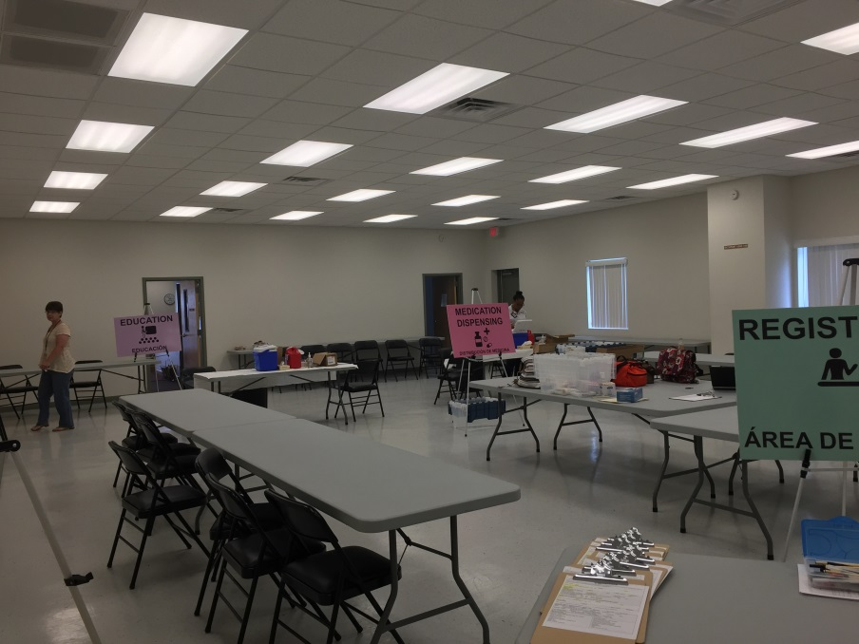
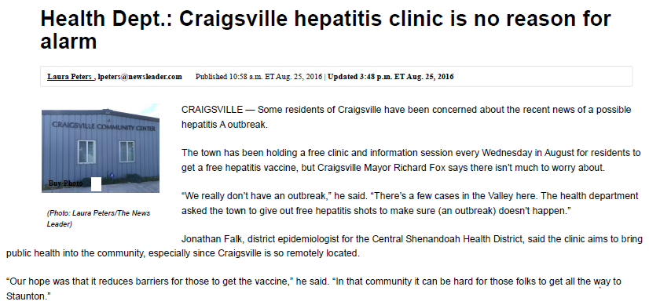
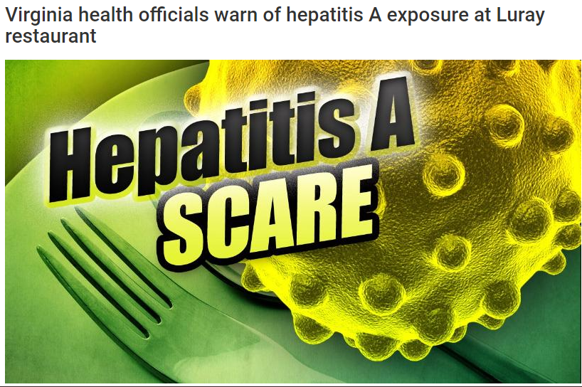
Case Study: Hepatitis A Point of Dispensing Sites Event Date: August, 2016

Slide 21
Case Study – Hepatitis A Outbreak
A greater than expected number of cases of Hepatitis A was noted in the greater Augusta region of CSHD since the beginning of the 2016 with no common source. Many of the primary cases had a history of drug use, but no obvious common source for the illicit drugs has been found. Many of the cases have been more severe than typical for hepatitis A, with liver enzymes in the thousands and need for in-patient care for several of the patients.
Weekly Hepatitis A Vaccination Point of Dispensing Sites were established for each Wednesday in the month of August.
11 Different Personnel provided 123 Vaccines over the course of 5 PODs
Utilized 3 MRC Volunteers in registration
Through partnership with CSEMS was able to contact all EMT-I & EMT-P’s for availability
3 Medics responded with availability to vaccinate utilizing the new CSEMS Protocol

Slide 22
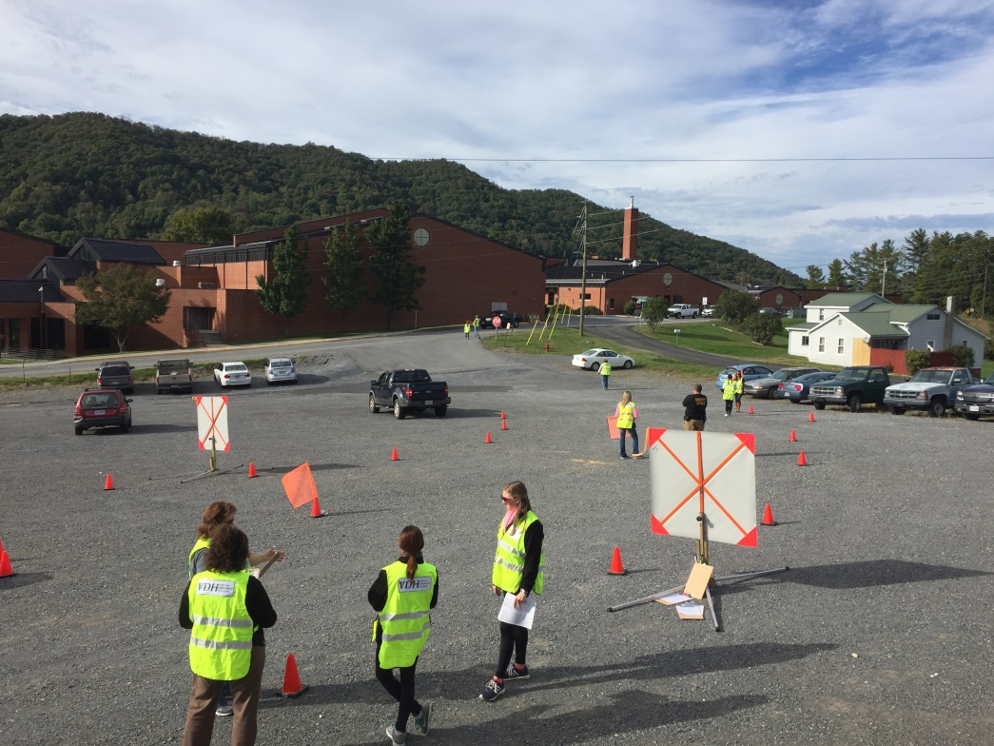
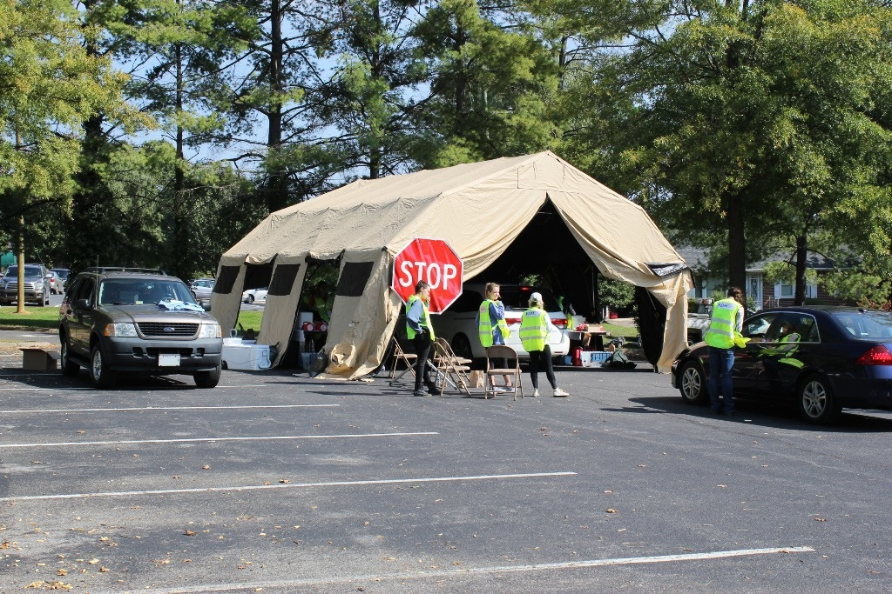
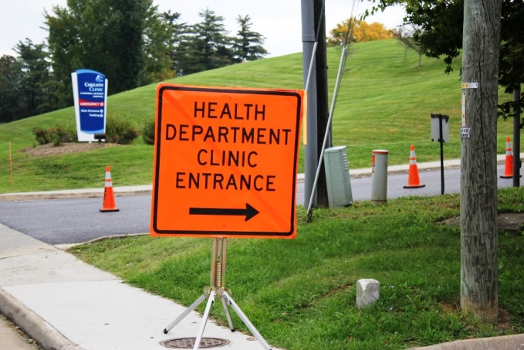
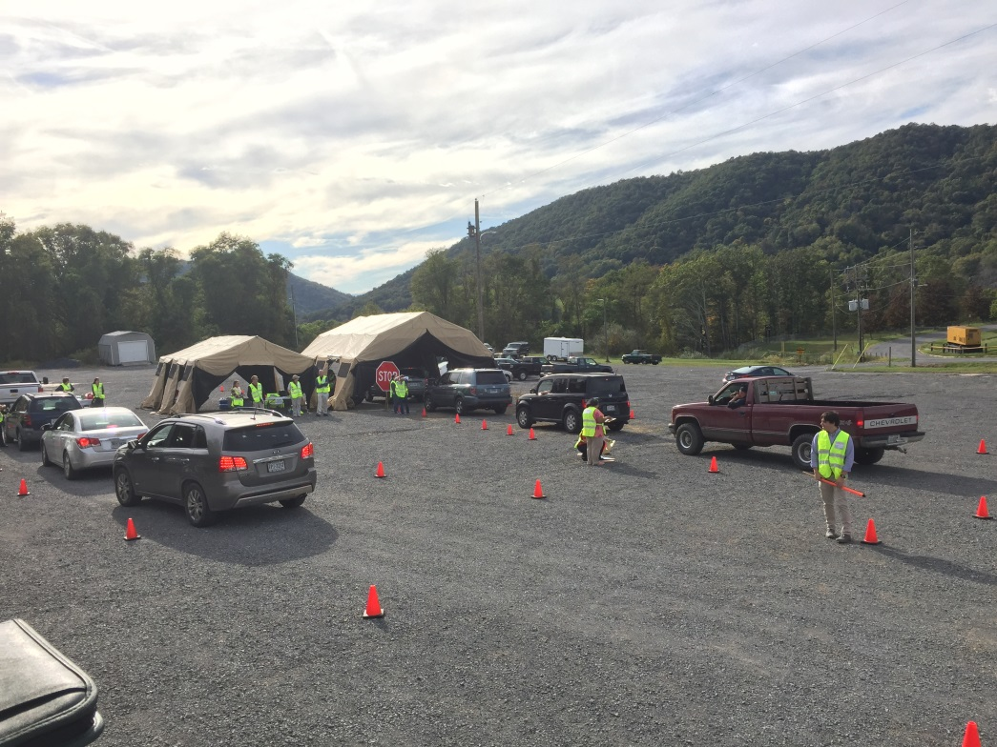
Case Study: CSHD 2016 FluEx Event Dates: October 11th 2016 (Bath County) & October 16th 2016 (Rockbridge County)

Slide 23
Case Study – 2016 CSHD FluEx
Exercises were a test of the ability for Central Shenandoah Health District to set-up and operate two Point of Dispensing Exercises within a week and limited staff. A total of 9 CSHD personal participated in the below exercises. Community Partnership were the key to success!
Bath County Exercise
Rockbridge County Exercise
181 Vaccines Administered in 3 Hours (4% of Population) by 44 Persons
Partnership with Bath County Emergency Management, Sherriff Department, School System
5 MRC Volunteers (2 Clinical. 3 Traffic)
1 EMS Vaccinator/Stand-By Unit
7 Department of Social Services Persons (Registration)
16 University Students
328 Vaccines Administered in 3 Hours by 57 Persons
Partnership with Rockbridge County, Carilion Stonewall Jackson Hospital, Lexington City, and Buena Vista City
1 MRC Volunteer
2 EMS Vaccinators
3 CERT Volunteers
22 University Students

Slide 24
Case Study: EMS Vaccination Clinics Event Dates: November 2016 – February 2017
LHEC Reached out to District Career and Volunteer EMS Agencies
10 Clinics Established
115 Vaccines Administered
8 Additional EMS Vaccinators Trained
DATE | EMS Vaccinator Clinic Event
Nov 15 | 29 Doses Administered at Harrisonburg Rescue Squad – 4 EMS Vaccinators
Nov 17 | 11 Doses Administered at Highland Rescue Squad– 2 EMS Vaccinators
Dec 5 | 9 Doses Administered at Staunton Augusta Rescue Squad - 1 EMS Vaccinators
Dec 6 | 3 Doses Administered at Fishersville ACFR – 2 EMS Vaccinators
Dec 15 | 2 Doses Administered at Verona ACFR – 2 EMS Vaccinators
Jan 16 | 7 Doses Administered Bridgewater EMS – 1 EMS Vaccinators
Jan 23 | 11 Doses Administered CSEMS EMT-B Course (Verona) – 1 EMS Vaccinators
Jan 30 | 12 Doses Administered Grottoes Rescue – 1 EMS Vaccinator
Feb 7 | 4 Doses Administered Kerrs Creek – 2 EMS Vaccinators
Feb 9 | 9 Doses Administered EMT-B Course (Harrisonburg) – 1 EMS Vaccinator

Slide 25
Questions or Concerns
Hilary Jacobson
Local Health Emergency Coordinator
Central Shenandoah Health District
Hilary.Jacobson@vdh.virginia.gov
Christopher Rini
Northwest Medical Reserve Corps Coordinator
Christopher.Rini@vdh.virginia.gov

