Slide 1
Hepatitis A Outbreak and Egyptian Strawberries
Angela Myrick-West, Epidemiologist
Cindy McKelvy, Environmental Health
Andrea Young, Epidemiologist
Mary Laurel Castle, Coordinator

Slide 2
The first interview
Single case of HAV reported in Henrico in late July
Patient initially did not return calls
Initial interview focused on close contacts and need for PEP
Food history revealed
several exposures for
undercooked oysters
Notes:
I was helping to cover communicable disease in Henrico while Laura Young, the Hwenrico Epi, was on vacation. Laura had initially reached out to this patient but he had not returned calls. The following week, he called and I initiated follow-up with him. He was very ill still and it was difficult for him to talk for long. I focused on his household and close contacts and ensuring PEP for them. One of the most immediate public health measures we can do is ensure that potentially exposed received PEP; and the Hep A vaccine is universally recommended anyways.
Initial discussion with the case and his girlfriend revealed they had multiple undercooked oyster exposures. I discussed this potential exposure with the foodborne epi deputy and with local EH. I sent Cindy on a wild goose chase to inspect the local restaurant and get oyster tags.

Slide 3
Getting on the right track
Questioned frozen fruit exposure due to recent recalls in Canada
Sent email to Central Region Epis to see if there were other cases. We had 2 more!
“Do you think you can figure it out?”… “Yes!”
Sent me all of his debit and credit invoices for the past 2 months
Notes:
I also questioned fresh or frozen fruit exposures on the first interview attempt b/c there was a current recall in Canada of a frozen berry-cheery blend. The patient stated that he rarely ever bought or consumed fruit. The patient had not traveled outside of Virginia during the 15-50 days prior to onset.
Most of our HAV cases in Central have been imported other than an outbreak in Crater in 2007 and a cluster in Chickahominy area in 2014. So, I emailed the other epis in central to se if they had cases reported that week, and both Richmond and Chesterfield had just had cases reported. The Richmond case had not traveled outside of the metro area.
I called the case patient back and inquired further about food exposures. He was feeling better and was very motivated to figure out what had made him ill. He asked me if I could figure it out, and I told him if I had the right pieces o the puzzle then Yes, I thought I could. Since he had poor food recall, he printed and faxed me his entire debit and credit car bills for the past 2 months

Slide 4
What are you eating so often at Tropical Smoothie?
Notes:
And the first thing I noticed was that he ate at tropical smoothie 2-3 times weekly. But he had told me he didn’t eat fruit very often???
He indeed frequently went for large smoothies as recharge after long hours on his feet at a stressful job. He had not thought of the smoothie as fruit at all or even of TS as a restaurant bc he would just run in-and-out with his smoothie. He most often got a strawberry-based smoothie and very rarely ordered a meal.

Slide 5
Expanded investigation
Richmond and Chesterfield Epis called their 2 cases back and inquired about restaurants including Tropical Smoothie Cafe
Called Central Shenandoah Epi to see if he had any cases that did not fit their current outbreak profile
Notified Central Office of my suspicions and Regional colleagues to be on the lookout
Notes:
I called Richmond and chesterfield and they re-interviewed their cases questioning several restaurant and grocery exposures that fell in the exposure period. The Richmond case had also consumed TS and the Chesterfield case said she had frequently gone to TS but did not think she had been during the exposure time frame.
Central Shenandoah was investigating an HAV outbreak in a social networking group so I called the Epi, Jonathan, to see if he had any cases that didn’t seem to fit with his cluster. And if he did, did they eat at TS.
I also notified Central office foodborne staff and then discussed my concerns on our Monday Investigation Team meeting.

Slide 6
A handful of cases
Wednesday, Aug 3, 2016
6 cases reported drinking fruit smoothies from Tropical Smoothie in the 15-50 days prior to symptoms onset
Henrico EH responded by visiting their locations
Notes:
Jonathan’s case reported TS exposure.
Andrea Young in Prince William reported 3 cases and called them all back and all had TS smoothie consumption.
Hand off to Cindy

Slide 7
EH Investigation
August 5, 2016
Conference call with Office of Environmental Health and the 3 Districts with implicated cafes
HAV Genotype 1B
EH site visits
Notes:
Jonathan had already submitted stool and blood on his case with TS consumption and it was identified by CDC as a 1B, a strain more common in the Middle East

Slide 8
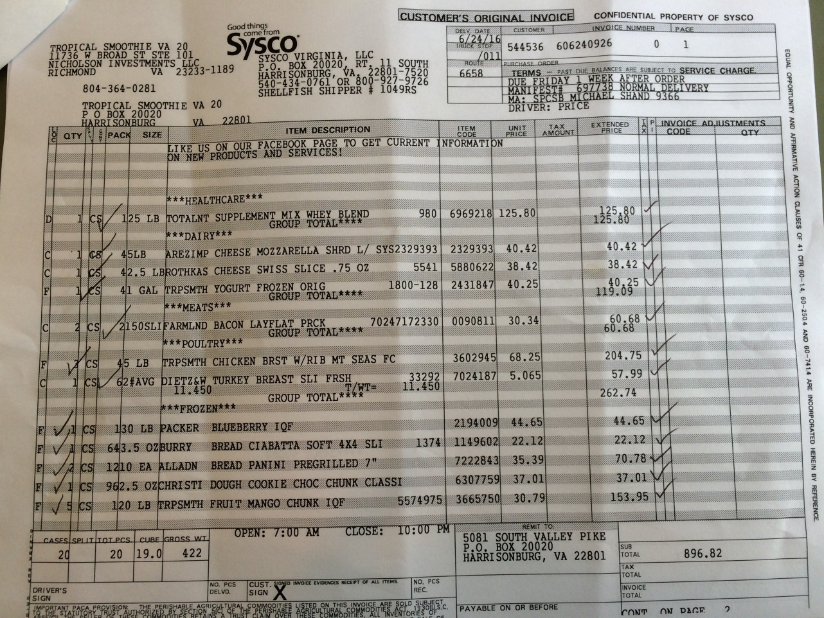
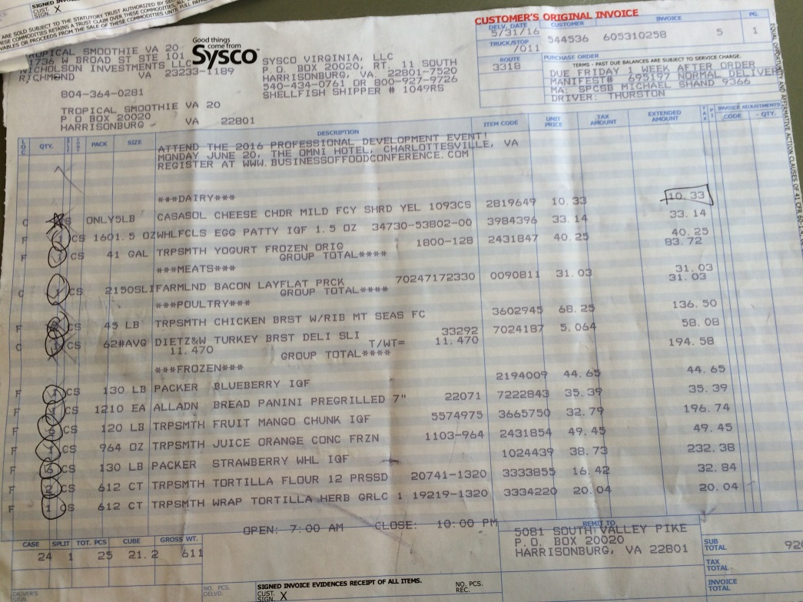
Site Visits and Invoices
Notes:
In Henrico, we also decided to go ahead and collect food specimens in whirl bags. We wanted to have food items as close to the time of when food consumption had occurred as possible. In Henrico, EH invited Epi to come along with them for the site visits. We had 4 different locations in Henrico and ¾ had been frequented by the ill case patients.

Slide 9
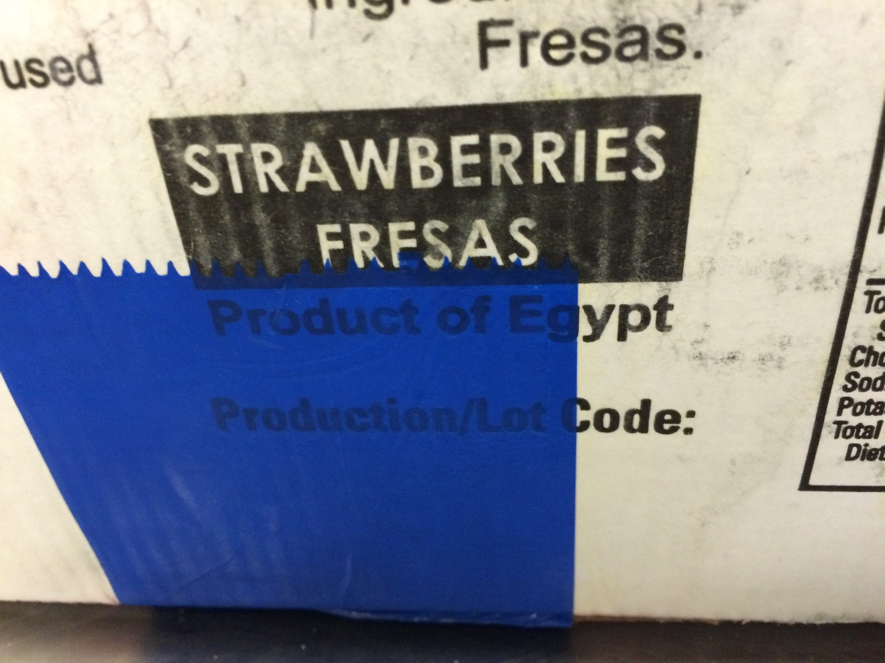
Why are your strawberries from Egypt?
Notes:
For each food product, we photographed and recorded lot numbers and looked for country of origin. We were surprised to see that the strawberries were all products of Egypt. The store manager was also surprised they were from Egypt as he said they had always previous been marked California.

Slide 10
The downside of business cards
Beautiful Saturday and I was walking to the pool…
TS Corporate could not reach anyone at CO and had my cell number
Provided background information and suspicions about the strawberries
Notes:
Hand back to Angie---
The following day, I was getting ready to enjoy some time at the pool with my family when I made the mistake of answering my work cell phone. It was the medical consultant for TS and several corporate members on a conference call. They had been trying to reach someone for hours and I was the only person they got.
I provided them with an overview of the 6 cases and the possibly implicated TS locations as best I could. I explained the 1B finding in Jonathan’s case. TS was shocked that they had Egyptian strawberries, they noted that they paid extra for large sweet California berries.

Slide 11
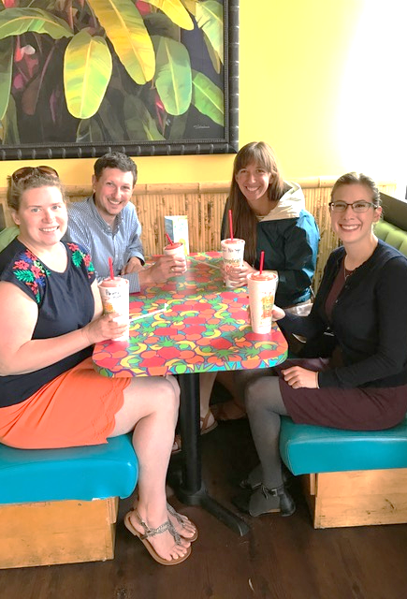
Action!
TS decided to remove all of the strawberries from their locations.
Single largest factor in curbing the outbreak!
We negotiated holding on to one box at each implicated location for testing.
Notes:
There were several calls to me throughout that weekend. Without hesitation, TS decided to remove all of the Egyptian strawberries. Ultimately, this was the single largest factor to curb the outbreak and prevent any further spread of disease.
They were going to destroy all of the berries by pouring soap over them and placing them in the dumpster. I negotiating holding at least 1 box at each of the implicated store locations as well as at any other locations where there was freezer space.

Slide 12
Public Notification
Press release was issued by VDH on Friday, August 19, 2016, informing patrons of Tropical Smoothie that they should receive PEP for HAV if they consumed strawberries.
Notes:
VDH did not issue a notification to the public until Friday, August 19.
We may have been able to prevent cases had the public been notified sooner b/c we could have initiated PEP. Releasing this information on a Friday made it difficult for the local health departments to respond to concerned calls, and we had no supplies of HAV vaccine for PEP purposes within our clinics in Central Region and across other jurisdictions in the state, which led to frustrations for both local epis and health directors but also to public dissatisfaction
Given that TS has already pulled the strawberries and since HAV is a universally recommended vaccine anyways, earlier notifications could have prevented morbidity

Slide 13
EH Actions Continued
August 19, 2016- forward…
EH revisited all locations
Collected boxed samples and delivered to DCLS
Verification checks
Recall checks
FDA results
Notes:
Hand off to Cindy
EH went out and collected the boxes of strawberries, etc…
Hand off to Andrea

Slide 14
PWHD’s events within the event

Slide 15
Supplement of PWHD Involvement in the Early Investigation
Late July/Early Aug - Also concerned over increase in Hepatitis A reports (three in one week)
Investigations initiated immediately
No out of state travel in any of the histories/No Connections
Received notice from Regional Epidemiologist and Division of Surveillance and Investigation (DSI) of increased reports in other regions as well
Re-interviewed cases with questions based on clues from Epi Investigations in the other Regions
Ultimately confirmed consumption of Tropical Smoothie Café (TSC) products in Prince William Cases
Notes:
PWHD became concerned in late July after receiving three reports of acute Hep A over the course of one week (unusual!)
Investigations were initiated immediately and significant effort was made to try and identify commonalities due to onsets and geographic proximity.
Difficult due to length of incubation period and recollection of food history etc.
Probed about potential for common grocery stores fresh/frozen produce, farmer's markets, church/community activities, Fourth of July, recreational and water activities, etc.
Otherwise seemingly unrelated
No out of state travel in any of the histories.
Through Regional and DSI- informed of increased reports in other regions as well
All three were re-interviewed with more probing questions based on epi info coming from other regions’ investigations
In conjunction with the initial genotyping results of the 1B, Ultimately confirmed TSC consumption with PWHD cases

Slide 16
Supplement of PWHD involvement in the early investigation
Within 24-48 hours of the involved regions all confirming TSC connections:
Public Health Nurses (PHNs) coordinated case samples for submission to Centers for Disease Control (CDC) for genotype testing
Environmental Health (EH) contacted the owner/operators of the establishments and initiated inspections- also noted Egyptian strawberries
Owners were communicating with employees reinforcing employee health requirements
Notes:
In conjunction with the initial genotyping results of the 1B, Ultimately confirmed TSC consumption with PWHD cases
Within 24-48 hours of the lead, CD PHNs were coordinating samples for submission to CDC testing and EH was in contact with owner/operators owners communicated with employees, strawberries highly suspect

Slide 17
A time of uncertainty….
Between initial PWHD investigations and VDH release, PWHD had no new cases
As a result, PWHD uncertain about what impact to expect from public
Upon notification of VDH Press Release, Senior PHNs reached out to local providers to gather picture of Immune Globulin (IG) and HAV Vaccine availability
After VDH release activity began to pick up with calls and questions
A few additional cases were investigated and staff was allocated to ensure team was supported to handle potential influx
Notes:
Between initial PWHD investigations and VDH release, PWHD had no new cases (approx 3 weeks)

Slide 18
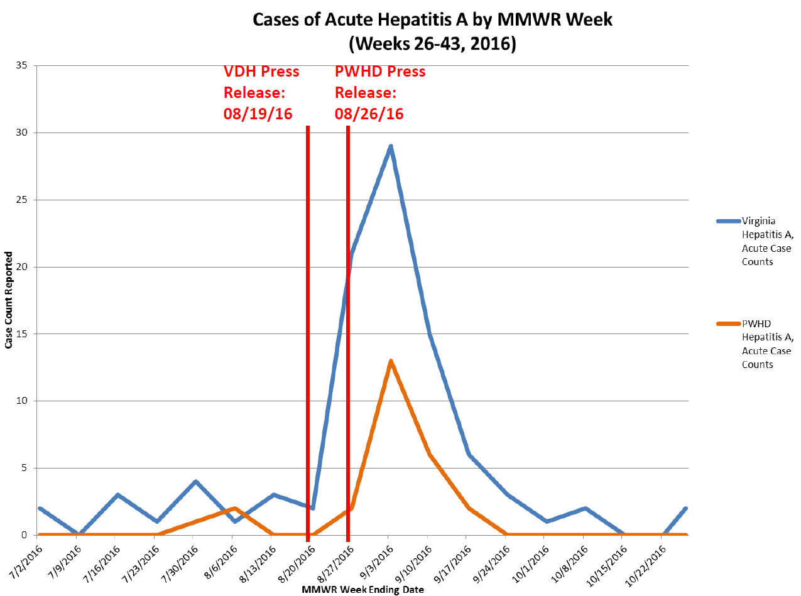

Slide 19
And so begins, an event within an event:

Slide 20
Day 1
Thursday afternoon (8/25/2017 at 14:30)
Less than 1 week after VDH press release, PWHD was contacted by DSI regarding report from TSC Corporate Medical Consultant
Diagnosis of acute HAV in TSC employee
Investigation began immediately
Employee was very cooperative and forthcoming with information
Consented to PWHD communication with employer
Several issues raised concerns which would warrant public notification
PWHD Leadership informed of situation and EP&R Coordinator was brought into the response at 16:30

Slide 21
Day 1
Thursday Night (8/25/2017):
PWHD communicated with VDH, TSC Corporate Medical Consultant, and Store Owner
Primary issues were employee Postexposure Prophylaxis (PEP) and potential for patron notification
Due to expanding incident and need for coordination, PWHD scheduled a conference call for morning
Conference call scheduled for: PWHD, DSI Foodborne Epi (Regional Epi out office), Regional PIO (also out of office Day 1, Returned Day 2), Store Owner and Corporate Medical Consultant
VDH Leadership ultimately took command for directing the coordination call scheduled for the following morning and introduced an expectation for press release to be prepared for dissemination approximately 12 hours later
Challenging to prepare for press release prior to coordination call

Slide 22
Day 2
Friday Morning (08/26/2017):
EP&R Coordinator scheduled internal conference call to set battle rhythm for response
Internal PWHD conference call conducted to prepare for the VDH/TSC call
VDH/TSC Coordination call:
Revealed conflicting information
Due to concerns for public health, all agreed for the need to act on information obtained during PWHD interview
Concluded contact investigation would focus on:
General public notification
TSC employee assessments
Notes:
Friday Morning:
EP&R Coordinator scheduled internal conference call to disseminate ICS 201, identify staff positions, and set battle rhythm for response
Internal PWHD conference call conducted to prepare for the VDH/TSC call:
With limited foresight into the outcome of the scheduled coordination call, local IMT identified the need to have planning call following the VDH led call
VDH/TSC Coordination call:
PWHD provided situation update which revealed two VERY different accounts of illness history and activities during the infectious period.
Due to concerns for public health, all agreed for the need to act on information obtained during PWHD interview.
Considered tracking patrons by sales receipts but logistically was not feasible
Contact invetigation:
General Public Notification
TSC Employee Assessments

Slide 23
Day 2 – Let the Panic Begin: General Public Notification
10:30: VDH/TSC Coordination call concluded
Joint press conference scheduled for 12:00
Opportunity for internal planning meeting eliminated
Involved PWHD staff were dispersed throughout the district
PIO from both VDH & TSC worked to establish mutually agreeable messaging to demonstrate difference from prior VDH statement
Notes:
10:30: VDH/TSC Coordination call concluded at 10:30 with joint press conference (PWHD & Local TSC Owner) scheduled for 12:00 at central PWHD location
Accelerated timeline eliminated opportunity for internal planning meeting
PWHD staff dispersed throughout the district were challenged with:
Driving to location of press conference
Locating appropriate attire (some ran home, some ran to the store, some borrowed from colleagues)
Establish talking points for the media and the agency representatives
Script, translate, and record PWHD call-line which would be announced in the press release and press conference
Notify staff of impending press release
PIO from both VDH & TSC worked to establish mutually agreeable messaging

Slide 24
Day 2- EP&R Concerns
EP&R identified need for EH, EP&R, Health Director, Epi, and PIO to meet in one location.
Unable to meet at Health Department Operations Center (HDOC) due to scheduled press conference at Lee Ave. location. Group met at Lee Ave.
EP&R Coordinator brought supplies for temporary HDOC
Internet outage at Lee Ave. location
Notes:
EP&R identified need for EH, EP&R, Health Director, Epi, and PIO to meet in one location.
Unable to meet at HDOC due to scheduled press conference at Lee Ave. location. Group met at Lee Ave.
EP&R Coordinator brought supplies for temporary HDOC
Internet outage at Lee Ave. locationcould not communicate with central office via email. Central Office had to fax press release.

Slide 25
Day 2 (+) Employee Assessments
Owner agreed to compile list of TSC employees for public health assessment
Priority 1: Exposed & within window for PEP
Priority 2: Exposed & beyond window for PEP
PHN team assigned to Hep A response split into two “units”
TSC Employee Assessments
Non-Employee reports
Varying recommendations for those with prior immunity, those who received PEP, and those without immunity or PEP
All employees assessed (few with leverage from employer)
All available employees were given PEP on the afternoon of Day 2
Notes:
During VDH/TSC call, Owner agreed to compile list of TSC employees for public health assessment
Two Tiers
Tier 1: Exposed & within window for PEP
Tier 2: Exposed & beyond window for PEP
PHN team (already actively engaged in the larger Hep A response) split into two “units”
TSC Employee Assessments
Non-Employee reports
Varying recommendations for those with prior immunity (monitor for s/s), those who received PEP (PAGE 13 DCM and page 5 of 100), and those without immunity or PEP (exclusion? Page 5 of 100)
Several were able to prove prior immunity
All employees assessed (few with leverage from employer)
All available employees were given PEP on the afternoon of Day 2

Slide 26
Through the Weekend and Beyond….
Personnel assigned to return calls within 2 hours between 8am and 5pm
Sit Reps sent to Local and VDH Leadership through PEP window (of PWHD event)
Updated local line when PEP window changed, returned calls within 1 business day
Continued to coordinate with TSC location owner/operator to provide technical assistance and conduct health surveillance for employees
Ensured media statements distributed through various means (IPs, blast fax, etc.)
Notes:
Challenging to outline the differences for the specified timeframe being announced by the PWHD press release:
ALL food items (not only Strawberries)
ONLY at this location (not statewide TSC locations)
Also had to take into account days in which case did not work but products prepared by pt were served
Assigned response personnel for returning calls within 2 hours from 8-5 (urgent, not emergent) phone could be checked off site and rotating field phones sent home with those assigned personnel. Also linked voicemail to automated email which sent message to defined distribution list.
Updated local line when time period for PEP changed and continued to return calls within 1 business day
Continued direct liaison with owner/operator to answer questions/concerns and conduct health surveillance for employees
Talking points from VDH were very helpful but unclear to staff what was public information versus internal
Ensured media statements shared with IPs, UCs, blast fax, etc.

Slide 27
Successes
Teamwork/Division of activities
No secondary cases
Process was familiar- increased volume of routine investigations
Collaboration between jurisdictions was seamless
Support from Regional Epi and DSI for coordination of labs, flow of information
Talking Points from DSI

Slide 28
Challenges
Explaining seemingly conflicting information in local vs. state-wide press release
Staff unclear which talking points were internal vs. public information
PWHD CD Staff spread thin
Many TSC staff had left PWHD area to return to college
Additional food service worker suspected cases identified
Medical community’s evaluation of appropriate PEP timeframes and vaccine
Notes:
Challenging to outline the differences for the specified timeframe being announced by the PWHD press release:
-ALL food items (not only Strawberries)
-ONLY at this location (not statewide TSC locations)
-Also had to take into account days in which case did not work but products prepared by pt were served
Talking points from VDH were very helpful but unclear to staff what was public information versus internal

Slide 29
Lessons Learned
Statewide Event/Overall:
Prophy of food service ? Ultimately 2 cases (no change in dates)
Timing is important-Timeframe from initial release was not conducive to public clinic within PWHD to screen and offer PEP
Identification of internal versus external information
Could/Should have involved local EP&R earlier
Local Event within Event:
Should have anticipated concerned patrons presenting to the physical food establishment
Challenge with Central Office establishing local timelines (unable to set battle rhythm at the local level)

Slide 30
Lessons Learned
Informing EP&R Earlier in initial incident for situational awareness-
Could have made recommendations which would have smoothed the response to the “Event within the Event”
For example: enlist additional staff to triage phone calls, begin EP&R documentation of response (IAP), etc.
Could have intervened to establish more manageable timelines between VDH & PWHD
Important to clearly identify lead agency for response
Internet hot spots for backup
Internal Staff Notifications: Need to remember that all staff represent PWHD in the community and need to be aware of high-profile events involving PWHD
Notes:
If PWHD EP&R coordinator had been involved in the earlier response activities associated with VDH press release, could have improved response to event within event
By the time out of “crisis mode”, end of business day on a Friday and too late to loop in additional staff
EP&R looped in earlier: Could not obtain necessary info to document response (IAP, useful for future responses) without significantly slowing down timeline

