Slide 1
VDH Readiness Academy Planner Session

Slide 2
PHEP Capability 7: Mass Care Sheltering
The ability to coordinate with partner agencies to address the public health, medical, and mental/ behavioral health needs of those impacted by an incident at a congregate location. This capability includes the coordination of ongoing surveillance and assessment to ensure that health needs continue to be met as the incident evolves.

Slide 3
Related PHEP Functions
Function 1: Determine public health role in mass care operations
Function 2: Determine mass care needs of the impacted population
Function 3: Coordinate public health, medical, and mental/behavioral health services
Function 4: Monitor mass care population health

Slide 4
General
Local sheltering is a responsibility of the local jurisdiction: usually under ESF-6, headed by DSS.
Most LHD’s are involved in coordinating the staffing to support the ESF8 component of shelter operations.
Most LHDs in Virginia have experience supporting local sheltering operations
There has been excellent collaboration by LDHs with their local partners in many jurisdictions
The efforts to create, build and maintain MRCs has and will continue to benefit shelter support
First to report upon activation may be PH personnel
Not all PHNs have skill sets/competencies needed for Special Medical Needs (SMN) section of shelters

Slide 5
Survey Results
100% report EH and Disease Surveillance/Investigation support capability in shelters
Ninety four (94) percent report MRC support of shelter operations
Seventy one(71) percent report assigning LHD nurses to shelters for support
Sixty nine (69) percent report a screening/triage capability
Sixty three (63) percent report EMS support of shelter operations
Fifty four (54) percent report a medically fragile evacuee clinical support capability
Fifty one (51) percent report CSB support of shelter operations
Forty nine (49) percent report a WIC counseling support capability
Thirty seven (37) percent report basic first aid support capability
Twenty nine (29) percent report local hospital support of shelter operations

Slide 6
LHD Tasks
Be prepared for self-sufficient operations landfall (L) to L+72 hours
Strengthen (recruit and train) MRCs
Coordinate for private sector healthcare support
Engage Nurse Managers in all facets of this effort
PRE-EVENT: Coordinate with local Emergency Management and other private and public sector partners
Tension: Hospitalization vs. shelter for medically fragile
Staffing Expectations
DURING:
Intake
First Aid
Counseling

Slide 7
2017 National Security Health Preparedness Index
NHSPI is a tool for identifying both strengths and gaps in the protections needed to keep people safe and healthy in the face of large scale public health threats. This fourth release of the Index combines 139 measures from 59 sources.
Virginia’s overall index score for the 2017 NHSPI is 7.5, tied for number two overall among states’ scores. The overall national average is 6.8. Scores are based on a 10-point scale.
Index report concerns VDH, but also other state agencies: DCLS/DGS, VDBHDS, VDACS, VDOE, VDEQ, VDSS, health care facilities and EMS community, and local partners and private sector.

Slide 8
Community Planning and Engagement
Gaps
State Public Health Accreditation
Percentage of 1) Emergency Management and 2) Emergency Medical Services Agencies participating in Healthcare Coalitions
Percentage of population, 19 years or younger residing within 50 miles of pediatric trauma center.
Proportion of Medical Reserve Corps (MRC) members who are physicians.
Low Annual Adult Volunteer Rate

Slide 10
Virginia Zika Task Force
May 1, 2017
Office of the Governor
Commissioner VDH
Virginia Zika Task Force
VDEM
VDH OEP
Governor’s Office Representative
Lt. Governor’s Office Representative
Clinician Outreach Task Group
Communications Task Group
Human Surveillance Task Group
Maternity Health Task Group
Mosquito Control Task Group
Blood/Tissue Safety Task Group
Others
Lead: VDH ORCE
DVS
Lead: VDH OEPI
Lead: VDH OEPI
Lead: Virginia Mosquito Control Association
Lead: American Red Cross
DBHDS
Input from all Task Groups
DGS DCLS
VDH Office of Family Health Services
Virginia Blood Services
DOE
LEGEND:
BHDS: Virginia Department of Behavioral Health and Developmental Services
DCLS: Division of Consolidated Laboratory Services
DCR: Virginia Department of Conservation and Recreation
DGS: Virginia Department of General Services
DOE: Virginia Department of Education
DVS: Virginia Department of Veterans Services
OEP: Office of Emergency Preparedness
OEPI: Office of Epidemiology
ORCE: Office of Risk Communications and Education
SCHEV: State Council of Higher Education for Virginia
VACO: Virginia Association of Counties
VCU Health: Virginia Commonwealth University Medical Center
VDEM: Virginia Department of Emergency Management
VDH: Virginia Department of Health
VDOF: Virginia Department of Forestry
VDGIF: Virginia Department of Games and Inland Fisheries
VHHA: Virginia Hospital and Healthcare Association
VML: Virginia Municipal League
SCHEV
VDACS
VDH OEPI
DGS
VDGIF
VHHA
VDOF
DCR
MSV
VACO
State agency
Private Sector
VML
Non-governmental organization

Slide 11
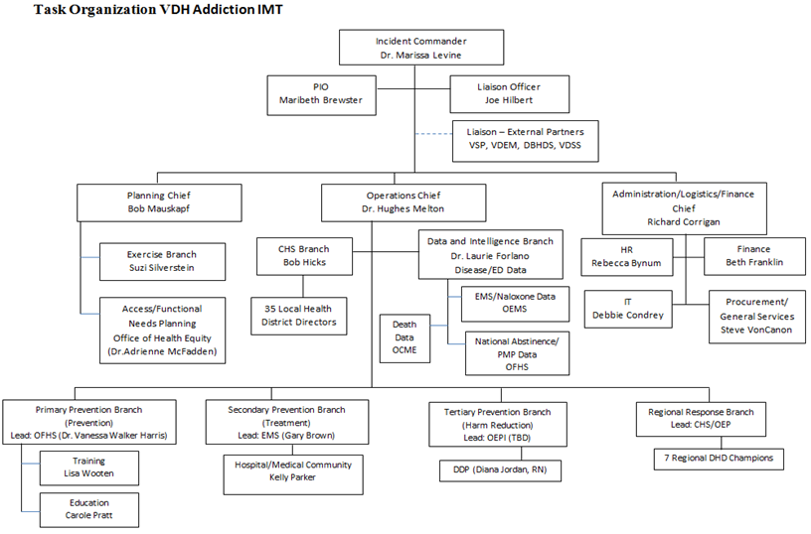

Slide 12
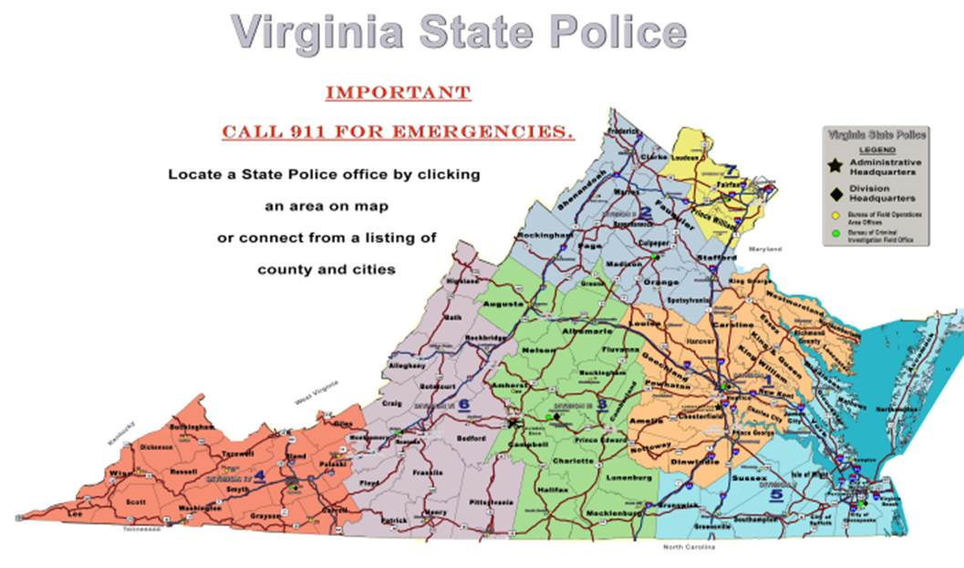
Virginia Zika Task Force
May 1, 2017
Office of the Governor
Commissioner VDH
Virginia Zika Task Force
Alison Ansher MD, MPH
Lorrie Andrew-Spear, PIO
Jeff Walker, Emergency Coordinator
VDEM
VDH OEP
Governor’s Office Representative
Lt. Governor’s Office Representative
Wade Kartchner, MD, MPH
Lorrie Andrew-Spear, PIO
Michael Keatts, Emergency Coordinator
Clinician Outreach Task Group
Communications Task Group
Human Surveillance Task Group
Maternity Health Task Group
Mosquito Control Task Group
Blood/Tissue Safety Task Group
Others
Tom Franck, MD, MPH
Matt Lipani, PIO
James Moss, Emergency Coordinator
Lead: VDH ORCE
DVS
Lead: VDH OEPI
Lead: VDH OEPI
Lead: Virginia Mosquito Control Association
Lead: American Red Cross
Laura Kornegey, MD, MPH
Bobby Parker, PIO
Becky McCabe, Emergency Coordinator
DBHDS
Input from all Task Groups
DGS DCLS
VDH Office of Family Health Services
Virginia Blood Services
DOE
LEGEND:
BHDS: Virginia Department of Behavioral Health and Developmental Services
DCLS: Division of Consolidated Laboratory Services
DCR: Virginia Department of Conservation and Recreation
DGS: Virginia Department of General Services
DOE: Virginia Department of Education
DVS: Virginia Department of Veterans Services
OEP: Office of Emergency Preparedness
OEPI: Office of Epidemiology
ORCE: Office of Risk Communications and Education
SCHEV: State Council of Higher Education for Virginia
VACO: Virginia Association of Counties
VCU Health: Virginia Commonwealth University Medical Center
VDEM: Virginia Department of Emergency Management
VDH: Virginia Department of Health
VDOF: Virginia Department of Forestry
VDGIF: Virginia Department of Games and Inland Fisheries
VHHA: Virginia Hospital and Healthcare Association
VML: Virginia Municipal League
SCHEV
Sue Cantrell, MD
Bobby Parker, PIO
Becky McCabe, Emergency Coordinator
VDACS
VDH OEPI
DGS
VDGIF
VHHA
VDOF
DCR
MSV
VACO
State agency
Kerry Gateley, MD, MPH
Matt Lipani, PIO
Michael Keatts, Emergency Coordinator
Private Sector
Heidi Kulberg, MD
Larry Hill, PIO
Judy Cooling, Emergency Coordinator
Non-governmental organization
VML

Slide 13
Exercises
Marble Challenge TTX 6/27 FSE, Oct 24-25
UASI TTX 6/8 (NCR SNS) at RSS, Sandston
Collecting data on LHD Mass Vacc Exercises in Fall. Developing Report Card???
National Level Event (NLE) EXERCISE ARDENT SENTRY / ATLANTIC FURY, 7-11 May 2018
Pt Mvt TTX, Jan-Feb/18
PanFluEx, TBD (Fall 18)

Slide 14
Pilot Programs
Operational Readiness Review
Mission Ready Packages
Private Sector Pharmacy Partners

Slide 15
PanFlu Planning
Reenergized Emphasis / Updated CDC Guidance
Priority Populations
Critical Infrastructure
Continuity of GOVERNMENT
Private / Public Partnerships
Feds will turn to us for vaccine
H1N1 ops will evolve
OEpi-Immunizations and OEP will be joined at the hip
Need to reenergize Immunization Registry
What are your expectations vis a vis report card?

Slide 16
Plans
Update StratPlan conforming to Grant Applications and state requirements. Adding NHSPI gaps findings
Publish updated VDH ERP
Complete review of ESF-8 portion of COVEOP
Prep for Hurricane Season (focus on Shelter VDH staffing)
COOP delivered 4/1 to VDEM…internal input posted to SHAREPOINT

Slide 17
Questions?
Dr. Hughes Melton, Chief Deputy Commissioner Public Health and Preparedness
Hughes.melton@vdh.virginia.gov
804-864-7025
Bob Mauskapf, Director Emergency Preparedness Bob.Mauskapf@vdh.virginia.gov
804-864-7035
Cindy Shelton, Assistant Director, Emergency Preparedness
Cindy.Shelton@vdh.virginia.gov
804-864-7486
Jennifer Freeland
VDH State Volunteer Coordinator
Jennifer.freeland@vdh.virginia.gov
804-396-0543
Kim Allan, Operations Director
Kim.Allan@vdh.virginia.gov
804-864-7030
Suzi Silverstein, Director, Risk Communications and Education Suzi.Silverstein@vdh.virginia.gov
840-864-7538
Patrick Ashley, Hospital Emergency Coordinator
Patrick .Ashley@vdh.virginia.gov
804-864-7033
General Info / Contact
http://www.vdh.virginia.gov/OEP/

