Slide 1
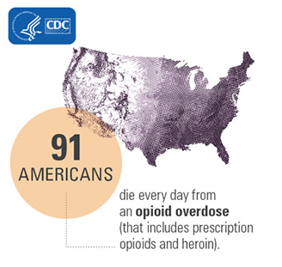
Addiction and the Preparedness Community Henrico County’s Response to the Opioid Epidemic
Henrico County Health District
Susan Fischer Davis, M.D., Director
Virginia Public Health and Healthcare Preparedness Academy
June 1, 2017

Slide 2
Outline
Henrico Heroin Task Force
Members
The Charge
Henrico Health Department Role
Meetings
Report to the County Manager
Recommendations and Actions
Power Point Example: The Opioid Epidemic: Henrico County Response

Slide 3
Henrico Heroin Task Force

Slide 4
Henrico Heroin Task Force
Appointed by John Vithoulkas, County Manager, 5/16
Members
Humberto Cardounel, Police Chief
Susan Fischer Davis, MD, Director, Health Department
Tony McDowell, Fire Chief
Shannon Taylor, Commonwealth’s Attorney
Michael Wade, Sheriff
Laura Totty, Director, Mental Health and Developmental Services, Chair
Beth Teigen, Ph.D. Assistant Superintendent for Instruction Henrico County Public Schools
Judge John Marshal, Circuit Court
Notes:
Mental Health charged with leading the Task Forcee
Others participate periodically, including Laura Young, Henrico Health District Epidemiologist

Slide 5
Henrico Heroin Task Force Opioid Summit – March 1, 2017

Slide 6
Heroin Task Force – The Charge
What efforts are currently underway in Henrico County to address the heroin/opioid issues? Specifically, what is each agency doing and how are we coordinating our efforts?
Within our current funding resources, are there enhancements that can be made to strengthen our efforts?
What suggestions do we have for additional resources?

Slide 7
Heroin Task Force - HCHD’s Role
Public health data providers
Centers for Disease Control and Prevention
VDH OCME: Fatal Drug Overdose Quarterly Report
VDH OEPI Syndromic Surveillance: Emergency Department Visits for Overdose by Opioid, Unspecified Substance and Heroin Among Virginia Residents
Notes:
Role right from the start. Used this ability to kick-start the Task Force and to get everyone on the same page.
Syndromic surveillance is a strategy used by public health to detect emerging issues and monitor the health of people in the community. Virginia Department of Health’s (VDH) Office of Epidemiology collects and analyzes health data from participating emergency departments and urgent care centers to identify emerging trends of public health concern. The data are categorized into syndromes based on the patient’s reason for visit (chief complaint) or diagnosis. Analytic tools are then used to rapidly identify unusual patterns in time or space that might indicate situations of concern. The geographic location is assigned based on the patient’s residential zip code provided.
The Virginia Department of Health (VDH) receives data on visits to 82 acute care hospital emergency departments (EDs) and 13 free-standing EDs in Virginia for purposes of public health surveillance.
The discharge diagnosis is a coded field that uses standardized values outlined by the International Classification of Diseases (ICD) 9th and 10th Revision code sets.

Slide 8
Heroin Task Force - HCHD’s Role
Data assimilators
Division of Fire
Division of Police
Sheriff’s Office
Mental Health and Developmental Services
Commonwealth’s Attorney Office
Notes:
Round out the description of the epidemic and the impact on local government services

Slide 9
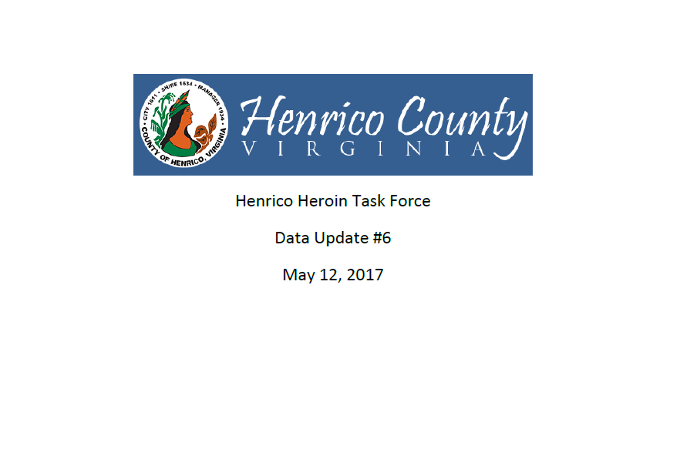
Notes:
Usually about 5 pages in length.

Slide 10
Henrico Heroin Task Force Meetings
May 13, 2016
Topic: Data sharing, current practices and initiatives, challenges of 6 departments, planning
Experts: Task Force members
May 27, 2016
Topic: Treatment options, recovery, barriers, personal testimony
Experts: LCSW Program Director, Family Counseling Center for Recovery; Medical Director, The Coleman Institute; Ops Manager, McShin Foundation; Treatment Consultant, American Addiction Centers; Participant, Henrico ORBIT Program
Notes:
In addition to sharing data at meeting, there is a topic/speaker.

Slide 11
Henrico Heroin Task Force Meetings
June 10, 2016
Topic: Issues Facing Schools, Interventions, Criminal Justice
Experts: Director of Counseling, Godwin HS Principal, Security, HCPS; Supervisor, Drug Court; Ops Manager, McShin Foundation; Treatment Consultant, American Addiction Centers
June 24, 2016
Topic: Personal testimony, problems with the system, barriers to treatment, solutions
Experts: RISE and ORBIT program participants, Henrico Jail East
Notes:
RISE: Recovery in a Secure Environment
RISE – Phase I
Named “PROJECT HOPE” by the participants, this fourteen-hour per day program at Henrico County’s Jail East offers a long-term, jail-based addictive behaviors treatment program to inmates. The program consists of separate housing for participants which becomes a milieu in which persons can take a good, hard, honest look at themselves. Members are interviewed prior to being included in the program in order to determine their appropriateness and motivation for the program. This program is not funded by any additional taxpayer money and considered to be unique in its approach.
RISE – Phase II
On August 15, 2000, a 36-bed therapeutic community was started at Henrico County Regional Jail East. PROJECT FRESH START consists of separate housing for participants, a twelve-hour per day schedule of activities. Members participate in five-week, twenty- five hour sessions of the pre-treatment, motivational program, “LIFE WITHOUT A CRUTCH.” Upon completion of the initial five- weeks, they continue for at least three cycles as mentors on a decreasing frequency basis. Graduates of LWC immediately begin a twice-weekly relapse prevention group. Henrico Mental Health/ Substance Abuse jail team members facilitate these groups, participate in community meetings, offer guidance to security staff and direct the program.
Jail East pod housing participants in Project Hope. Inmates must show participation and obey the rules of the program. Currently 100 inmates are part of the addiction/abuse program
New Beginnings
Applying the same theory to female addicts, New Beginnings offers parallel programs to “PROJECT FRESH START” and “PROJECT HOPE” to women with similar schedules and programming. Because of the unique recovery needs of women, specialized programs such as “HELPING WOMEN RECOVER” and numerous topics on healing after periods of abuse have been incorporated.
ORBIT Program
Run by Henrico Sheriff and Drug Court. 12 months in length with at least 6 months taking place while inmates are housed in the Henrico Jail. The remaining 6 months is a combination of work release and community service with ongoing in-jail supervision.

Slide 12
Henrico Heroin Task Force Meetings
July 7, 2016
Topic: Emergency department response opioids, opportunities to collaborate, enhancing treatment options at discharge
Experts: Director, VA Poison Center; Medical Director, VA Poison Center; Director, Emergency physicians, Bon Secours
July 16, 2016
Topic: Criminal justice, alternative sentencing, day reporting centers
Experts: Judge, Henrico Circuit Court; Judge, General District Court; Chief, Henrico Probation and Parole

Slide 13
Henrico Heroin Task Force Meetings
July 22, 2016
Topic: Family member experience, barriers to treatment, solutions
Experts: Family members of individuals with substance use disorder

Slide 14
Henrico Heroin Task Force Report, 8/1/16 Contents
Executive Summary
Background
Defining the Problem
Henrico Health District, VDH
Division of Fire
Division of Police
Commonwealth’s Attorney’s Office
Sheriff’s Office
Mental Health and Developmental Services
Meetings
Recommendations
Prevention
Treatment
Communication
Criminal Justice System
Resources
Notes:
Between July 22 and August 1, 2016, wrote report for the County Manager. Task Force met with the County Manager pm August 1, 2016 to present report.

Slide 15
Henrico Heroin Task Force Recommendations and Actions
Prevention
Hold 6 prevention/awareness activities before 6/2017
Sponsored A Community Summit on the Heroin/Opioid Epidemic – Engaging Our Community to Find Solutions
Keynote Speakers
James B. Comey, Former Director, FBI
Chuck Rosenberg, Administrator, DEA
Link to Summit video: http://henrico.us/news/2017/03/community-summit-on-heroin-and-opioid-crisis
Expand drug take-back events – April 29, 2017
Create school division task force to educate students and families
Provide “hands only” CPR for community
Include opioid overdose and treatment education as part of CPR class for middle- and high-schoolers
Notes:
Over 600 attendees at Opioid Summit

Slide 16
Examples of Recent Community Events Related to Opioid Epidemic
March 13, 2017: Fairfield Town Hall, 7:00 pm, East Rec Center
April 3, 2017: Heroin Hardest Hit, 7:00 pm, Godwin and Freeman High Schools
April 26, 2017: New Kent County Town Hall, 6:00 pm
April 27, 2017: Fairfield Town Hall Eastern Henrico Recreation Center, 7:00 pm
April 29, 2017: Regional Town Hall Meadowbrook High School Delegate Aird(63rd ), Delegate Bagby (74th), Delegate Bourne (71st), Delegate McQuinn (70th), 10-12
April 29, 2017: DEA - Drug Take Back: https://apps.deadiversion.usdoj.gov/pubdispsearch/spring/main?execution=e2s1
May 2, 2017: Chris Herren, 7:00 pm, Deep Run High School
Notes:
14 community events since mid-March 2017
Link to DEA’s Controlled Substance Public Disposal Locations; enter zip code and search radius for locations

Slide 17
Recent Community Events Related to Opioid Epidemic
May 2, 2017: Varina Town Hall Henrico Theater, 6:30 pm
May 4, 2017: Henrico Citizen’s Academy, 6:00 pm
May 10, 2017: Brookland Town Hall, Board Room, Government Center, 7:00 pm
May 18, 2017: bouncebackhc.com web-site launched
May, 2017: Henrico Today article: Henrico Confronts Opioid Epidemic
May, 24, 2017: Tuckahoe Town Hall, Tuckahoe Library and live stream, 6:30 pm
June 13, 2017: Revive training for the community Woodman Road, 5:30-7:00 pm

Slide 18
Henrico Heroin Task Force Recommendations and Actions
Treatment
Explore grant opportunities for treatment options
Priority: addressing gaps in the continuum of treatment for individuals in court system
Received $50,000 grant from VA Supreme Court for Vivitrol Treatment Program in Drug Court
Encourage use of peer recovery coaches/support
Create online reference guide of available resources
Bouncebackhc.com – launched 5/18/17
Magnets with bouncebackhc.com available 6/1/17
Develop protocols with EDs that assure a warm hand-off to increase likelihood of treatment initiation
Expand availability of naloxone

Slide 19
Henrico Heroin Task Force Recommendations and Actions
Communication
Continue monthly meetings of Heroin Task Force
Create a comprehensive data situation report
Ensure all EMS providers have information and skills necessary to respond to opioid overdose

Slide 20
Henrico Heroin Task Force Recommendations and Actions
Criminal Justice System
Conduct cost-benefit analysis of instituting a Day Reporting Center
Provide wraparound recovery program for post-RISE/ORBIT individuals to reduce likelihood of relapse/re-incarceration
Explore alternatives to/expansion of Henrico Drug Court

Slide 21
Board of Supervisors – New Budget Item
$200,000.00 for Heroin Task Force
Will be used for prevention efforts
Available after July 1, 2017

Slide 22
Power Point for Presentations to Henrico Community, County Management, and Board of Supervisors

Slide 23
The Opioid Epidemic Henrico County Response
Henrico Area Mental Health
and Developmental Services
Laura S. Totty, Director
Henrico County Division of Police
Dirk D. Engels, Captain
Henrico County Health Department
Susan Fischer Davis, M.D., Director
May 24, 2017
Notes:
Thank Laura Young, HCHD Epidemiologist, and Rosie Hobron, Office of the Chief Medical Examiner Epidemiologist, for their assistance with the data preparation for this talk.
91 Americans die every day from an opioid overdose
3 Virginians die every day from an opioid overdose
Nearly every week 1 person dies in Henrico County from an opioid overdose
Behind every death statistic there is a life lost, often a life of a young adult. Behind every life lost are grieving families and loved ones. Behind every life lost is a community, such as Henrico, struggling to find solutions to this devastation.
We know that these numbers are just the tip of the iceberg and that for every person who dies from an opioid overdose, hundreds more are suffering with an opioid use disorder.

Slide 24
Outline
Opioid overview
Opioid overdose death data
United States
Virginia
Henrico County
Henrico Heroin Task Force
Opioid statistics summary
Resources
Questions
Notes:
In order to get everyone on the same page about the breadth of the opioid epidemic and to help prepare for the discussions we will have tonight, our presentation will include a brief overview of selected opioids, a review opioid overdose death data for the US, VA, and Henrico, and an update on the work of the Henrico Heroin Task Force.

Slide 25
Opioids
Heroin
Fentanyl
Carfentanil
Oxycodone (OxyContin)
Hydrocodone (Vicodin)
Morphine
Codeine
Methadone
Notes:
Opioids are a class of drugs that act directly on the central nervous system to reduce pain.
Opioids we hear about related to the current opioid epidemic include illicit or illegal opioids such as heroin, non-pharmeceutical fentanyl, and carfentanil, as well as prescription opioids such a OxyContin and codeine, which have the potential for misuse.
________________________________________________________________________________________________________________________
Natural opioid analgesics including morphine and codeine, and semi-synthetic opioids analgesics, including oxycodone (OxyContin) and hydrocodone (Vicodin)
Methadone, a synthetic opioid
Synthetic opioid analgesics other than methadone, including tramadol, fentanyl, carfentanil; and
Heroin: illegally made and synthesized from morphine

Slide 26
Heroin
Made from morphine which is found naturally in the seedpods of poppy plants
Symptoms of overdose: slow and shallow breathing, constricted pupils, blue lips and fingernails, clammy skin, seizures, coma, death
Typically injected but can be smoked or snorted
Illegal and highly addictive
Notes:
This is a picture of poppy plants which may be familiar to you from the scene in the Wizard of Oz where Toto, Dorothy, and the Lion fall asleep while running through a poppy field on their way to the Emerald City. Drowsiness is one of the side effects of heroin and other opioids. Symptoms of heroin overdose include slow and shallow breathing, constricted pupils, coma, and death.
______________________________________________________________________________________________________________________________
Where is morphine found?
Morphine is the most abundant opiate found in opium, the dried latex extracted by shallowly scoring the unripe seedpods of the Papaver somniferum poppy.

Slide 27
Heroin - Risk Factors
Past misuse of prescription opioids strongest risk factor for starting heroin
More than nine in 10 people who use heroin also used at least one other drug
Injecting heroin increases the risk for HIV, hepatitis B and C
28% increase in rate of reported of hepatitis C cases in Virginia between 2010 and 2015
Notes:
_____________________________________________________________________________________________________________________________________________________
Heroin use has been increasing in recent years among men and women, most age groups, and all income levels. Some of the greatest increases have occurred in demographic groups with historically low rates of heroin use: women, the privately insured, and people with higher incomes. In particular, heroin use has more than doubled in the past decade among young adults aged 18 to 25 years.
The rate of reported cases of Hepatitis C (HCV) in VA increased 28% between 2010 and 2015, with the primary risk factor being injection drug use.

Slide 28
Fentanyl
50x more potent than heroin
100x more potent than morphine
Two types:
Pharmaceutical: primarily prescribed to manage pain associated with advanced cancer
Non-pharmaceutical: illicitly manufactured and often mixed with heroin with or without the user’s knowledge
Notes:
Synthetic opioid
____________________________________________________________________________________________________________________________________________________
Brand names: Duragesic · Actiq · Abstral · Subsys · Fentora · Sublimaze · Lazanda · Ionsys · Onsolis · fentaNYL Citrate Novaplus· fentaNYL Transdermal System Novaplus · Duragesic Mat

Slide 29
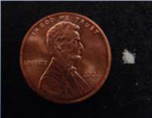
Carfentanil
Analog of fentanyl
10,000x more potent than morphine
100x more potent than fentanyl
General anesthetic or tranquilizer for large animals, such as elephants
Can be absorbed through skin or inhaled and presents a danger to first responders and others
Identified for first time in VA in 11/2016
Notes:
Carfentanil is an analog or similar to fentanyl
The lethal dose range for carfentanil in humans is unknown; however, carfentanil is approximately 100 times more potent than fentanyl, which can be lethal at the 2-milligram range (photograph), depending on route of administration and other factors.
Picture from a DEA Officer Safety Alert: Carfentanil: A Dangerous New Factor in the U.S. Opioid Crisis
___________________________________________________________________________________________
It is marketed under the trade name Wildnil as a general anaesthetic agent for large animals, such as elephants.

Slide 30
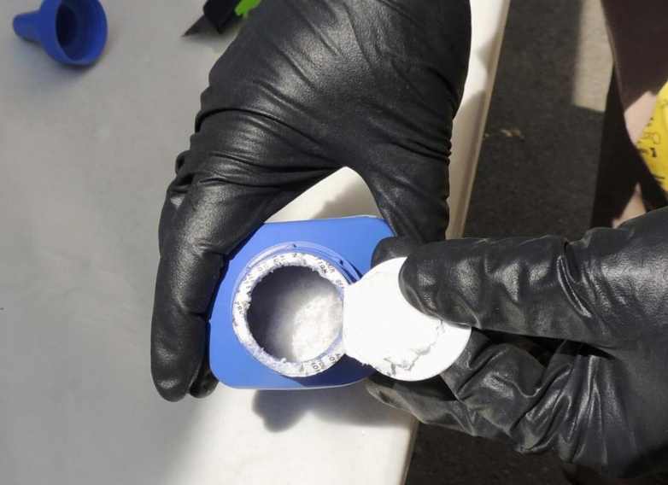
Notes:
Canadian authorities showed printer ink bottles containing carfentanil imported from China in Vancouver in June 2016.
Source: Boston Globe, October 16, 2016

Slide 31
Opioid Overdose Death Data United States
National Vital Statistics
Centers for Disease Control and Prevention

Slide 32
Opioid Deaths, United States, 2015
33,091 opioid overdose deaths
16% increase from 2014
Likely driven by heroin and illicitly manufactured fentanyl
91 Americans die every day from an opioid overdose
Notes:
2015 is the most recent year for which CDC has published data on overdose deaths involving opioids.
____________________________________________________________________________________________________________________
52,404 drug overdose deaths
33,091 (63.1%) involved an opioid
15.6% increase from 2014, driven by synthetic opioids other than methadone, most likely heroin and illicitly manufactured fentanyl

Slide 33
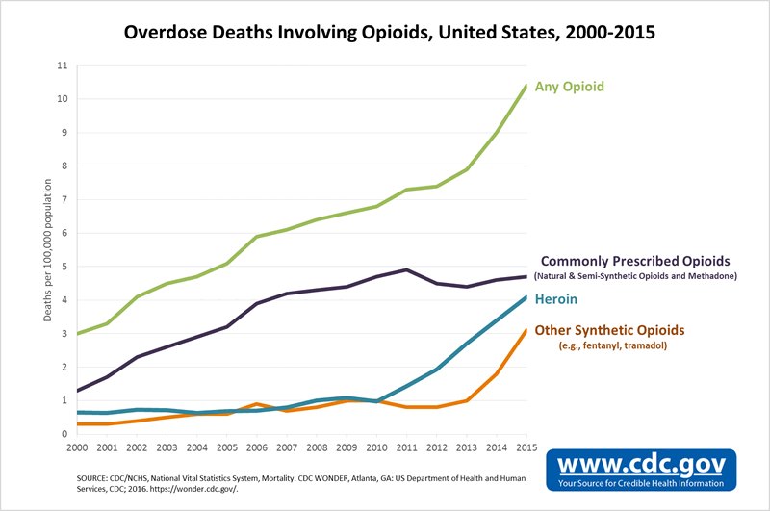
Notes:
This graph shows the rate per 100,000 population of Overdose Deaths Involving Opioids in the United States
From 2000 to 2015, death rates increased from 3 per 100,000 to 10.4 per 100,000, or 247%
During this same time period death rates involving Commonly Prescribed Opioids, such as codeine and oxycodone, also increased and accounted for nearly half of opioid overdose deaths
The 16% increase from 2014 to 2015 is driven largely by increases in deaths involving heroin and synthetic opioids other than methadone.
Death rates from heroin increased 21%
Death rates from synthetic opioids, mostly fentanyl, increased by 72%
Of note, on this graph Commonly Prescribed Opioids includes methadone, which is prescribed for opioid addiction treatment. In the next slide, methadone will be removed from this line.
____________________________________________________________________________________________________________________________________________________
During 2015, a total of 52,404 persons in the United States died from a drug overdose, an increase from 47,055 in 2014; among these deaths,
33,091 (63.1%) involved an opioid, an increase from 28,647 in 2014.
The age-adjusted opioid-involved death rate increased by 15.6%, from 9.0 per 100,000 in 2014 to 10.4 in 2015, driven largely by increases in deaths involving heroin and synthetic opioids other than methadone.
Death rates for natural/semisynthetic opioids, heroin, and synthetic opioids other than methadone increased by 2.6%, 20.6%, and 72.2%, respectively (Table 1) (Table 2). Methadone death rates decreased by 9.1% (Table 1).
How the data are calculated
CDC’s standard analysis approach has combined the natural, semi-synthetic, and synthetic opioid categories (including methadone) when reporting deaths involving opioid analgesics, also referred to as prescription opioids. Using this method, in 2015 there were almost 22,000 deaths involving prescription opioids, equivalent to about 62 deaths per day. This is an increase from approximately 19,000 in 2014.¹ A significant portion of the increase in deaths was due to deaths involving synthetic opioids other than methadone, which includes fentanyl. Law enforcement agencies have reported recent increases in seizures of illegally-made (non-pharmaceutical) fentanyl.² It is presumed that a large proportion of the increase in deaths is due to illegally-made fentanyl.¹ Unfortunately, information reported about overdose deaths does not distinguish pharmaceutical fentanyl from illegally-made fentanyl.
Given the recent surge in illegally-made fentanyl, the CDC Injury Center is analyzing synthetic opioids (other than methadone) separately from other prescription opioids. This new analysis can provide a more detailed understanding of the increase in different categories of opioid deaths from previous years. Using this analysis, in 2015 there were more than 15,000 deaths involving this more limited category of prescription opioids (an increase in this category of 443 since 2014), equivalent to about 42 deaths per day.³ Changing the way deaths are analyzed seems to result in a decrease in deaths involving prescription opioids. But, this new number is likely an undercount of deaths related to prescription opioids, because it does not include deaths that are associated with pharmaceutical fentanyl, tramadol, and other synthetic opioids that are used as pain relievers.
What this means
Drug overdose deaths can be hard to categorize
In approximately 1 in 5 drug overdose deaths, no specific drug is listed on the death certificate. In many deaths, multiple drugs are present, and it is difficult to identify which drug or drugs caused the death (for example, heroin or a prescription opioid, when both are present).³
Regardless of the analysis strategy used, prescription opioids continue to be involved in more overdose deaths than any other drug, and all the numbers are likely to underestimate the true burden given the large proportion of overdose deaths where the type of drug is not listed on the death certificate. The findings show that two distinct but interconnected trends are driving America’s opioid overdose epidemic: a 15-year increase in deaths from prescription opioid overdoses, and a recent surge in illicit opioid overdoses driven mainly by heroin and illegally-made fentanyl. Both of these trends continued in 2015.³
Methadone death rates declined by 9.1% from 2014 to 2015. Declining trend observed since 2008 following efforts to reduce methadone use for pain, including FDA warnings, limits on high dose formulations, and clinical guidelines

Slide 34
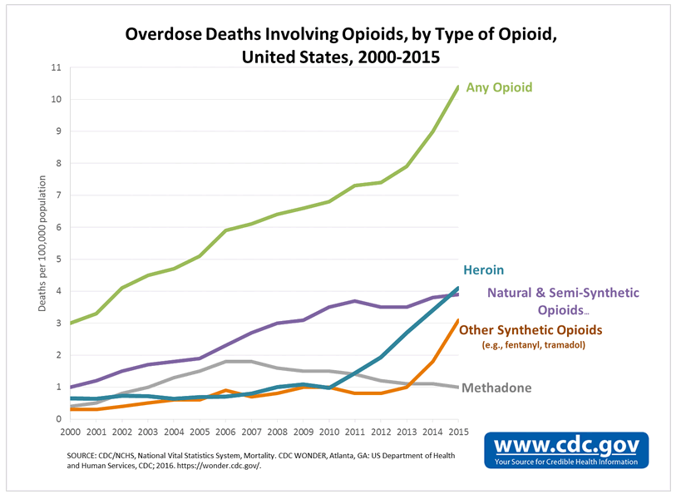
Notes:
With methadone removed (now shown in grey), the rates of death due to heroin surpasses that of prescription opioids, which is further evidence of heroin and other synthetic opioids such as fentanyl driving the increase in overdose deaths involving opioids.
__________________________________________________________________________________________________________________________________________________
Death rate from heroin increased 20.6% from 2014 to 2015
Death rate from synthetic opioids other than methadone, which includes fentanyl, increased 72.2% from 2014 to 2015
How the data are calculated
CDC’s standard analysis approach has combined the natural, semi-synthetic, and synthetic opioid categories (including methadone) when reporting deaths involving opioid analgesics, also referred to as prescription opioids. Using this method, in 2015 there were almost 22,000 deaths involving prescription opioids, equivalent to about 62 deaths per day. This is an increase from approximately 19,000 in 2014.¹ A significant portion of the increase in deaths was due to deaths involving synthetic opioids other than methadone, which includes fentanyl. Law enforcement agencies have reported recent increases in seizures of illegally-made (non-pharmaceutical) fentanyl.² It is presumed that a large proportion of the increase in deaths is due to illegally-made fentanyl.¹ Unfortunately, information reported about overdose deaths does not distinguish pharmaceutical fentanyl from illegally-made fentanyl.
Given the recent surge in illegally-made fentanyl, the CDC Injury Center is analyzing synthetic opioids (other than methadone) separately from other prescription opioids. This new analysis can provide a more detailed understanding of the increase in different categories of opioid deaths from previous years. Using this analysis, in 2015 there were more than 15,000 deaths involving this more limited category of prescription opioids (an increase in this category of 443 since 2014), equivalent to about 42 deaths per day.³ Changing the way deaths are analyzed seems to result in a decrease in deaths involving prescription opioids. But, this new number is likely an undercount of deaths related to prescription opioids, because it does not include deaths that are associated with pharmaceutical fentanyl, tramadol, and other synthetic opioids that are used as pain relievers.
What this means
Drug overdose deaths can be hard to categorize
In approximately 1 in 5 drug overdose deaths, no specific drug is listed on the death certificate. In many deaths, multiple drugs are present, and it is difficult to identify which drug or drugs caused the death (for example, heroin or a prescription opioid, when both are present).³
Regardless of the analysis strategy used, prescription opioids continue to be involved in more overdose deaths than any other drug, and all the numbers are likely to underestimate the true burden given the large proportion of overdose deaths where the type of drug is not listed on the death certificate. The findings show that two distinct but interconnected trends are driving America’s opioid overdose epidemic: a 15-year increase in deaths from prescription opioid overdoses, and a recent surge in illicit opioid overdoses driven mainly by heroin and illegally-made fentanyl. Both of these trends continued in 2015.³
Methadone death rates declined by 9.1% from 2014 to 2015. Declining trend observed since 2008 following efforts to reduce methadone use for pain, including FDA warnings, limits on high dose formulations, and clinical guidelines

Slide 35
Rates of Overdose Deaths Involving Heroin or Fentanyl, 2015
Increased across all demographics
Increased across all US regions
Highest among 25 – 44 year old males
Highest among white non-Hispanic individuals
Notes:
_____________________________________________________________________________________________________________ Synthetic Opioids Heroin
other than methadone
Race/Ethnicity** 2014 2015 %change 2014 2015 %change
White, non-Hispanic 4,685 (2.4) 7,995 (4.2) 75.0§§ 8,253 (4.4) 10,050 (5.4) 22.7§§
Black, non-Hispanic 449 (1.1) 883 (2.1) 90.9§§ 1,044 (2.5) 1,310 (3.1) 24.0§§
Hispanic 302 (0.6) 524 (0.9) 50.0§§ 1,049 (1.9) 1,299 (2.3) 21.1§§

Slide 36
Opioid Overdose Death Data Virginia
Office of the Chief Medical Examiner
Virginia Department of Health
Notes:
The opioid overdose death data for Virginia is from the Office of the Chief Medical Examiner, which is part of the VA Department of Health

Slide 37
Opioid Overdose Deaths Virginia, 2016*
1,133 opioid overdose deaths
40% increase from 2015
Likely driven by heroin and illicitly manufactured fentanyl
3 Virginians die every day from an opioid overdose
*Data for 2016 are predicted totals for the entire year
Notes:
Opioid overdose death data for 2016 is a predicted total based on the first three quarters of 2016. These numbers are subject to change when toxicology reports are complete.
In 2016, 1,079 opioid overdose deaths occurred in Virginia.
As with the US data, the increase in the number of deaths is likely driven by heroin and fentanyl

Slide 38
Overdose Deaths Involving Opioids Virginia, 2007-2016*
*Data for 2016 are preliminary totals for the entire year
Notes:
This graph of the number of Overdose Deaths Involving Opioids in Virginia from 2007 through 2016 shows that the number of deaths was relatively stable until 2012 when a sharp increase began. By 2016, the number of overdose deaths involving opioids was 1133, an increase of 98% from 2012.
The 40% increase from 2015 to 2016 is driven largely by increases in number of deaths involving fentanyl and heroin.
Number of deaths from heroin increased 31%
Number of deaths from fentanyl increased by 175%. Between 2015 and 2016, fentanyl became the main driver of the increase in deaths causing over half of all Virginia overdose deaths involving opioids
__________________________________________________________________________________________________________________________________________________
Death rates for prescription opioids increased 18%
From 2007 to 2016, 120% increase in number of deaths for all opioids ((1133-515)/515)*100
From 2007-2015, opioids (fentanyl, heroin, and/or one or more prescription opioids) made up approximately 75% of all fatal drug overdoses annually in Virginia. However, this percentage is increasing each year due to the significant increase in fatal fentanyl and/or heroin overdoses beginning in late 2013 and early 2014. Of the fatal opioid overdoses from 2007-2015, 26.8% had one or more benzodiazepines contributing to death.
Fentanyl:
175% increase from 2015 to 2016 ((618-225)/225)*100
1187% increase from 2007 to 2016 ((618-48)/48)*100
Heroin:
30% increase from 2015 to 2016 ((448-342)/342)*100
833% increase from 2010 to 2016 ((448-48)/48)*100
The total number of fatal fentanyl-related drug overdoses have sharply increased since 2012; which coincides with the dramatic increase in fatal heroin overdoses. Prior to 2013, most fentanyl-related deaths were due to illicit use of pharmaceutically produced fentanyl. However, in late 2013, early 2014, law enforcement investigations and toxicology testing demonstrated an increase in illicitly produced fentanyl. By 2016, most fatal fentanyl-related overdoses were due to illicitly produced fentanyl and fentanyl analogs, and not pharmaceutically produced fentanyl. The first 9 months of 2016 had a 160.8% increase in the number of fatal fentanyl overdoses compared to the same time frame (Q1 - Q3) of 2015.
1 Historically, fentanyl has been categorized as a prescription opioid because it is mass produced by pharmaceutical companies. However, recent law enforcement investigations and toxicology results have demonstrated that several recent fentanyl seizures have not been pharmaceutically produced, but illicitly produced. This illicit form of fentanyl is produced by international drug traffickers who import the drug into the United States and often, mix it into heroin being sold. This illicitly produced fentanyl , especially fentanyl mixed with heroin, has been the biggest contributor to the significant increase in the number of fatal opioid overdoses in Virginia.
2 Illicit and pharmaceutically produced fatal fentanyl overdoses are represented in this analysis. This includes all different types of fentanyl analogs (acetyl fentanyl, furanyl fentanyl, etc.)
1 ‘All Opioids’ include all versions of fentanyl, heroin, prescription opioids, and opioids unspecified
2 ‘Opioids Unspecified’ are a small category of deaths in which the determination of heroin and/or one or more prescription opioids cannot be made due to specific circumstances of the death. Most commonly, these circumstances are a result of death several days after an overdose, in which the OCME cannot test for toxicology because the substances have been metabolized out of the decedent’s system.
3 Fatal opioid numbers have changed slightly from past reports due to the removal of fentanyl from the category of prescription opioids, as well as the addition of buprenorphine, levorphanol, meperidine, pentazocine, propoxyphene, and tapentadol added to the li9st of prescription opioids.

Slide 39
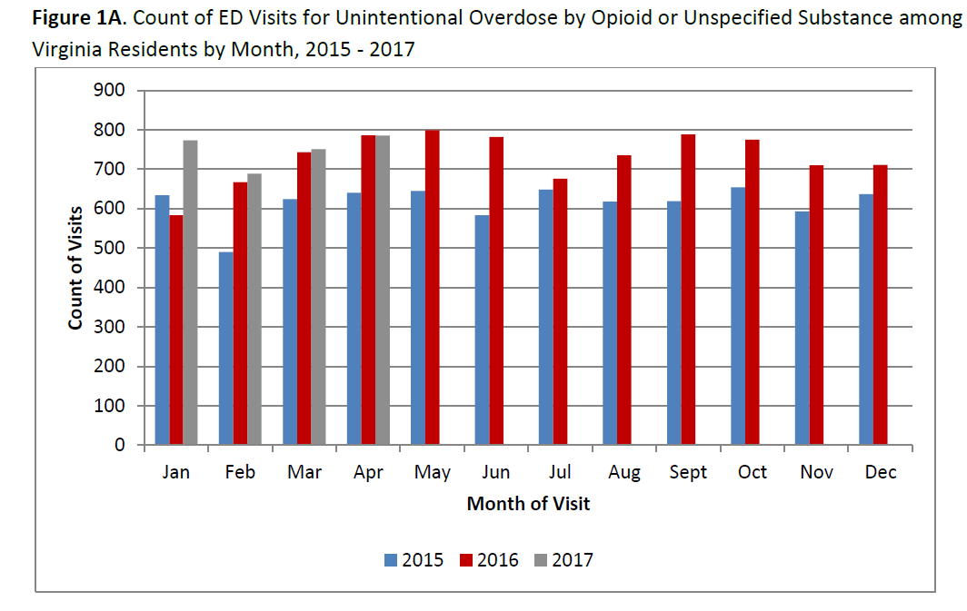

Slide 40
Fentanyl and/or Heroin Overdose Deaths per 100,000 Population by Virginia Locality, 10/2015 –10/2016
Notes:
This map shows fentanyl or heroin overdose deaths per 100,000 people by Virginia locality from October of 2015 to October of 2016.
Overdose death rates due to illicit opioids, such as fentanyl and heroin, have higher rates in urban areas, including Richmond city and Petersburg.
____________________________________________________________________________________________________________________________________
West county = Highland
East county = Gloucester, Norfolk, Portsmouth
North counties = Faquier, Culpepper, Orange

Slide 41
Prescription Opioid Overdose Deaths (Excluding Fentanyl) per 100,000 Population by Virginia Locality, 10/2015 – 10/2016
Notes:
In contrast, overdose death rates due to prescription opioids have higher rates in rural areas and are especially concentrated in counties in Southwest Virginia, such as Wise and Dickenson counties.
___________________________________________________________________________________________________________________________________________________
Southwest counties = Wise, Dickenson, Buchanan, Russell
North of far southwest = Giles, Pulaski
Northeast = Westmoreland

Slide 42
Opioid Overdose Death Data Henrico County
Virginia Department of Health
Office of the Chief Medical Examiner
Henrico County
Division of Fire
Division of Police
Sheriff’s Office
Mental Health and Developmental Services
Commonwealth’s Attorney Office

Slide 43
Gun, Motor Vehicle, Opioid, and Drug (All) Deaths, Henrico County, 2007 – 2016*
*Data from 2016 are preliminary totals for the entire year
Notes:
Number of deaths by year of death
In 2016, deaths due to guns and motor vehicle accidents combined were approximately the same as all drugs overdose deaths in Henrico.
2016
Gun 31
MVA 22
Drugs (All) 52
Opioids 45

Slide 44
Opioid Overdose Deaths Henrico County, 2016*
45 opioid overdose deaths
22% increase from 2015
Likely driven by heroin and illicitly manufactured fentanyl
Nearly every week 1 person dies in Henrico County from an opioid overdose
*Data for 2016 are preliminary totals for the entire year
Notes:
In 2016, 45 opioid overdose deaths occurred in Henrico.

Slide 45
Overdose Deaths Involving Opioids Henrico County, 2007-2016*
*Data from 2016 are preliminary totals for the entire year
Notes:
In Henrico, from 2007 to 2016, the number of deaths involving opioids increased from 15 to 45, or 200%
From 2010, when fentanyl was first noted in Henrico OCME data, to 2016, deaths due to fentanyl and deaths due to heroin increased by about 600%
___________________________________________________________________________________________________________________________
Although the number of deaths due to prescription opioids was relatively stable in the last 10 years, between 2015 and 2016 there was a 22% increase
From 2012 to 2016, the number of deaths involving opioids increased from 21 to 45, or 114%
The 22% increase from 2015 to 2016 is driven largely by increases in deaths involving fentanyl.
Number of deaths from fentanyl increased by 91%
Number of deaths from prescription opioids increased 22%
Number of deaths from heroin decreased 13%
From 2010 (when fentanyl first noted in OCME data) to 2016, the number of deaths involving fentanyl increased from 3 to 21, or 600%.
From 2010 to 2016, the number of deaths involving heroin increased from 4 to 24, or 500%.
Notes from Rosie:
I guarantee that the number final will be higher. Due to the holidays in Nov and Dec, it’s expected that our tox turnaround takes longer than any other time of the year because everyone is out (it happens every darn year). So when our typical turnaround time is ~3 months other times of the year, it can be ~3-4.5 months around this time period.
Don’t forget to take into account the important role illicit fentanyl plays in these deaths. The market is flooded with the stuff at the moment. I’ve heard time and time again, that because fentanyl is so potent, drug dealers and traffickers have the potential of making TONS of money off the stuff. It’s all about the profit margin that attracts them-a small amount of fentanyl, which packs a major punch, can be cut into heroin, cocaine, etc. in very tiny amounts; so a little investment by the dealer into a chunk of fentanyl can go really REALLY far and put a ton of money in their pocket.
We often see waves of deaths, where one week or one month, we’ll see a higher than expected number of deaths in one region because a new, potent drug gets introduced into the community. Now, this isn’t to say that we see a HUGE spike in deaths, just more than normal in a set time period. Now, taking into account a year of these tiny fluctuations which may not look like much individually, but it can really add up when combined over a years’ time. The one exception I can think of was that big increase in Chesterfield around this time last year…which was when heroin-fentanyl was brought into the community.
Anyways, I hope these are some reasons why the numbers may look one way mathematically, but when you take into account some of the other behind the scene factors, the actual numbers are going to be a little different. I think everyone agrees that the opioid ‘epidemic’ is an evolving one; first Rx, then heroin, then illicit fentanyl. To me, we are at a point where we’ve done a pretty good job on restricting illegal use with all the regulations and laws around the PMP, but that has fed into another bigger problem we can’t surveil nor control nearly as easily: illegal drugs. I think we are nowhere near solving the problem and from just looking at our cases at the beginning of this year (2017), the number and rates of death continue to increase.

Slide 46
Individuals Undergoing Detoxification by Substance, Henrico Sheriff’s Office, 2013 - 2016
Notes:
Up to this point, I have presented data for deaths involving opioids. We know that number of deaths is just the tip of the iceberg in quantifying the scope of this epidemic. The following data illustrates some of the impact of the opioid epidemic among those who are struggling with an opioid use disorder as well as the impact on organizations trying to help.
These data from the Sheriff’s Office provide a summary of individuals undergoing detoxification by substance in Henrico jails. For all years, the number of opioid detoxifications was higher than for any other substance, reaching 1192 in 2016.
_______________________________________________________________________________________________________________________________
These data refer to individuals, not to visits. For example, 1192 individuals went through detoxification for opioids through the Henrico jails in 2016.
Source: Henrico County Sheriff’s Office
RESULTS FOR 2016 (SHERIFF’S OFFICE)
Total Detox Visits for 2016=2325
Total Opiates for 2016=1192
Average pregnancies for 2016=6
Average pregnancies on opiates for 2016=3

Slide 47
Opioid-related Narcan Administrations, Henrico Division of Fire, 2015 and 2016
Notes:
This graph from Henrico Division of Fire shows the number of Narcan administrations in 2015 and 2016.
In 2015, 198 doses of Narcan were administered, 40% of which were assumed to be opioid-related based on the symptoms and response of the victim. In 2016, the number of Narcan administrations increased to 303, 59% of which were assumed to be opioid-related.
_____________________________________________________________________________________________________________________________________________________
From Kelly on 2/27/17: We don’t have the ability to specify just heroin or not – we simply go by symptoms and response to Narcan – so……………any suspected opioid. You can change the 2016 number to 303 – same percent is fine
40% of Narcan administrations in 2015 were opioid-related
59% of Narcan administrations in 2016 were opioid-related
Narcan (Naloxone)
Prescription drug
Naloxone, sold under the brandname Narcan among others, is a medication used to block the effects of opioids, especially in overdose. Naloxone may be combined within the same pill as an opioid to decrease the risk of misuse. When given intravenously, it works within two minutes, and when injected into a muscle, it works within five minutes. The medication may also be used in the nose. The effects of naloxone last about half an hour to an hour. Multiple doses may be required, as the duration of action of most opioids is greater than that of naloxone.Naloxone, sold under the brandname Narcan among others, is a medication used to block the effects of opioids, especially in overdose. Naloxone may be combined within the same pill as an opioid to decrease the risk of misuse. When given intravenously, it works within two minutes, and when injected into a muscle, it works within five …
en.wikipedia.org · Text under CC-BY-SA license
Wikipedia
Other brand names: Naloxone HCl Novaplus · PremierPro Rx naloxone HCl · EVZIO

Slide 48
Fatal and Non-fatal Heroin Overdoses, Henrico Division of Police, 2014 - 2016
Notes:
This graph from Henrico Police shows fatal heroin overdoses in the lighter color and non-fatal heroin doses in the darker color. Between 2014 and 2016 there was an 82% increase in the number of fatal heroin overdoses and a 179% increase in non-fatal heroin overdoses.

Slide 49
Heroin Possession Charges, Henrico Division of Police, 2014 - 2016
Notes:
This graph from Henrico Police shows that the number of possession charges for heroin increased from 249 in 2014 to 488 in 2016, representing a 96% increase.

Slide 50
Percent of Clients Presenting for Treatment with Opioid Addiction, Henrico Area Mental Health and Development Services, 2008 - 2016
Notes:
My final graph reflects the upward trends seen throughout the all the data presented today; from 2008 to 2016, the percent of clients presenting for treatment due to opioid addiction to Henrico Mental Health Services increased from 18% to 53%.

Slide 51
Henrico Heroin Task Force Recommendations and Actions
Criminal Justice System
Conduct cost-benefit analysis of instituting a Day Reporting Center
Provide wraparound recovery program for post-RISE/ORBIT individuals to reduce likelihood of relapse/re-incarceration
Explore alternatives to Henrico Drug Court

Slide 52
Recent State and Federal Actions
State receives $9,760,000 grant from Substance Abuse and Mental Health Services Administration to fight opioid epidemic, May 2017
Opioid addiction crisis in VA declared a public health emergency, November 21, 2016
Statewide standing order that authorizes pharmacists to dispense naloxone
Surgeon General’s Report Facing Addiction in America, published November 2016
Statewide standing order that authorizes pharmacists to dispense naloxone
Newly licensed prescribers and pharmacists automatically registered in VA Prescription Monitoring Program as of January 1, 2016
Notes:
Substance Abuse and Mental Health Services Administration (SAMHSA) grant
Purchase medication
Support medical staff to prescribe and oversee clinical treatment
Remove barriers to treatment access, such as transportation

Slide 53
2/23/17 Announcement: Governor McAuliffe Signs Bills to Continue Fighting Opioid Epidemic
SB848 and HB1453: allow community organizations to possess and dispense naloxone to those that they train to use it
HB2317: allows local departments of health to administer harm reduction programs in parts of the state with very high rates of HIV and Hep C. These programs will exchange dirty syringes for clean ones, offer testing for Hep C and HIV, and connect people to addiction treatment.
HB1786: initiates a family assessment and plan of care from local social services if a child is found to have been exposed to substances in utero. This connects the mother to treatment if necessary and provides services to ensure the safety of both the mother and the child.
HB2165: mandates that all opioid prescriptions will be transmitted to pharmacies electronically by 2020 and creates a workgroup to study how to implement this change
Notes:
Eight counties in Virginia (Buchanan, Dickenson, Russell, Lee, Wise, Tazewell, Patrick and Wythe) ranked in the top 5% of the most vulnerable counties nationwide.

Slide 54
Summary
91 Americans die every day from an opioid overdose
3 Virginians die every day from an opioid overdose
Nearly every week 1 person dies in Henrico County from an opioid overdose
The number of deaths from an opioid overdose is the tip of the iceberg
Notes:
The number of deaths is just the tip of the iceberg that represents this opioid epidemic.

Slide 55
Resources
Substance Abuse and Mental Health Service Administration (SAMHSA): http://www.samhsa.gov/
National Institute on Drug Abuse (NIDA): https://www.drugabuse.gov/
Centers for Disease Control and Prevention (CDC): http://www.cdc.gov/drugoverdose/index.html
Virginia Department of Health: http://www.vdh.virginia.gov/commissioner/opioid-addiction-in-virginia/
Notes:
VaAware is a collaboration among four Virginia agencies, the Department of Health, Department of Behavioral Health and Developmental Services, Department of Criminal Justice Services, and Department of Health Professions.

Slide 56
Resources
Surgeon General’s Report Facing Addiction in America: https://addiction.surgeongeneral.gov/
Rudd RA, Seth P, David F, Scholl L. Increases in Drug and Opioid-Involved Overdose Deaths — United States, 2010–2015. MMWR Morb Mortal Wkly Rep, December 30, 2016;65:1445–1452. DOI: http://dx.doi.org/10.15585/mmwr.mm655051e1
Virginia Department of Health, Office of the Chief Medical Examiner, http://www.vdh.virginia.gov/medical-examiner/forensic-epidemiology/
Notes:
VaAware is a collaboration among four Virginia agencies, the Department of Health, Department of Behavioral Health and Developmental Services, Department of Criminal Justice Services, and Department of Health Professions.

Slide 57
