Slide 1
Public Health and Healthcare Preparedness Academy 2017 Legal Considerations in an Emergency
R. Brent Rawlings
Vice President and General Counsel
Virginia Hospital & Healthcare Association

Slide 2
Overview
About VHHA
EMTALA
HIPAA
Liability

Slide 3
About VHHA

Slide 4
VHHA: Role in Emergency Preparedness
VHHA is VDH’s primary partner in the implementation of Hospital Preparedness Program (HPP) activities
Develop grant submittal to ASPR
Develop budget instructions for hospitals
Review and approve hospital budget requests
Provide guidance regarding program requirements
Review hospital performance to ensure that grant requirements are being met
Conduct periodic hospital site visits
Manage the Virginia Healthcare Alerting & Status System (VHASS)

Slide 5
VHHA: Role in Emergency Preparedness
Virginia’s HPP organizes hospitals into 6 regions
Each region has a hospital preparedness coordinating group which provides oversight and direction to regional activities
Coalition partners are invited to participate in regional committees
VHHA has MOU with each regional group
VHHA also contracts with Regional Coordinator who works with regional committee and hospitals within region

Slide 6
EMTALA

Slide 7
What is EMTALA?
Emergency Medical Treatment and Active Labor Act (EMTALA)
Requires hospitals to perform on all patients who present to the emergency department a Medical Screening Exam (MSE) to determine if Emergency Medical Condition (EMC) exists
If MSE exists, must treat or stabilize within its capability or transfer to a hospital that has capability to treat or stabilize
Complaint driven process
CMS will investigate any alleged violations
Civil monetary penalty of up to $50,000 per violation
Patients can also bring civil action against the hospital (up to malpractice cap $2.25M)

Slide 8
EMTALA: Hospital Concerns in a Disaster
Unable to provide Medical Screening Examination (MSE) and patient stabilization due to lack of resources
Possibility of systematic re-direction or transfer for non-critical patients
EMTALA requirements continue to apply during a disaster with limited exceptions (42 CFR §489.24(a)(2)(i))
Only during federally-declared emergencies
Does not apply to hospital-specific, local, or State emergencies
Transfers in accordance with a “community response plan” will not result in sanctions under EMTALA

Slide 9
EMTALA: Basic Requirements
Medical Screening Examination (MSE)
Not the same as triage
Hospitals must perform an MSE on all patients except under a Section 1135 waiver
Hospital may be able to postpone the MSE
Must be conducted by a Qualified Medical Person (QMP)
Provide stabilization services and MSEs “within the capabilities” of the facility
Staff
Resources
Hospital’s past practices of accommodating patients in excess of their capacity
Notes:
Interpretive Guidelines suggest that where hospital has exceeded its customary strategies to stretch its resources (SURGE) but still cannot meet needs of ED patients, capacity is exceeded and hospital can go on diversion
But the ED never truly closes until all patients and staff are evacuated. Still have to take walk-ins and those that arrive despite diversion

Slide 10
EMTALA: Options for Managing ED Surges
Alternative screening sites on campus
MSE can take place in alternative site on the campus
Redirection and logging in outside the ED permissible
Individual redirecting must be qualified to recognize individuals in need of immediate treatment in the ED
Alternative screening sites off campus for ILI
Hospitals and community officials may encourage the public to go to sites off campus
Available only for influenza-like illness (ILI)
BUT, may not redirect an individual who has already presented at ED
Cannot be held out to public as a place that provides care for EMCs
If individual needs additional medical attention on an emergent basis, hospital must arrange for referral/transfer
Screening clinics at sites not under control of a hospital
No EMTALA obligation
Hospitals may encourage public to go to these sites for ILI screening
BUT, may not redirect an individual who has already presented at the ED to go to the screening clinic

Slide 11
EMTALA: Options for Managing Ebola
Hospitals, EMS, and Public Health Officials can develop pre-hospital protocols
Suspected Ebola cases can be brought to designated hospitals
BUT if individual presents to the ED, the hospital must provide a MSE
Cannot post signs directing individuals exposed with Ebola from coming to ED, but can direct to various locations on campus
Hospitals expected to have capability to isolate patient and initiate stabilizing treatment

Slide 12
EMTALA: Waiver During a Disaster
Section 1135 Waiver
Authorizes HHS Secretary to waive sanctions for
Otherwise inappropriate transfer of an individual who has not been stabilized if the transfer arises out of the circumstances of the emergency OR
Direction or relocation of an individual to receive a MSE if the relocation is done pursuant to an “appropriate State emergency preparedness plan” or a “State pandemic preparedness plan”
Generally limited to the 72-hour period beginning with implementation of hospital disaster protocol (or for pandemic until termination of the declaration of public health emergency)
Hospital must be within the defined emergency area
All other requirements of EMTALA remain in effect
Notes:
Effects transfers normally prohibited under EMTALA of individual with unstable EMCs so long as the transfer is necessitated by the circumstances of the declared emergency
Waived only if:
President has declared and emergency or disaster under the Stafford Act or the National Emergencies Act AND
Secretary of HHS has declared a public health emergency AND
Secretary invokes waiver authority (which may be retroactive) including notifying Congress at least 48 hours in advance AND
Waiver includes waiver of EMTALA requirements and the hospital is covered by the waiver
Katrina
Permitted to make otherwise prohibited transfer after MSE
But also prior to MSE so long as transfer pursuant to state emergency preparedness plan
If no preparedness plan, then MSE still required.

Slide 13
EMTALA: Planning Considerations
Amend hospital EMTALA diversion policies:
Documentation that shows hospital has exceeded capabilities
Identify the point that hospital will be operating at capacity
Identify decision-making authority
Outline notification mechanism
Establish transfer protocols
Development of policies regarding alternative screening sites on and off campus
Development of policies regarding referral of patients to ILI sites not under control of the hospital
Development of policies and procedures for the transfer of patients when hospital is unable to provide stabilization

Slide 14
EMTALA: Key Takeaways
The basic requirements for MSE, stabilizing EMC within the capability of the hospital, and appropriate transfer continue to apply in a disaster or public health emergency, with very limited exceptions
Waivers are possible, but even then, not all requirements are waived
Emergency preparedness planning must include provisions to address compliance with EMTALA

Slide 15
HIPAA

Slide 16
What is HIPAA?
Health Information Portability and Accountability Act of 1996
Applies to “covered entities” and “business associates” and their “workforce”
Applies to the use and disclosure of Protected Health Information (PHI) by covered entities
Governs privacy and security of PHI
Minimum Necessary Standard
Applies during disasters and public health emergencies
Impermissible use or disclosure (aka “breach”) must be reported to affected individuals, DHHS, and the media (if more than 500)
Notes:
HIPAA protects the privacy of patient’s PHI, but is balanced to ensure that appropriate uses and disclosures of the information still may be made when necessary to treat a patient, to protect the nation’s public health, and for other critical purposes.
HIPAA is NOT set aside in an emergency.
HIPAA does not apply to all organizations that may be involved in emergency preparedness and response: e.g., does not apply to social service agencies, public health agencies, and law enforcement.
E.g., Red Cross can share patient information or a social services agency can share a list of names with persons with disabilities to a transportation contractor.
Waiver of some requirements is possible, but only in certain federally declared disasters.
OCR more recently provided a bulletin on privacy in emergency situation in Nov. 2014 in response to the Ebola outbreak and questions that arose at the time.
I’ll review some of those highlights here.

Slide 17
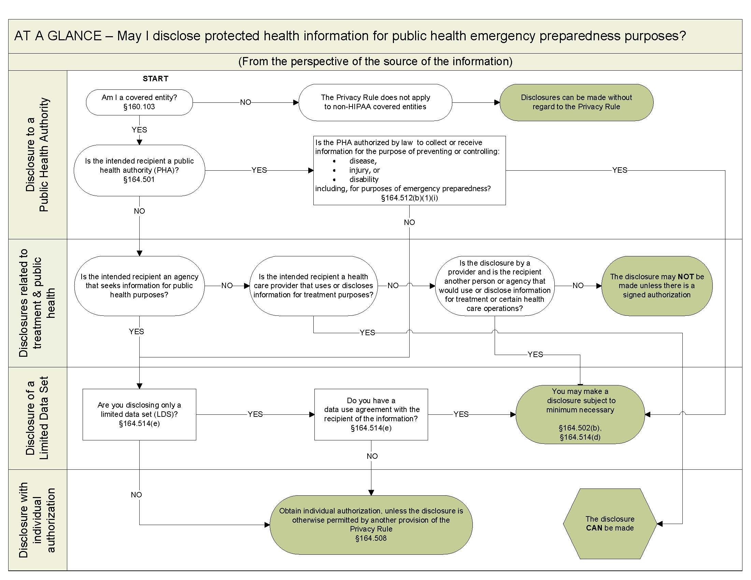
OCR HIPAA Emergency Planning Tool
https://www.hhs.gov/sites/default/files/ocr/privacy/hipaa/understanding/special/emergency/emergencyprepdisclose.pdf
Notes:
This tool predates the Nov. 2014 OCR guidance, but it is still applicable and provides a good overview of disclosures that can be made in the context of emergency preparedness.
Knowing what information can be released, to whom, and under what circumstances, is critical in disaster response.
To achieve this, need to work with privacy officials and legal counsel to plan and develop policies and procedures for information release prior to an event.

Slide 18
HIPAA: Permissible Disclosures in a Disaster
Treatment
Health care providers can share PHI as necessary to provide treatment
Sharing information between providers
Referring patients for treatment
Coordinating patient care with others
Minimum necessary rule does not apply when shared between providers
Providers can also share patient information to the extent necessary to seek payment for services or for purposes of conducting operations
No patient authorization required
Minimum necessary standard does not apply
Notes:
Health care providers can share PHI as necessary to provide treatment
Sharing information between providers (ambulance service and hospital; hospital and clinic)
Referring patients for treatment (linking relocated patients with available providers in the area)
Coordinating patient care with others (such as emergency relief workers or others that can help connect patients with health services)
Minimum necessary rule does not apply when shared between providers

Slide 19
HIPAA: Permissible Disclosures in a Disaster
Public Health Activities
Disclosure of PHI to federal or state government agencies responsible for public health and authorized by law to collect and receive such information
Extends to individuals acting under a grant of authority from or under contract with the public health agency
Examples include:
Reporting of disease or injury
Reporting vital events, such as deaths
Public health surveillance, investigations, or interventions
Specific information requested by the public health agency in response to bioterrorism threats or other public health emergency (e.g., patient disease, care, and response to treatment)
Covered entities may disclose PHI to a foreign agency at the direction of a public health agency
Covered entities may also notify individuals who may have been exposed to disease where authorized by law (but without revealing PHI of another person)
Notes:
HIPAA recognizes the need for public health authorities and others responsible for ensuring public health and safety to have access to PHI that is necessary to carry out their mission.
An example of federal public health authority would be that a health care provider would be permitted to disclose to the CDC PHI on an ongoing basis as needed to report all prior and prospective cases of patients exposed to or confirmed to have Ebola.
In Virginia, list of diseases reportable to VDH include disease caused by an agent that may have been used as a weapon, outbreaks, Sever Acute Respiratory Syndrome, Ebola, unusual occurrence of disease of public health concern.
Minimum necessary standard applies, but can rely upon the representations from the public health authority that the information requested is the minimum necessary.
It is not clear whether the exception allows reporting to RHCC or Emergency Operations Centers or the Medical Control Officer. Unless there is a statute authorizing the activity, public health authority exception should not be relied upon.
Reminder that other requirements like accounting of disclosure still apply.

Slide 20
HIPAA: Permissible Disclosures in a Disaster
Notification
Disclosure of PHI about a patient as necessary to identify, locate, and notify family, guardian, or any other person responsible for the patient’s care
Patient location, general condition, or death
May involve notification to police, press, or public at large
Best interest/professional judgment standard applies
Disclosure of PHI with disaster relief organizations authorized to assist in disaster relief efforts (e.g., Red Cross)
Notes:
The health care provider should get verbal permission from the individual or otherwise be able to reasonably infer that the patient does not object, when possible; if the individual is incapacitated or not available.
May share under these circumstances if, in professional judgment, doing so is in the patient’s best interest.
Sharing with disaster relief organization does not require obtaining patient’s permission to share the information if doing so would interfere with the organization’s ability to respond to the emergency.

Slide 21
HIPAA: Permissible Disclosures in a Disaster
Facility Directories
PHI contained in facility directories (patient condition, patient location, religious affiliation) may be disclosed
Where the patient has not objected, patient is incapacitated, or believed to be in best interests of the patient and consistent with any prior patient preferences
To any individual asking for the patient by name (patient condition and location)
To clergy (religious affiliation) without the requirement that the clergy ask for the patient by name
Notes:
HIPAA recognizes the need for public health authorities and others responsible for ensuring public health and safety to have access to PHI that is necessary to carry out their mission.

Slide 22
HIPAA: Permissible Disclosures in a Disaster
Imminent Danger
Providers may share PHI with anyone as necessary to prevent or lessen a serious and imminent threat to the health and safety of another individual or the public where consistent with applicable state law and standards of ethical conduct
Can only be disclosed to those individuals who can reasonably abate the threat
Good faith standard applies
National Security
Providers may disclose PHI to authorized federal officials for intelligence, counter-intelligence, and other national security activities
Notes:
For example, if a provider identifies an unexplained disease outbreak suspected to be the result of a bioterrorist attach, the provider may disclosure PHI of infected individuals to certain public officials to control the outbreak and prevent further infection.
Good faith standard applies with a presumption that the provider has acted in good faith if action based on actual knowledge or reliance on credible representation by a person with apparent knowledge or authority.
National security exception may be applicable in a bioterrorist attach to allow providers to disclose PHI to government authorities in the course of their investigation.

Slide 23
HIPAA: Waiver During a Disaster
Section 1135 Waiver
Authorizes HHS Secretary to waive sanctions for
Requirement to obtain a patient’s agreement in order to speak with family members or friends
Requirement to honor a patient’s request to opt out of the facility directory
Requirement to distribute a notice of privacy practices;
Patient’s right to request privacy restrictions or confidential communications
Must be a federally-declared public health emergency or disaster
Generally limited to the 72-hour period beginning with implementation of hospital disaster protocol (or for pandemic until termination of the declaration of public health emergency)
Hospital must have instituted disaster protocol and be within the defined emergency area
All other requirements of HIPAA remain in effect
Notes:
Effects transfers normally prohibited under EMTALA of individual with unstable EMCs so long as the transfer is necessitated by the circumstances of the declared emergency
Waived only if:
President has declared and emergency or disaster under the Stafford Act or the National Emergencies Act AND
Secretary of HHS has declared a public health emergency AND
Secretary invokes waiver authority (which may be retroactive) including notifying Congress at least 48 hours in advance AND
Waiver includes waiver of EMTALA requirements and the hospital is covered by the waiver

Slide 24
HIPAA: Planning Considerations
Amend hospital HIPAA policies and procedures to reflect exceptions relevant to emergency and disaster situations
Consider creating a separate set of HIPAA policies and procedures for emergency and disaster situations
Educate employees, staff, and providers

Slide 25
HIPAA: Key Takeaways
HIPAA applies during disasters and public health emergencies
Waivers are possible, but only for federally-declared emergency or disaster and even then, not all requirements are waived
Emergency preparedness planning must include provisions to address compliance with HIPAA

Slide 26
Liability

Slide 27
Liability Concerns in a Disaster
Failure to prepare
Failure to respond
Liability associated with “altered standards of care”
E.g.,
Failure to prepare for SARS II (Toronto SARS II)
Failure to anticipate flooding and relocate generators to top floor (Katrina)
Failure to evacuate in a timely manner
Failure to have emergency power
Failure to utilize realistic planning assumptions

Slide 28
Liability: Potential Sources of Protection
Volunteers
Good Samaritan Act
Emergency Services and Disaster Laws
Sovereign Immunity
Federal Volunteer Protection Act
Employees
State tort law

Slide 29
Liability: Good Samaritan Law (Va. Code § 8.01-225)
Applies to provision of emergency care to ill or injured persons
Rendered:
At the scene of an accident, fire, or any life-threatening emergency
At a location for screening or stabilization of an EMC arising from an accident, fire, or life-threatening emergency
En route to any hospital, medical clinic, or doctor’s office
Without compensation - available only to volunteers
Gaps - does not cover:
Non-emergency care or preventative care rendered during an emergency
Care rendered as part of the scope of employment
Does not protect institutional health care providers (e.g., a hospital or health system)
Notes:
Immunity is better suited to a “side of the road” situation than a public health response
Volunteers or employees of a locality that provide without compensation emergency services are also immune from liability when rendering in good faith emergency care or assistance in person or by telephone or other means of communication whether at the scene of an accident or while transporting such injured or ill person. (A)(5)
Coverage also available for EMS medical directors, physicians providing assistance, dispatcher and other communications providers.
NOTE: compensation does not include “the salaries of police, fire or other public officials or personnel ho render such emergency assistance.” (F)

Slide 30
Liability: State Volunteer Immunity (Va. Code § 2.2-3600)
Virginia State Government Volunteers Act
Grants sovereign immunity to “volunteers in state and local services”
Extends to Medical Reserve Corps (MRCs) and Community Emergency Response Teams (CERTs)
Without compensation - available only to volunteers
Gaps - does not cover:
Care rendered as part of the scope of employment
Institutional health care providers (e.g., a hospital or health system)
Notes:
individuals involved in emergency services and preparedness activities pursuant to the definition of “emergency services” in § 44-146.16 shall be considered volunteers in state and local services

Slide 31
Liability: Federal Volunteer Immunity (42 U.S.C. § 14501)
Federal Volunteer Protection Act
Limits liability of volunteers of non-profit organizations or governmental entities for economic damages
Extends to Medical Reserve Corps (MRCs) and Community Emergency Response Teams (CERTs)
Without compensation - available only to volunteers
Gaps - does not cover:
Care rendered as part of the scope of employment
Institutional health care providers (e.g., a hospital or health system)
Non-economic damages
Liability to non-profit or non-governmental entity for which the volunteer performs services
Notes:
individuals involved in emergency services and preparedness activities pursuant to the definition of “emergency services” in § 44-146.16 shall be considered volunteers in state and local services

Slide 32
Liability: Title 44 (Va. Code § 44-146)
Commonwealth of Virginia Emergency Services and Disaster Law
Grants immunity from liability in a Governor-declared state of emergency
Immunity from liability (except willful misconduct) for public and private entities engaged in emergency service activities pursuant to the law (“Section A Immunity”)
Immunity from liability for licensed individuals qualified to provide professional, mechanical, or other skills during a disaster (“Section C Immunity”)
Gaps - does not cover:
Pre-declaration activities
Section A may not apply to medical care rendered during an emergency in a hospital setting in the normal course of operations
Section C immunity only applies to care rendered without compensation
Notes:
individuals involved in emergency services and preparedness activities pursuant to the definition of “emergency services” in § 44-146.16 shall be considered volunteers in state and local services

Slide 33
Liability: Title 44 (Va. Code § 44-146)
Also includes protection from liability for death or injury or for loss of/damage to property for individuals or entities who provide services, goods, or real or personal property, without compensation:
Pursuant to Governor-declared emergency OR during a formal exercise or training of the OEMS or a responsible county or city emergency management entity AND
At the request and direction of the OEMS or a responsible county or city emergency management entity
Death, injury or damage, must have been proximately caused by the emergency or formal exercise or training that simulates conditions of an actual emergency
Gaps - does not cover:
Pre-declaration activities
Goods, services, or property for compensation or within the scope of employment
Notes:
individuals involved in emergency services and preparedness activities pursuant to the definition of “emergency services” in § 44-146.16 shall be considered volunteers in state and local services

Slide 34
Liability: Altered Standards of Care (Va. Code § 8.01-225.02)
Focus is on allocation of scarce resources
Any health care provider who responds to a disaster is not liable (except for gross negligence or willful misconduct) for injury or wrongful death of any person arising from the delivery or withholding of health care when
State or local emergency has been or is subsequently declared in response to a disaster (emergency or major disaster as defined in Title 44) AND
Emergency caused a lack of resources rendering the health care provider unable to provide the level or manner of care otherwise required
Lack of resources must be attributable to the disaster
Gaps - does not cover:
Lack of resources in absence of emergency or major disaster
Death or injury not resulting from the lack of resources
Notes:
individuals involved in emergency services and preparedness activities pursuant to the definition of “emergency services” in § 44-146.16 shall be considered volunteers in state and local services

Slide 35
Liability: Key Takeaways
Liability can arise in a number of circumstances involved in public health emergencies and disasters
Legal standards and laws that apply in the ordinary course of business apply in public health emergencies and disasters, with limited waivers or exceptions
Virginia and federal laws are flexible and provide some immunity to volunteer and certain emergency services workers, but not a bar to suit

Slide 36
Thoughts/ Questions

