Slide 1
Ethical Decision Making During a Disaster
Rebecca Bigoney, MD
Executive Vice President and Chief Medical Officer
Mary Washington Healthcare
June 1, 2017

Slide 2
Objectives
Identify the major ethical issues which arise in disaster management.
Identify ethical principles to guide provision of care and resource distribution in a disaster.
Provide practical guidance for policy and procedure development.

Slide 3
I have no conflicts of interest to declare.

Slide 4
What We Will Talk About
Ethical issues in disaster medicine
Rationing care
Ethical options for distributing care
Values
Principles
Policy Development
Caveats and pitfalls
What to do with all of this information

Slide 5
Disasters in Fredericksburg

Slide 6
Ethical Issues in Disaster Medicine
Who gets what treatment when there is not enough for everybody?
How do we honor patient rights like privacy or the right to request or refuse treatment?
How far does healthcare workers’ duty to provide care extend even at our own peril?
What do we owe our fellow providers and first responders by way of fidelity and reciprocity?

Slide 7
Rationing
Failure to have the resources to provide all of the care which could be beneficial.

Slide 8
Ethical Options
Save all or save none
Medical need
General need
Queuing – first come, first serve
Lottery
Likelihood of medical success
Immediate usefulness
Give to those who require less resources
Give to those on whom others depend

Slide 9
What Gets to Count and What Doesn’t?
What does not count.
What might count.
Social worth
Ability to pay
“Importance”, power, connections
Constituency?
Age?
Likelihood of success/prognosis?
Self-induced disease or contribution to the problem?

Slide 10
Where Do We Start?
We need:
  Values
  Principles
  Input
  Tools and rules

Slide 11
Values

Slide 12
  Saving lives--? Saving the most lives? Does quality of life matter? Does the length of remaining life matter?
  Justice and equity - fair distribution of burdens and benefits
  Respect for persons - honor patient rights and civil liberties; minimize necessary breaches.
  Nonmaleficence - do no harm. To minimize harm transfer, conserve, reuse, substitute, and avoid avoidable harm.
  Transparency - stakeholders should participate in guideline development and be aware of policies.
  Nonabandonment –obligation to continued care and comfort
  Stewardship - protect, develop, and distribute resources to maximize benefit
  Proportionality - minimize compromise for minimum time
  Professionalism - duty to care even at personal risk, with accommodations for our colleagues at higher risk.
  Reciprocity - prioritization of those who provide care, not only so that they can continue to do so, but also in return for their assumption of disproportionate burdens

Slide 13
Principles

Slide 14
  Declared disaster
  Collaboration with NVHA and Health Department
  Exhaust all other possibilities. Transfer, share, cancel nonessential procedures, maximize staffing, repurpose, reuse, substitute
  Decisions do not consider social worth or ability to pay
  Limitations to care will be scaled and minimum necessary, reasonable, proportional, equitable, nondiscriminatory, transparent, and legally compliant
  Rationing applied to all patients, not just disaster victims
  Direct caregivers will not be asked to make rationing decisions
  Ongoing assessment may prioritize patients up or down
  We will mitigate risks to the extent possible
  Prioritize those who are essential to providing care
  Assure safety and security for health care providers and patients

Slide 15
Tools and Rules: Policy Development

Slide 16
Policy Development
Inclusive rather than exclusive
Emergency Department and Critical Care physicians and nurses; first responders; local Health Department; organizational leadership; legal/regulatory; public representatives; ethics
Approved by Medical Staff Executive Committee and Board

Slide 17
Our Policy

Slide 18
  Resource distribution teams report to Incident Command.
  SCRAT: Scarce Resource Allocating Team: Senior Medical Director or CMO chairs. Assures that all alternatives have been implemented; moves nonessential services; identifies resources needing distribution; distributes workload.
  MCAT: Medical Care Assessment Team: 3 physician leaders. Uses Resource Allocation Tool to determine which patients receive resources, reviewed daily.
  Triage Review Team: Quality Department staff, community, and/or Board members; retrospective review of MCAT actions.
  Palliative Care Team: assures comfort and nonabandonment.

Slide 19
Resource Allocation Tool

Slide 20
  Identify eligible patients
  Exclusion criteria applied
    Tier 1: s/p arrest with anoxia; severe cognitive impairment, coma, PVS (not MR or developmental delay); advanced stage of metastatic cancer, neuromuscular disease; multiorgan system failure on ventilator; severe burns
    Tier 2: End stage organ failure of heart, lungs, or liver
  Remaining patients stratified using combination of mSOFA tool and points for age
  Reevaluate daily
  Patients can opt to refuse treatments

Slide 21
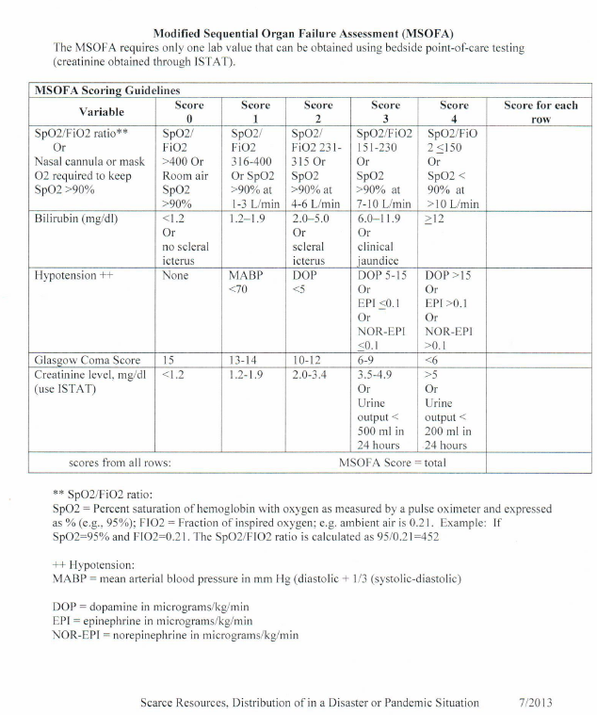

Slide 22
Liability and Crisis Standards of Care
Three Levels of Activation:
  Conventional
  Contingency
  Crisis
Legal protection in Virginia for declared emergency.

Slide 23
Caveats and Pitfalls
No perfect tool
Justice concerns
Different guidelines in different facilities – opportunity to game system?
?Right to appeal?
Decision making on the fly; you can’t turn back

Slide 24
So, What Do We Do?
Better off with something than nothing for guidance.
Clarify your own values and principles and those of your organization.
Encourage proactive conversation and guideline development.
Recognize the ambiguity and moral distress associated.
Ultimate goal to have a statewide standard.

Slide 25
End

